Slide 1

6th Students' Conference on Engineering & Systems (SCES-2020)
July 10-12, 2020
MNNIT Prayagraj (INDIA)
Intelligent Speed Estimation in Induction Motor Drive Control using Feed - Forward Neural Network Assisted Model Reference Adaptive System
Paper ID 101
Authored by: Arpit Bhushan Sharma, Sandeep Tiwari and Brijesh Singh
Presented by
Arpit Bhushan Sharma
DEPARTMENT OF ELECTRICAL AND ELECTRONICS ENGINEERING
KIET Group of Institution, Ghaziabad-INDIA

Slide 2
Key Features
The different features and key points which are included in the paper are:
Adjustable speed of induction motor (IM) is powered without a velocity sensor is one of the most alluring solutions with high energy efficiency, low cost, and compact size drives.
The efficiency will increase enormously if these kinds of systems will come into existence through intelligent expert systems.
The study is based on the estimation of the intensity of rotor flux using multilayered feed-forward neural network technology in a speed estimator.
The execution of the energy with the projected estimator is tested on various operational conditions, particularly in low-speed situations.
The IM speed is estimated and controlled by the Artificial Neural Network (ANN).
In the proposed study 08, 20 and 02 neurons have been chosen in the input, hidden and output layers to model the ANN.

Slide 3
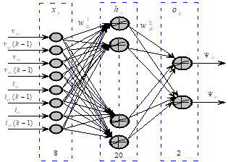
What is Neural Networks ?
Artificial neural networks or connectionist systems are computing systems vaguely inspired by the biological neural networks that constitute animal brains. Such systems "learn" to perform tasks by considering examples, generally without being programmed with task-specific rules.
In the proposed study 08, 20 and 02 neurons have been chosen in the input, hidden and output layers to model the ANN.

Slide 4
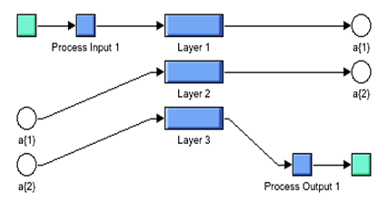
The controlled drive orientation with speed encoder is run through the dataset of 5000 samples for the artificial neural network.
The drive runs in a low region of speed ranging from (100 to -100) RPM with connecting load and without connecting load to it, to generate a training dataset for evaluation of results. The neural network is trained by the Levenberg Marquardt feed forward back propagation neural network algorithm.
To get high accuracy by balancing the rotor resistance variability, the model is trained online with feed backward neural network by adjusting the weights at low speed.
The Simulink model demonstrates the possibility to use a feedforward neural network (static neural network) to estimate (more precisely to approximate) the mechanical speed of the induction motor.

Slide 5
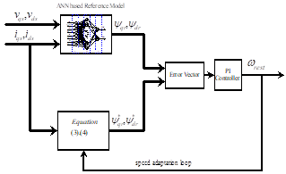
Intelligent Estimation of Speed in Induction Motor Drive
The basic function of ANN is to think and learn like a network of biological neurons.
The basic unit of ANN is a neuron, which has an activation function, weight, and bias.
In comparison to other ANNs, a multilayer feed-forward (MLFF) neural network is more commonly applied in the speed estimation of motors.
These networks do not have a backward connection between the layers and the output from the previous layer passed on to the next layer only.

Slide 6
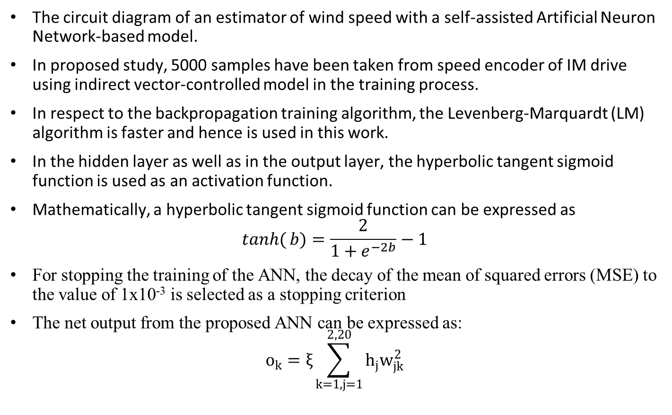
The circuit diagram of an estimator of wind speed with a self-assisted Artificial Neuron Network-based model.
In proposed study, 5000 samples have been taken from speed encoder of IM drive using indirect vector-controlled model in the training process.
In respect to the backpropagation training algorithm, the Levenberg-Marquardt (LM) algorithm is faster and hence is used in this work.
In the hidden layer as well as in the output layer, the hyperbolic tangent sigmoid function is used as an activation function.
Mathematically, a hyperbolic tangent sigmoid function can be expressed as
$$\tanh{(}b)=\frac{2}{1+e^{−2b}}−1$$
For stopping the training of the ANN, the decay of the mean of squared errors (MSE) to the value of 1x10⁻³ is selected as a stopping criterion
The net output from the proposed ANN can be expressed as:
$$o_{k}=ξ\sum_{k=1,j=1}^{2,20}{h_{j}w_{jk}^{2}}$$

Slide 7
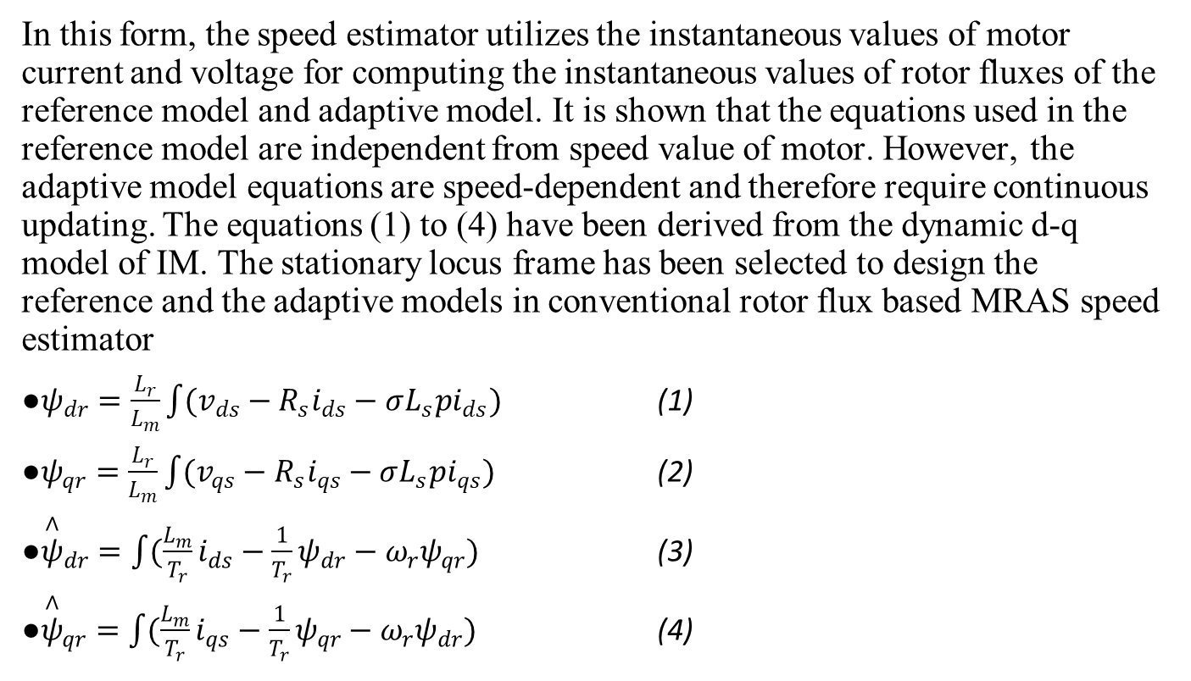
Evaluation Based on MRAS model
In this form, the speed estimator utilizes the instantaneous values of motor current and voltage for computing the instantaneous values of rotor fluxes of the reference model and adaptive model. It is shown that the equations used in the reference model are independent from speed value of motor. However, the adaptive model equations are speed-dependent and therefore require continuous updating. The equations (1) to (4) have been derived from the dynamic d-q model of IM. The stationary locus frame has been selected to design the reference and the adaptive models in conventional rotor flux based MRAS speed estimator
$ψ_{dr}=\frac{L_{r}}{L_{m}}\int{(v_{ds}−R_{s}i_{ds}−σL_{s}pi_{ds})}$ (1)
$ψ_{qr}=\frac{L_{r}}{L_{m}}\int{(v_{qs}}−R_{s}i_{qs}−σL_{s}pi_{qs})$ (2)
${\overset{∧}{ψ}}_{dr}=\int{(\frac{L_{m}}{T_{r}}}i_{ds}−\frac{1}{T_{r}}ψ_{dr}−ω_{r}ψ_{qr})$ (3)
${\overset{∧}{ψ}}_{qr}=\int{(\frac{L_{m}}{T_{r}}}i_{qs}−\frac{1}{T_{r}}ψ_{qr}−ω_{r}ψ_{dr})$ (4)

Slide 8
Test Results
Indirect vector-controlled drive with polyphase squirrel cage induction motor of 4 kW, 400 V, 50 Hz, 4 pole and 1430 RPM is modeled and simulated in MATLAB software.
The parameters of the induction motors are shown in Table 1 and Simulink model of induction motor drive.
The Drive is run with a speed encoder while estimators are run in an open loop to estimate the actual running speed of the motor.
The results obtained on some important operating conditions are illustrated and discussed in subsequent sections
Parameter | Value
Stator Resistance (R_{s}) | 14.85 mΩ
Rotor Resistance | 9.295 mΩ
Stator Inductance | 0.302 mH
Rotor Inductance | 0.302 mH
Mutual Inductance | 10.46 mH
Inertia | 0.0131 Kg.m²
Pole Pair | 2
Friction Factor | 0.002985 Nm-sec

Slide 9
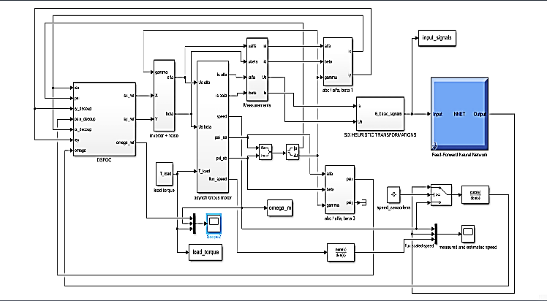
The ANN tool gives us the estimation of different parameters and the torque value after implementation of 8-20-2 neural network for getting the results of load torque, estimated torque, and modelled torque of the induction motor for better accuracy
Setpoint tracking with a nominal resistance value
Setpoint tracking with 50% difference in stator resistance
Speed reversal with 25% change in stator resistance

Slide 10
Response on 120 rad/s of speed tracking: (a) conventional-MRAS (b) NN-MRAS (c) motor torque

Slide 11
Response on 05 rad/s of speed tracking: (a) conventional-MRAS (b) NN-MRAS (c) motor torque

Slide 12
Response on 120 rad/s with 50 % stator resistance mismatch: (a) conventional-MRAS (b) NN-MRAS (c) motor torque

Slide 13
Response on 05 rad/s with 50 % stator resistance mismatch: (a) conventional-MRAS (b) NN-MRAS (c) motor torque

Slide 14
Response on speed reversal (120 to -120 rad/s) with 25 % stator resistance mismatch: (a) conventional-MRAS (b) NN-MRAS (c) motor torque

Slide 15
Response on speed reversal (120 to -120 rad/s) with 25 % stator resistance mismatch: (a) conventional-MRAS (b) NN-MRAS (c) motor torque

Slide 16
Conclusion
This paper presented a speed estimator based on the MRAS scheme assisted by and artificial neural network for sensor less operation of induction motor drive.
The controlled drive orientation with speed encoder is run through the dataset of 5000 samples for the artificial neural network.
The drive runs in a low region of speed ranging from (100 to -100) RPM with connecting load and without connecting load to it, to generate a training dataset for evaluation of results.
Here the dataset is divided in the random state of 2:3, where 2000 data values are taken for training from conventional model to test the data at different operating conditions and 3000 values are taken for testing and implementing the results.
The Artificial neural network of (8-20-2) structure is proposed to replace the numerical reference model with more hidden layers to get the better accuracy of output.
The Levenberg-Marquardt algorithm is used to train the proposed neural network.
The performance of the drive is extensively examined with a proposed speed estimator on various realistic functioning environments such as speed change, speed reversal, and load variations.
The simulation result verifies the superiority of the proposed speed estimator.

Slide 17
Load torque, modeled speed, and estimated speed of induction motor after running the ANN model.
The Levenberg-Marquardt algorithm is used to train the proposed neural network.
The performance of the drive is extensively examined with a proposed speed estimator on various realistic functioning environments such as speed change, speed reversal, and load variations.
The simulation result verifies the superiority of the proposed speed estimator

Slide 18
References
D. Mitronikas and A. N. Safaris, "An improved sensorless vector-control method for an Induction motor drive," IEEE Trans. Indust. Elect., vol. 52, no. 6, pp. 1660-1668, Dec. 2005.
M. Rashed and A. F. Stronach, "A stable back-EMF MRAS-based sensorless low-speed Induction motor drive insensitive to stator resistance variation," IEE Proceedings - Electric Power Applications, vol. 151, no. 6, pp. 685-693, 7 Nov. 2004.
E. Levi and Mingyu Wang, "A speed estimator for high-performance sensorless control of Induction motors in the field weakening region," IEEE Trans. Power Electr., vol. 17, no. 3, pp. 365-378, May 2002.
V. Arunachalam, H. Srinivasan, and A. Muthuramalingam, “A novel NN based rotor flux MRAS to overcome low-speed problems for rotor resistance estimation in vector-controlled IM drives,” Front Energy, vol. 10, no. 4, pp 382–392, 2016.
Y. B. Zebedee, S. M. Gadoue and D. J. Atkinson, "Model Predictive MRAS Estimator for Sensorless Induction Motor Drives," IEEE Trans. Indust. Elect., vol. 63, no. 6, pp. 3511-3521, June 2016.
V. Vasic, S. N. Vukosavic, and E. Levi, "A stator resistance estimation scheme for speed sensorless rotor flux-oriented Induction motor drives," IEEE Trans. Ener. Conver. vol. 18, no. 4, pp. 476-483, Dec. 2003.
A. Iqbal and M. R. Khan, "Sensorless control of a vector controlled three-phase Induction motor drive using artificial neural network," 2010 Joint International Conference on Power Electronics, Drives and Energy Systems & 2010 Power India, New Delhi, 2010, pp. 1-5.
S. M. Gadoue, D. Giaouris, and J. W. Finch, "Sensorless Control of Induction Motor Drive at Very Low and Zero Speed Using Neural Network Flux Observers," IEEE Trans. Indust. Elect., vol. 56, no. 8, pp. 3029-3039, Aug. 2009.

Slide 19
S. M. Gadoue, D. Giaouris, and J. W. Finch, "A neural network-based stator current MRAS observer for speed sensorless Induction motor drives," IEEE International Symposium on Industrial Electronics, Cambridge, 2008, pp. 650-655.
R. Ajabi Farshbaf, M.R. Azizian, and A. Ebrahimi “NN-MRAS based speed estimator VS. RF-MRAS one: design and comparison,” IEEE Conference Proceeding on Power Electronics and Drive Systems Technology, pp. 223-228, 2012.
S. M. Gadoue, D. Giaouris, and J. W. Finch, "Low-speed operation improvement of MRAS sensorless vector control Induction motor drive using neural network flux observers," IECON 2006 - 32nd Annual Conference on IEEE Industrial Electronics, pp. 1212-1217, 2006.
S. Maiti, V. Verma, C. Chakraborty, and Y. Hori, "An Adaptive Speed Sensorless Induction Motor Drive with Artificial Neural Network for Stability Enhancement," IEEE Trans. Indust. Inform., vol. 8, no. 4, pp. 757-766, Nov. 2012.
Giribabu Dyanamina, Mukesh Kumar Pathak, and Satya Prakesh Srivastava, “Parallel Stator Resistance Estimator Using Neural Networks for Rotor Flux Based Model Reference Adaptive System Speed Observer” Electric Power Components and Systems, Vol. 44, No. 6, pp. 658-672, 2016.
M. E. Elbuluk, Liu Tong, and I. Husain, "Neural-network-based model reference adaptive systems for high-performance motor drives and motion controls," IEEE Trans. Indust. Application., vol. 38, no. 3, pp. 879-886, May-June 2002.
Baburaj Karanayil, Muhammed Fazlur Rahman, and Colin Grantham “Online Stator and Rotor Resistance Estimation Scheme Using Artificial Neural Networks for Vector Controlled Speed Sensorless Induction Motor Drive” IEEE Trans. Indust. Elect., pp.167- 176, vol. 54, no. 1, 2007.
Manolis I.A. Lourski, “A brief description of Levenberg-Marquardt Algorithm”, Institute of Computer Science Foundation for research and technology (ICSRT) -Hellas (FORTH), Vassilika Vouton, Greece, February 2011
A. Tiwari, B. Kumar, and Y.K. Chauhan, “ANN-based RF-MRAS speed estimation of Induction motor drive at low speed”, International Conference on Electronics, Communication and Aerospace Technology, ICECA 2017.

Slide 20
MathsWork, "MATLAB 2015," MathsWork, october 2015. Available: https://in.mathworks.com/. [Accessed February 2020]
A. Kerboua, A. Metatla, R. Kelailia, and M. Batouche, “Fault Diagnosis in Induction Motor using Pattern Recognition and Neural Networks,” 2018 International Conference on Signal, Image, Vision and their Applications, SIVA 2018, pp. 1–7, 2019, doi: 10.1109/SIVA.2018.8660995.
A. Venkadesan, S. Himavathi, A. Muthuramalingam, and K. Sedhuraman, “ANN based Flux Estimator for Rotor Resistance Estimation in Vector Controlled im Drives,” 2018 IEEE International Conference on System, Computation, Automation and Networking, ICSCA 2018, no. 1, pp. 1–5, 2018, doi: 10.1109/ICSCAN.2018.8541240.
P. M. Menghal and A. J. Laxmi, “Real time control of Induction motor using neural network,” Proceedings - 2018 International Conference on Communication, Information and Computing Technology, ICCICT 2018, vol. 2018-Janua, pp. 1–6, 2018, doi: 10.1109/ICCICT.2018.8325873.

Slide 21
Thank You !

