Slide 1
AI-Powered Document Insights and Data Extraction
Name: Bashar

Slide 2

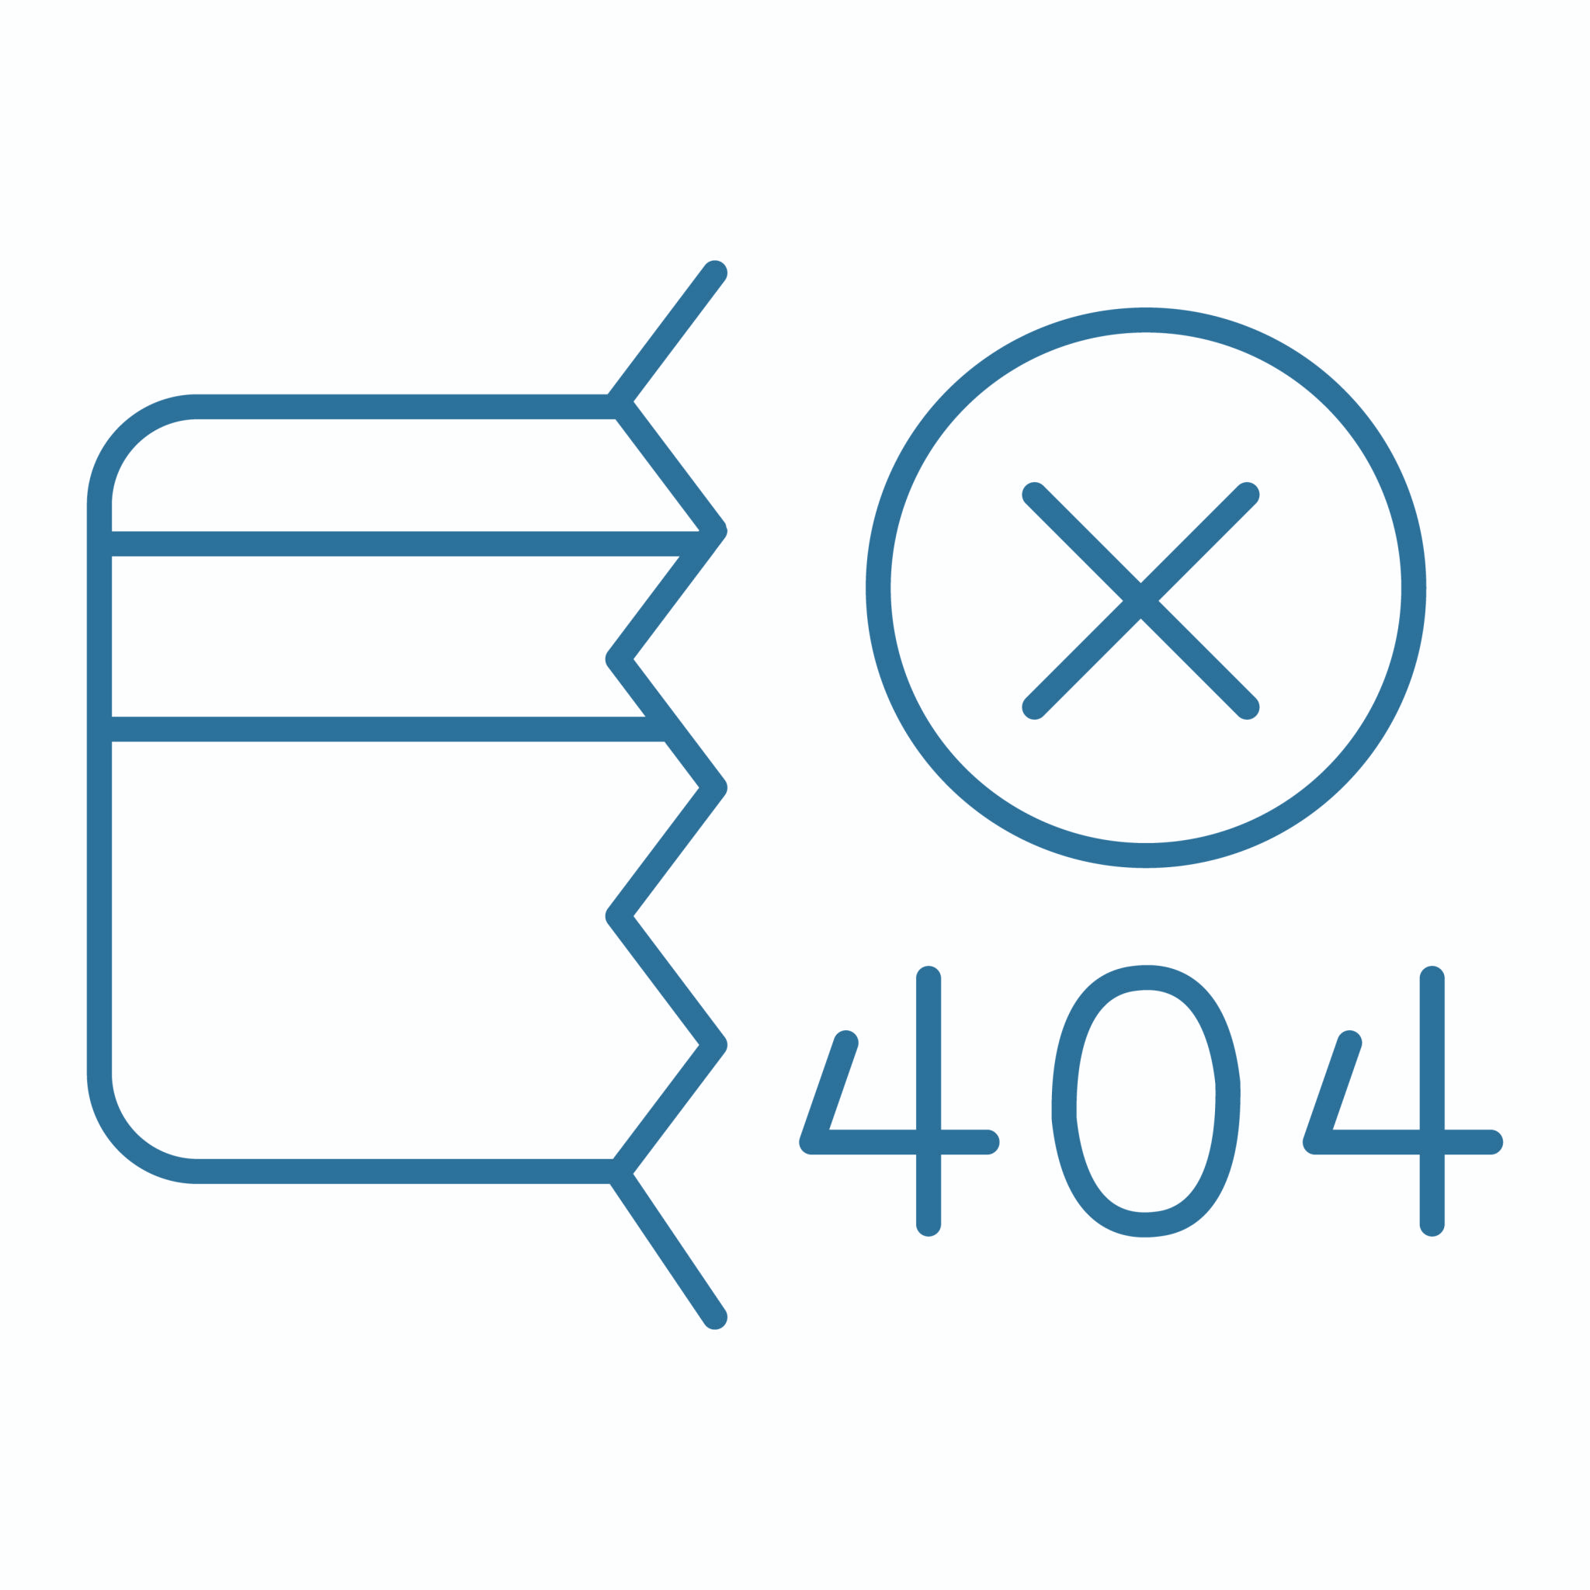


Problem Statement | Pharmaceutical Document Intelligence
Answering compliance questions from bundled, partly scanned supplier PDFs, with every answer traced to its page.
Pain Point | How Your Pipeline Solves It
Scanned pages have no text layer | Deskew + EasyOCR + table-row rebuild (99.5% word recall)
Many documents in one PDF | Page classification + boundary rules (20 of 20 pages correct)
Look-alike documents confuse search | Route by document type + exact-ID lookup (hit rate 89% → 100%)
Answers must be verifiable | [n] citations, sources table and a confidence level
Supplier documentation arrives as multi-document PDF bundles: certificates, declarations and specifications stitched together, often scanned, with key values locked in tables. Finding one lot's expiry date means opening the right file and the right page by hand.
  Challenge
An open-source RAG pipeline: OCR for scanned pages, automatic splitting into typed documents, routed vector search over line-aware chunks, and a local LLM that answers with page citations and a confidence level.
  Solution
Notes:
Add Links

Slide 3
System Architecture | Open-Source, Metadata-Routed RAG Pipeline
PDF upload → Text layer? PyMuPDF : deskew + EasyOCR + table-row rebuild → Page classification & document splitting (Mistral, JSON) → Line-aware chunking
→ BGE-small embeddings → LlamaIndex vector store → Route by document type (+ exact-ID fallback) → Top-4 chunks → Mistral-7B answer with [n] citations → Confidence check
Component Specifications
Component | Technology Choice | Configuration Details
OCR Engine | EasyOCR 1.7 (English) + PyMuPDF | Scanned pages only (< 50 chars of text); 200 dpi; deskew; table rows rebuilt; O→0, l→1 fixed in IDs
Text Chunking | Sentence splitter at line breaks | 256 tokens, 30 overlap; one Document per page; table rows never cut
Embeddings | BAAI/bge-small-en-v1.5 | 384 dimensions, 33M parameters; query prefix; doc type embedded with the text
Vector Database | LlamaIndex in-memory index | Cosine similarity, exact search, metadata filters on doc_type
Retriever | Dense + metadata routing | Top-K = 4; LLM picks the doc type → filtered search; exact-ID and weak-match fallbacks
LLM | Mistral-7B-Instruct v0.2, 4-bit (llama.cpp) | 4,096 context, temperature 0, max 350 tokens, stop sequences
Prompt Strategy | Grounded prompt, numbered sources | Cite [n] per fact, copy values exactly, read tables by row, fixed "could not find" reply

Slide 4
Pipeline Performance Metrics | 10 Test Questions with Known Answers, Laptop CPU
🧪 Retrieval Performance
Test set: 9 questions with known answer pages + 1 out-of-scope question, over a digital Cytiva bundle and a scanned West bundle (20 pages). K = 4; a chunk is relevant if it comes from an answer page.
Recall@K: 94.4% at K = 4 with routing (83.3% when searching all documents)
Mean Reciprocal Rank (MRR): 0.89 with routing (0.72 without)
Precision@K: 50.0% with routing (41.7% without)
Hit Rate: 100% with routing (88.9% without) (percentage of queries with at least 1 relevant result)
💊 End-to-End Accuracy
Strict grading: every key value must appear in the answer; also checked by reading every answer.
Answer Accuracy: 70% (evaluated on 10 test questions; all 3 misses came from the right page, read wrongly)
Citation Accuracy: 88.9% (8 of 9 answers cited the page that holds the answer)
Factual Consistency: 100% (every number in every answer appears in its sources; automatic check)
🧑‍🎓 System Performance
Measured on a laptop CPU (no GPU); a Colab T4 GPU is much faster.
Average Response Time: 32.9 seconds per question
OCR Processing: 13.5s per scanned page (page classification: 18.8s per page)
Retrieval Latency: 23ms vector search; 3.4s including the LLM routing call
LLM Generation: 32.0s average

Slide 5
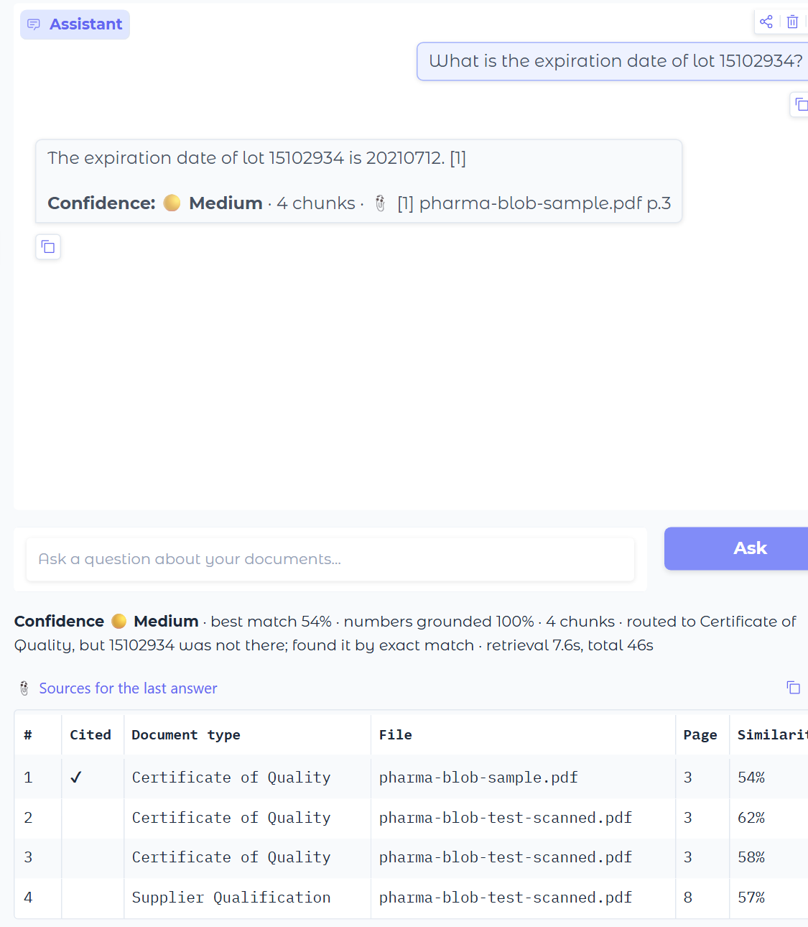
Pipeline in Action | Exact Lookup Across Two Look-Alike Certificates
Example Query 1: Factual Lookup by Lot Number
Query: "What is the expiration date of lot 15102934?"
Retrieved Chunks:
"…Product: AKTA ready High Flow Kit · Lot Number: 15102934 · Expiration Date: 20210712…" (Cytiva certificate, p.3, found by exact ID) (Similarity: 0.54)
"QUALITY CERTIFICATE No. 80372784-000010 (continued) · Batch No. | Mfg Date | Exp Date…" (West, scanned p.3) (Similarity: 0.62)
"D000291871 | 500 | 2024-10-22 | 2029-10-21 | 2024-11-11 | Lionville, PA…" (West, scanned p.3) (Similarity: 0.58)
Final Answer: "The expiration date of lot 15102934 is 20210712. [1]" Correct, rated Medium: routing chose Certificate of Quality, but the top hits were the look-alike West certificate, so the exact-ID lookup put the Cytiva page first.
UI: the cited answer, confidence, routing note and sources table →

Slide 6
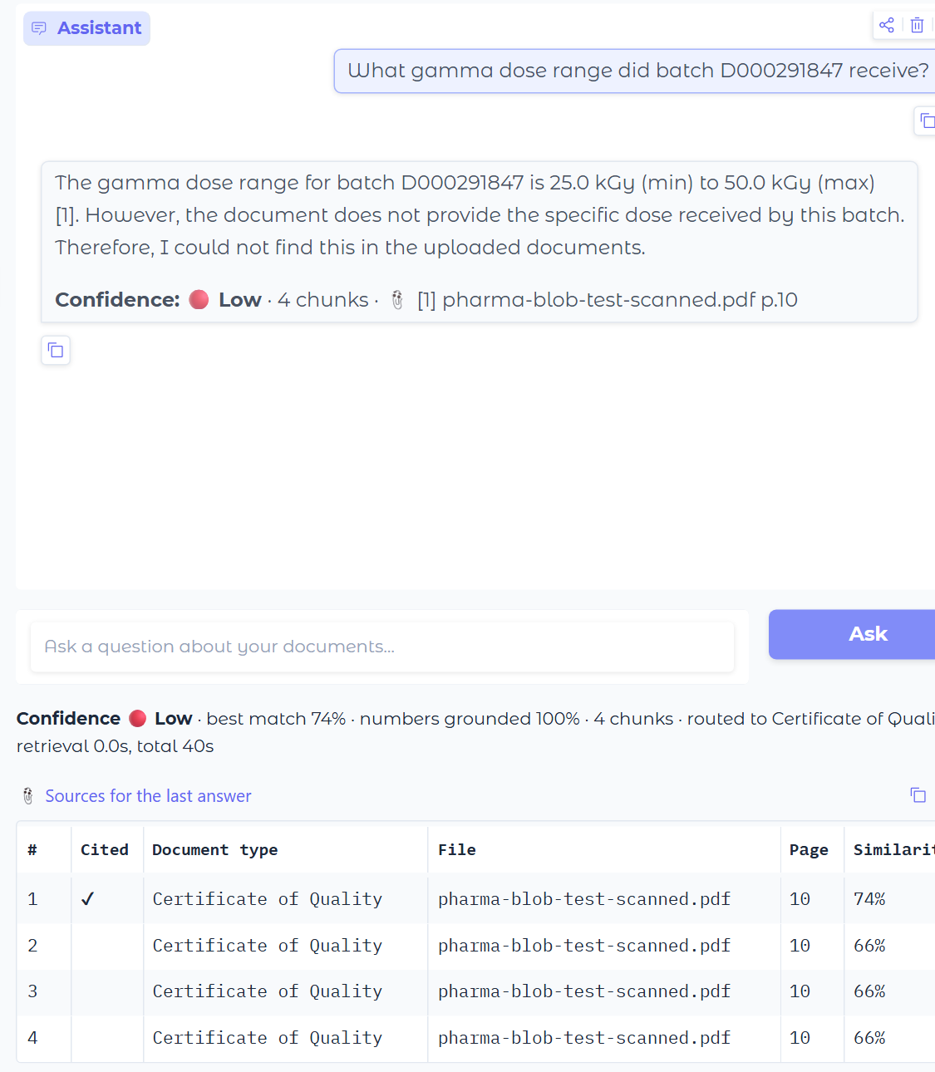
Pipeline in Action | When the Model Misreads a Table
Example Query 2: Table Lookup in a Scanned Certificate
Query: "What gamma dose range did batch D000291847 receive?"
Retrieved Context: 4 chunks, all from the scanned STERIS certificate (p.10). The top chunk (similarity 0.74) holds both the line "Validated Dose Range 25.0–50.0 kGy" and the batch row "D000291847 | … | 27.3 | 38.1 | PASS". Response Quality: Wrong. Mistral gave 25.0–50.0 kGy, then said it could not find the batch value. The confidence check rated it Low, so the user is warned.
Strength: OCR, routing and retrieval all worked on a scanned page. Limitation: a 7B model can still read the wrong line of a table.
UI: the Low-confidence answer and its sources →

Slide 7
Design Decision Analysis | Open-Source, Measured, Traceable
Model Selection Reasoning
Key Trade-offs Made
🧪 Speed vs. Accuracy:
Chose 4-bit Mistral-7B and BGE-small so everything runs free on a CPU or T4; the cost is ~33 s per answer on CPU.
For accuracy: a larger model would read tables better, and a reranker would sharpen the top-4.
📍Complexity vs. Maintainability:
Kept an in-memory index and simple, explainable rules (continuation markers, ID changes) instead of extra services.
Added OCR deskew, row rebuild and exact-ID lookup: each fixed a failure the test set exposed.
Decision | Rationale | Trade-offs Considered
BGE-small-en-v1.5 | Best retrieval in my Project 6 comparison (vs. MiniLM, E5); small and free | Larger embedders might rank better but run slower
256 tokens, line breaks, one doc per page | Keeps table rows whole and every chunk inside one document | Sliding window across pages: mixed documents in one chunk
Mistral-7B-Instruct, local | Most accurate open model I tested (vs. Phi-2, TinyLlama); data stays local | Slower and weaker than Gemini on tables; 3 of 10 answers wrong
LlamaIndex in-memory index | Zero setup, metadata filters built in, enough for 51 chunks | FAISS or Qdrant for persistence and scale
Constraints: no paid APIs, a laptop CPU for development and a free Colab T4 for running. Every choice was checked against the 10 test questions.

Slide 8
Current Limitations & Next Steps | From Prototype to Production
Current Limitations
Answer Generation (Mistral-7B)
  Misreads tables: took "Validated Dose Range" over the batch's own row
  Incomplete answers: listed 1 of 5 sub-suppliers, yet rated High
Routing & Confidence
  Questions naming only a code (ECN-2024-0027) route to the wrong type
  Confidence checks similarity and numbers, not completeness
Speed & Scale
  On CPU: 8.4 min to ingest 20 pages, ~33 s per answer
  In-memory index rebuilt each session; no persistence for 1,000+ PDFs
Proposed Enhancements
Short-term (next 2 weeks):
Completeness check for list and table questions (compare source rows with the answer)
Run on a T4 GPU and cache ingestion results between sessions
Medium-term (next month):
Hybrid BM25 + vector search with a cross-encoder reranker
Layout-aware table extraction for scanned pages
Grow the test set and re-run it on every change
Long-term Vision:
Persistent vector DB with supplier, product and lot metadata
Batch GPU ingestion for thousands of supplier PDFs
Connect to document management / QMS, with human review of Low-confidence answers

Slide 9
Project Impact & Learning Outcomes | What This Pipeline Enables
What I Learned
Technical
  OCR repair (deskew, table rows), metadata-routed RAG, JSON-constrained LLM output
  Evaluation: Recall@K, MRR, citation accuracy, re-running tests after every change
Skills Developed
  Python, LlamaIndex, llama.cpp, EasyOCR, Gradio, prompt engineering
  Problem-solving and documentation: reporting failures as well as wins
Biggest Lesson
  Most accuracy gains came from fixing the input (OCR, chunking), not the model
  Two fixes caused regressions that only a re-run of the tests revealed
Potential Business Impact
Faster document review:
20 pages sorted into 15 typed documents automatically, with no manual sorting
Answers in about 30 s (CPU) with the exact page cited, instead of searching bundles by hand
Trust and compliance:
Every answer traceable to a page; Low confidence flags answers to double-check
Runs fully on-premise: no supplier data leaves the company
Open-source stack: no per-question API cost
Where it fits:
Supplier qualification and incoming-material review
Pre-filling compliance checklists from certificates
First-line answers for QA teams, with human review

Slide 10
Thank you

