Slide 1
Development of Output Signal Differentiator for Nonlinear Observer based Trajectory Tracking of a Quadcopter
Thesis Defense on April 15, 2020
Basharnavaz Khan
Notes:
Thank you for joining in and agreeing to conduct the defense online. I have planned to go over the key points of work, notable contributions and its necessity and motivation. Which may have been buried under a lot of jargon, additional details, pretext preamble etc. in a 100 page plus document

Slide 2
Outline
Problem Statement
Literature Review
Motivation
Objective
Steps
Mathematical Development
Simulation
Practical Implementation and Testing
Results and Conclusion
Notes:
Just to provide and outline, the presentation will roughly follow this order.
We start with the problem statement where we define what exactly we are trying to solve.
The relevant literature that motivates this study, and that the work that is used to conduct the study.
Then we look at the specific points that motivated this study.
The Objective

Slide 3
Problem Statement
Robust controllers such as H∞ control algorithm developed for quadcopters are susceptible to external disturbances through linearization of the non-linear dynamics. Observers developed to match external disturbances are asymptotic and require initializers.

Slide 4
Literature Review
Control: Back stepping for attitude and sliding mode control for orientation (Bouabdallah & Siegwart, 2005).
Observer Based Control: To control against external disturbances (Mokhtari et al., 2006)
Observers: Nonlinear Disturbance Observer and Super Twisting Observer which need initial esitmates (Fethalla et al., 2017a), (Fethalla et al., 2018).

Slide 5
Literature Review (contd)
Double Sided Kernel: Algebraic differentiation without singularity. (Ghoshal et al., 2017a)
Dynamic Ridge Regression: Obtaining unknown kernel parameters though optimization (Ravichandran, 2018)
Fourth Order Kernel: Doubles sided Kernel expressions along with dynamic ridge regression optimization (Sinha, 2018)

Slide 6
Motivation
Observers (NDO and STO) require initializers
Algebraic estimators are deadbeat observers
Simulations in (Fethalla et al., 2017a), (Fethalla et al., 2018) use simple sinusoidal disturbances
Algebraic Estimators never implemented on Embedded Systems

Slide 7
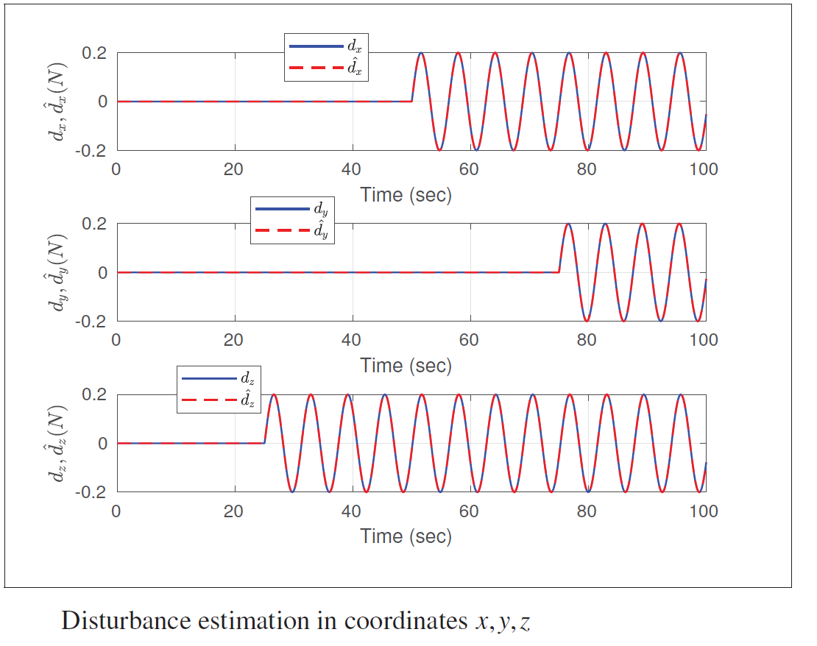
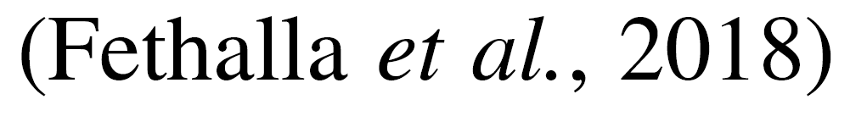

Slide 8
Objective
Develop kernel-based algebraic differentiators that employ a fourth-order LTI structure over a moving window in conjunction with dynamic ridge regression to estimate external disturbances on the quadcopter
Compare the performance of the developed observer against observers in literature in closed-loop with a tracking control of a quadcopter in simulation and on a practical setup

Slide 9
Steps/Phases
Mathematical Development of Signal Differentiator
Comparison in Simulation
Comparison on Practical Setup

Slide 10
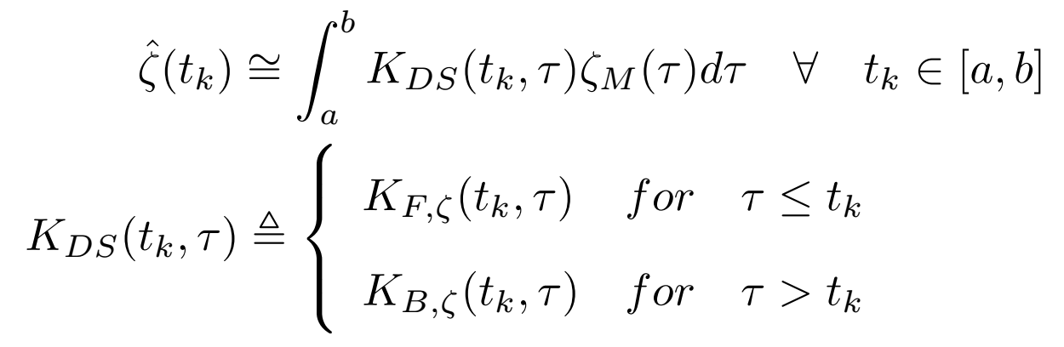
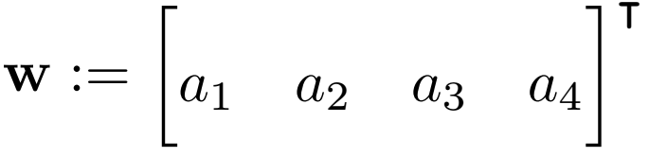
Kernel Estimation
Estimate within a window:
The forward and backward kernels are linear functions of kernel parameters
Notes:
This is the main equation of Kernel Estimation. If you want a estimate zeta at a time instant tk then you gather measurements around tk within a “window of observation”
Between points a and B

Slide 11
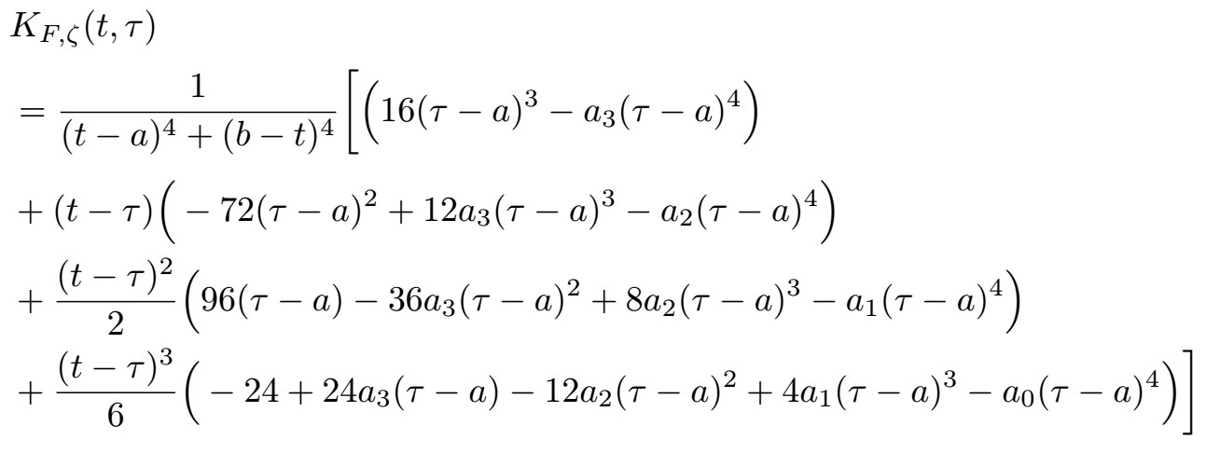
The Fourth Order Forward Kernel Expression

Slide 12
Development of Signal Differentiator
3 positions and 3 orientation angles are treated as independent systems
Sliding window approach to observe the position and orientation
The Optimization Problem: parameters for kernel for the window
Kernel differentiator to estimate higher order derivatives and construct full state estimate
Full state estimate to disturbance estimates

Slide 13
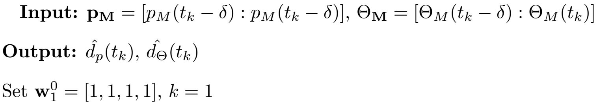
Sliding Window Approach
3 positions and 3 orientation angles are treated as independent systems
Observe the attitude

Slide 14
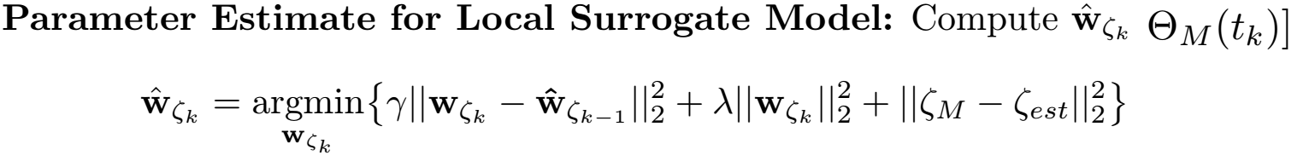
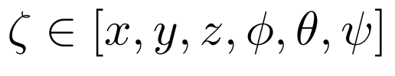
The Optimization Problem
The Optimization Problem: parameters for kernel for the window
The computationally expensive optimization is done using numerical methods

Slide 15
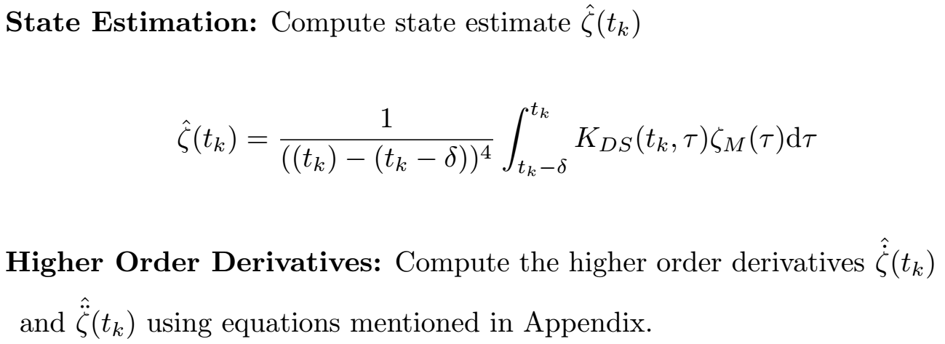
Full State Estimate
Kernel differentiator to estimate higher order derivatives and construct full state estimate

Slide 16
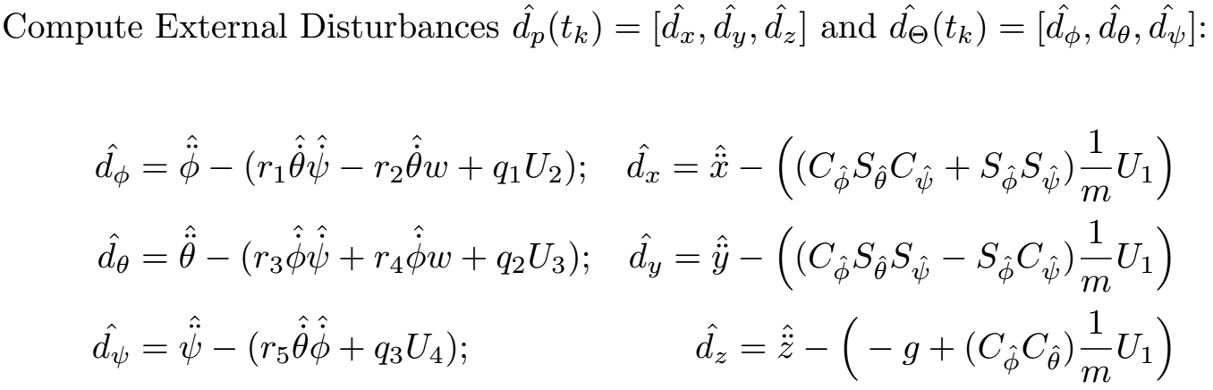
Full state estimate to disturbance estimates

Slide 17
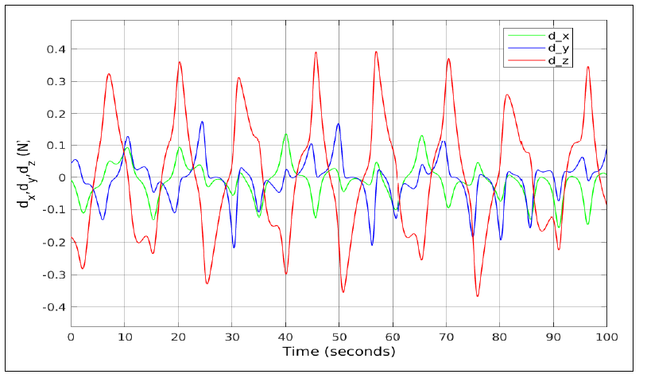
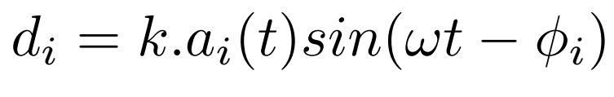
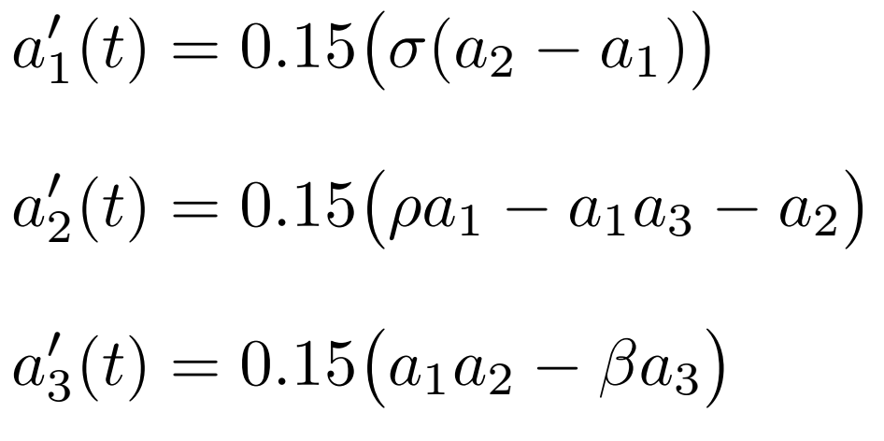
Simulation
Extensive simulation tests of quadcopter flights under different kinds of disturbances, Chaotic, Linear, constant.
Chaotic Disturbances are modeled after Lorenz system

Slide 18
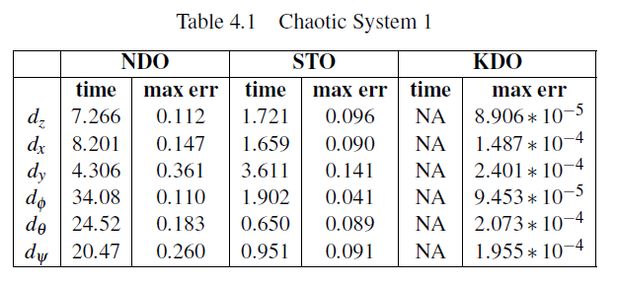
Simulation Result: Chaotic Disturbances
KDO does not have a convergence time since it is a deadbeat observer

Slide 19
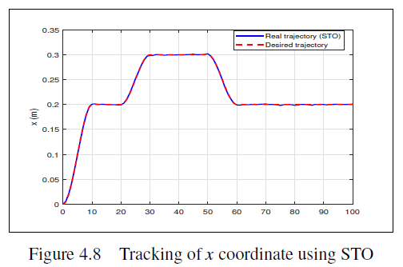
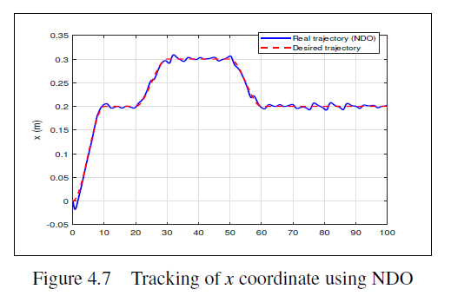
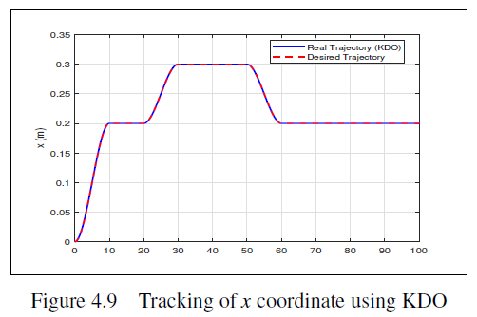
Trajectory Tracking under Chaotic Disturbances

Slide 20
Practical Implementation
Practical Setup
Distributed Computing
Closed Form Optimization, Vectorization, GSL
Quadcopter Hardware

Slide 21
Practical Setup
MAVROS/MAVLink: Modelled on ROS, expands ROS capability for message passing using lightweight message passing protocol MAVLink
Xbox Kinect: Motion sensing to estimate global attitude of quadcopter during flight
Onboard computer: Odroid XU4 that runs ROS on Linux and connects to PIXHawk 3DR flight control board
Computational Graph: Complex computations done on Ground Station computer. Results transmitted through MAVLink to onboard computer

Slide 22
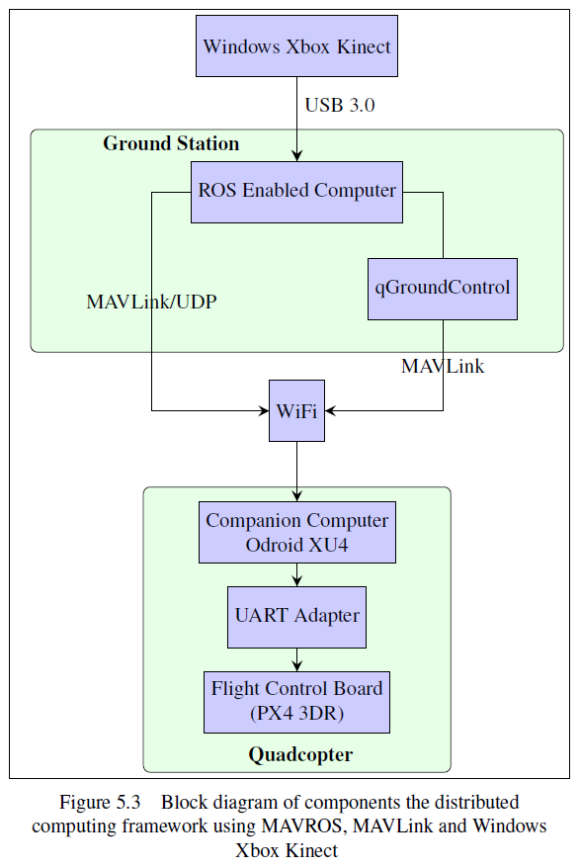
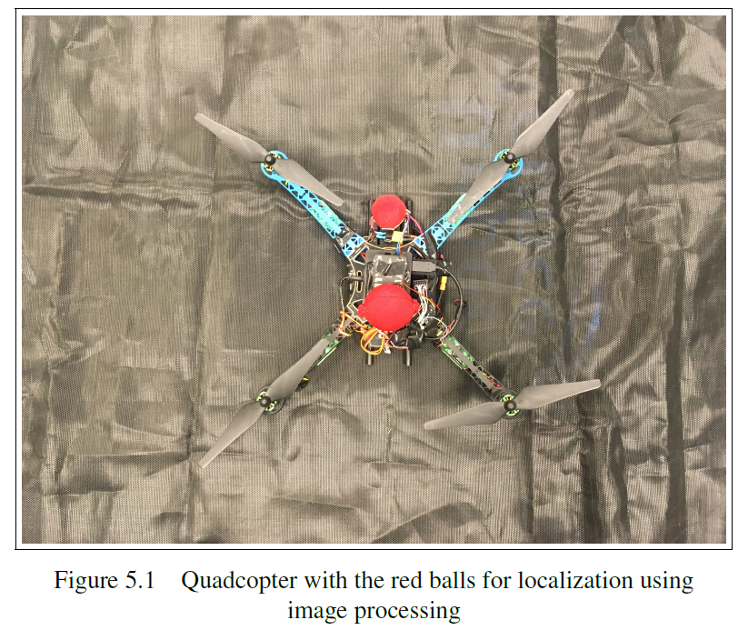

Slide 23
Distributed Computing and Custom Messaging
MAVROS: ROS package enables MAVLink extendable communication between computers running ROS, MAVLink enabled GCS.
MAVLink: Lightweight messaging protocol for communicating with drones
Custom Messaging : Send custom messages from GSC to PX4
Define custom ROS message on GSC
Create MAVROS plugin on GSC that subscribes to computed disturbances and sends over MAVLink
Define custom uORB message on PX4
Notes:
MAVLink follows a modern hybrid publish-subscribe and point-to-point design pattern: Data streams are sent / published as topics while configuration sub-protocols such as the mission protocol or parameter protocol are point-to-point with retransmission.
start by creating a new MAVROS plugin
Edit mavros_plugins.xml (in workspace/src/mavros/mavros_extras)
Edit CMakeLists.txt (in workspace/src/mavros/mavros_extras)
Inside common.xml in (workspace/src/mavlink/message_definitions/v1.0),
PX4:
Inside common.xml (in Firmware/mavlink/include/mavlink/v2.0/message_definitions), add your MAVLink message as following (same procedure as for MAVROS section above):

Slide 24
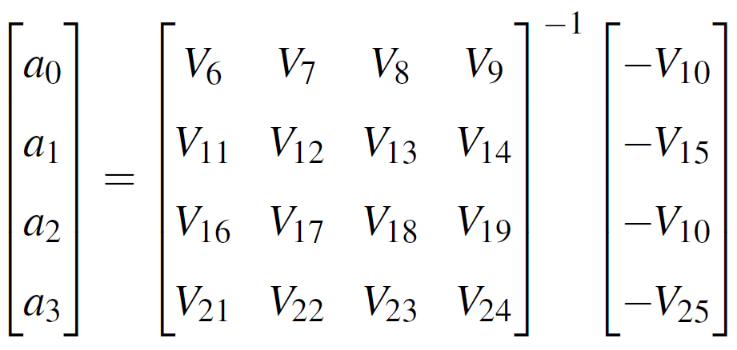
Closed Form Optimization
Numerical Optimization is computationally expensive with undefined convergence rates
Closed form expressions of parameter estimates are obtained using Kernel Reproducing property

Slide 25
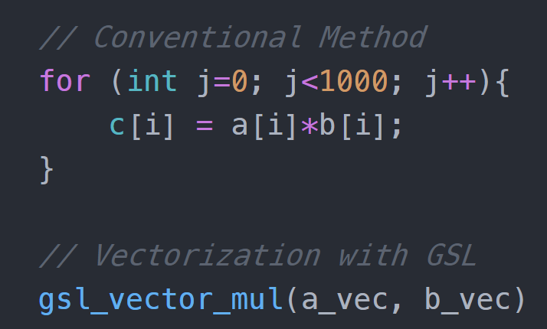
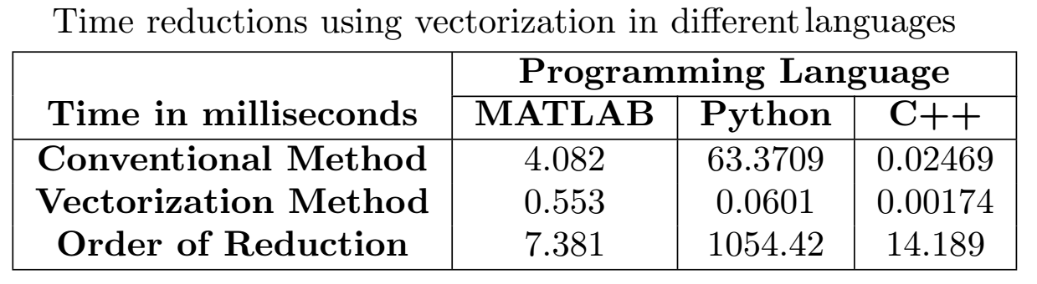
Vectorization
Vectorized code is easier to read.
Fewer lines of code: fewer bugs.
The code resembles standard mathematical notation
Removes inefficient, difficult to read for loops
Notes:
Parallel computing for faster computation.
SIMD (Single Instruction, Multiple Data) architectures.
SIMD is a class of parallel computing in which the logical processors
perform a single instruction on multiple data points simultaneously.

Slide 26
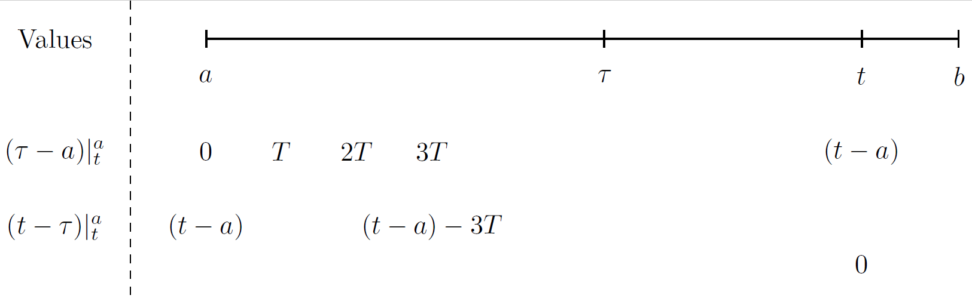
GNU Scientific Library provides a stable API for scientific computing which is used for vectorization
Notes:
GNU – SL is a combination of LAPACK which is built on top of
BLAS(Basic Linear Algebra Subprograms), optimized for speed on intel architectures
They take use of floating point hardware such as SIMD instructions

Slide 27
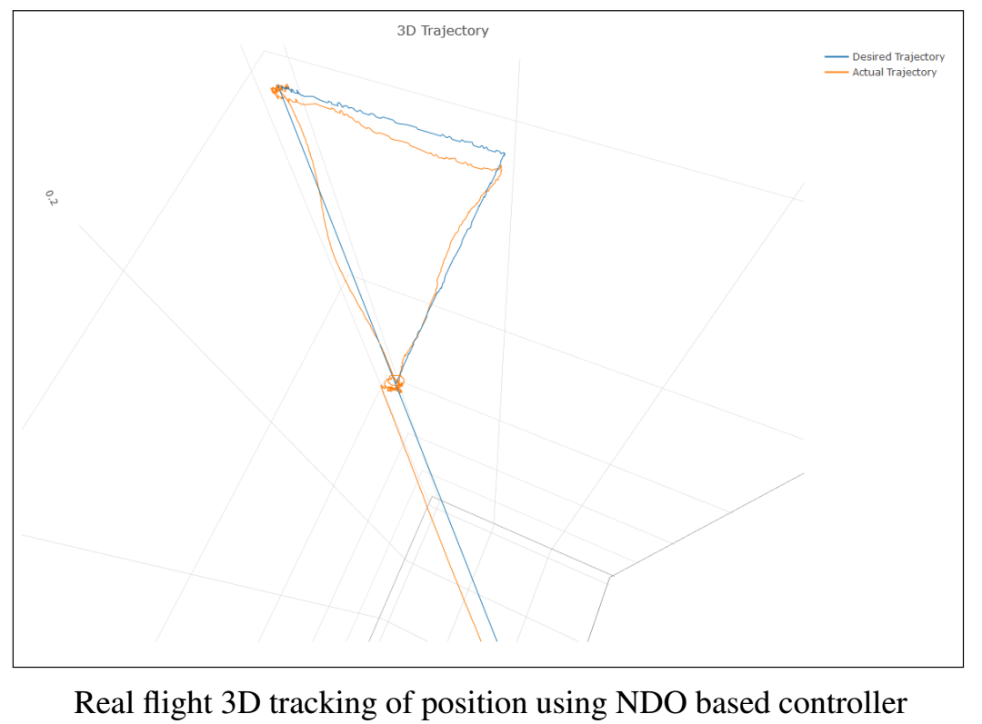
Practical 1: Without External Disturbances
Each observer was tested on the same trajectory
Trajectory is a triangle 1m above the ground with flight duration of 100 seconds
Attitude gains are tuned first, then position gains
Once the NDO is tuned the controller gains are kept constant

Slide 28
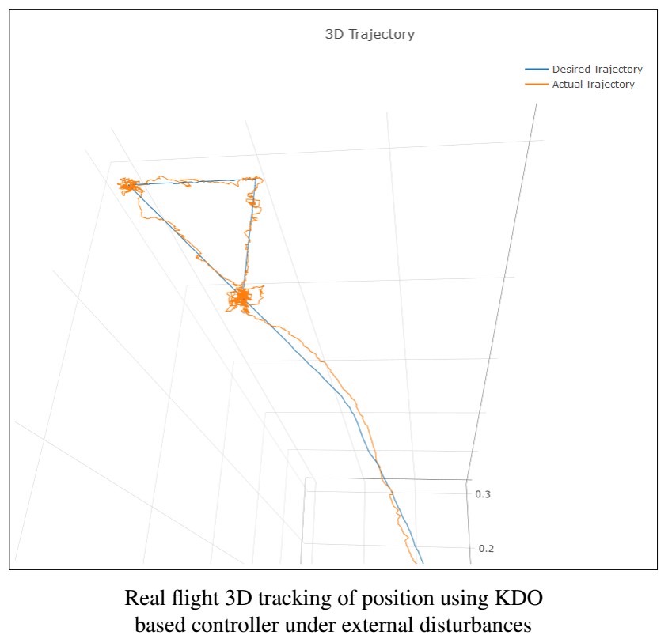
Practical 2: With External Disturbances
External Disturbances are provided using a CONAIR 1600 air blower.
Trajectory is same as previous case
Controller gains are kept same

Slide 29
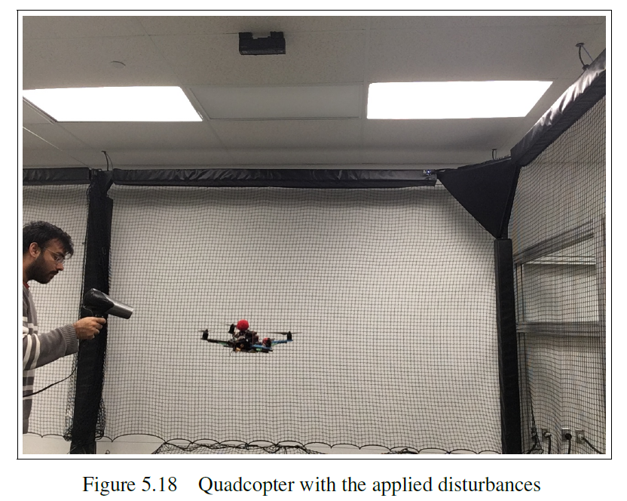

Slide 30
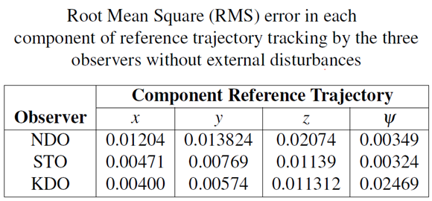
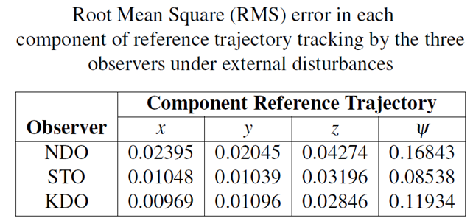
Results

Slide 31
Outcomes
Developed non asymptotic kernel observer for quadcopter
Derived alternative closed form solution to the optimization problem
Practical Implementation of Kernel Differentiation methods on embedded platforms

Slide 32
If I had to do it again?
Use quadcopter state coupling for better estimation
Use sensor information in disturbance estimation expressions as much as possible
Streamline the process. Better Simulation to Hardware Deployment workflow
Use ROS-Gazebo for simulations

Slide 33
References
Bouabdallah, S. & Siegwart, R. (2005). Backstepping and sliding-mode techniques applied to an indoor micro quadrotor. Conference Proceedings presented in Proceedings of the 2005 IEEE international conference on robotics and automation (pp. 2247-2252).
Fethalla, N., Saad, M., Michalska, H. & Ghommam, J. (2017a). Robust observer-based backstepping controller for a quadrotor UAV. Conference Proceedings presented in 2017 IEEE 30th Canadian Conference on Electrical and Computer Engineering (CCECE) (pp. 1-4).
Fethalla, N., Saad, M., Michalska, H. & Ghommam, J. (2018). Robust observer-based dynamic sliding mode controller for a quadrotor UAV. IEEE Access, 6, 45846-45859.
Mokhtari, A., M’Sirdi, N. K., Meghriche, K. & Belaidi, A. (2006). Feedback linearization and linear observer for a quadrotor unmanned aerial vehicle. Advanced Robotics, 20(1), 71-91.
Ghoshal, D. P., Gopalakrishnan, K. & Michalska, H. (2017a). Algebraic parameter estimation using kernel representation of linear systems. IFAC-PapersOnLine, 50(1), 12898-12904.
Ravichandran, P. (2018). Dynamic regression in tracking of chaotic system trajectories. (Thesis). Consulted at http://digitool.Library.McGill.CA/R/?func=dbin-jump-full&object_id=161212.

