Slide 1

Customer Retention
Online Shopping

Slide 2
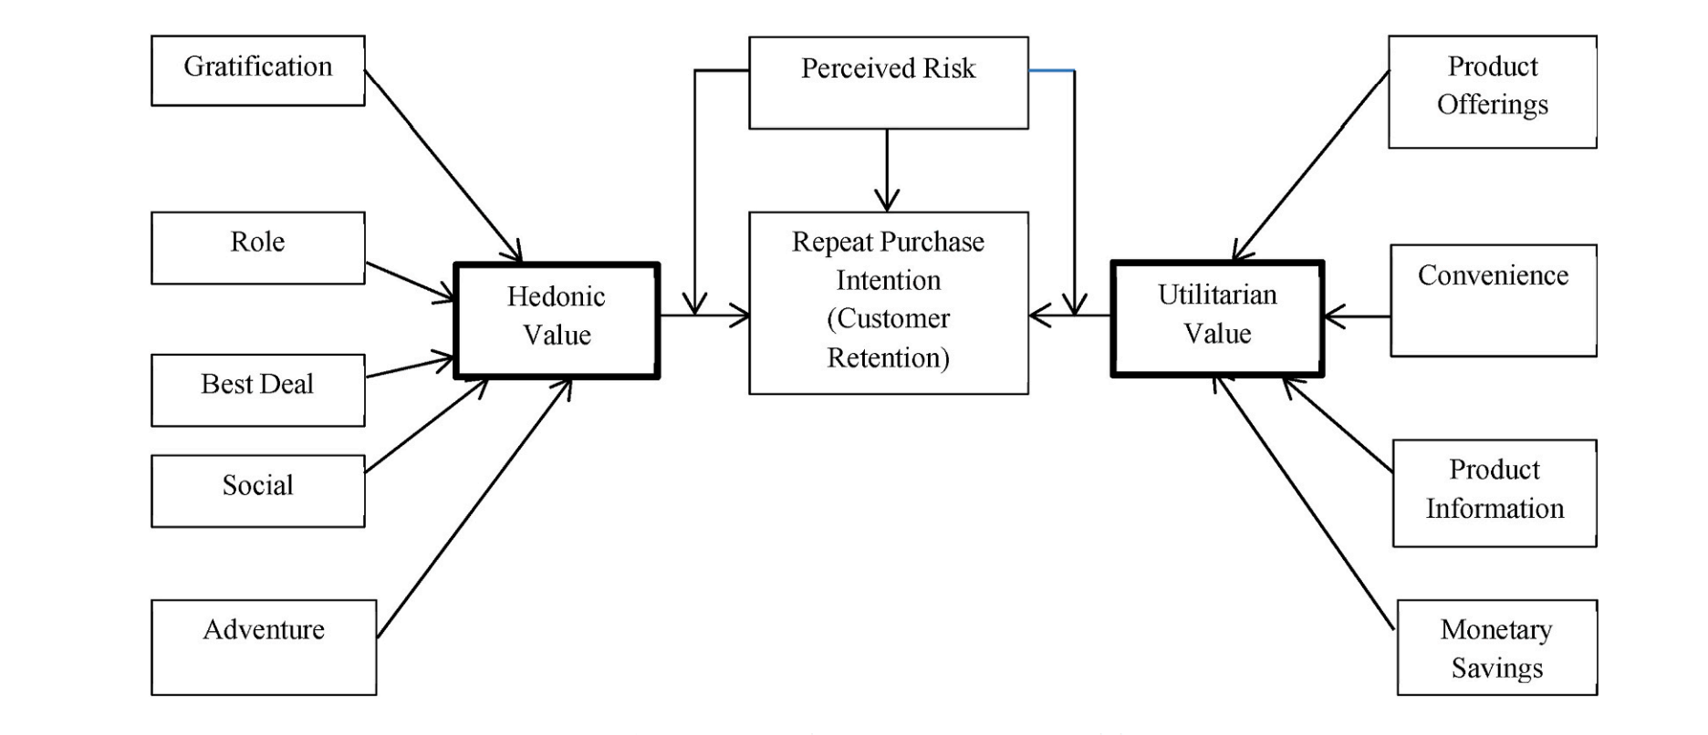
Introduction
Customer satisfaction has emerged as one of the most important factors that guarantee the success of online store; it has been posited as a key stimulant of purchase, repurchase intentions and customer loyalty.
Five major factors that contributed to the success of an e-commerce store have been identified as:
Service quality,
System quality,
Information quality,
Trust and
Net benefit.

Slide 3

Problem Statement
E – Retailing Factors and Preferences that helps in customer retention and customer activation…

Slide 4

Understanding…
There are many e-commerce players in the market but few players managed to be on the table.
The success factors may vary for player based on their business size , variety, range etc.
Let find out which factors helps these players to gain market share and customer bases. The factors like:
Content
User Interface
Payments
Offer / Discounts
Loyalty Programs
Website traffic and their duration
Range of products and value for their money etc…

Slide 5
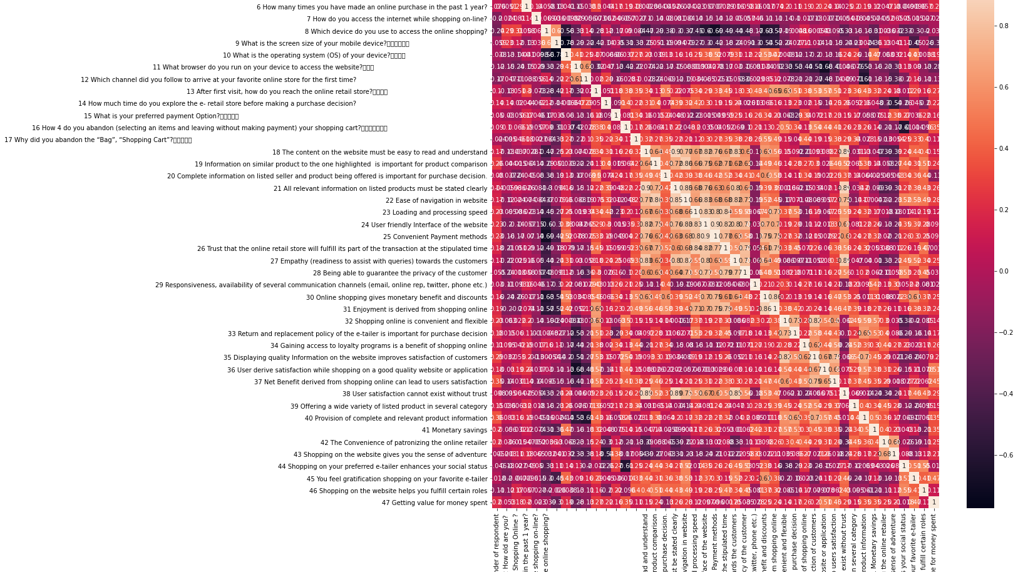
EDA Steps and Visualisation…

Slide 6

Removed Pincode Column from dataset as it seem not relevant and doesn’t affect the data.
Null values are checked but no null value found in dataset.
Columns with Int64 datatype are considered for visualisation purpose.
Dataset Info, Describe , Co relation of dataset is performed for understanding the Central Tendency and also analysing multi variant analysis
Yeo – Johnson Method is used for scaling of data.
Box plot are used to identify the outliers
Categorical variables are untouched as they seem to be less relevant for the model building of the dataset.

Slide 7
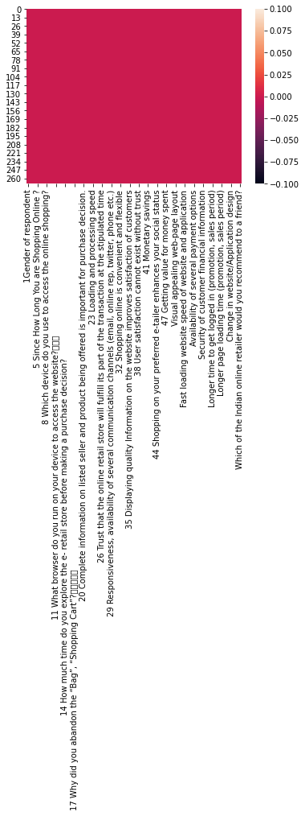
No Null Values In Dataset…

Slide 8
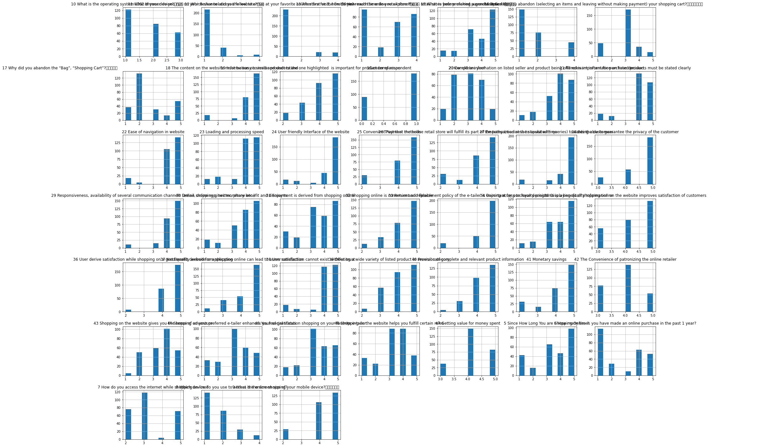
Visualisation of Distribution

Slide 9
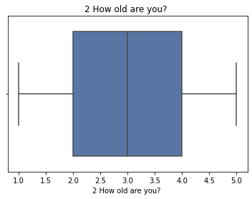
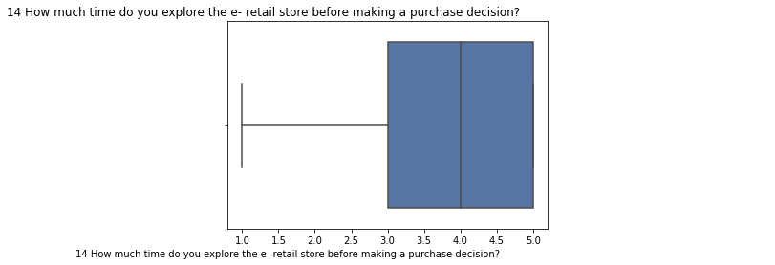
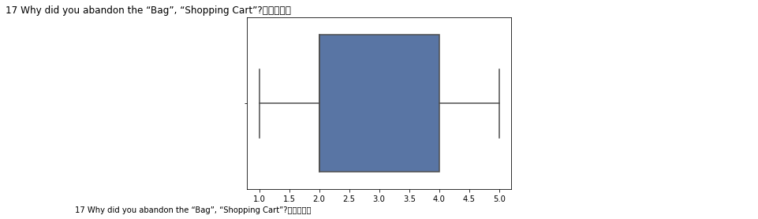
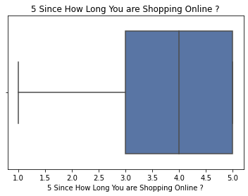
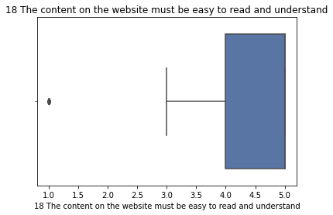
Uni Variant Analysis : Box Plot
Median of Age of end user is 3.
Outliers are less.
Most of data is in between 3 and 5 for time spend on online shopping.
For abandon of bag and shopping cart is between 2 and 5.
Content on website is having a median of 5 and most of the data is in between 4 and 5.

Slide 10
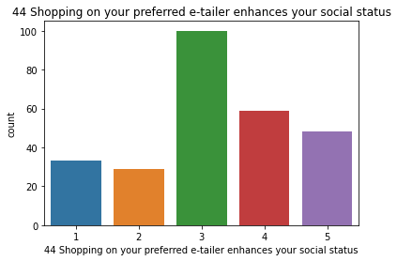
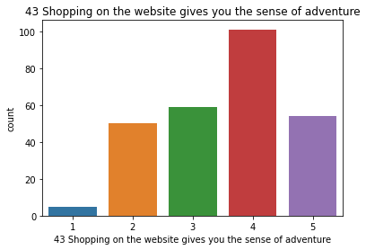
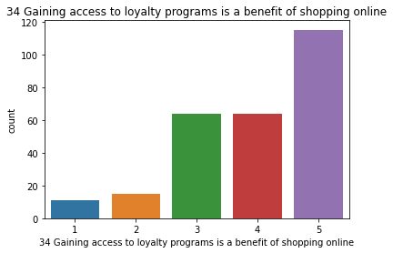
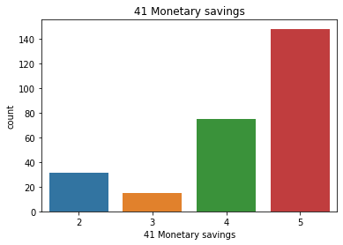
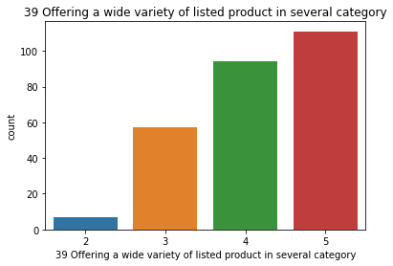
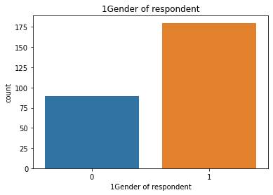
Bar chats for each variables
Data Set Contains a greater number of male users when compare to female users.
Most of the male users age is in between 31-40 and female users is 21-30.
Most of them use smartphones to access.
Debit / Credit Card payments are most preferred
Content, Loyalty, Discounts help in the conversion and while making purchase decision.

Slide 11
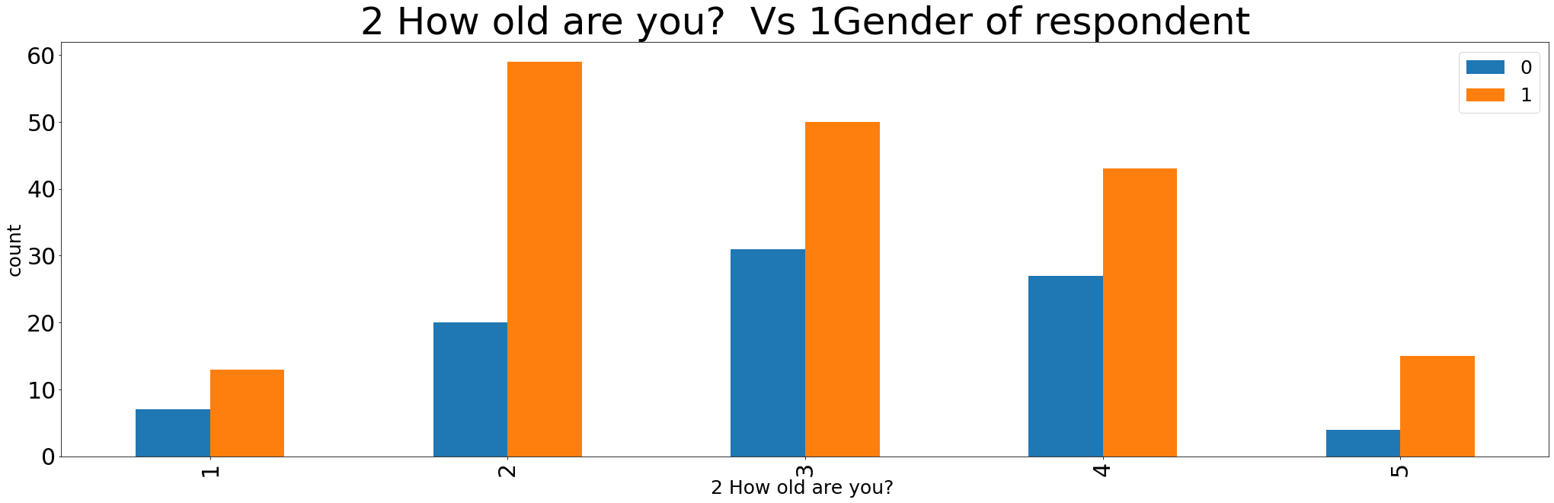
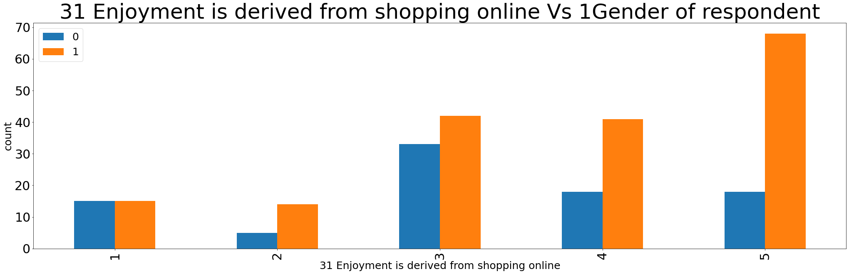
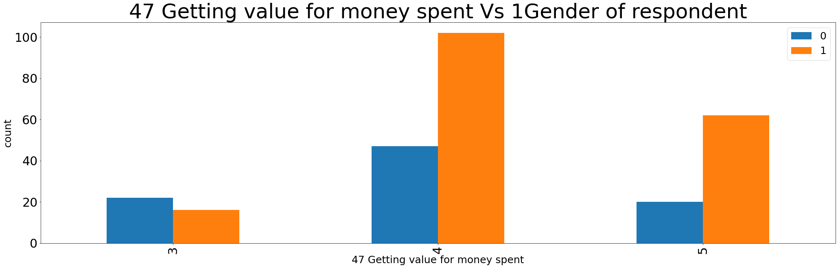
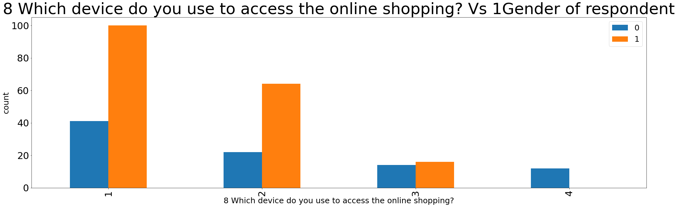
Bi Variant Analysis
Maximum males' users are between 31–40-Year-old whereas maximum females users age is in between 21-30 Years
Both Male and Females use Smartphones for accessing the online shopping
Both the genders agree that online shopping is Value for money
Maximum Number of Males opted for indifference and most of the females feel that enjoyment is derived from Shipping Online
Screen Size is different for Maximum Females and Males while do online shopping
Both genders trust that online retail store will fulfill its parts of transaction at stipulated time

Slide 12
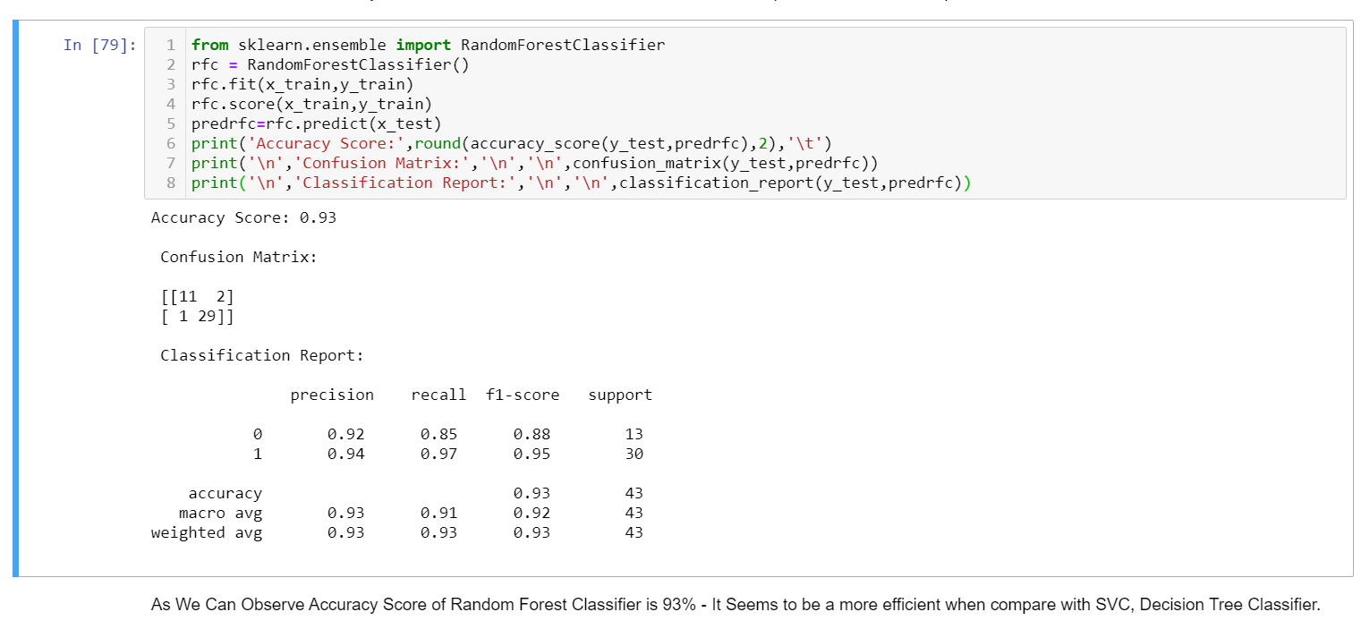
RandomForestClassifier – Best Model

Slide 13
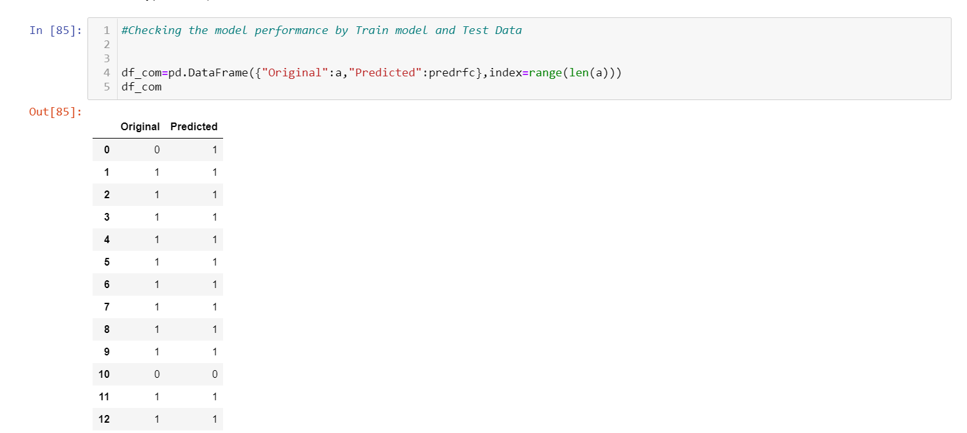
Model Testing – 93% Accuracy

