Slide 1
SECURE DATA HIDING IN IMAGES USING STEGANOGRAPHY
CAPSTONE PROJECT
Presented By: Bashayer.M
Student Name : Bashayer.M
College Name & Department : P.R.Engineering College

Slide 2
OUTLINE
Problem Statement
Technology used
Wow factor
End users
Result
Conclusion
Github Link
Future scope

Slide 3
PROBLEM STATEMENT
In today’s digital world, data security and privacy are major concerns. Traditional encryption methods, while effective, can attract unwanted attention from attackers. Steganography provides an alternative by hiding information inside digital media, such as images, in a way that is undetectable to casual observers.

Slide 4
TECHNOLOGY USED
Programming Language: Python, Java, or C++
Libraries: OpenCV, or NumPy, PIL (Python Imaging Library)
GUI (Optional): Tkinter (Python), Java Swing
Encryption (Optional): AES or RSA for enhanced security
Platforms: Visual Code or IDLE Python

Slide 5
WOW FACTORS
Implement Least Significant Bit (LSB) Steganography or other steganographic techniques.
Ensure the hidden data is not easily detectable or alterable.
Develop an encryption mechanism to enhance security.
Create a user-friendly interface for encoding and decoding messages.
Support various image formats like PNG, BMP, or JPEG.
A tool that can hide and retrieve text messages within images securely.
A system that prevents unauthorized access to hidden data.
A comparison of different steganographic techniques for effectiveness.

Slide 6
END USERS
This project is useful for various individuals and organizations that need secure communication and data protection. Below are some key end users:
Cybersecurity Professionals
Government & Military Organizations
Journalists & Whistleblowers
Corporate & Business Executives
Everyday Users (Privacy Enthusiasts)
Digital Forensics Experts
Artists & Digital Content Creators
Blockchain & Cryptocurrency Users

Slide 7
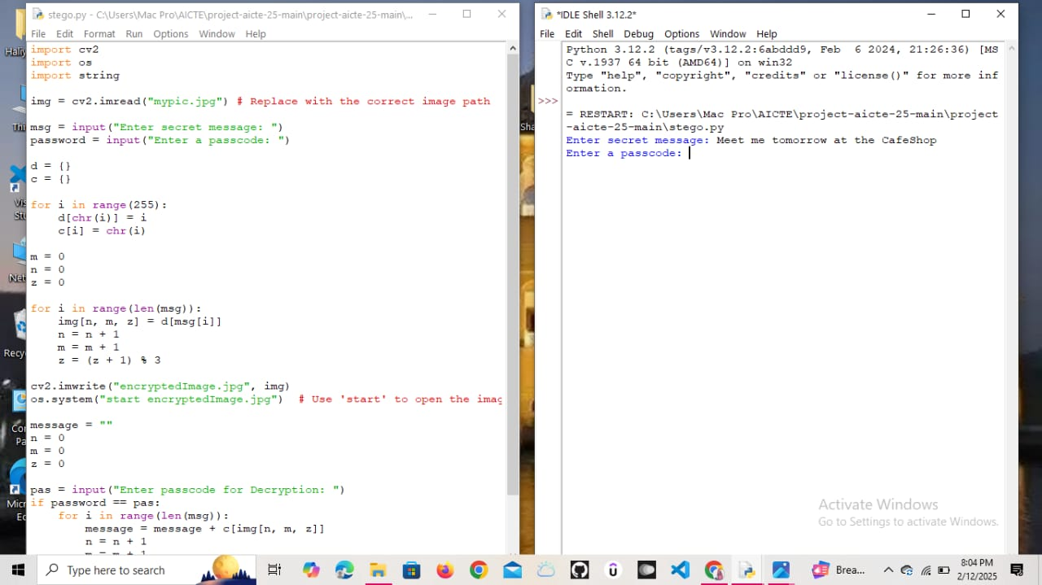
RESULTS- Output Image-1

Slide 8
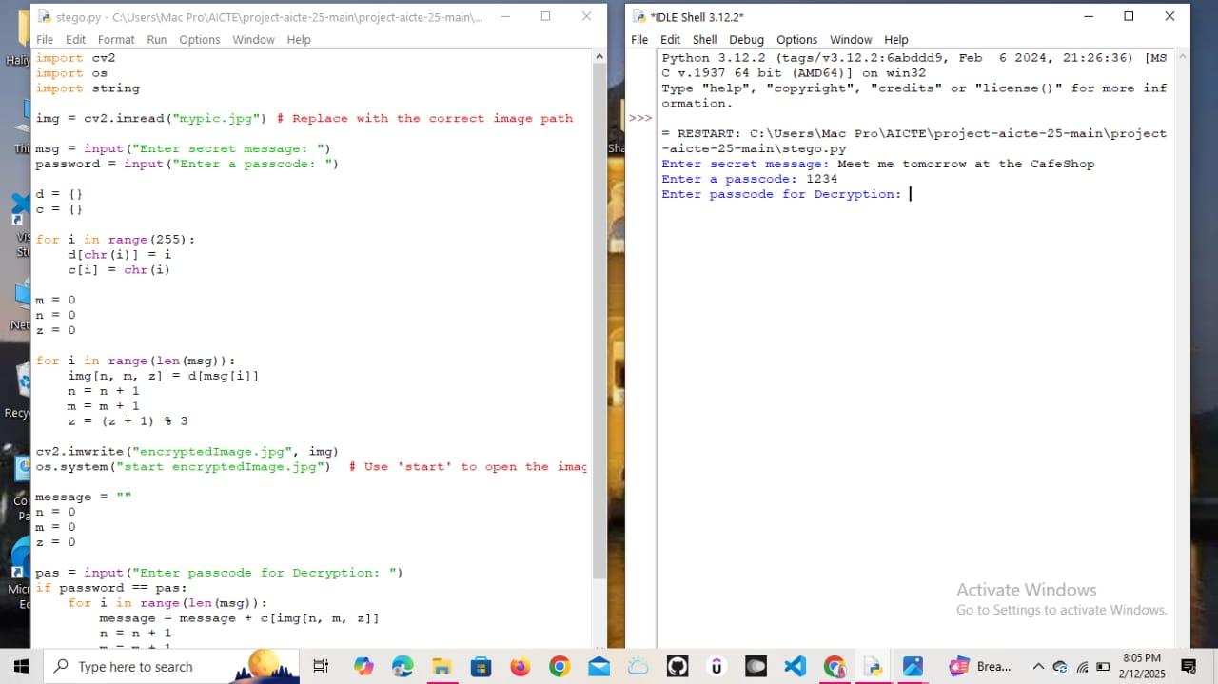
Output Imgae-2

Slide 9
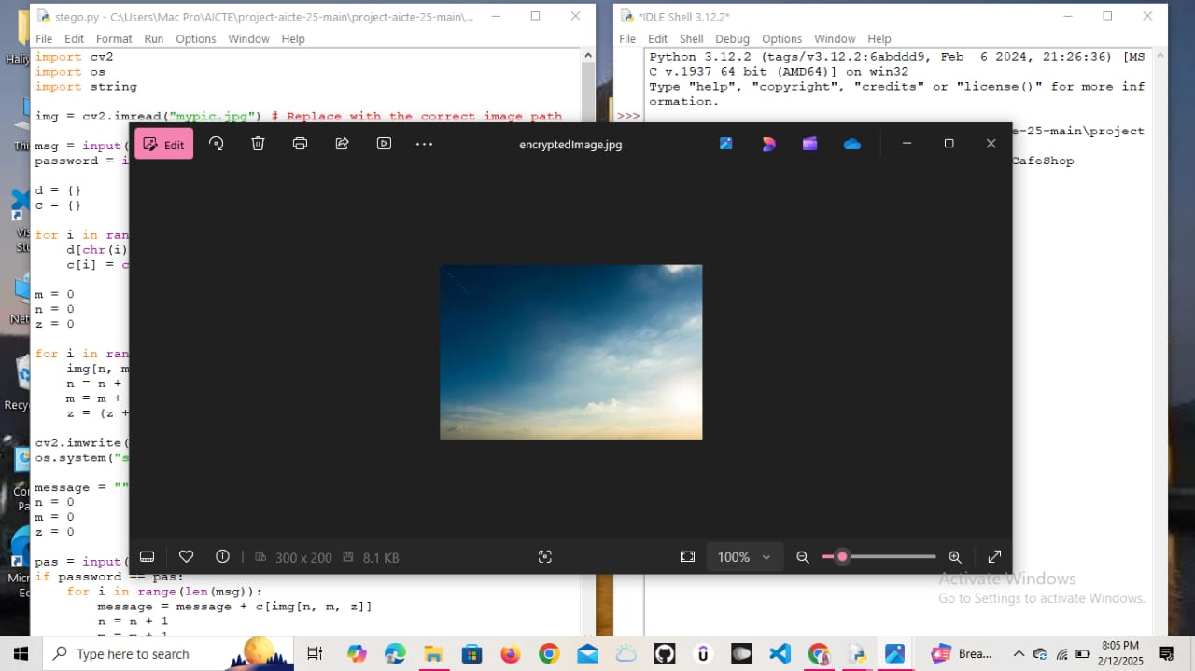
Output Image-3

Slide 10
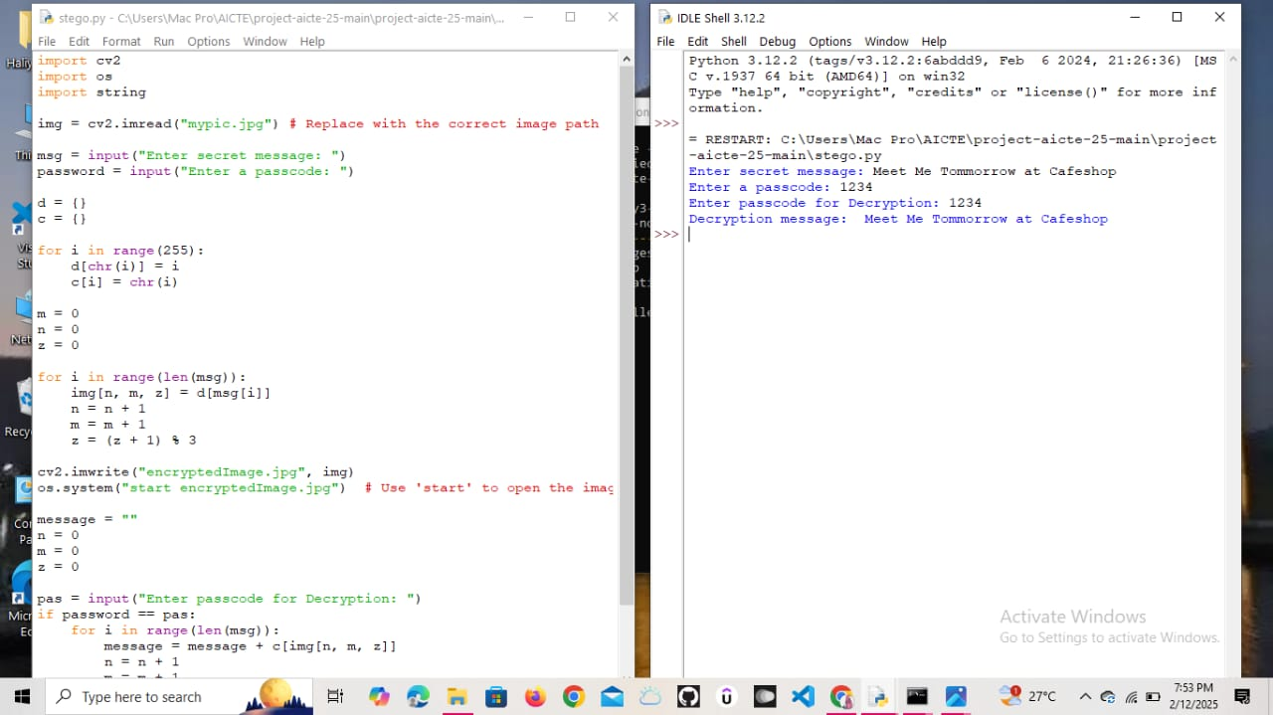
Output Image-4

Slide 11
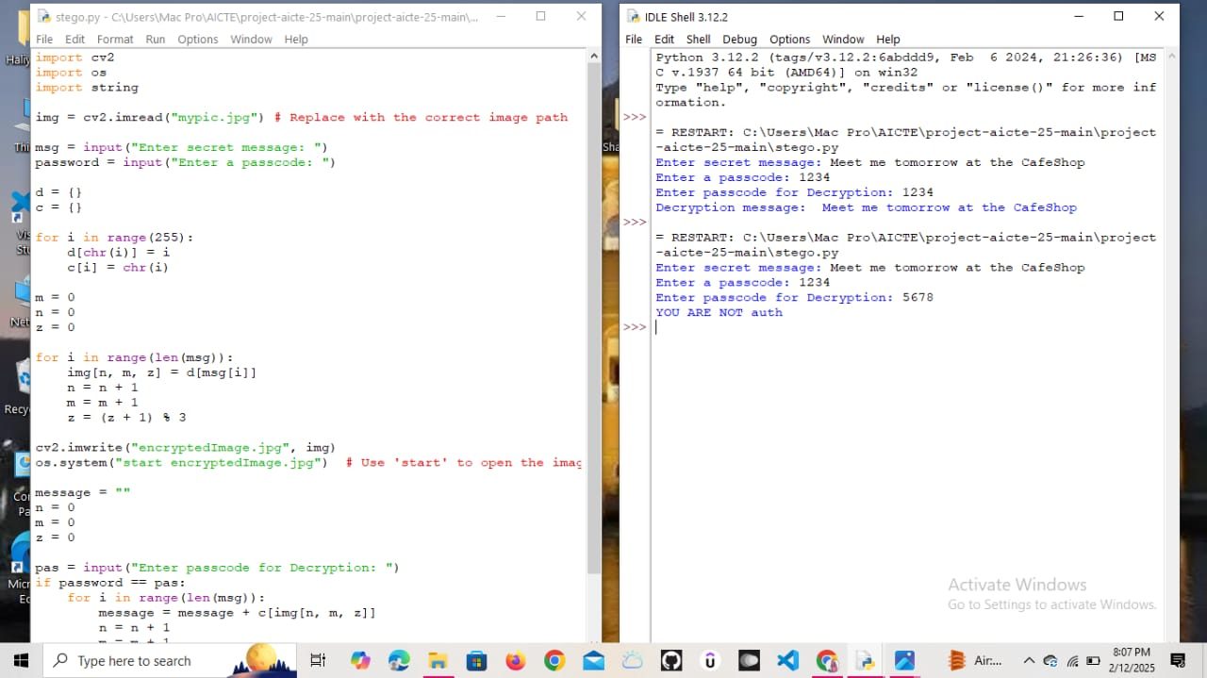
Output Image-5

Slide 12
CONCLUSION
In this project, we successfully implemented a steganographic method to securely hide data within images. By embedding secret messages within the pixel values of an image, we ensured that the hidden data remained imperceptible to the human eye while maintaining image quality.
Our approach effectively demonstrated how Least Significant Bit (LSB) substitution (or any other method you used) can be used to achieve secure data transmission. The experimental results showed that the original and stego images had minimal perceptual differences, proving the efficiency of the technique in preserving image integrity.

Slide 13
GITHUB LINK
https://github.com/bashayer2004/AICTE-Cybersecurity-Project-Bashayer.git

Slide 14
FUTURE SCOPE(OPTIONAL)
Support for audio and video steganography.
Integration with Machine Learning to detect steganographic content.
Steganalysis defense mechanisms to avoid detection by attackers.

Slide 15
THANK YOU

