Slide 1
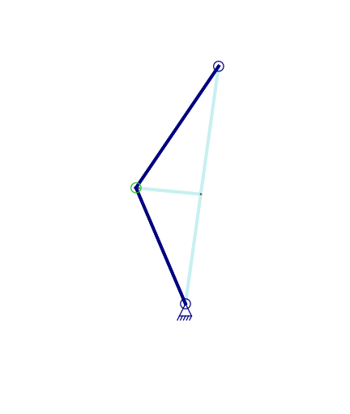








L2i
a
h
$$α$$
a
L1i
$$θ$$
$$\left(β\right)$$
$$X$$

Slide 2
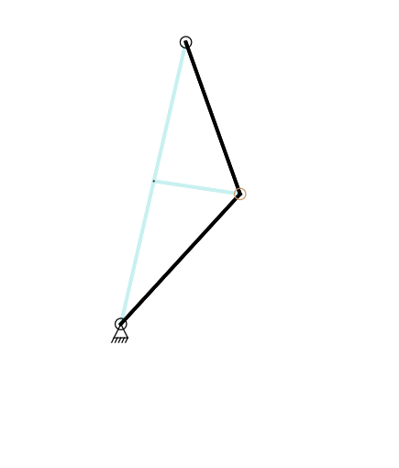




a
L2i
h
a
$$α$$
L1i
$$θ$$
$$\left(β\right)$$
$$X$$

