Slide 1
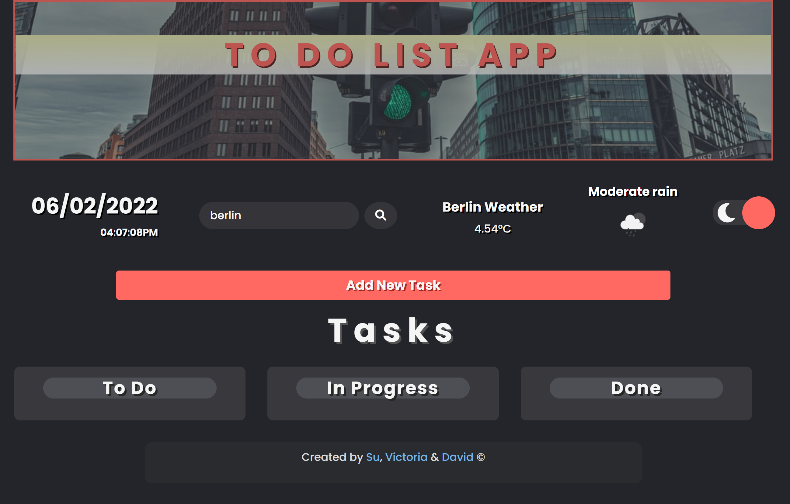
Notes:
Welcome, our Team has three members: Victoria, David and myself.
Our app will enable users to add, track, update, edit and delete tasks.

Slide 2

Agenda
1 : Design Analysis (including OOP Design )
Use Case Diagram, Class Diagram
2 : Agile Project Methodology + Tech Stack + Code
Pair Programming, Code Review, Git and GitHub
Code – Pair Programming and tech stack
App Demo
3 : Sprint – 2 & 3
4 : Additional features
Weather API - Open Weather
Unplash API
Light and Dark mode
Drag and Drop API
5: Github + Code walkthrough + Lesson learned
Notes:
This is our presentation agenda. I will go through first two items : Design Analysis and Agile Project Methodology + Tech Stack and code.

Slide 3
Design Analysis
Sprint -1
Task 1 – App Wireframes
Sprint-3
Task 8 – Update Tasks
Task 9 – Persisting Task with Local Storage
Task 10 – Deleting Tasks
Sprint -2
Task 4- Task form Input Validation
Task 5 – Displaying Date
Task 6 – Create a class using JavaScript
Task 7 – Display Tasks
Task 2 – Implement wireframes using bootstrap
Task 3 – Create a task card layout
Notes:
We were given the design documentation for all three sprints. So, instead of diving straight into Sprint -2. We reviewed the tasks and did the project planning.

Slide 4
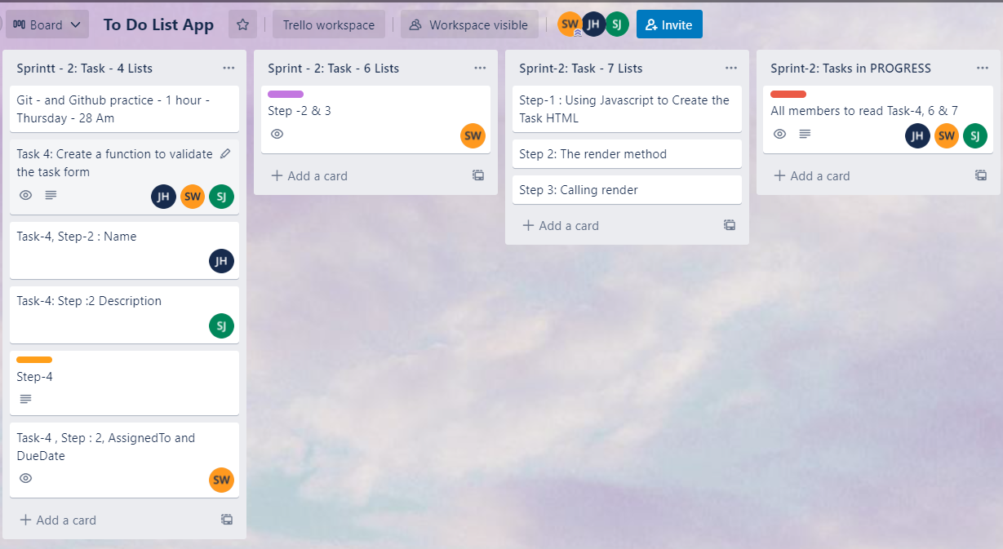
Agile Project Methodology - Trello
D
V
D
D
V
V
D
V
D
V
Notes:
For planning, we used Trello and List all the tasks and split the tasks among our team members.

Slide 5

OOP Design Analysis: Use Case Diagram
Use Cases
Render
Add task
Edit Task
System
Delete Task
User
Save tasks
Mark as Done
Local Storage/ Database
Notes:
After having a thorough understanding of the design requirements, we used our knowledge and drew this Use Case Diagram.

Slide 6
OOP Design Analysis: Class Diagram
Task Manager
+ tasks : Array + currentId : number
- addTask( ) - editTask( ) - deleteTask( ) - createTaskHTML( ) - formatStatus( ) - render( ) - getTaskById( ) - save( ) - load( )
UML Conventions
ClassName
property_name : type
method( ) : type
Notes:
And class diagram to ensure we include all the methods and know the parameters for the Task Manager class.

Slide 7
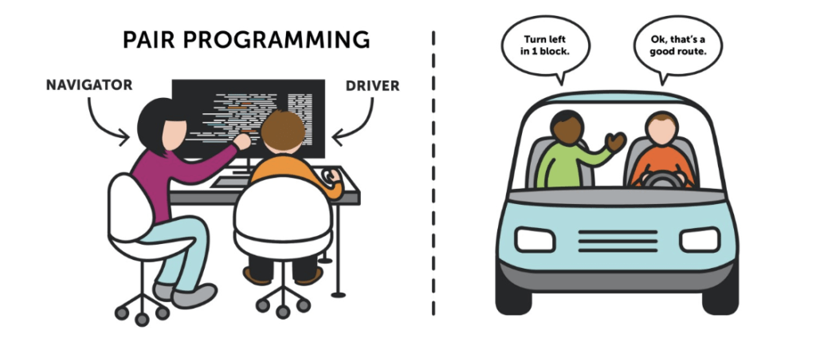
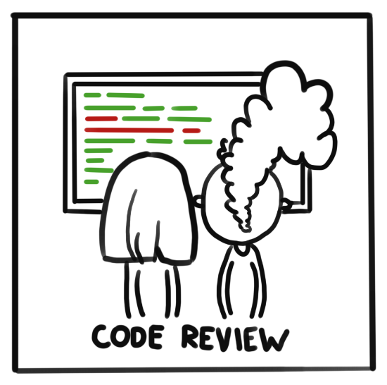




Code Review Process + Technology Stack
Notes:
Majority of our code was written using pair programming approach. For individual tasks, we ensured we reviewed PR prior to merging.
Technology stack for this project is HTML, CSS and JS.
For code tracking and management, we used git and github.

Slide 8
DEMO
Notes:
Now, I will handover to Victoria for a demo.

Slide 9
GitHub Page
Branch management Walkthrough
README.md file documentation
Notes:
Show github – only 25 secs
For this project, we have also written the comprehensive design doc. At the end of this doc, you see this git and github guideline we follow for the code management.
For indi

Slide 10
Code Walkthrough
Additional Features – Weather API & Unplash API
Drag and Drop API
Refactoring of TaskManager class to implement encapsulation
Notes:
For codewalk through, I would like to focus on three implementations.

Slide 11
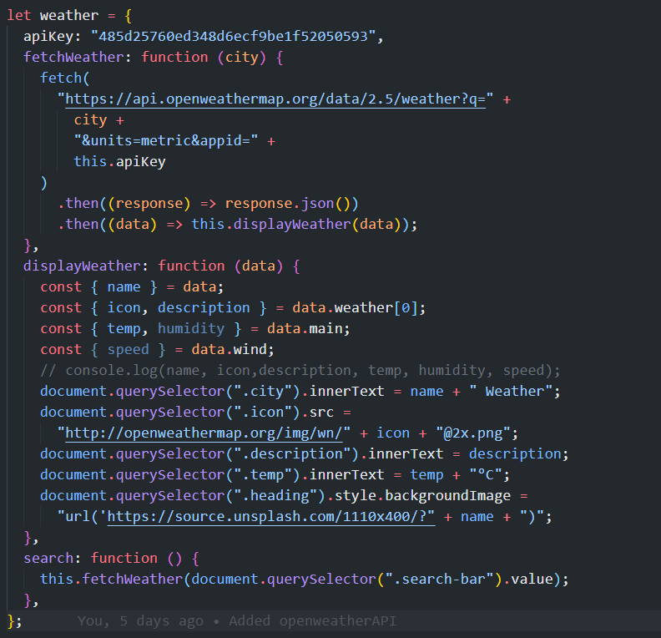
Additional Features : Weather API & Unplash API
Functional programming
Notes:
For Open Weather API and Unsplash API, we have created the weather object and pass in all the required parameters.

Slide 12
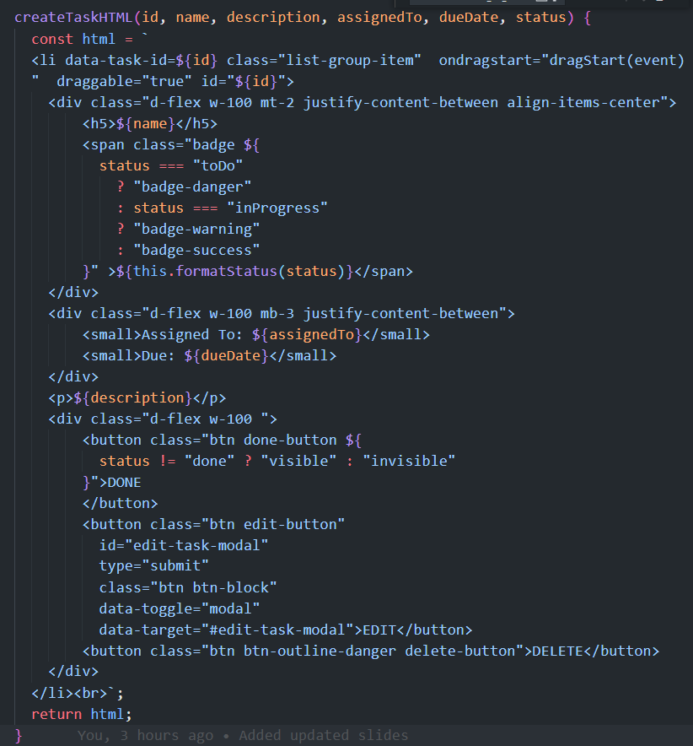
Drag and Drop API
Notes:
To implement drag and drop, tasks have been set to draggable=true. This allows them to be dragged and dropped into the drop zone. We have also added an onDragStart event.

Slide 13
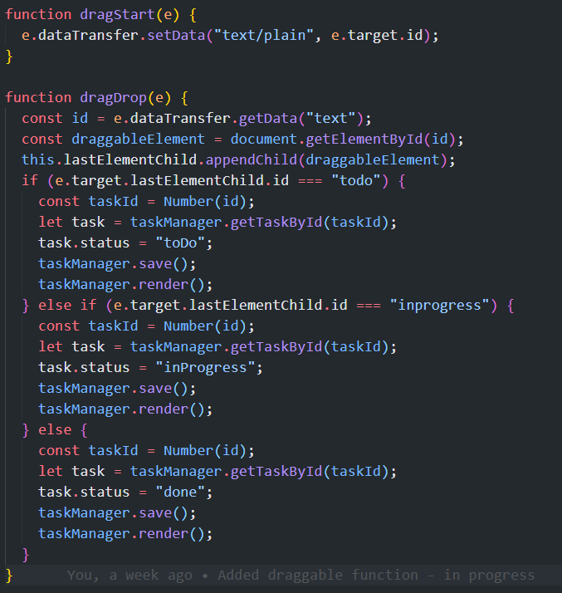
Drag and Drop API
Notes:
This is how we have implemented dragStart and dragDrop function. In here, you can see that for every drag and drop, taskManager saves and renders.

Slide 14
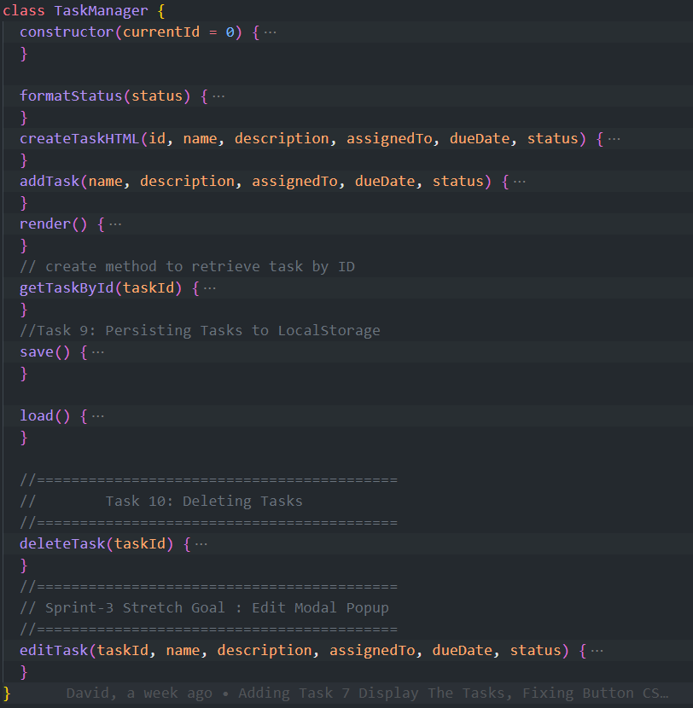
Refactor TaskManager Class
Notes:
We have refactored the Taskmanager class, and have brought createTaskHTML function inside. This is in accordance with OOP encapsulation principles.

Slide 15
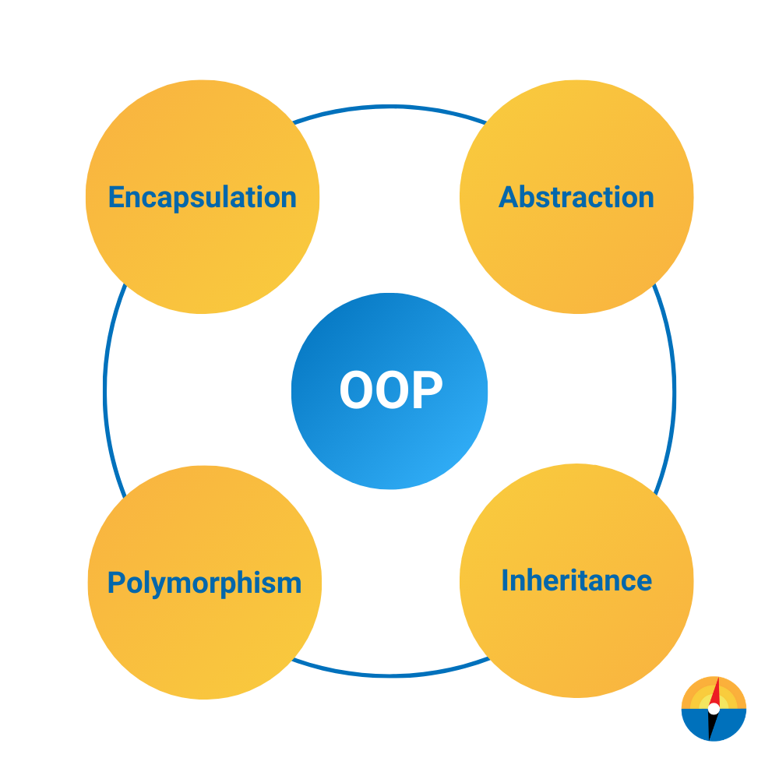



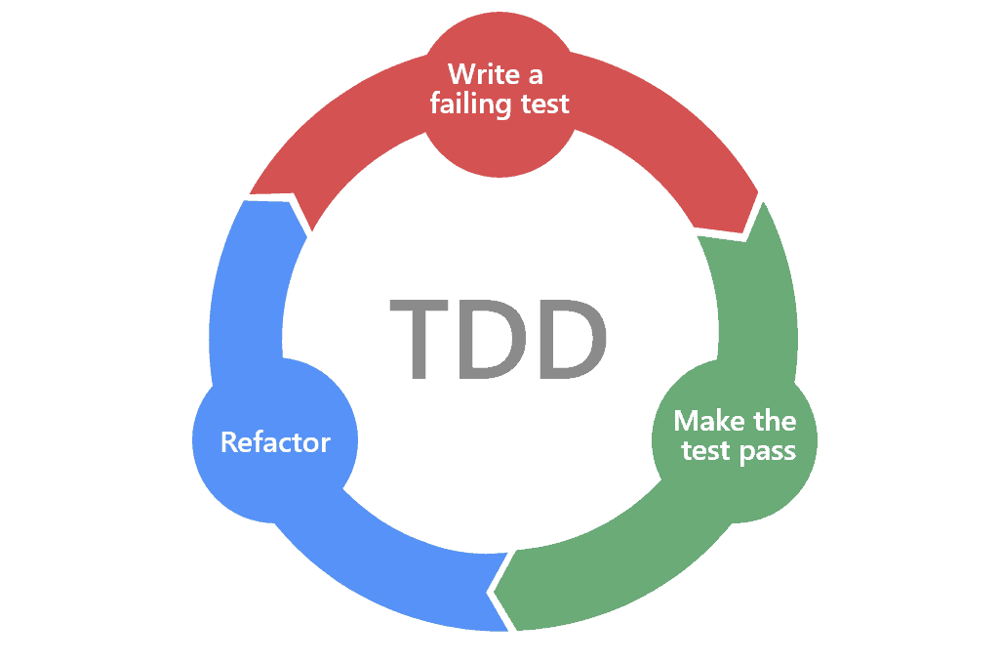

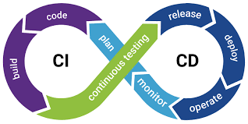
Lessons Learned
Code Review , CI/CD &
Team Work
Debugging Sills
&
What TDD is
JavaScript
&
API calling
OOP Design Principles
Particularly
Encapsulation

Slide 16
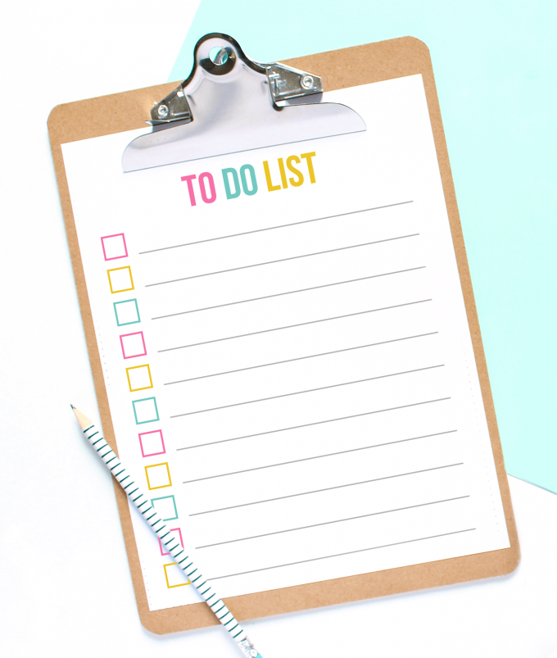
Thanks!

Slide 17


(3) Additional Feature : Light and Dark mode
<input type="checkbox” class="checkbox" id="checkbox" />
Font awesome – moon and sun
Light-dark toggle
Checkbox click event
🌙
🌞

Slide 18
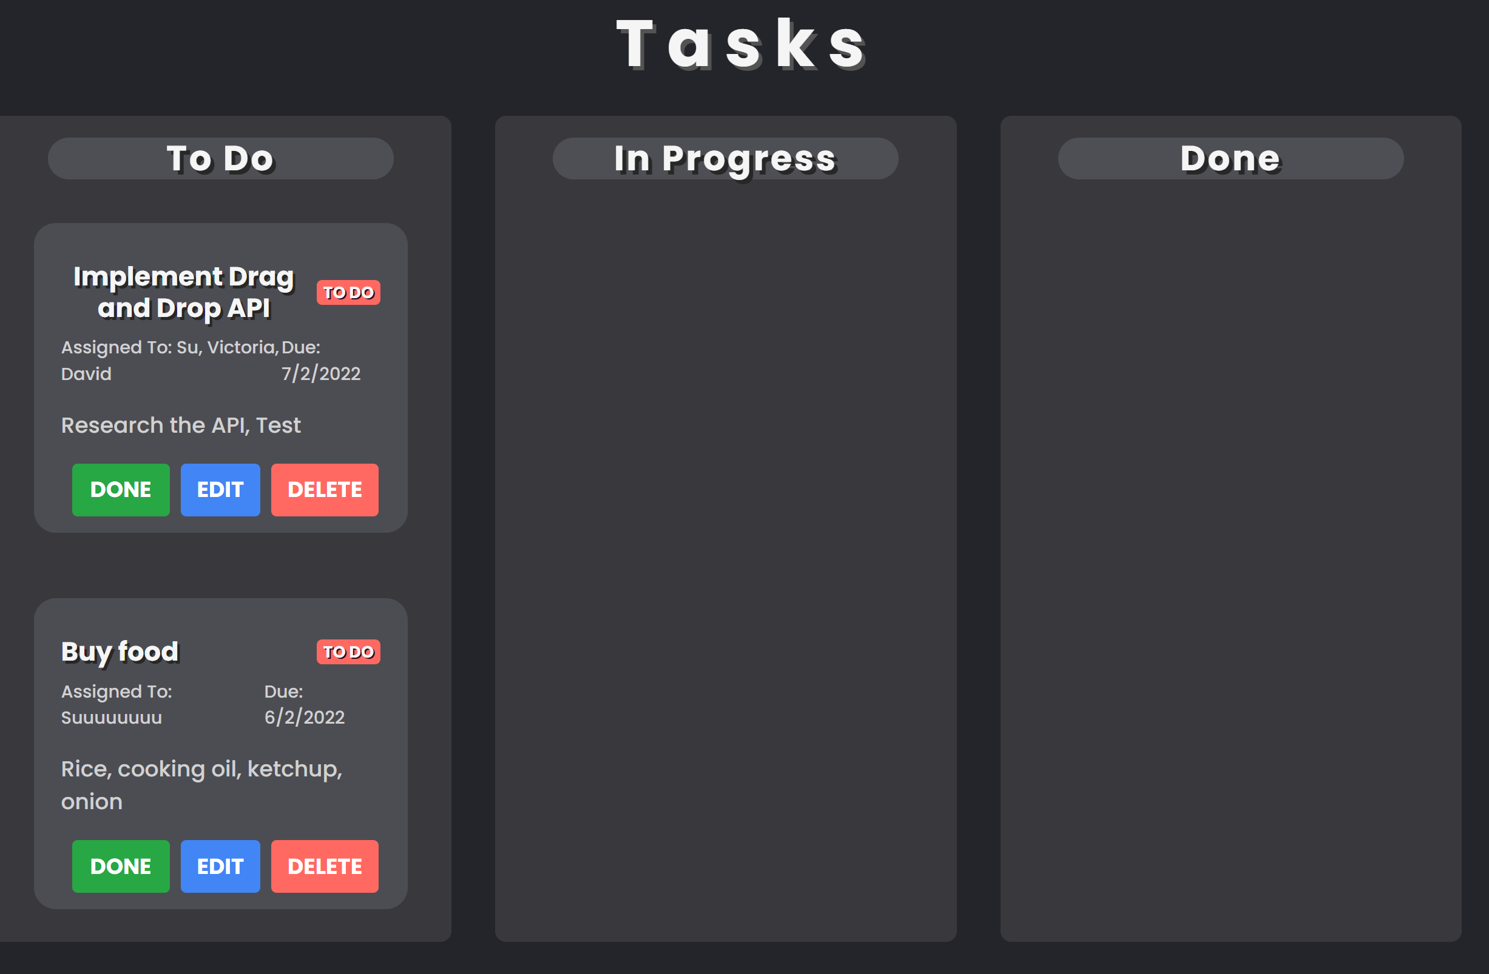
Additional Feature : Drag and Drop API
Draggable
Each To Do list needs to be Draggable
Drop Target
Drop Target
Notes:
All the items need to be draggable into drop target.

Slide 19
(4) Additional Feature : Drag and Drop API
Draggable
Drop Target
Events
dragStart
dragOver
dragEnter
Attributes
ondragstart="dragStart(event)" draggable="true”
Events
dragOver
dragDrop
Update status
save( )
render( )

