Slide 1
CALIFORNIA HOUSING
Predicting Median House Value with Machine Learning
A Regression Project • 1990 U.S. Census Data • 5 Algorithms Compared
Prepared by: Maria
Notes:
Greet the class/teacher. State the project name and one-line goal: predicting California house prices using machine learning regression models. Keep this slide brief - 15-20 seconds.

Slide 2
What We'll Cover
The Problem
The Dataset
01
02
What we're predicting and why it matters
20,640 California census records
Cleaning the Data
Feature Engineering
03
04
Hidden issues we had to fix
Making the data more meaningful
Five Models
Results & Recommendation
05
06
Training and comparing algorithms
Which model wins, and why
Notes:
Quick roadmap slide - just read the six section titles aloud so the audience knows what's coming. Don't over-explain here.

Slide 3
The Problem
Real estate prices depend on dozens of interacting factors — location, income levels, housing density, and more.
Goal: Build a model that predicts the median house value of a California neighborhood from its census data — useful for buyers, sellers, and policy planners alike.
20,640
Census Records
9
Original Features
5
This is a REGRESSION problem
Models Compared
We predict a continuous dollar amount — not a category.
Notes:
Explain: previous project (Adult Census Income) was CLASSIFICATION (predicting a category). This project is REGRESSION - predicting an exact number (house price). Mention the 3 stats briefly.

Slide 4
The Dataset
1990 U.S. Census — California Housing Prices (Kaggle)
longitude / latitude
Geographic location
housing_median_age
Age of homes in the block
total_rooms / total_bedrooms
Total rooms & bedrooms (block-level)
population / households
People and households in the block
median_income
Median household income ($10,000s)
ocean_proximity
Categorical: distance to ocean
median_house_value
TARGET — what we predict
Notes:
Walk through the feature list briefly. Emphasize the last row (highlighted) is the TARGET variable we're trying to predict. Mention ocean_proximity is the only categorical column.

Slide 5
Cleaning the Data
Two hidden issues had to be found and fixed before modeling
Price Cap Artifact
Missing Values
965
207
rows capped at exactly $500,001 — the true value of expensive homes was lost during Census collection.
rows missing total_bedrooms (~1% of data) — a real NaN this time, not disguised.
Fix: dropped these rows — the true value can't be recovered, and keeping them would teach the model a false ceiling.
Fix: filled with the median value — preserves the data since missingness looks random, not systematic.
Notes:
This slide shows you understand real data quality issues, not just textbook cleaning. Price cap: explain the Census top-coded expensive homes at exactly $500,001. Missing bedrooms: explain median imputation reasoning.

Slide 6
Feature Engineering
Raw counts describe a whole neighborhood block — ratios describe an actual household
rooms_per_household
bedrooms_per_room
population_per_household
total_rooms ÷ households
total_bedrooms ÷ total_rooms
population ÷ households
Average home size in the area
Housing “type” signal — apartments vs. houses
A crowding indicator
Notes:
Explain WHY these matter: a block with 5000 total rooms just has more houses, not necessarily nicer ones. Dividing by households gives per-house numbers that actually predict value.

Slide 7
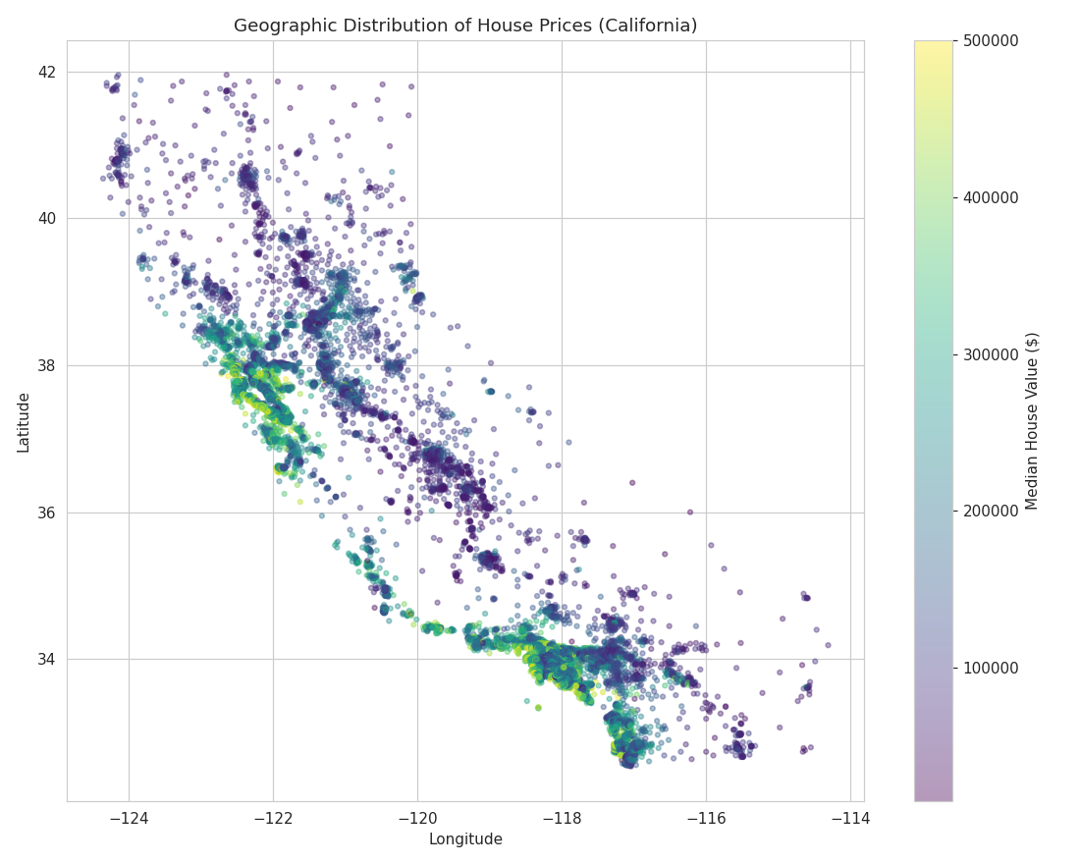
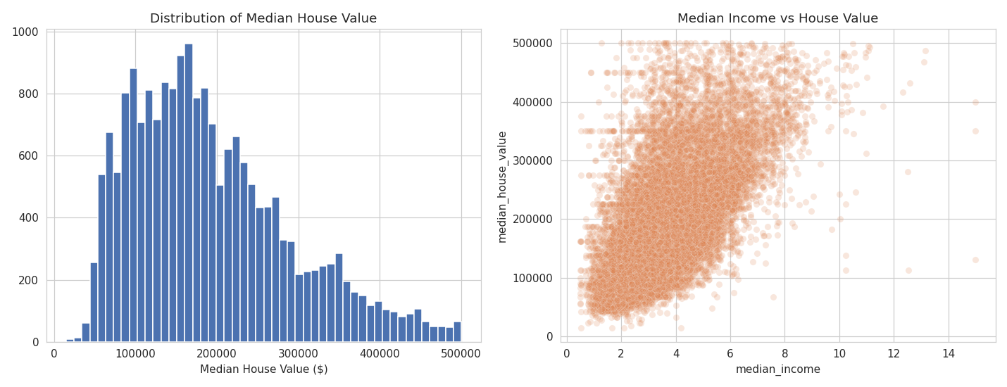
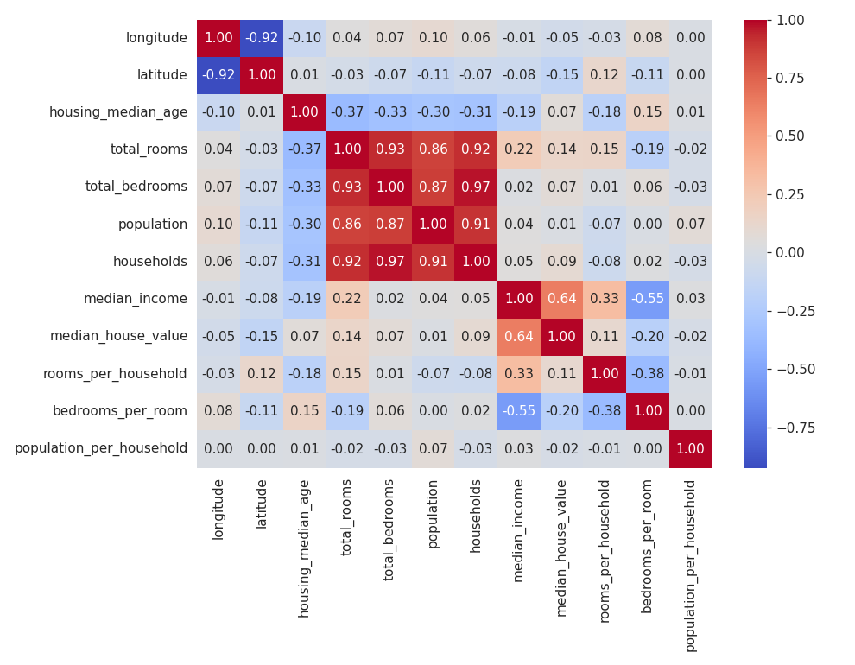
What the Data Shows
Income vs. price shows a strong upward relationship — our best single predictor.
Prices cluster along the coast — location matters a lot.
Notes:
Point to the map: bright yellow/green spots = expensive, matching SF Bay Area and coastal LA. Then explain median_income has the strongest correlation (0.64) with house value in the heatmap.

Slide 8
Preparing the Data for Modeling
1
Encode categories
ocean_proximity → one-hot encoded (5 categories → 4 columns)
2
Scale numeric features
median_income (0–15) vs. total_rooms (1000s) — standardized for fair comparison
3
Train / test split
80% train (15,740 rows) / 20% test (3,935 rows)
Notes:
Explain scaling in simple terms: without it, KNN and Linear models get confused by a column with values in the thousands vs a column with values 0-15. Tree models don't need scaling but we scale anyway for consistency where relevant.

Slide 9
Five Algorithms, One Fair Test
All trained and tested on the exact same data split
1
2
3
4
5
Linear Regression
Ridge Regression
Decision Tree
Random Forest
KNN Regressor
The straight-line baseline
Linear + regularization
Learns non-linear splits
200 trees, averaged
Averages nearest neighbors
Notes:
Briefly name all 5. Emphasize: same train/test split, same features, same preprocessing pipeline for each - this is what makes the comparison fair.

Slide 10
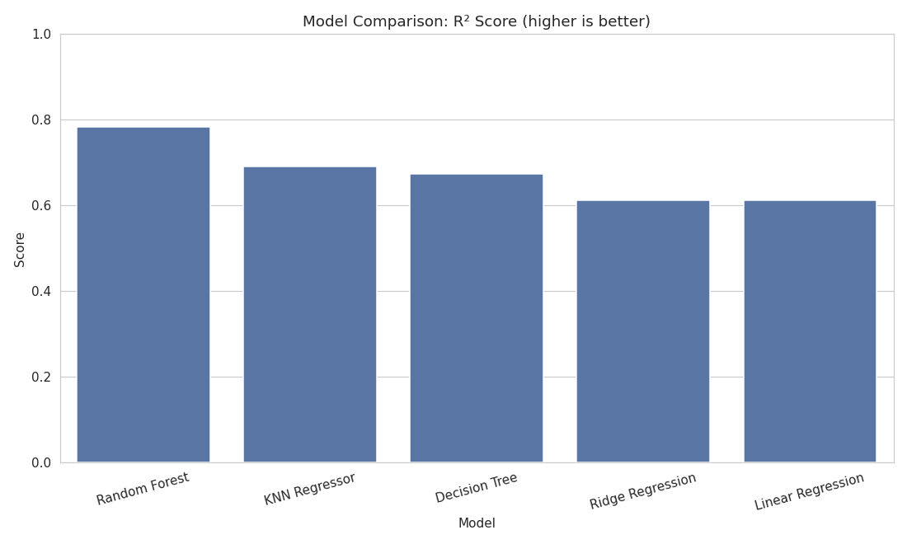
Results: R² Score by Model
R² measures how much of the price variation the model explains (1.0 = perfect)
Model
MAE
RMSE
R²
Random Forest
$31,195
$46,614
0.782
KNN Regressor
$38,496
$55,516
0.691
Decision Tree
$38,335
$57,010
0.674
Ridge Regression
$45,481
$62,204
0.612
Linear Regression
$45,481
$62,206
0.612
Notes:
Point at the bar chart first - Random Forest is tallest. Then walk the table: Random Forest has the lowest error (MAE $31,195) and highest R2 (0.782). Note Linear and Ridge are nearly identical - regularization barely mattered here.

Slide 11
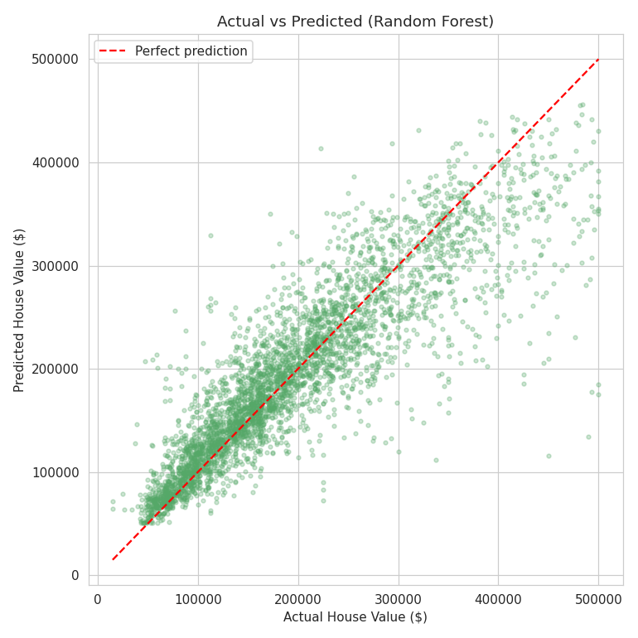
Why Random Forest Wins
Captures non-linear patterns
Income's effect on price differs by location — straight-line models can't represent that
Ensemble reduces overfitting
200 trees averaged smooth out noise a single Decision Tree overfits to
Handles mixed feature scales natively
No sensitivity to total_rooms (1000s) vs. bedrooms_per_room (0–1)
Actual vs. Predicted — points near the line are accurate
Notes:
Explain each reason in plain language. If asked a follow-up 'what's a trade-off', mention: Random Forest is less interpretable than Linear Regression - harder to explain exactly why one house got its predicted price.

Slide 12
Key Takeaways
Random Forest was the best model: R² = 0.782, average error ≈ $31,000
Median income and location are the strongest price predictors
Careful cleaning (price cap, missing values) and feature engineering mattered as much as model choice
Regression ≠ classification: different metrics (MAE/RMSE/R²), same rigorous comparison process
Thank You!
Questions welcome
Notes:
Summarize the 4 takeaways in your own words. End confidently: 'Thank you, happy to take questions.' Take a breath before opening the floor.

