Slide 1
ABADA
OPEN SOURCE · SELF-HOSTED
Build processes that improve
with every execution
Durable orchestration for AI agents, people and systems — with evidence-driven, human-governed change.
CREATE OR IMPORT
RUN
OBSERVE
IMPROVE
Design · AI · BPMN
Agents · humans · systems
Facts · history · telemetry
Validated proposals · review
Patrick Bashizi · Democratic Republic of the Congo
abadaplatform.com
Notes:
Open on the lifecycle, not on a file format. Abada supports both new process creation and bounded BPMN import.
[Sources]
- Repository product documentation: docs/development/studio-app-spec.md
- Program: https://labs.google/aifuturesfund/africaailab

Slide 2
ABADA
02
AI workflows need an operational lifecycle
A model response takes seconds. A business process may run for days.
DURABLE STATE
Work must survive restarts and long waits.
DETERMINISTIC CONTROL
Decisions and retries cannot depend on model improvisation.
HUMAN AUTHORITY
People must own approvals, exceptions and change adoption.
OPERATIONAL EVIDENCE
Attempts, latency, failures and outcomes must remain observable.
Abada connects these requirements in one governed lifecycle.
Google Africa Applied AI Lab · 2026
abadaplatform.com
Notes:
Frame the problem as the operational gap around AI, not as a critique of BPMN or XML.
[Sources]
- Runtime semantics: docs/reference/runtime-semantics.md
- Persistence model: docs/architecture/runtime-state.md

Slide 3
ABADA
03
One platform for the full process lifecycle
1
2
3
4
CREATE OR IMPORT
RUN
OBSERVE
IMPROVE
Visual Studio
AI authoring
APL or supported BPMN
Gemini agents
Human work
Systems + decisions
Execution history
Attempts + latency
Failures + outcomes
Findings
Validated proposal
Governed adoption
Studio
Engine + PostgreSQL
Durable facts
Insight Engine
Every participant advances the same versioned process state.
Google Africa Applied AI Lab · 2026
abadaplatform.com
Notes:
Walk left to right. Import is one option in the first phase; it is not the product identity.
[Sources]
- Studio lifecycle: docs/development/studio-app-spec.md
- Insight lifecycle: docs/reference/insight-loop.md

Slide 4
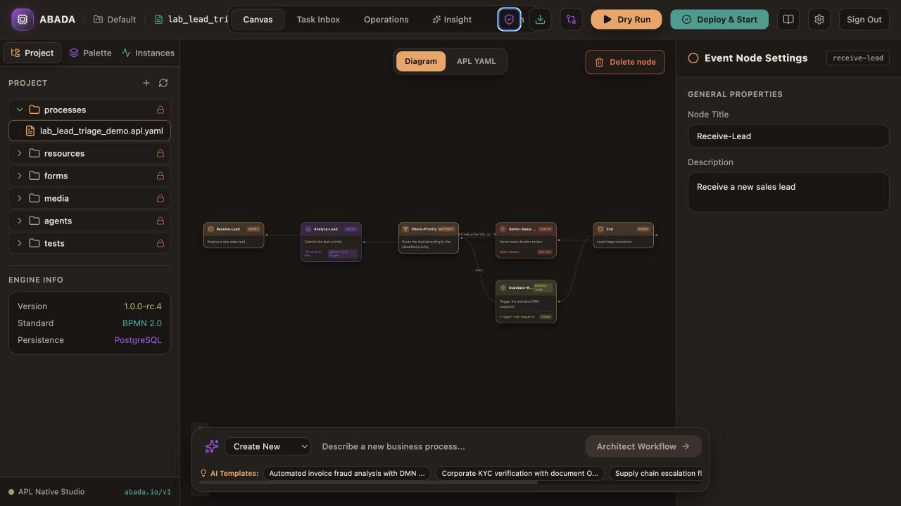
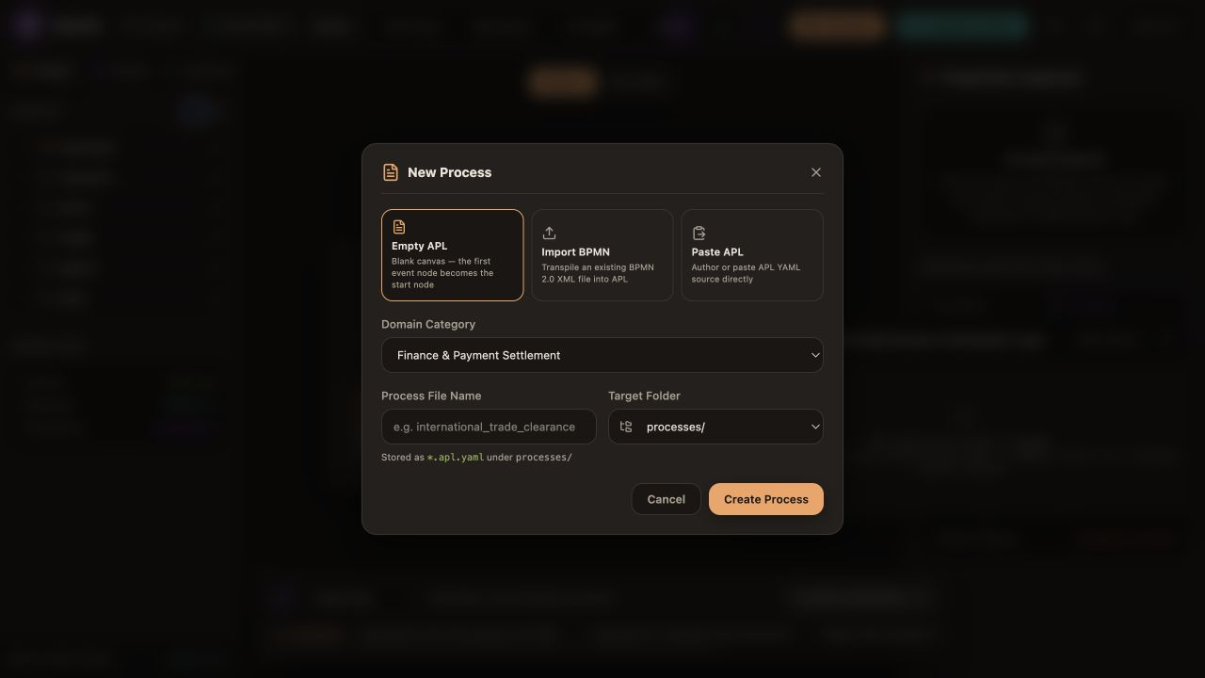
ABADA
04
Create intelligent processes
REAL STUDIO
Multiple entry points
Visual
Start from a blank canvas.
AI-assisted
Describe a process in plain language.
Native
Author or paste reviewable APL.
Interoperable
Import the supported BPMN subset.
Safe to explore
Dry Run stays local and mocked.
APL is the native representation beneath Studio — not the whole product story.
Google Africa Applied AI Lab · 2026
abadaplatform.com
Notes:
Use the real Studio capture to establish that Abada creates new processes and also supports import.
[Sources]
- Product captures: submissions/google-africa-ai-lab-2026/assets/studio-lead-triage-canvas.png and studio-new-process.png
- Studio specification: docs/development/studio-app-spec.md

Slide 5
ABADA
05
Gemini becomes a governed workflow participant
The model call is outside the workflow transaction. Its accepted result re-enters through the durable worker contract.
STUDIO
ENGINE
AGENT WORKER
GEMINI
Model · prompt
output contract
Durable agent work
PostgreSQL state
Bounded timeout
validation · retry
Structured result
confidence
Persisted attempt metadata
AT-LEAST-ONCE
resolved model · provider · attempt · duration · confidence · tools · error type · prompt hash
Validated output drives deterministic routing to a person or system.
Google Africa Applied AI Lab · 2026
abadaplatform.com
Notes:
Emphasize the durable boundary. Do not claim exactly-once model execution or executable function-calling tools today.
[Sources]
- Agent worker contract: docs/reference/agent-worker.md
- External worker semantics: docs/reference/external-worker-protocol-v1.md

Slide 6
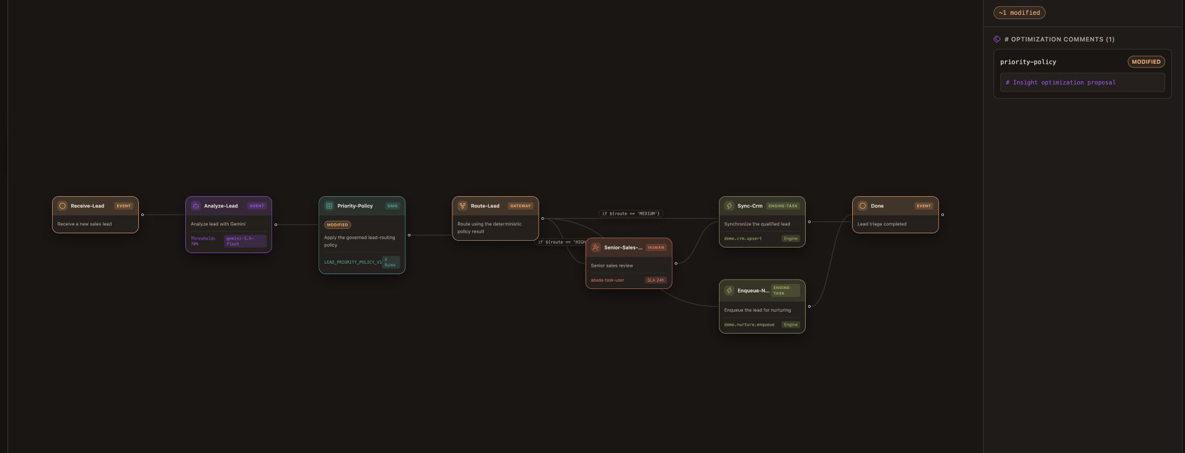
ABADA
06
Insight turns evidence into governed improvement
FACTS
FINDINGS
VALIDATED PROPOSAL
HUMAN REVIEW
NEW VERSION
REAL LOCAL EXECUTION
Gemini 3.6 Flash
4
persisted LOW runs
FALLBACK_THRASH
The LLM proposed an explicit LOW rule. The definition remains unchanged until a person approves it.
NOT APPROVED
Google Africa Applied AI Lab · 2026
abadaplatform.com
Notes:
This is a real local execution captured on 31 August 2026. Four genuine LOW lead-triage runs used Gemini 3.6 Flash, produced persisted execution facts and triggered the FALLBACK_THRASH finding. The LLM-generated proposal adds an explicit LOW decision rule. It remains in Draft and was not approved.
[Sources]
- Insight contract: docs/reference/insight-loop.md
- PostgreSQL integration evidence: engine/src/test/java/com/abada/engine/core/InsightLoopIntegrationTest.java
- Lead-triage demo definition: submissions/google-africa-ai-lab-2026/demo/lead-triage.apl.yaml
- Real execution capture: submissions/google-africa-ai-lab-2026/assets/studio-insight-real.png
- Model and execution date: Gemini 3.6 Flash · local execution · 2026-08-31

Slide 7
ABADA
07
Reliable and accountable by design
1.0.0-rc.4
323
Published evaluation release candidate
tests passed in the recorded release gate
IMPLEMENTED
IMPLEMENTED
PostgreSQL authority
Recovery
Mutable process state is database-authoritative.
Leases, retries and restart-safe acquisition.
IMPLEMENTED
IMPLEMENTED
Atomicity
Governance
State, work, history and outbox commit together.
Backend RBAC, audit and immutable versions.
Google Africa Applied AI Lab · 2026
abadaplatform.com
Notes:
Treat the release and test count as evidence, not as market traction. External effects remain at-least-once.
[Sources]
- Release gate: docs/development/1.0-rc.4-gate-report-2026-08-30.md
- Runtime state architecture: docs/architecture/runtime-state.md
- Release notes: docs/release-notes/1.0.0-rc.4-release-notes.md

Slide 8
ABADA
08
Create natively. Import when needed.
Interoperate across new processes and existing investments through an explicit compatibility boundary.
CREATE
IMPORT
EXECUTE
EXPORT
Visual Studio
AI authoring
APL
Supported BPMN
compatibility report
One canonical graph
one durable runtime
Supported round-trip
for interoperability
LIMITED
Standard BPMN 2.0 · Abada-native extensions · documented Camunda 7 profile
Unsupported execution semantics fail explicitly. Abada does not claim full BPMN coverage.
Google Africa Applied AI Lab · 2026
abadaplatform.com
Notes:
Keep this as an adoption and interoperability feature. Do not make legacy modernization the hook.
[Sources]
- BPMN support: docs/reference/bpmn-support.md
- Compatibility profiles: docs/bpmn/compatibility-profiles.md
- Round-trip gate: studio/scripts/kitchen-sink-roundtrip.mts

Slide 9
ABADA
09
Built for high-stakes operations in Africa
BANKING
TELECOM
Commercial path
KYC · credit exceptions
fraud review
Onboarding · incidents
escalation
NOW
Open-source core
FUTURE
Managed hosting
Enterprise support
AGRITECH
GOVTECH
Producer cases · documents
field-data routing
Citizen requests
auditable approvals
Self-hosting keeps deployment and data-location choices with the operator.
Target use cases — not customer traction or invented market size.
Google Africa Applied AI Lab · 2026
abadaplatform.com
Notes:
Present these as target use cases. No market-size, customer-count or revenue claim is made.
[Sources]
- Product positioning: README.md
- Deployment boundaries: docs/reference/deployment-support.md

Slide 10
WHY GOOGLE AFRICA APPLIED AI LAB
Turn Gemini capabilities into
reliable workflow primitives
Three-month focus
01
Governed function calling
Structured external actions with operator-controlled tools.
02
Multimodal agent nodes
Document and image understanding inside durable processes.
03
African-language evaluation
Measure and improve process interactions across local languages.
Patrick Bashizi
Founder · Democratic Republic of the Congo
bashizip@gmail.com · abadaplatform.com
Notes:
Close on concrete work the Lab can accelerate. Function calling, multimodal nodes and African-language evaluation are roadmap items, not current-product claims.
[Sources]
- Abada 1.1 roadmap: docs/development/roadmap-to-1.1.0-rc.md
- Program: https://labs.google/aifuturesfund/africaailab

