Slide 1
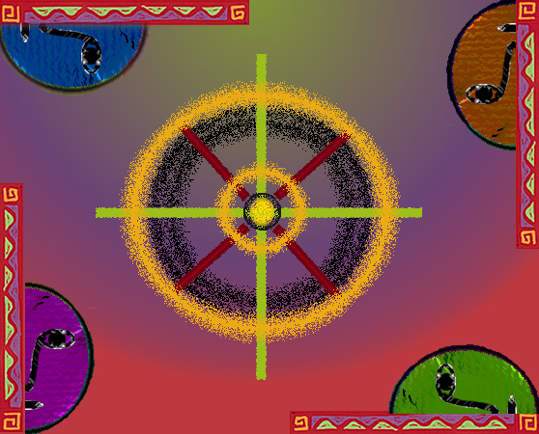
5
Organizational
Structure

Slide 2
Designing Organizational Structure
Organizing: the process by which managers establish working relationships among employees to achieve goals.
  Organizational Structure: formal system of task & reporting relationships showing how workers use resources.

Slide 3
Factors Affecting Organizational Design
Figure 8.1
Environment
Determine design
or organizational
structure
Strategy
Technology
Human
Resources

Slide 4
Determinants of Structure
  The environment: The quicker the environment changes, the more problems face managers.
    Structure must be more flexible when environmental change is rapid.
  Strategy: Different strategies require the use of different structures.

Slide 5
Determinants of Structure
  Technology: The combination of skills, knowledge, tools, equipment, computers and machines used in the organization.
    More complex technology makes it harder for managers to regulate the organization. Technology can be measured by:
      Task Variety: new problems a manager encounters.
      Task Analyzability: programmed solutions available to a manager to solve problems.
    High task variety and low analyzability present many unique problems to managers.
      Flexible structure works best in these conditions.
    Low task variety and high analyzability allow managers to rely on established procedures.

Slide 6
Determinants of Structure
  Human Resources: the final factor affecting organizational structure.
    Higher skilled workers who need to work in teams usually need a more flexible structure.
  Managers must take into account all four factors (environment, strategy, technology and human resources) when designing the structure of the organization.

Slide 7
Job Design
Job Design: group tasks into specific jobs.
  Job simplification: reduction of the tasks each worker performs.
  Job enlargement: increase tasks for a given job.
  Job enrichment: increases the degree of responsibility a worker has over a job.

Slide 8
Functional structure
    Functional structure consists of departments such as marketing, production, and finance.
    A functional structure is one of the most common organizational structures. Under this structure, the organization groups employees according to a specialized or similar set of roles or tasks

Slide 9
Pros
      Workers can learn from others doing similar tasks.
      Easy for managers to monitor and evaluate workers.

Slide 10
Cons
      Hard for one department to communicate with others.
      Managers can become preoccupied with their department and forget the firm

Slide 11
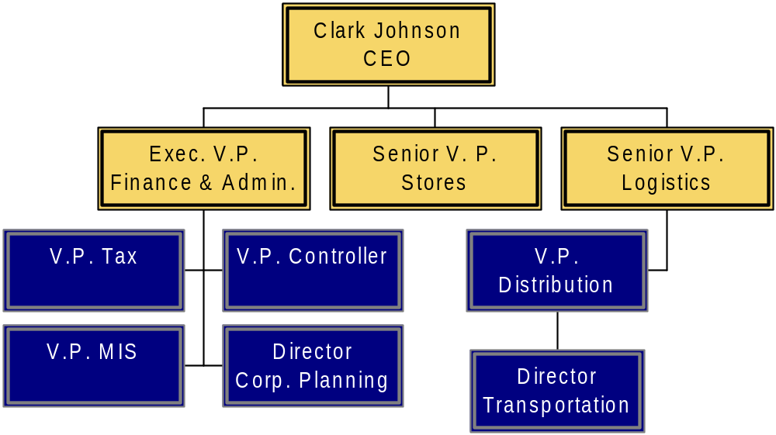
Functional Structure
Figure 8.3

Slide 12
Divisional Structures
A division is a collection of functions working together to produce a product.
  Product structure: divisions created according to the type of product or service.
  Geographic structure: divisions based on the area of a country or world served.
  Market structure: divisions based on the types of customers served.

Slide 13
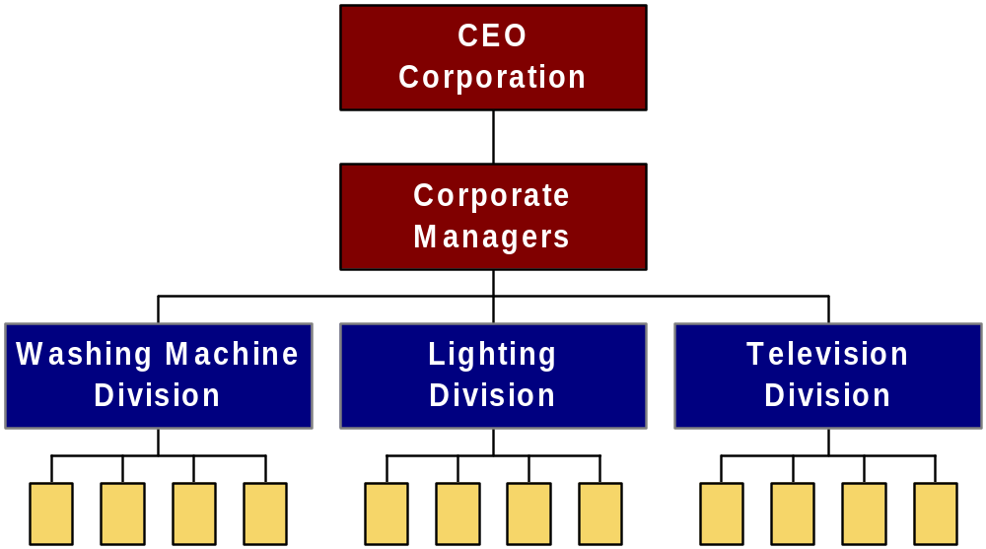
Product Structure
Figure 8.4a

Slide 14
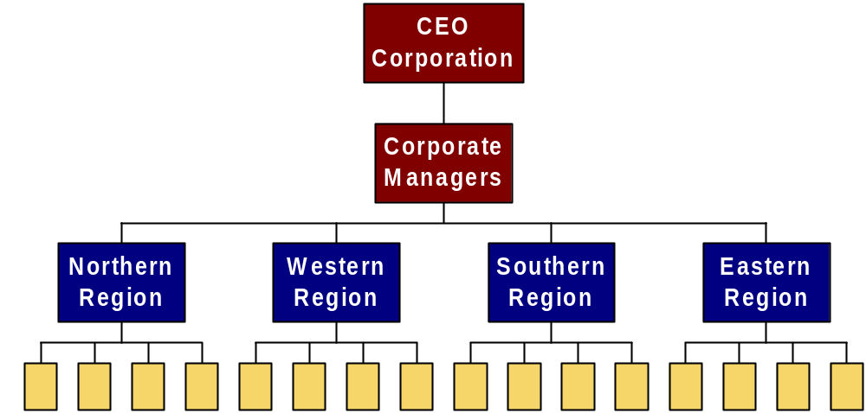
Geographic Structure
Figure 8.4 b

Slide 15

Market Structure
Figure 8.4c

Slide 16
Matrix & Product Teams
  Matrix structure: managers group people by function and product teams simultaneously.
    Results in a complex network of reporting relationships.
    Very flexible and can respond rapidly to change.
    Each employee has two bosses which can cause problems.

Slide 17
Matrix Structure
Figure 8.7a
CEO
Func.
Managers
Sales
Design
Production
Product
team A
Team Managers
Product
team B
Product Team
Product
team C
= two boss employee

Slide 18
Coordinating Functions
To ensure sufficient coordination between functions, managers delegate authority.
  Authority: the power vested in the manager to make decisions and use resources.
  Hierarchy of authority: describes the relative authority each manager has from top to bottom.
    Span of Control: refers to the number of workers a manager manages.

Slide 19
Tall & Flat Organizations
  Tall structures have many levels of authority relative to the organization’s size.
    As levels in the hierarchy increase, communication gets difficult.
    The extra levels result in more time being taken to implement decisions.
    Communications can also become garbled as it is repeated through the firm.
  Flat structures have few levels but wide spans of control.
    Results in quick communications but can lead to overworked managers.

