Slide 1
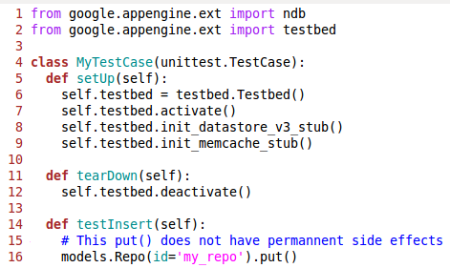
Testbed
App Engine SDK component to stub out services for local testing
The testbed module allows you to use stubs for the capability_service, channel, images, mail, taskqueue, urlfetch, user, xmpp

