Slide 2
Automatic Geo-Alignment of Artwork
Indrajeet Sen
is2n22@soton.ac.uk
26th September 2023

Slide 3

Mission : Making Reading Immersive

Slide 4
PROBLEM STATEMENT
Can we make reading more relatable?
As per data from UNESCO, an estimated 617 million children and adolescents worldwide are falling short of the minimum proficiency standards in reading.

Slide 5
Mission : Making Reading Immersive
Incorporating visual illustrations into the act of reading can undeniably elevate the reading experience, making it more captivating and immersive. Nevertheless, the pinnacle of this enhancement is reached when the content itself is expertly tailored to resonate with the geographical and cultural backgrounds of the readers.
An Indian kid will not be aware of fish & chips.
Similarly, someone in Italy will not relate to dosa.

Slide 6
OPEN QUESTIONS
Can we develop a system that automatically generates text and images precisely aligned with the geographic and cultural contexts of individual readers?
Is it possible to harness the capabilities of large language models (LLMs) and stable diffusion models to achieve this alignment efficiently and effectively?

Slide 7
REQUIREMENTS
Input text to be geographically aligned
TARGET LOCATION of reader
IDENTIFY objects in the input text that can be geo-aligned
IDENTIFY the entity type of these objects
IDENTIFY the object alternatives in TARGET LOCATION
GENERATE geo-aligned text
GENERATE geo-aligned image

Slide 8
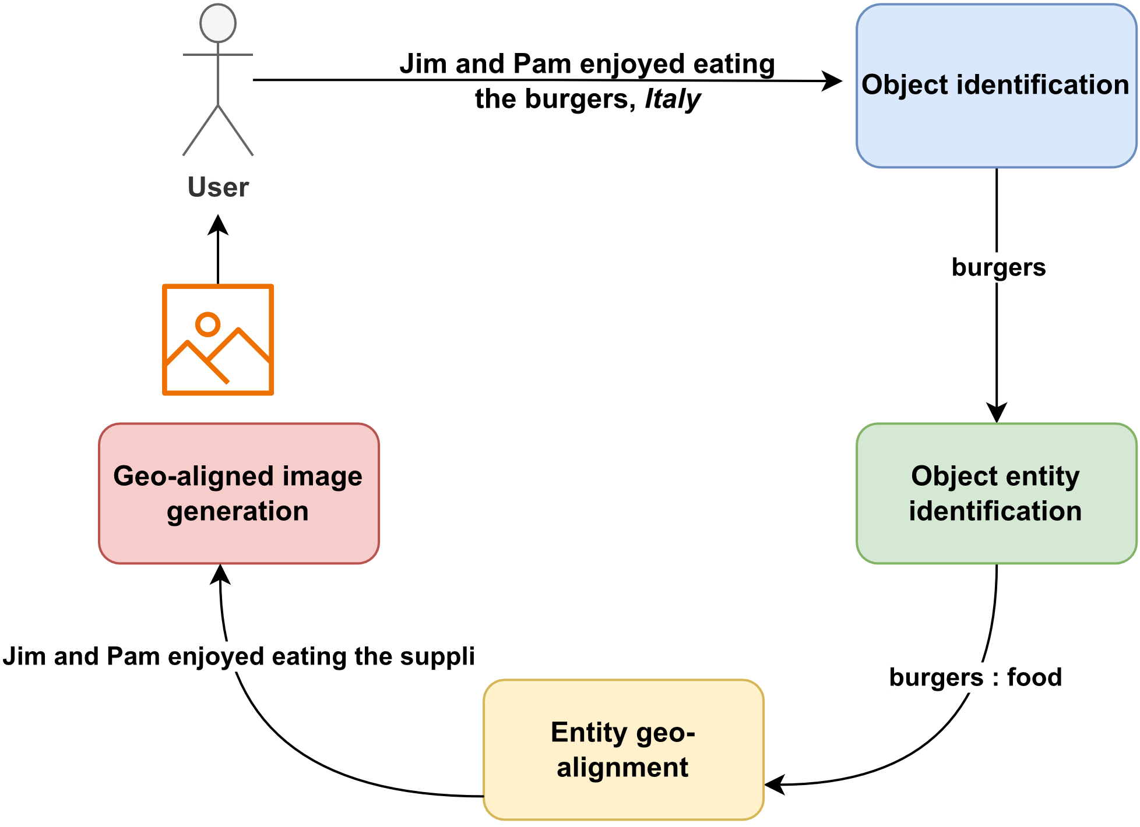
USE CASE
INPUT : Jim & Pam enjoyed eating the burgers.
TARGET LOCATION : ITALY

Slide 9
AVAILABLE ALTERNATIVES?
No product / framework providing an end-to-end automation of the entire process.
IDENTIFY the objects in TARGET LOCATION ? Search engine query but MANUAL process.

Slide 10

LARGE LANGUAGE MODEL
Large language models, such as GPT-3 (Generative Pre-trained Transformer 3) and BERT (Bidirectional Encoder Representations from Transformers), Devlin et al. (2018), have fundamentally reshaped the landscape of understanding and generating natural language. These models are characterized by their enormous size, often boasting hundreds of millions or even billions of parameters.
Their utilization has resulted in groundbreaking advancements across various NLP tasks, including language translation, sentiment analysis, question-answering, and text generation.

Slide 11


STABLE DIFFUSION
Stable diffusion is a cutting-edge technique in the field of image generation that has garnered significant attention for its ability to produce high-quality and coherent images.
By gradually adding noise and smoothing it out over multiple steps, stable diffusion allows for the generation of diverse and complex images with a remarkable degree of stability and control.

Slide 12
THE IMPORTANCE OF PROMPTS
LANGUAGE MODEL
OR STABLE DIFFUSION
PROMPT RESPONSE
A prompt in the context of language models refers to a specific input or query provided to the model to elicit a desired response

Slide 13
CLOZE – STYLE PROMPTS
A cloze is the removal of one or more words (or tokens) from a sentence or piece of text, and the objective of cloze-style prompts is to guess the missing word(s).
Egypt is famous for its [MASK].
The [MASK] is the national animal of Canada.

Slide 14
WHAT ARE WE DOING DIFFERENTLY?
PROBING LLMs for geo-aligning our input text
PROBING LLMs for object entity detection
Why not ask a chat based LLM like ChatGPT to do the above?
Response structure is NOT consistent, parsing would be difficult
Lack of precise responses
Leveraging STABLE DIFFUSION for geo-aligned images
Build a Django web-application for automating the entire process and creating a product

Slide 15
WHAT ARE WE DOING DIFFERENTLY?
Embed target location data in prompts for our LLM and Stable Diffusion model
Base prompt for stable diffusion: Jim and Pam enjoyed eating the suppli
Prompt + Geo-location: Jim and Pam enjoyed eating the suppli in Italy

Slide 16
ARCHITECTURE
Object identification – NLTK Part of speech (POS) tagging
Object entity identification – Generate prompts and yield response from pre-trained LLMs (BERT, RoBERTa).
Entity geo-alignment - Generate prompts and yield response from pre-trained LLMs (BERT, RoBERTa).
Geo-aligned text generation – LLM
Geo-aligned image generation – Stable Diffusion

Slide 17
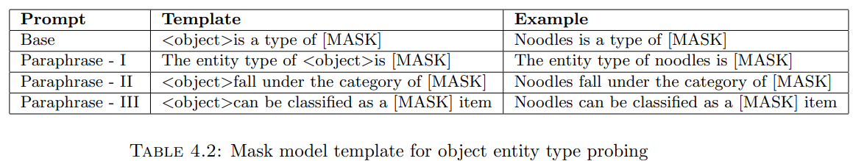
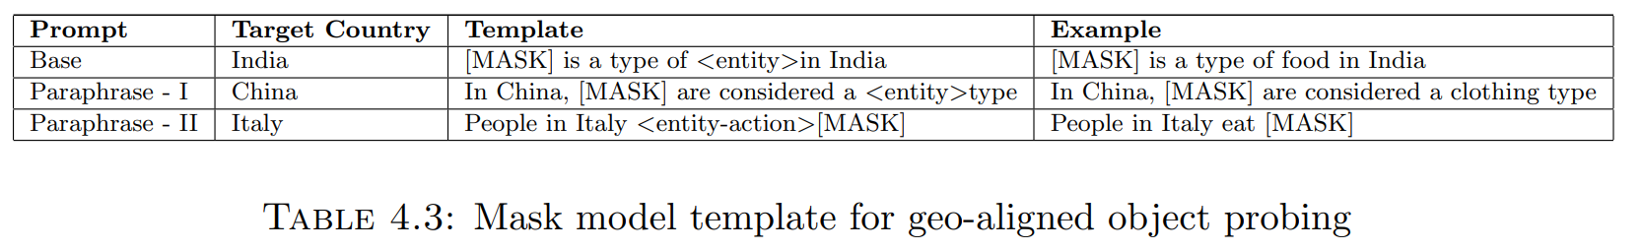
PROMPT DESIGN

Slide 18
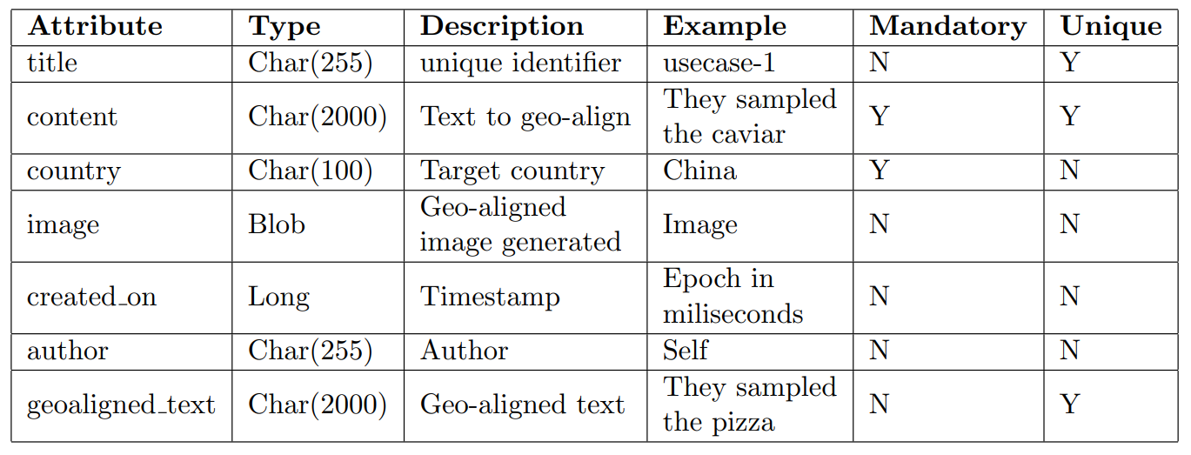
DATABASE SCHEMA : GeoAlignment

Slide 19
Experiment
Dataset – sentences curated from Wikidata
Gold reference texts curated from Wikidata
List of food and clothing for target countries curated from Wikidata
Large Language Models : BERT-base, BERT-large, RoBERTa
Test Entities: FOOD , CLOTHING
Target locations: INDIA, CHINA, ITALY

Slide 20
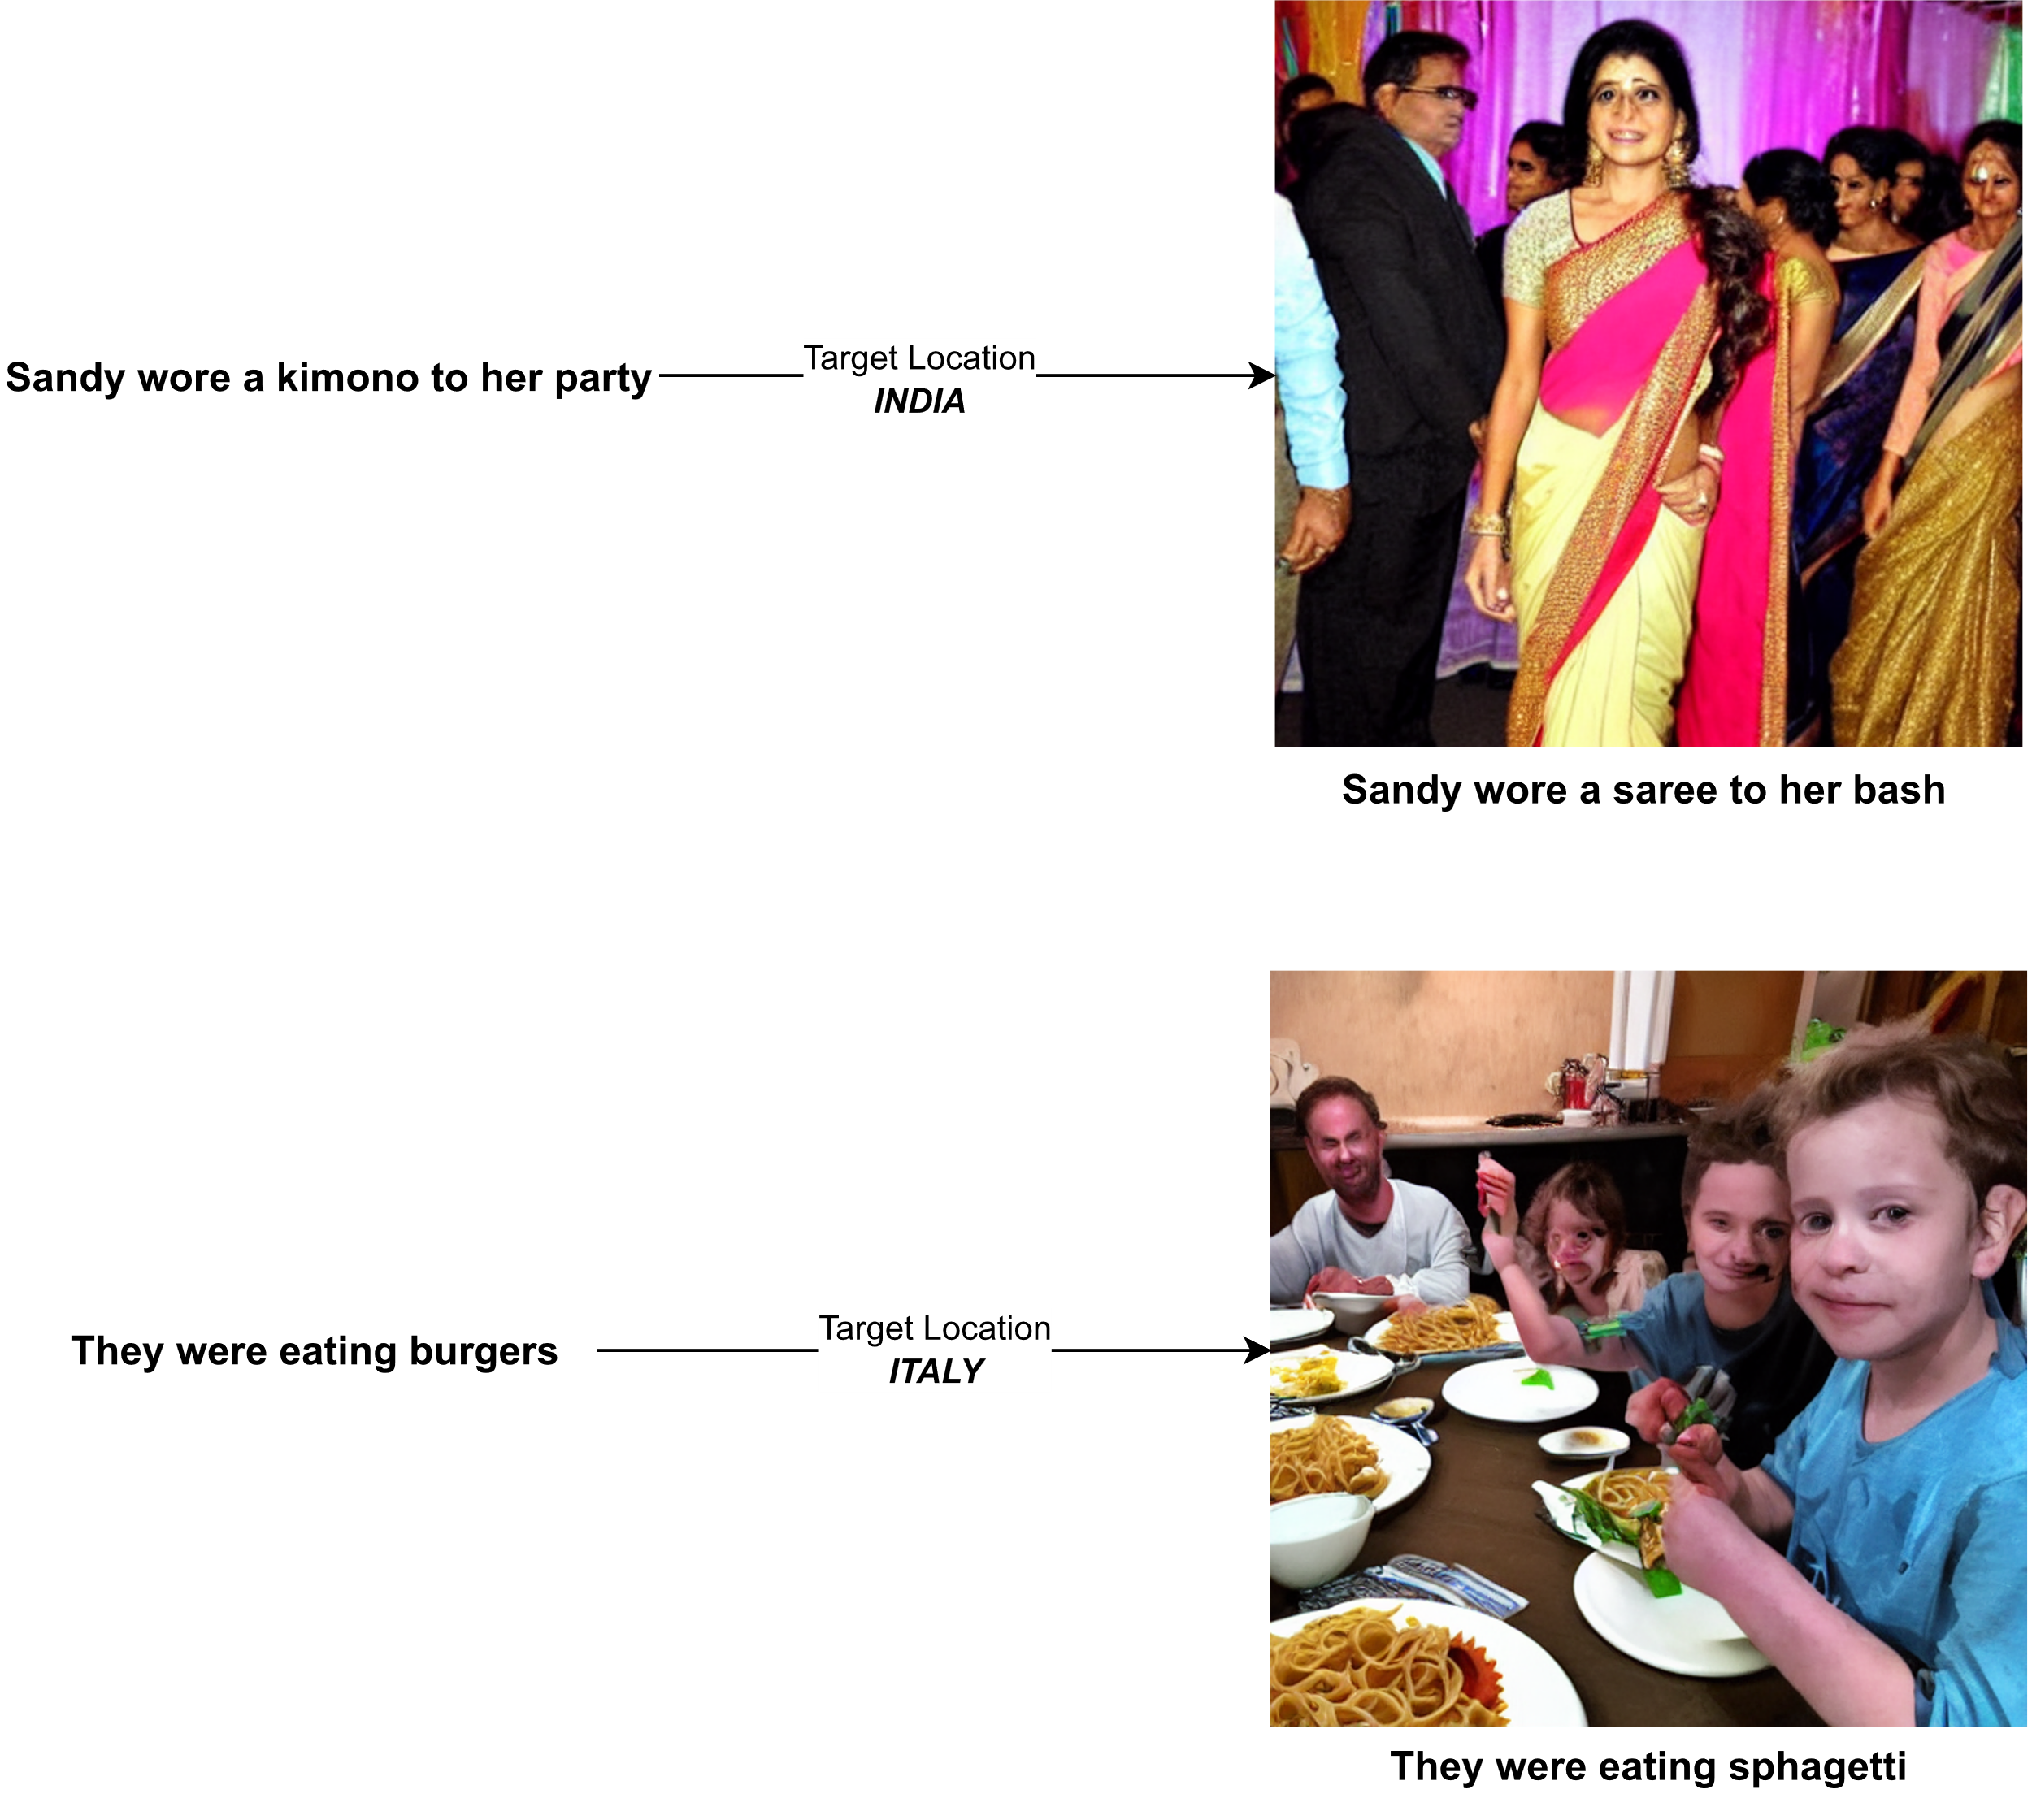
DOES IT WORK?

Slide 21
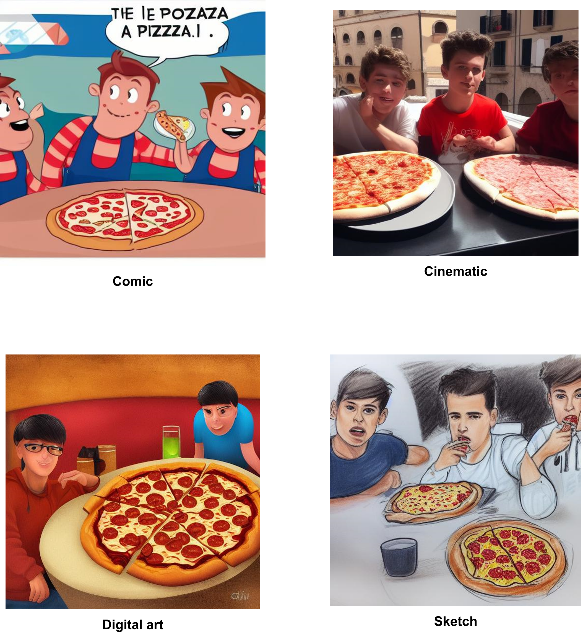
DOES IT WORK : STYLES
Input : The boys devoured the samosas.
Target location : ITALY

Slide 22
EVALUATION METRICS
Text generation
BERTScore
Image generation
CLIPScore

Slide 23
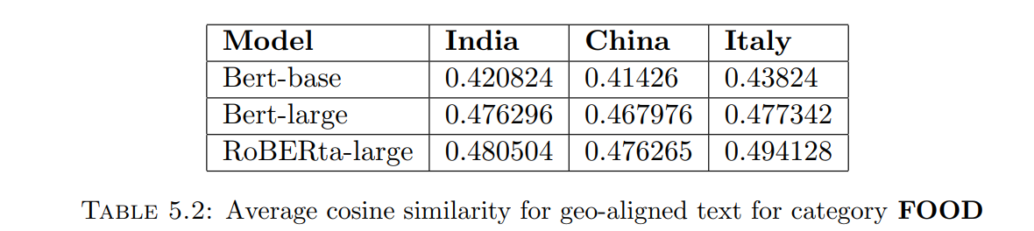
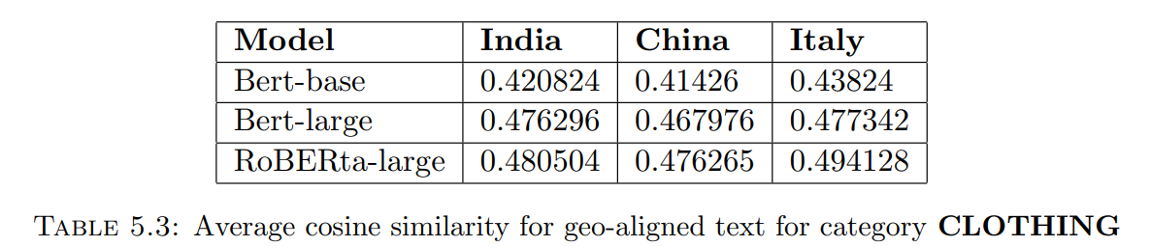
IT’S A NUMBERS GAME
TEST ENTITIES : FOOD , CLOTHING
TARGET LOCATIONS : INDIA, CHINA, ITALY

Slide 24
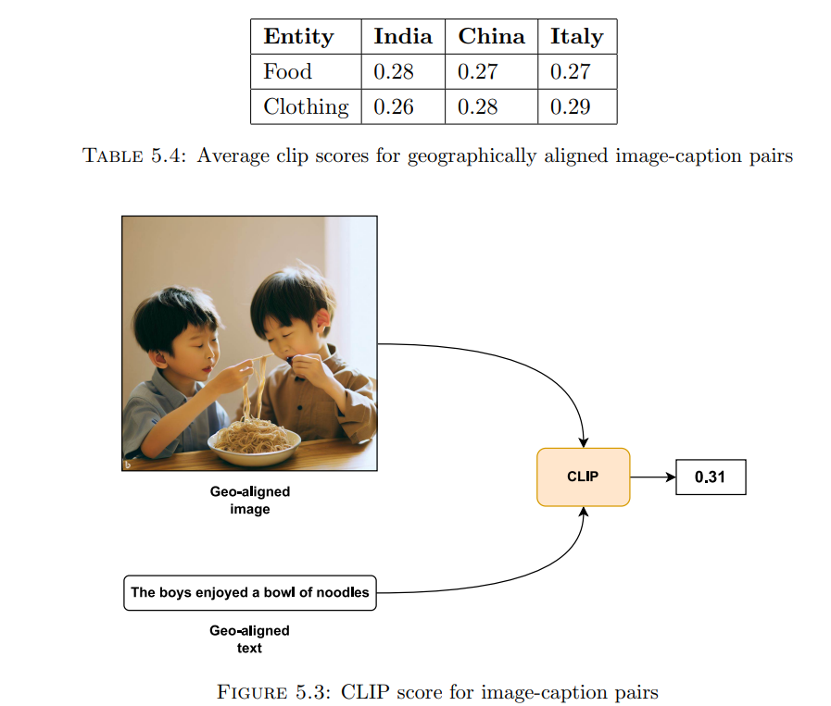
IMAGE GENERATION EVALUATION

Slide 25
CHALLENGES?
Fine tuning at LLM required for compound entity objects like:
Fish and chips (FOOD)
Salwar kameez (CLOTHING)
Fine tuning STABLE DIFFUSION required in cases where quality of geo-aligned image is poor or inaccurate
LLM Bias & offensive responses – Introduce user feedback loop
Notes:
Bias – cannabis was a response for food in Canada

Slide 26
FUTURE WORK
Develop user feedback loop
Experiment with larger language models like Llama (Meta) for more precise geo-aligned results
Evaluate with more entity types and target locations

Slide 27
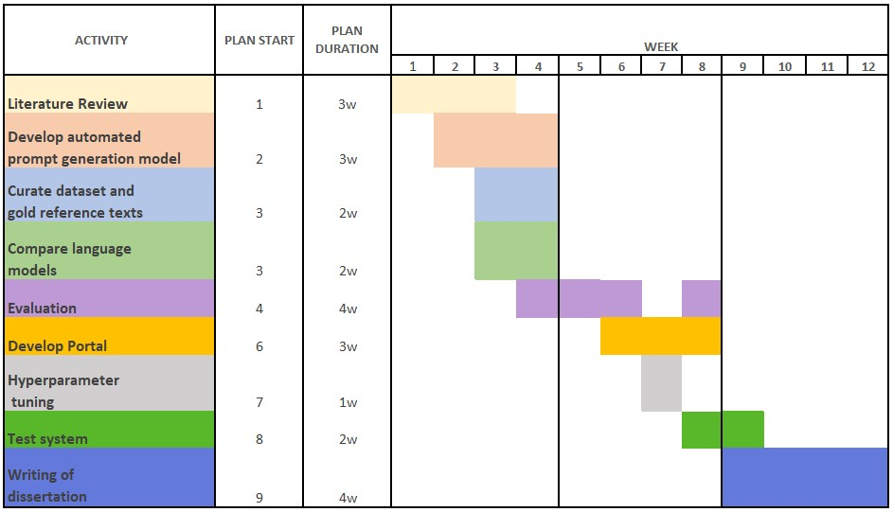
PROJECT MANAGEMENT
Github code repository : http://www.github.com/sen15recess/auto-geo-alignment
Project Management : Trello Dashboard

Slide 28
THANK YOU

