Slide 1
KM@IT in FY 08-09
Welcome to 1st KSS in FY 08-09 under
KM Community IT Strategies & Governance

Slide 2
KSS @ IT in FY 08-09: A bird’s eye-view
Theme : Innovate Together
Planning and MES solutions
Integrated with Daily Mgmt
Strengthen & Extend IT enabled
Supply Chain Solutions
Enhance Data Analysis &
Decision making capabilities
We are
here
KM
@
IT
Web services thru dor net
Provide Speedy &
Cost effective IT solutions
Customer Focused
ITS Processes
Facilitate Growth &
Globalization thru IT
Community : IT Strategies & Governance
IT Appl & SW Engg
IT Infrastructure

Slide 3
Web Services
- using .NET F/W
KM Presentation
05.04.2008
Fredi B Zarolia

Slide 4
Discussion Flow
What is a web service
Pros and Cons of using a web service
Web services in the .Net stack
Building a web service in .Net
R&D Problem Statement
Proposed solution

Slide 5
Web Service
Web services are software systems that make it easier for different systems to communicate with one another automatically in order to pass information or conduct transactions.
Characterized by:
Small functions built up to a bigger function
Disaggregate larger systems and distribute
Can be distributed anywhere, plugged in anywhere
Loose coupling
Evolving into a software/functionality pick and mix.
Analogy : Lego

Slide 6
Examples
Microsoft Passport
Microsoft Live Search Web service
Amazon Simple Storage Service (Amazon S3)
Amazon Elastic Compute Cloud (Amazon EC2) – Beta
Google web services - search, spell check etc.

Slide 7
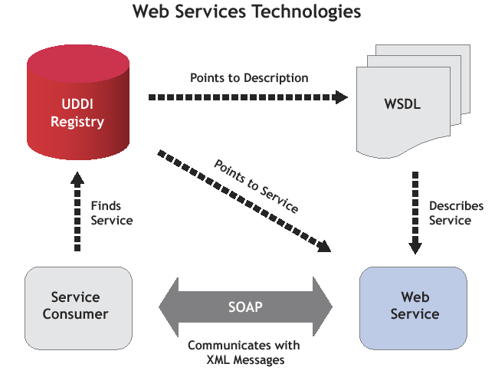


Slide 8
Pros & Cons
Pros
A Web Service is accessible over the Web
Web Services are platform-independent and language-neutral (HTTP+XML)
Build Internet-scale application
Can be used across Internet proxies and firewalls
A Web Service provides an interface that can be called from another program.
A Web Service is registered and can be located through a Web Service Registry.
Web Services support loosely coupled connections between systems.
Cons
Overhead. Transmitting all your data in XML is not as efficient as using a proprietary binary code.
The object state may not be transmitted in entirety.
Because of overhead cannot be used in critical real-time applications

Slide 9
Web services in the.Net Stack
Microsoft .NET Framework
ASP.NET
Windows Forms
Web Forms
Web Services
Services Framework
Base
Data
Debug
...
Common Language Runtime
System Services

Slide 10
Web services Application Model
Web Service
Developer
Web Application
Developer
Web Server 1
Service App
asmx
.aspx
Web Server 2
Service App
Proxy
Web Form

Slide 11
Building a web service .Net
Web Service:
http://144.0.1.102/empdetails/service.asmx
Consumer:
http://144.0.6.189/details/

Slide 12
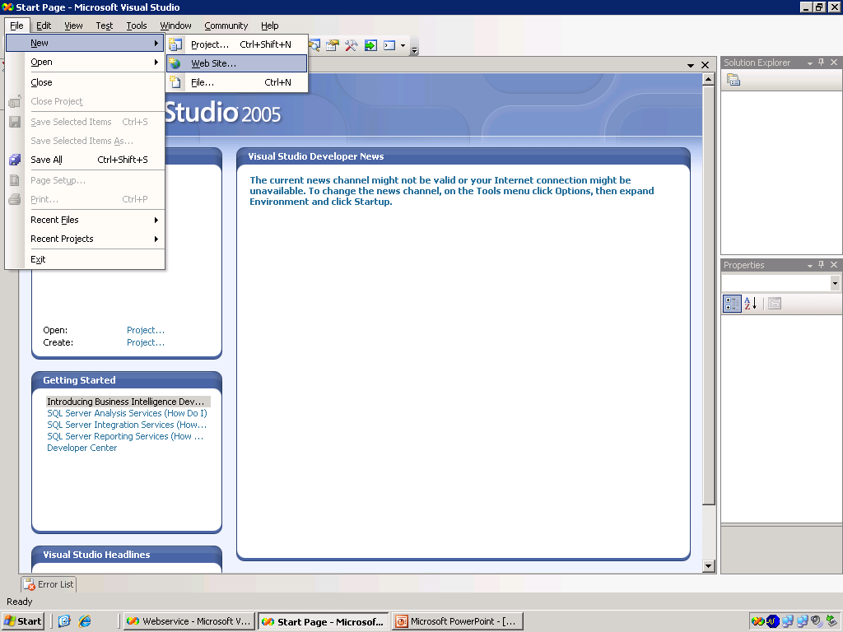
Step 1.Select File->New->WebSite option

Slide 13
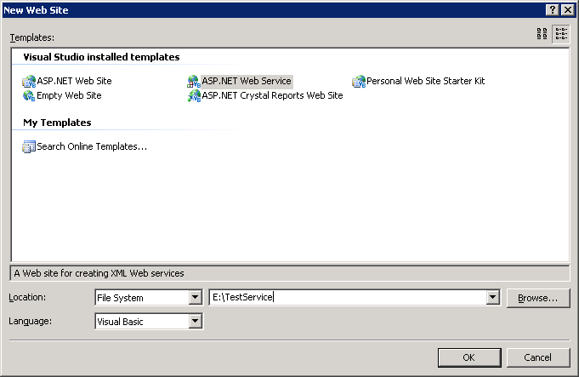
Step 2. Select ASP.NET Web Service templates

Slide 14
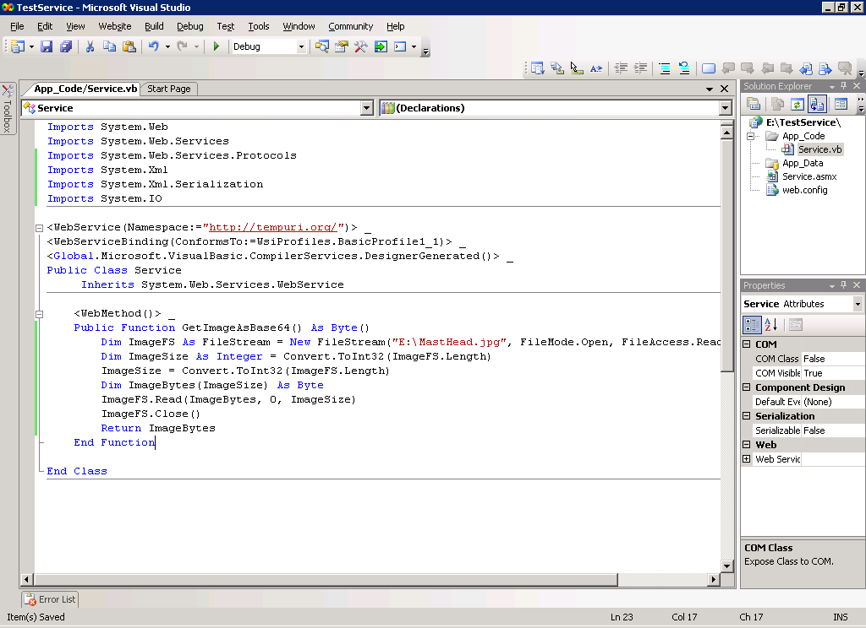

Step 3. Define Web Service function with Input and return type specified(eg:GetImageAsBase64)

Slide 15
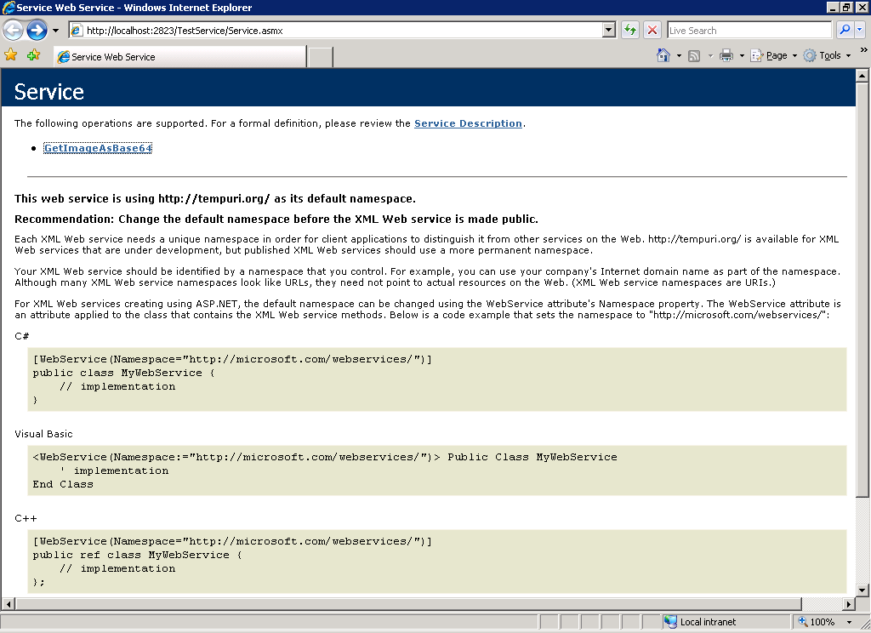

Step 4. After executing it shows the Web Service description

Slide 16
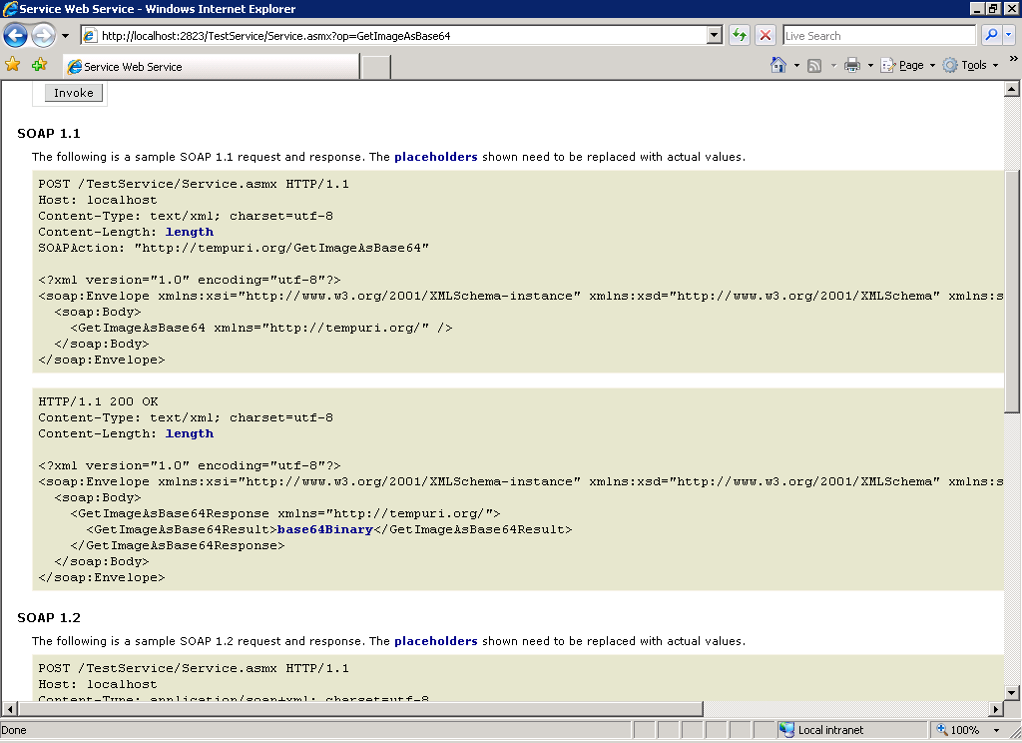

Step 5. This shows SOAP Format

Slide 17
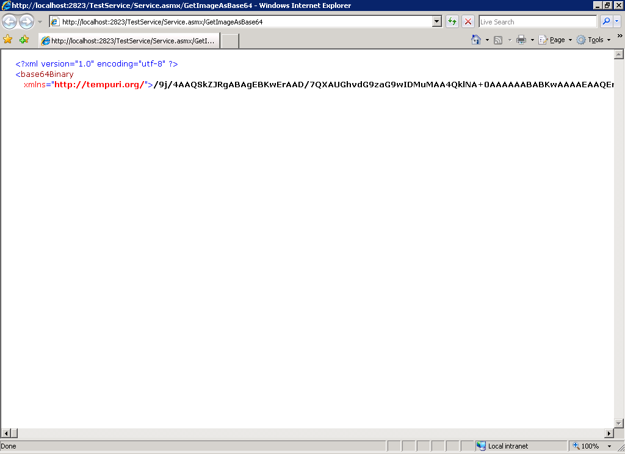
Step 6.The Output

Slide 18
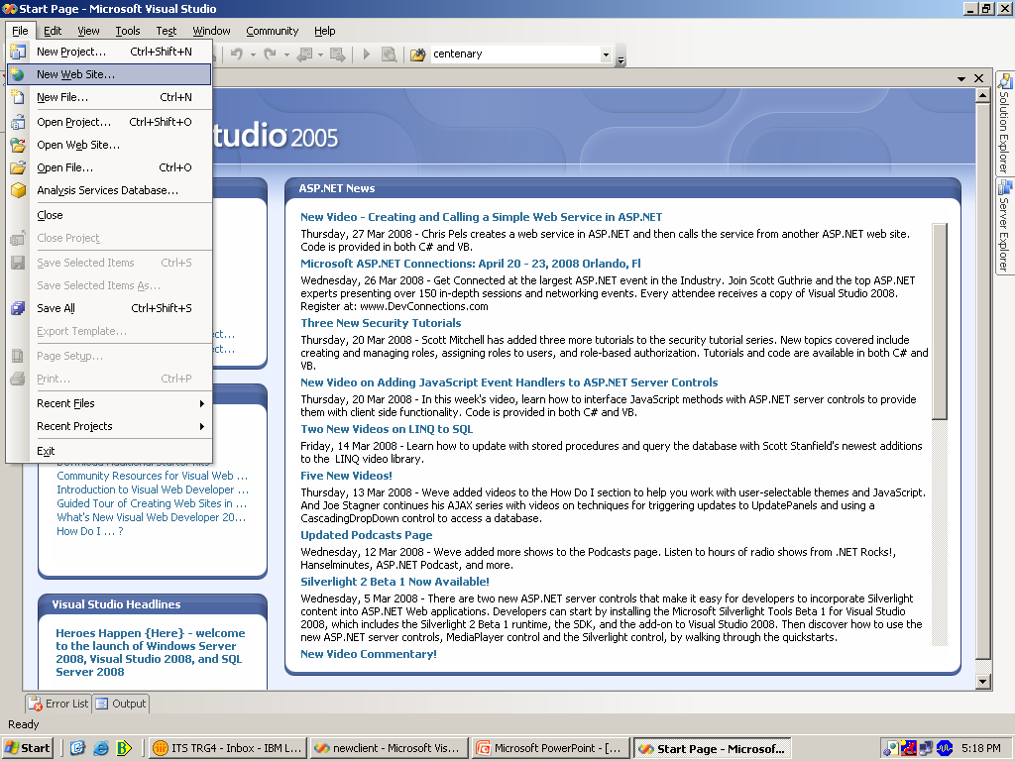
Consuming Web Service
Step 1. Create new Web Site

Slide 19
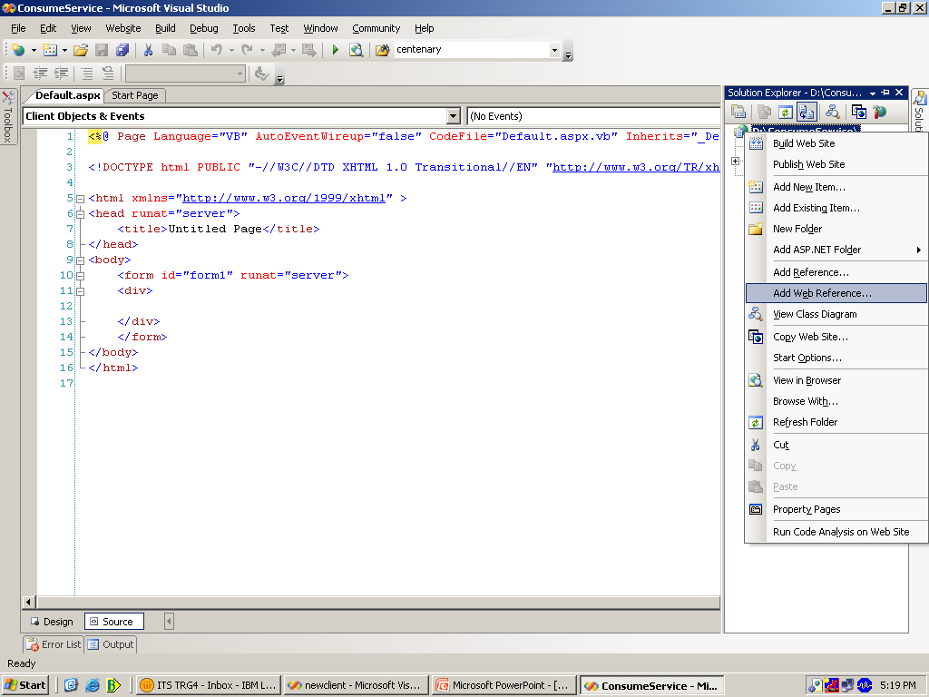
Step 2.Right click on project and select Add Web Reference..

Slide 20
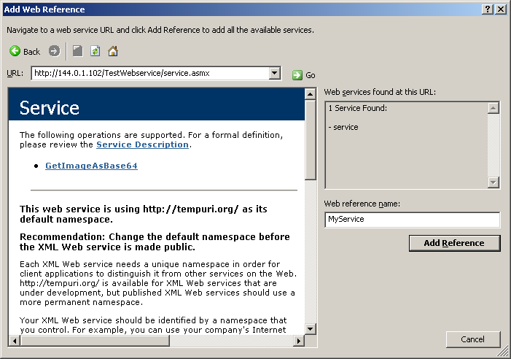



Step 3.Type address of web service and then add it to project

Slide 21
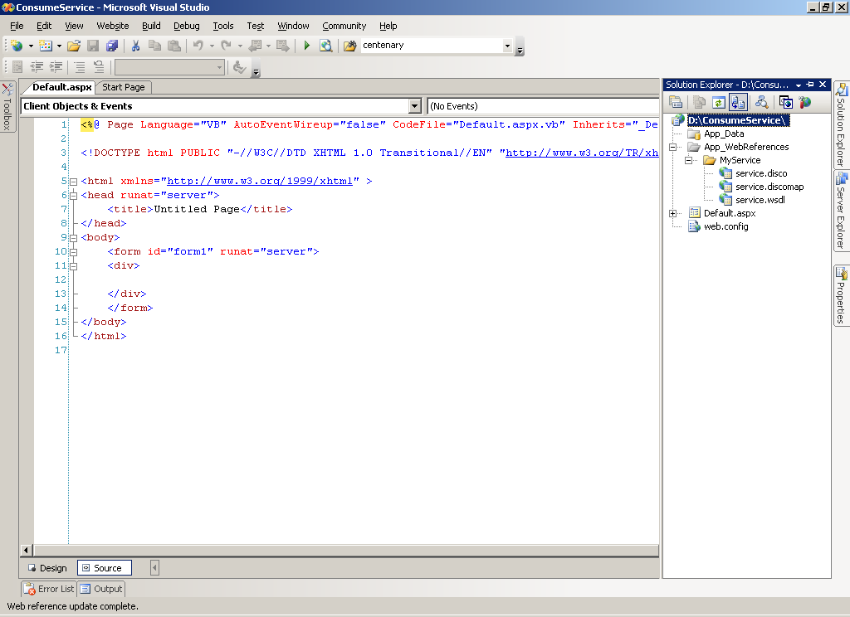

This adds corresponding .disco file

Slide 22
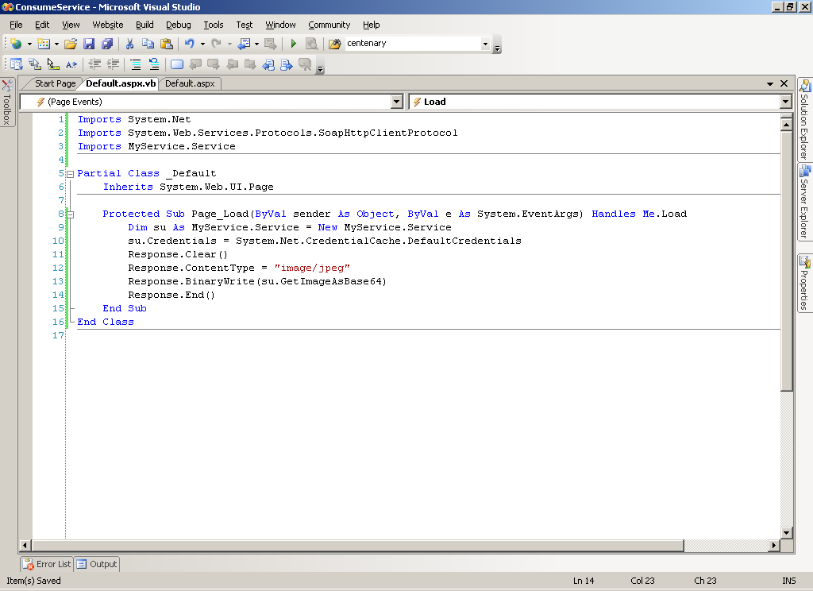


Step 4.Import service and receive output from web service and display accordingly

Slide 23
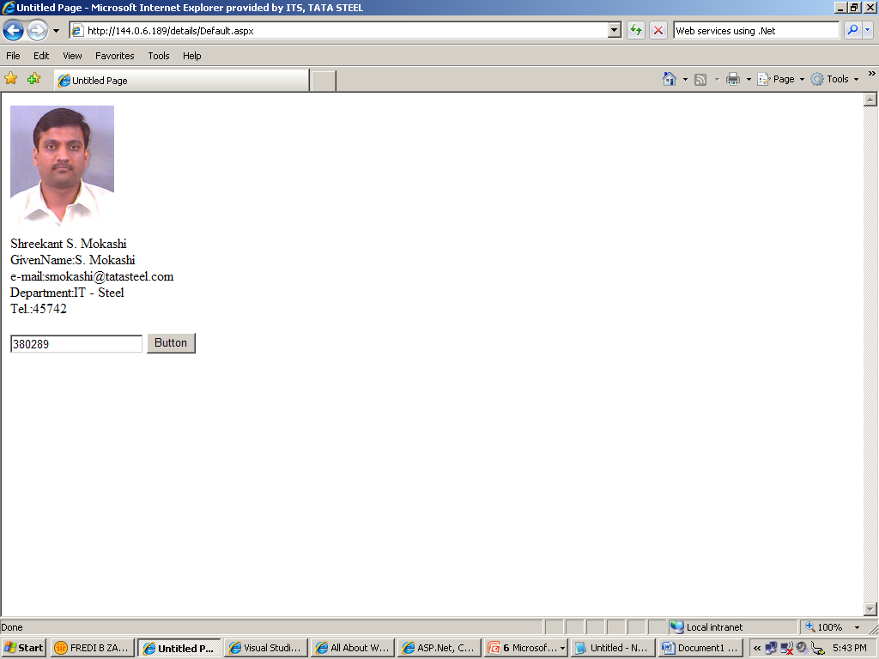
Out Put

Slide 24
R&D Problem Scenario
Proprietary algorithms have been developed over the years at both Tata Steel and Corus. These are the IP of the respective companies and hence the internals of these algorithms cannot be exposed. These programs were developed by scientists and researchers in the companies and as such are not built as per software development standards. The apprehension is that these programs may be using idiosyncrasies of the language and the compiler with which these were created leading to portability problems.
The programs were developed using the following:
Languages : Delphi at Corus, Fortran and C at Tata Steel
Platform: MS Windows/DOS and Linux
Compilers : GNU Fortran or C and Visual Studio based
The business requirement today is to share these algorithms as generic services that can be consumed by either side.

Slide 25

Proposed Solution Architecture
Windows Backend Server
(With Windows based Algorithms)
Linux Backend Server
(With Linux based Algorithms)
DOS Backend Server
(With Dos based Algorithms)
Windows Adapter Client
Linux Adapter Client
DOS Adapter Client
Meta Repository
Windows Adapter
Linux Adapter
DOS Adapter
Algorithm Invoker Service
ASP.NET Web Services Infrastructure – Algorithms exposed as Web Services

Slide 26
Proof of Concept
User fills up a form and submits
The values are passed onto the Algorithm
The algorithm processes and returns the result
Challenges:
Should map to the solution architecture - Generic
The consumer, the web service host and algorithm are on separate systems
Consumer and web service host run on Windows 2003 .The algorithm runs on a Linux Cluster @ R&D.
The output is a graph plot – a JPEG image
Communication among systems to be on TCP/IP stack (cannot use Disk or File system i/o)
Team:
Dr. M Murugananth (R&D), Fredi Zarolia
K Krishna Raju and Shoaib Jameel
Advisors:
Indraneel Mazumder, Ashutosh Kumar
Microsoft:
Bhasker Joshi, Arjun Bahri

Slide 27



1.Invokes Web Service
Modeling Algorithms of R&D Dept. Tata Steel
Microsoft Windows System
Consumer/User
2.Form Loads
9. Decoding, Image Displayed
6. Algorithm creates an image
Web Service
3. Enters values &
Clicks “SUBMIT”
5. Passes values to the modeling algorithm
8. Encoding passed to Web service via sockets
4. Connects to the Adapter via sockets and passes values along with the file name
GNU/Linux System
7.Image encoded to Base64 format by the adapter
Linux Adapter (C Program)

Slide 28
Current Status
Through and Through XML Web services – mapping to generic solution
Communication over Sockets
Image output encoded in XML, this can be extended to any file format (doc, xls, mp3. etc.)
Integration with R&D Algorithm underway.

Slide 29
Thank You
Questions
KM
Suggestions
Ideas
Criticism

Slide 30
Discussion
XML poisoning is one of the top threats
Using certificates for security and authentication
Microsoft --> provisions and safeguards in win 2k3 for security against threats on web services
Languages for coding being used in TATA Steel Ltd.- Dutch, Chinese, English

