Slide 1

ROUND 01
MedSathi
From “take your medicine” to guided medication care.
A voice-first, caregiver-connected medication companion for elderly and low-literacy patients.
VOICE-FIRST
VISION AI
CAREGIVER LINK
Problem • Solution • Architecture • Data • APIs • AI • Scale

Slide 2
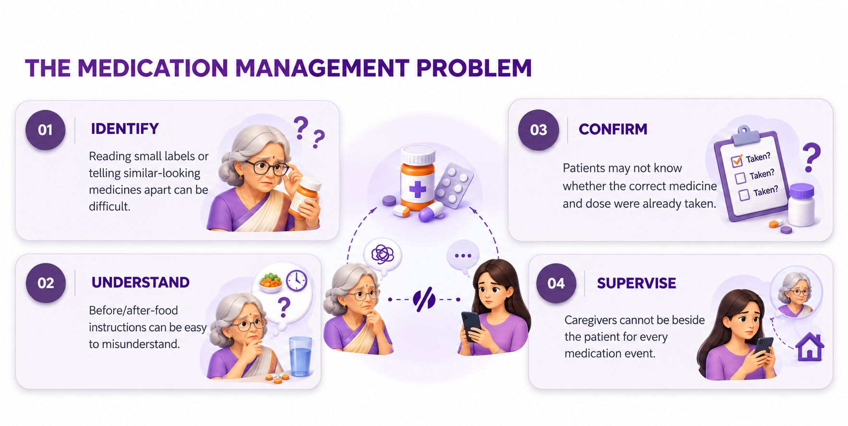
Problem understanding
02
A medication event has multiple points where uncertainty can enter.
ONE DOSE. MANY QUESTIONS.
“Which medicine is this?”
“Before or after food?”
“Did I already take it?”
When the caregiver is away, these questions become a real-time support gap—not just a memory problem.
1
IDENTIFY
2
UNDERSTAND
3
CONFIRM
4
SUPPORT
CORE GAP • Reminder ≠ complete medication guidance
2

Slide 3
Proposed solution: a guided medication event
03
Connect caregiver configuration, patient interaction, verification and follow-up.
01
CONFIGURE
02
UNDERSTAND
03
VERIFY
04
GUIDE
05
CONFIRM
Caregiver sets medicine, dosage, timing, meal relation & reference images.
Patient speaks naturally; MedSathi interprets intent and context.
Camera-based check returns Correct / Wrong / Uncertain.
Caregiver-configured dosage becomes simple voice + visual guidance.
Dose is logged; missed or uncertain events can reach the caregiver.
A reminder tells. MedSathi guides. And when uncertain, it does not guess.
3

Slide 4
System architecture
04
Patient/caregiver apps → API layer → deterministic orchestration → data + AI services.
NODE.JS + EXPRESS API
CLIENTS
AI SERVICE
DATA & STORAGE
Caregiver Web App
Patient Companion
Auth & access
Gemini Vision
Gemini NLU
Structured JSON
Supabase Auth
PostgreSQL + RLS
Cloudinary
Medication + schedules
Medication event/state engine
AI orchestration
Notifications
Image service
AI proposes structured results → application state machine validates → database records the event
4

Slide 5
Technology stack
05
Lightweight for the MVP, modular enough to evolve.
FRONTEND
BACKEND
DATA
React • Vite • TypeScript
Tailwind • Router
Node.js • Express • TypeScript
REST APIs
Supabase • PostgreSQL
Auth • RLS
AI
MEDIA
DELIVERY
Gemini API
Vision + NLU • Structured output
Cloudinary
Medicine + profile images
GitHub • Vercel
Backend hosting
Principle: use AI where ambiguity exists; use deterministic software where correctness matters.
5

Slide 6
06
Backend approach: deterministic orchestration around AI
Backend owns business rules, security, event state and integrations.
1
REQUEST
Authenticated REST action enters the system.
NON-NEGOTIABLES
Dosage is caregiver-configured—not invented by AI.
2
VALIDATE
Schema + authorization + medication context.
AI never directly mutates medication state.
3
ORCHESTRATE
State machine decides the next permitted step.
Uncertain verification stops, retries, or escalates.
4
AI CALL
Only when voice/image understanding is needed.
Secrets and privileged DB access stay server-side.
5
DECIDE
Normalize result: Correct / Wrong / Uncertain / Intent.
Idempotent events prevent duplicate dose logs.
6
COMMIT
Write event/log/alert; return next action.
6

Slide 7
07
Database design
PostgreSQL models medication relationships as connected data.
caregivers
patients
caregiver_patient
medicines
id
id
caregiver_id
id
name
name
patient_id
patient_id
contact
age
role
name
auth_user_id
photo_url
reference_image
schedules
medication_events
alerts
medicine_id
schedule_id
patient_id
time
status
event_id
frequency
taken_at
type
meal_relation
verification
read_at
Supabase Auth + PostgreSQL RLS • caregiver/patient relationships define access to patient data
7

Slide 8
API design
08
Small, purpose-driven endpoints keep the client simple and the backend auditable.
AUTH
PATIENTS
MEDICINES
POST /auth/register
POST /auth/login
GET /me
POST /patients
GET /patients/:id
PATCH /patients/:id
POST /medicines
GET /medicines/:id
PATCH /medicines/:id
EVENTS
ALERTS
AI
GET /events/today
POST /events/:id/verify
POST /events/:id/confirm
GET /alerts
POST /alerts/:id/read
POST /ai/understand
POST /ai/verify-medicine
JWT-authenticated • validate at the boundary • consistent success/error response shape
8

Slide 9
Automation opportunities
09
Act at the right moment so the patient does not have to remember the system.
T−30
MEAL PROMPT
If food-dependent, prompt the patient to prepare for the meal.
T0
DOSE EVENT
Ask naturally: “Have you finished breakfast?”
T+
VERIFY
Request medicine/tablet image; compare with caregiver reference.
FOLLOW-UP
NO RESPONSE
Retry after the configured interval; escalate repeated uncertainty.
MISSED
CAREGIVER ALERT
Create an alert when a dose is missed or needs attention.
Goal: reduce repeated manual checking while keeping humans in control.
9

Slide 10
10
AI integration: useful, bounded, auditable
Gemini handles perception and language; the application remains the source of truth.
VISION
LANGUAGE
STRUCTURED OUTPUT
Medicine cover / tablet image
↓
Reference comparison
↓
Correct / Wrong / Uncertain
“yes, I ate” / “not yet” / “I took it”
↓
Intent + context
Schema-bound JSON
↓
Backend validation
↓
State-machine action
SAFETY BOUNDARY • AI cannot prescribe, change dosage, or silently mark a dose as taken.
10

Slide 11
11
Scalability & deployment approach
Start as a modular monolith; scale the bottlenecks independently as usage grows.
MVP
GROWTH PATH
PRODUCTION GUARDRAILS
✓
Vercel frontend
✓
Background job worker
✓
RLS + least privilege
✓
Node/Express API
✓
Queue scheduled events
✓
Secrets only on server
✓
Supabase Postgres + Auth
✓
Cache read-heavy views
✓
Rate limits + audit logs
✓
Cloudinary + Gemini
✓
Image CDN
✓
Retries + idempotency
✓
DB indexes + read scaling
✓
Monitoring + backups
Scale the workload, not the complexity: API → jobs → data → AI calls can evolve independently.
11

Slide 12
12
The technical idea in one picture
A human problem translated into a bounded, auditable software system.
→
→
→
→
PATIENT
MEDSATHI
STATE ENGINE
DATABASE
CAREGIVER
speaks / shows medicine
understands / verifies
controls next step
records the event
sees what needs attention
Care that speaks. Confidence that stays.
MedSathi extends caregiver presence—without giving AI authority over medication decisions.
ROUND 01 • IDEATION & INITIAL SUBMISSION
12

