Slide 1
Introduction to
git and Docker
Allen Ou

Slide 2

What is git
git : Version control system, used for managing codes.
github : an online service, used for storing codes.

Slide 3
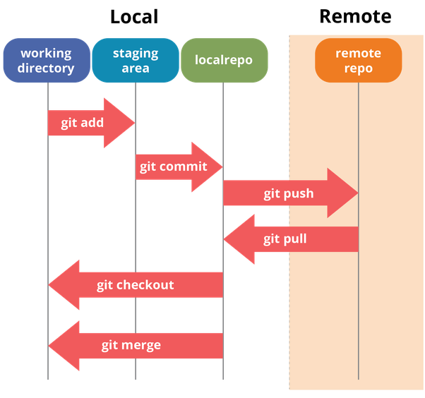
Code management

Slide 4
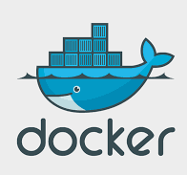

What is docker ?
Docker is a open platform to build, ship, and run distributed applications, whether on laptops, data center VMs, or the cloud.
It help us to build applications to deploy/develop our projects (for example, deep learning frameworks) quickly .
Also, docker supports several OS like Ubuntu, Mac, and Windows.
Notes:
We don’t have to worry about any package forgot to installed, or we developed a project that one computer could compile but the other one could not.

Slide 5
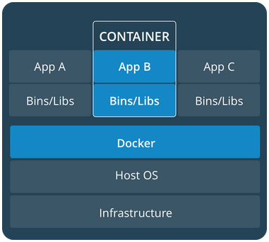
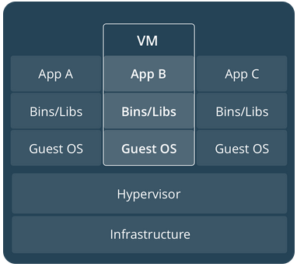
Docker Container vs. Virtual Machine
Resource
CPU, Storage, Memory,
VirtualBox
Isolation
Conflict of apt packages
Different Ubuntu versions (no mess up)
OpenCV versions
Run the same code on WS and RPi
Notes:
Containerization, also called operating-system-level virtualization is an approach for virtualization. It could simulate a process that could share all the host resources, like CPU, RAM, USB devices … , so the efficacy could almost reaches on the host. No need to use hypervisor to simulate hardware like Full Virtualization.

Slide 6
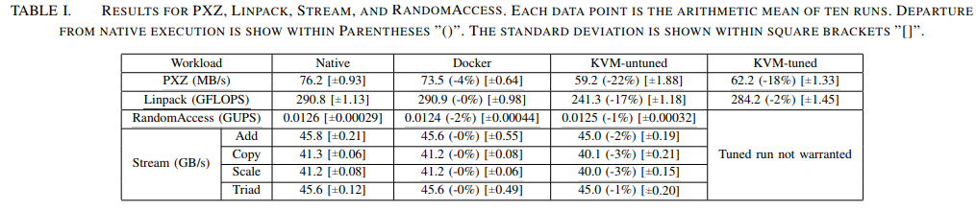
Why we use docker ?
Easy to setup Docker engine on your PC.
Deploy applications with no dependency issue brothering you.
Cloud storage called dockerhub to push/commit/pull image like github.
Run application as fast as on host environment.
2014 IBM research paper titled "An Updated Performance Comparison of Virtual Machines and Linux Containers"

Slide 7
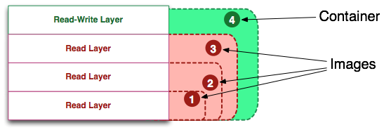
Docker image vs. container
Docker image is what your needed dependencies and your project codes stored.
Docker container is a live instance of docker image, and also add a read-write layer for saving what you done to this instance.
Notes:
if an image is a class, then a container is an instance of a class

Slide 8
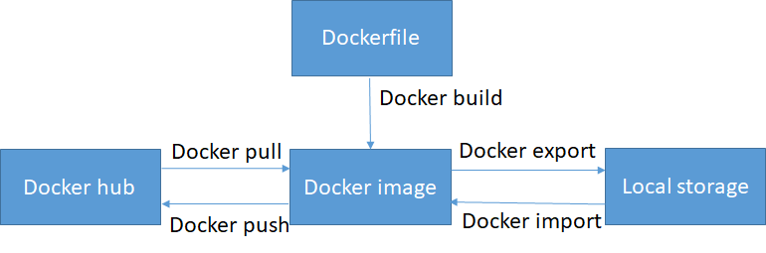
Docker CLI -- image management
docker images
docker pull
docker push
docker build
docker rmi
docker save
docker load
Docker save
Docker load

Slide 9
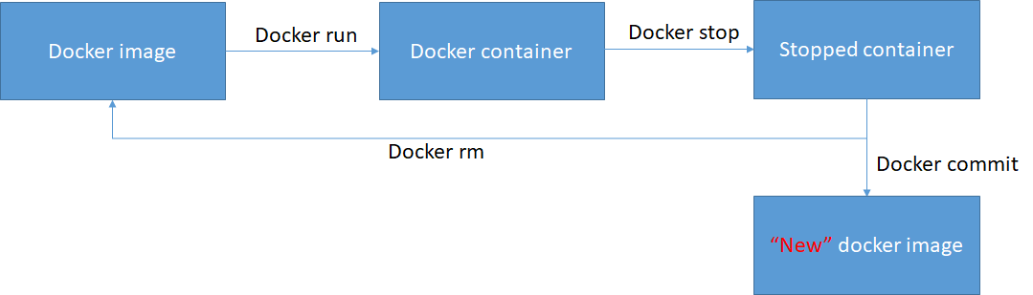
Docker CLI -- container management
docker run
docker stop
docker commit
docker exec
docker ps
docker rm
Docker start

