Slide 1
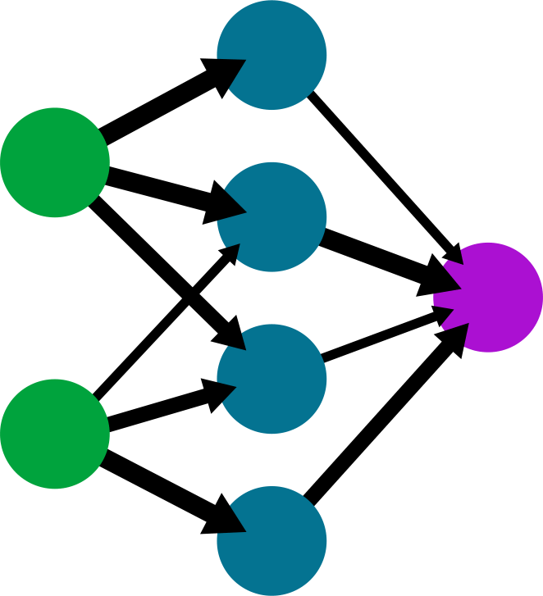
A
B
F
[-0.023, 0.17, -0.007, -0.33]
C
E
1
+10
D

