Slide 1
Spiking Neural Networks
Continuous Control
Daniel Kuknyo

Slide 2
Methods of the experimentation
Environments: BipedalWalker and MountainCar
Q-learning
Q-learning with state space discretization
Q-learning actor-critic
Soft actor-critic for continuous control
SA2C soft actor dual critic for continuous control
SA2C with feedforward actor and spiking critic

Slide 3
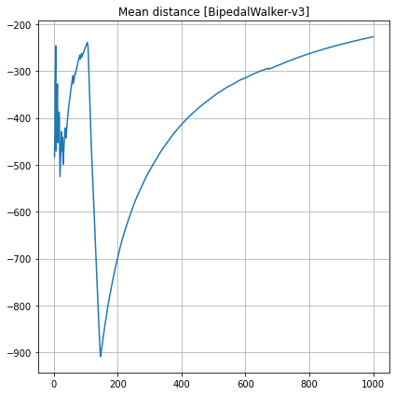
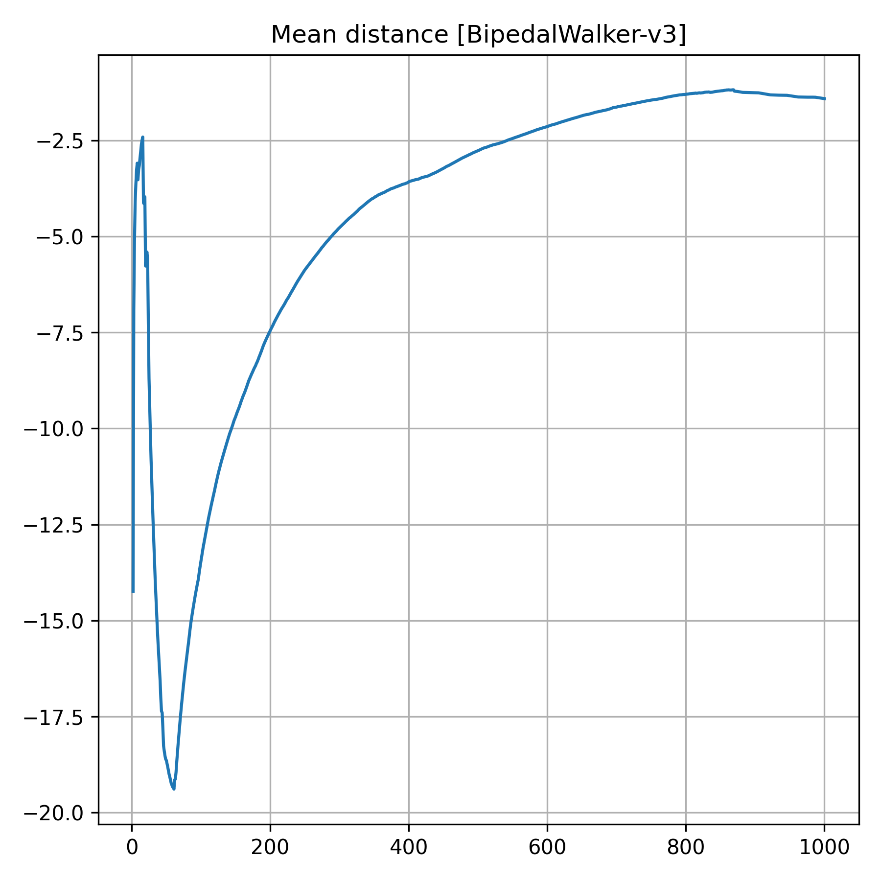
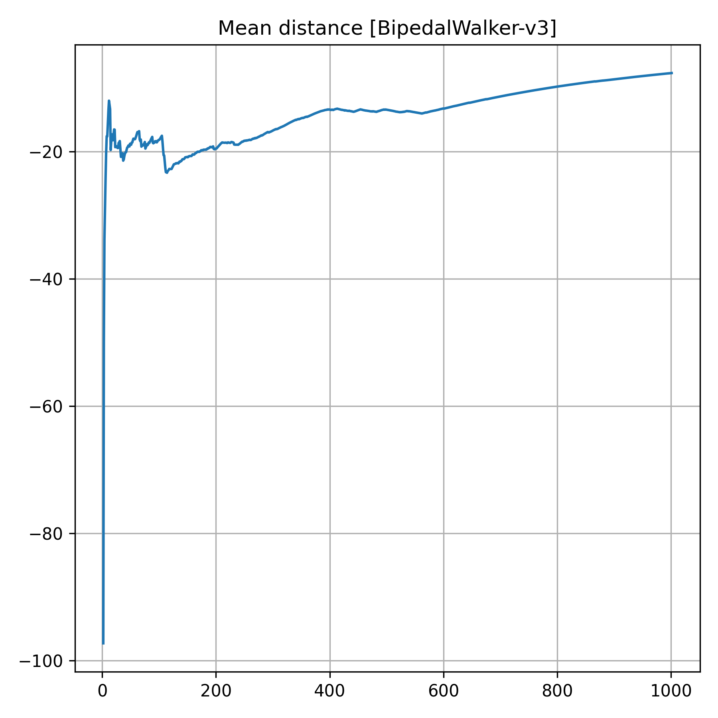
Distances walked
SAC SA2C SA2CF

Slide 4
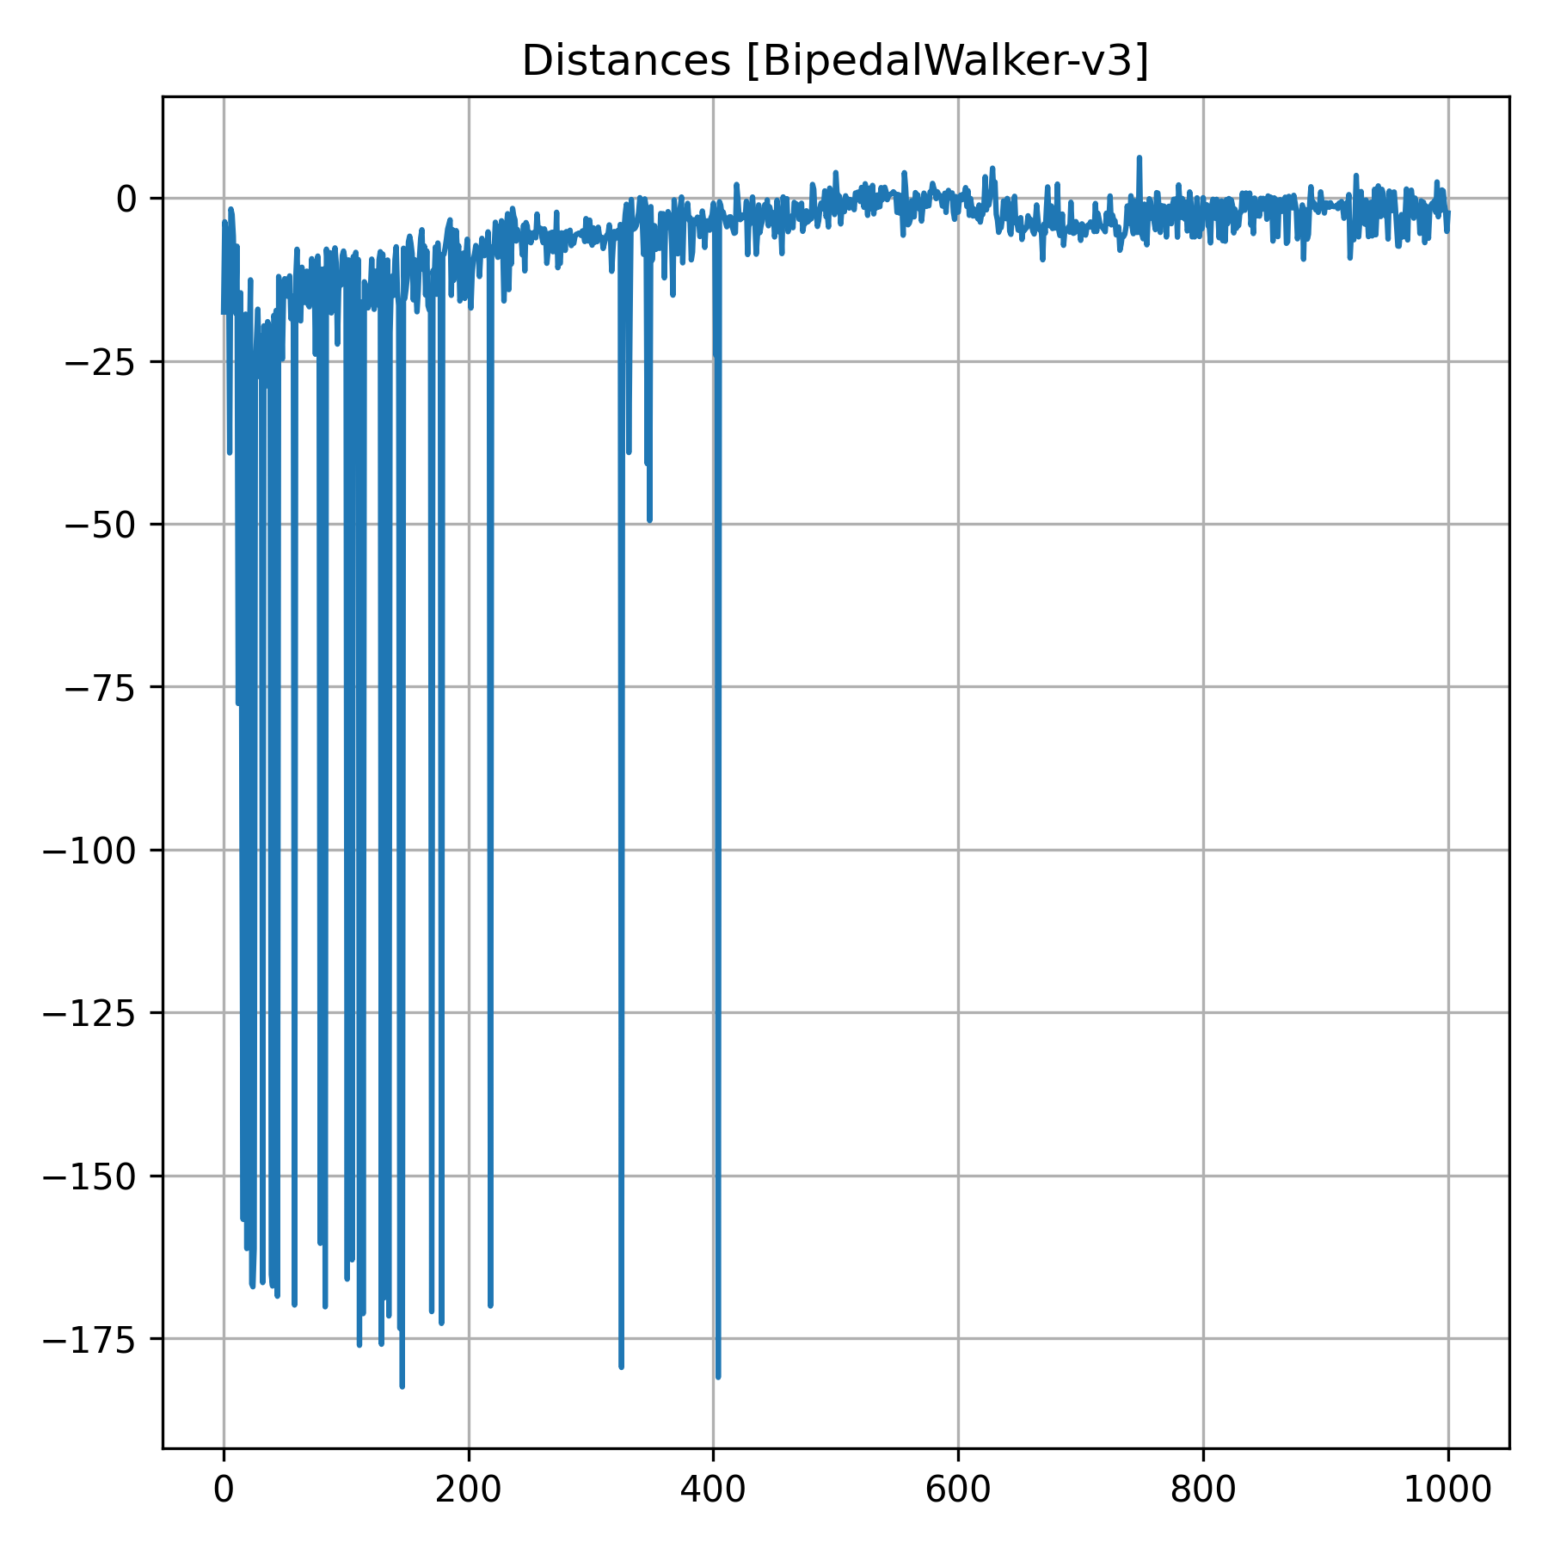
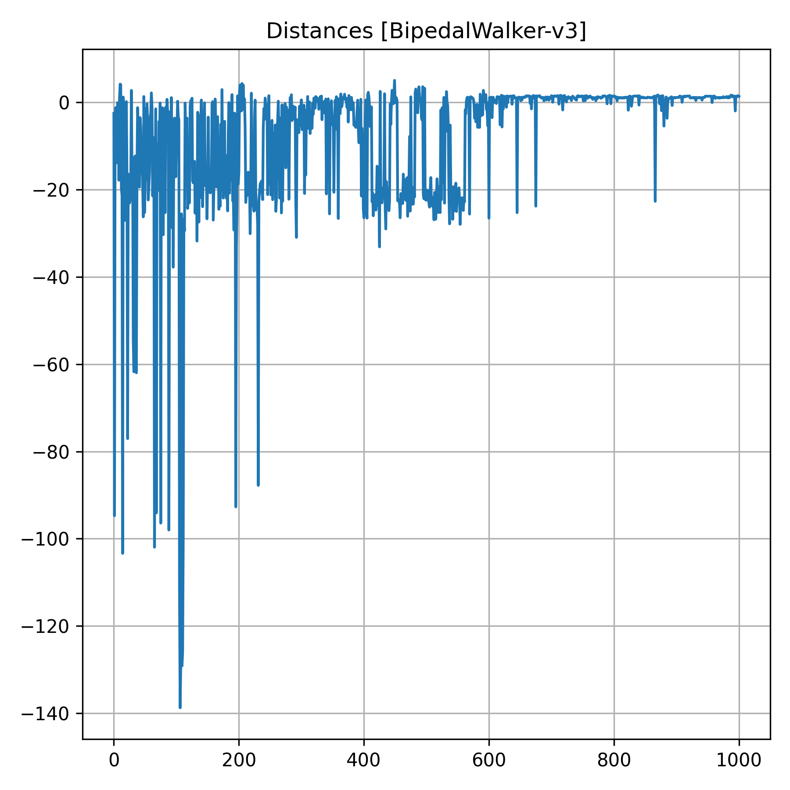
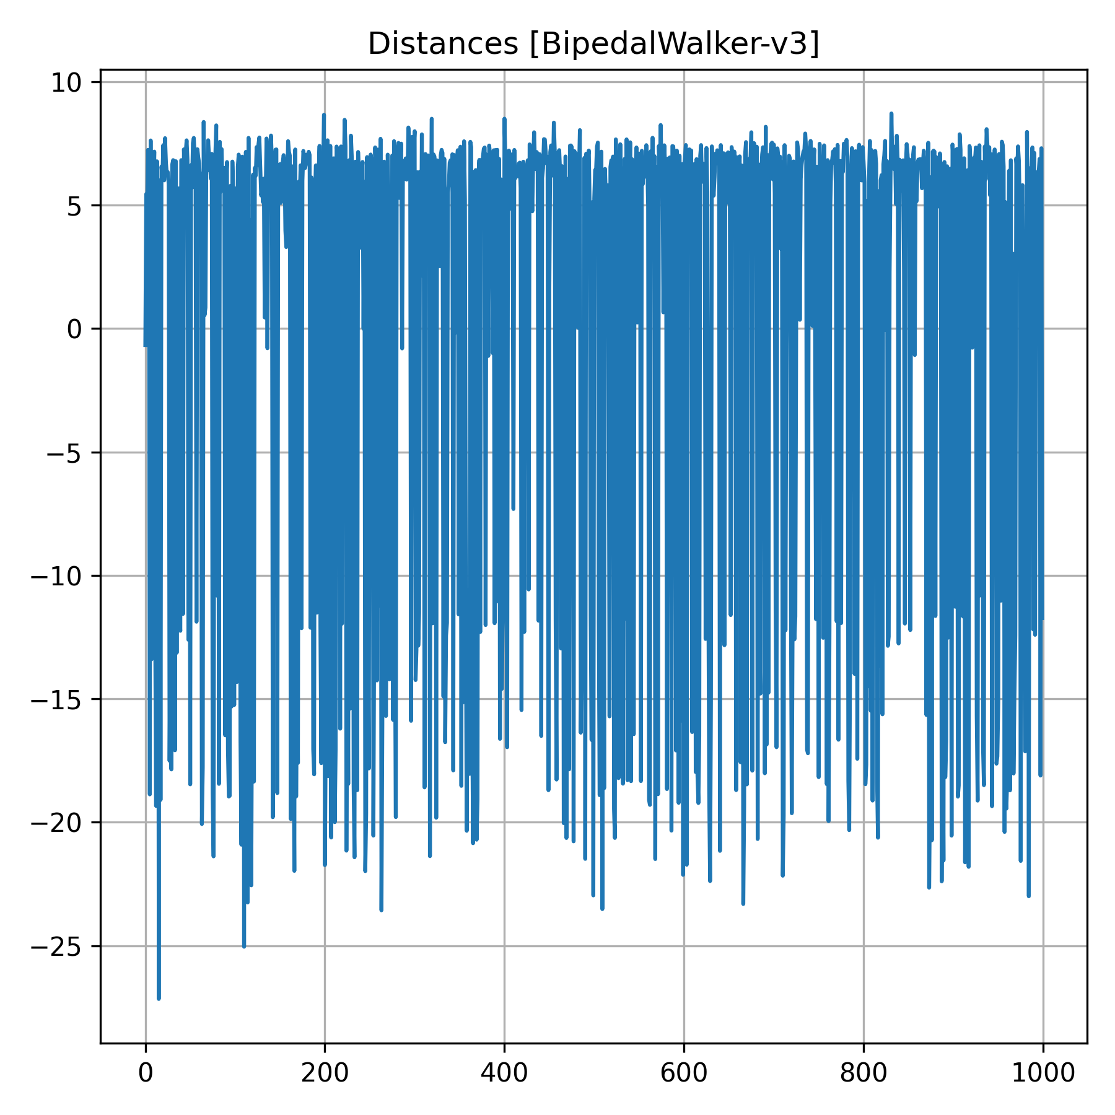
Rewards
SAC SA2C SA2CF

Slide 5
Conclusions
The best performing model was the one with two spiking critics and one simple feedforward actor
The worst approach was to discretize the action space
Adding neurons to the layers improved performance
Adding layers to the model deteriorated performance
The best performing models did not have time to finish due to interruptions
The most difficult problem to handle was the differences in dimensionality added due to Gaussian currents and prediction iterations

