Slide 1

THINK UNLIMITED
WE LEARN FOR THE FUTURE
GAGAN: GENERATIVE ADVERSARIAL NETWORK WITH GENETIC ALGORITHMS
Final Project Presentation – CS/CE Algorithms and Design Analysis
PRESENTED BY:
AHSAN SIDDIQUI BASIL ALI KHAN

Slide 2
PROBLEM DESCRIPTION & MOTIVATION
GANs are powerful but unstable models for image generation.
Traditional training uses backpropagation for both generator and discriminator.
We explore the use of Evolutionary Algorithms (EA) to optimize discriminator weights.
This aims to improve diversity and robustness without relying solely on gradient descent.

Slide 3
PROBLEM STATEMENT
Goal: Train GANs more reliably by replacing discriminator training with EA.
Problem: Can evolutionary methods provide a stable and diverse training process?
Assumption: Discriminator architecture remains fixed, only weights evolve.

Slide 4
RELATED WORK
Traditional GAN: Simultaneous gradient descent for G & D.
WGAN, Spectral Normalization: Improve loss behavior, but still use gradients.
GAGAN: Introduces EA to evolve discriminator weights instead of training.

Slide 5
PROPOSED SOLUTION
Maintain a population of discriminator weight sets.
Evaluate fitness based on classification accuracy (real vs. fake).
Use selection, crossover, mutation to evolve the population.
Generator trained with gradient descent using best discriminator.

Slide 6
ALGORITHM OVERVIEW
Initialize generator and a population of discriminator weights.
For each epoch:
Train generator using feedback from the current best discriminator.
Evaluate fitness of each weight set.
Apply EA operators to generate next population.
Add label smoothing and noise injection for stability.

Slide 7
COMPLEXITY ANALYSIS
Generator training: O(n), where n = batch size.
Discriminator evolution: O(p), where p = population size.
Empirical: 5 min/epoch using 10% CelebA on RTX 3060.
Scalability: Time grows linearly with dataset size and population size.

Slide 8
EXPERIMENTAL SETUP
Dataset: 10% of CelebA dataset.
Framework: PyTorch.
Batch size: 32; Population size: 10.
Metrics: Training loss curves, visual inspection of outputs.

Slide 9
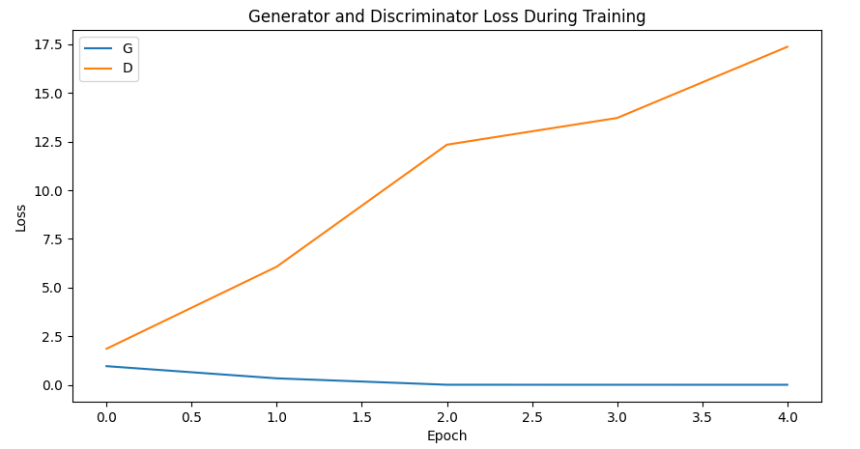
RESULTS & FINDINGS

Slide 10
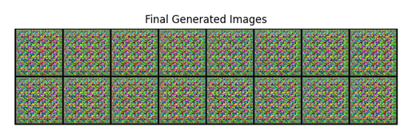
RESULTS & FINDINGS

Slide 11
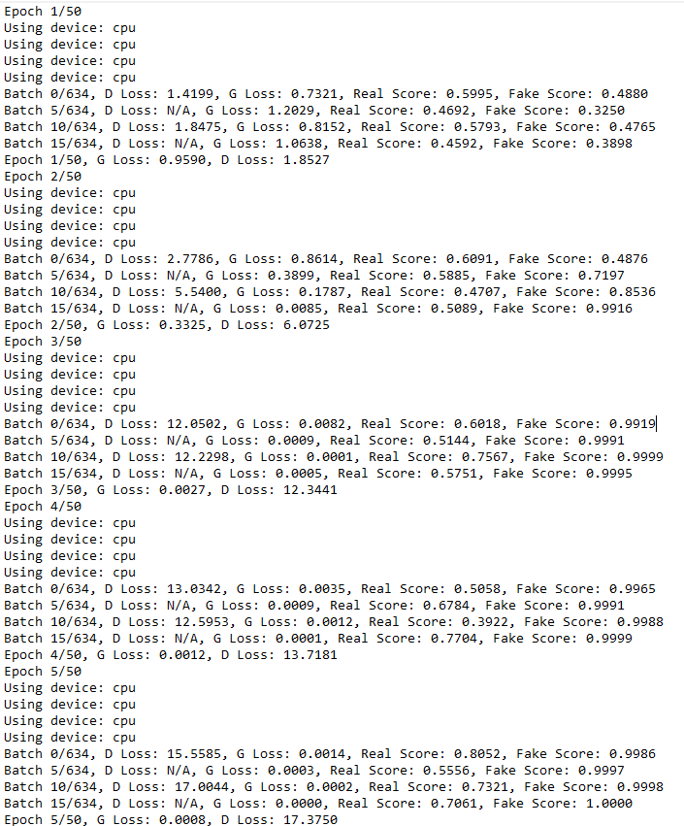

Slide 12
DEMO
Random noise input -> Generator -> Images.
Best discriminator evaluates real/fake.
Fitness scores assigned to all weight sets.
EA produces next generation of weights.
Repeat for multiple epochs; image quality improves over time.

Slide 13
LIMITATIONS/FUTURE WORK
High computational cost for large populations.
Didn’t include spectral norm or gradient penalty.
Future: Hybrid models (EA + backprop), larger datasets, parallelism.

Slide 14
CONCLUSION
GAGAN replaces backprop for D with evolutionary optimization.
Improved training stability and diverse outputs.
Offers a novel perspective for GAN training.
Potential for further research and scaling.

Slide 15
REFERENCES
Konstantopoulou, D.; Zacharia, P.; Papoutsidakis, M.; Leligou, H.C.; Patrikakis, C. GAGAN: Enhancing Image Generation Through Hybrid Optimization of Genetic Algorithms and Deep Convolutional Generative Adversarial Networks. Algorithms 2024, 17, 584. https://doi.org/10.3390/a17120584
Paszke, A., Gross, S., Massa, F., Lerer, A., Bradbury, J., Chanan, G., ... & Chintala, S. (2019). PyTorch: An Imperative Style, High-Performance Deep Learning Library. Advances in Neural Information Processing Systems, 32, 8024–8035
Liu, Z., Luo, P., Wang, X., & Tang, X. (2015). Deep learning face attributes in the wild. In Proceedings of the IEEE International Conference on Computer Vision (ICCV) (pp. 3730–3738).​

Slide 16
THANK YOU!

