Slide 1
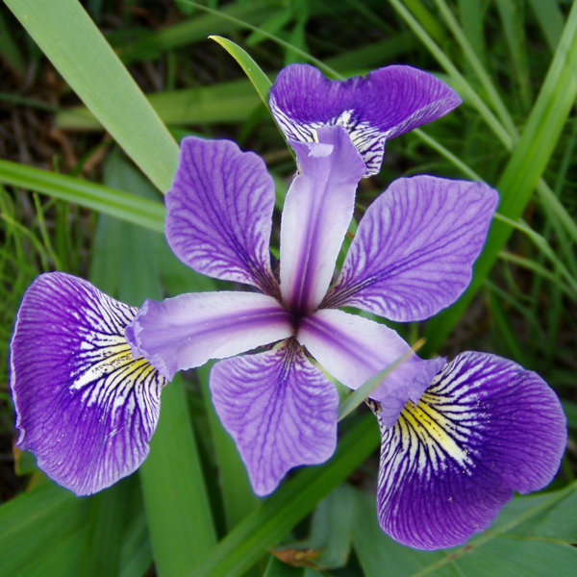
Curve Fitting and
Parameter Estimation for a
Logistic Regression Classifier
Basil Imoberdorf
CO3: Optimisation and Bio-Inspired Algorithms
Source: https://sitelikeet.life/product_details/53557483.html

Slide 2

Content
Context
  Classification vs. Regression
  Applications of Classification
Logistic Regression
  Example on the Iris data set
  Loss Landscapes
Optimisation Problem
Gradient Descent
Simulated Annealing
Compare Results

Slide 3
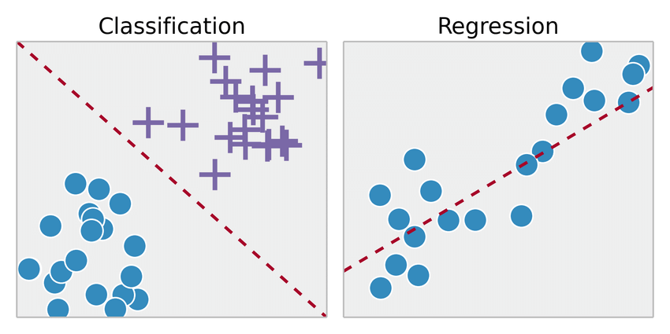
Classification vs. Regression Context
Categorizing data into classes based on their features.
https://www.researchgate.net/publication/326175998_Master_Thesis_Analysis_of_Control_Attainment_in_Endogenous_Electroencephalogram-Based_Brain_Computer_Interfaces/figures?lo=1

Slide 4
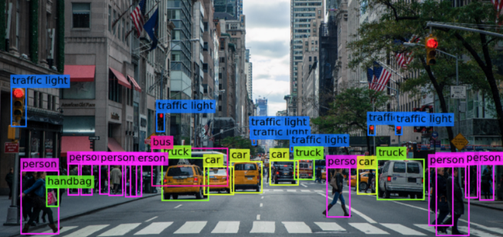

Applications in Machine Learning Context
Computer Vision
  Self-driving cars
Image Classification
  Face Recognition
Medical Diagnosis
  Cancer Yes/No?
Source: https://www.ufrjnautilus.com/post/vis%C3%A3o-computacional-e-carros-aut%C3%B4nomos
Source: https://eminebozkus.medium.com/exploring-the-iris-flower-dataset-4e000bcc266c

Slide 5
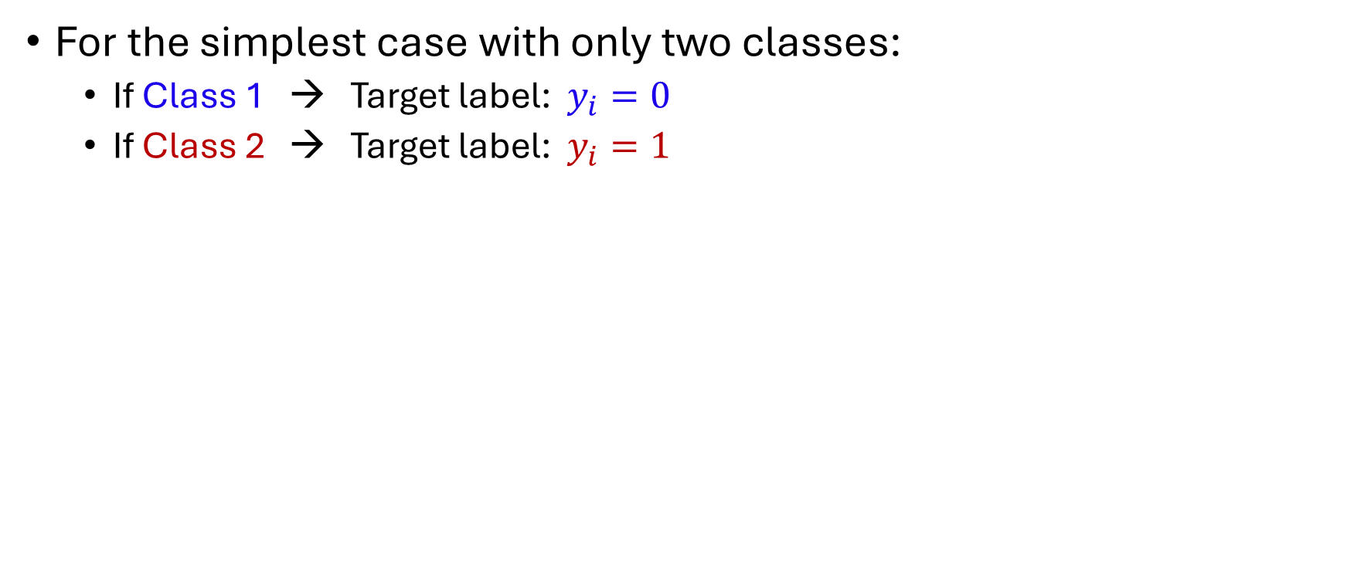
Logistic Regression
For the simplest case with only two classes:
  If Class 1 → Target label: $y_{i}=0$
  If Class 2 → Target label: $y_{i}=1$

Slide 6
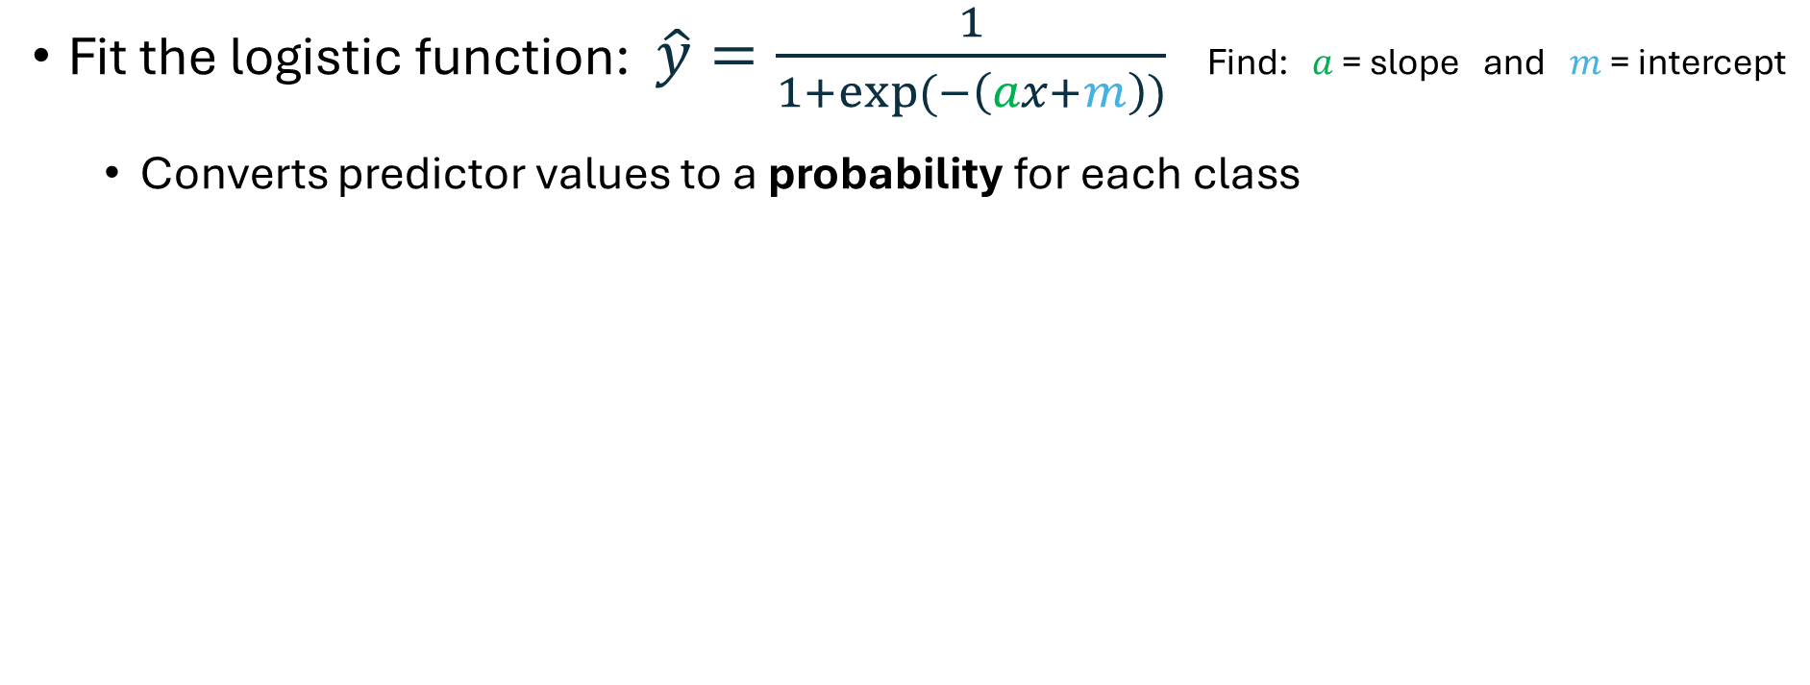
Logistic Regression
Fit the logistic function: $\hat{y}=\frac{1}{1+exp⁡(−\left(ax+m\right))}$ Find: $a$ = slope and $m$ = intercept
  Converts predictor values to a probability for each class

Slide 7
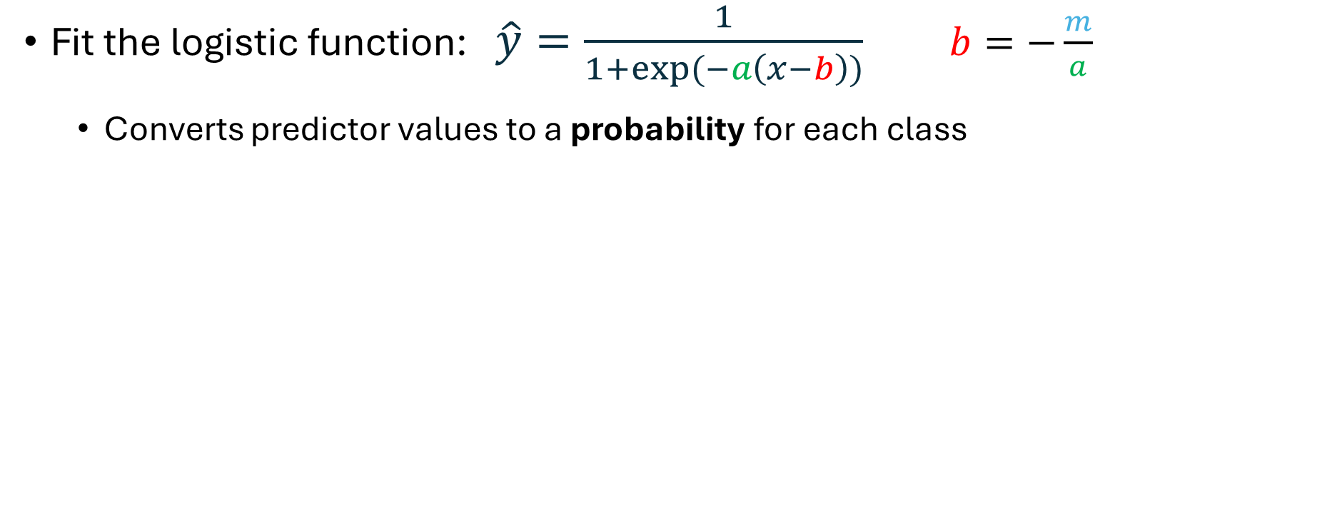
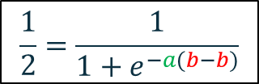
Logistic Regression
Fit the logistic function: $\hat{y}=\frac{1}{1+exp⁡(−a\left(x−b\right))}$ $b=−\frac{m}{a}$
  Converts predictor values to a probability for each class
$$\frac{1}{2}=\frac{1}{1+e^{−a(b−b)}}$$

Slide 8
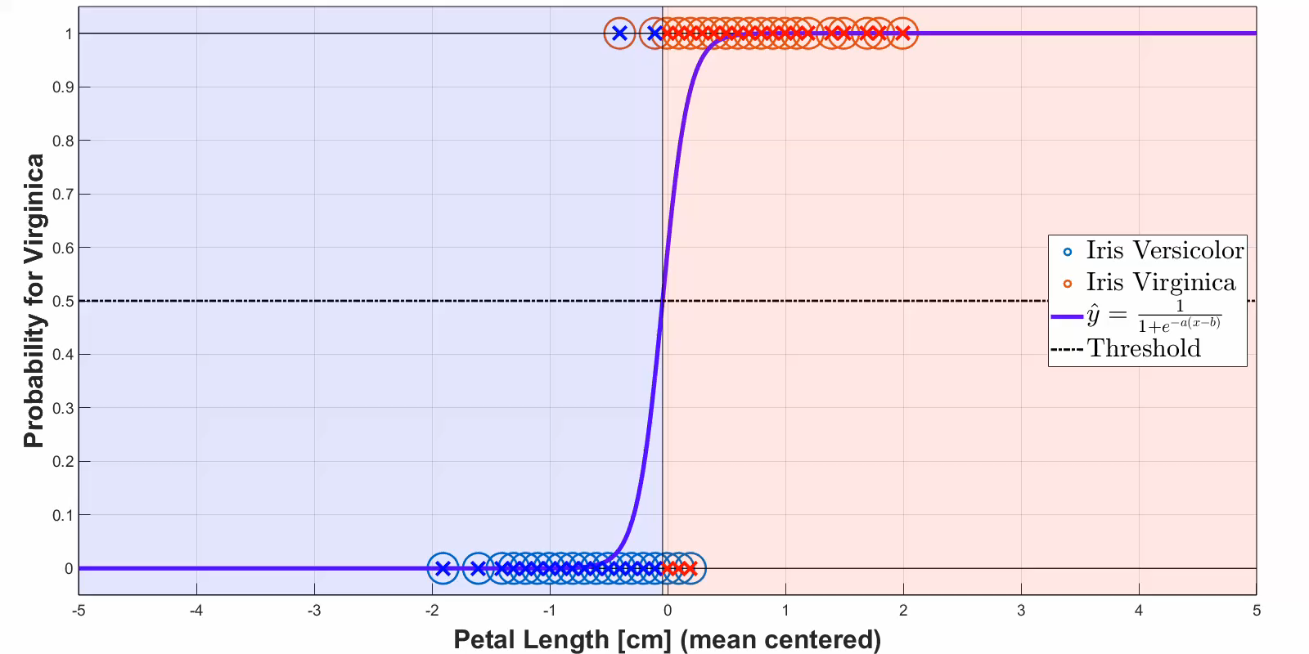
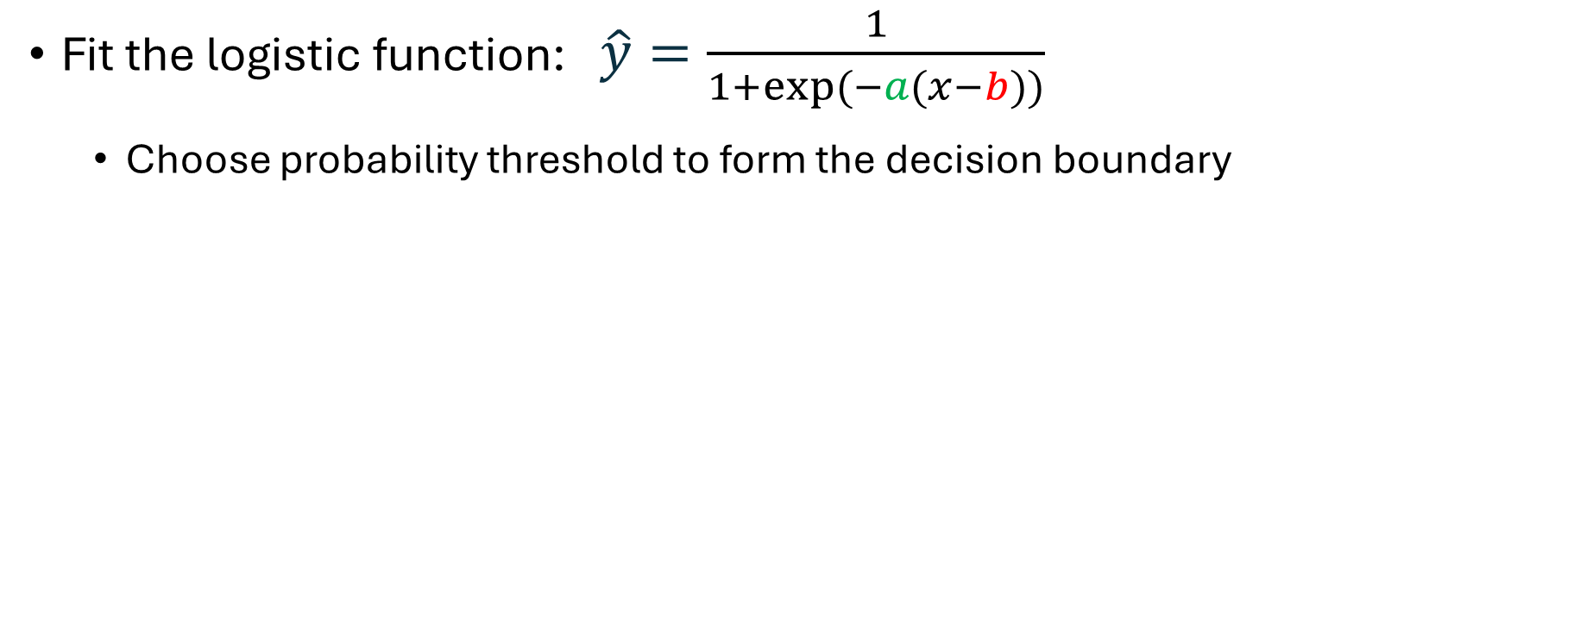
Logistic Regression
Fit the logistic function: $\hat{y}=\frac{1}{1+exp⁡(−a(x−b))}$
  Choose probability threshold to form the decision boundary

Slide 9
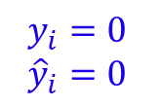
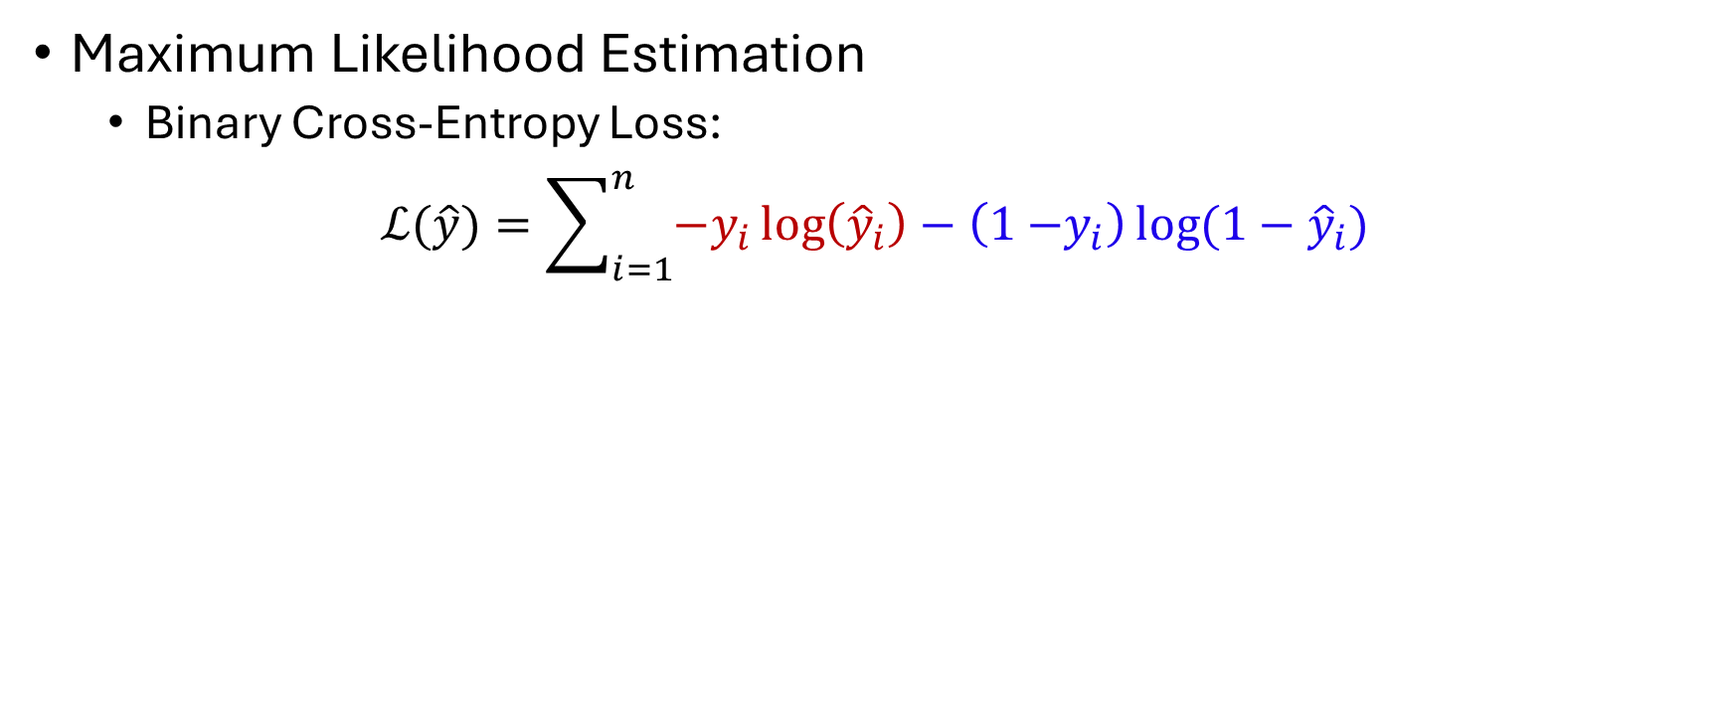
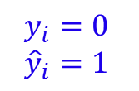
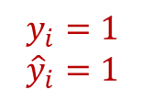
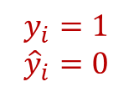
Loss Functions
Maximum Likelihood Estimation
  Binary Cross-Entropy Loss:
$$ℒ(\hat{y})=\sum_{i=1}^{n}{{−y}_{i}\log\left({\hat{y}}_{i}\right)−\left(1{−y}_{i}\right)\log{(1−{\hat{y}}_{i})}}$$
$$y_{i}=1$$
${\hat{y}}_{i}=0$
$$y_{i}=0$$
${\hat{y}}_{i}=1$
$$y_{i}=0$$
${\hat{y}}_{i}=0$
$$y_{i}=1$$
${\hat{y}}_{i}=1$

Slide 10
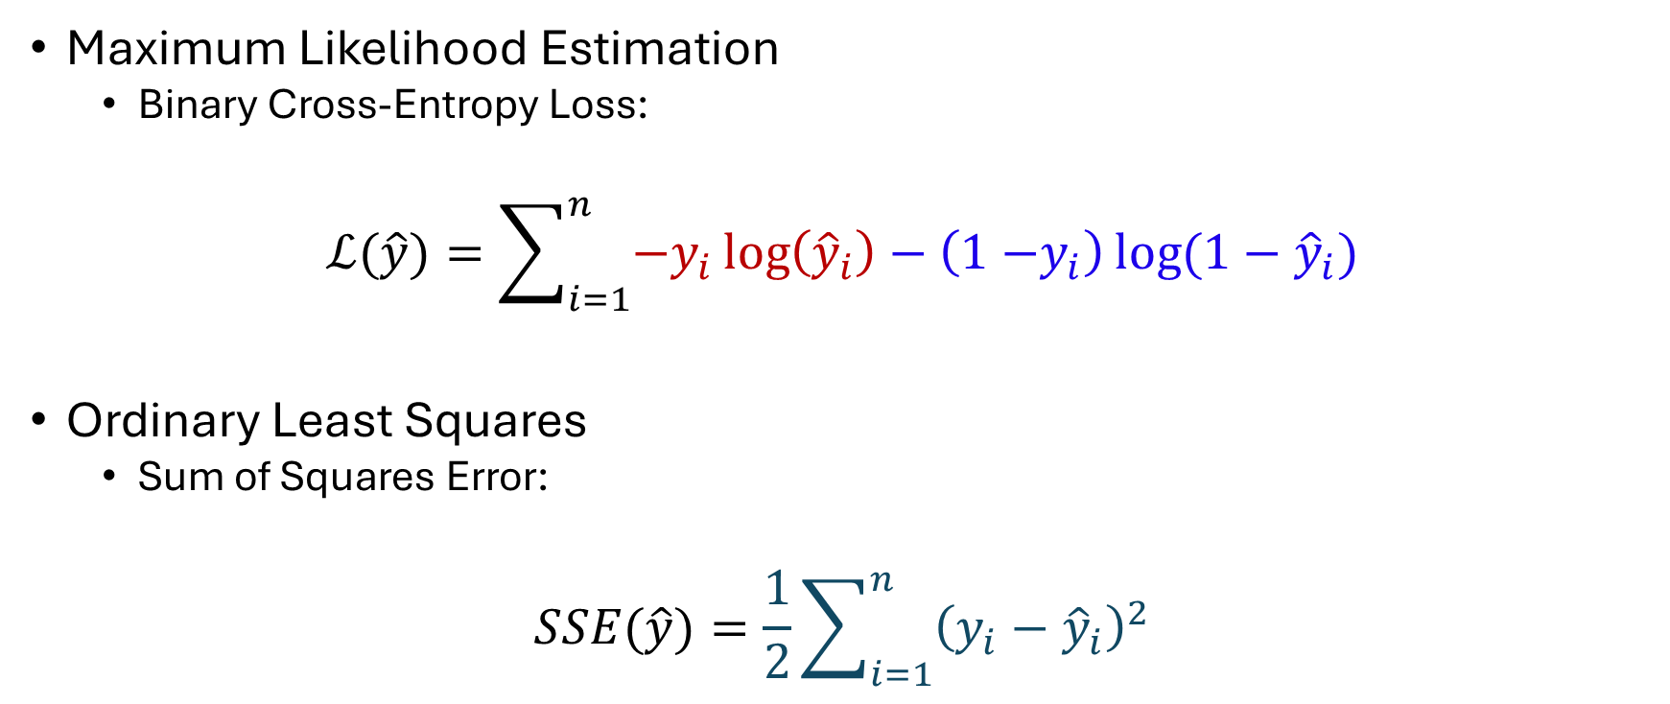
Loss Functions
Maximum Likelihood Estimation
  Binary Cross-Entropy Loss:
$$ℒ(\hat{y})=\sum_{i=1}^{n}{{−y}_{i}\log\left({\hat{y}}_{i}\right)−\left(1{−y}_{i}\right)\log{(1−{\hat{y}}_{i})}}$$
Ordinary Least Squares
  Sum of Squares Error:
$$SSE(\hat{y})=\frac{1}{2}\sum_{i=1}^{n}{{\left(y_{i}−{\hat{y}}_{i}\right)}^{2}}$$

Slide 11
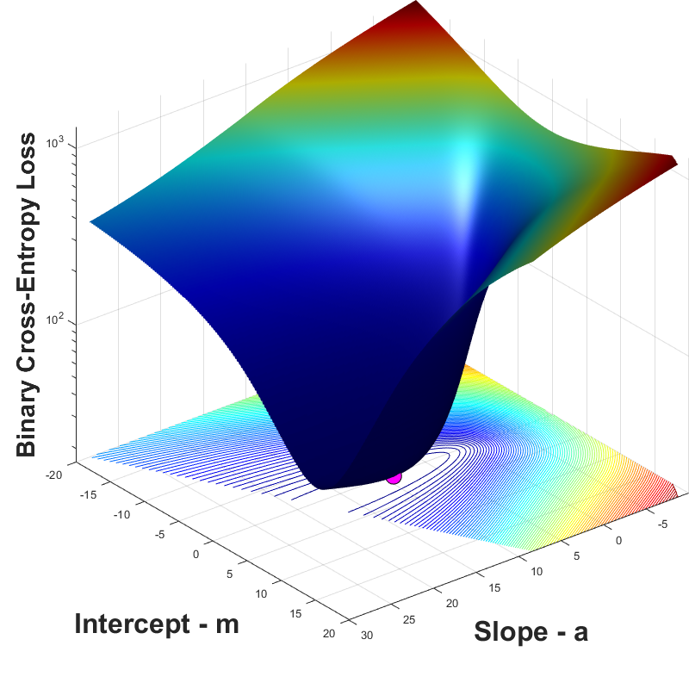
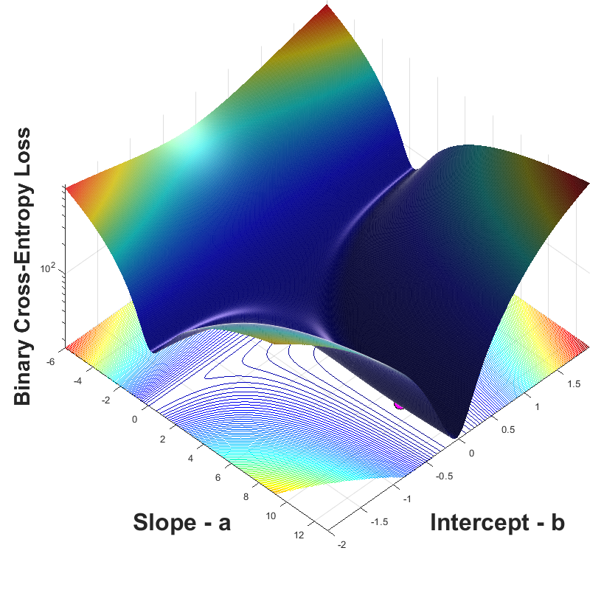
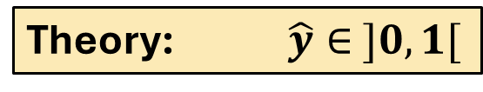
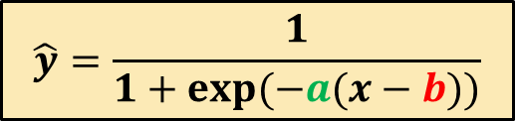
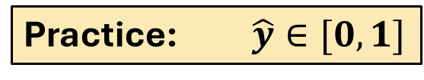
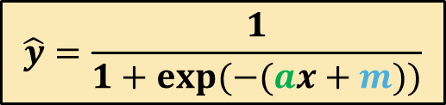

Loss-Landscapes: Binary Cross-Entropy
$$\hat{y}=\frac{1}{1+exp(−(ax+m))}$$
$$\hat{y}=\frac{1}{1+exp(−a(x−b))}$$
Theory: $\hat{y}∈ ]0,1[$
Practice: $\hat{y}∈[0,1]$
$$−log\left(0\right)=∞$$

Slide 12
Loss-Landscapes: Binary Cross-Entropy
$$\hat{y}=\frac{1}{1+exp(−(ax+m))}$$
$$\hat{y}=\frac{1}{1+exp(−a(x−b))}$$

Slide 13
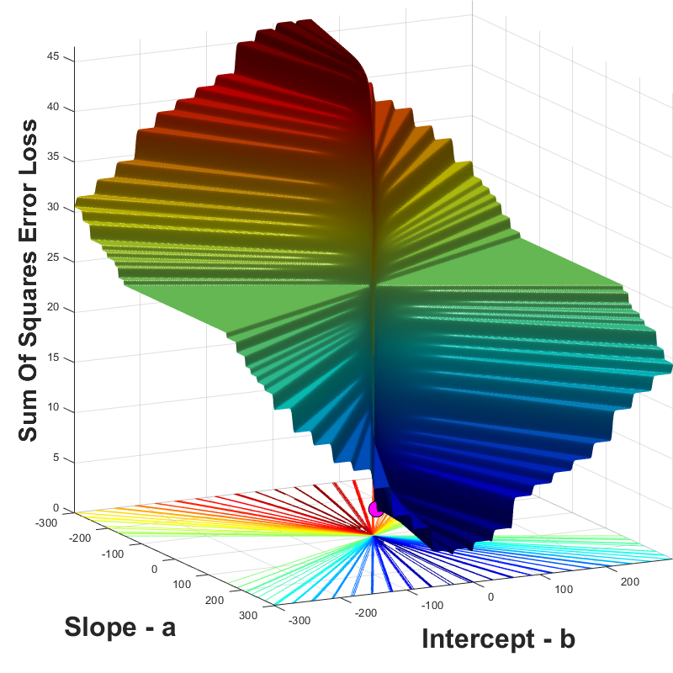
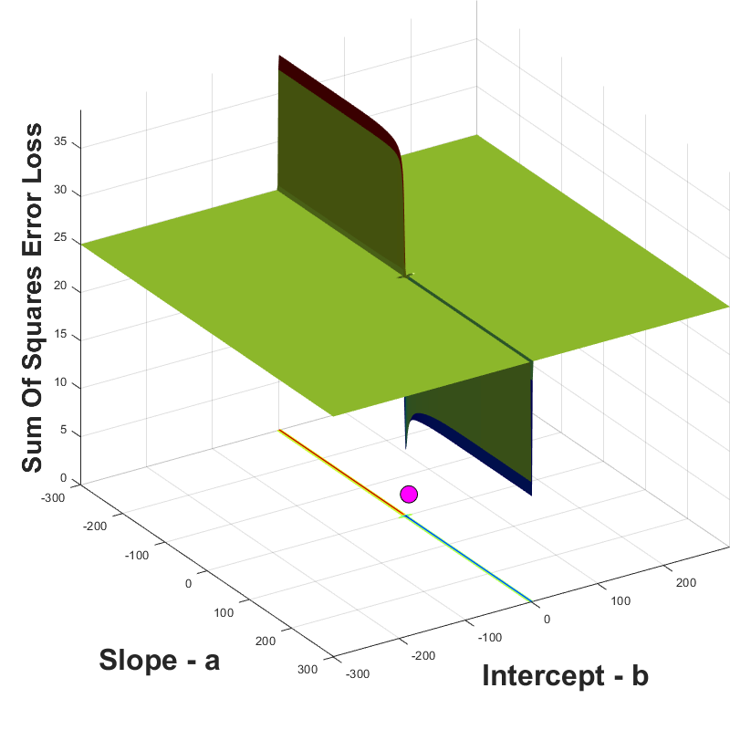
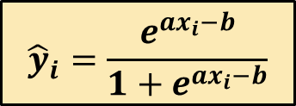
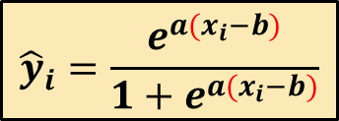
Loss-Landscapes: Sum of Squares
$${\hat{y}}_{i}=\frac{e^{ax_{i}−b}}{1+e^{ax_{i}−b}}$$
$${\hat{y}}_{i}=\frac{e^{a{(x}_{i}−b)}}{1+e^{a(x_{i}−b)}}$$

Slide 14
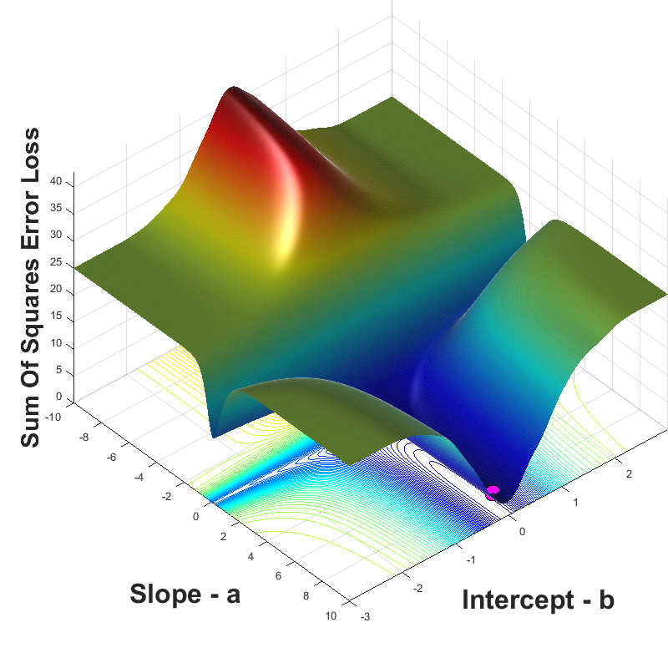
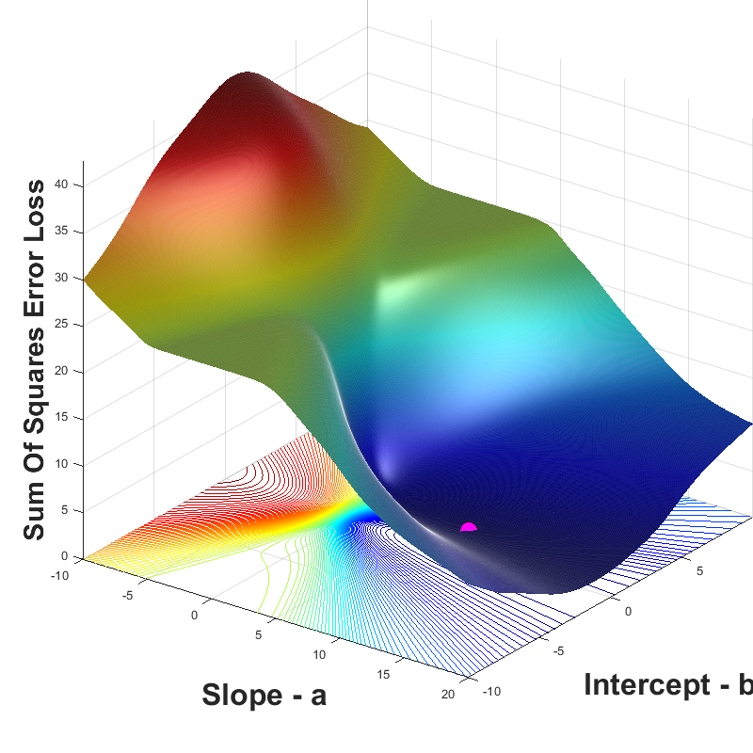
Loss-Landscapes: Sum of Squares
$${\hat{y}}_{i}=\frac{e^{ax_{i}−b}}{1+e^{ax_{i}−b}}$$
$${\hat{y}}_{i}=\frac{e^{a{(x}_{i}−b)}}{1+e^{a(x_{i}−b)}}$$

Slide 15
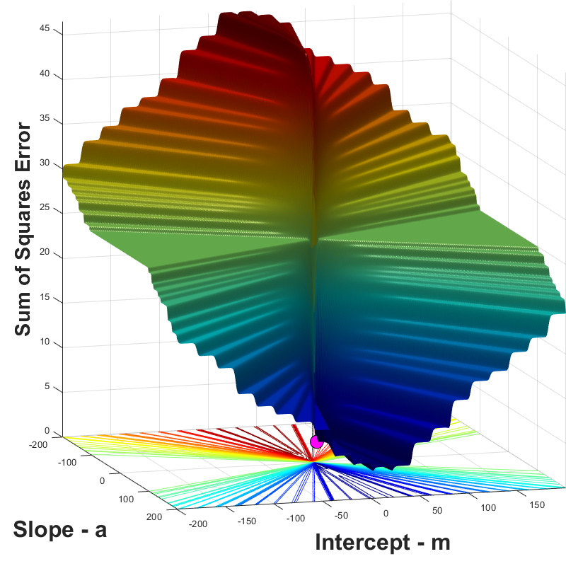
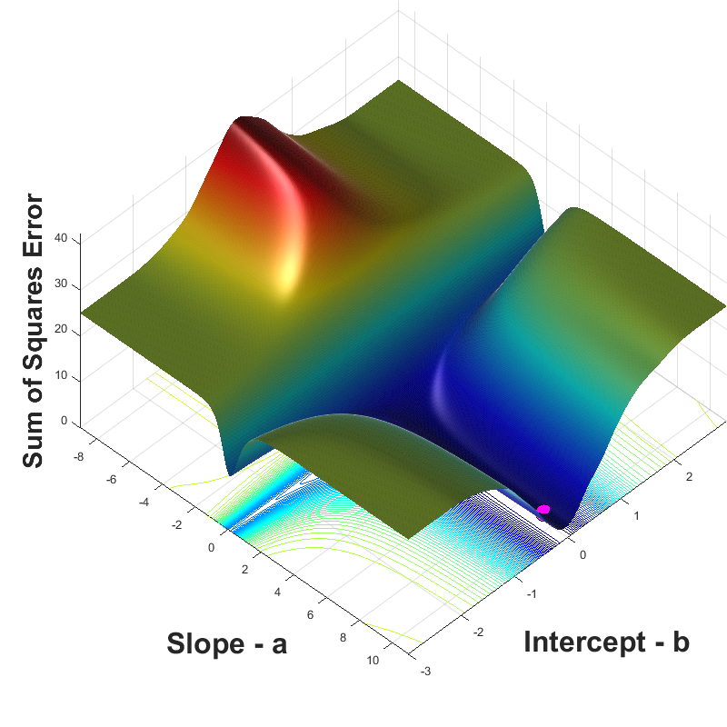
Loss-Landscapes: Sum of Squares
$$\hat{y}=\frac{1}{1+exp(−(ax+m))}$$
$$\hat{y}=\frac{1}{1+exp(−a(x−b))}$$

Slide 16
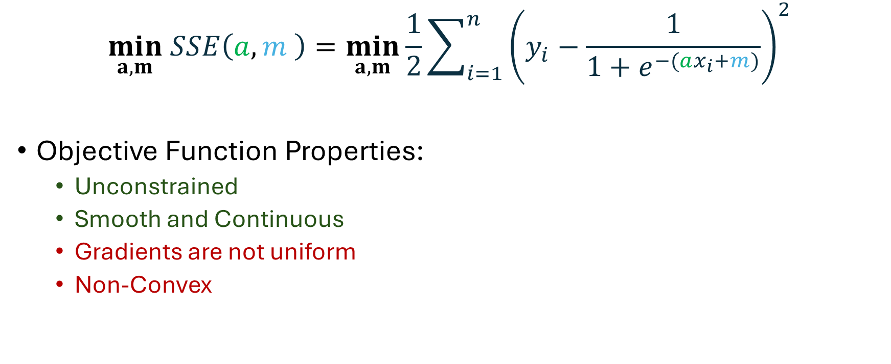
Optimisation Problem
$$\min_{a,m} SSE\left(a,m \right)=\min_{a,m}\frac{1}{2}\sum_{i=1}^{n}{{\left(y_{i}−\frac{1}{1+e^{−(ax_{i}+m)}}\right)}^{2}}$$
Objective Function Properties:
  Unconstrained
  Smooth and Continuous
  Gradients are not uniform
  Non-Convex

Slide 18
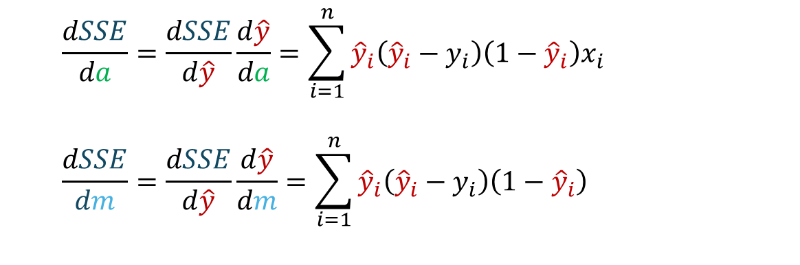
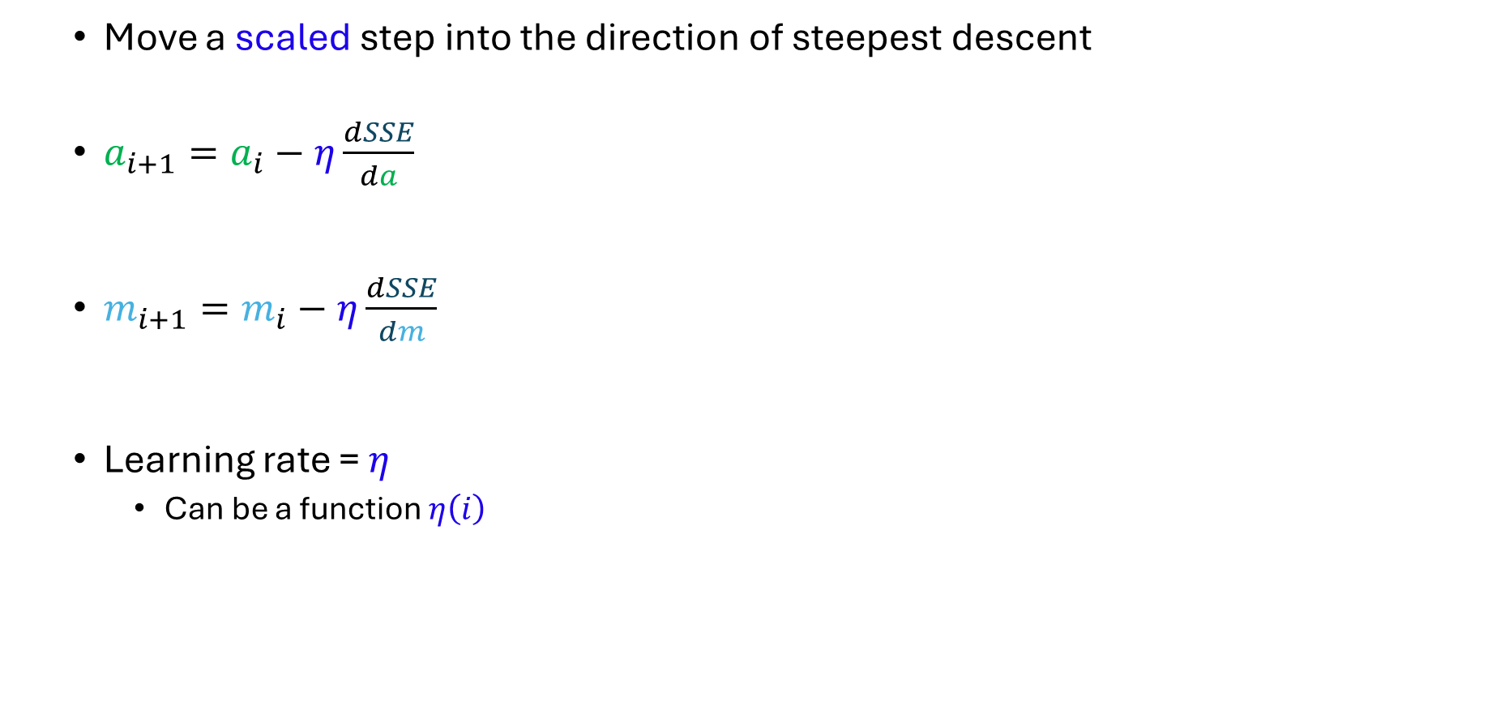
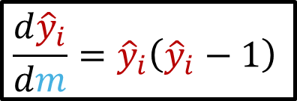
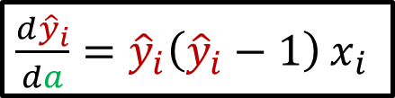
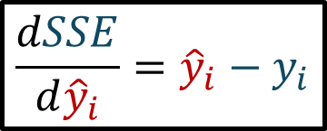
Gradient Descent Algorithm
  Move a scaled step into the direction of steepest descent
  $a_{i+1}=a_{i}−η\frac{dSSE}{da}$
  $m_{i+1}=m_{i}−η\frac{dSSE}{dm}$
  Learning rate = $η$
    Can be a function $η\left(i\right)$
  $$\frac{dSSE}{da}=\frac{dSSE}{d\hat{y}}\frac{d\hat{y}}{da}=\sum_{i=1}^{n}{{\hat{y}}_{i}\left({\hat{y}}_{i}−y_{i}\right)\left(1−{\hat{y}}_{i}\right)x_{i}}$$
  $$\frac{dSSE}{dm}=\frac{dSSE}{d\hat{y}}\frac{d\hat{y}}{dm}=\sum_{i=1}^{n}{{\hat{y}}_{i}\left({\hat{y}}_{i}−y_{i}\right)\left(1−{\hat{y}}_{i}\right)}$$
$$\frac{dSSE}{d{\hat{y}}_{i}}={\hat{y}}_{i}−y_{i}$$
$\frac{d{\hat{y}}_{i}}{da}={\hat{y}}_{i}\left({\hat{y}}_{i}−1\right)$ $x_{i}$
$$\frac{d{\hat{y}}_{i}}{dm}={\hat{y}}_{i}\left({\hat{y}}_{i}−1\right)$$

Slide 19
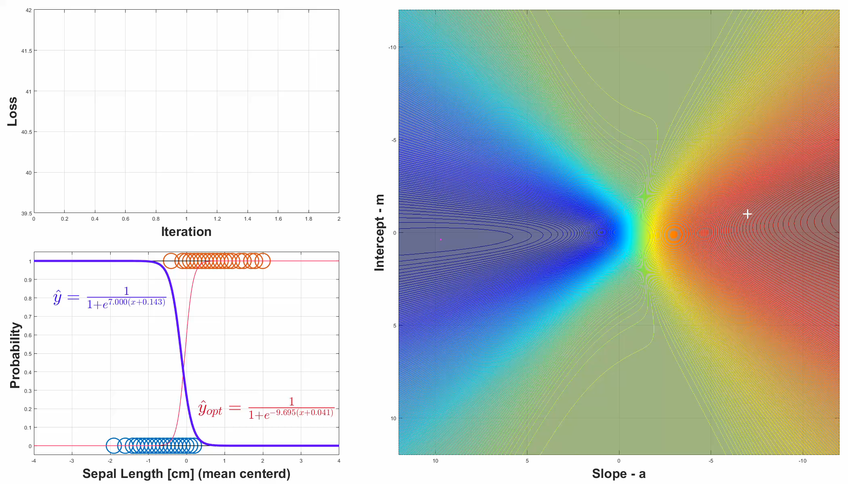

Gradient Descent: Near Optimum
$$η=0.1$$

Slide 20
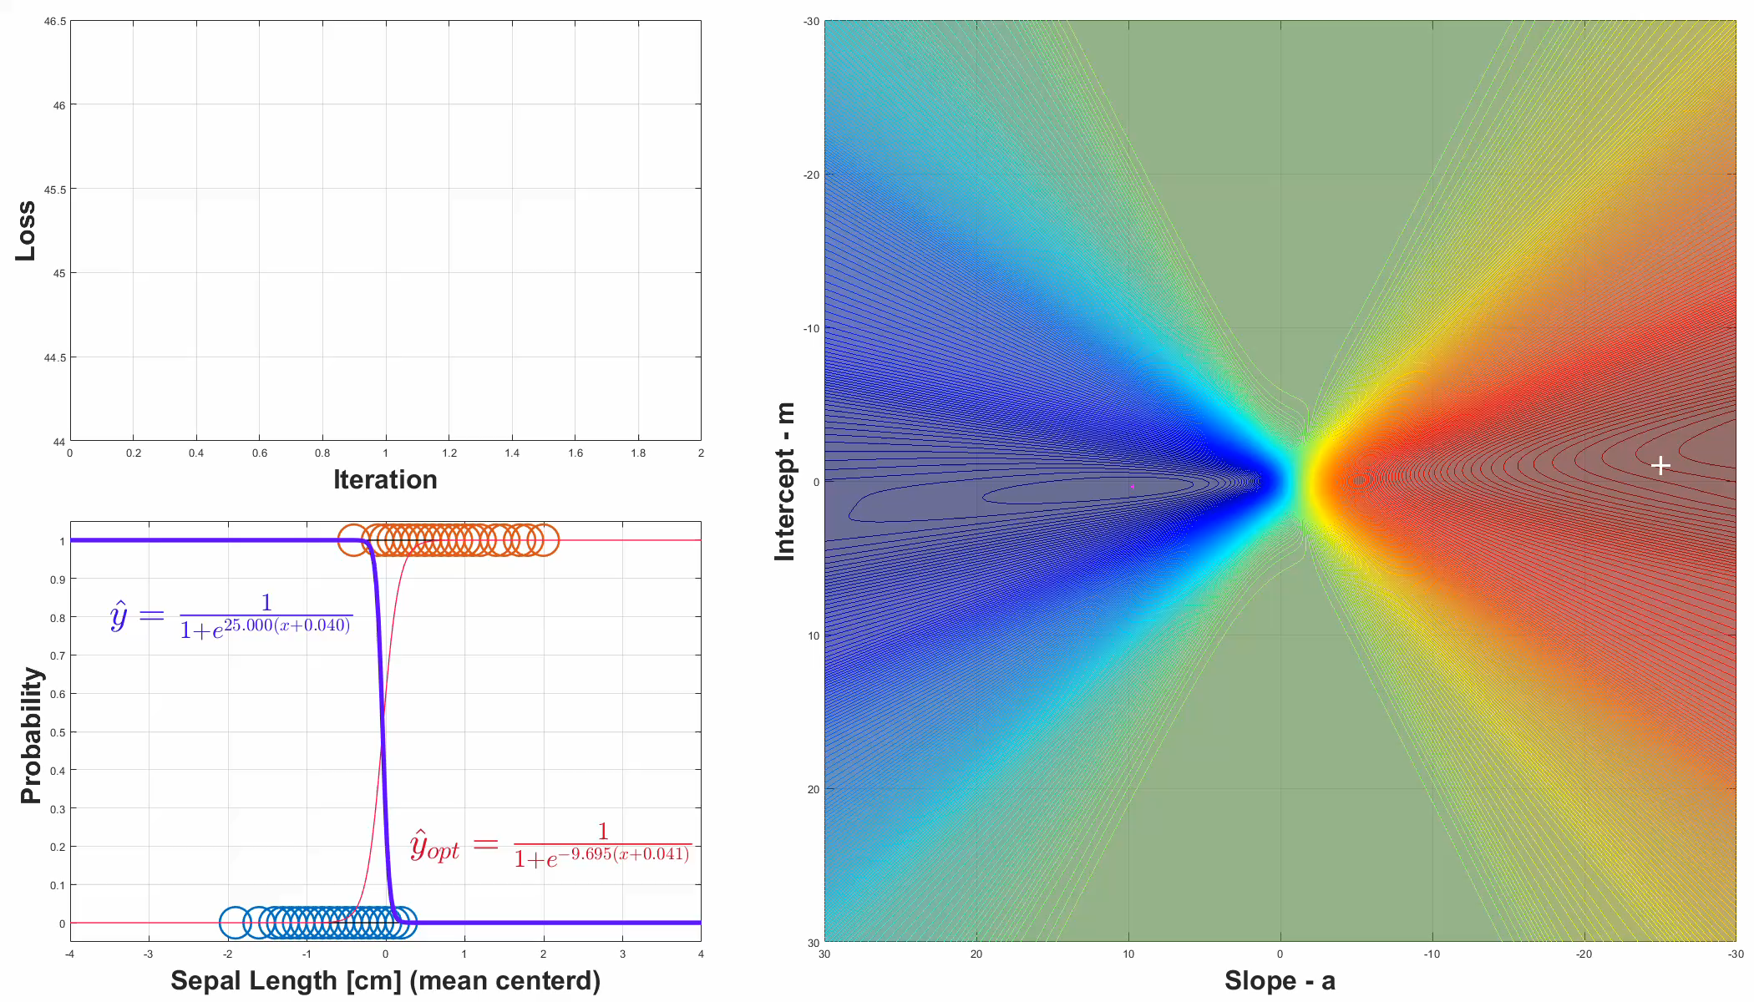

Gradient Descent: Far form optimum
$$η=0.4$$

Slide 21



Gradient Descent: Start in the plains
$$η={10}^{6}$$

Slide 22
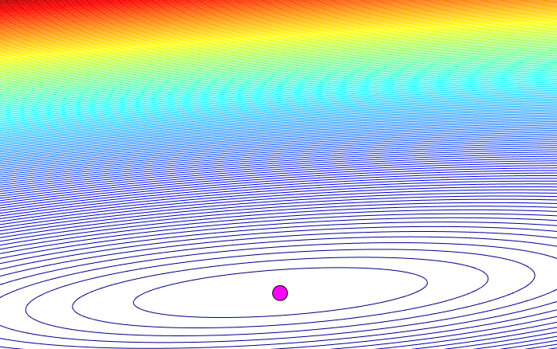


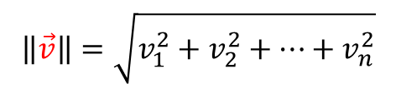
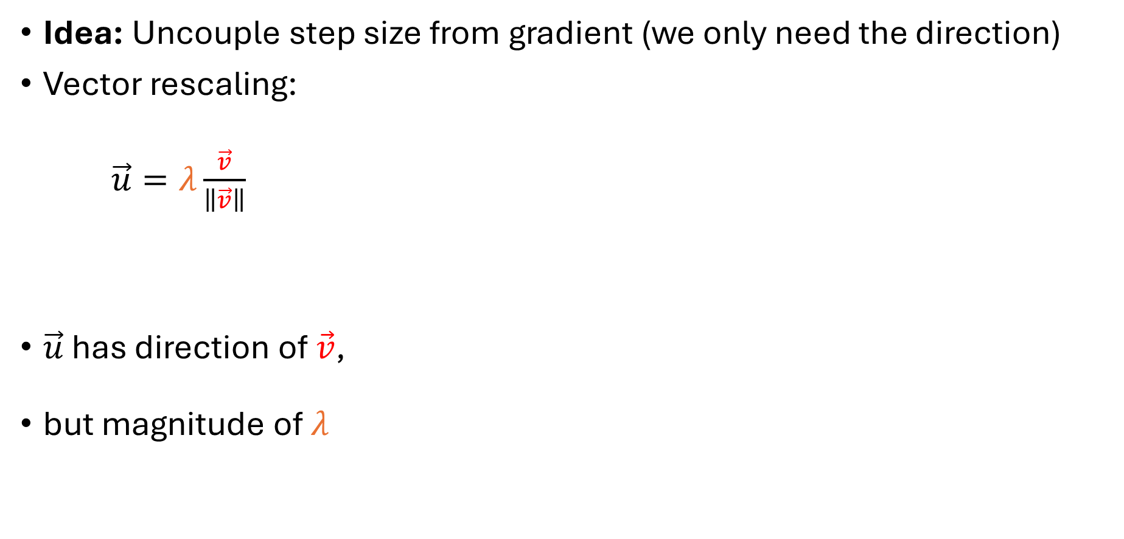
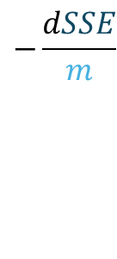
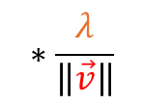
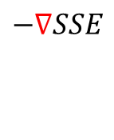

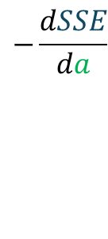

Gradient Normalisation
Idea: Uncouple step size from gradient (we only need the direction)
Vector rescaling:
$\vec{u}=λ\frac{\vec{v}}{\left\|\vec{v}\right\|}$
$\vec{u}$ has direction of $\vec{v}$,
but magnitude of $λ$
$$−\frac{dSSE}{da}$$
$$\left\|\vec{v}\right\|=\sqrt{v_{1}^{2}+v_{2}^{2}+…+v_{n}^{2}}$$
$$−\frac{dSSE}{m}$$
$$−∇SSE$$
$$\vec{v}$$
$$\vec{u}$$
$$\left\|\vec{v}\right\|$$
$$λ$$
$$∗\frac{λ}{\left\|\vec{v}\right\|}$$

Slide 23


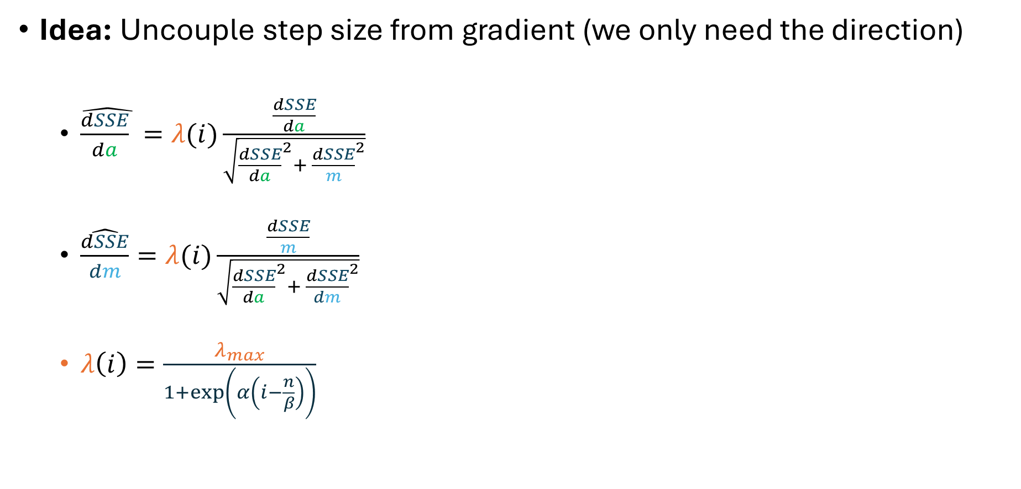
Gradient Normalisation
Idea: Uncouple step size from gradient (we only need the direction)
  $\hat{\frac{dSSE}{da} }=λ(i)\frac{\frac{dSSE}{da}}{\sqrt{{\frac{dSSE}{da}}^{2}+ {\frac{dSSE}{m}}^{2}}}$
  $\hat{\frac{dSSE}{dm}}=λ(i)\frac{\frac{dSSE}{m}}{\sqrt{{\frac{dSSE}{da}}^{2}+ {\frac{dSSE}{dm}}^{2}}}$
  $λ\left(i\right)=\frac{λ_{max}}{1+\exp\left(α\left(i−\frac{n}{β}\right)\right)}$
$$−\frac{dSSE}{da}$$
$$λ_{max}$$
$$−\frac{dSSE}{m}$$
$$−∇SSE$$
$$i$$

Slide 24
Normalized Gradient Descent:

Slide 25
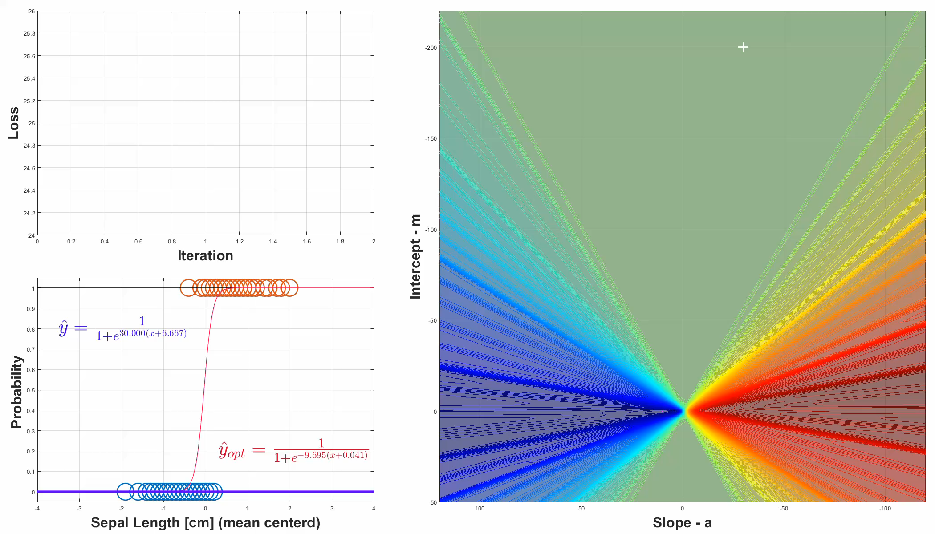
Normalized Gradient Descent: Far Far Away

Slide 26
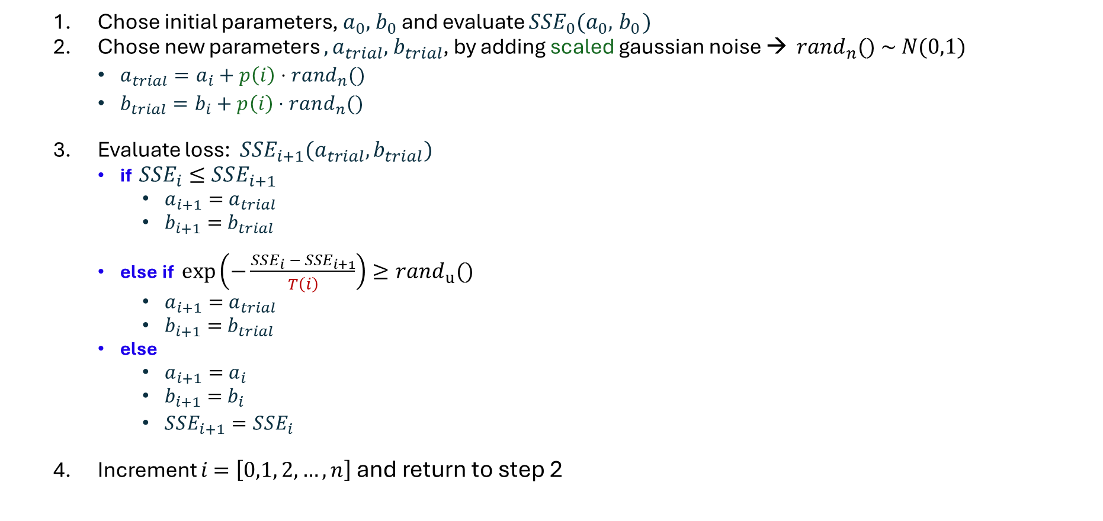
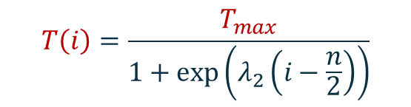
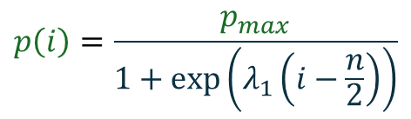
Simulated Annealing
  Chose initial parameters, $a_{0}, { b}_{0}$ and evaluate $SSE_{0}(a_{0}, { b}_{0})$
  Chose new parameters $,a_{trial}, { b}_{trial}$, by adding scaled gaussian noise → $rand_{n}() \sim N(0,1)$
    $a_{trial}=a_{i}+p\left(i\right)⋅rand_{n}()$
    $b_{trial}=b_{i}+p\left(i\right)⋅rand_{n}()$
  Evaluate loss: $SSE_{i+1}(a_{trial},b_{trial})$
    if $SSE_{i}≤SSE_{i+1}$
      $a_{i+1}=$ $a_{trial}$
      $b_{i+1}=$ $b_{trial}$
    else if $exp\left(−\frac{SSE_{i} − SSE_{i+1}}{T\left(i\right)}\right)≥rand_{u}()$
      $a_{i+1}=$ $a_{trial}$
      $b_{i+1}=$ $b_{trial}$
    else
      $a_{i+1}=$ $a_{i}$
      $b_{i+1}=$ $b_{i}$
      $SSE_{i+1}=SSE_{i}$
  Increment $i$ $=\left[0,1, 2,…,n\right]$and return to step 2
$$p\left(i\right)=\frac{p_{max}}{1+\exp\left(λ_{1}\left(i−\frac{n}{2}\right)\right)}$$
$$T\left(i\right)=\frac{T_{max}}{1+\exp\left(λ_{2}\left(i−\frac{n}{2}\right)\right)}$$

Slide 27
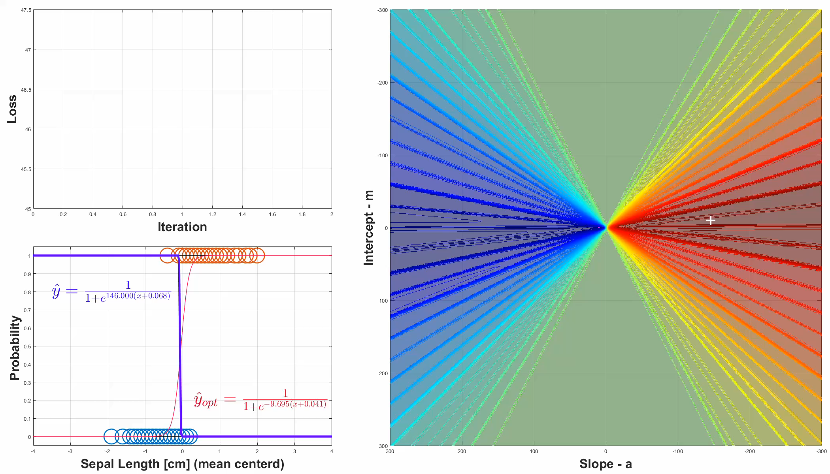

Simulated Annealing:
$p_{max}=5$

Slide 28


Simulated Annealing: often not converging
$p_{max}=5$

Slide 29


Simulated Annealing: enlarged search reach
$p_{max}=30$

Slide 30


Comparison of Results:
Iterations: 100 10’000 114
Initial parameters: $a_{0}=−20$
$b_{0}=+20$
Gradient Descent
  Gets stuck if it starts too far from optimum
Normalized Gradient Descent
  Does converge fast
  Hyperparameter tuning necessary for $λ\left(i\right)$
Simulated Annealing
  Needs much more iterations (n>10’000) for consistency
scipy.optimize.minimize( … , method=‘Nelder-Mead’)
  Finds the minimum reliably and fast
$$a_{opt}=9.6950$$
$$b_{opt}=0.4019$$
$${SSE}_{min}=2.5216$$

Slide 31
Conclusions
Gradient Descent is not robust
  gets stuck in shallow gradients
  overshoots on steep gradients
Normalizing the gradient allows for more control
  Can overcome shallow or steep gradient issues
  Needs hyperparameter tuning for each problem
Simulated Annealing is more robust
  Does not need gradient information
  Can start much further away from optimum and still find the optimum
  Removing the Boltzmann acceptance criterion can improve convergence

Slide 32


Remarks
Logistic Regression can be extended to any number of dimensions,
$\hat{y}=\frac{1}{1+exp⁡(−z)}$ $z=β_{0}+$ $β_{1}x_{1}+β_{2}x_{2}+…+β_{n}x_{n}=β^{T}x$
And to any number of classes, $K$, using the SoftMax function:
$σ{\left(z\right)}_{i}=\frac{e^{z_{i}}}{\sum_{j=1}^{K}{e^{z_{j}} }}$

Slide 33

Thanks for Listening

