Slide 1
Chunking and its Methods

Slide 2

Agenda
What is Chunking
Methods of Chunking
Sliding Window Chunking
Modality Chunking
Recursive Chunking
Context-Enriched Chunking

Slide 3
What is Chunking
the process of breaking text into smaller parts so we can compare and match them with the query
Example: (Here We all are present the ppt ) this will chunk [“Here”,”We”,”all”,”present”,”the”,”pptx”]
Applications: various algorithms in machine learning. And mainly used for Rag Methods

Slide 4
Methods of Chunking

Slide 5
Methods of Chunking
There are many types of Chunking Methods and here we are presenting the main 4 types
Sliding Window Chunking
Modality Chunking
Recursive Chunking
Context-Enriched Chunking

Slide 6
Sliding Window Chunking

Slide 7
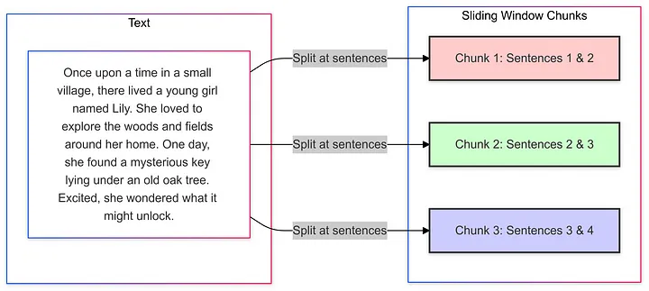
Sliding Window Chunking

Slide 8
Creates overlapping chunks by sliding a window over the text
Best for: such as legal or medical texts.
Example:
text = The quick brown fox jumps over the lazy dog. The dog barks at the fox. The fox runs away into the forest.
sample output could be:
[['The', 'quick', 'brown', 'fox', 'jumps'], ['brown', 'fox', 'jumps', 'over', 'the'], ['jumps', 'over', 'the', 'lazy', 'dog.'], ['the', 'lazy', 'dog.', 'The', 'dog'], ['dog.', 'The', 'dog', 'barks', 'at'], ['dog', 'barks', 'at', 'the', 'fox.'], ['at', 'the', 'fox.', 'The', 'fox'], ['fox.', 'The', 'fox', 'runs', 'away'], ['fox', 'runs', 'away', 'into', 'the'], ['away', 'into', 'the', 'forest.']]

Slide 9
Modality Chunking

Slide 10
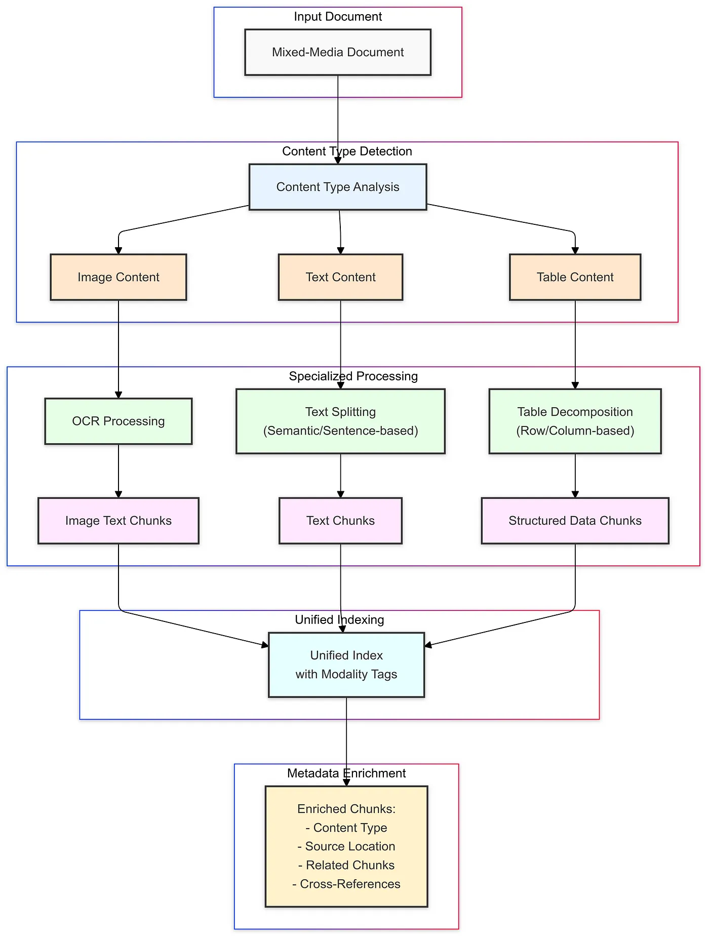
Modality Chunking
Handles different content types (text, tables, images) separately, chunking each according to its nature.
Best For:
Mixed-media documents like scientific papers or user manuals.

Slide 11
Here, I am using the DOCX files as input to extract the text content and separate it into chunked sizes
Example:
FIle =basilresume.docx
sample output could be:
{'chunks': ['BASIL AHAMED Python Developer | Fresher Chennai,IN • basilahamed46@gmail.com • + 917397061751 • LinkedIn • Github ', 'SUMMERY As a fresher Python Developer, I bring proficiency in SQL, Web Technology, Linux, Cloud Computing, and Cyber Security.

Slide 12
Recursive Chunking

Slide 13
Recursive Chunking
A strategy where the text is broken into chunks recursively by adjusting the chunk size dynamically based on sentence boundaries or other logical markers.
It tries to preserve the integrity of sentences and smaller paragraphs.
Best for: such as legal or medical texts.
Example:
text = Mac OS is owned by Apple Inc. It was first released in 1984..
sample output could be:
Chunk 1: "Mac OS is ", Chunk 2: "OS is owne", Chunk 3: "is owned b", Chunk 4: "owned by A", Chunk 5: "by Apple I", Chunk 6: "pple Inc. I", Chunk 7: "Inc. It wa", Chunk 8: "It was fi", Chunk 9: "was first ", Chunk 10: "first rel", Chunk 11: "released", Chunk 12: "eased in ", Chunk 13: "in 1984."

Slide 14
context enriched

Slide 15
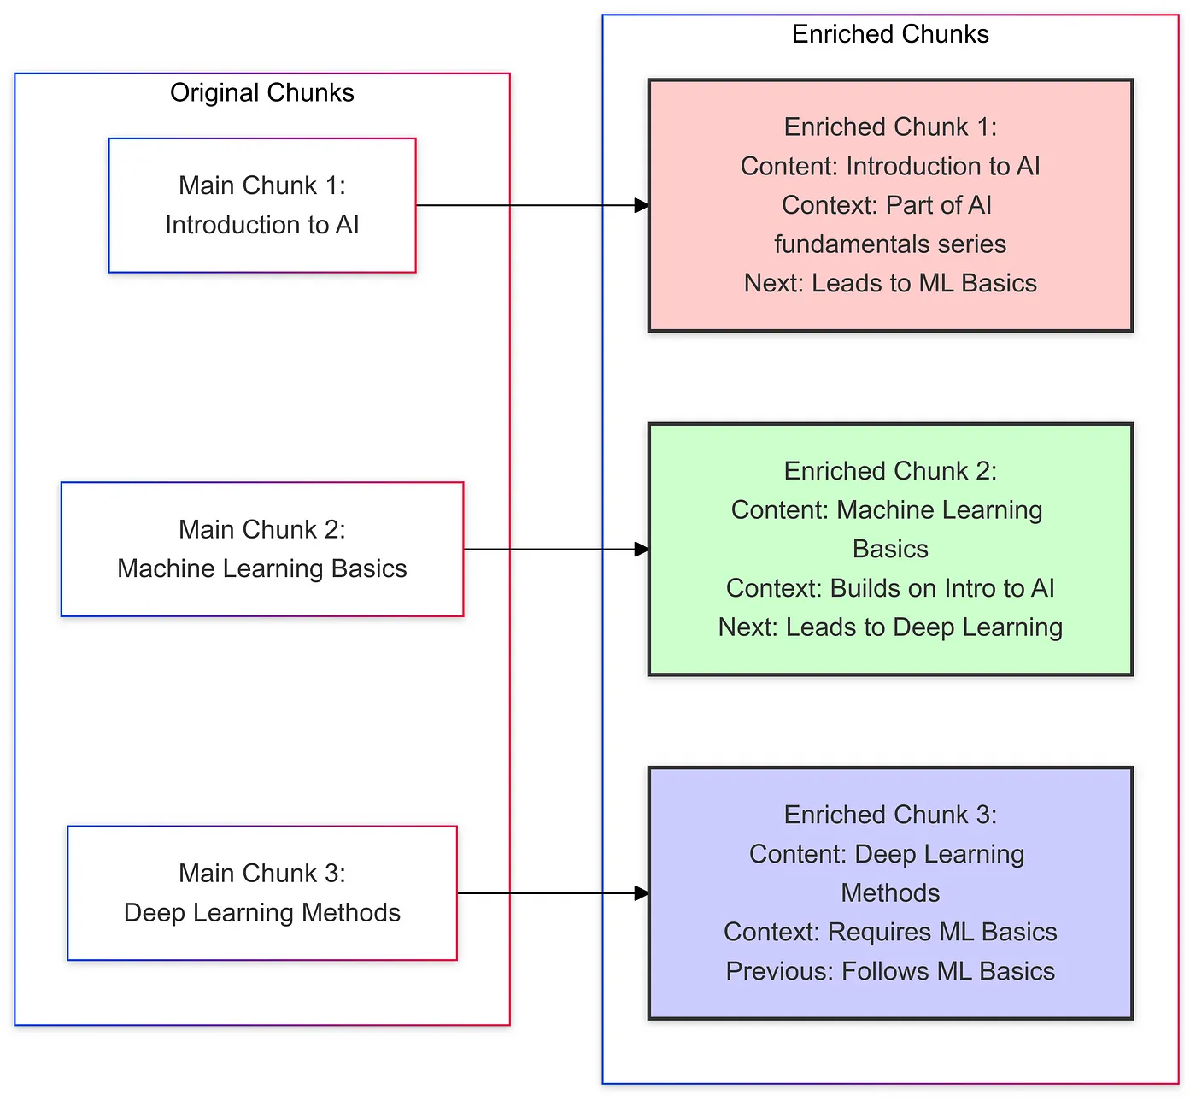
context enriched

Slide 16
A method of chunking that involves dividing the text into overlapping sections, with the added complexity of retaining context by using metadata (e.g., page number or document source).
Best for: Long documents where coherence across many chunks is essential
Example:
text = Mac OS is owned by Apple Inc. It was first released in 1984 and has evolved significantly over the years.
sample output could be:
Chunk 1:Mac OS is owned by Apple Inc. It was first released in 1984 and has evolved significantly over the years. Metadata: {'index': 1, 'text': 'Mac OS is owned by Apple Inc. It was first released in 1984 and has evolved significantly over the years.'}

Slide 17
Thank you
By
Basil Ahamed
Suresh manikandan

