Slide 1
RETAIL SALES PERFORMANCE ANALYSIS: DISCOUNT IMPACT ON PROFITABILITY
Executive Dashboard tracking KPIs, Sales, Trends, Category, Regional and Top Performers Insights.

Slide 2
This project explores retail sales data to evaluate revenue, profit, and
the impact of discount levels on profitability. Using Power BI, interactive
visuals were created to analyse trends across categories, regions and
discount bands. The analysis aims to identify critical discounts
thresholds where profit declines and provide insights to support better
pricing and business decision-making.

Slide 3
DATA OVERVIEW Purpose: To analyse how discounts influence sales revenue and profitability in retail. Size & scope: Contains transactional data for products sold over a specific period. Type of data: Mixed- numerical(sales, profit, discount), categorical(product, region), data/time(transactional data). Source: Shared by examiner for the purpose of this project.

Slide 4
KEY FIELDS
Profits: profit earned from the sale
Order_Date: date of the order
Order_Id: unique identifier for each order
Cost: cost of the products sold
Region: geographical location of the sales
Discount: discount applied to the order

Slide 5
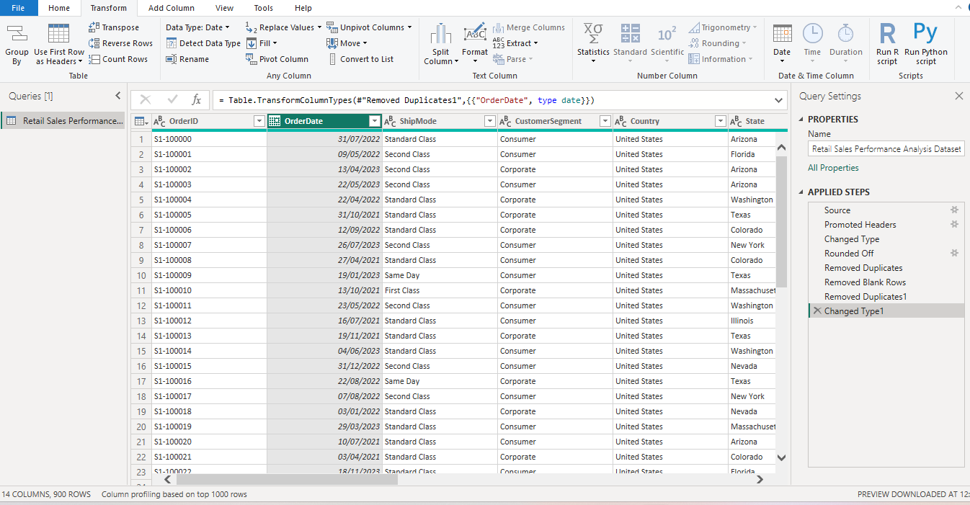
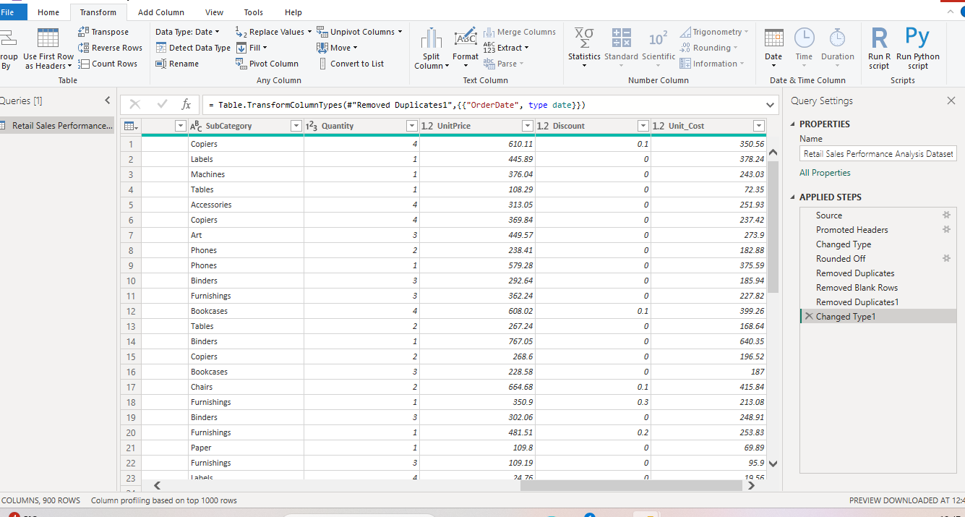

Slide 6
First issue: The unit_cost was imported without been rounded unlike the unit_price which can pose as an issue later and
is inconsistent with currency standards, also is not realistic for financial reporting.
Decision: Rounded the unit_cost to two decimal place.
Second issue: Checked for duplicate records by attempting to remove duplicate across key columns.
Observation;
Removing duplicates on single columns such as shipmode and order_date reduced row counts, but this was expected as
Multiple transactions can share the same mode or order_date.
Decision: No duplicate rows were found when checking across all columns. Therefore, no records were removed.

Slide 7
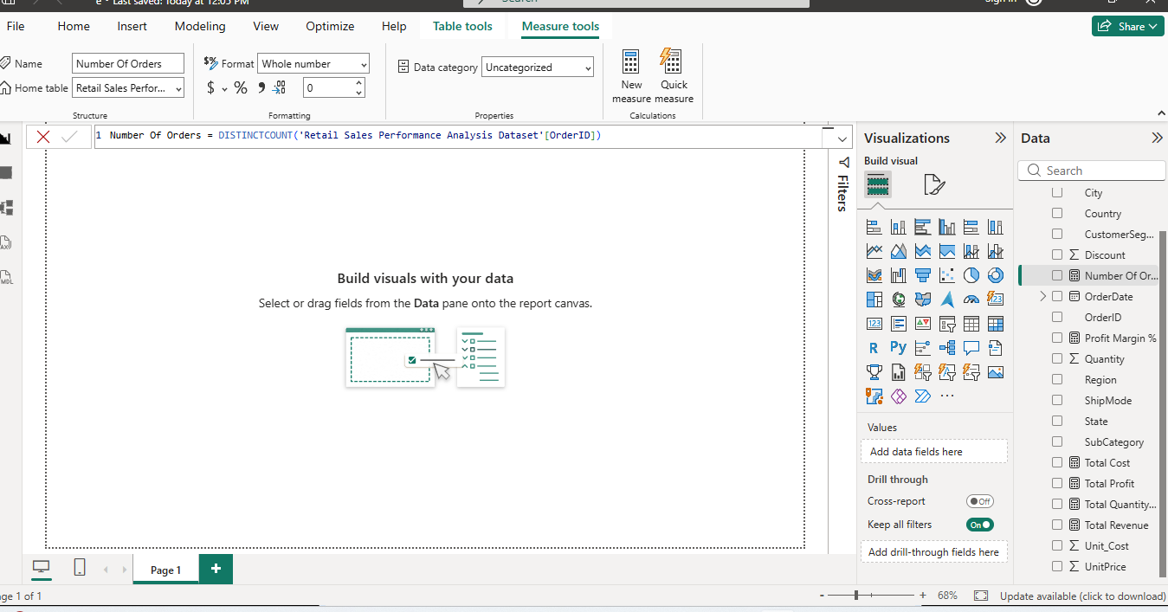

Slide 8
The six measures I created are;
Total revenue
Total cost
Total profit
Total quantity
Profit margin %
Number of orders
Total Revenue - calculates the total net sales generated by multiplying quantity and unit price for each transaction and adjusting for discount. The SUMX function iterates through each row to commute revenue after discount, ensuring accurate aggregation of sales performance.
Total Cost – calculates the total cost by multiplying the quantity sold by the unit cost for each transaction and aggregating the results across the dataset.
Total profit – This measures overall profitability by subtracting Total cost from Total Revenue, providing a clear view of financial performance.
Total Quantity – represents the total number of units sold, calculated using SUM function on the Quantity column
Profit Margin% - Profit margin measures profitability efficiency by dividing Total profit by Total revenue and expressing the result as a percentage, with a conditional check to return blank when revenue is zero to avoid calculation errors.

Slide 9
Number of Orders – Calculates the Total number of unique transactions using the DISTINCTCOUNT Function on the Order ID field.

Slide 10
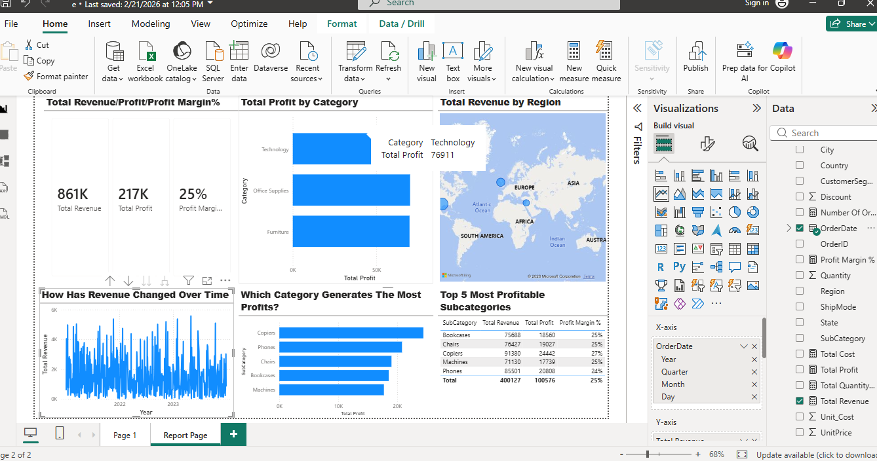

Slide 11
Key Business insights for Senior Management
The business is performing profitably with a healthy 25% profit margin, indicating efficient cost management and strong revenue generation.
The technology category is the primary profit driver and should be prioritized for investment, marketing and product expansion.
Revenue performance varies significantly by region, suggesting opportunities to investigate underperforming regions and replicate strategies from high-performing markets.
Revenue trends fluctuate over time, indicating possible seasonality or inconsistent sales performance that may require demand forecasting and promotional planning.
Furniture should be investigated further as it appears to generate lower profit compared to technology and office supplies, suggesting margin pressure.

Slide 12
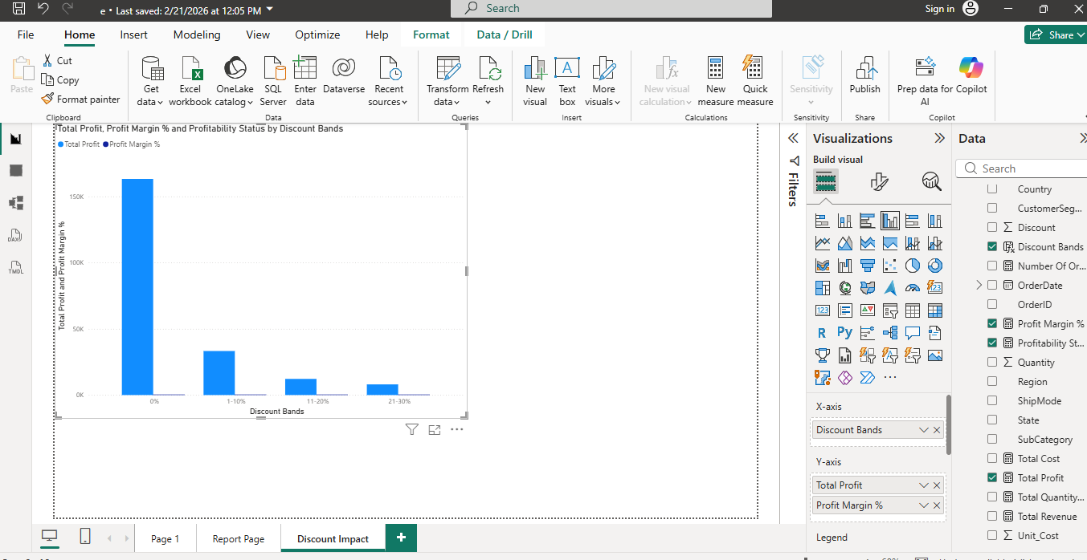

Slide 13
Recommendations
The 21-30% discount band requires further investigation as it generates significantly lower profit compared to lower discount levels
While there might not be any losses recorded yet, profit still shrinks with higher discounts. This suggests a risk threshold; Profitability may turn negative if discounts exceed 30%.
Profit declines sharply as discount levels increase. Discounts above 20% significantly reduce profitability, and 21-30% generates minimal profit. High discount strategies should be carefully controlled.

Slide 14
Limitations and next steps
One limitation of this dashboard is that it focuses mainly on historical sales performance and does not include external factors such as customer demographics, market trends or competitor data. Additionally, the analysis is based on aggregated data, which may hide detailed transactional insights. The regional map also shows revenue distribution but does not explain the reasons behind regional performance differences.
As a next step, further analysis could be conducted to identity the causes of revenue fluctuations over time and investigate underperforming regions. Additional customer segmentation analysis could also be introduced to better understand buying behaviour. Furthermore, incorporating forecasting models would help predict future sales trends and support strategic decision-making. Finally, integrating more detailed cost analysis would improve profit optimisation insights. Lastly, conduct a detailed analysis of discount bands to evaluate their impact on profitability and ensure optimal pricing strategy.

