Slide 1
Data modelling session
How to make an afl elo model in excel
How to make a basic afl machine learning model in python
28/3/2019

Slide 2

outline
What we will cover
An intro to Elo – what is it, how does it work
Creating a simple AFL Elo model in Excel
Assessing its profitability over the past 6 seasons
Exploring the accuracy across seasons
Creating a simple machine learning AFL model in Python
Utilising AutoML to create a simple AFL model based on Supercoach scores

Slide 3

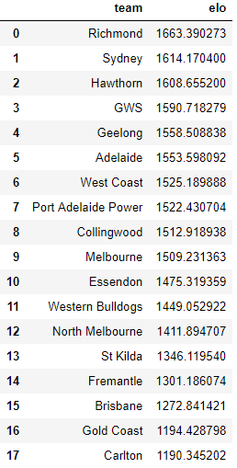
An intro to the elo rating system
A method for calculating the relative skill levels of players in zero-sum games
Developed by Arpad Elo, a Hungarian-American physics professor
Each team starts with an Elo of 1500 and gains or loses Elo after each game they play
It rewards winning teams by taking a portion of the loser’s Elo rating and adding it to the winner’s rating
The beauty of Elo ratings is that they can be converted to probabilities which can then be converted to odds. For example, a team whose rating is 100 greater than their opponent has a 64% probability of winning ($1.56 odds).
We can therefore use Elo to create a simple model which we can bet off

Slide 4
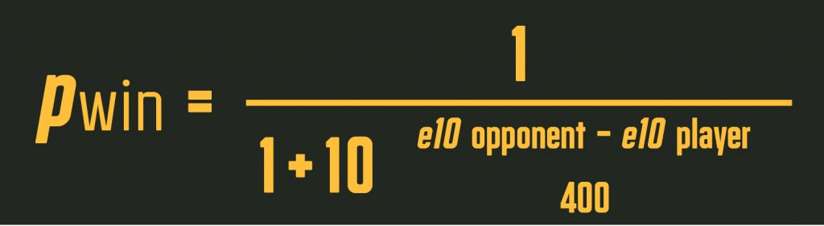
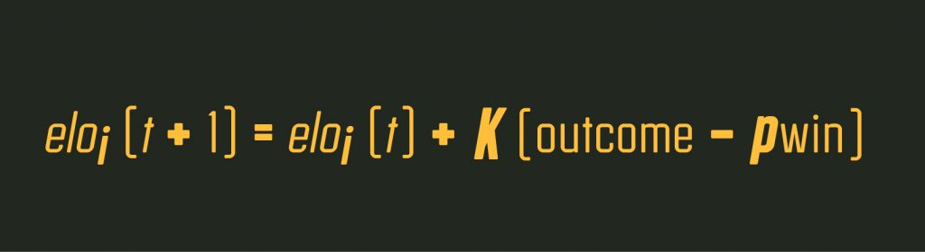
The algorithm
First, get the Elo score for each team. If they’ve never played a game, their Elo will start at 1500.
Calculate the probability for each team winning from their Elo score. Use the formula here ->
Choose a K-Factor. This determines how much a match will impact the ratings of each team. A standard K-Factor is 30
After the match, update the Elo for each team using this formula ->
Elo to probability
The Elo update formula

Slide 5
Live elo example
“Elo Delta”
K-factor = 30
BOMBERS
TIGERS
1667
1833
vs.
ELO WIN: 72%. ODDS: $1.39
ELO WIN: 28%. ODDS: $3.57
TIGERS WIN
NEW ELO
Tigers New Elo = 1833 + 30 * (1-0.72)
Tigers New Elo = 1833 + 9
Tigers New Elo = 1842
Bombers New Elo = 1667 + 30*(0-0.28)
Bombers New Elo = 1667 – 9
Bombers New Elo = 1658
TIGERS
+9
1842
BOMBERS
-9
1658
BOMBERS WIN
NEW ELO
TIGERS
-21
1812
BOMBERS
1688
+21

Slide 6
model time
Let’s now create an elo model in excel

Slide 7
Potential improvements
There are a myriad of improvements we can make to our simple Elo model
Create a dynamic K-factor that changes depending on how important the game is (e.g. Finals, early season games, late season games)
Revert the Elos of teams back to the mean of 1500 by a factor at the beginning of each season (e.g. If a team finishes the season at an Elo of 1600, they could be reverted back by 50 Elo points (i.e. a reversion to the mean of 50%)
Try a range of K-factors and HGA values and choose the ones which optimize some metric (perhaps profit/loss, or accuracy)
Stack the Elo model into a Machine Learning model

Slide 8

What is machine learning?
Machine learning models “learn” from data by reading through data and updating the weights of the variables which you input into the model
The model will learn quickly which the important variables are
The more data, the better the model
ML can be used with a range of algorithms, all with their own pros and cons
We will use an automated machine learning tool which means that we don’t need to worry about the algorithm or how to train the model – it will just train itself

Slide 9
How to build a sports/Racing predictive model
STEPS INVOLVED IN BUILDING A SPORTS BETTING MODEL using machine learning
Find & pull data source
Explore data & find important relationships
Choose the most optimal algorithm based on a metric (like accuracy)
Sit back and watch the action (& have patience)
Automate your strategy and model with Betfair’s API
Back test & build staking strategy

Slide 10
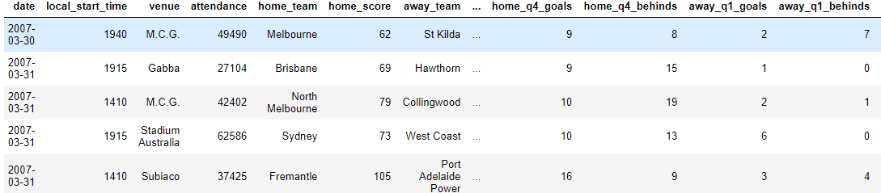
Afl Machine learning model building process
1. Get the data from afltables.com.au or Fitzroy
Data available from afltables.com.au, footywire.com, Betfair (for odds) and the fitzRoy R package

Slide 11
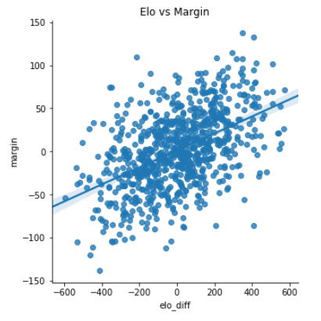
Machine learning model building process
2. Explore data to find important features
The next step is to explore the data and look for relationships which may help to predict the outcome of a footy match
An example is the relationship between team Elo difference (i.e. the difference between team 1’s Elo and team 2’s Elo) and margin
Perhaps Elo difference is a good predictor of margin. We can use this as a feature in our model

Slide 12
Machine learning model building process
3. Split the data into three sets, Build a machine learning model and optimise over a time period
We split our data into three data sets:
A “train” dataset, which is the data which the model will learn from
A “validation” dataset, which is what we will use to optimize the model
A “test” dataset, which is what we use to test the true performance of the model
For our Excel Elo model, a natural split would be to make the training data 2012-2016, the validation data 2017 and the test data 2018
We then try out a range of algorithms suited to the problem (e.g. Linear Regression if we were predicting margin, or Logistic Regression if we are predicting win/loss). We choose the best algorithm for the job.
We then optimize the model on the validation data based on some metric. An example may be accuracy (i.e. how many correct predictions it got)

Slide 13
Betfair’s scholarship program
If you’re risk-averse or not comfortable putting your own cash behind your model, you can apply for a Betfair Scholarship
If your application is successful, Betfair will provide funding. You get to keep any profits
Betfair customers can submit an application to our internal data science team. Successful applicants will receive $1000 of funding.

