Slide 1

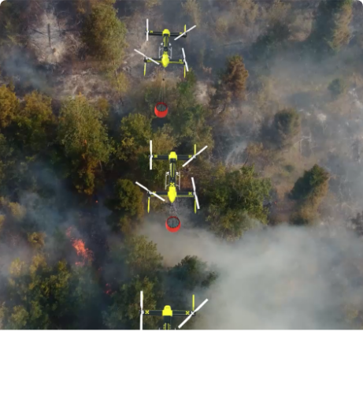

AI PROJECT REPORT
Edge AI-Based UAV for Intelligent Fire Detection & Victim Prioritization
Emergency Response & Real-Time Decision Support System
PROJECT TEAM
24BRS1355 – Basil Joseph
24BRS1387 – Grace Maria James
PROJECT GUIDE
Prof. Vijayaprabhakaran K
SCHOOL:
School of Computer Science and Engineering (SCOPE)
INSTITUTION
Vellore Institute of Technology, Chennai

Slide 2




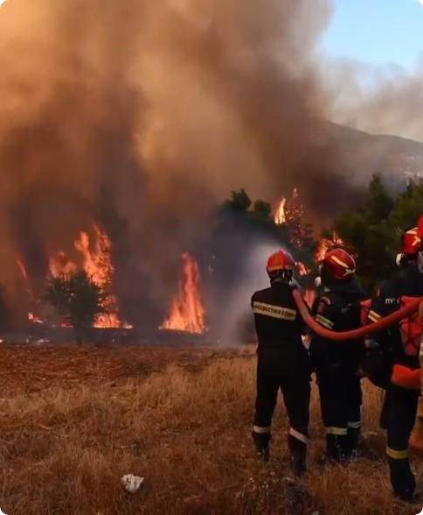


Application Domain & Disaster Management Context
AI & UAVs in Disaster Management
Deploying Edge AI-enabled Unmanned Aerial Vehicles (UAVs) for high-risk fire emergencies across forests, industrial plants, warehouses, and urban zones.
Hazardous conditions like intense heat, toxic smoke, and structural collapse make human reconnaissance extremely dangerous and slow.
Critical Need: Delivering instantaneous aerial situational intelligence directly at the disaster edge.
4.4M+
Rapid Prep
Annual Global Injury Fatalities (WHO)
WHO Key Priority to Save Lives

Slide 3


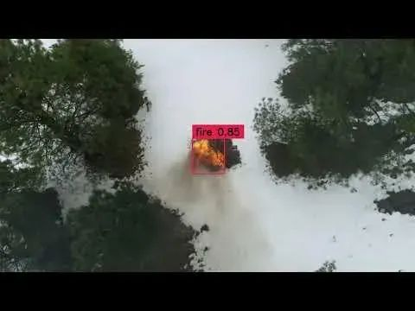
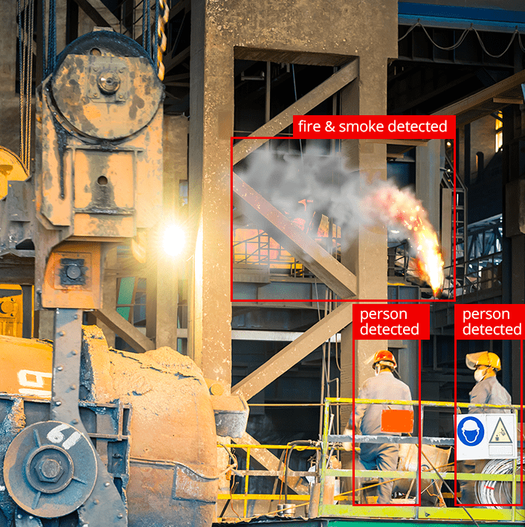
Existing UAV Systems & Operational Gaps
What Current UAVs Can Do
Critical Limitations (The Operational Gap)
•
Fire & Smoke Detection: Standard visual/thermal thresholding to detect presence of flame.
•
No Victim Detection: Zero awareness of trapped victims near fire boundaries.
•
No Condition Estimation: Incapable of assessing victim body pose (sitting, lying, immobile).
•
GPS Alert Generation: Sending raw coordinate coordinates of the fire perimeter.
•
Live Video Streaming: Transmitting unanalyzed video back to ground control operators.
•
No Rescue Prioritization: Cannot rank rescue urgency across multiple victims.
•
High Cognitive Load: Responders must manually watch raw video streams under high stress.
•
Basic Flight Autonomy: Waypoint navigation over pre-mapped hazard zones.

Slide 4



Motivation & Stakeholder Decision Framework
UAV → Fire + Victim Pose → Rescue Priority → Mission Report
UAV → Fire → Raw Video Alert
Answers only: "Where is the fire?"
Answers: "Who needs immediate rescue first?"
Primary Stakeholders
Key Decisions Assisted
•
Fire & Rescue Departments & Municipal Stations
•
Automated Fire Severity Verification (Low to Critical)
•
National Disaster Response Force (NDRF / SDRF)
•
Victim Trapped Count & Observable Posture Assessment
•
Industrial Emergency Response & Forest Patrols
•
Optimized Rescue Team Dispatch Order & GPS Telemetry

Slide 5








Core Project Objectives
1. Fire Detection
2. Fire Severity
3. Human Detection
4. Pose Estimation
Real-time flame detection using optimized YOLO11n fine-tuned on DFire & FLAME.
Area expansion and smoke density analysis categorizing severity (Low to Critical).
Detecting trapped victims from top-down aerial viewpoints using VisDrone dataset.
Skeleton keypoint tracking to detect postures: Standing, Sitting, Lying, Running.
5. Victim Tracking
6. Rescue Priority
7. GPS Logging
8. Mission Report
Persistent ID tracking via ByteTrack to monitor movement velocity and avoid re-counts.
Context-Aware Victim Prioritization Engine (CVPE) generating urgency matrix.
Geo-tagging victim coordinates and fire location on telemetry log.
Automated incident command summary generation for rapid deployment.

Slide 6









Overall Proposed System Flowchart
Drone Platform
Pi Camera
Preprocessing
UAV Airframe
Video Feed
Resize/Normalize
Fire Detection
Human Detection
Pose Estimation
Tracking
YOLO11n
VisDrone Model
RTMPose
ByteTrack
⭐ Context-Aware Victim Prioritization Engine (CVPE) ⭐
Mission Report
Primary Novel Contribution — Multi-modal Contextual Fusion
GPS & Dashboard

Slide 7



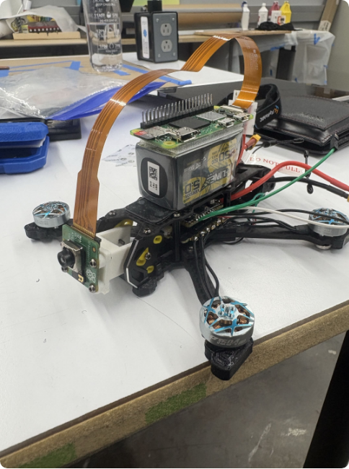
Hardware Architecture & Fallback Option
Primary Edge Hardware Rig
ESP32 Fallback Option:

Slide 8







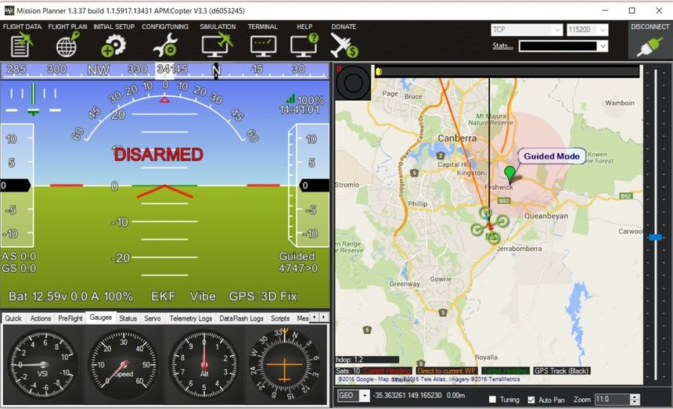

Software Stack & Framework Integration
Python 3.10
OpenCV
YOLO11n
RTMPose
ByteTrack
Core Language
Preprocessing
Object Detection
Pose Estimation
Tracking
Ground Control & Telemetry
Dashboard & Visualizer
Integrated with Mission Planner / QGroundControl via MAVLink protocol for autonomous grid flight path execution.
Streamlit / WebGL real-time interface displaying live HUD feed, victim priority matrix, and GPS mission logs.

Slide 9





Multi-Modal AI Inference Pipeline
AI PIPELINE
Input Stream
Fire & Severity
Person BBoxes
Pose & Tracking
Rescue Priority
640×480 @ 30 FPS RGB video capture.
YOLO11n outputs bbox & severity rating.
YOLO Person detector aerial mapping.
Keypoints + ByteTrack velocity vectors.
Priority score calculation & logging.
Target Latency: < 50ms / frame Optimization: INT8 Model Quantization Execution: Parallel Thread Pools

Slide 10
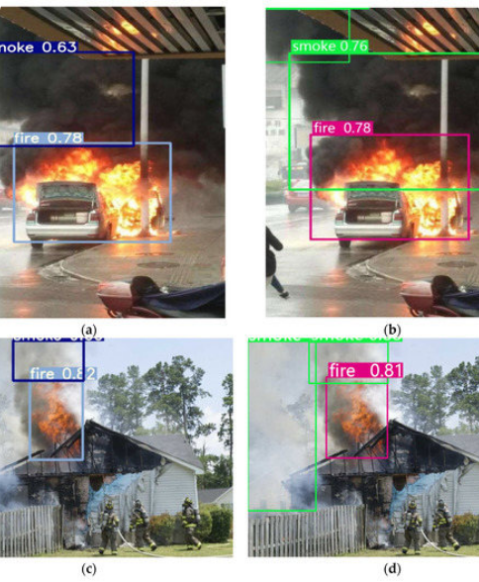
Module 3 & 4: Fire Detection & Severity Estimation
Fire Localization & Severity Pipeline
•
Datasets Used: DFire & FLAME (Wildfire aerial RGB benchmarks).
•
Model Architecture: YOLO11n fine-tuned on $640 \times 640$ resolution.
•
Severity Logic: Calculates fire region pixel area expansion rate and visual smoke density over sliding temporal window.

Slide 11
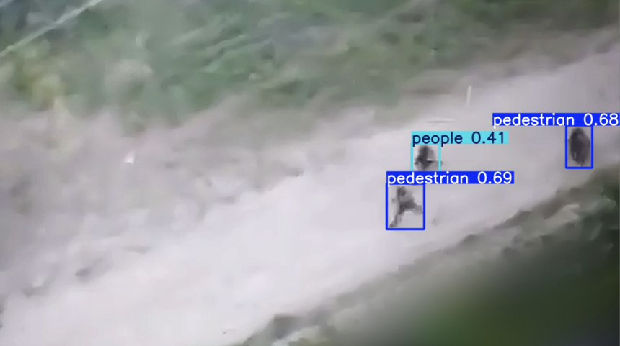
Module 5: Aerial Human Detection Under Smoke
Top-Down Aerial Victim Localization
•
Datasets: VisDrone & COCO Person fine-tuned for aerial views.
•
Challenge Addressed: Standard pedestrian detectors fail on small-scale top-down perspectives from 15–30m UAV flight altitudes.
•
Smoke Resilience: Contrast enhancement and frame preprocessing improve detection under partial smoke obscuration.
Output:

Slide 12
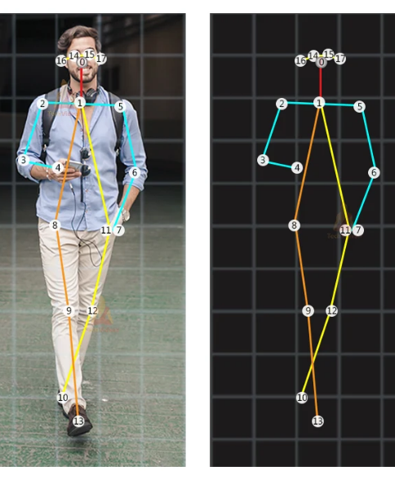
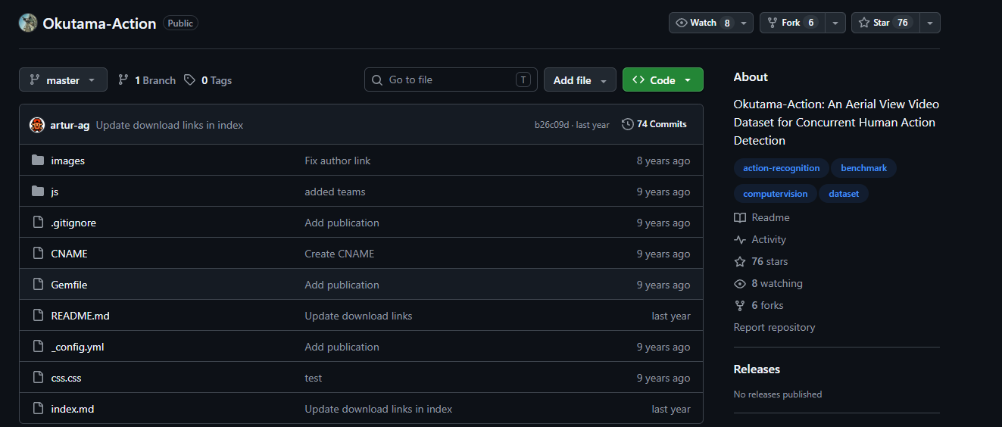
Module 6 & 7: Pose Estimation & Person Tracking
MODULE SPECIFICATION
Skeleton Keypoint Posture Analysis
•
Pose Datasets: COCO Keypoints, MPII, and Okutama-Action.
•
Model: YOLO-Pose / RTMPose keypoint estimator (17 body joints).
•
Posture Classifications:
•
Tracking Framework: ByteTrack maintains unique IDs across frames to measure movement velocity vectors and eliminate duplicate counts.

Slide 13

⭐ Primary Novelty — Context-Aware Victim Prioritization Engine (CVPE)
CVPE Fusion Engine: Fuses Fire Severity, Victim Body Pose, Movement Velocity, and Proximity to Fire to generate real-time rescue prioritization rankings.
Victim ID | Body Pose | Tracked Movement | Proximity to Fire | Assessed Priority Score | Actionable Rescue Recommendation
Victim A | Running | High Velocity | Far Distance |  | Self-evacuating; monitor trajectory remotely.
Victim B | Standing | Low Velocity | Near Hazard |  | Guiding assistance needed; exit path clear.
Victim C | Sitting | Low / Trapped | Near Hazard |  | Immediate responder team deployment required.
Victim D | Lying | None (Immobile) | Near Hazard |  | Top Priority: Medical extraction team dispatch!

Slide 14
Dataset Matrix & Benchmark Specifications
Task Module | Dataset Name | Primary Characteristics & Application | Role in Pipeline
Fire Detection | DFire & FLAME | Wildfire aerial images with flame and smoke bounding annotations. | Train YOLO11n Fire Model
Human Detection | VisDrone & COCO | Drone aerial top-down view object detection benchmarks. | Train Aerial Person Detector
Pose Estimation | COCO Keypoints & MPII | Multi-person 17 keypoint body joint posture benchmark. | Train RTMPose / YOLO-Pose
Action / Motion | Okutama-Action (Opt.) | Aerial action benchmark for running, standing, sitting posture. | Fine-tune Motion Vectors
Validation | Custom Drone Video | Real-world field flight test video captured during flight trials. | Final Real-World Validation

Slide 15
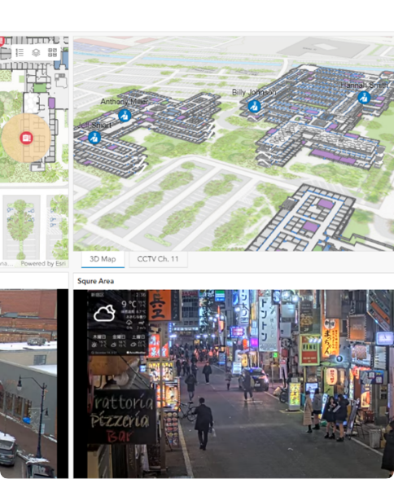
Expected Field Demonstration Mockup
Incident Command Control Interface
•
Live Telemetry Feed: Overlaid bounding boxes with pose skeletons and priority tags.
•
GPS Coordinate Stream: Auto-generating geo-referenced victim locations for NDRF dispatch.
•
Mission Report Export: Generates instant incident summary PDF/JSON logs.

Slide 16




Target Evaluation Metrics
> 85%
15–25
< 60ms
> 90%
mAP @ 0.5
Edge FPS
Inference Latency
Priority Accuracy
Detection accuracy across fire and aerial victims.
Real-time throughput on Raspberry Pi 4 edge platform.
Total pipeline processing latency per video frame.
Rescue Priority Score classification accuracy.

Slide 17





System Key Advantages
Low Cost & Portable
Onboard Edge AI
Real-Time Response
Built using affordable COTS quadcopter airframes and edge compute SBCs.
Processes telemetry locally on the UAV without reliance on cloud connection.
Low latency inference ensures rapid emergency triage for first responders.
Scalable & Modular
Intelligent Decision Support
Fallback Resilient
Allows easy updating or replacement of AI detection models independently.
Replaces raw video analysis with actionable priority scores for commanders.
Supports ESP32 contingency streaming option during hardware shortages.

Slide 18





Edge AI-Based UAV for Intelligent Fire Emergency Response
Problem
Solution
Impact
Existing disaster UAVs lack victim condition awareness and rescue triaging capabilities.
Lightweight multi-modal Edge AI pipeline running fire, pose, and tracking on Raspberry Pi 4.
CVPE Engine provides actionable priority scores to save lives during critical emergency windows.
THANK YOU
Questions & Answers

Slide 19






Image Sources
https://www.asce.org/-/media/asce-images-and-files/publications-and-news/source/images/2025/07-july/automated-aerial-firefighting-drones-to-provide-faster-responses/fire-drones-firesw2-resized.png
Source: www.asce.org
https://mapi.associatedpress.com/v2/items/5c6a02fc033942d7b6a8ef8ac99adfb7.0/thumbnail/GRE%20WILDFIRES%2020260802cr_1920x1080.jpg?nfe=true&app=MPK&wm=false&tag=iid~5c6a02fc033942d7b6a8ef8ac99adfb7!rsn~0!cid~f0ec334a3763499184955eb54ddea489!orgId~46611!qt~fkfJv7DQareI!orgNm~Daily%20Independent%20News%20-%20Sun%20(API%20Production%20Key)!role~Thumbnail!mt~video!fmt~JPEG%20Baseline
Source: www.yourvalley.net
https://preview.redd.it/help-mounting-battery-and-raspberry-pi-on-3-5-quad-v0-2m5k51zi7syg1.jpg?width=2160&format=pjpg&auto=webp&s=6cca35c539be3366b2a044310a5eab79301025e0
Source: www.reddit.com
https://www.mdpi.com/sensors/sensors-23-07086/article_deploy/html/images/sensors-23-07086-g008-550.jpg
Source: www.mdpi.com
https://miro.medium.com/v2/resize:fit:1400/1*1Jfggy7jPBNP9-vKJYr2ow.gif
Source: medium.com
https://user-images.githubusercontent.com/48796009/228968225-7509e39c-9d41-42f5-aed9-3387ad9eaa17.png
Source: github.com

Slide 20


Image Sources
https://www.esri.com/arcgis-blog/app/uploads/2025/03/Dashboard.png
Source: www.esri.com
https://www.fireapparatusmagazine.com/wp-content/uploads/2020/08/2007FApetrillowftic-p04.jpg
Source: www.fireapparatusmagazine.com

