Slide 1
Model Server — Progress Report
Context-Aware Adaptive Perception for Flood-Rescue UAVs
Platform: NVIDIA Jetson Orin · TensorRT · FastAPI
Scope: Onboard vision inference + adaptive model orchestration
Status: Working prototype — flood + human + combined rescue mode

Slide 2
My Role in the Bigger Picture
I own the Model Server node
User prompt --> Gateway --> LLM (decides intent)
|
|----> ► MODEL SERVER (my scope: vision + model switch)
|
|----> Rule Gate --> Drone Server (flight control)
v
Reply
• Upstream (not mine): Gateway, LLM, user interface
• Downstream (not mine): Rule Gate, Drone Server, flight control
• Mine: deterministic, real-time perception + adaptive compute on the edge

Slide 3
What the Model Server Does
Starts idle; runs inference only when a tool is activated
Capability | Detail
Flood classification | ResNet18 — Flooded / Non-Flooded
Flood segmentation | DeepLabv3+ (MobileNetV3) — mask + flood ratio
Human detection | YOLOv8n — person bounding boxes
Combined rescue mode | Flood grid + humans on the same frame
Localization | Simulated GPS for flooded cell + each human
Acceleration | TensorRT engines, CUDA streams, FP16
Adaptation | Context-aware selection + smart segmentation
Interfaces | REST /tool, live WS /ws/live, dashboard

Slide 4
System Architecture — Adaptive Pipeline
Camera frame
|
► Context Evaluator CPU/GPU/mem (real) + UAV/mission (sim)
|
► Model Selector which model leads + run/skip segmenter
|
► Model Manager lazy load + cache + TensorRT engines
|
► Inference Engine preprocess -> infer -> postprocess
|
► Performance Monitor FPS · latency · power · memory
|
v outputs --> dashboard / WebSocket / (future) ROS topics

Slide 5
Node Responsibilities (1/2)
• Task Session · core/task_session.py
  Active tool state: idle / detect_flood / detect_human / detect_combined
  Entry point for Gateway/LLM via POST /tool; triggers warmup + inference
• Context Evaluator · core/context_evaluator.py
  System context: CPU, memory, GPU load (REAL)
  UAV / environment / mission context currently SIMULATED (no FC yet)
• Model Selector · core/model_selector.py
  Chooses primary model from flood ratio (ResNet18 <-> DeepLabv3+)
  Gates the expensive segmenter on battery / CPU constraints

Slide 6
Node Responsibilities (2/2)
• Model Manager · core/model_manager.py
  Lazy load, cache, unload/switch; picks TensorRT engine when available
  Falls back to PyTorch if an engine is missing
• Inference Engine · core/inference_engine.py
  Pinned-memory preprocessing, FP16 autocast, CUDA-stream execution
  Stable output contract (label / mask+ratio / boxes) across backends
• Performance Monitor · core/power_monitor.py + payload metrics
  FPS, latency, memory, CPU, Jetson power (tegrastats VDD_IN)
• Supporting: model_warmup, inference_gate, flood_grid (GPS), trt_runner, gpu_runtime

Slide 7
Live Dashboard
Operate and observe the server in real time
• Input source: live camera OR offline video upload
• Task buttons: Test flood · Test human · Test both · Stop
• Live feed: annotated frames over WebSocket (flood grid, human boxes)
• Flood panel: status, ratio, primary model, most-flooded-cell GPS
• Human panel: count + per-person GPS (bbox centroid)
• Performance panel: latency, FPS, memory, CPU
• Power panel: idle / inference / extra watts
• Offline panel: stride, altitude, export path -> auto report + plots

Slide 8
Offline Benchmark — Methodology
Reproducible per-frame evaluation on real footage
• Upload video -> run a tool -> export per-video folder
• Outputs: overlay MP4, metrics.csv (one row/frame), plots, HTML/MD report
• Stride = 1 -> genuine time series (no interpolation)
• 12 clips processed (archive, YouTube, drone rescue, synthetic)
Chosen for deep analysis: chittur_river_rescue (combined mode)

Slide 9
Why chittur_river_rescue Is the Best Clip
Only clip exercising the full rescue pipeline at once
Property | Value | Why it matters
Mode | detect_combined | Flood AND human paths both active
Mean flood ratio | 0.57 (0.46-0.70) | Above 0.20 -> segmenter stays active
Mean humans/frame | 1.68 (1-3) | Multiple people -> per-human GPS
Mean FPS | 34.5 | Highest among combined+human clips
Steady p95 latency | 30.1 ms | Tight, stable distribution
Represents the actual mission: people stranded in flood water — flood mapping + human localization simultaneously.

Slide 10
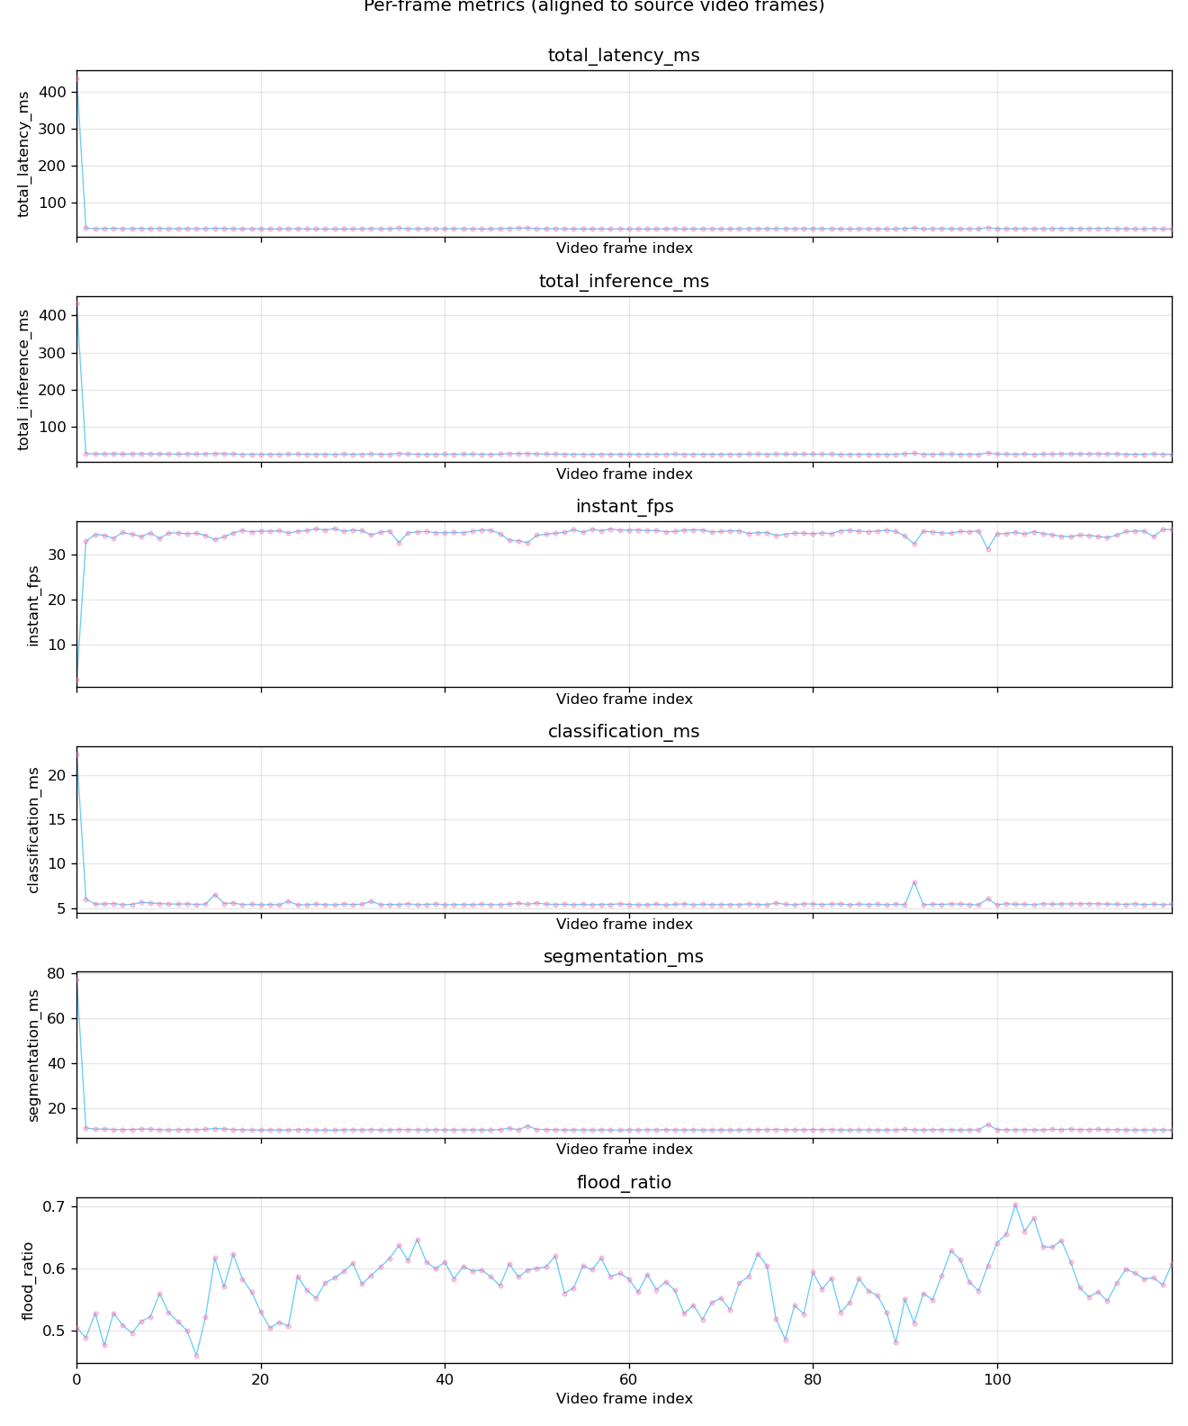
Results — Per-Frame Overview (chittur)
120 frames · combined mode · 50 m simulated altitude · stride 1

Slide 11
Results — Latency Breakdown (Steady State)
Stage | Mean (ms) | Backend
Classification (ResNet18) | 5.6 | TensorRT
Segmentation (DeepLabv3+) | 11.0 | TensorRT
Human + compose (YOLOv8n) | ~14.5 | TensorRT
Total inference | 31.2 | —
Total latency | 32.1 | end-to-end
• Steady-state: mean 28.7 · p50 28.6 · p95 30.1 ms
• Sustained ~34.5 FPS in full combined mode
• Segmentation = largest single cost -> the target of adaptation

Slide 12
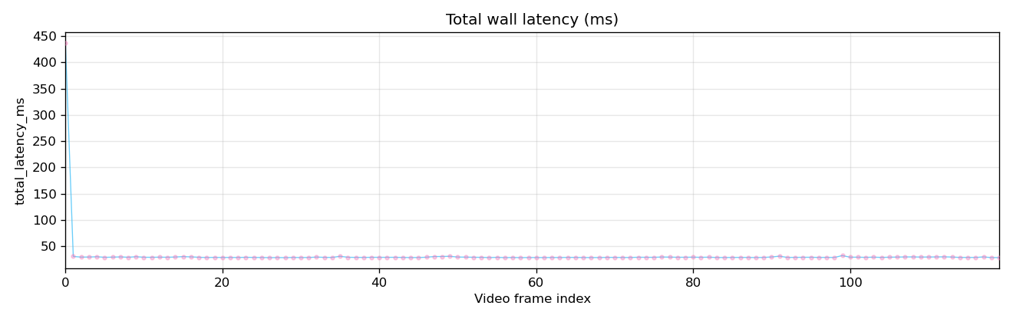
Tradeoff 1 — Cold Start vs Steady State
• First frame: 436 ms vs steady ~29 ms
• Cause: one-time model load + GPU warmup
  clf 134 ms + seg 53 ms + human 3.4 ms = 191 ms
• Single outlier inflates mean (32.1 ± 37.2 ms)
• Steady-state p95 is only 30 ms — true operating point
• Takeaway: warm up before flight; report steady-state

Slide 13
Tradeoff 2 — Logical Switch vs Physical Swap
The key design decision
Approach | Latency | Note
Logical primary switch | 0.016 ms avg | Both models stay loaded; change leader
Physical model swap | 255 ms | Unload clf + load seg (worst case)
• 36 switches over 50 steps cost ~0.016 ms each — effectively free
• Physical swap is ~16,000x slower
• Decision: keep both flood models resident, switch logically -> no stutter
• Cost: higher VRAM (acceptable on Orin for 2 small models)

Slide 14
Tradeoff 3 — Smart Segmentation (Accuracy vs Speed)
DeepLab is the most expensive stage — run it only when needed
• Policy: skip segmentation when classifier says 'dry' + periodic refresh + hysteresis
• Dry scenes: classifier-only (~6 ms) instead of clf+seg (~17 ms)
• Flood scenes (like chittur): segmenter forced active -> full accuracy
• Tradeoff: small risk of late flood onset, bounded by SEG_INTERVAL refresh
• Net effect: spend GPU budget where flood actually exists

Slide 15
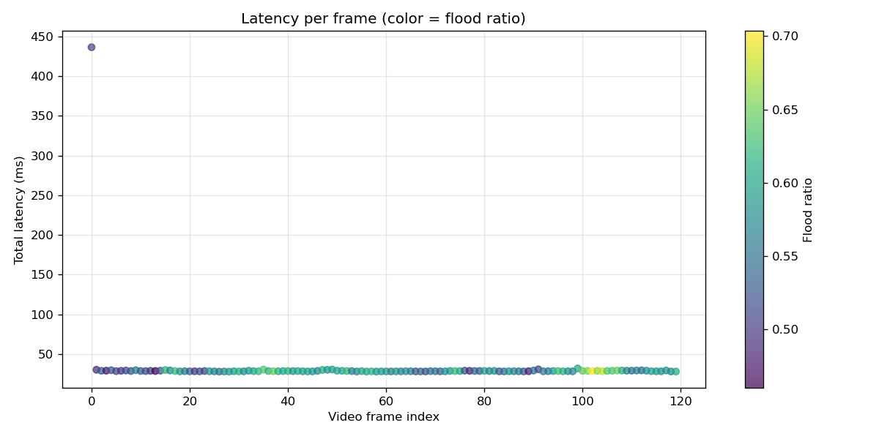
Tradeoff 4 — Altitude vs Resolution
• Higher altitude -> wider ground coverage per frame
• But -> coarser pixels (GSD) -> small humans / flood edges shrink
• Lower altitude -> sharper detail, less area, more passes
• Benchmark simulates altitude via resize (pre-flight study)
• Implication: choose altitude per mission (search wide vs inspect close)

Slide 16
Resource Usage (chittur, combined mode)
Resource | Value
Memory (RSS) | ~1.22 GB stable (no leak across 120 frames)
CPU | ~26% mean (12-45%)
Flood ratio | 0.46-0.70 (consistently flooded)
Humans | 1-3 per frame
Power | not captured in this offline run (tegrastats live-only)
• Memory flat -> clean lazy-load + cache, no per-frame growth
• CPU headroom remains for the rest of the onboard stack

Slide 17
Cross-Video Sanity Check
Stable behavior across very different footage
Video | Frames | FPS | p95 ms | Flood | Humans
chittur_river_rescue | 120 | 34.5 | 30.1 | 0.57 | 1.68
kherson_drone_rescue | 1033 | 37.4 | 28.8 | 0.31 | 0.0
archive_flood_airfield | 2177 | 21.8 | 55.5 | 0.34 | 0.02
archive_flood_1955 | 485 | 26.9 | 50.0 | 0.73 | 0.0
youtube_cumbria_rescue | 377 | 23.0 | 59.0 | 0.15 | 2.29
Higher-res / busier clips cost more per frame, but the pipeline stays stable (no crashes, no memory growth) over 2000+ frame runs.

Slide 18
Key Takeaways
• Real-time on the edge: ~34 FPS, p95 30 ms in full combined rescue mode
• Adaptation works: logical switching is free; smart segmentation saves the most expensive stage
• Stable: flat memory, tight latency over long runs
• Honest scope: UAV state + GPS are SIMULATED; vision + compute adaptation are REAL
• Clean boundaries: drop-in perception node for the Gateway/LLM stack

Slide 19
Limitations & Next Steps
• Limitations
  Lightweight test weights -> results validate the pipeline, not operational accuracy
  UAV context simulated; power not logged offline
  One model per task slot
• Planned
  Real context schema + mission-linked policy + decision logging
  Closed loop: Performance Monitor -> Model Selector (auto-degrade under load)
  Model registry + 2nd-tier models (MobileNetV2, UNet-Light, YOLOv8s)
  Flight integration (Pixhawk/ROS 2) for real GPS — interface-first

Slide 20
Thank You
Model Server — adaptive, real-time, edge perception for flood-rescue UAVs
Repo: github.com/aykumar21/Drone_LLM
Stack: Python · FastAPI · PyTorch · TensorRT · CUDA · YOLOv8 · Jetson Orin

