Slide 1
Lecture 18
Queues
Stacks
Trees

Slide 2
Outcomes
To understand Queues
To be able to implement Queues in C#
To understand Stacks
To be able to implement Stacks in C#
To understand Trees

Slide 3
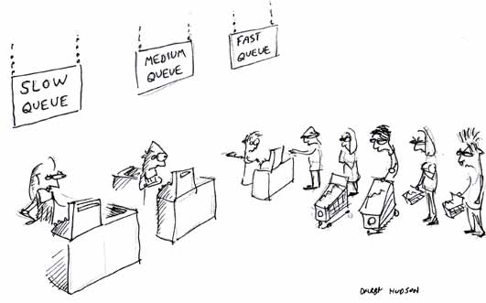

Slide 4
Queue
A queue is a data structure in which data enter at the rear of a list and are removed from the front of the list.
Queues are used to store items in the order in which they occur.
Queues are an example of a First-In, First-Out data structure.

Slide 5
Queue operations
adding a new item is called Enqueue
removing an item from a queue is called Dequeue.

Slide 6
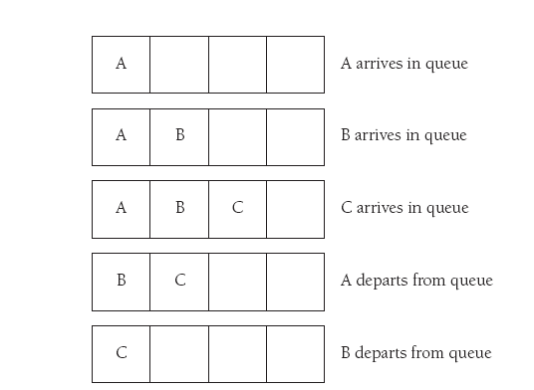
FIFO

Slide 7
Queue used
In operating systems, for controlling access to shared system resources such as printers, files, communication lines, disks and tapes.
When placed on hold for telephone operators.
SMS sending handling

Slide 8
Queues used
For simulation of real-world situations. For instance, a new bank may want to know how many tellers to install. The goal is to service each customer within a "reasonable" wait time, but not have too many tellers for the number of customers. To find out a good number of tellers, they can run a computer simulation of typical customer transactions using queues to represent the waiting customers.

Slide 9
Priority Queue
Elements are pulled highest-priority-first
Operations:
insertWithPriority
pullHighestPriorityElement
Efficiency – implementation dependent:
Enqueue – O(log n)
Dequeue – O(log n)

Slide 10
Double-ended queue (Deque)
Pronounced “deck”
Operations:
insert element at back
insert element at front
remove last element
remove first element
examine last element
examine first element

Slide 11
Queue implementation in .Net
Queue<T>
Operations:
Enqueue(item as T)
Peek() as T
throws InvalidOperationException
Dequeue() as T
throws InvalidOperationException
Count
Efficiency – O(1)

Slide 12
Stack
Stacks is a special-purpose data structures which is only optimized for a limited number of predefined operations (namely Pop and Push)
Stack is an implementation of Last-in-First-out logic (LIFO)

Slide 13
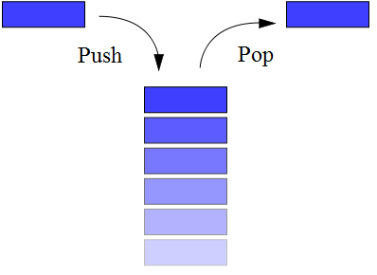
Stack
Classic implementation of Stack support only two operations:

Slide 14
Stack
Push – adds new element to the top of the stack
Pop – removes top element from the stack
As an addition, particular implementations could provide Peek functions – get the reference to the top element without removing it

Slide 15
Stack
Performance:
All operations are O(1)

Slide 16
Stack applications
Expression evaluation and syntax parsing
Runtime memory management

Slide 17
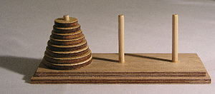
Stack applications
Hanoi tower

Slide 18
Stack implementation in .Net
Stack<T>
Operations:
Push(A as T)
Pop() as T
throws InvalidOperationException
Peek() as T
throws InvalidOperationException
Count

Slide 19
Tree
Tree is a data structure that emulates a hierarchical tree structure with a set of linked nodes.

Slide 20
Tree - terminology
A node is a structure which contains a value
Each node in a tree has zero or more child nodes
A node that has a child is called the child's parent node (or ancestor node)
A node has at most one parent.

Slide 21
Tree – terminology
The height of a node is the length of the longest downward path to a leaf from that node. The height of the root is the height of the tree.
The depth of a node is the length of the path to its root
The topmost node in a tree is called the root node

Slide 22
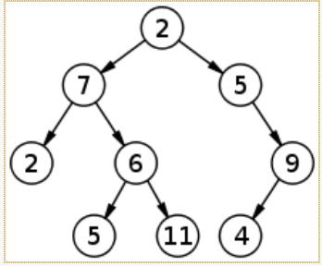
Tree

Slide 23
Tree - traversal
Tree is not accessible by index. In order to access an element you should navigate from a root node node-by-node
In order to access all nodes recursion should be used

Slide 24
Recursion
Recursion is a method where the solution to a problem depends on solutions to smaller instances of the same problem

Slide 25
Tree – get all values
public void GetAll(List<string> result, Node node)
{
result.Add(node.Value);
foreach (var child in node.Children)
GetAll(result, child);
}

Slide 26
The End

