Slide 1
SOFTWARE ENGINEERING INTERNSHIP
Mid-Internship Review
Lumenor · May to July 2026
Three work-streams: QA on FlowX, a product landing page, and the IFN platform.
Basil Stevenson
ICFAI · BCA (IP2)
Company tutor: Rama Raju sir

Slide 2
CONTEXT
The company and my work
Lumenor builds software for solar-energy businesses: a customer suite (solarX, flowX, fixX), plus coreX for internal teams. My first half centered on FlowX: Inventory, Sales and CRM, HRMS, Accounting, Procurement.
01
02
03
QA on FlowX
Lumenor landing page
IFN platform
Flow-tested FlowX: 67 tests, 19 bugs logged, including 2 security criticals.
Built and shipped the public product marketing site.
Built ICFAI Founders Network, a members-only founder platform.
Closing the loop: IFN is built for my own university's founder community.
Basil Stevenson · Lumenor · Mid-Internship Review
02 / 06

Slide 3
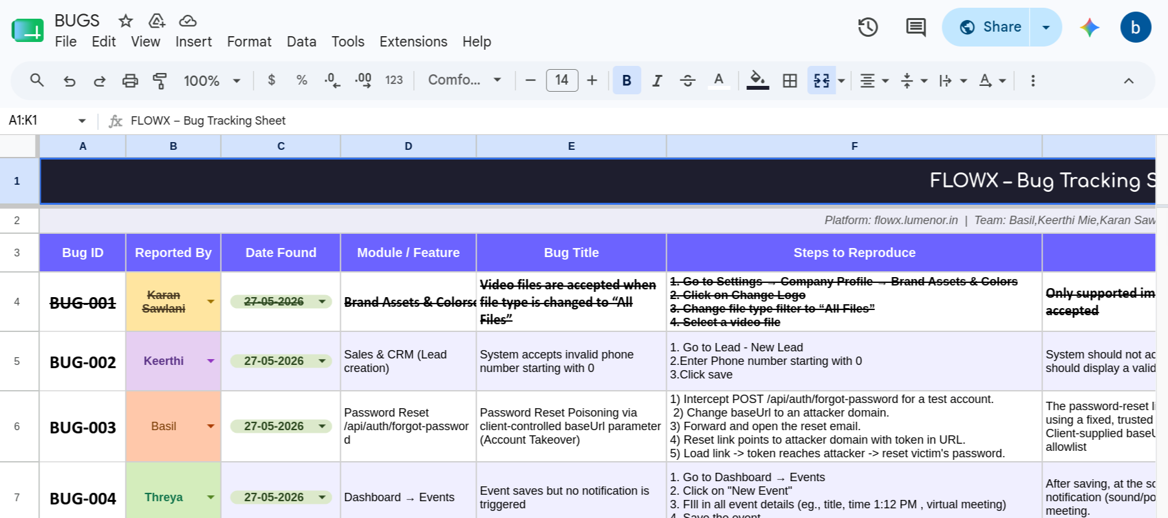
WORK-STREAM 1 · QUALITY ASSURANCE
Testing FlowX
67
19
7
2
tests run
bugs found
modules covered
security criticals
Brief: test FlowX like a user, optimize the happy paths, flag flaws. Assigned to FixX first; moved to FlowX when FixX was not ready. I also offered security testing, from a penetration-testing background.
Selected findings (mine)
• Account takeover: password-reset poisoning via a client-controlled baseUrl leaks the reset token to an attacker domain (Critical).
• Info disclosure: a duplicate warehouse code surfaces the raw ORM error, leaking internal file paths and schema.
• Data integrity and crashes: address corrupted on every save, a broken CSV round-trip, a search that crashes on an undefined field.
Tooling: Playwright automated flows (shared HTML reports); each bug logged with module, repro steps, expected versus actual, priority, status.
Basil Stevenson · Lumenor · Mid-Internship Review
03 / 06

Slide 4

WORK-STREAM 2 · FRONTEND
Lumenor landing page
• Built and shipped the public marketing site for Lumenor.
• Headline: “Run your entire solar business in one place.”
• Responsive layout that presents the product to prospects.
Live: basiltest.github.io/lumenor
Basil Stevenson · Lumenor · Mid-Internship Review
04 / 06

Slide 5
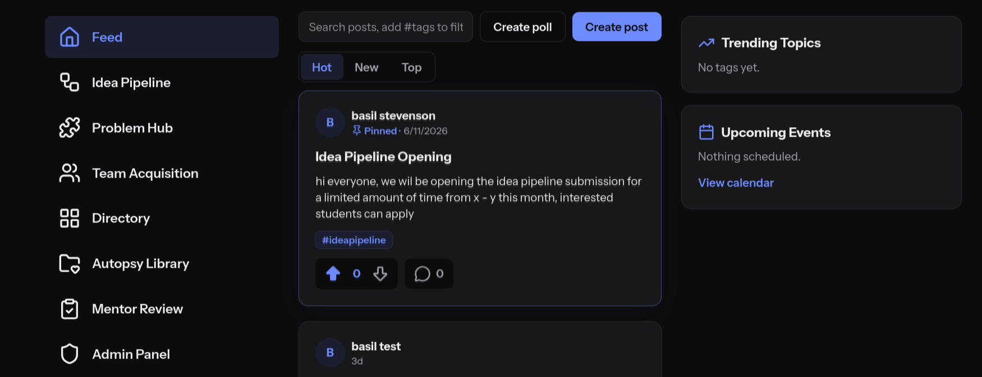
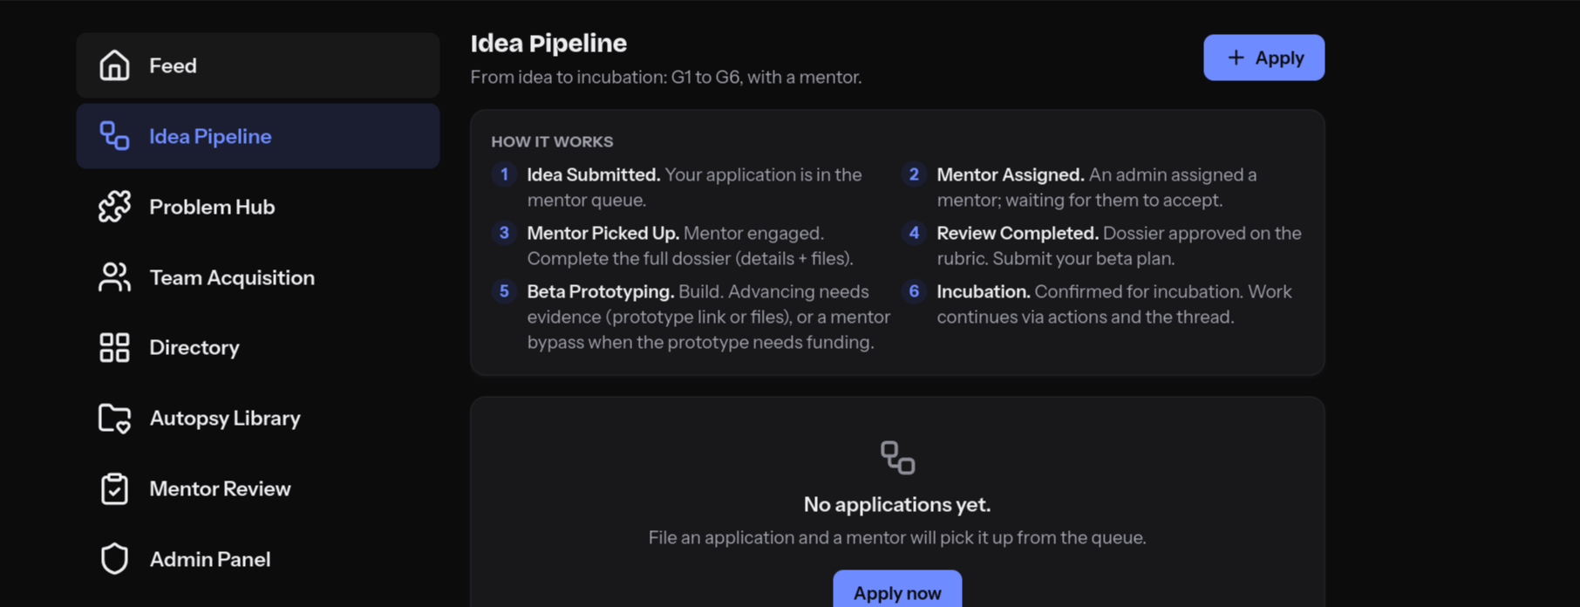
WORK-STREAM 3 · FLAGSHIP BUILD
IFN: ICFAI Founders Network
A members-only platform for the university's founder community.
Feed
Idea Pipeline G1-G6
Problem Hub
Team Acquisition
Calendar
Directory
Notifications
Moderation
Admin
Auth and Roles
Stack: Vite single-page app on Vercel, backed by Supabase (Auth + Postgres + Row-Level Security), no custom backend. Now hardening for production and moving to self-hosted infrastructure.
Basil Stevenson · Lumenor · Mid-Internship Review
05 / 06

Slide 6
OUTLOOK
What's next and what I learned
Second half
What I learned
• IFN: finish the pipeline end-to-end testing; moderation and reporting.
• IFN: self-host migration off Supabase Cloud and Vercel onto the office server; captcha rollout.
• FlowX: retest the fixed bugs and widen coverage.
• Reproducible bug reporting, priority triage, and security testing of auth and error handling.
• Full-stack delivery: auth, RLS and data modeling, a SPA, shipped to production.
• Working inside a real SaaS team.
• Building depth in Docker, Git & agentic AI.
Halfway in: bugs found, products shipped, more to build.
Basil Stevenson · Lumenor · Mid-Internship Review
06 / 06

