Slide 1
INTERNSHIP PROJECT REPORT I
Lumenor Internship Review
Lumenor · May to July 2026
Three work-streams: QA on FlowX, a product landing page, and the IFN platform.
Basil Stevenson
Roll No 24BCAHH010052 · BCA, Second Year · ICFAI
Company mentor: Rama Raju sir
Internship duration: May to July 2026

Slide 2
SECTION 1
Introduction
Lumenor builds software for solar-energy businesses: a customer suite (solarX, flowX, fixX), plus coreX for internal teams.
• Team assigned: the FlowX team: Inventory, Sales and CRM, HRMS, Accounting, Procurement.
• Project domain: Quality Assurance and full-stack web development.
• Purpose of the internship: test real product flows, ship production frontend, and build a platform end to end.
Basil Stevenson · Lumenor · Internship Review
02 / 11

Slide 3
SECTION 2
Project overview
01
02
03
QA on FlowX
Lumenor landing page
IFN platform
Flow-test FlowX and flag flaws. Problem: ship a reliable product before release.
Build the public marketing site. Problem: present the product to prospects.
Build a members-only founder platform. Problem: connect the university founder community.
Objective: contribute across QA, frontend, and full-stack product within one internship.
Basil Stevenson · Lumenor · Internship Review
03 / 11

Slide 4
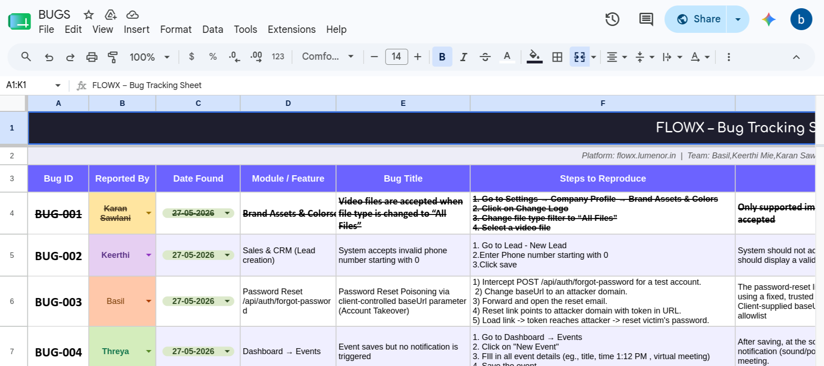
SECTION 5 · WORK COMPLETED
QA on FlowX
67
19
7
2
tests run
bugs found
modules covered
security criticals
Brief: test FlowX like a user, optimize the happy paths, flag flaws. Assigned to FixX first; moved to FlowX when FixX was not ready. I also offered security testing, from a penetration-testing background.
Selected findings (mine)
• Account takeover: password-reset poisoning via a client-controlled baseUrl leaks the reset token to an attacker domain (Critical).
• Info disclosure: a duplicate warehouse code surfaces the raw ORM error, leaking internal file paths and schema.
• Data integrity and crashes: address corrupted on every save, a broken CSV round-trip, a search that crashes on an undefined field.
Tooling: Playwright automated flows (shared HTML reports); each bug logged with module, repro steps, expected versus actual, priority, status.
Basil Stevenson · Lumenor · Internship Review
04 / 11

Slide 5

SECTION 5 · WORK COMPLETED
Lumenor landing page
• Built and shipped the public marketing site for Lumenor.
• Headline: “Run your entire solar business in one place.”
• Responsive layout that presents the product to prospects.
Live: basiltest.github.io/lumenor
Basil Stevenson · Lumenor · Internship Review
05 / 11

Slide 6
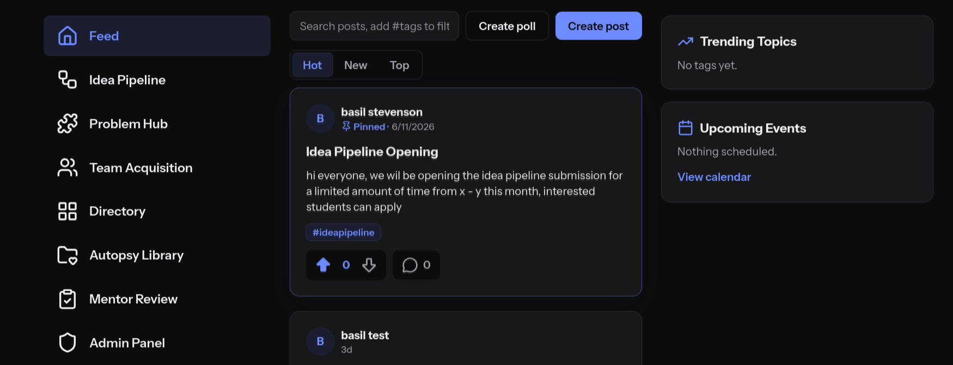
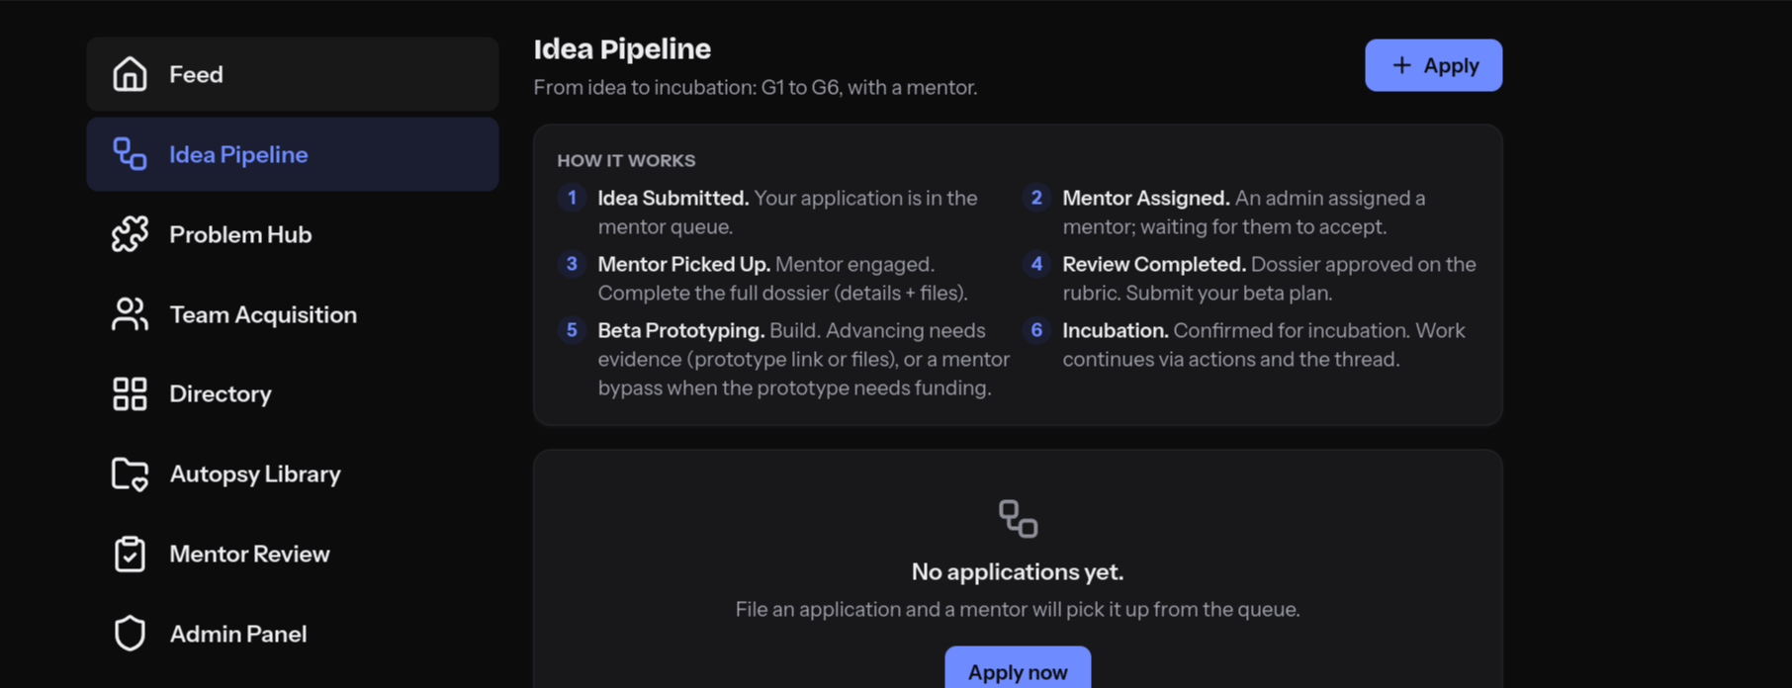
SECTION 5 · WORK COMPLETED
IFN: ICFAI Founders Network
A members-only platform for the university's founder community, built and iterated largely solo.
Feed
Idea Pipeline G1-G6
Problem Hub
Team Acquisition
Calendar
Directory
Notifications
Moderation
Admin
Auth and Roles
Stack: Vite single-page app on Vercel, backed by Supabase (Auth + Postgres + Row-Level Security), no custom backend. Now hardening for production and moving to self-hosted infrastructure.
Basil Stevenson · Lumenor · Internship Review
06 / 11

Slide 7
SECTION 6
Methodology and approach
• Process: Agile and iterative work, with weekly progress and review inside the team.
• QA approach: exploratory testing plus Playwright automation; every bug logged with module, repro steps, expected versus actual, priority, and status.
• Build approach: full-stack delivery: auth, Row-Level Security, data modeling, and a single-page app shipped to production.
• Working practice: dogfooding the products inside a live SaaS team.
Basil Stevenson · Lumenor · Internship Review
07 / 11

Slide 8
SECTION 7
Tools and technologies
Languages, frameworks, data, and tooling used across the three work-streams.
Python
JavaScript
React
Vite
Playwright
Supabase
Postgres
Row-Level Security
Vercel
Docker
Git and GitHub
LLMs
Vector databases
Basil Stevenson · Lumenor · Internship Review
08 / 11

Slide 9
SECTION 8
Results and progress status
19
2
3
~55%
bugs logged
security criticals
products delivered
internship progress
• QA: 67 tests run across 7 FlowX modules; 19 bugs logged, including 2 security criticals reported with repro steps.
• Landing page: shipped live to prospects.
• IFN platform: built end to end and iterating; auth, RLS, feed, idea pipeline, and admin in place.
Project completion status: about 55 percent, at the mid-internship point.
Basil Stevenson · Lumenor · Internship Review
09 / 11

Slide 10
SECTION 9
Challenges and solutions
• FixX not ready: reassigned to FlowX and ramped on its modules quickly to keep testing on schedule.
• Surfacing security flaws: reported auth and error-handling bugs responsibly, each with clear repro steps and priority.
• Solo scope on IFN: sliced the build into vertical features and shipped iteratively instead of all at once.
• Self-host migration: planned a phased move off Supabase Cloud and Vercel onto the office server, with captcha to follow.
Basil Stevenson · Lumenor · Internship Review
10 / 11

Slide 11
SECTIONS 10 TO 12
Outcomes, plan, and conclusion
Work plan (second half)
Learning outcomes
• IFN: finish the pipeline end-to-end testing; moderation and reporting.
• IFN: self-host migration off Supabase Cloud and Vercel onto the office server; captcha rollout.
• FlowX: retest the fixed bugs and widen coverage.
• Reproducible bug reporting, priority triage, and security testing of auth and error handling.
• Full-stack delivery: auth, RLS and data modeling, a SPA, shipped to production.
• Working and dogfooding inside a real SaaS team.
• Building depth in Docker, Git, agentic AI, LLMs, and vector databases.
Conclusion: halfway in, bugs found, products shipped, more to build.
Basil Stevenson · Lumenor · Internship Review
11 / 11

