Slide 1
Regenerative Braking System
Modulation and Technical Study
Brought to you by:
Maissa Lajmi – Ghaith Abid

Slide 2
Table of Content
Abstract
How RBS works?
System Architecture
Project Scope
Future Plans & conclusion
Simulation
Requirements
Units and algorithms

Slide 3
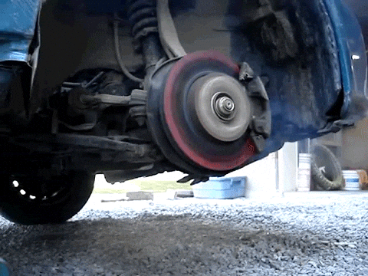
Abstract
In conventional vehicles, braking is mainly achieved through friction brakes, where kinetic energy is converted into heat and lost to the environment.
To solve this massacre, Regenerative braking offers a smarter alternative with a clever engineering approach: during deceleration, the electric motor, despite being a “motor”,
can operate as a generator, converting that
wasted kinetic energy back into electrical
energy to charge the battery. This for sure
improves overall energy efficiency and extends
driving range.

Slide 4
SHOW TIME
How Regenrative Braking System actually works??

Slide 6
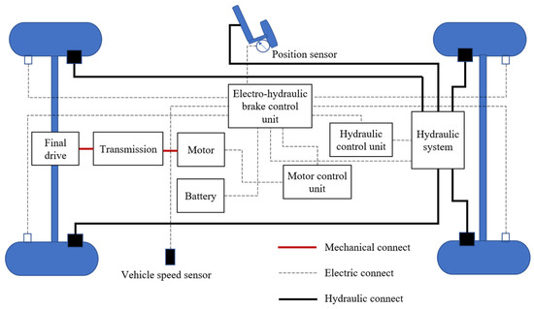
System Architecture

Slide 7
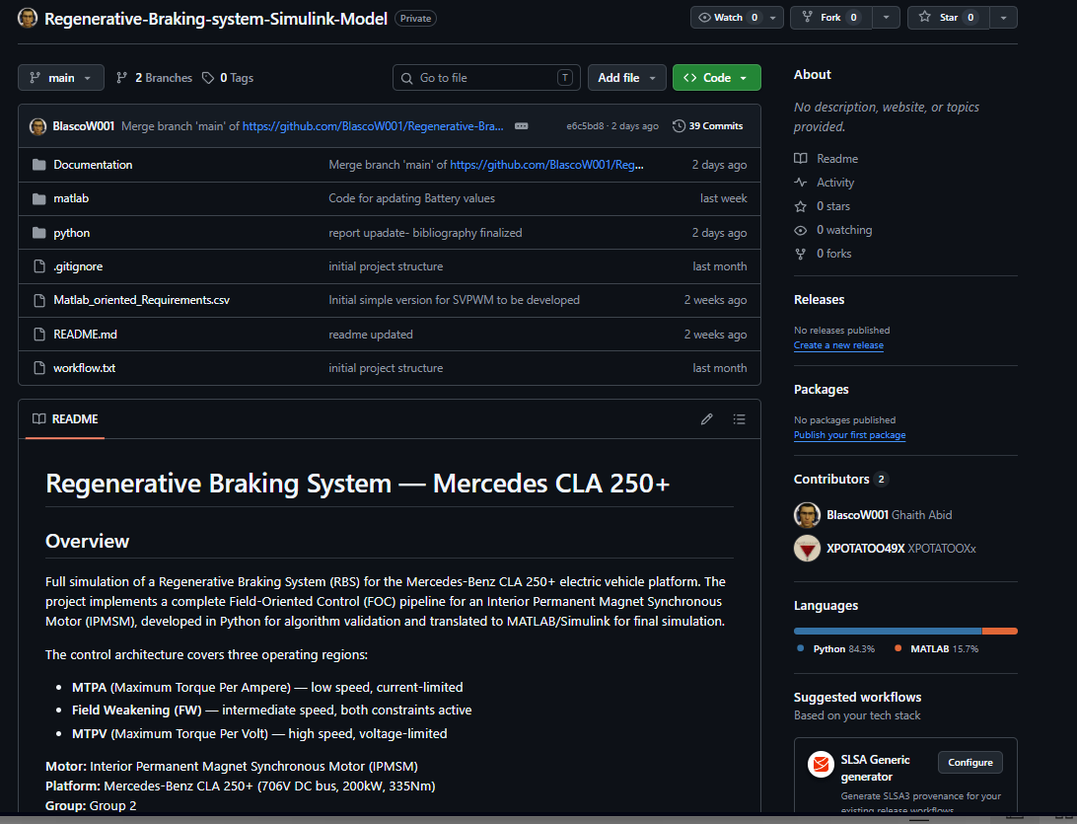
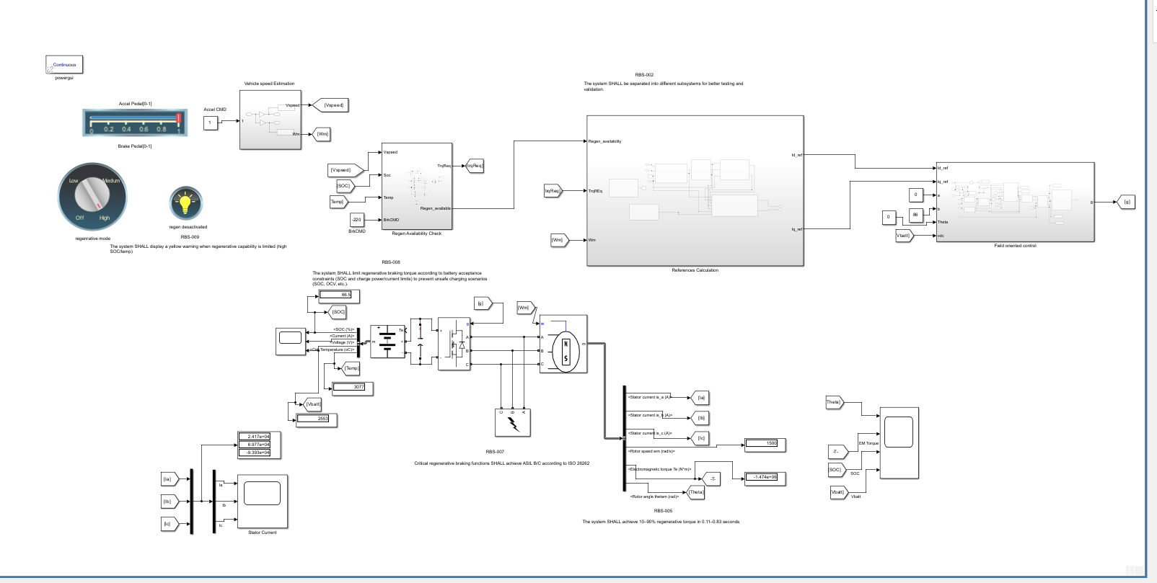
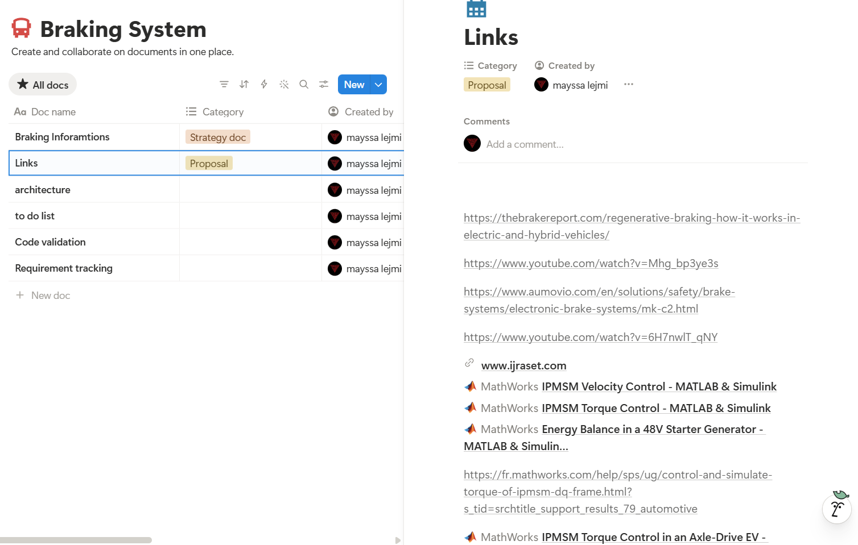
Project scope
GITHUB
MATLAB
NOTION

Slide 8
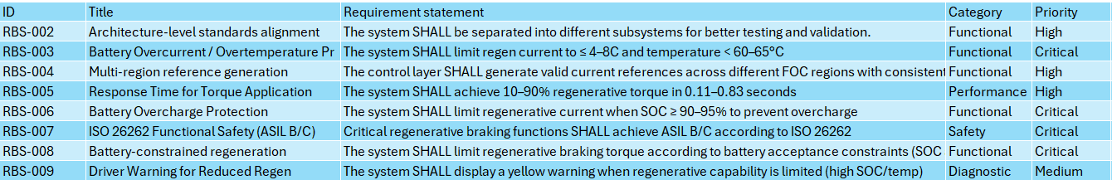
!Requirements!

Slide 9
MATLAB Simulation

Slide 10
Thanks!
Do you have any questions?
ghtmun7@gmail.com
+216 92 206 846
mayssalajmi1970@gmail,com
Not

