Slide 1
Programming the mbot STEM Camp
By Basil Wong
5th Year Engineering Physics

Slide 2
What is programming
Telling the computer what to do.

Slide 3
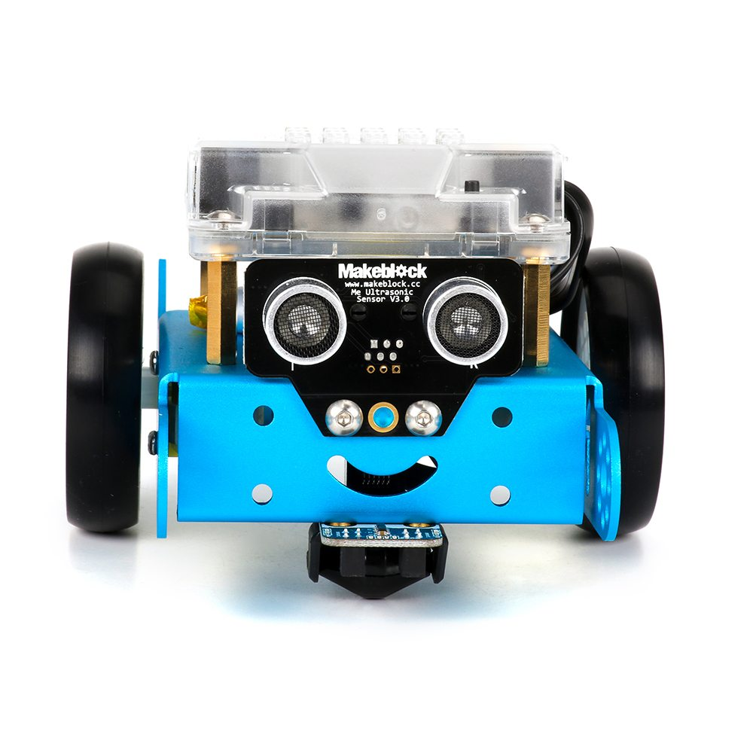
What is an mbot
A cute little robot that you can program.

Slide 4
How to Program the Robot
Download the Arduino IDE
  https://www.arduino.cc/en/Main/Software
Go to GitHub to download the open source package
  https://github.com/Makeblock-official/Makeblock-Libraries
Download the WINCHIP DRIVER
  http://www.driverscape.com/download

Slide 5
Changes in Terminal
rm -rf /System/Library/Extensions/usb.kext
  Type the above text into terminal and press enter.

Slide 6
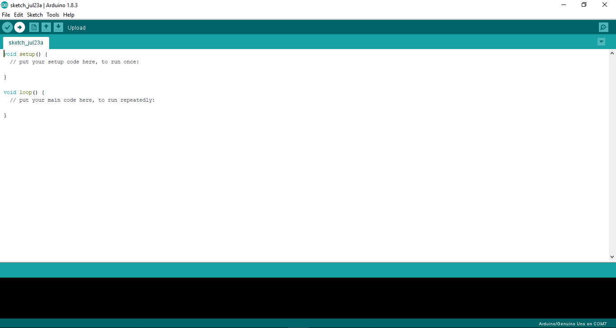

Slide 7
How to manage Libraries
Sketch
  Include library
    Add ZIP library
    choose the downloaded library

