Slide 1
Summary for Today: Engineering and Technology Day 2
Mbot component overview
Technology explanation
Coding overview
Mission objectives

Slide 2
MBOT ROVERS
Basil Wong

Slide 3
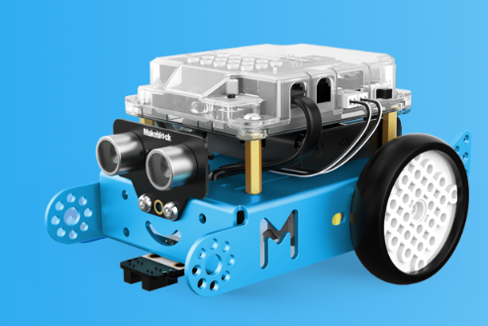

Slide 4
Components

Slide 5
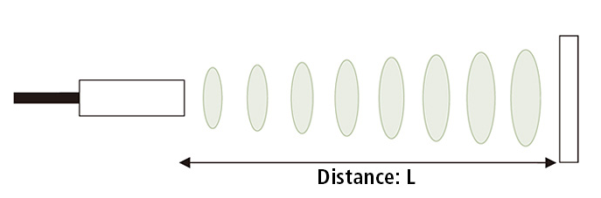
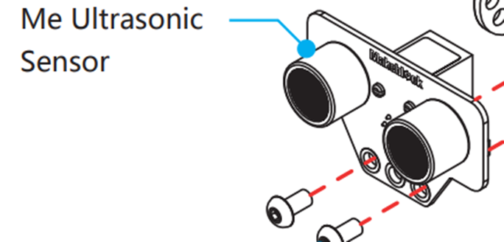
Ultrasonic Sensor
ultrasonic sensors measure distance by using ultrasonic waves
sensor head emits an ultrasonic wave and receives the wave reflected back from the target
measuring the time between the emission and reception
Distance = Speed * Time

Slide 6

Car on the road example

Slide 7
Calculation used by sensor
Distance L = 1/2 × T × C

Slide 8
What are Ultrasonic Waves?

Slide 9
What are ultrasonic Waves
sound waves transmitted at a frequency greater than 20,000 hz per second, or beyond the normal hearing range of humans

Slide 10
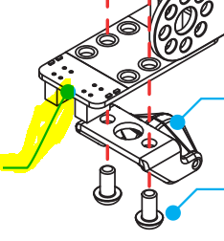
Line Following Sensor
Mbot has infrared sensors underneath that it uses to detect if there are lines below it.
They are what determine whether the robot is over the line or not.

Slide 11
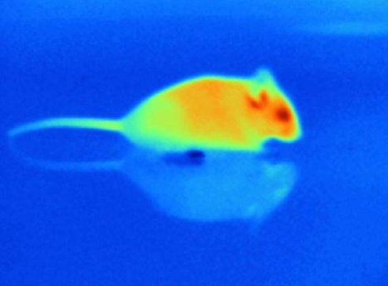
Fun fact
Infrared is what some snakes used to detect their prey.

Slide 12
How do they recognize the line
The colour is key.
Dark colours are a poor reflectors while light colours are good reflectors
The infrared sensors receive the reflections of infared waves off the surface.

Slide 13


Slide 14

Bluetooth module

Slide 15
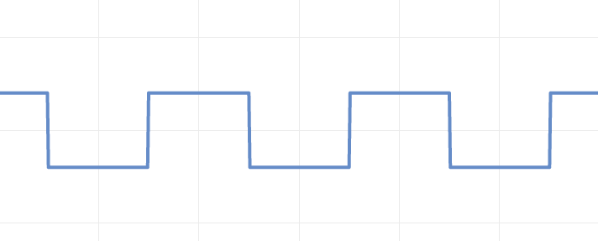
What are they communicating

Slide 16
What is Bluetooth
Bluetooth technology is a short-range wireless communications technology
Bluetooth RF transceiver (or physical layer) operates in the unlicensed ISM band centered at 2.4 gigahertz (the same range of frequencies used by microwaves and Wi-Fi)

Slide 17
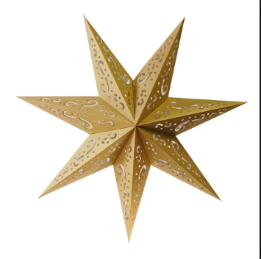
How do they connect?
RF topology:
“Master” and up to 7 “slaves”
Ex: phone(master) connecting to speakers

Slide 18
Bluetooth
They communicate bits with data waves.
Waves are like microwaves.
The master(your phone) dictates when signals are sent back and forth

Slide 19
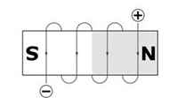
DC Motors
The DC motor is a machine that transforms electric energy into mechanical energy in form of rotation
DC motors have inductors inside, which produce the magnetic field used to generate movement.

Slide 20
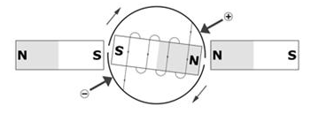
Electromagnet
An electromagnet, which is a piece of iron wrapped with a wire coil that has voltage applied in its terminals

Slide 21
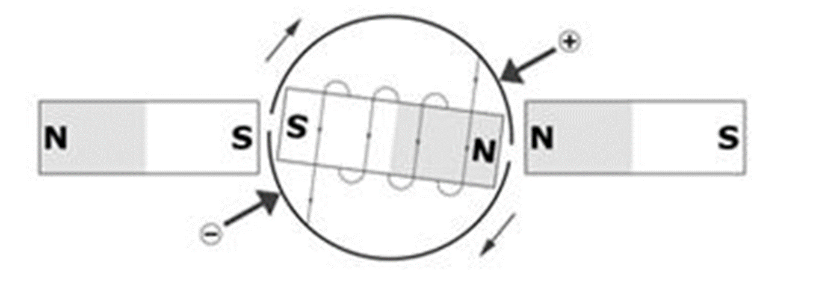
Torque
When voltage(electricity) is applied to the electromagnetic, its magnetic field interacts with the fixed magnets.

Slide 22
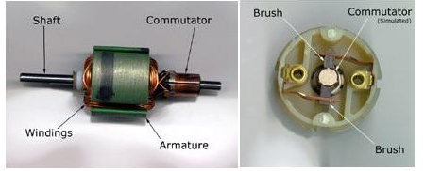
Changing Polarity

Slide 23
Coding for the mbot Rover

Slide 24
Coding environment
Algorithms can be written in either the mblock or Arduino environment.
You should all already have the Arduino environment setup.
The mblock environment is downloaded, please ask for help with setting it up if you want to use it.

Slide 25
Lab rules
You will be coding in partners/groups of three.
Two people per computer.
No computer games today.

Slide 26
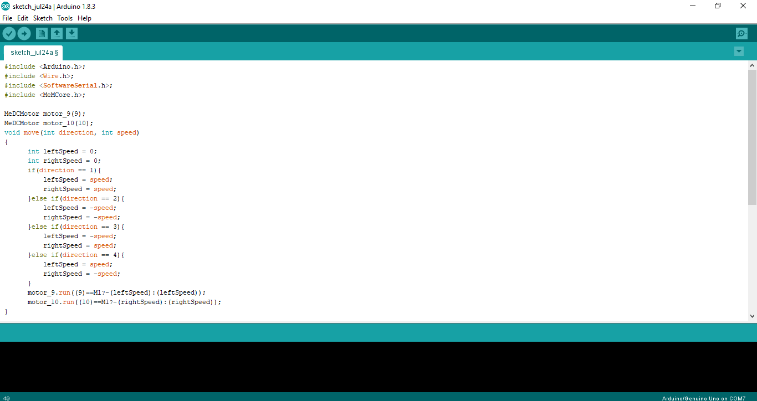

Slide 27
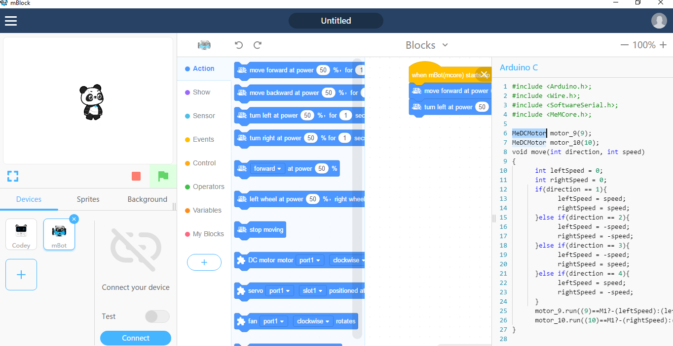

Slide 28
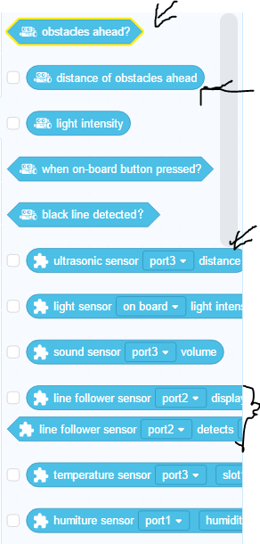
Programming sensors

Slide 29
Uploading to the mbot

Slide 30
School Does not Allow Drivers for Serial Connection
So here is our solution:
Complete the code on your computer.
Copy the code to a usb stick.
Bring it to my computer for upload to mbot
So you can test out your code.

Slide 31
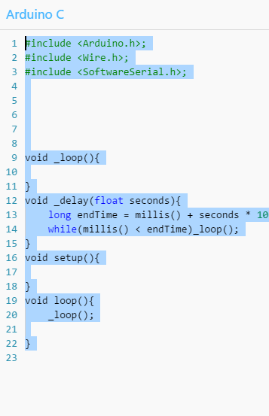
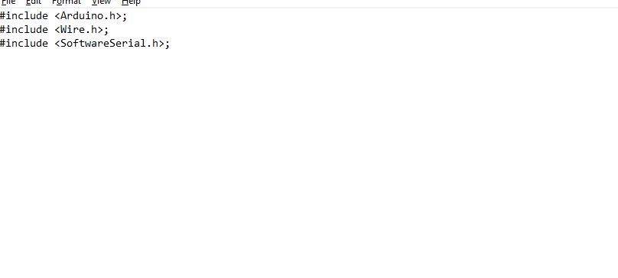
Copying to usb stick
Textedit, under applications.

Slide 32
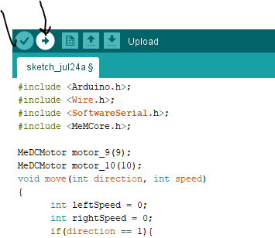
Bring usb to my computer
Open arduino, open text file.
Copy paste from text file to arduino.
Click verify, upload

Slide 33
Mars rover Missions

Slide 34
Mission 1: Location Recon
Pieces of Tape in four places.
Rover must start at one piece of tape and roll over all the other pieces of tape and return to the original piece of tape.
Fully automated, only allowed to press the go button, then the robot must be left untouched for the rest of the mission.

Slide 35
Mission 1 Tips
Timing
Directional

Slide 36
Mission 2: terrain navigation
Robot starts at designated piece start tape.
Drives until gets close to the wall, then turns around and comes back and stops at the start tape.
Robot cannot touch the wall or it causes an earthquake.

Slide 37
Mission 2 tips
Ultrasonic sensing
The toughest part will likely be getting the mbot to return right to the tape.

Slide 38
Sumo wrestling
Teams will have their code compete against each other.
Two teams will upload code to the robot.
Robots will start at random ends of the mat.
Robot loses when they are fully outside of the mat.
Basil is the referee and makes final decisions.
Ties will be decided by the level of difficulty of the code. (if similar then results in 1 point tie)
Each team plays every other team.
Team with the best record at the end wins

