Slide 1
Engineering and Technology Introduction
Basil Wong

Slide 2
What Are we going Over today (there are Questions/breaks in Between Each thing)
A little bit about me
Getting to know you Guys
my Technical Experience and What I am Researching
What is Engineering And Technology
What we are Going to Go Over in Class

Slide 3
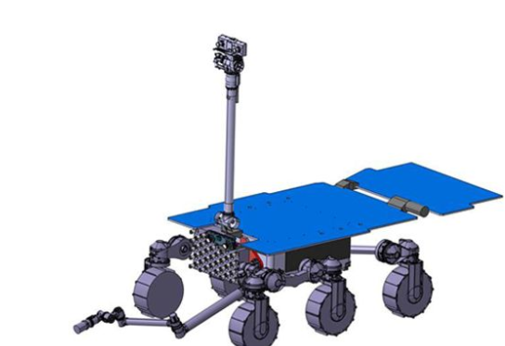
UK engineers will design a robot that can retrieve rock samples on Mars so they can be sent to Earth for study.
https://www.bbc.com/news/science-environment-44728947

Slide 4
Who Am I?
Basil Wong
22
5th Year Engineering Physics Student at UBC
I like math, Coding, solving problems, sports(hockey, Basketball, Football) and music

Slide 5
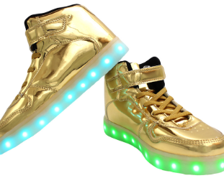
Getting To Know You guys
Everyone say Hi, Say their name and Say something about the shoes they are wearing (size, colour, who makes them)

Slide 6
My Technical Experience and What I am Researching
yay

Slide 7



Past Jobs
Intel
Neurio
UBC ORBIT

Slide 8


More About UBC Oribt
Trillium
Canadian Satellite Design Challenge

Slide 9
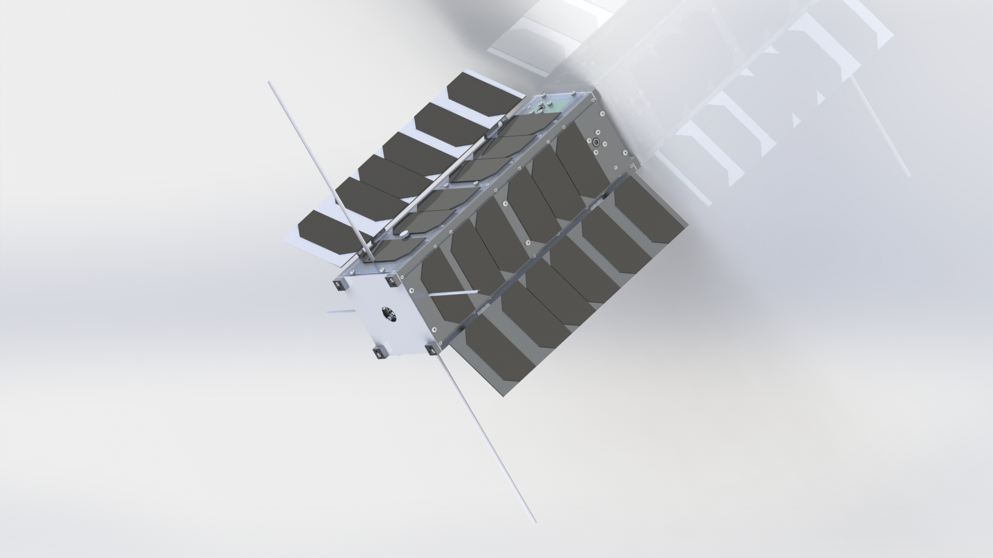

Slide 10

What I am Researching
quantum-dot cellular automata (QCA) networks
a computational nanotechnology
based on field-coupled arrays of finite-state automata

Slide 11
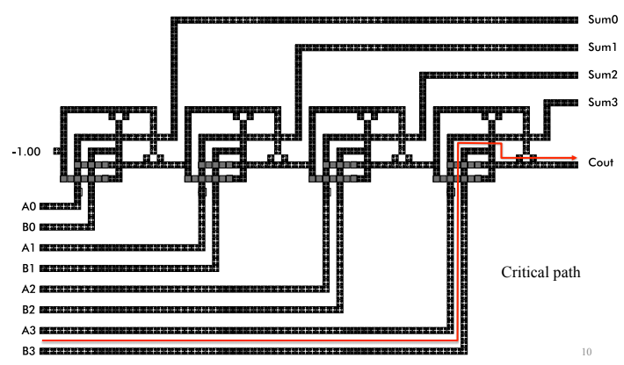
DEEP pipelining in clocked qca

Slide 12

What is Quantum Computing…

Slide 13

D-Wave

Slide 14
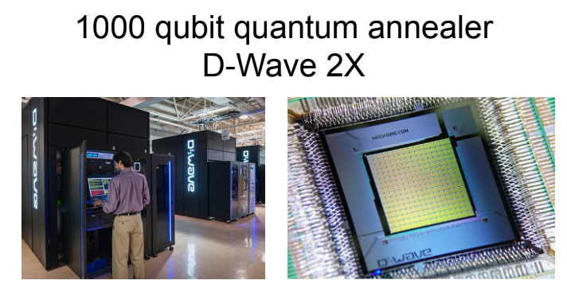
Quantum Annealer

Slide 15
What is Engineering And technology
huh

Slide 16
Someone who does precision guesswork based on unreliable data provided by those of questionable knowledge
Engineer: noun.[En-juh-neer]
See also Wizard, magician

Slide 17
Engineering is essentially using skills to make things

Slide 18
Discussion
You guys have been listening for a while, so I wanna hear about what you all think about engineering
What’s something that has been engineered
What kind of skills does an engineer have

Slide 19
What are we going to go over in class
yep

Slide 20
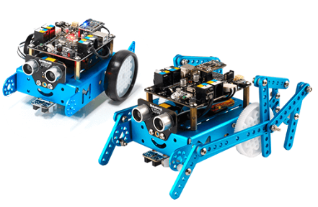
mBot

Slide 21
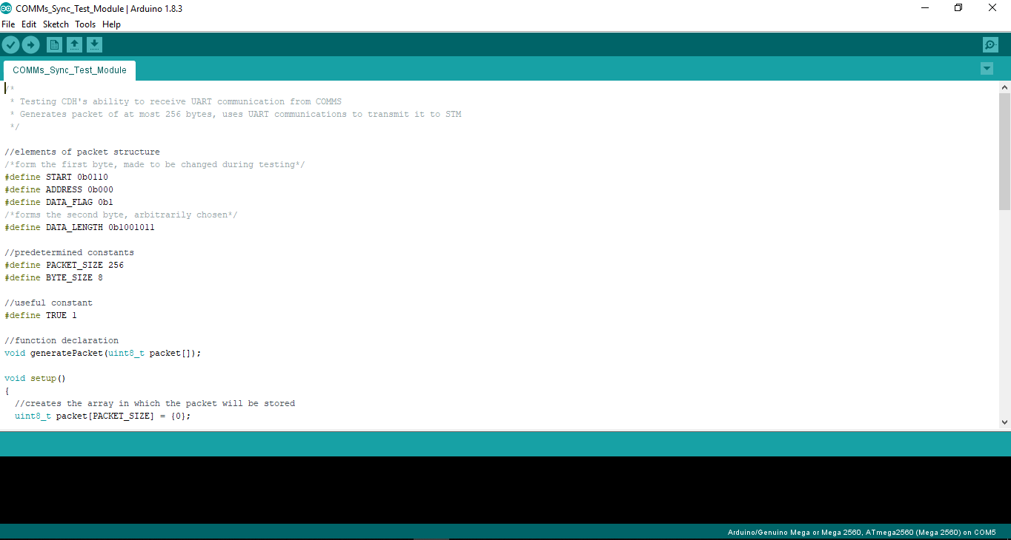

Slide 22
Fundamentals of programming
Logic
Functions
Memory access

Slide 23
Schedule

Slide 24
First Day
First day:
Learning how to upload code to the mbot
Learning about github and linkedin

Slide 25
Second Day
Second Day:
Learning about programming in C
Obstacle course

Slide 26
Third Day
Third Day:
Obstacle course
Sensors course

Slide 27
Field Trip
Fourth Day:
Field trip

Slide 28

triumf
Canada’s Particle Accelerator centre
500 MeV Cyclotron & Proton Beam Lines
ARIEL
high-power superconducting electron linear accelerator
ATLAS
Large Hadron Collider (LHC) at CERN will use proton-proton collisions at the highest energy ever achieved in the laboratory to look for the Higgs boson
UCN
Its' goal is to provide the world's highest density of ultra-cold neutrons.

Slide 29
Friday
Working on your fair projects
cool

