Slide 1
Android Boot Process
by mzlogin
GitHub: https://github.com/mzlogin

Slide 2
Pre-knowledge

Slide 3
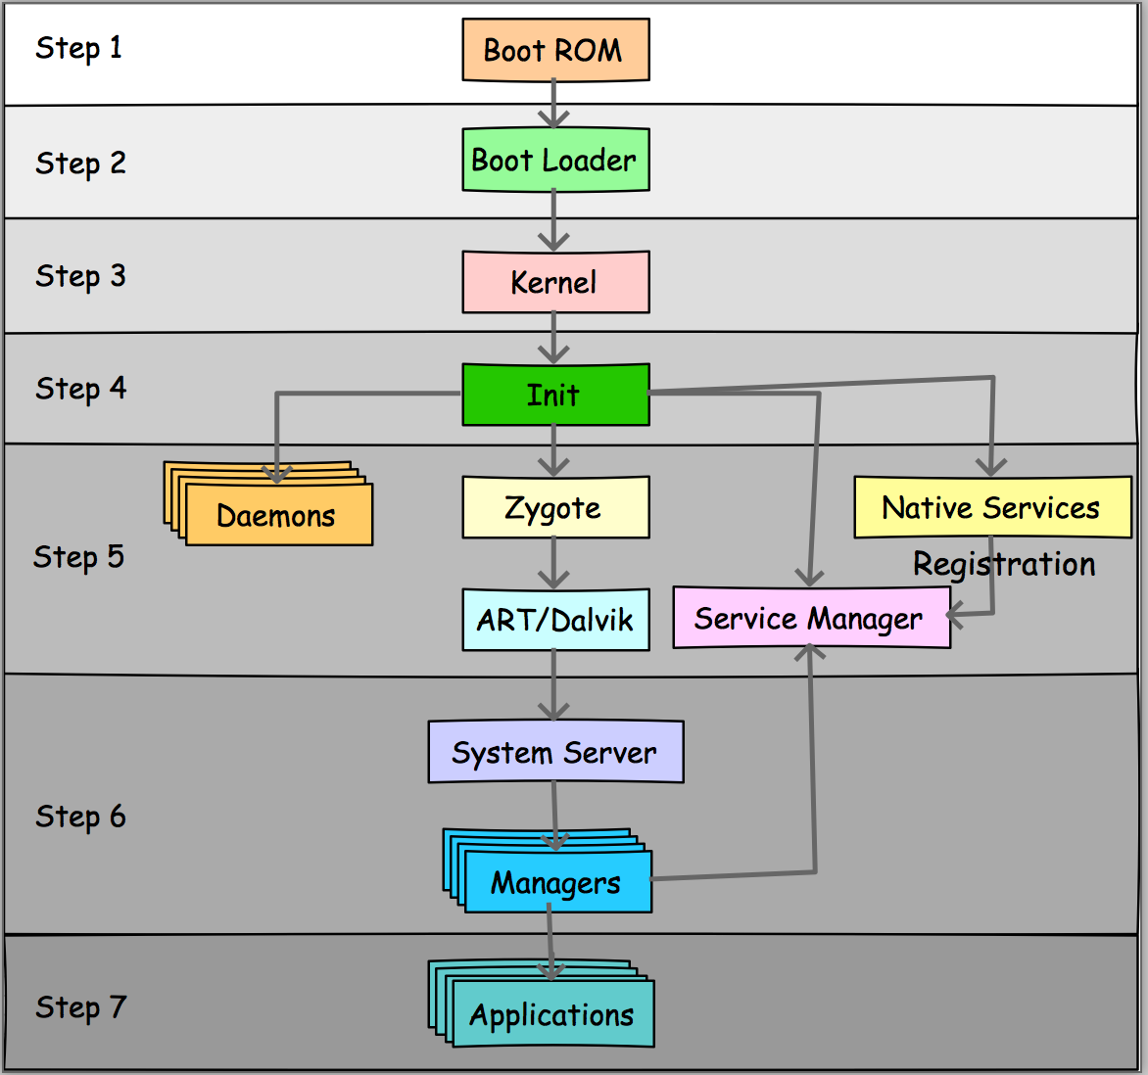
Summary
Power On

Slide 4
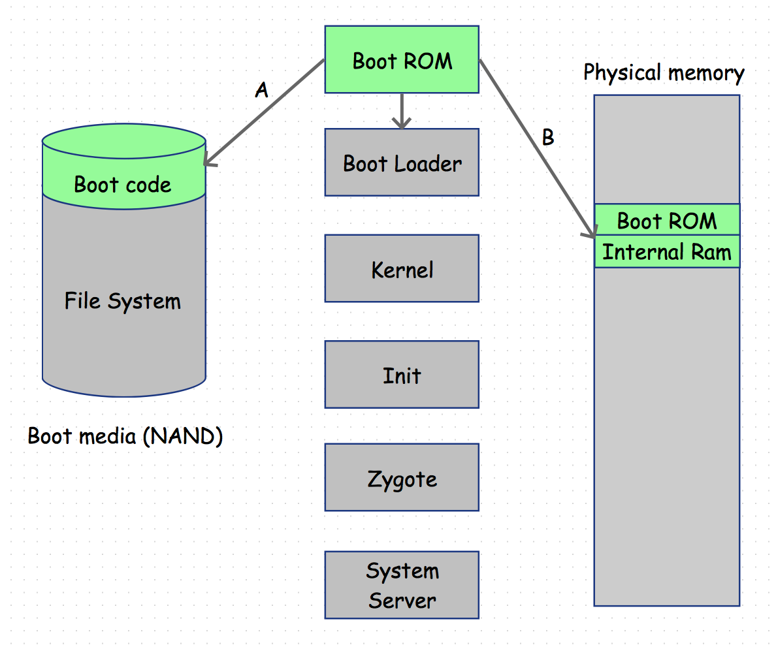
Step 1. Power on and boot ROM code execution

Slide 5
Boot ROM
a small piece of code that is hardwired in the CPU ASIC
will execute when power supplies are stable
Sub-steps
A. Determine where to find the first stage of the boot loader.
B. Load the first stage boot loader to internal RAM, perform a jump and execution continues in the boot loader.

Slide 6
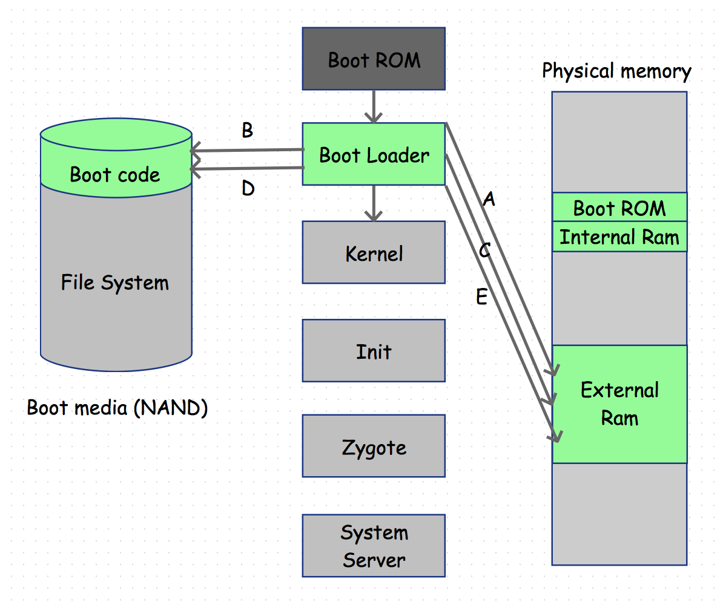
Step 2. The boot loader

Slide 7
Boot Loader
A program to set up initial memories and load the kernel to RAM.
Sub-steps
A. The first boot loader stage detect and set up external RAM.
B. The first boot loader stage load the main boot loader to external RAM.
C. The second stage of the boot loader. (set up file systems, additional memory, network, low level memory protections and security options, etc.)
D. Look for a Linux kernel and place it in the RAM to boot.
E. Jump to the Linux kernel.

Slide 8
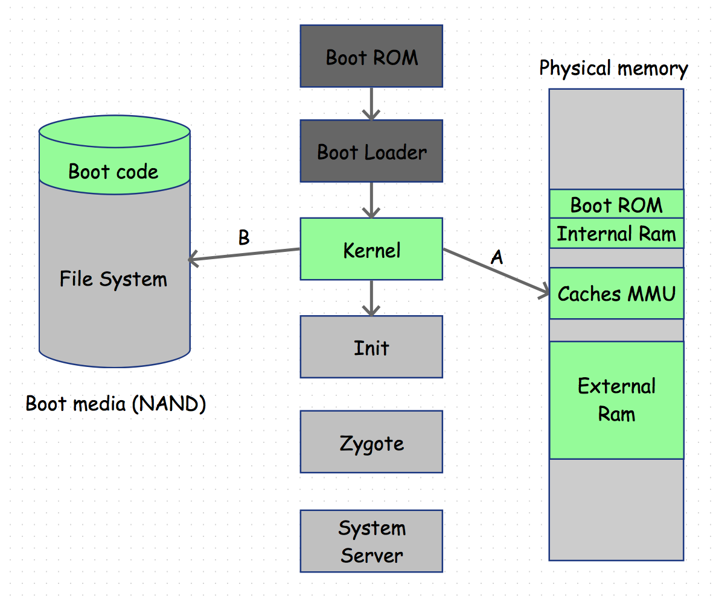
Step 3. The Linux kernel

Slide 9
Linux Kernel
It will set up everything that is needed for the system to run. Initialize interrupt controllers, set up memory protections, caches and scheduling.
Sub-steps
A. Initialize the memory management units and caches, then the system will be able to use virtual memory and launch user space processes.
B. Launch init process as the initial user space process.

Slide 10
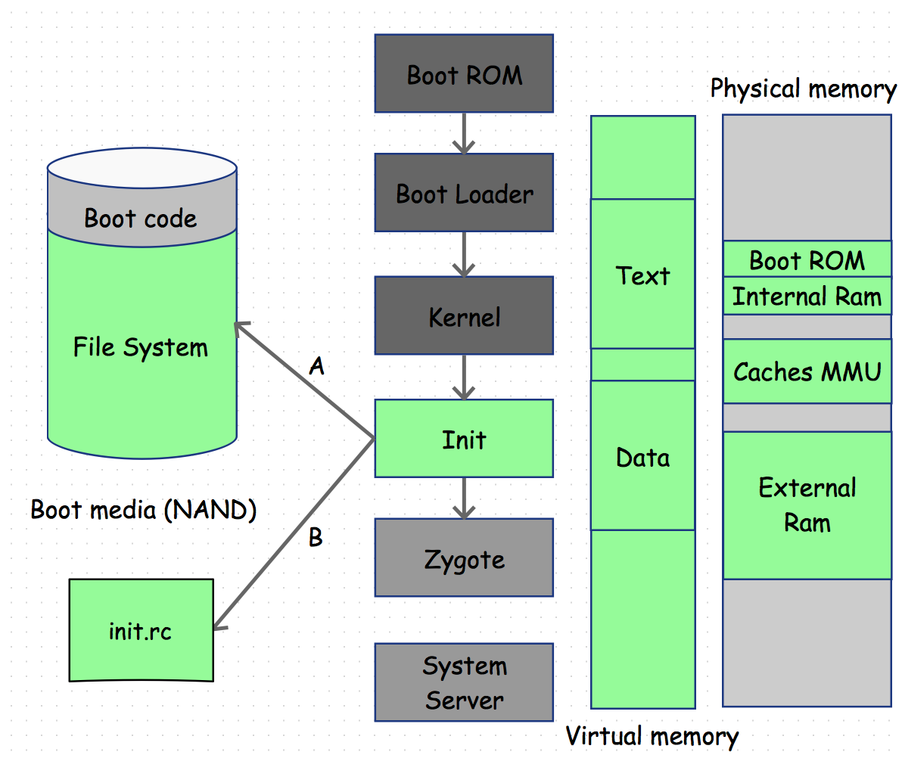
Step 4. The init process

Slide 11
Init Process
Grandmother of all processes.
Sub-steps
A. Mount directories like /sys, /dev, /proc, find init.rc file
B. Parse init.rc and run tasks in it
global environment variables
mount partitions
directories permissions
start services (daemons, native services, service manager, zygote, bootanim, …)
…
At this stage you can see boot animation on device screen.

Slide 12
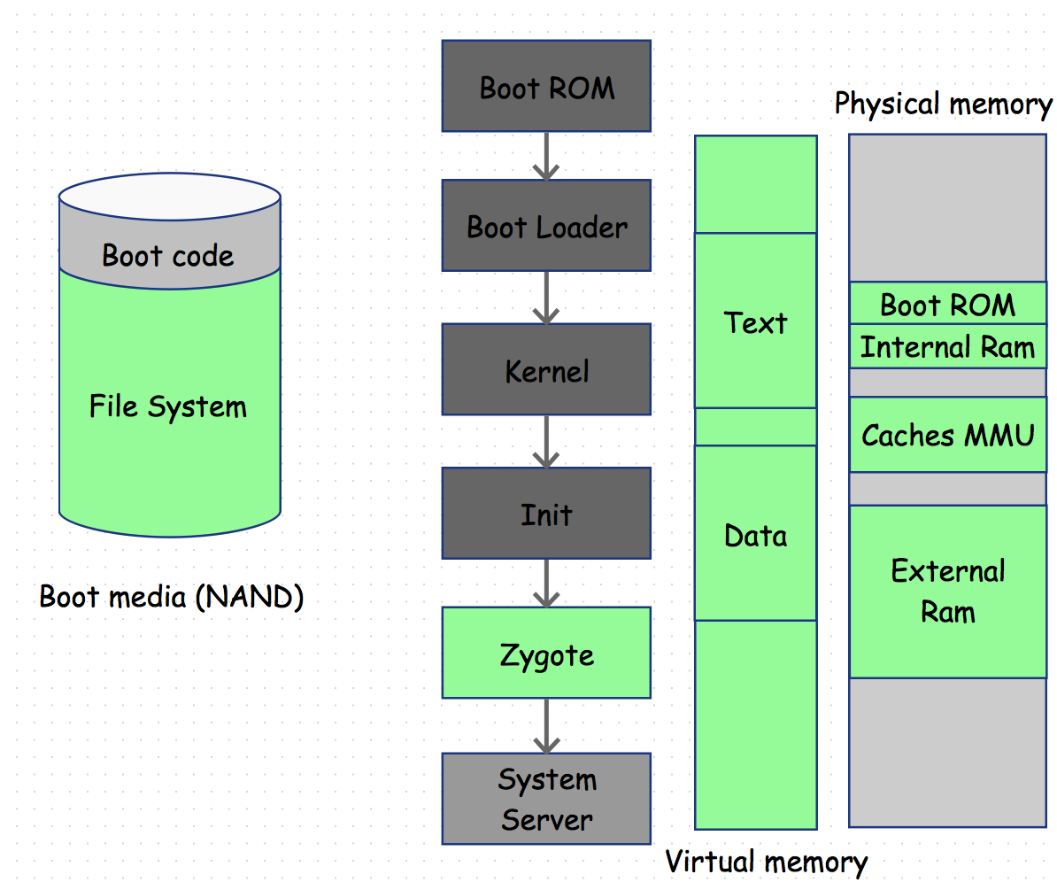
Step 5. Zygote and Dalvik/ART

Slide 13
Zygote
All VM processes are forked from zygote.
Sub-steps
registerZygoteSocket()
preload()
preloadClasses() — preloaded-classes
preloadResources() — /system/framework/framework-res.apk
startSystemServer()
runSelectLoopMode()

Slide 14
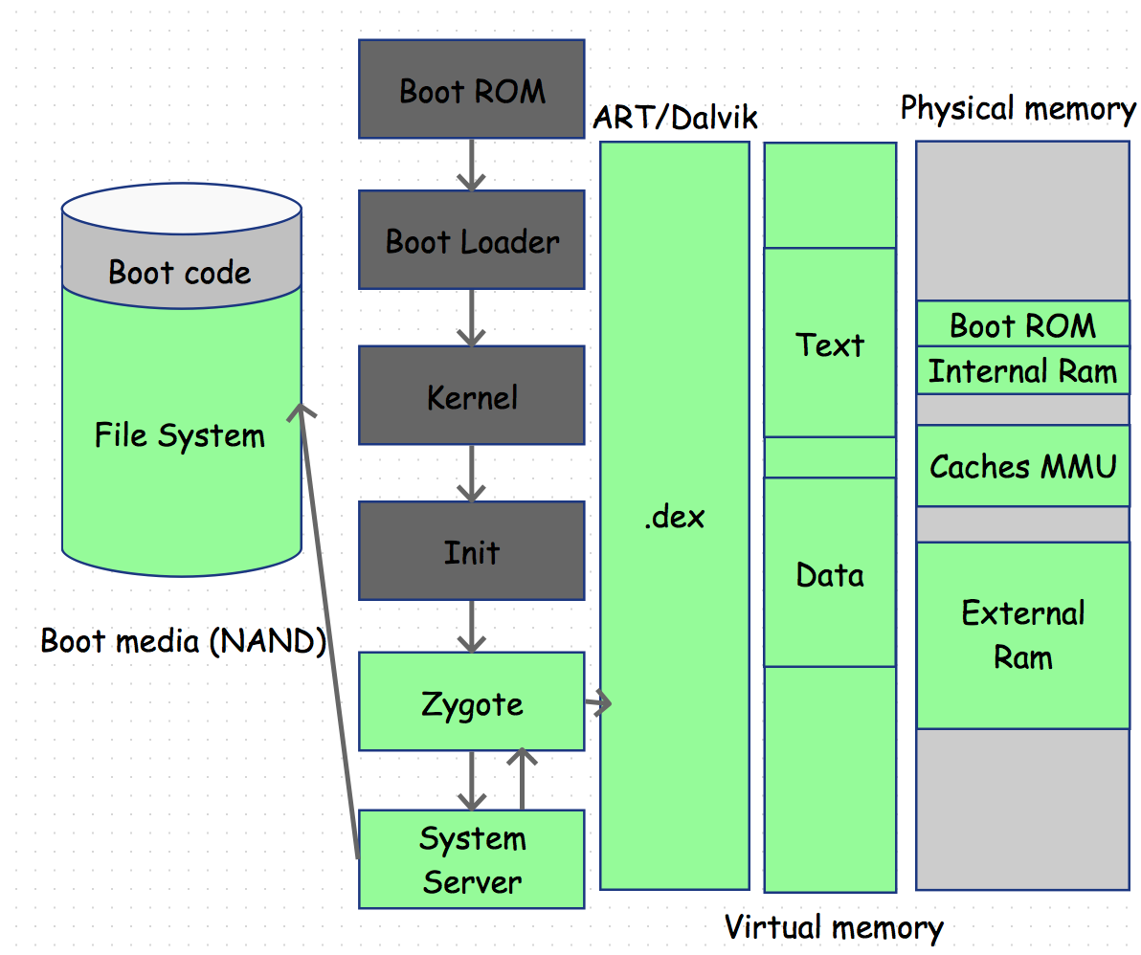
Step 6. The system server

Slide 15
System Server
First java component to run in the system
It will start all the Android services.
Power Manager
Activity Manager
Telephony Registry
Scheduling Policy
Package Manager
Account Manager
…

Slide 16
Step 7. Boot completed
broadcast BOOT_COMPLETED
start home activity

Slide 17
Extra knowledge: Tools for analyzing Android Bootup
logcat
adb logcat -d -b events | grep boot
adb logcat -d | grep preload
bootchart

Slide 18
References
IN DEPTH : ANDROID BOOT SEQUENCE / PROCESS
The Android boot process from power on
What is the difference between a Bootrom vs bootloader on ARM systems
Tools for analyzing Android Bootup
Internal RAM
What Is Internal RAM?

Slide 19
Q & A

Slide 20
Thanks

