Slide 1
AWS Bootcamp: Week 1 - AWS Fundamentals and Core Services
Presented by: [Tahira murtaza]

Slide 2
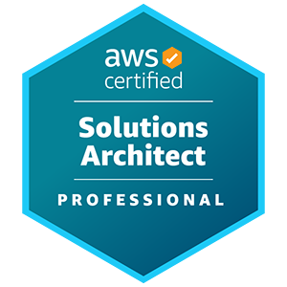
Introduction to Cloud Computing and AWS
What is Cloud Computing?
Benefits of Cloud Computing
Introduction to AWS:
What is it? Why AWS?
AWS Global Infrastructure:
Overview and Regions
AWS Free Tier
Overview and Pricing

Slide 3
Compute Services (EC2, Lambda, Elastic Beanstalk)
EC2:
- Instances, Types, Pricing, and Management
- Launching and Managing EC2 Instances
Lambda:
- Serverless architecture and use cases
Elastic Beanstalk:
- Deploying applications without managing infrastructure

Slide 4
Storage Services (S3, EBS, Glacier, EFS)
AWS Storage Options:
S3: Buckets, Objects, Versioning, and Permissions
EBS: Persistent block storage for EC2
Glacier: Archival storage
EFS: File storage and use cases

Slide 5
Networking Services (VPC, Route 53, ELB, CloudFront)
VPC:
Virtual Private Cloud, Subnets, Route Tables, and Security Groups
Route 53:
DNS Management and Domain Setup
Elastic Load Balancer (ELB):
Load Balancing and Content Delivery
CloudFront:
Content Delivery Network (CDN)

Slide 6
Advanced Topics and Real-World Applications
Security and Identity Management (IAM, KMS, Secrets Manager):
IAM: Users, Groups, Roles, and Policies
KMS: Key Management
Secrets Manager: Managing secrets and credentials
Databases (RDS, DynamoDB, Aurora, Redshift):
RDS: Relational Databases
DynamoDB: NoSQL Database
Aurora and Redshift: High-performance Databases

Slide 7
DevOps and Automation Tools
Infrastructure as Code:
Using AWS CloudFormation
CI/CD Tools:
CodePipeline and CodeDeploy
Automation:
Automating deployments and scaling applications

Slide 8
Job Preparation and AWS Certification
AWS Certifications Overview:
Solutions Architect, Developer, SysOps, etc.
Resume Building:
Highlighting AWS skills
Interview Preparation:
Common AWS questions and scenarios
Hands-on Practice:
Final mini-project or case study

