Slide 1

Basics of Neural Network Programming
Binary Classification
deeplearning.ai

Slide 2
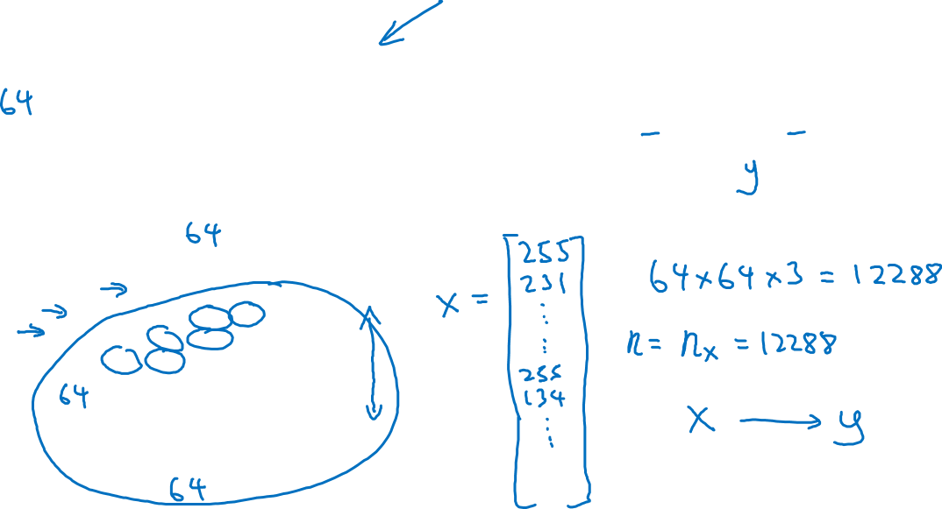
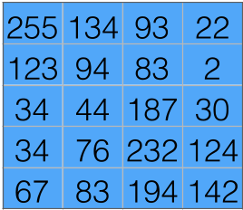
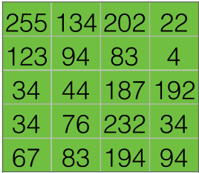
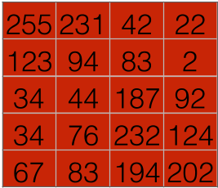
Binary Classification
1 (cat) vs 0 (non cat)
Blue
Green
Red

Slide 3
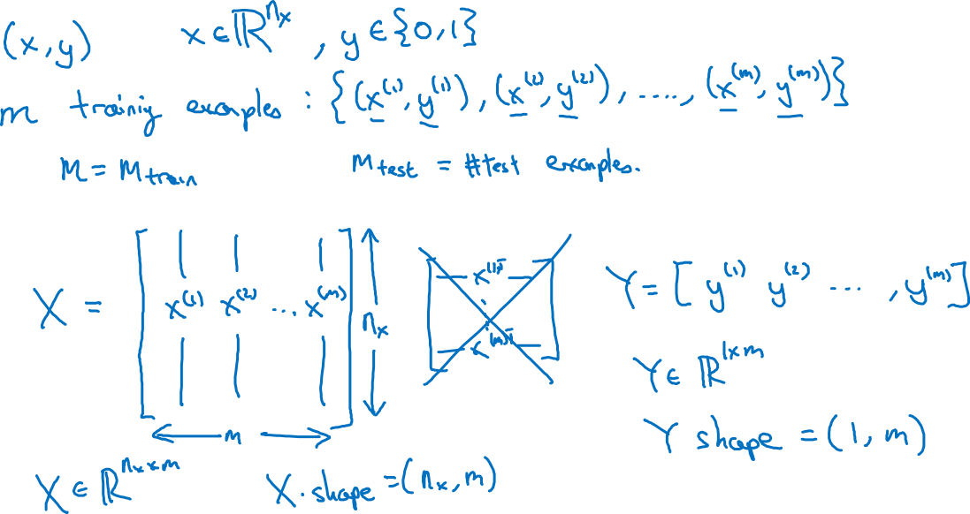
Notation

Slide 4
Basics of Neural Network Programming
Logistic Regression
deeplearning.ai

Slide 5
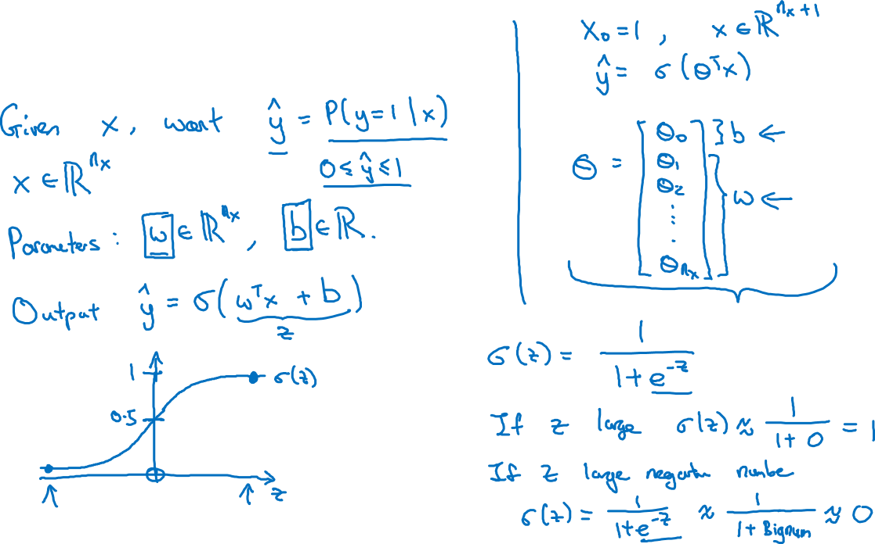
Logistic Regression

Slide 6
Basics of Neural Network Programming
Logistic Regression
cost function
deeplearning.ai

Slide 7
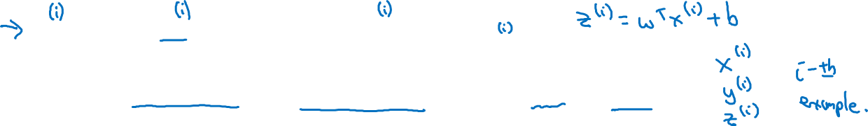
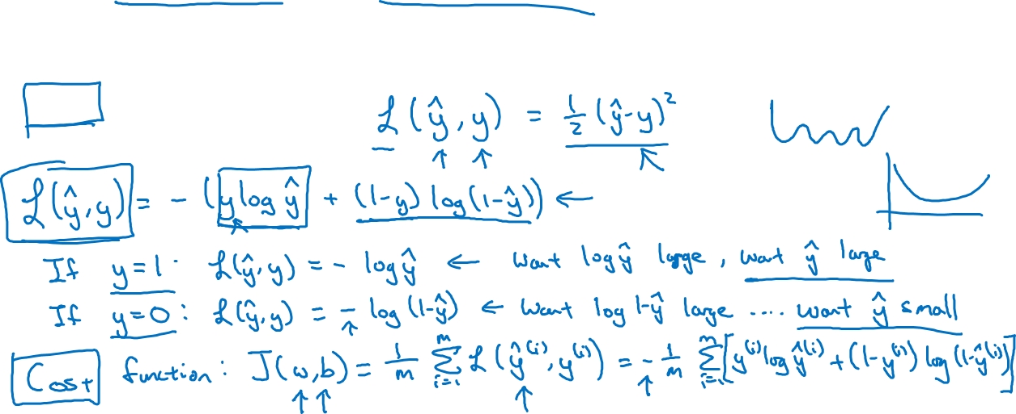
Logistic Regression cost function
, where
Given want .
Loss (error) function:

Slide 8
Basics of Neural Network Programming
Gradient Descent
deeplearning.ai

Slide 9
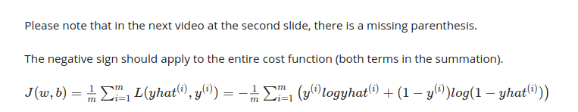


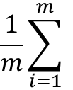
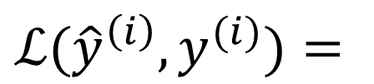
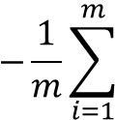

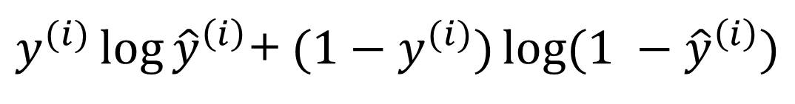


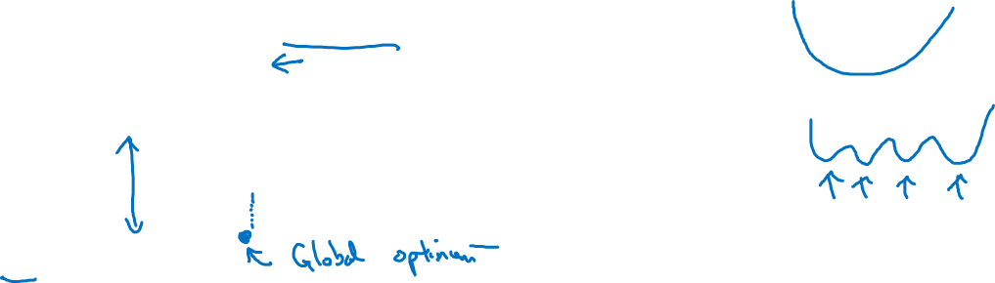
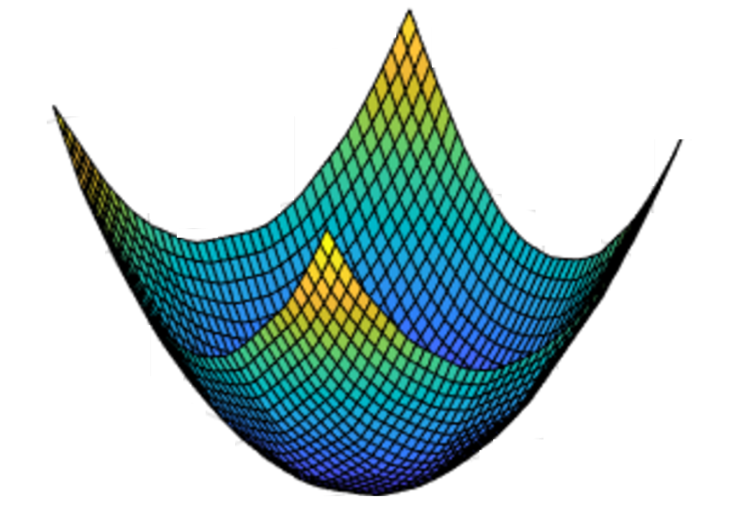


Gradient Descent
Recap: ,
+
Want to find that minimize

Slide 10
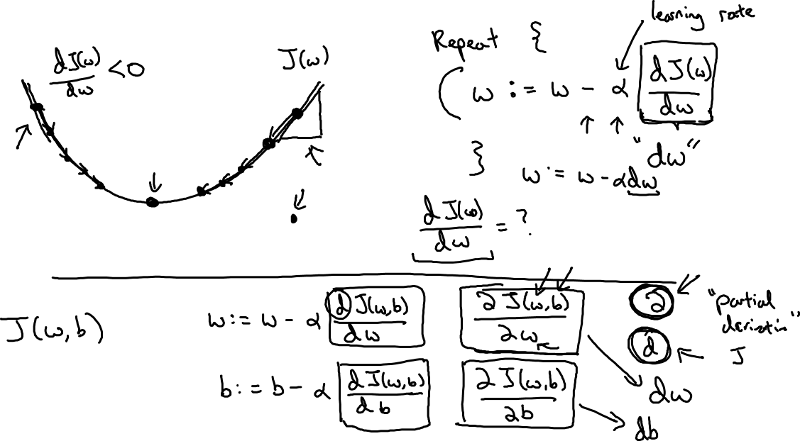

Gradient Descent

Slide 11
Basics of Neural Network Programming
Derivatives
deeplearning.ai

Slide 12
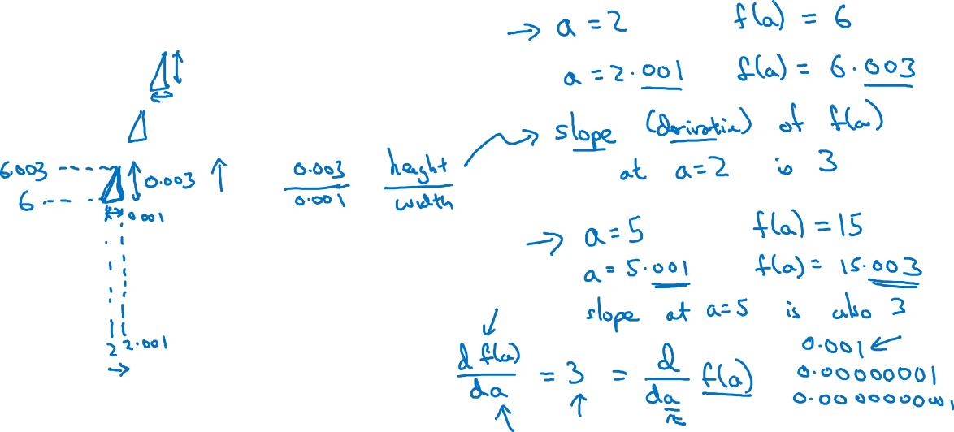


Intuition about derivatives

Slide 13
Basics of Neural Network Programming
More derivatives examples
deeplearning.ai

Slide 14
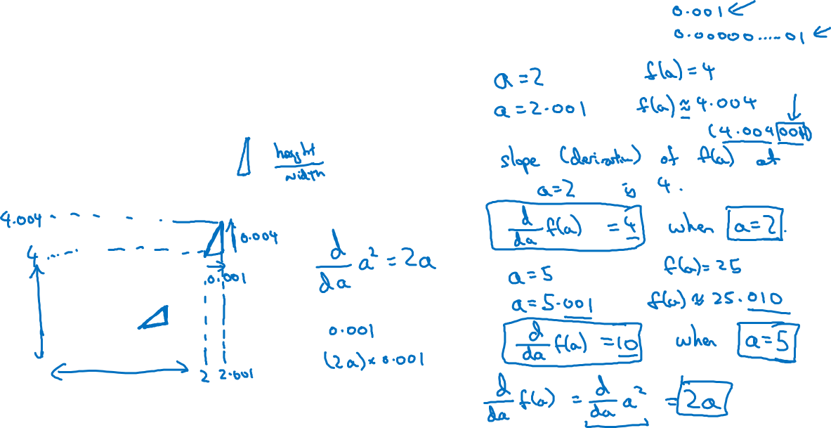


Intuition about derivatives

Slide 15
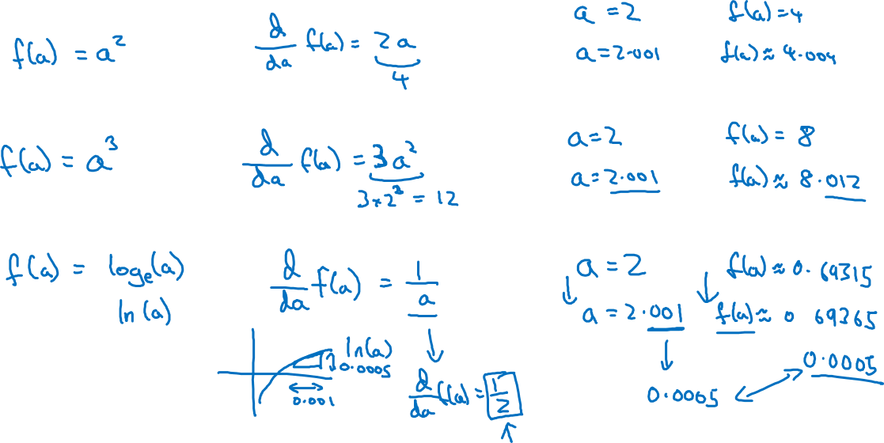
More derivative examples

Slide 16
Basics of Neural Network Programming
Computation Graph
deeplearning.ai

Slide 17
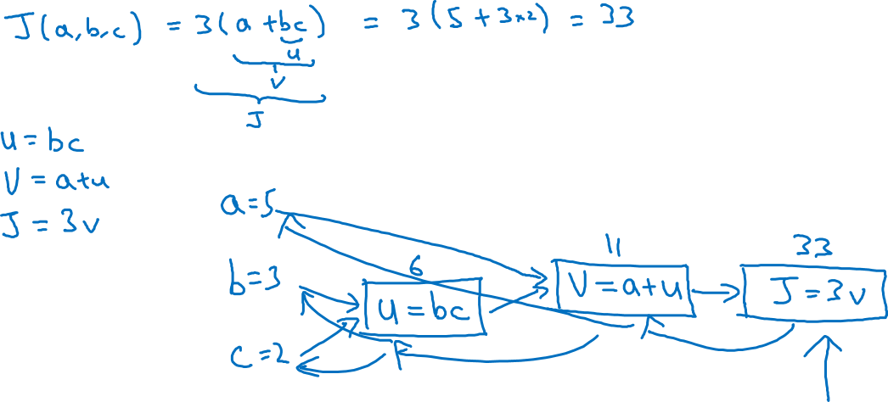
Computation Graph

Slide 18
Basics of Neural Network Programming
Derivatives with a Computation Graph
deeplearning.ai

Slide 19
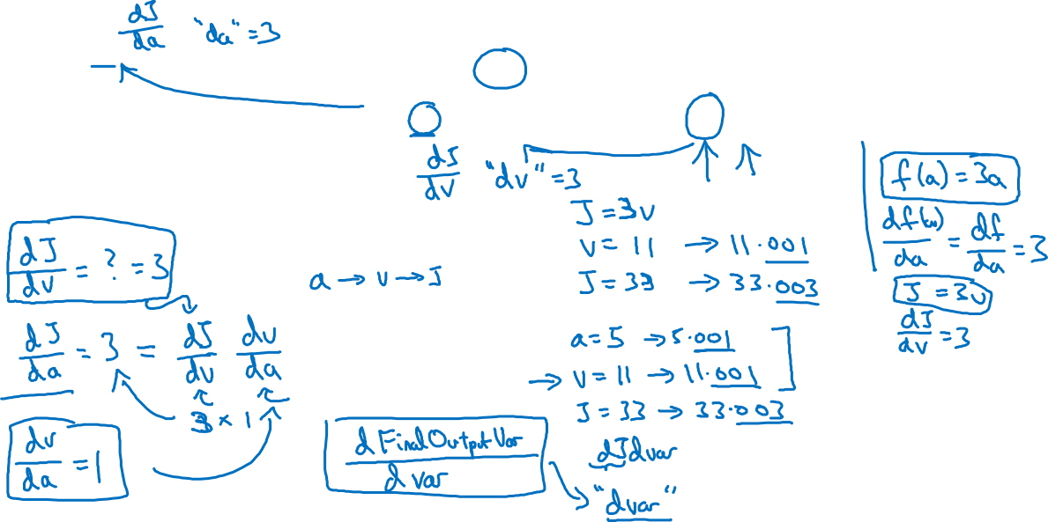



Computing derivatives
11
33
6
=

Slide 20
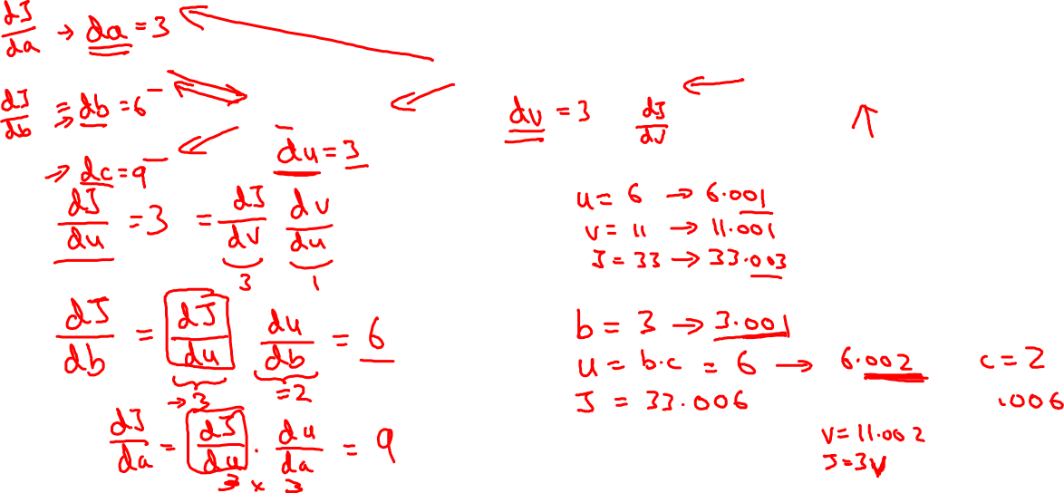
Computing derivatives
11
33
6
=

