Slide 1
CASE: THE ADVENT OF SMARTPHONE APPLICATIONS
Abdul Basit Shoukat Solkar
Jay Mahesh Todkari
Rutvik Haresh Ghole

Slide 2
Problem Statement
To draw useful insights from the dataset that has around 10000+ applications data. Expected solution:
1.Draw insights about the parameters that drive the success of an application in the markets. You may assign different weights to the parameters.
2.Come up with top 100 applications of all and justify your results with Visualisations.
3.Come up with bottom 100 apps you would rank after taking various parameters into consideration their reasons of failure with visualisations.

Slide 3
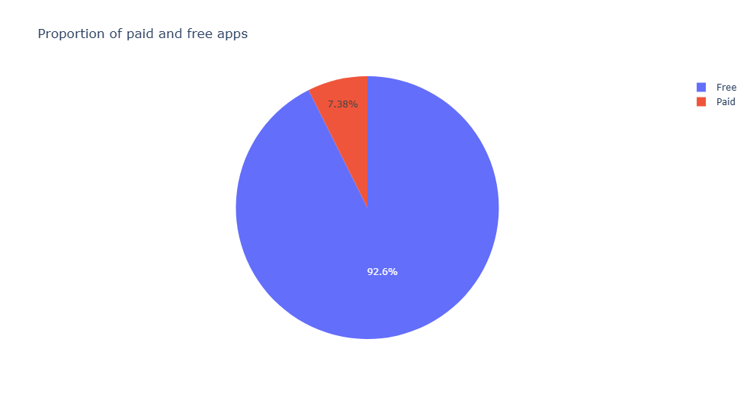
Free vs Paid
 | Free (mean) | Paid (mean)
Downloads | 1.6 million | 91k
Ratings | 4.1 | 4.2
Review_per_install | 221 | 23

Slide 4
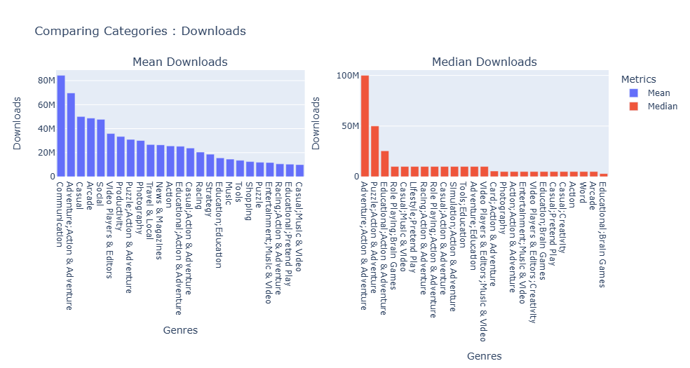
Comparing Categories

Slide 5
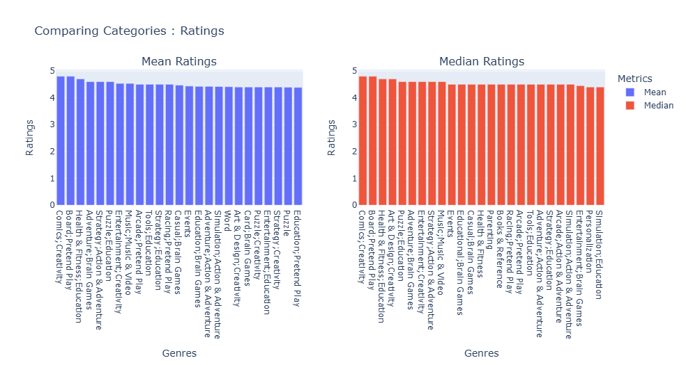

Slide 6
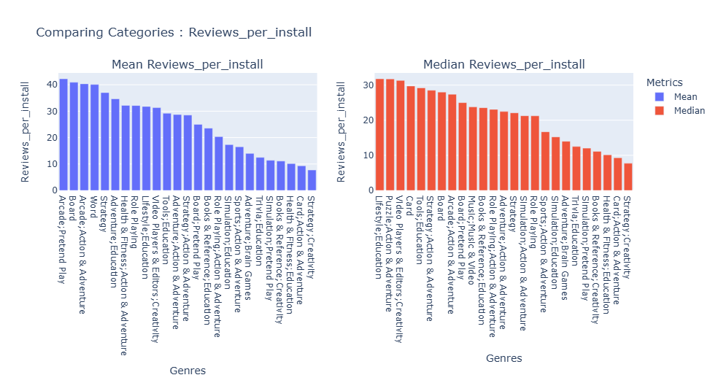

Slide 7
Mean and median downloads of top 25 categories is taken.
Downloads: for top 25 categories ratings are almost up to 80M.
Ratings : for top 25 categories ratings are almost as i.e between 4M to 5M.
Review per install: for top 25 categories ratings are almost as up to 40M.

Slide 8
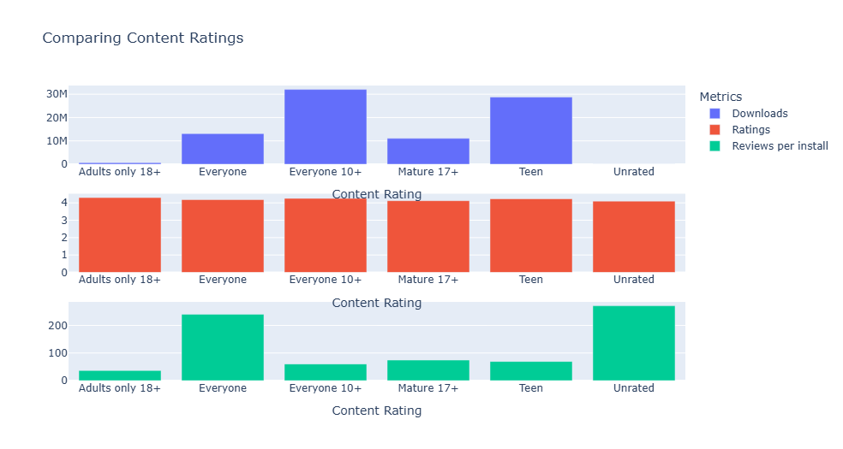
Comparing Content Ratings

Slide 9
Downloads : ‘Everyone 10+’ and ‘Teen’ category apps have avg downloads of 25 to 30 million , ‘Everyone’ and ‘Mature 17+’ have downloads between range of 10 to 12 million while Adults and Unrated apps have very less number of downloads.
Ratings : Ratings are almost same for each category.
Reviews per install : ‘Unrated’ and ‘Everyone’ category apps have less reviews compared to their downloads. Other category apps good balance between reviews and downloads.

Slide 10
Weights assigned
Formula used :
Score = downloads * 0.4 + ratings * 0.2 + review_per_install * 0.1 + 1*0.05 + 1*0.2 + 1*0.05
Weights for each feature:
Downloads : 40%
Ratings : 20%
Review_per_install : 10%
Categories : 5%
Content Rating : 5%
Genre: 20%

Slide 11
Reasons for Low Ranking
Less number of downloads
Less number of reviews.
No updates

Slide 12
Thanks!

