Slide 1


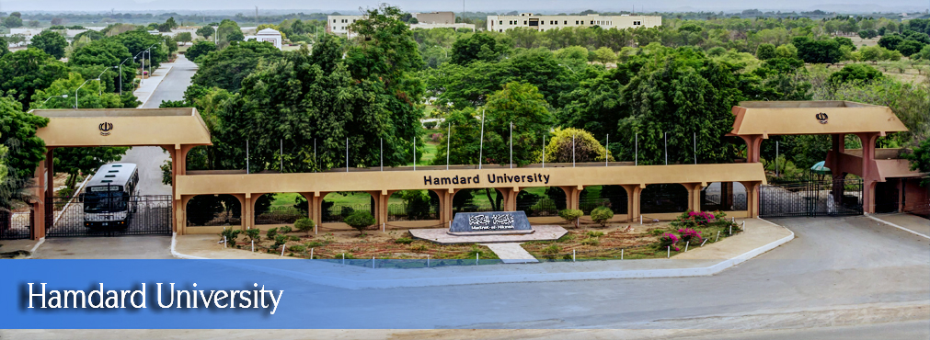
Brain Tumor Detection And Classification, Using Deep Learning, (Web And Application)
FYP Proposal
Abdul Basit | (1546-2021)
Shah Muhammad Uzair | (2398-2021)
Muzamil hussain | (1474-2020)
Supervisor-Mr Mohsin Raza Khan CO-Supervisor Dr.Khurram Iqbal
Hamdard University

Slide 2
Outline
Group Introduction
Problem Statement
Project Objectives
Project Scope
Architectural Big Picture
Methodology
Role & Responsibility
Project Milestones
Project Plan (Time lines)
Project Budgeting
Project Tools
Project Deliverables

Slide 3
Group Introduction
Group Members
Abdul Basit
Shah Muhammad Uzair
Muzamil Hussain
Supervisor: Dr. Khurram Iqbal
Why we selected him as supervisor?
We selected him as our supervisor because of his expertise in the field of deep learning model. His extensive knowledge and experience in this domain provide invaluable guidance for our project. Moreover, his background in developing web and application-based solutions aligns perfectly with the technical aspects of our project, ensuring we receive the best possible support and mentorship.
Relevant Expertise
He has experience in similar domain and industry project which is related to our project.
Relevant Experience
He has 8+ years of prolific experience in academia and IT industry.

Slide 4
Problem Statement
Detecting brain tumors early is tough, often leading to late diagnoses when treatment is less effective. Annotating brain tumor images manually takes a lot of time, slowing down the development of accurate machine learning models. The differences in tumor size, location, and appearance make detection even harder. Current models struggle to work well with different datasets due to varying imaging methods and patient differences. There aren't enough high-quality, publicly available datasets to compare and improve algorithms. Better methods and more datasets are needed to improve patient outcomes and advance brain tumor detection.

Slide 5
Project Objectives
.
Create a Deep Learning Model Build a model to accurately detect and classify brain tumors from MRI scans.
Improve Diagnosis Make the detection process more accurate to help doctors diagnose brain tumors better.
Build User-Friendly Web & App Develop easy-to-use web and mobile application for accessing the detection system.
Test and Validate the Model Thoroughly test the model to ensure it works well with different images.
Protect Patient Data Ensure that all patient information remains private and secure..

Slide 6
Project Scope
In this project, we will focus on creating a system using deep learning to find and classify brain tumors in MRI scans. Our goal is not to invent new MRI machines or change how they work. We assume we'll have enough different data to train and test our system, and we can use techniques to improve the data quality before feeding it into our model. Details like how machines talk to each other or exact machine specifications don't matter for this project. What's important is making sure our system can accurately and sensitively detect tumors. This will help doctors better diagnose and treat brain cancers.

Slide 7
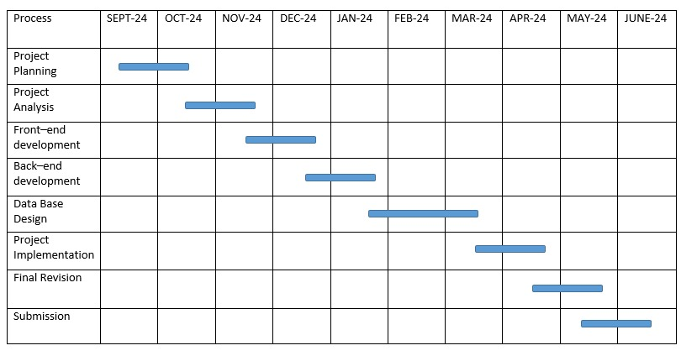
Architecture Big Picture

Slide 8
Project Methodology
Data Collection: Gather labeled brain MRI scans with tumor information.
Data Preprocessing: Adjust MRI scans for clarity and diversity.
Model Design: Develop a neural network to detect tumors using MRI images.
Transfer Learning: Use pre-existing models to improve efficiency.
Training and Testing: Train the model and validate its accuracy on different datasets.
Documentation: Record steps and results for transparency.
Why?
Efficiently develop a reliable system for brain tumor detection in MRI scans.

Slide 9
Project Role & Responsibilities
RACI Chart
Project Deliverable Activity | Supervisoror | Abdul Basit | Shah Muhammad Uzair | Muzamil Hussain
Project Planning | C, I | R | R | R
Project Analysis | C, I | A, I | R | R
Project Design | C, I | R | R | R
Project Implementation | C, I | A | A | R
Project Documentation | C, I | R, A | R, A | R, A
Finalize and Deployment | C, I | R, A | R, A | R, A

Slide 10
Project Milestones
Information gathering
Literature review
Planning
Annotation(Annotate the collected video conference data by labeling the emotions and sentiments expressed by participants)
Algorithm selection
Feature extraction (Extract relevant features from the video and audio data.)
Model building
Model training (Train the sentiment analysis model using the annotated video conference dataset.)
Real-time integration (Integrate the sentiment analysis model into the video conference software or platform.)
Designing
Testing
Deployment
Maintenance

Slide 11

Project Plan
Project Initiation
Define Objectives and Scope: Outline goals and scope of brain tumor detection and classification.
Literature Review: Review existing methods in brain tumor detection using deep learning.
Stakeholder Identification: Engage with healthcare professionals and end-users for insights.
Data Collection and Preparation
Dataset Gathering: Collect diverse, annotated brain MRI scans.
Data Preprocessing: Normalize and augment data to improve quality.

Slide 12
Project Plan
Model Development
Architecture Design: Design deep neural network architecture for tumor detection.
Implementation: Code model using TensorFlow for scalability.
Model Training and Validation
Training Process: Train model with dataset, optimize parameters.
Validation: Validate model with separate dataset, address overfitting.
Testing and Evaluation
Testing: Evaluate model on independent dataset.
Performance Metrics: Measure accuracy, precision, recall, and F1 score.

Slide 13
Project Budgeting
Developers (Data Scientist/Deep Learning Engineer):
1 person @ 40,000 PKR/month x 3 months: 120,000 PKR
Hardware and Software:
GPU Server Rental:
8,000 PKR/month x 3 months: 24,000 PKR
Hard Drives:
4,000 PKR x 2: 8,000 PKR
Software Licenses and Tools:
Anaconda, Python 3.9.12, VS Code, Jupyter Notebook, PyCharm:
Included in developer costs

Slide 14
Project Budgeting
Internet and Electricity:
Internet:
1,000 PKR/month x 3 months: 3,000 PKR
Electricity:
1,000 PKR/month x 3 months: 3,000 PKR
Dataset Acquisition:
Purchase of diverse and annotated brain MRI scans: 5,000 PKR
Miscellaneous:
Contingency (10% of total): 9,000 PKR
Total Estimated Cost: 172,000 PKR

Slide 15
Project Tools
Software Requirements
Anaconda
Python 3.9.12
Vs code
Jupyter notebook
pycharm

Slide 16
8- Project Deliverables
FYP-I Evaluation
FYP-II Evaluation
SRS Document
Budget Document
WBS
Project Plan
Design Mockup
Data Collection Interface
Project Report - I
Funding Proposal
Survey Paper (First Draft)
UI Design
Proposed System
User Manual
Source Code CD
Project Report - II
Research Paper (First Draft)

Slide 17
THANK YOU!

