Slide 1
ONLINE FOOD DELIVERY SYSTEM
PROJECT
ON

Slide 2
Team Members
Aditya More
Akash Goel
Appana Tulasi Krishna
Basit Fayaz

Slide 3
ABSTRACT
Manage the whole process of ordering food online.
Built using Java, Spring-Boot with Hibernate, and ReactJS.
Motive to manage the food items, perform the order, and payment.
User and Admin access.

Slide 4
Technologies used
Database: Oracle Database 11g Express Edition
Back-end: Java, Spring-Boot with Hibernate
Front-end: ReactJS

Slide 5
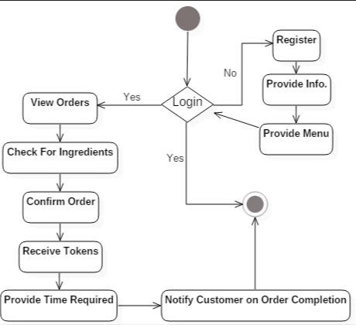
Activity diagram

Slide 6
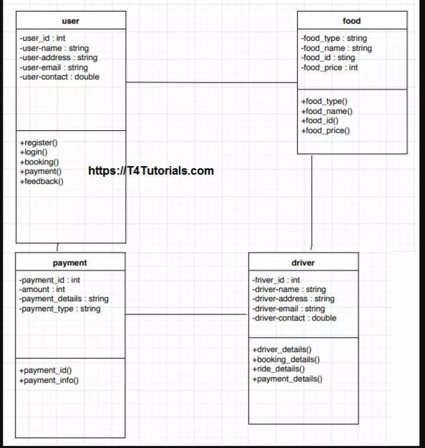
Class diagram

Slide 7
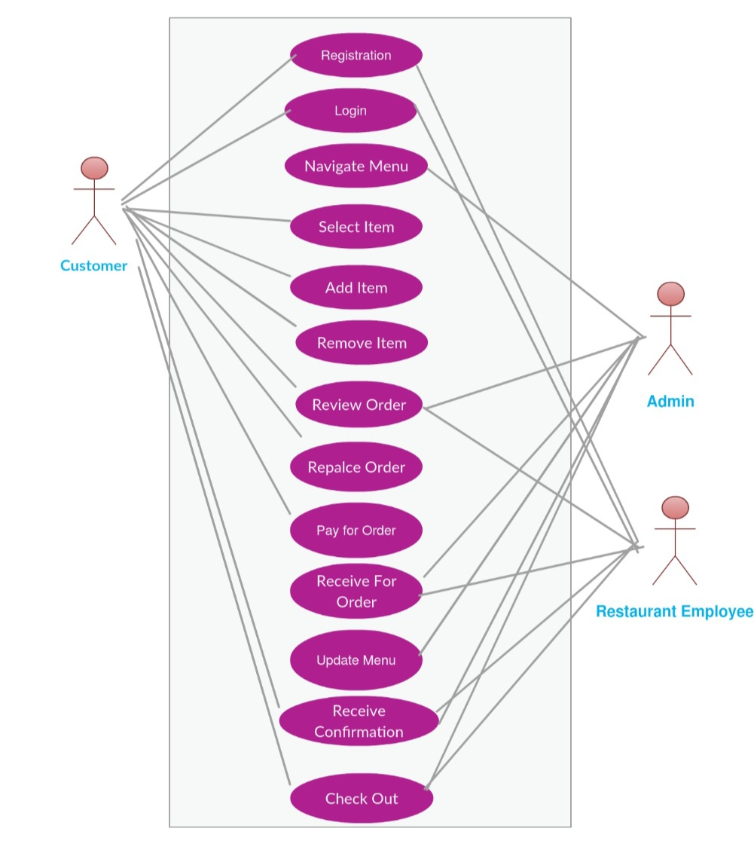
Case diagram

Slide 8
Modules:
Bill module
Cart module
Category module
Customer module
Item module
Order module
Restaurant module

Slide 9
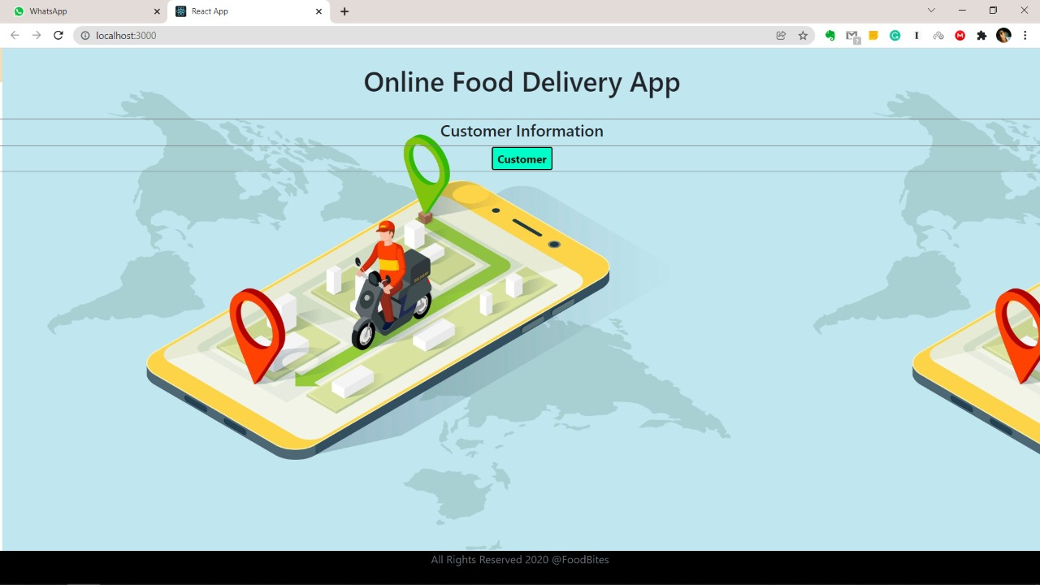

Slide 10
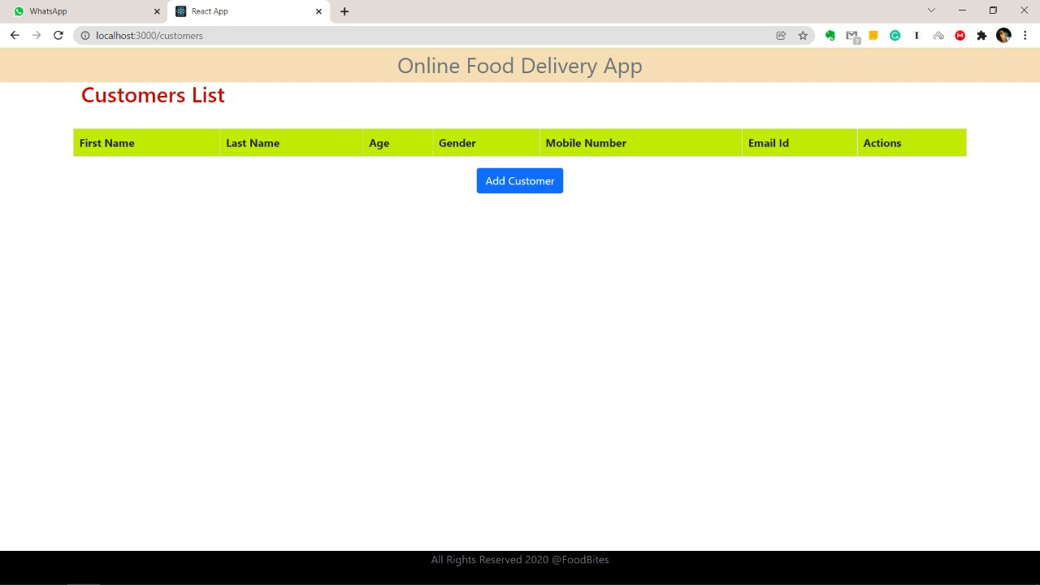

Slide 11
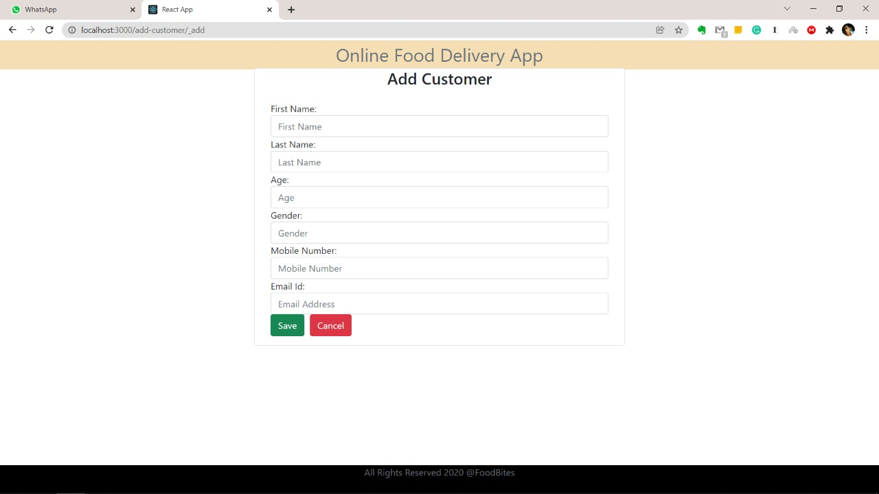

Slide 12
Thank You

