Slide 1

Ontology Based Knowledge Healthcare System
Major Project Presentation
Submitted by:
Basit Halim(201600112)
Asifur Rahman(201600660)
Under the supervision of:
INTERNAL REVIEWER
PROJECT MENTOR
Mr. Dhruba Ningombam Dr. Md. Tanwir Uddin Haider
Assistant Professor(SG), Associate Professor, CSE
Computer Science and Engineering, National Institute of Technology,
Sikkim Manipal Institute Of Technology. Patna

Slide 2
CONTENTS
Serial No. | Title | Page No.
1 | ABSTRACT | 3
2 | INTRODUCTION | 4-5
3 | LITERATURE SURVEY | 6-7
4 | PROBLEM DEFINITION | 8
5 | SOLUTION STRATEGY | 9
6 | DESIGN | 10-12
7 | IMPLEMENTATION | 13-18
8 | RESULT | 19-26
9 | LIMITATION | 27
10 | CONCLUSION AND FUTURE SCOPE | 28-29
11 | GANTT CHART | 30
12 | REFERENCES | 31
13 | ACKNOWLEDGEMENT | 32

Slide 3
ABSTRACT
The project ‘Ontology based Knowledge Healthcare System’ is developed in order to construct a decision making ontology model for disease detection and treatment suggestion through symptoms.
The project ontology based knowledge healthcare system is developed in the web ontology language (OWL).
Web ontology language is chosen as the development environment because it allows by having essential relationships between concepts built into them, they enable automated reasoning about data.
Automated reasoning about data is easy to implement in semantic graph databases that use ontology as their semantic schema and thus web ontology language (OWL) was used.
It takes decisions on its own rather than just being an input output system. In the Healthcare sector, one of the most valuable challenges is the one connected with the information extraction from raw data that implies the automatic detection of significant facts in unstructured texts and their transformation into structured documents, which are indexable and query able exactly like databases.

Slide 4
INTRODUCTION
What is ontology?
Ontologies formalise the semantics of the domain explicitly by describing their elements; and thus, they consist of concepts that describe the internal features of the concepts, and the properties that describe the relationships between these concepts. Ontologies are based on a shared and consensual domain knowledge agreed by a community.
The information extraction from raw data that implies the automatic detection of significant facts in unstructured texts and their transformation into structured documents, which are indexable and queryable exactly like databases. It incorporates the automation and ease to the process of disease detection and treatment suggestion
The automation and ease to the process of disease detection and treatment suggestion. Also, it takes into consideration the many factors that are associated with each disease and its types. During the course, an ample sized data was studied, analysed and interpreted in order to carve out the general rules that would be implied with certain features.
The Object properties on the other hand define the relationships between individuals. Individuals are like instances of a class. In OWL an individual can be instance of more than one class and can have polymerous object as well as data properties.

Slide 5
The rules hold utmost importance and any misrepresentation or inconsistency may lead to inaccuracy. It takes into account four diseases, namely: Diabetes, Cancer, Heart Disease, Covid-19 and Tuberculosis
These are further sub classified into their types. Also a patient is allotted a Patient’s Id, weight, age, gender amongst other factors. It is done in order to rationalize the symptoms as some of them may rely on these given factors as well
The Uschold and King’s method proposes the following activities:
(1) Identify the purpose of the ontology
(2) Build the ontology by capturing knowledge and identifying key concepts and properties in the domain, coding knowledge, and reusing other ontologies inside the current one,
(3) Evaluate the ontology, and
(4) Document the ontology.

Slide 6
LITERATURE SURVEY
SL No | Author & Paper details | Paper And Publication Details | Findings | Relevance to the project
1. | G. Suresh Babu A. Sunitha | Ontology driven knowledge based healthcare system and emerging area -challenges and opportunities. ISPRS Technical Commission VIII Symposium, 09 – 12 December 2014 | it is a theoretical approach to the challenges and opportunities that a knowledge engineer would face if they were to make a ontology based healthcare system. | Describe approach in establishing firm linkage between different ontologies related to diseases, places and environments in our integrated platforms
2. | Dendani Nadjette 1 Allouani Rayene 1 1 Badji Mokhtar-Annaba University | Rule based decision system support system and domain Ontology for diabetes diagnosis IC 2019, AFIA, Jul 2019, Toulouse, France | Uses AI(Rule based reasoning) It aims at helping the doctor diagnosis diabetes type and propose treatment | Formulation of rules for the system were learnt. Although they were inference and not knowledge rules . Also, how a rule is made was learnt

Slide 7
SL No | Author | Paper And Publication Details | Findings | Relevance to the project
3 | Robert J. Rovetto and Riichiro Mizoguchi | Casuality and ontology of disease Applied Ontology, vol. 10, no. 2, pp. 79-105, 2015 | Takes only causation into Account. No model purpose Just general Discussion of Casual chains vis-A-vis disease ontology | Treatment suggestion ways were learnt from and incorporated in suggesting tests in our project
4 | Nureize Arbaiy, Shafiza Eliza Sulaiman et al | Integrated knowledge based expert system for disease diagnosis system. (IRIS2017) 6–7 May 2017, Melaka, Malaysia | Does not implement owl ontologies Only related to pneumonia,thallassemia and arthrimitis | Integrated knowledge based expert system for disease diagnosis system It is a theoretical approach to ontology for disease diagnosis. It describes the probable path and connections amongst class

Slide 8
Problem Definition
In the current scenario and also generally, most people do not consult a doctor. Also in recent times of Covid 19 it is not possible for people to go to a doctor.
Multiple diseases have similar symptoms resulting in overlapping of classes.
The process of data acquisition (see framework fig 1.1) involves collecting patient information data such as Age, Gender, Symptoms etc (object as well as data properties) are mostly unstructured and are thus very difficult to collect and visualize.
This field is such, that every case may have certain hidden components/Symptoms (Individuals, data properties, object properties) that may be the driving factor for that certain case. This causes inconsistency in the data analysis and thus resulting in inconsistent Semantic web rule language Rules (SWRL Rules).
Often the patients data property HasAge (Age) is incorrect on the prescription which may be used for data acquisition. This may lead to inaccuracy in Semantic web rule language Rules (SWRL Rules) formation resulting in inaccurate results.

Slide 9
Solution Strategy
The project requires the work of a knowledge engineer. A knowledge engineer interacts with the field experts, collects data and learns aptly regarding the domain of the project (in this case regarding Diseases namely Diabetes, Covid 19, Cancer, Tb and Heart disease). Further, the knowledge engineer using the domain data acquired creates ontology and Semantic web rule language Rules (SWRL Rules).
Firstly, Data Acquisition phase is carried out. Data is acquired through various sources such as medical diagnostic center, Medical clinics.
Afterwards in the Data Validation phase, the earlier acquired data is then manually validated through data acquired through websites such as . This confirms the accuracy, consistency and reliability of the dataset.
Data properties such as HasAge and HasGender are included in the ontology. These are the data properties that effect result of the ontology.
A primary key HasPatientId is included in the data property.

Slide 10




DESIGN
EXPERTS
KNOWLEDGE ACQUISITION
KNOWLEDGE VERIFICATION AND
VALIDATION
KNOWLEDGE BASE AND OTHER COMPONENTS
KNOWLEDGE ENGINEER
DEVELOPER INTERFACE
USER
KNOWLEDGE REPRESENTATION
Figure 6.1 - Knowledge Based System Architecture
The above figure represents the architectural diagram of a Ontology based knowledge healthcare system. The various servers and their organization has been represented.

Slide 11
LOGIN USER/KE
Knowledge
Acquisition
RULES
LAB DATA
SYMPTOMS
WEB DATA
DIAGNOSIS
M.I- MYOCADIAL INFACTION
K.R- KNOWLEDGE REPRESENTATION
G.U.I - GRAPHICAL USER INTERFACE
TEST
REPORT
DISEASE
TB
CANCER
COVID 19
DIABETES
HEART
LATENT
ACTIVE
TYPE 1
TYPE 2
M.I*
ARRYTHMIA
MEDICATION
SPARQL
TREATMENT
K.R*
G.U.I*
SURGERY
ONTOLOGY
Fig 6.2 :Proposed Framework

Slide 12
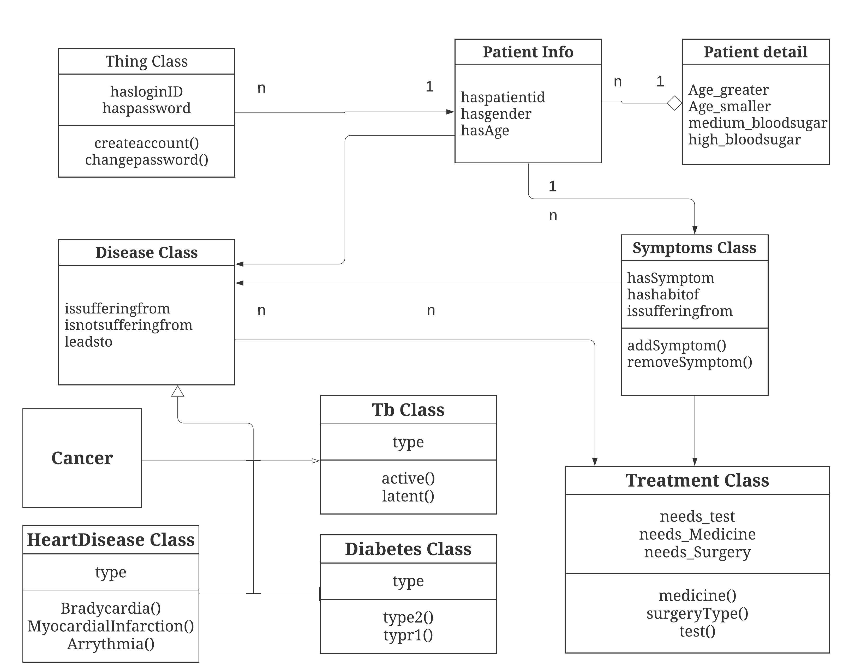
CLASS DIAGRAM
Covid 19
FIG 6.3 : CLASS DIAGRAM FOR ONTOLOGY BASED KNOWLEDGE HEALTH CARE SYSTEM

Slide 13
IMPLEMENTATION
Identify the purpose of the ontology.
Test where the ontology development is carried out by applying natural language analysis techniques to texts.
Build the ontology by capturing knowledge and identifying key concepts and properties in the domain, coding knowledge, and reusing other ontologies inside the current one.
Relational schema aims to extract relevant concepts, properties, relations from databases schema or relations.
Evaluate the ontology.

Slide 14
IF patient is male And if there is chest pain AND IF there is pain in upper part of the body AND If it last more than 5 mins And if sweating occur And if he feel nausea then he is suffering from myocardial infraction.
IF patient is female And If she having features of ‘RULE 1’ And if there is shortness of breath And IF vomiting occurs Then she is suffering from myocardial infraction.
IF Patient has feature of RULE 1 And IF patient has features of Rule 2’ THEN Recommend “Stress Test“ And Then Recommend ‘Angiogram’ And Then Recommend ‘Echocardiogram’.
IF patient has slow heart beat AND IF patient feels palpitations AND IF patient experiencing syncope THEN he is suffering from “BARDYCARDIA-Arrhythmias”.
IF patient has fast heartbeat AND IF patient feels palpitations AND IF patient experiencing syncope THEN he is suffering from “TACHYCARDIA-Arrhythmias”.
IF patient has Arrhythmias THEN recommend Blood Test Then recommend EKG THEN Recommend chest-Xray THEN recommend heart catheterization Then recommend echocardiogram THEN recommend electrophysiologic test.
IF patient has myocardial infarction THEN consult doctor.
IF patient has bradycardia-Arrhythmias THEN suggest pacemaker.
IF patient has tachycardia-Arrhythmia THEN perform Vagal maneuvers.
The above represents the IF-THEN rules .Which are later converted into the First order predicate .

Slide 15
U->(PATIENT(M)^ ~PATIENT(F)) v (~PATIENT(M)^ PATIENT(F))
For All(X,Y) U ^ PERSISTENT_COUGH^ BLOOD_COUGH ^ BREATHING _PAIN ^WEIGHT_LOSS=> TB
For All(X,Y) U ^ PDP_POSITIVE ^ BCG=> FALSE POSITIVE
For All(X,Y) U ^ PDP_NEGATIVE ^ AIDS => FALSE NEGATIVE
For All(X,Y) U ^ PDP_POSITIVE ^ BLOODTEST_POSITIVE ^ SPUTUM_NEGATIVE => Latent TB
For All(X,Y) U ^ PDP_NEGATIVE ^ BLOODTEST_NEGATIVE ^ SPUTUM_POSITIVE => ACTIVE TB
For All(X,Y) U ^ LATENT TB => IMAGING TEST
For All(X,Y) U ^ LATENT TB => (U ^ ~ ACTIVE TB)
For All(X,Y) U ^ PATIENT(M) ^ HUNGER ^ DECREASED_SEX_TIME ^ POOR_MUSCLE_STRENGTH => DIABETES
For All(X,Y) U ^ PATIENT(F) ^ HUNGER ^ FREQUENT_URINATION ^ UNIARY_TRACT_INFECTION => DIABETES
For All(X,Y) U ^ (PATIENT(M) ^ ~PATIENT(F) ^ DIABETES ^ AGE <=20 => TYPE 1 v (~PATIENT(M) ^ PATIENT(F))
For All(X,Y) U ^ (PATIENT(M) ^ ~PATIENT(F) ^ DIABETES ^ AGE > 20 => TYPE 2 v (~PATIENT(M) ^ PATIENT(F))
For All(X,Y) U ^ ((PATIENT(M) ^ ~PATIENT(F) ^ TYPE 1 => (~PATIENT(M) ^ PATIENT(F)
First Order Predicate Logic

Slide 16
SWRL RULES
patient_id(?p), hasSymptom(?p, h_bloodsugar) -> issufferingfrom(?p, Diabetes)
Above rule relates Diabetes disease with its symptoms
patient_id(?p), issufferingfrom(?p, Active_TB) -> isnotsufferingfrom(?p, Latent_TB)
Above rule relates Latent Tb disease with its symptoms
patient_id(?p), hasSymptom(?p, Change_in_bowel_movement), hasSymptom(?p, Easy_bruising), hasSymptom(?p, Mole_with_changing_features), hasSymptom(?p, Pale_complexion), hasSymptom(?p, change_in_urination), hasSymptom(?p, fatigue), hasgender(?p, "male") -> issufferingfrom(?p, Cancer)
Above rule relates Cancer disease with its symptoms and gender
patient_id(?p), hasSymptom(?p, Shortness_of_breadth), hasSymptom(?p, jaw_pain), hasSymptom(?p, nausea), hasSymptom(?p, vomiting) -> issufferingfrom(?p, Myocardial_Infarction)
Above rule relates Myocardial Infarction (Heart Disease) with its symptoms
patient_id(?p), issufferingfrom(?p, Cancer), hasgender(?p, "male") -> needtest(?p, CT_SCAN), needtest(?p, MRI), needtest(?p, Radiology)
Above rule relates Cancer disease and the gender of the patient with the tests required for that disease

Slide 17
INDIVIDUALS
SL No | Individuals | Properties
1. | 12345 Basit_halim Age Gender Weight_loss | This Individuals are associated with patient and contain vital informal for various parameter. These Individuals Helps us to differentiate patient with different attributes.
2. | Anxiety Blurry_Vision Fatigue Jaw_Pain Fever LightHeadness | This Individuals represent different kind of symptoms associated with various diseases These Individuals are further utilised by the SWRL rules and mapped to the particular diseases.
3 | Stress_Test PDP_Test Sputum Test CT_Scan EKG ECG | These Individuals represents different kind of Tests associated with various diseases. After Mapping Symptoms with SWRL rules.The system will recommend test and the results are then mapped with Treatment.

Slide 18
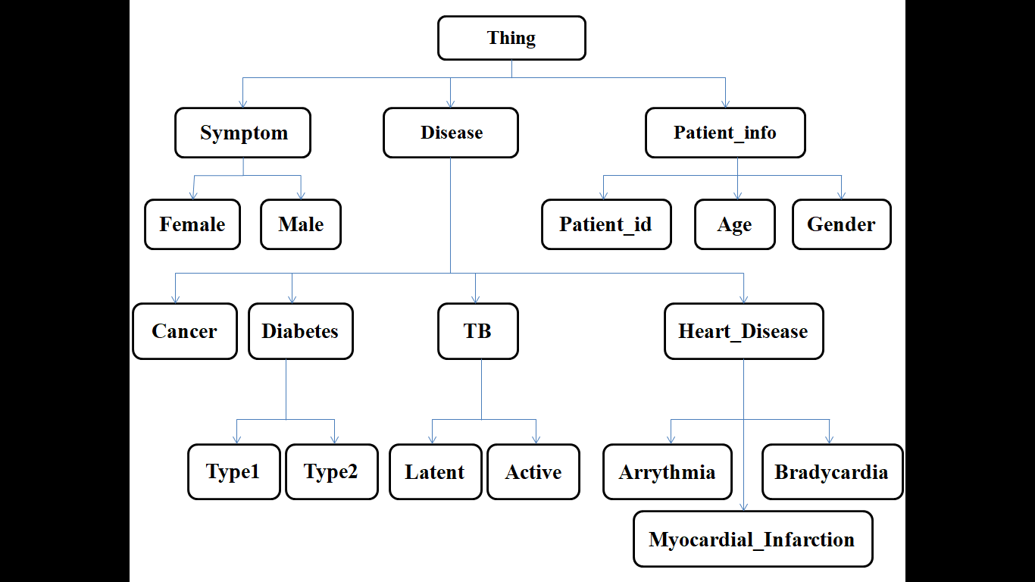
CLASS HEIRARCHY
Covid_19

Slide 19
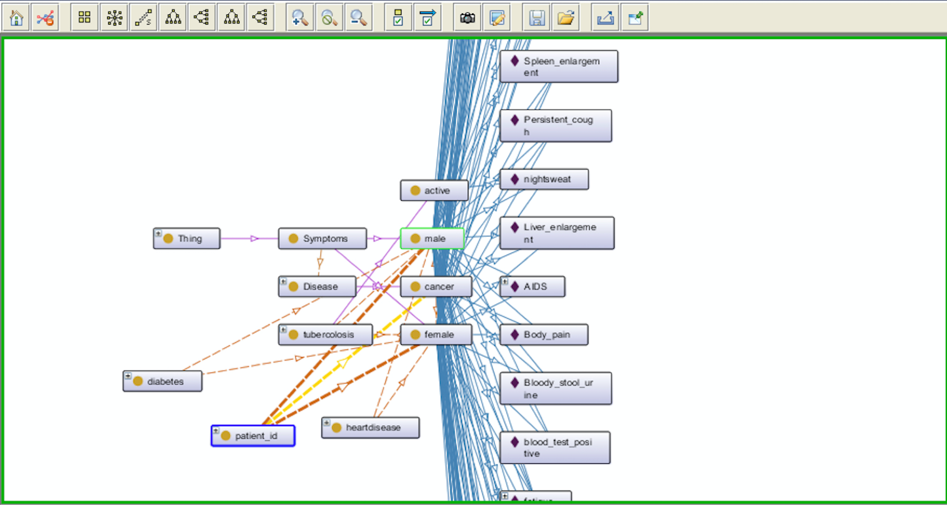
RESULTS
Figure 8.1– Ontology Graph depicting the relationships between class and individual through properties.
The above figure represents the Knowledge Graph, where the types and the relationships between them are expressed by nodes and edges between these nodes, By describing the structure of the knowledge in a domain, the ontology sets the stage for the knowledge graph to capture the data

Slide 20
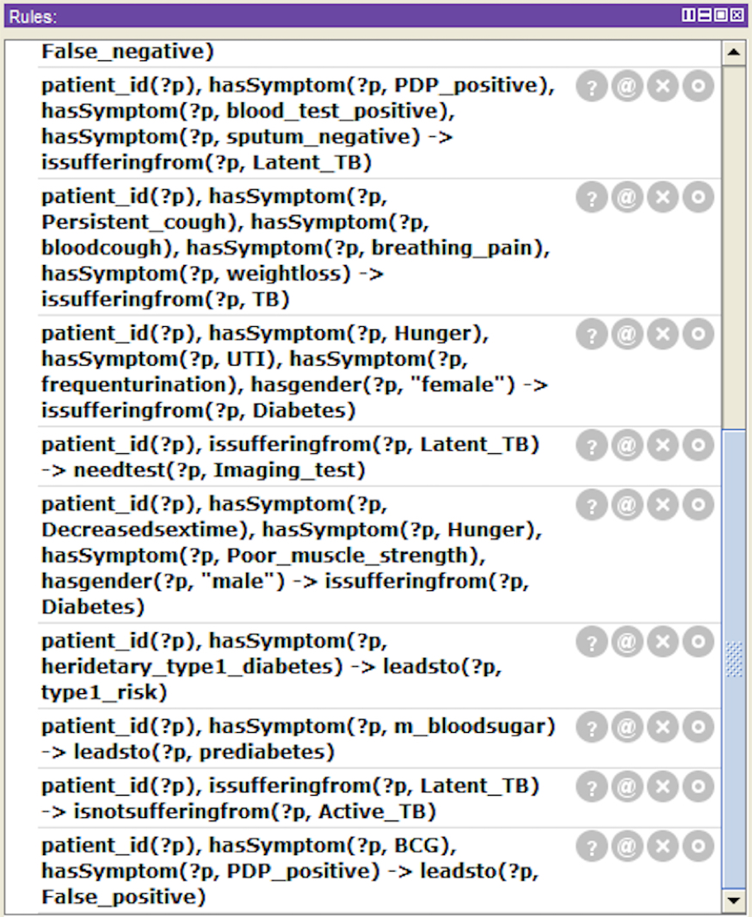
Figure 7.1 –SWRL for Tuberculosis
The above figure represents the SWRL rules for Tuberculosis. The Semantic Web Rule Language (SWRL) is an expressive OWL-based rule language. SWRL allows users to write rules that can be expressed in terms of OWL concepts to provide more powerful deductive reasoning capabilities.

Slide 21
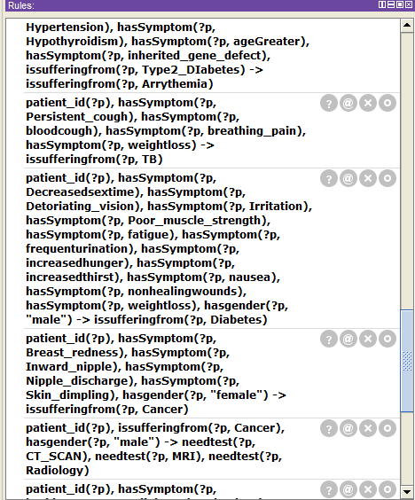
Figure 7.2 - SWRL for Diabetes (Male)

Slide 22
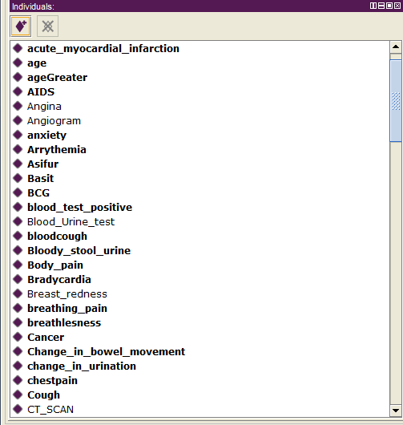
Figure 7.3 – INDIVIDUAL PROPERTIES
Individuals (instances) are the basic, "ground level" components of an ontology. The individuals in an ontology may include concrete objects such as people, animals, tables, automobiles, molecules, and planets, as well as abstract individuals such as numbers and words.In the above the fig it shows symptoms of different disease which are assigned to the system.

Slide 23
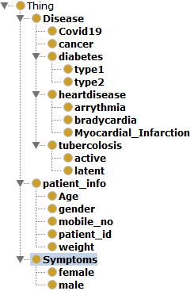
Figure 7.4 -CLASS HIERARCHY
The above figure represents the class hierarchy Ontology Knowledge Based Health Care System . The asserted class hierarchy view is one of the primary navigation devices in Protégé. It is presented as a tree where nodes in the tree represent classes

Slide 24
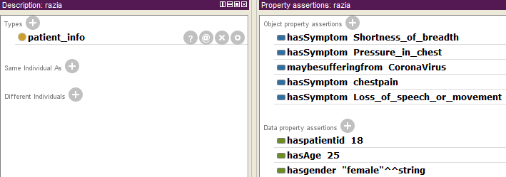
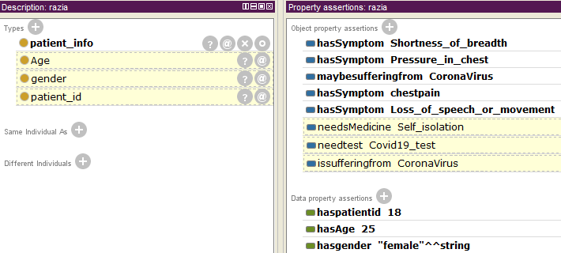
a
b
Figure 8.2 - Showing the automated system making decision from symptoms to diseases (Covid 19), tests (Covid 19 test) and treatment (self isolation) from a to b.

Slide 25
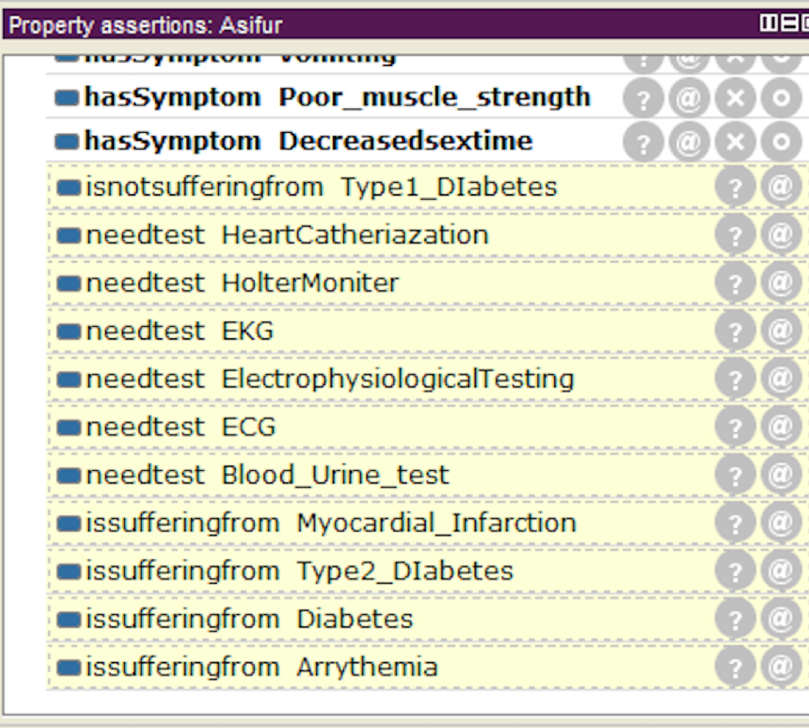
Figure 8.3 - Showing result (disease and its type, tests) for the given Symptoms
The above figure represents the automated decision taken by the system with respect to symptoms of the patient Asifur, the diseases suffering from and also the tests needed.

Slide 26
LIMITATIONS
The Ontology have the following limitations:
No proper mechanism to convert knowledge rules to SWRL rules.
Relationship can result lead to error if individual properties are not defined properly.
Overlapping in class hierarchy.
The Knowledge based e-healthcare system has the following limitations:
There are lots of ambiguity in terms of data as the upper and lower threshold of many parameter in data collection.
Patient history is not taken into consideration.

Slide 27
FUTURE WORK
Afterwards this project may be developed into a whole system of its own which may include pulse oximeter, vitals checker and maintainer amongst others.
We hope to build in future such low cost sensors which maybe attached into smartphones so that every one may be aware of their health at all this.
It will correctly detect all the relevant symptoms from the subject’s body and will further eliminate the possibility of human error and improve accuracy of the result to maximum.

Slide 28
CONCLUSION
This project has infact woven great results inspite of being just a prototype and with limited data availability.
Machine learning, natural language processing and convolution network can make the take easier without human intervention in SWRL rule formation.
The best part yet about this approach is infact this very approach. As every patient and every case is different from the other, this approach enables the doctor himself to add rules specific to a patient pertaining to their case and can also add new rules for new cases in medical profession.
This project brings to an end a very dangerous millennial habit of surfing Google for symptoms and diseases the results of which have often been found highly volatile and inaccurate. Accuracy of the data on websites are highly inconsistent and thus the results.
This approach enables generic as well as individual interaction and rules formulation making it so much effective.

Slide 29
GANTT CHART
ACTIVITY | TIME FRAME (Year 2020)
 | Jan. (13-01-2020) | February (13-02-2020) | March (16-03-2020) | April (6-04-2020) | May (30-05-2020)
Literature Survey
Problem Identification
Design
Implementation
Documentation
Proposed Activity
Completed Activity

Slide 30
REFERENCES
[1] McBride, et al, RDF Semantics. W3C, 2004.
[2] G. Suresh Babu et al ,Ontology driven knowledge based healthcare system and emerging area -challenges and opportunities,ISPRS Technical Commission VIII Symposium, 09 – 12 December 2014.
[3] Mike Dean, G.S., Sean Bechhofer et al,OWL web ontology language reference,W3C Recommendation,2004
[4] Dhana Nadini ,Semantics Web and Ontology, Bookboon (2014)
[5] Priti Srinivas Sajja, Rajendra ,Knowledge-Based Systems for Development,Model, Applications & Research,Vol. 1, pp 1 – 11, 2010
[6] Faten Kharbat 1 et al,Building Ontology from Knowledge Base Systems,Data Mining in Medical and Biological Research,2008
[7]Chisholm RL. Annotating the human genome with Disease Ontology, BMC Genomics, 2009, vol. 10 (pg. S1-S6)

Slide 31
ACKNOWLEDGEMENT
The success of this project required a lot of guidance from many people and we’re privileged to have got this all along the completion of our project
We’re profoundly grateful to Dr. Tanwir Uddin Haider, Associate Professor, CSE dept, NIT Patna, our external project guide for his valuable guidance, help, suggestions and assessment.
We owe our deep gratitude to our project guide Mr. Dhruba Ningombam, who guided us till the completion of our project work by giving necessary information.
We express our gratitude to Dr. Kalpana Sharma, Professor and HOD Computer Science Engineering Department for her support and guidance.
We would also like to heartily thank the project coordinators and all the professors and faculty members for their guidance and suggestions during our project work.
Date – 15/06/2020 Basit Halim Asifur Rahman
201600112 201600660

Slide 32
Thank You!

