Slide 1

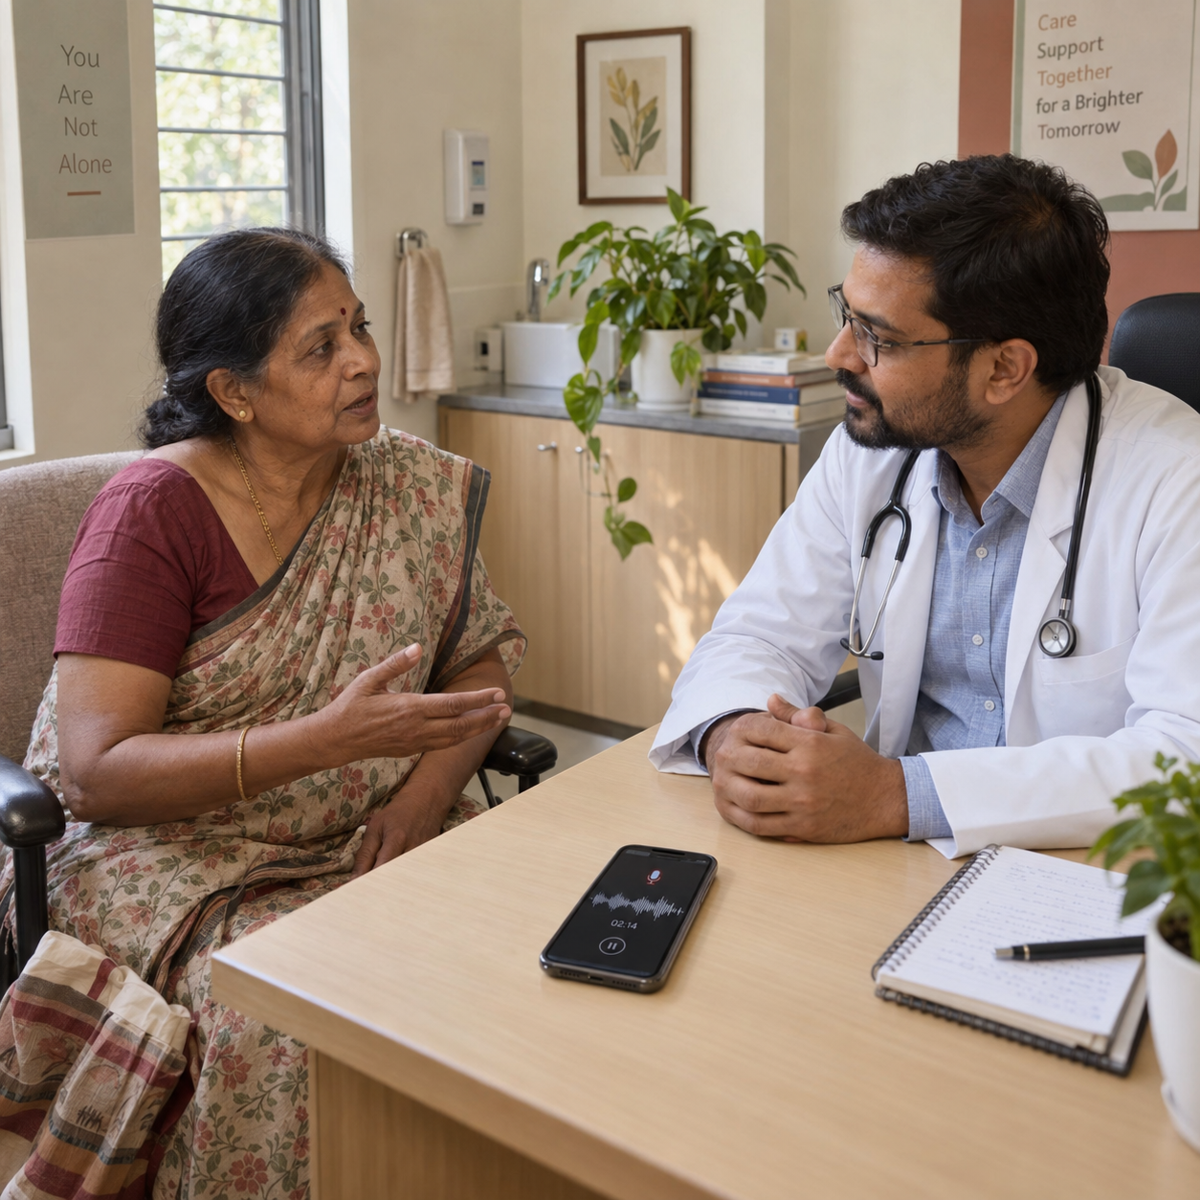

Sahara
A Palliative Care
Companion
Zeros and Ones
Illustrative consultation. No real patient use shown.
HEALTH-A-THON 2026 • PHASE 2 DRAFT
Notes:
Organiser template artwork/theme is unchanged. Product name and icon: TEAM_HANDOFF.md and output/android/play-listing/icon-512.png.
Generated concept illustration reused unchanged from submission/final/Saanthvana_Healthathon_2026-10-03-final.pptx, ppt/media/image23.png. It is not a patient photograph or deployment evidence.
Team code remains unknown.

Slide 2
Team
Clinical and product work together
Member | Role | Focus
Dr Sharada Vinod Kutty | Doctor partner | Clinical workflow
Dr Sujay Halkur Shankar | Clinician | Care framework
Shaik Abdul Basith | Technical lead | Product and engineering
Shaik Muhammad Awaiz | Technical member | Web and Android
Shirin Ayub | Medical student | Clinical input
Doctor specialities, biographies and photos remain to confirm.
HEALTH-A-THON 2026 • FINAL SUBMISSION
Notes:
Roster/roles: original submitted 3 October deck, slide 1. Contributions: repository history, MEETING_EVIDENCE_MAP.md and TEAM_HANDOFF.md.
The user explicitly deferred photographs and biographies. Doctor speciality, experience, institutional affiliations and final individual contributions remain to confirm.
Latest symptom-tracker clinical work is assigned to Shirin and remains pending. It is not a completed clinical module.

Slide 3
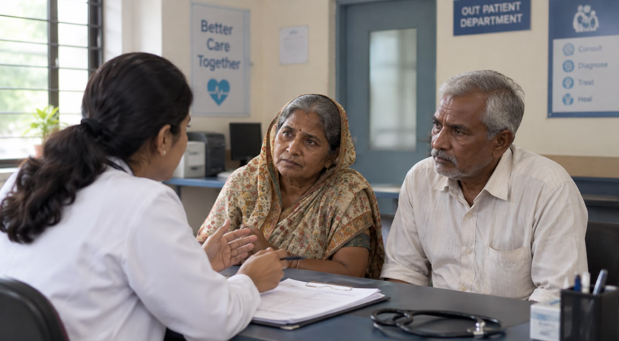
The problem
92% documented
after QI
The next team needs
the earlier conversation
24/26 documented
Chennai QI study
Illustrative family scene
External study, not Sahara results
HEALTH-A-THON 2026 • FINAL SUBMISSION
Notes:
The family scenario comes from the old submitted deck and is illustrative.
Primary evidence: Thangasamy DRJ et al., Initiating and Documenting Goals of Care Discussion in Patients with Advanced Pancreatic and Colorectal Cancers, published 4 November 2025. https://journals.sagepub.com/doi/10.1177/26892820251392545 and https://pubmed.ncbi.nlm.nih.gov/41340644/ .
Single-centre quality improvement, Cancer Institute (WIA), Chennai. Reported baseline documentation0%; QI result24/26=92.3%, reported92%. Two discussions had no documentation. No separate baseline denominator is given, so do not label baseline0/26.
The intervention included a standard procedure, referral changes and a paper record. It was not Sahara and did not establish that documentation improved goal-aligned treatment. Native chart uses fractions0,.92 with percentage formatting.

Slide 4
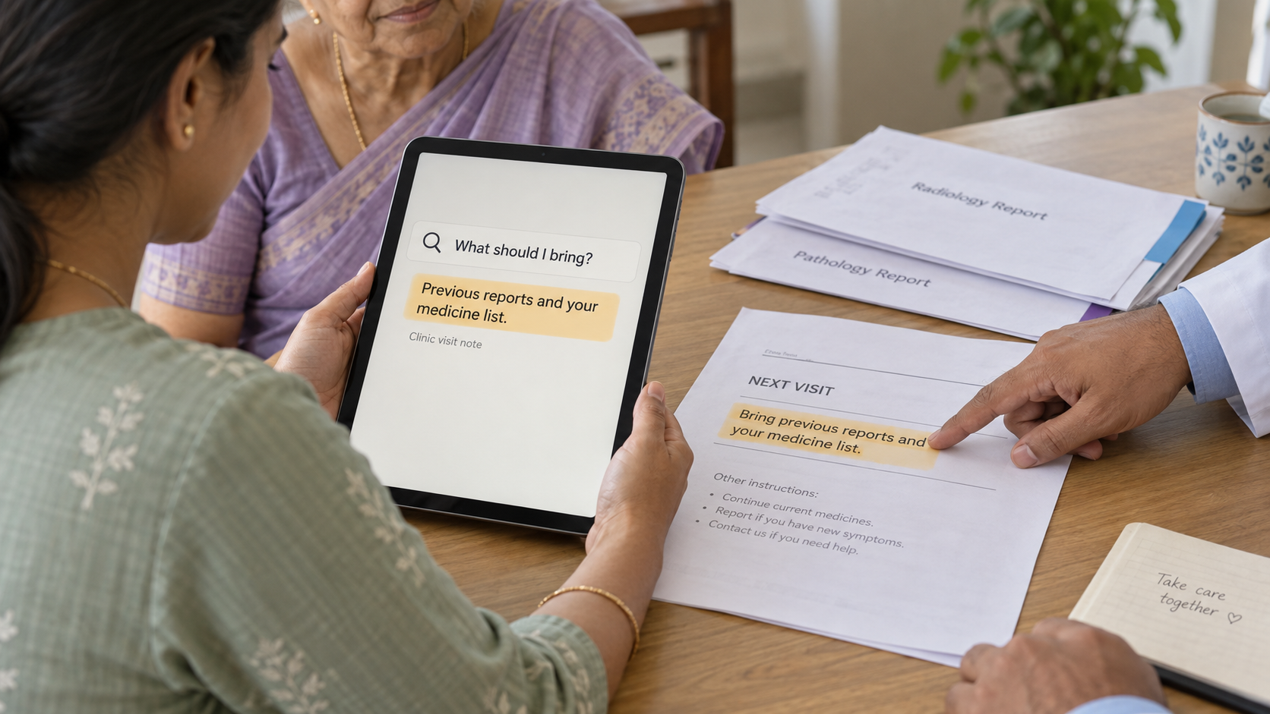
People and care setting
Patient and family
Say what matters.
Check the exact note.
Clinician
Lead, review
and revisit care.
Across clinic, home and the next care encounter
Illustration from Round 1. Clinical pilot not yet validated.
HEALTH-A-THON 2026 • FINAL SUBMISSION
Notes:
Primary user framing: form.md and FAMILY_CAREGIVER_DIRECTION.md. Clinician-led discussion with patient/family support.
Image is an unchanged generated concept from the old deck, ppt/media/image16.png. It is not a screenshot of current generative assistance or real patient use.
No actual hospital adoption, pilot enrolment or clinical outcome is established.

Slide 5
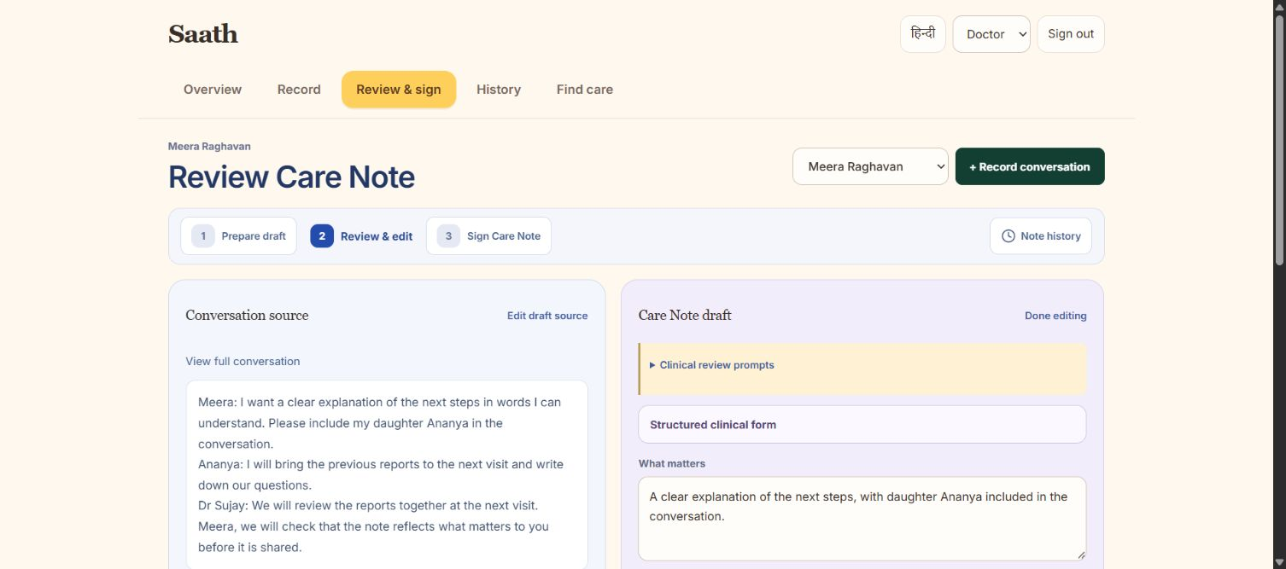
Goals-of-care journey
Source beside the Care Note
1
Consent + original
2
Clinician review
3
Release version
4
Exact-note confirmation
5
Permissioned retrieval
Actual web capture, 24 September. Fictional record and earlier name. Workflow is subject to clinical validation.
HEALTH-A-THON 2026 • FINAL SUBMISSION
Notes:
Current implemented workflow: TEAM_HANDOFF.md, android/release/store-draft.json and backend/shared-care source.
This is an editable workflow diagram, not evidence of completed clinical validation. Account roles require independent approval. A patient confirms an exact released version.
Original audio/reports remain private phone copies. Shared copied facts do not imply file sync. Confirmations are not claimed to be legally certified signatures, a living will, an advance directive or a treatment order.
Generative clinical drafting remains off.

Slide 6
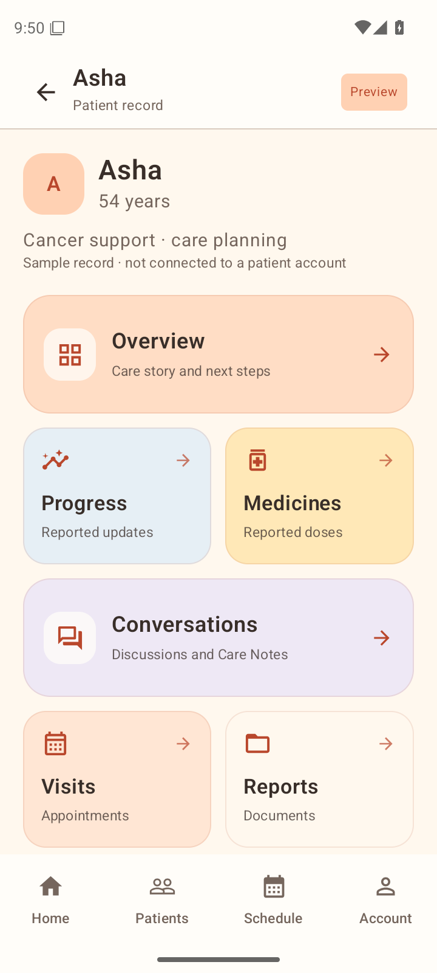
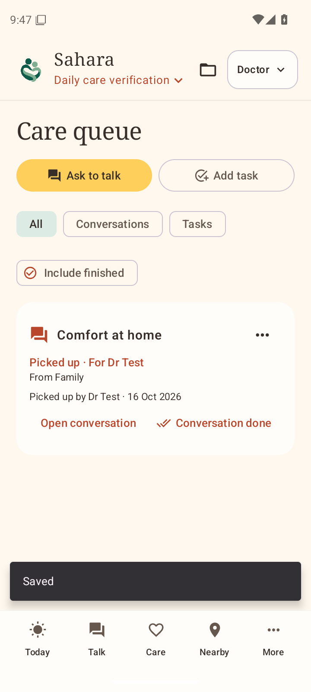
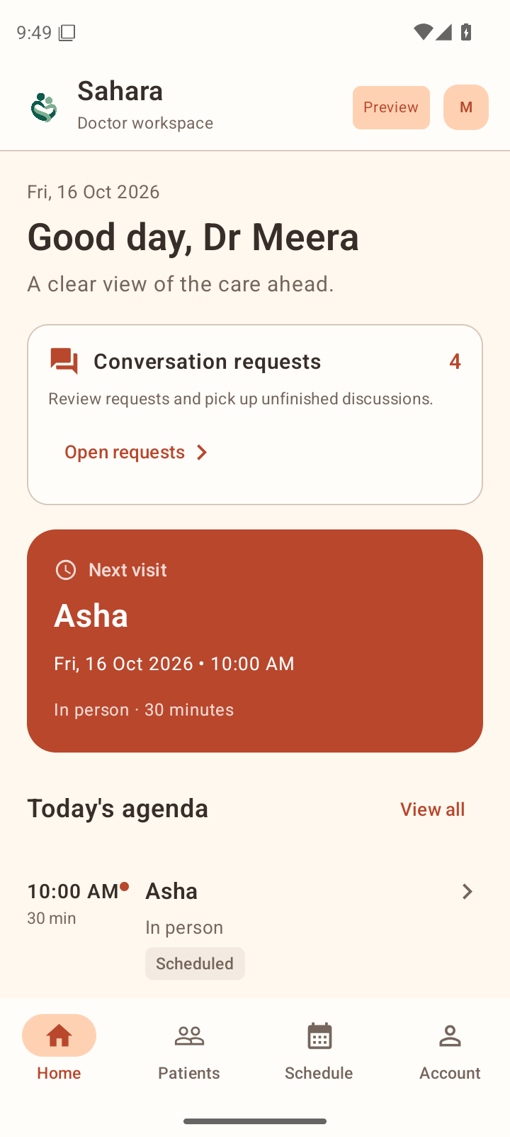
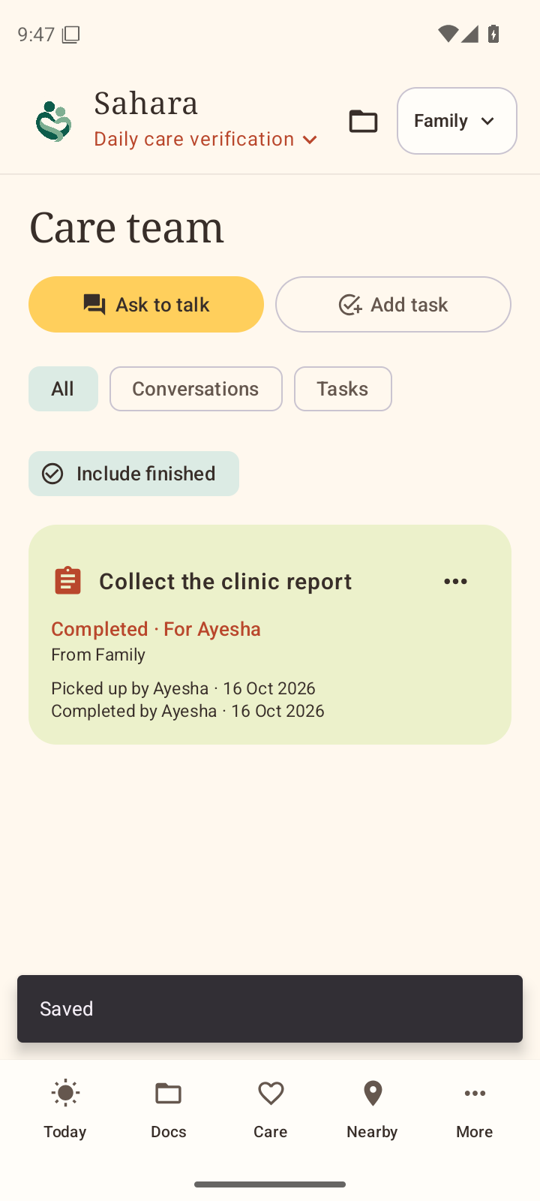
Working product
Family record
Request a discussion
Clinician workspace
Follow-up task
Actual 0.5 emulator screens, 19 October. Fictional fixtures. Current 0.6 handset verification remains pending.
HEALTH-A-THON 2026 • FINAL SUBMISSION
Notes:
Actual 0.5 Android emulator screenshots captured 19 October from output/android/verification/0.5.0/ci-runtime-38882501784/: fictional-patient-hub.png, conversation-request-picked-up.png, doctor-workspace.png and care-task-completed.png. Fictional fixtures and older preview UI remain visible.
These show earlier product actions, not latest 0.6 handset evidence, an authenticated real clinician, patient use or clinical validation. The 0.6.0(7) debug APK needs current physical-phone verification.

Slide 7
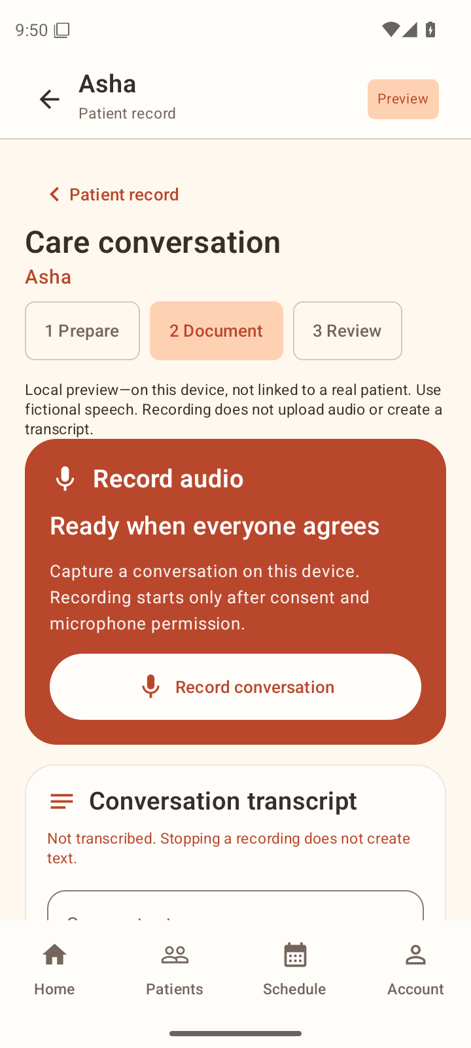
Technology and AI
On the phone
Approved
notes only
Hindi / English speech
Qwen3-ASR
OCR and translation
Editable corrections
Shared accounts
Access rules
Originals stay private
CARE extension
Proposed
Kotlin, Compose, Room, MapLibre and Supabase. Cloud patient scanning and generative clinical drafting stay off.
HEALTH-A-THON 2026 • FINAL SUBMISSION
Notes:
Architecture and model source: TEAM_HANDOFF.md. Local Qwen3-ASR0.6Bint8 and sherpa-onnx1.13.8, Apache2.0. MLKit OCR/translation is not described as open source.
ASR optional download987,015,347bytes,64bitprocess and minimum2.5GiB availableRAM. Optional translation pack must download before offline use.
The source-retention and human-review path is implemented. This diagram does not establish clinical language accuracy or a current0.6handset test.
Cloud records use Supabase. Original audio/report files are not synchronized. CARE integration is a proposed clinician-side extension; no CARE deployment or record exchange exists.
Free-tierGemini/publicphoto assistance stays off and must not receive patient data. SponsorSarvam access remains unconfirmed.

Slide 8
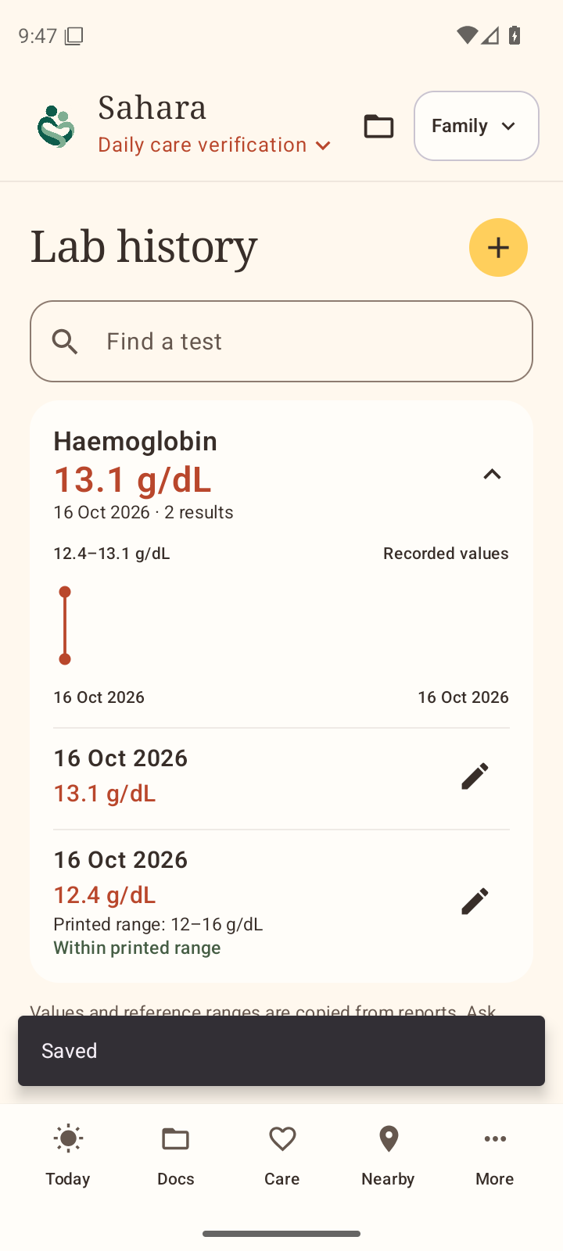
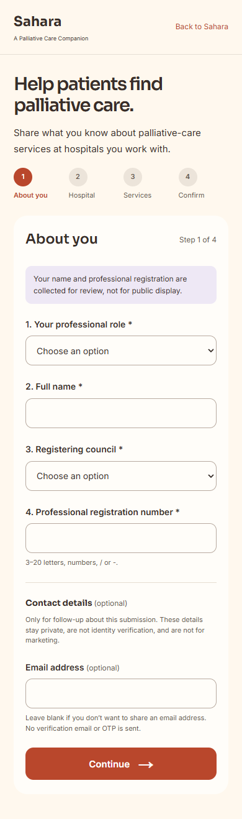
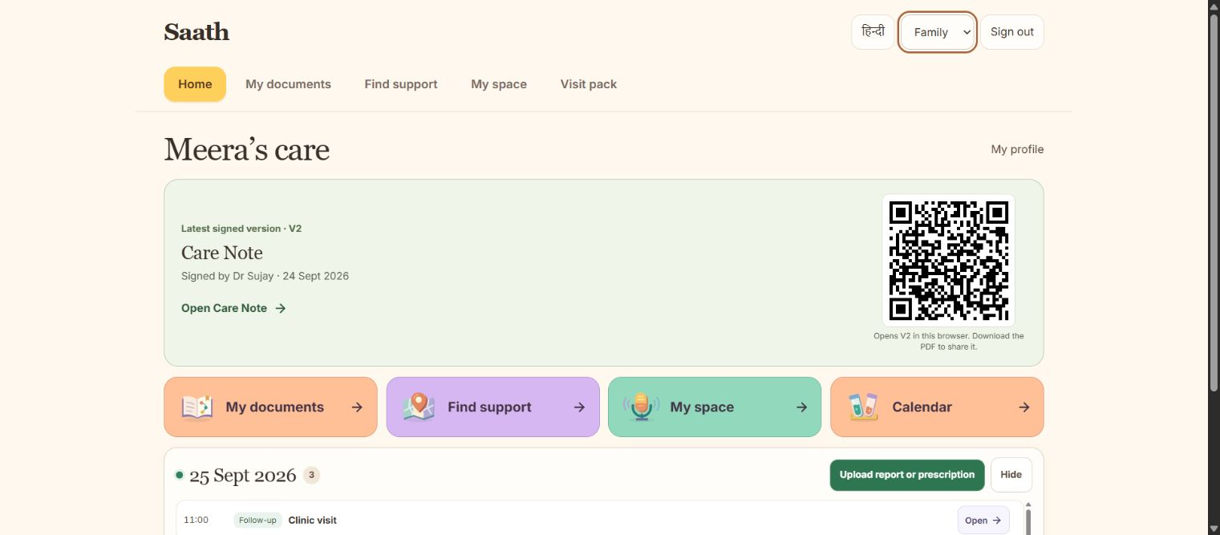
Build progress
September
19 October
23 October
Web Care Note
Native care tools
Hospital survey
Dated actual screens. Earlier records are fictional. Latest 0.6 debug APK adds local language tools.
HEALTH-A-THON 2026 • FINAL SUBMISSION
Notes:
Dated actual product captures: historical family web home,24 September; Android0.5 lab view,19 October; empty current public hospital intake,23 October. Sources and hashes are in assets/source-provenance.json.
Current survey screenshot captured from https://sahara.wedevit.in/hospital-survery after production deployment dpl_CRAGwBsq21vZ9tYTSnwFNKy1uDTa. It contains no submitted personal data. New survey source includes manual hospital name/address, state-aware search, explicit pin confirmation, no mobile-number field and optional physician text. Runtime verification is separately owned by the web workstream.
Current0.6 testAPK includes local language tools and directory data. A screenshot of an earlier version does not establish a current handset test or clinical accuracy.

Slide 9
Evaluation
147
284
65
Native checks
Web checks
Database checks
Speech fixture | Audio / inference | Observed
Synthetic English | 7.15 s / 5.95 s | Exact on one clip
Public Hindi | 9.12 s / 22.05 s | Word substitutions
Public Hinglish | 8.28 s / 22.53 s | Word / script errors
Next evidence: handset + clinician evaluation
Checks dated 19–20 October. Speech timings are desktop CPU tests, not clinical accuracy or phone performance.
HEALTH-A-THON 2026 • FINAL SUBMISSION
Notes:
Native checks: output/android/verification/features/mentor-delivery.json,147unitchecks/25suites,zero failures/errors/skips. Instrumentation compiled but did not execute on the current APK.
Web/database: TEAM_HANDOFF.md,284webchecks,47workflow+18directory database checks dated19 October.
ASR values from output/android/verification/qwen3-asr-inference.log: English7.15sinput/5.953sinference; Hindi9.12/22.047. Hinglish from output/android/verification/qwen3-asr-low-memory-inference.json:8.275/22.531. Rounded values in table.
These are narrow desktopCPU tests with synthetic/public non-patient fixtures. The English text matched that one fixture including negation. Hindi/Hinglish had errors. No clinicalWER/CER benchmark or handheld performance result exists. Historical memory-allocation failures remain in the logs.
Usability changes from team feedback: direct routine controls, fewer repetitive inputs and visible source review. No formal participant sample or measured patient benefit is claimed.

Slide 10
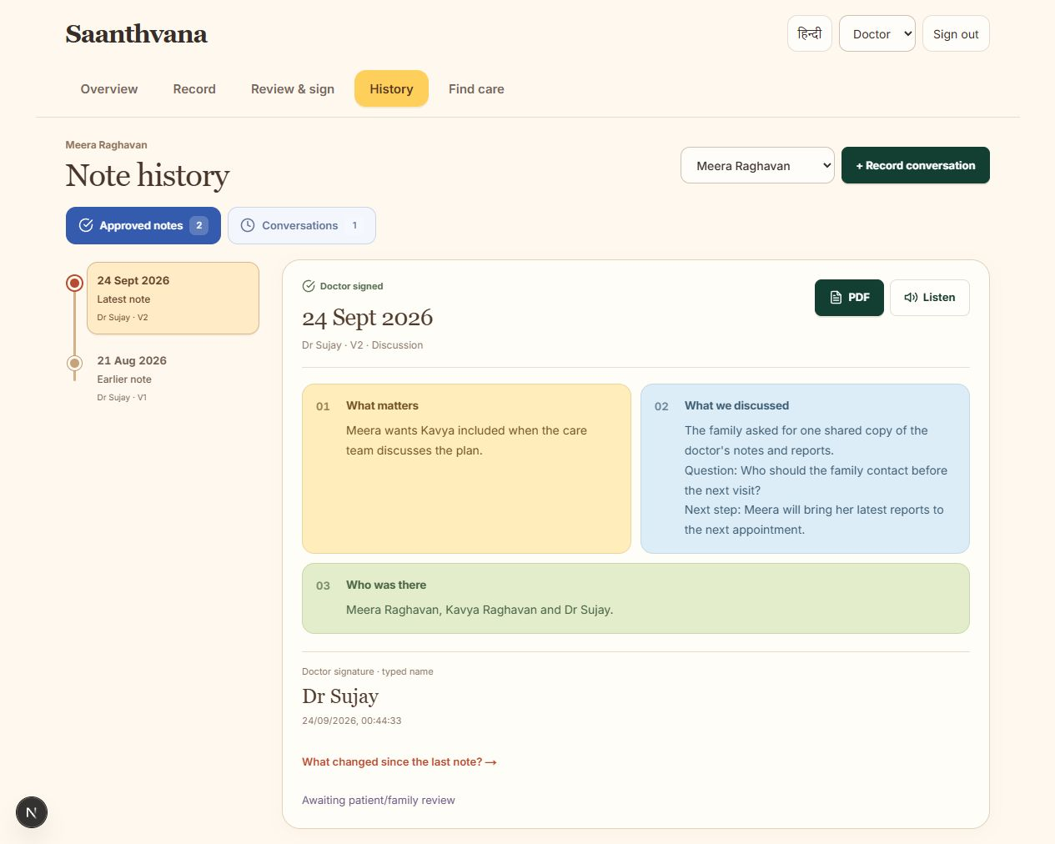
Safety and responsible AI
Named review
Check the source
before release
Exact version
Patient and family
confirm separately
Permissioned access
Historical fictional UI. Current access includes expiry/revocation. Patient use needs clinical oversight and validation.
HEALTH-A-THON 2026 • FINAL SUBMISSION
Notes:
The historical24 September note-history capture contains fictional records and the earlier name. Its self-entered reviewer label is not evidence of a verified professional identity or a certified signature. The screenshot still shows patient/family review pending.
Current shared-care source implements independent role approval, released note versions, exact-version confirmations, access expiry and revocation. These capabilities require clinical evaluation. No legally certified advance directive or treatment order is claimed.
Original audio/report files remain phone-private. AI can mishear words, numbers and negation. The intended care team must review original evidence before release. Clinical institution and, where applicable, ethics review are prerequisites to recruitment.

Slide 11
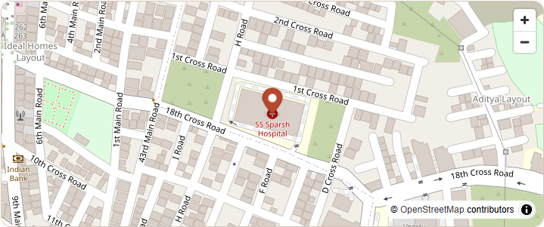
Deployment and cost
Cost area | Planning basis
One-time | Onboarding, devices, clinical validation
Ongoing | Hosting, database, support and governance
Per transaction | Local AI: no cloud call fee
Price / payer | Facility / NGO / government proposal
A supported clinical pilot
Amounts remain to confirm. Map: 23 October QA, OpenStreetMap contributors. No partner adoption claimed.
HEALTH-A-THON 2026 • FINAL SUBMISSION
Notes:
No monetary amounts or payer commitment are established. Table distinguishes one-time setup, ongoing operations, local inference and a proposed payer model.
Map is an actual23 October MapLibre/OpenStreetMap rendered QA capture, not an enrolled hospital or adoption claim. Attribution: OpenStreetMap contributors, https://www.openstreetmap.org/copyright . Search, if used, is Photon, https://photon.komoot.io .
Clinical owner, consent, supported phones, account recovery, training, clinical validation, support and governance must be costed. Original reports/audio remain local.

Slide 12
Next steps
Before patient use
1
Validate on phones
CARE clinician
extension
Hindi / English accuracy
2
Agree a clinical pilot
Consent, review and escalation
Prototype after
the core pilot
3
Measure the care flow
Retrieval and understanding
Public solution information: Yes
Shirin’s clinical symptom-tracker input remains pending. Team code, costs and narrated video still need confirmation.
HEALTH-A-THON 2026 • FINAL SUBMISSION
Notes:
Next gates remain current0.6 handset validation, Hindi/English clinical language evaluation, reliable account recovery, clinical approval and a governed pilot. No patient recruitment or clinical benefit is claimed.
CARE clinician extension remains proposed, not integrated. Shirin owns the pending clinical symptom-tracker input. Doctor specialities, biographies, team code, cost amounts, updated narrated video and organiser/jury access remain to confirm.
The user explicitly answered Yes to publicly sharing solution information. Private data, credentials, identities, conversations and unrestricted private code are excluded.

Slide 13
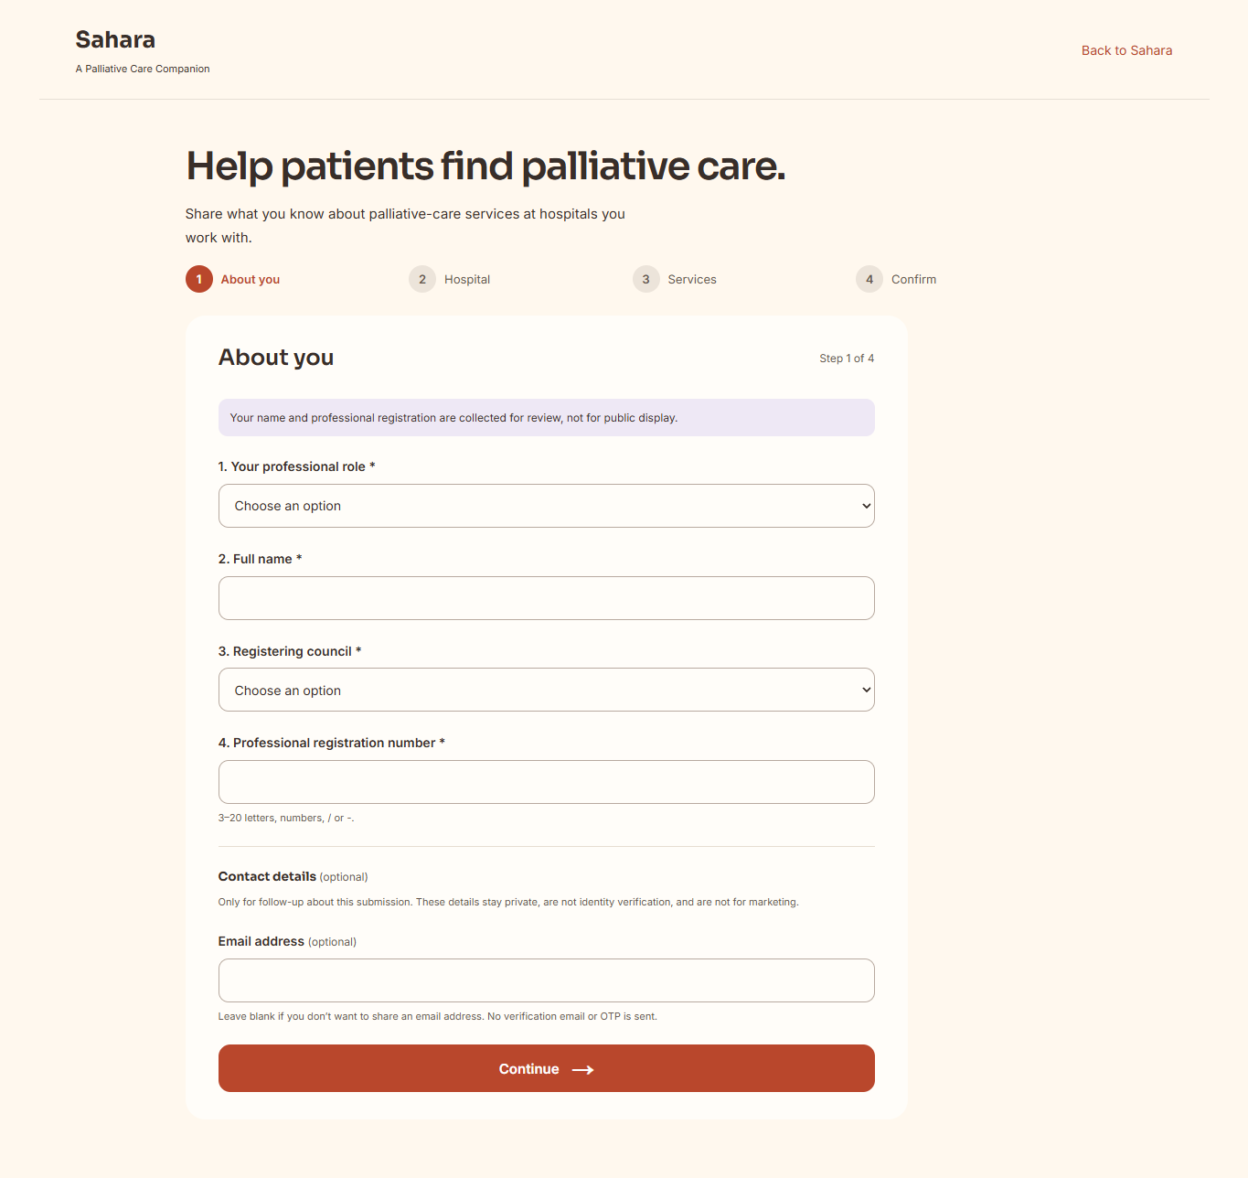
Sahara
A Palliative Care Companion
sahara.wedevit.in
workwithdevit@gmail.com
Current public web, 23 October. Empty survey intake.
HEALTH-A-THON 2026
Notes:
Product link: https://sahara.wedevit.in . Contact: workwithdevit@gmail.com . Current public web screenshot,23 October, is an empty hospital survey intake.
Repository remains private, and updated narrated video, organiser code access and team code remain preparation gaps. This local draft has not been externally submitted.

