Slide 1

Saanthvana
Goals-of-care
conversations
For people with cancer
and their families
Husband: yes · Daughter: no · Son: unsure
Zeros and Ones
Health-a-thon 2026
No one can find the earlier conversation.
continuity-loop-healthathon.vercel.app
Notes:
Illustrative scenario based on the user-supplied 23 September revision. The scenario does not claim an outcome or recommend CPR, ventilation or any other treatment.
[Sources]
- User-supplied Shirin story revision in the 24 September task context
- Saanthvana_Background_Rationale_1.pptx

Slide 2
When care changes, can the family find her wishes?
TWO MONTHS EARLIER
A conversation from two months ago
One missing record
A doctor discussed future complications during best supportive care. Only her husband attended.
“Would she want CPR and ventilation?”
A doctor discussed future complications with a 62-year-old patient starting best supportive care. Only her husband attended. Two months later, she is unconscious in the ED. Her husband says yes to CPR and ventilation; her daughter says no; her son is unsure. No one can find the earlier discussion.
The ED team cannot find the earlier conversation.
Husband
Yes
Daughter
No
TODAY · EMERGENCY DEPARTMENT
Three family views
Son · remote
Unsure
She is unconscious. No one can find that conversation.
Husband says yes. Daughter says no. Son is unsure.
A doctor-reviewed record could give the family and receiving team the same context to revisit.
No one knows what she discussed.
Single centre, advanced pancreatic / colorectal cancer.
This is not a Saanthvana result.
Illustrative scenario from the 23 September team discussion.
Notes:
This is an illustrative scenario. No statistic is used because the meeting could not confirm the 98.3% claim. The disagreement is shown without suggesting which treatment choice is right.
[Sources]
- User-supplied Shirin story revision in the 24 September task context
- source-materials/private-context/meetings/2026-09-23-transcript.txt

Slide 3
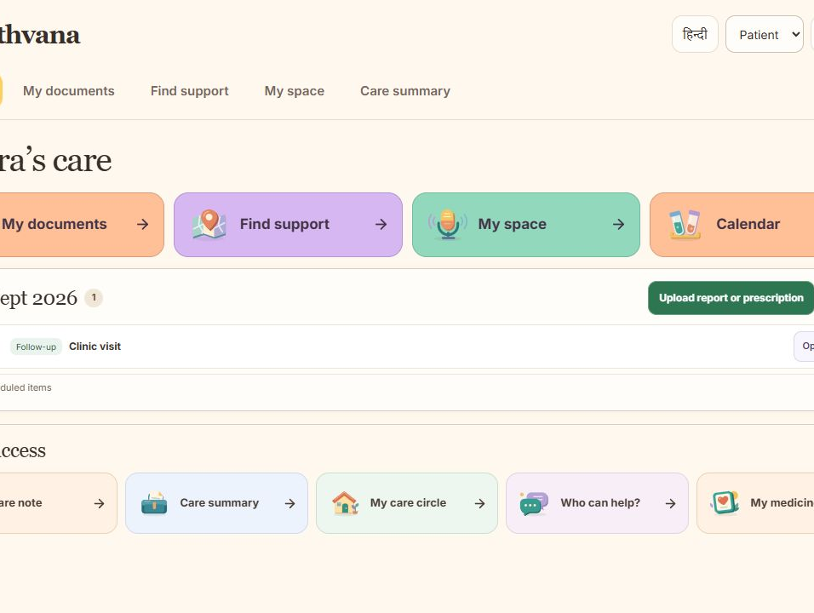
Four care spaces. Quick access for daily tasks.
My documents
Care note, summary, reports and a care timeline.
Find support
Nearby care, community links, medicine access and help at home.
My space + Calendar
Requests, notes, appointments and next visit.
Notes:
Actual local capture of the updated Home screen on 24 September 2026, including the four top categories, Today panel, upload action and Quick access.
[Sources]
- output/playwright/2026-09-24-home-desktop.png
- prototype/app/family-care-home.tsx

Slide 4
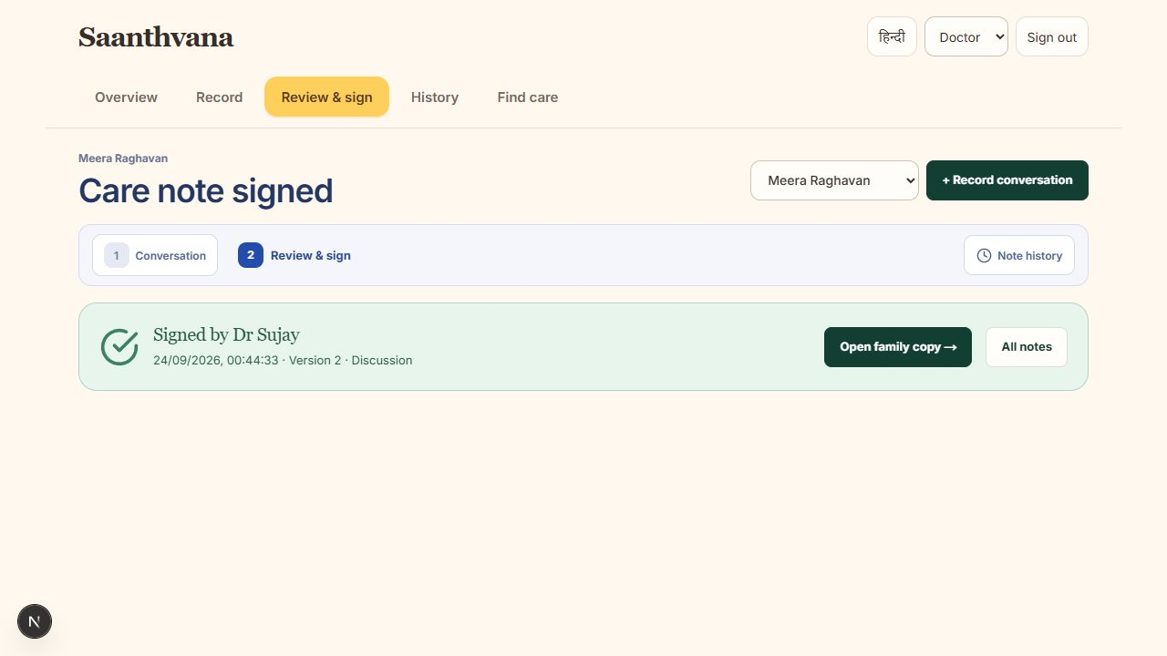
A doctor reviews, signs and shares a version
Check what was said
Check what was said
The doctor checks the note. The family sees what was agreed.
The doctor checks the note. The family sees what was agreed.
See earlier notes
The latest reviewed copy stays available. A new talk adds another version.
See earlier notes
The latest reviewed copy stays available. A new talk adds another version.
Notes:
Actual doctor review capture from the local app. The example patient data are synthetic.
[Sources]
- output/playwright/2026-09-24-doctor-signed.png
- prototype/app/doctor-note-review.tsx

Slide 5
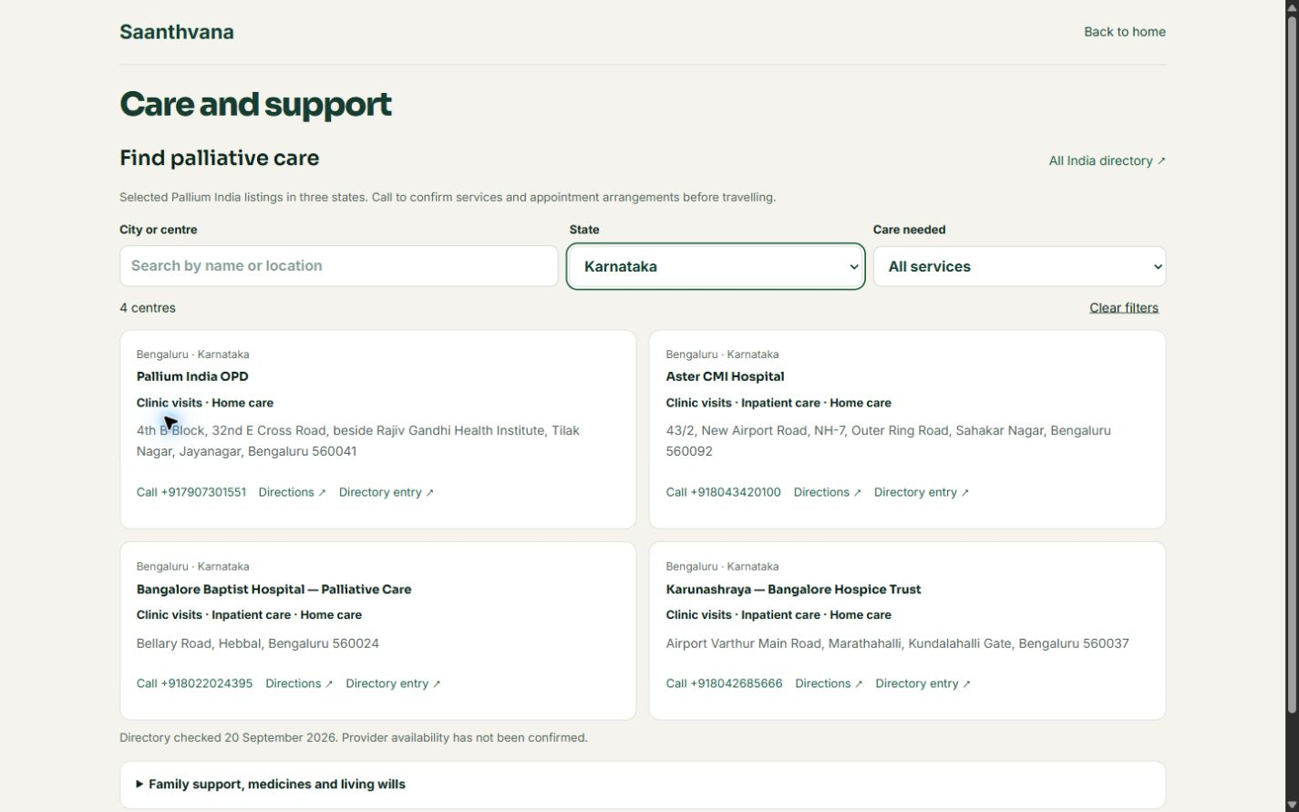
The family can ask. The care team can act.
1 · Ask
01
02
03
04
Patient or family requests a conversation about what matters.
Patient or family asks
Doctor reviews and signs
Doctor assigns a task
Family sees Today
Request a conversation about what matters.
The clinician checks and releases the summary.
A next step has a sender and an owner.
Open the task; view medicines and visits.
2 · Review
Example task: “Bring reports” · From Dr Sujay
The doctor reviews the request and signs the care summary.
Medicine completion is recorded by the family and can be undone.
Notes:
Editable workflow diagram based on the latest user direction. “Bring reports” is an example task, not a claim that a specific message has been sent. Today shows assigned tasks, recorded medicines and appointments; medicine completion is reversible.
[Sources]
- prototype/app/care-today.tsx
- prototype/app/care-conversation-request.tsx
- 24 September user task directions

Slide 6
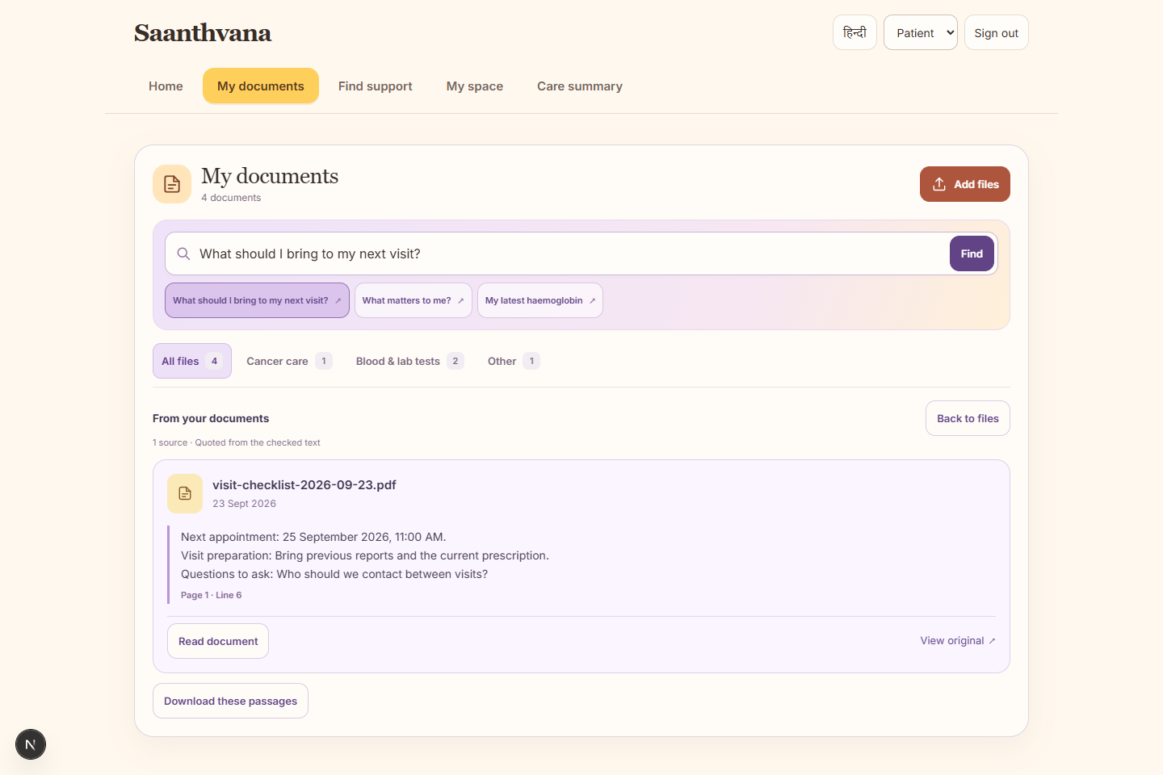
Reports, care timeline and nearby support
Capture with consent
Record or type the clinician-led discussion in the preferred language.
Draft from the conversation
Transcribe and organise stated information, keeping source passages visible.
Resolve before release
The doctor checks missing or unclear details and approves the written summary.
Keep a reviewed copy
The patient and authorised family can retrieve the latest released version.
Open the original report and its quoted passage.
Search, call or get directions. Confirm services before travel.
Planned integration. The current prototype uses sample conversation text and no live AI model.
Notes:
Both images are actual local product captures. The support directory does not confirm oral morphine stock or dispensing; families should call to check.
[Sources]
- output/playwright/2026-09-23-documents-desktop.png
- submission/screenshots/2026-09-20/care-desktop.png
- prototype/app/care-near-me.tsx

Slide 7
Planned: AI drafts. Doctor checks and shares.
1 · Capture
2 · Assist
3 · Review and share
Guided conversation
Physician review and versions
Family preparation
Care directory and nearby map
Consented transcription
Durable access and storage
Language evaluation
Restrict the competition demo to the agreed assistive scope
01
02
03
04
Compare drafts with source text.
Measure clinician corrections and retrieval time.
Ask families whether the summary is clear.
Capture
AI assists
Doctor checks
Family copy
Doctor-led discussion
Patient priorities and questions
Structure stated details
Keep source passages visible
Fix unclear details
Check and sign
Share the reviewed version
Return to the latest copy
AI connection is next. Today, the app organises the words you add.
AI integration is planned. The current prototype is synthetic and deterministic.
Notes:
AI remains the main planned tool: capture the discussion, help organise the words, then the doctor checks and signs before the family sees the note. No provider is connected.
[Sources]
- PROTOTYPE_HANDOFF.md
- 23 September meeting transcript
- User-supplied 24 September workflow direction

Slide 8

A 60–90 day pilot can test this workflow
Clinical collaborators
Product and technology
Clinical collaborators
Product and technology
Dr Sharada Vinod Kutty
Dr Sujay Halkur Shankar
Shaik Abdul Basith
Shaik Muhammad Awaiz
Sharada Vinod Kutty
Sujay Halkur Shankar
Shaik Abdul Basith
Shaik Muhammad Awaiz
Proposed pilot measures · 60–90 days
Time to write the note · Time to find it · Tasks accepted and done
Proposed measures: source fidelity · clinician review time · retrieval success · follow-up closure
Public prototype
https://continuity-loop-healthathon.vercel.app/
Public prototype
Scan to open the current prototype.
https://continuity-loop-healthathon.vercel.app/
The hardest decisions shouldn’t be made without the right information.
The link opens the current public prototype. The latest home and Today changes are in this local build.
Notes:
The team is proposing a 60–90 day pilot. Measures are proposals, not results.
[Sources]
- PROJECT_CONTEXT_MAP.md (team names)
- VERCEL_DEPLOYMENT_HANDOFF.md (public URL)
- User-supplied 24 September pilot direction

