Slide 1

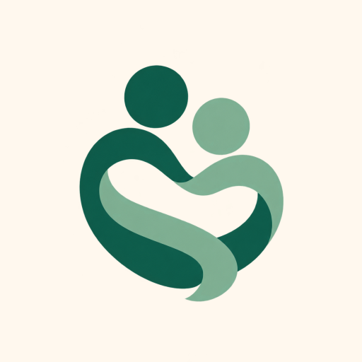
FINAL SUBMISSION
Sahara
A phone app for people with a serious illness, like advanced cancer, and their families. Their doctor discusses their end of life wishes; Sahara creates a clinical document, and an emergency doctor can read it in one scan.
TEAM NAME Zeros and Ones
TEAM CODE 37MYUP
Shaik Abdul Basith · Shaik Muhammad Awaiz · Dr Sharada Vinod Kutty · Dr Sujay Halkur Shankar · Shirin Ayub
Try it: sahara.wedevit.in · Android app and website · English, Hindi, Telugu, Urdu, Kannada
HEALTH-A-THON 2026 • FINAL SUBMISSION

Slide 2
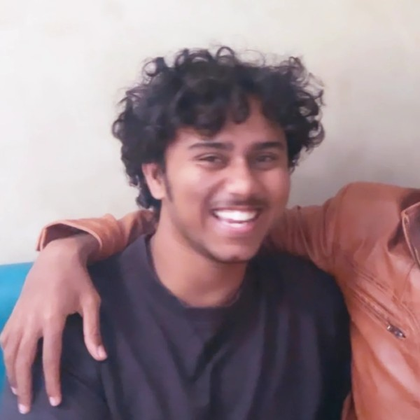
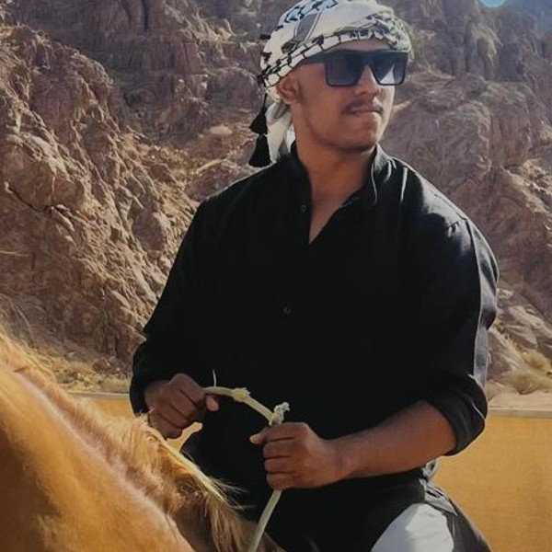
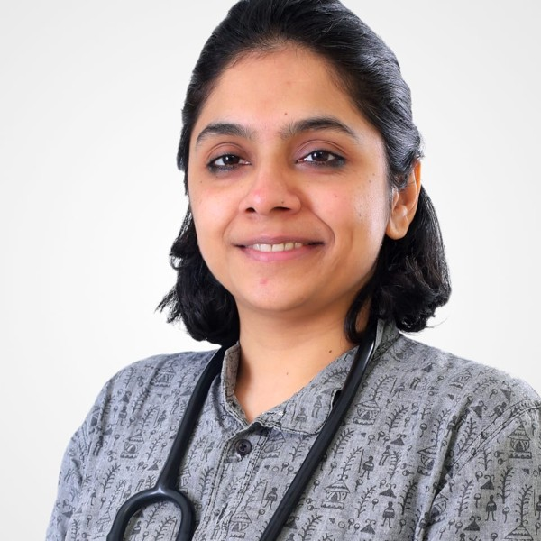
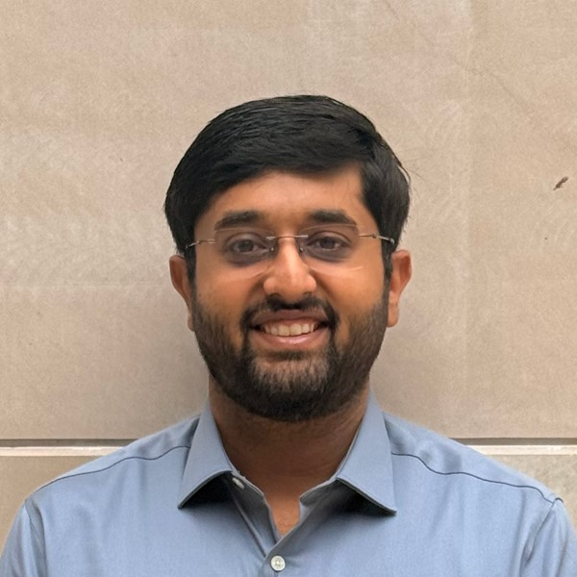
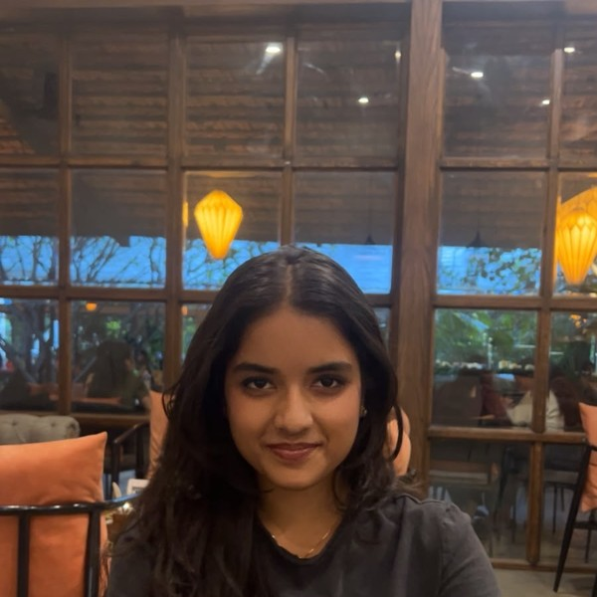


Team Overview & Background
Shaik Abdul Basith
Technical lead
WeDevIT
Led the build of the website and Android app; the AI that transcribes the conversation and fills the goals-of-care document; answers from reports; server, security and releases
Shaik Muhammad Awaiz
Android engineer
WeDevIT
Built Android screens: patient summary, care timeline, doctor schedule, family invites; AI retry and backup models; tested every version
Dr Sharada Vinod Kutty
Pulmonologist
AIIMS Mangalagiri
Wrote the clinical specifications and designed the goals of care document. Tested mock clinical conversations
Dr Sujay Halkur Shankar
Pulmonologist
Tata IISc Medical School
Defined the problem statement and the proposed solution. Provided relevant clinical documents and scores for design of tools
Shirin Ayub
Medical student
Designed the symptom log and defined caregiver portal needs. Instrumental in UI clean up and usability inputs
Our doctors chose this problem from their own clinics and checked every version.
Legal advice was sought: inputs and refining the goals of care wording and format.
Built by WeDevIT, the team’s company. The app is on Google Play under WeDevIT.
HEALTH-A-THON 2026 • FINAL SUBMISSION
Notes:
Doctor background from Dr Sujay (team chat, 25 Aug 2026): pulmonary specialists who have worked extensively with lung cancer; Dr Sujay has palliative-medicine exposure.

Slide 3
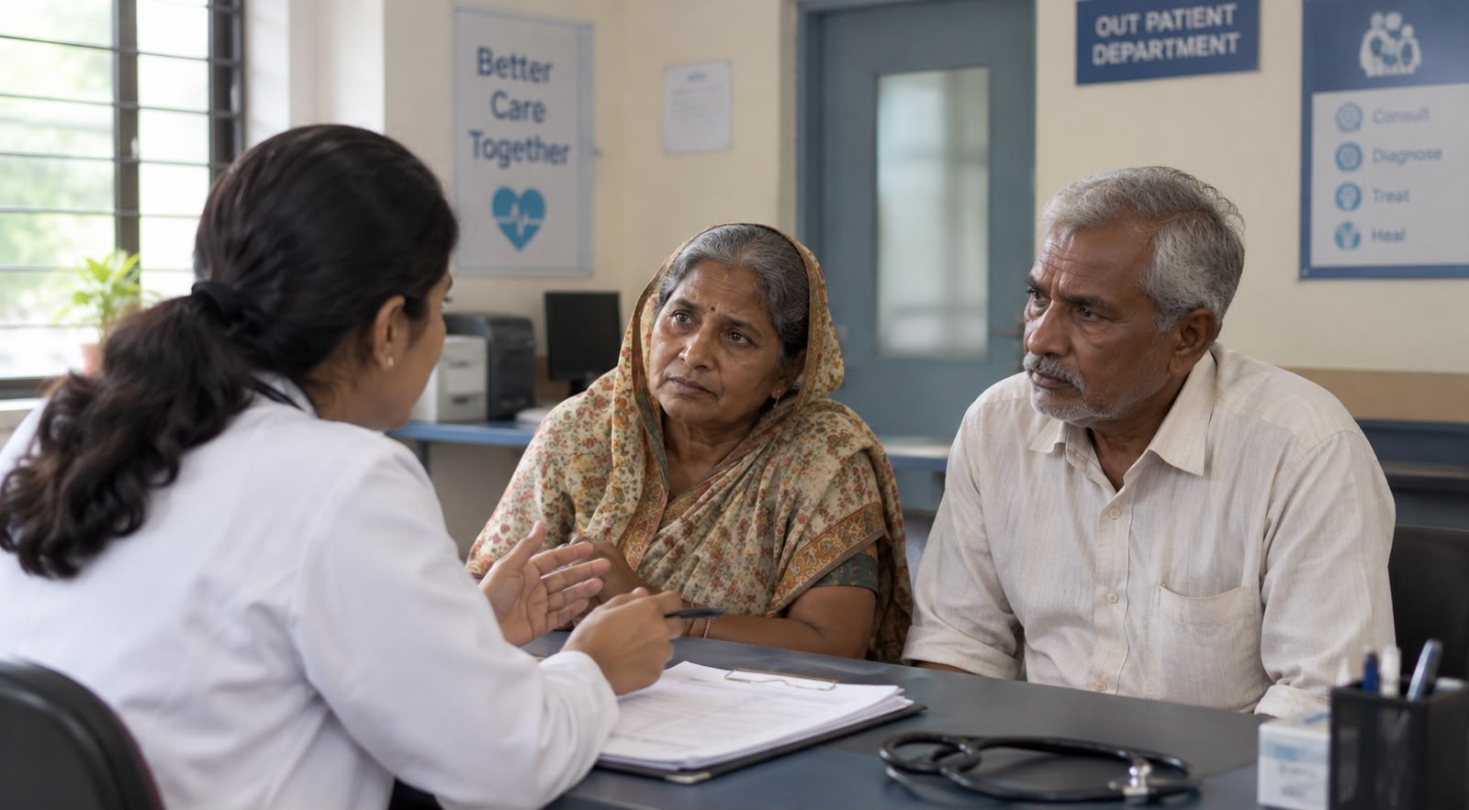







Problem Statement and Supporting Evidence
98%
30–37%
of India’s metastatic (advanced) cancer patients had unmet palliative-care needs.
Patil, BMJ Support Palliat Care 2024
of patients get timely palliative care referrals (two centres).
Venketeswaran, BMJ Support Palliat Care 2026
41%
88%
of cancer patients dying on active treatment had end-of-life care documented (one hospital).
Das, Cancer Med 2026
of urban adults want to choose their own end-of-life care.
Living Will Survey, IndiaSpend 2019
Example story (illustration). A 62-year-old woman with advanced breast cancer.
At the clinic, her doctor asks what treatment she would want if she got very sick. Only her husband is there.
What has to change
Her goals of care need to be documented, signed, and found in seconds in an emergency.
Two months later she is unconscious in the emergency room. Should doctors try to restart her heart (CPR)?
Her children disagree, and nobody can find what she said.
HEALTH-A-THON 2026 • FINAL SUBMISSION

Slide 4

Target Users and Use Case
Patient · at home
Logs symptoms, medications, and helps find care; access to clinical documents
Family · at home
Access to their patient’s portal; logs specific caregiver issues
Their doctor · clinic
Guides goals of care discussions; access to patient information: symptom trends, reports, medications
Emergency doctor · emergency room
Quick retrieval of the latest goals of care discussion to guide emergency medical decisions
Words used in this deck
Palliative care: care that eases pain and distress in a serious illness.
Goals of care: what treatment a patient wants, or refuses, near the end of life (CPR, ventilator, ICU).
QR code: a square barcode on the patient’s phone or card; a phone camera scan opens their wishes.
HEALTH-A-THON 2026 • FINAL SUBMISSION

Slide 5
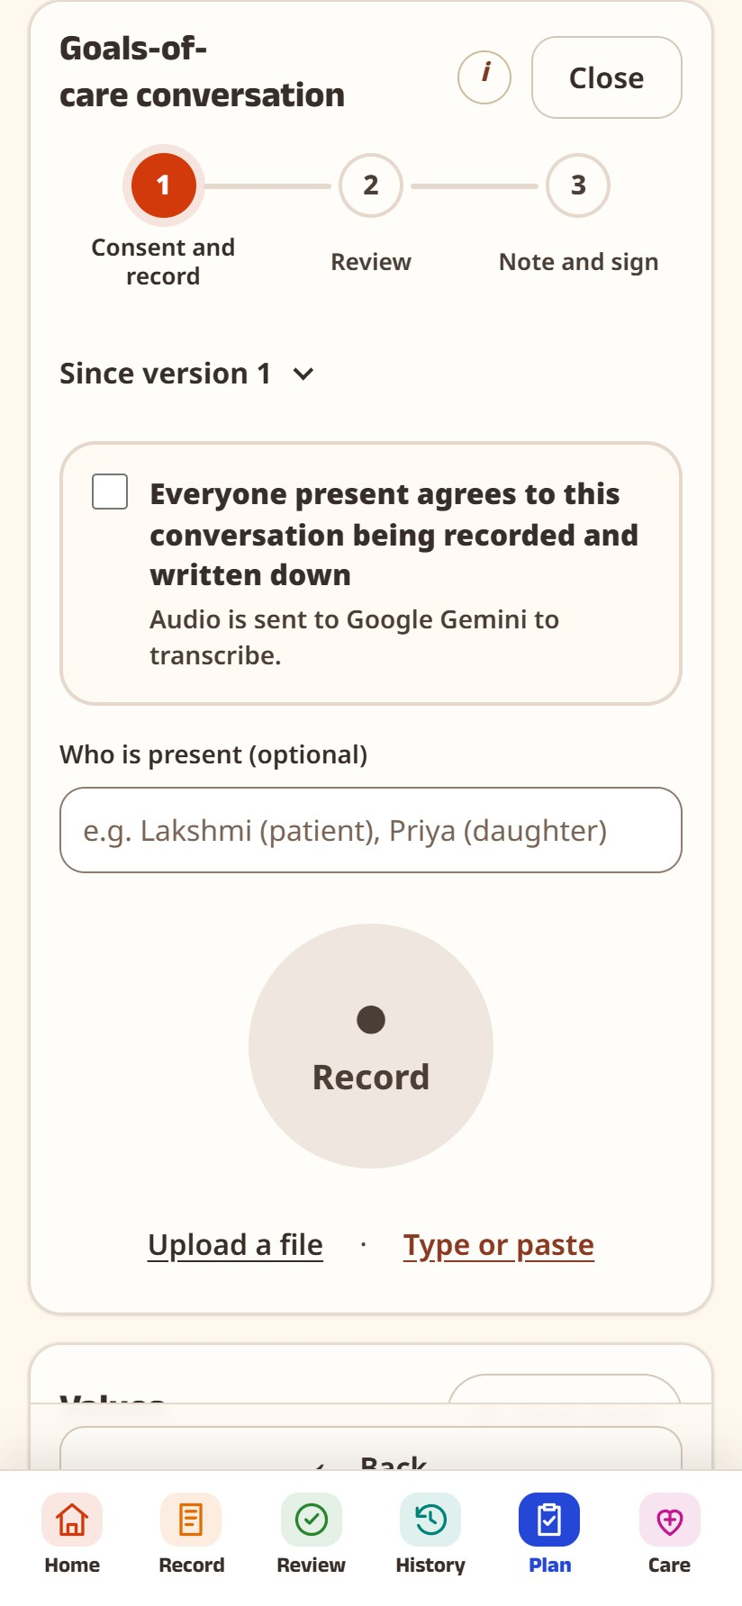
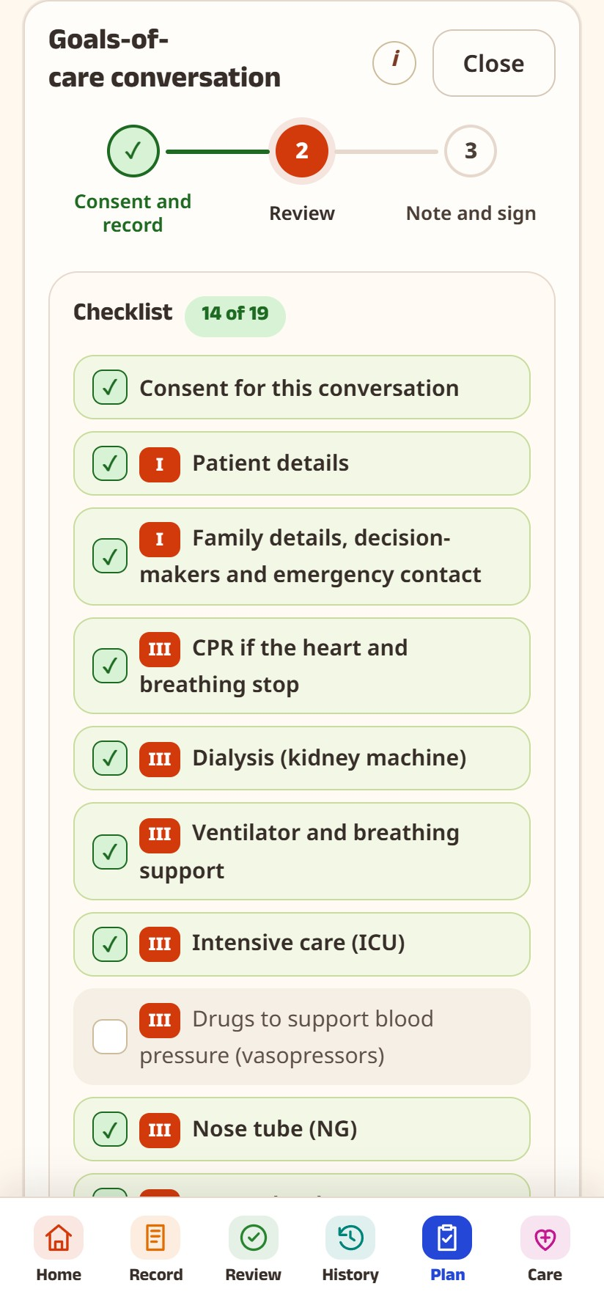
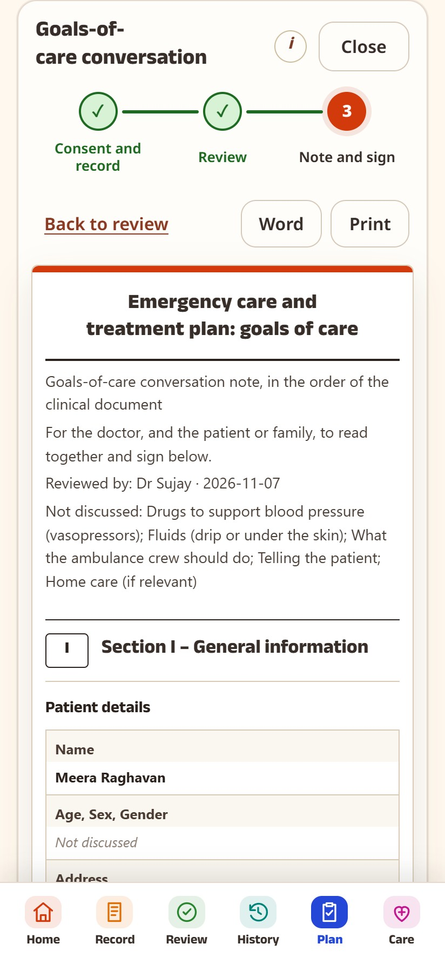
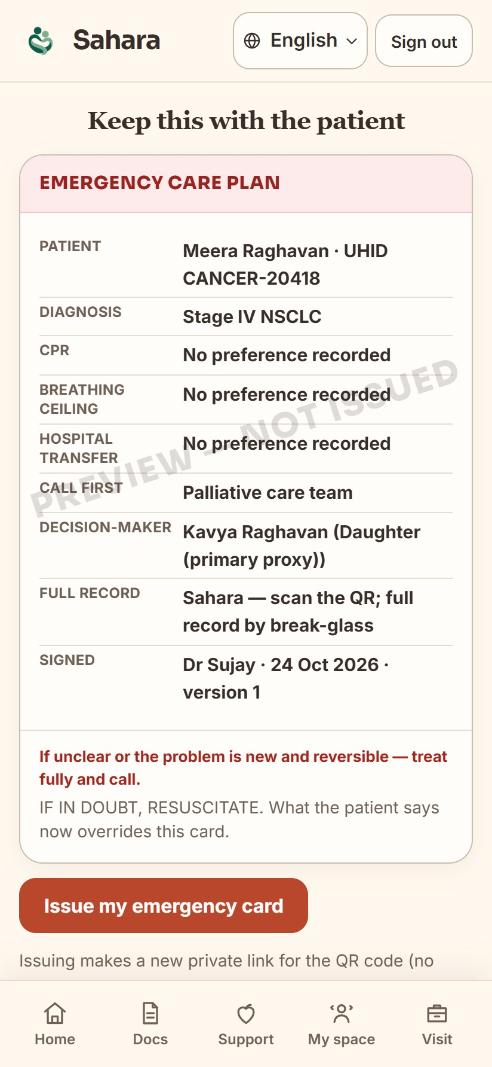
Solution Overview, Key Features & Impact (1/2)
In the clinic: the doctor talks, Sahara listens and writes.
After consent, the doctor leads the goals-of-care conversation and records it on the doctor portal. Today this is rarely documented.
1. Patient agrees, tap Record
Google’s Gemini AI types out who said what
2. A checklist ticks itself
Missed topics are flagged. Android: Dr Sujay’s 13 topics, with “Guide me” or “Free flow” taps
3. Answers fill the structured clinical document
Doctor checks the transcription and summary
4. Everyone signs on the phone
Doctor and patient or family sign; it locks and opens from a QR code in an emergency
HEALTH-A-THON 2026 • FINAL SUBMISSION
Notes:
Screens captured from the live website demo (sahara.wedevit.in, 5 Nov 2026) with a fictional patient (Meera Raghavan) and the fictional mock conversation docs/goc-mock-conversations/01-english.txt. The Android app has the same flow.

Slide 6
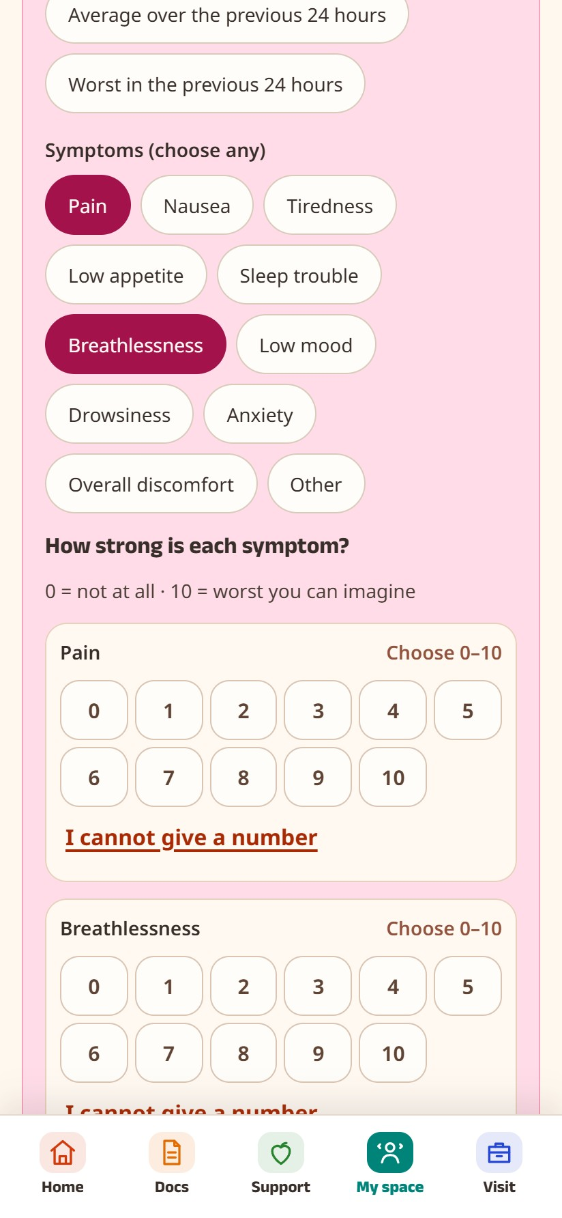
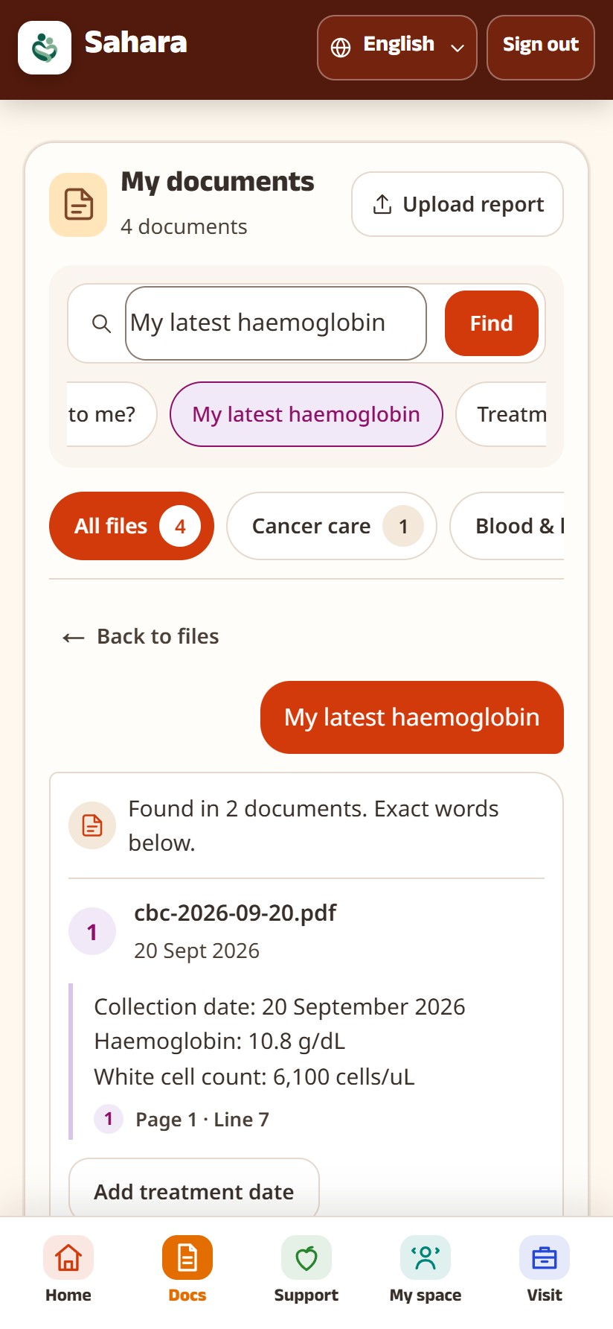
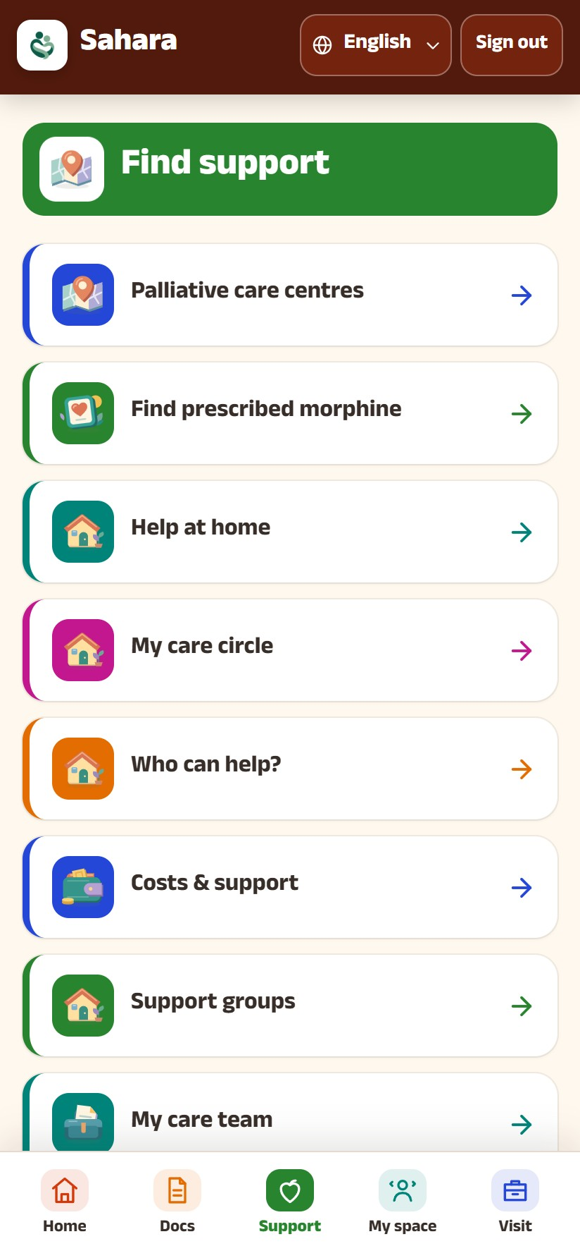





Solution Overview, Key Features & Impact (2/2)
At home, between visits: patients and families log how things are going; their doctor sees the trends.
Every feature is built on published guideline tools and validated questionnaires (ESAS-r symptoms, NCCN Distress Thermometer, ZBI-4 caregiver burden).
How I feel: symptoms (ESAS-r), a 0–10 distress scale (NCCN thermometer) and a pain body map; trends for the doctor.
Caregiver wellbeing (new): ZBI-4 check and a private journal; flagged when it worsens, with Tele-MANAS 14416, counsellors, respite care, support groups.
Medicines: pill tracker from prescription photos; tag pictures of your medicine strips for easy identification; dose ticks, reminders.
Documents: uploads sorted into prescriptions, bills, reports; questions answered with the line it came from.
Emergency: SOS button and a QR code with goals of care, contacts and medicines.
Help nearby: palliative-care centres and availability of morphine, emergency hospitals, ambulances, support groups.
Family: invited relatives share the record with their own access level; ability to manage caregiver concerns.
What we expect to change (to be measured in a pilot):
more of these talks written and signed · wishes found in seconds in an emergency · fewer family arguments at the bedside · doctors see problems before the next visit.
HEALTH-A-THON 2026 • FINAL SUBMISSION

Slide 7







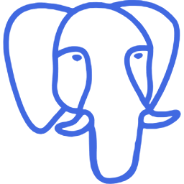
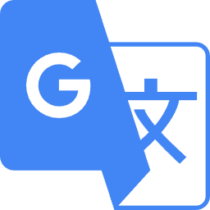


Technology, Tools, and AI Approach
How a conversation becomes a signed clinical document
Doctor’s phone
records only after patient consent
Our server
keeps the AI password; the phone never has it
Google Gemini AI
types out the talk and fills in the clinical document
Doctor
reads it, corrects it, signs; the patient or caregiver also signs
Locked document
PDF + QR code; any later change creates a new version that requires re-signatures
No internet, or the AI is busy? OpenAI Whisper turns speech into text on the phone itself. If that fails too, the doctor types.
Built with
Android
Kotlin + Compose
Next.js
Vercel
Supabase
PostgreSQL
the phone app
language and screens of the app
the website
puts the website online
server, sign-in, storage
database; each family sees only its own
Google Gemini
OpenAI Whisper
Google ML Kit
OpenStreetMap
Clinical tools
FHIR
AI: speech to text, fills the document
speech to text with no internet
5 languages and read-aloud on the phone
free map of nearby centres
ESAS-r, NCCN Distress Thermometer, ZBI-4
standard format hospital software can read
HEALTH-A-THON 2026 • FINAL SUBMISSION
Notes:
Logos from the simple-icons set (CC0), used only to name the tools we use. Gemini models: 3.1 Flash-Lite first, then other Flash models when busy; on-device Whisper; typing.

Slide 8
Build Sprint Journey and Progress
October – November 2026
Built
Doctor / legal feedback
Milestone
✓ Working now
Patient and family app · doctor’s view · recording → signed clinical document · QR code · website live
MON
TUE
WED
THU
FRI
SAT
SUN
Week 1
5 Oct
6
7
8
9
10
11
Shortlisted!
AI medicine organiser
Prescription organiser
Android app + map of centres
↻ Changed on the way
Website first, then a real Android app. The AI used to write the note; now the doctor leads and the AI only writes it down.
Week 2
12
13
14
15
16
17
18
Google Play test version
Testers invited
Privacy and account safety
Week 3
19
20
21
22
23
24
25
Sent to Google Play
Mentor review
Hospital survey feedback
Symptom tracker
⚠ Problems we solved
Google’s AI was often busy → automatic backups. Exact goals-of-care wording → copied.
Week 4
26
27
28
29
30
31
1 Nov
Pain body map
Hospital survey live
Team meeting: 9 changes
Dr Sharada’s medical rules
Goals of care + QR code
Legal advice on format
Recording → text
Ask your reports
Telugu, Urdu, Kannada
… Still to do
Test on many real phones · record a real practice talk with Dr Sharada
2
3
4
5
6
7
8
Doctor schedule
Dr Sujay tests the whole app
Clinical document word for word
Gemini AI + backups
Calmer, fewer taps
Dr Sujay’s 13 topics
8 practice talks pass
Caregiver wellbeing
Blue circle: 7 Nov, the day of this submission. Grey days are outside the build sprint.
HEALTH-A-THON 2026 • FINAL SUBMISSION
Notes:
Dates from the git history and team chat: shortlisted 9 Oct; native Android 9 Oct; Play testing 13-14 Oct; Play submission 19 Oct; survey feedback 23 Oct; survey live 27 Oct; team meeting 28 Oct; clinical spec 29 Oct; legal review 31 Oct; Dr Sujay walkthrough 3 Nov; clinical document word for word 4 Nov; Gemini fallback 5 Nov.

Slide 9
Evaluation and User Validation
1. Does it work? Our own tests
877
594 / 594
8 / 8
4 / 4
automatic checks on the Android app: all pass
automatic checks on the website: all pass
practice doctor–patient talks in 6 languages: every answer landed in the right place on the document
questions about a sample hospital report answered correctly
Automatic checks are small test programs that run after every change, so a broken feature is caught before release. The practice talks are made up, not real patients.
2. What experts told us, and what we changed
Dr Sujay Halkur Shankar
doctor, used the whole app on 3 Nov
Dr Sharada Vinod Kutty
doctor, wrote our medical rules on 29 Oct
Said: Is there a guide telling the doctor what to talk about next? And a medicine taken 4 times a day needs 4 ticks.
We changed: Checklist in the doctors’ order with a “not yet discussed” prompt; one tick per dose. Team chat: tubes-and-drains tracker, darker text.
Said: Comfort care must always continue, whatever treatment a patient refuses.
We changed: The app shows this on every signed document.
Not tested yet: with real patients · on many real phones · speech-to-text on real Hindi, Telugu and Kannada recordings · a doctor checking each translation means the same
HEALTH-A-THON 2026 • FINAL SUBMISSION
Notes:
Unit tests: HANDOFF 5 Nov (Android 877, web 594/594). Mock conversations: docs/goc-mock-conversations, English, Hindi, Hinglish, Telugu, Urdu, Kannada, disagreement, short talk; both matchers pass all 8. Ask documents: 4 questions on a practice discharge PDF (one needed a retry). Feedback: 3 Nov meeting transcript and team chat to 4 Nov (tubes and lines, faded text, checklist order); legal review 31 Oct; clinical spec 29 Oct.

Slide 10


Safety and Responsible AI
Privacy and consent
Limits on the AI
✓ Recording starts only after the patient ticks “I agree”
✓ The AI is used only with that consent
✓ Each family sees only their own records
✓ The AI never suggests treatment
✓ If a topic was not discussed, it says so; it does not guess
✓ If the AI is down, the phone or the doctor writes it
A person decides
For everyone
✓ The doctor reads, corrects and signs first
✓ The patient or family signs too
✓ Any later change creates a new version requiring re-signatures
✓ 5 Indian languages, and it reads text aloud
✓ Sign with a thumbprint; large text
✓ Demos use made-up patients only
HEALTH-A-THON 2026 • FINAL SUBMISSION

Slide 11

Deployment, Cost and Sustainability Plan
Pilot
Start in 1 clinic with our own doctors. Patients give consent as India’s data-protection law (DPDP Act) requires.
What it costs | Once | Every month
Servers and website (Supabase + Vercel) | – | ₹4,200
Google Gemini AI, per 30-minute talk | – | ≈ ₹2 a talk
Setting up and training clinic staff | ₹25,000 | –
Consent forms and legal check | ₹25,000 | –
Support from our team | – | ₹10,000
Cost per clinic, if 10 clinics share it | ₹5,000 | ≈ ₹1,600
Fitting in
Today it records on the doctor’s phone. Next: ambient listening, with room or lapel microphones in clinics. Later, FHIR export for hospital software.
Who pays
Clinics or charities pay a monthly fee. Free for patients and families.
We would charge ₹1,500–2,000 per clinic a month
Growing
Grants first, then palliative-care networks across India.
Our estimates from public prices: US$1 ≈ ₹94; Supabase $25 and Vercel $20 a month; Gemini ≈ $0.30 per million audio units (a 30-minute talk ≈ 58,000); 100 talks per clinic a month.
HEALTH-A-THON 2026 • FINAL SUBMISSION
Notes:
COST FIGURES ARE TEAM ESTIMATES from public list prices and an assumed Gemini audio price; confirm before submission. US$1 = Rs 94 (Dr Sujay, 7 Nov). Servers 45 x 94 = ~4,230. Per clinic monthly = (4,230 + 10,000) / 10 + 100 x 2 = ~1,620. One-time per clinic = 50,000 / 10 = 5,000.

Slide 12
What Next? Plans to take initiative forward (if any)
1
2
3
4
Prove it works
Test on many real phones; try room and lapel microphones (ambient listening). Record a real practice talk with Dr Sharada.
Pilot, 60–90 days
One clinic. Count how many talks get signed and how fast wishes are found.
Legal rules
What to do when a patient cannot decide, who may sign for them, and how a patient changes their goals of care.
Fund and grow
Grants, palliative-care networks, then link with hospital software.
Next version of the app: more features such as devices like feeding tubes · an improved caregiver portal · updates based on user feedback
Can the organisers share our solution publicly? YES
Slides, brief, video and app description. Not patient records, passwords or private code.
HEALTH-A-THON 2026 • FINAL SUBMISSION

Slide 13
Thank you
Zeros and Ones • 37MYUP
Try it: sahara.wedevit.in | Demo video: [add demo video link] | workwithdevit@gmail.com | Code: github.com/basithladdu/healthathon (private)
Shaik Abdul Basith · Shaik Muhammad Awaiz · Dr Sharada Vinod Kutty · Dr Sujay Halkur Shankar · Shirin Ayub
Health-a-thon 2026
HEALTH-A-THON 2026

