Slide 1
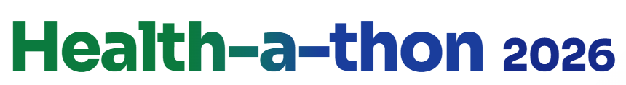
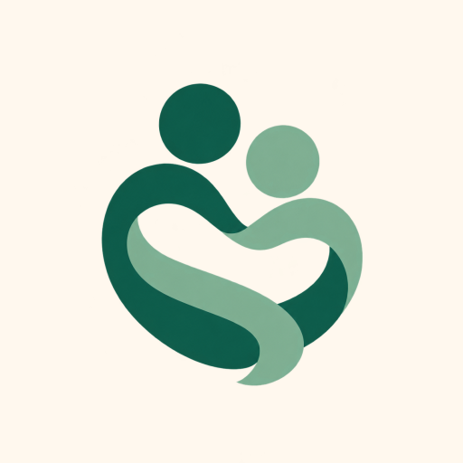
FINAL SUBMISSION
Sahara
A phone app for people with a serious illness, like advanced cancer, and their families. Their doctor asks what care they want near the end of life; Sahara writes it on a clinical document (goals of care), and an emergency doctor can read it in one scan.
TEAM NAME Zeros and Ones
TEAM CODE 37MYUP
Shaik Abdul Basith · Shaik Muhammad Awaiz · Dr Sharada Vinod Kutty · Dr Sujay Halkur Shankar · Shirin Ayub
Try it: sahara.wedevit.in · Android app and website · English, Hindi, Telugu, Urdu, Kannada
HEALTH-A-THON 2026 • TITLE

Slide 2
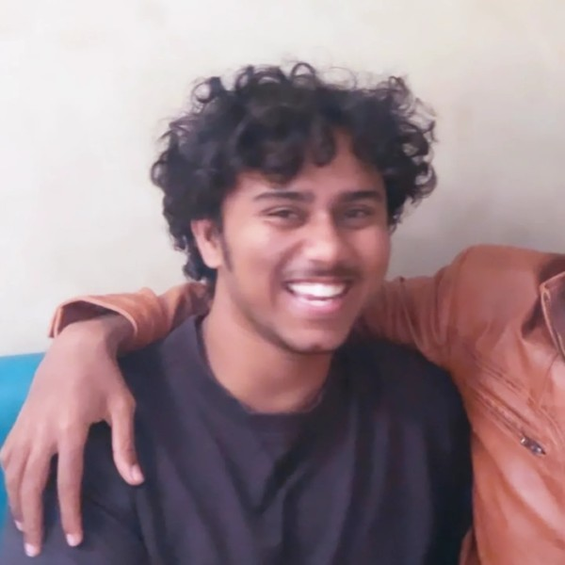
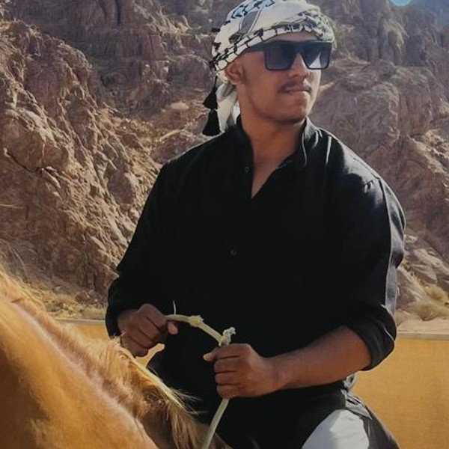
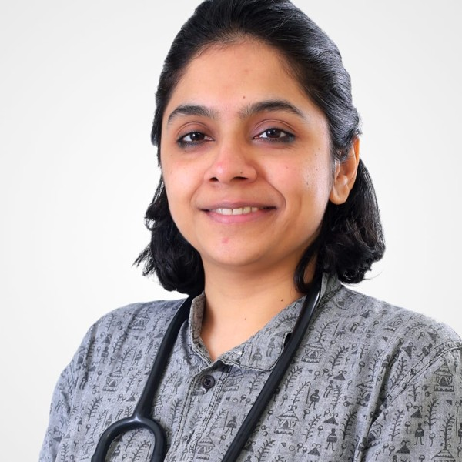
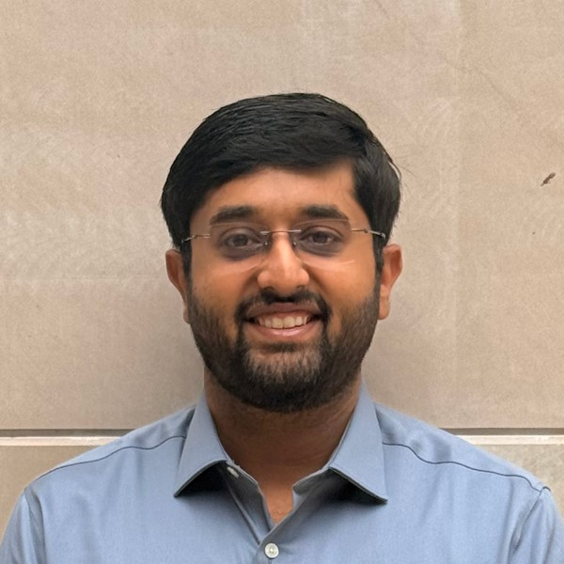
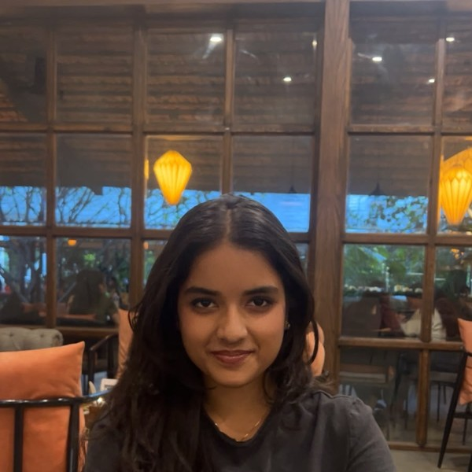
Team Overview & Background
Shaik Abdul Basith
Technical lead
Built the website and the AI that writes down the doctor’s conversation
Shaik Muhammad Awaiz
Engineer
Built the Android app and the server; tests every version
Dr Sharada Vinod Kutty
Doctor
Lung specialist. Wrote the medical rules the app follows
Dr Sujay Halkur Shankar
Doctor
Lung specialist who treats patients near the end of life. Set the order of questions
Shirin Ayub
Medical student
Designed how patients log their symptoms; researched caregiver stress
Our doctors chose this problem from their own clinics and check every version.
Legal advice was sought: inputs and refining the goals-of-care wording and format.
Built by WeDevIT, the team’s company. The app is on Google Play under WeDevIT.
HEALTH-A-THON 2026 • FINAL SUBMISSION
Notes:
Doctor background from Dr Sujay (team chat, 25 Aug 2026): pulmonary specialists who have worked extensively with lung cancer; Dr Sujay has palliative-medicine exposure.

Slide 3
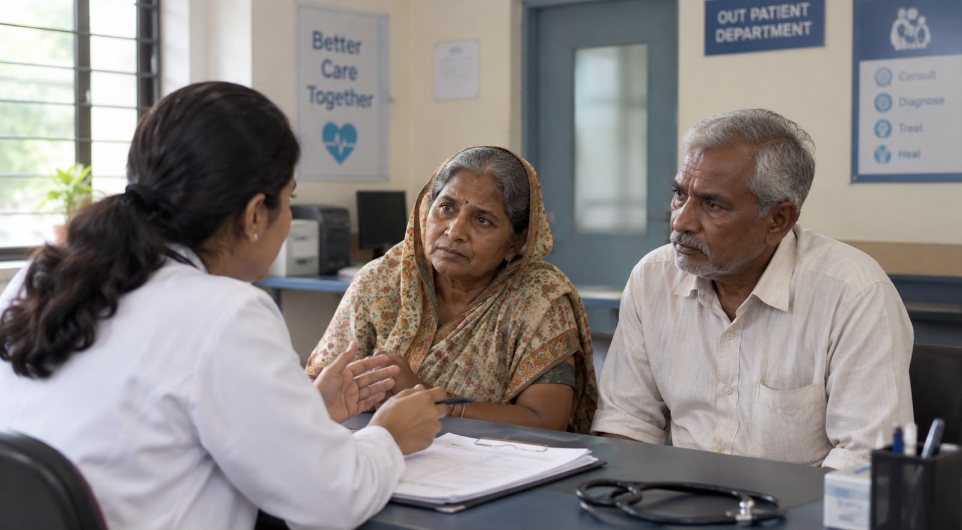

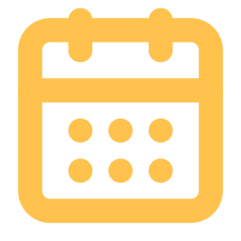

Problem Statement and Supporting Evidence
15.6 lakh
98%
new cancer cases in India in 2024.
IARC, GLOBOCAN 2024
of patients whose cancer had spread did not get the comfort care (palliative care) they needed.
Patil et al., 2024
88%
11.5%
of surveyed city patients wanted to choose their own end-of-life treatment.
IndiaSpend, 2019
of doctors (45 of 391) in one hospital were trained in advance care planning (recording these wishes).
Jacob et al., 2026
Example story (illustration). A 62-year-old woman with advanced breast cancer.
At the clinic, her doctor asks what treatment she would want if she got very sick. Only her husband is there.
What has to change
Her goals of care written on a clinical document, signed, and found in seconds in an emergency.
Numbers are from studies of different groups, not from Sahara.
Two months later she is unconscious in the emergency room. Should doctors try to restart her heart (CPR)?
Her children disagree, and nobody can find what she said.
HEALTH-A-THON 2026 • FINAL SUBMISSION

Slide 4
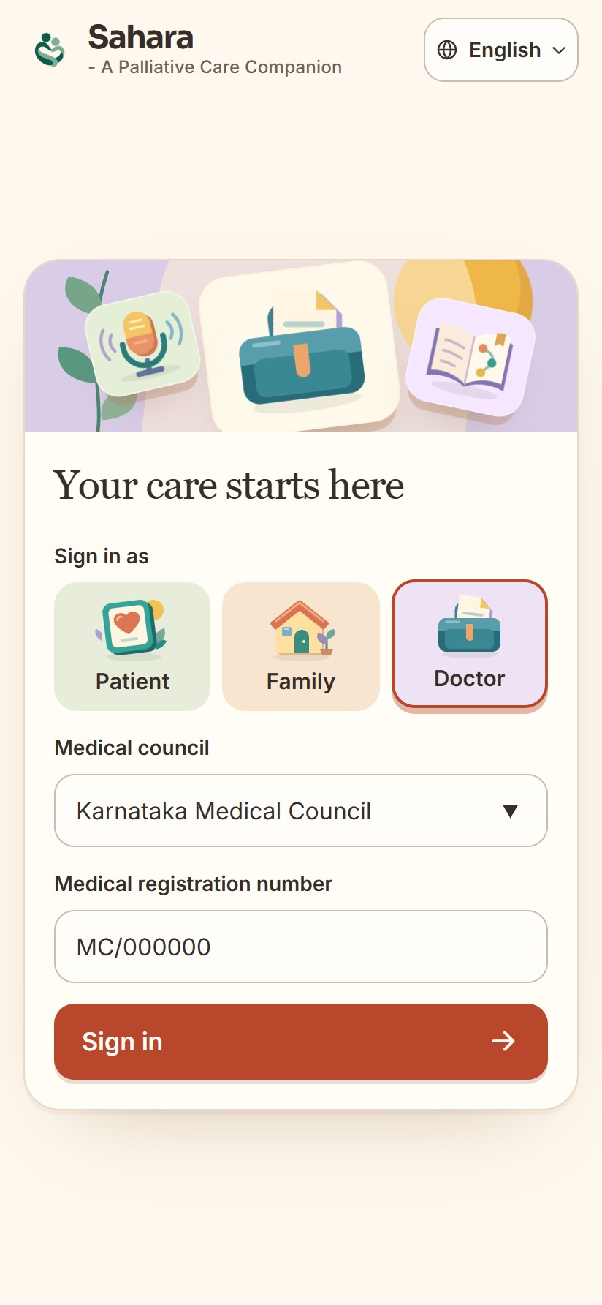
Target Users and Use Case
Patient · at home
logs how they feel; says what care they want
Family · at home
sees the same record; reads what the patient said
Their doctor · clinic
leads the conversation; checks and signs the document
Emergency doctor · minutes to decide
scans the patient’s QR code to see their wishes
Words used in this deck
Palliative care: care that eases pain and distress in a serious illness.
Goals of care: what treatment a patient wants, or refuses, near the end of life (CPR, ventilator, ICU).
Goals-of-care document: the clinical document, signed by doctor and patient or family, that records those wishes.
QR code: a square barcode on the patient’s phone or card; a phone camera scan opens their wishes.
HEALTH-A-THON 2026 • FINAL SUBMISSION

Slide 5
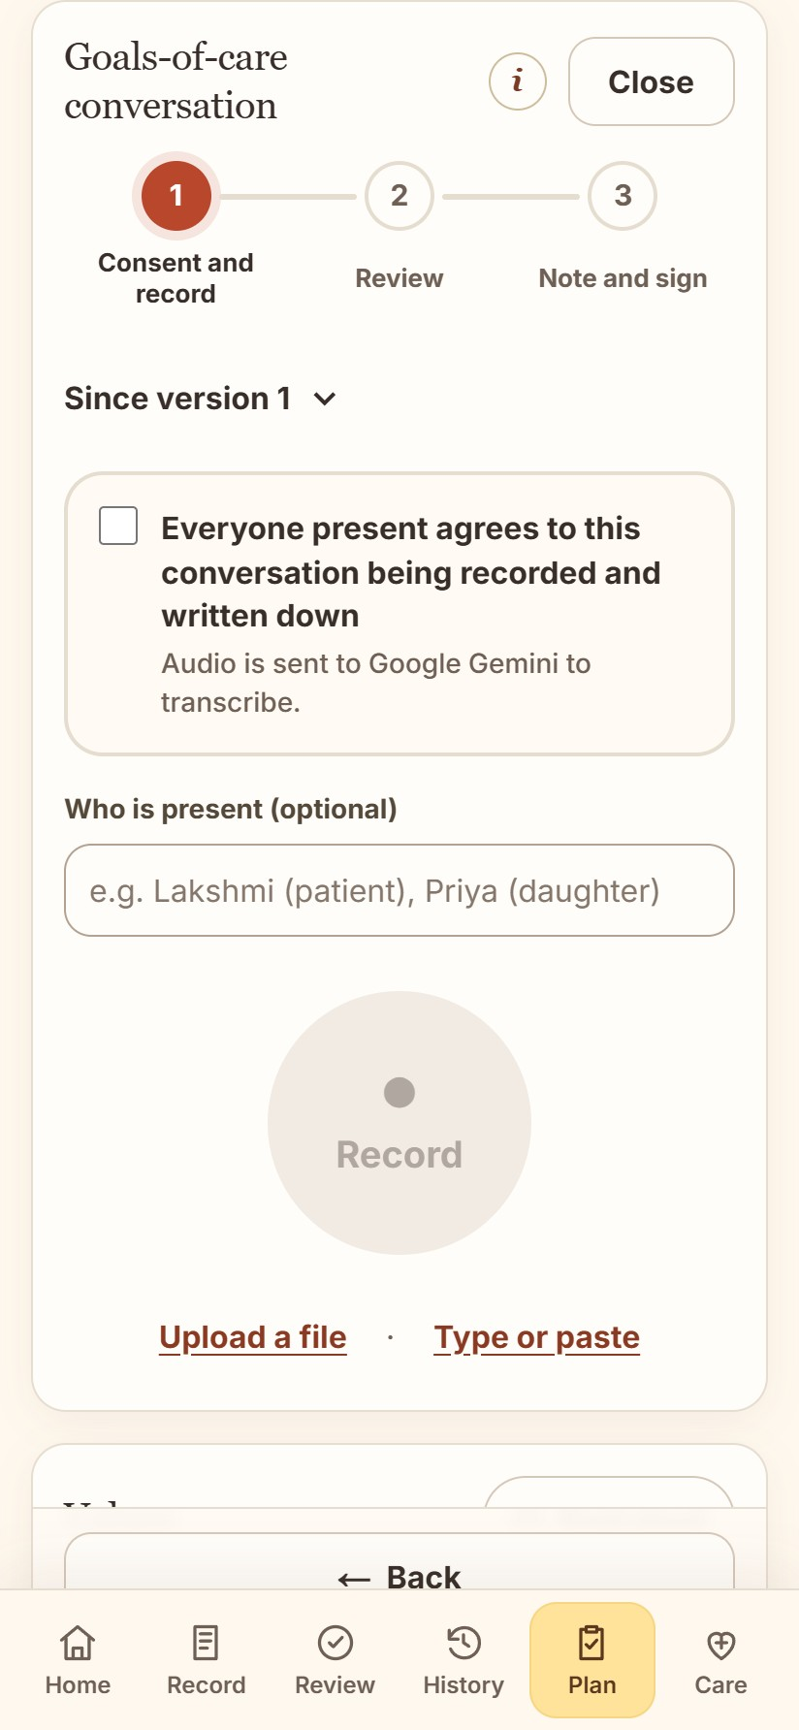
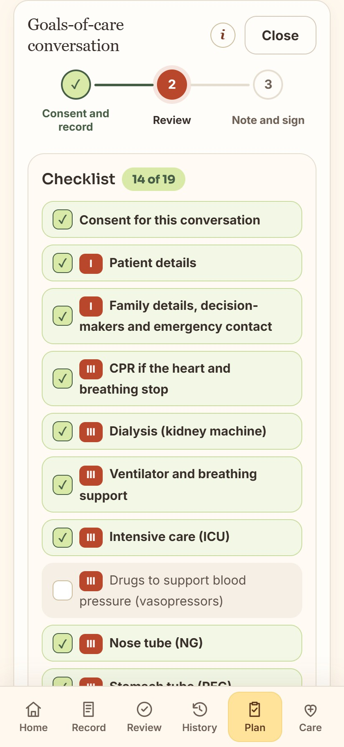
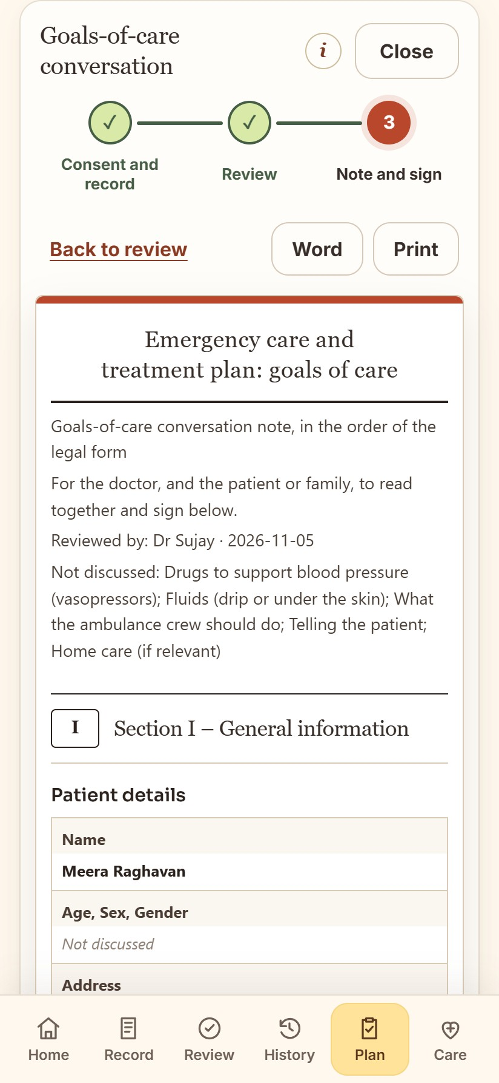
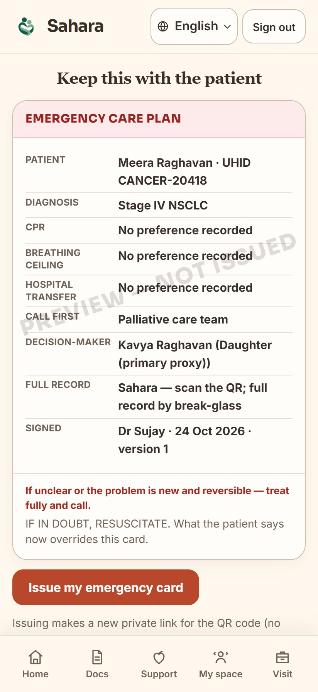
Solution Overview, Key Features & Impact (1/2)
In the clinic: the doctor talks, Sahara listens and writes.
The doctor asks the patient and family what care they want (a “goals-of-care” talk). Today this is often never written down.
1. Patient agrees, tap Record
Google’s Gemini AI types out who said what
2. A checklist ticks itself
Shows any topic the doctor has not asked yet
3. Answers fill the clinical document
The goals-of-care document, word for word. Doctor checks it
4. Everyone signs on the phone
The document locks and opens from a QR code in an emergency
HEALTH-A-THON 2026 • FINAL SUBMISSION
Notes:
Screens captured from the live website demo (sahara.wedevit.in, 5 Nov 2026) with a fictional patient (Meera Raghavan) and the fictional mock conversation docs/goc-mock-conversations/01-english.txt. The Android app has the same flow.

Slide 6
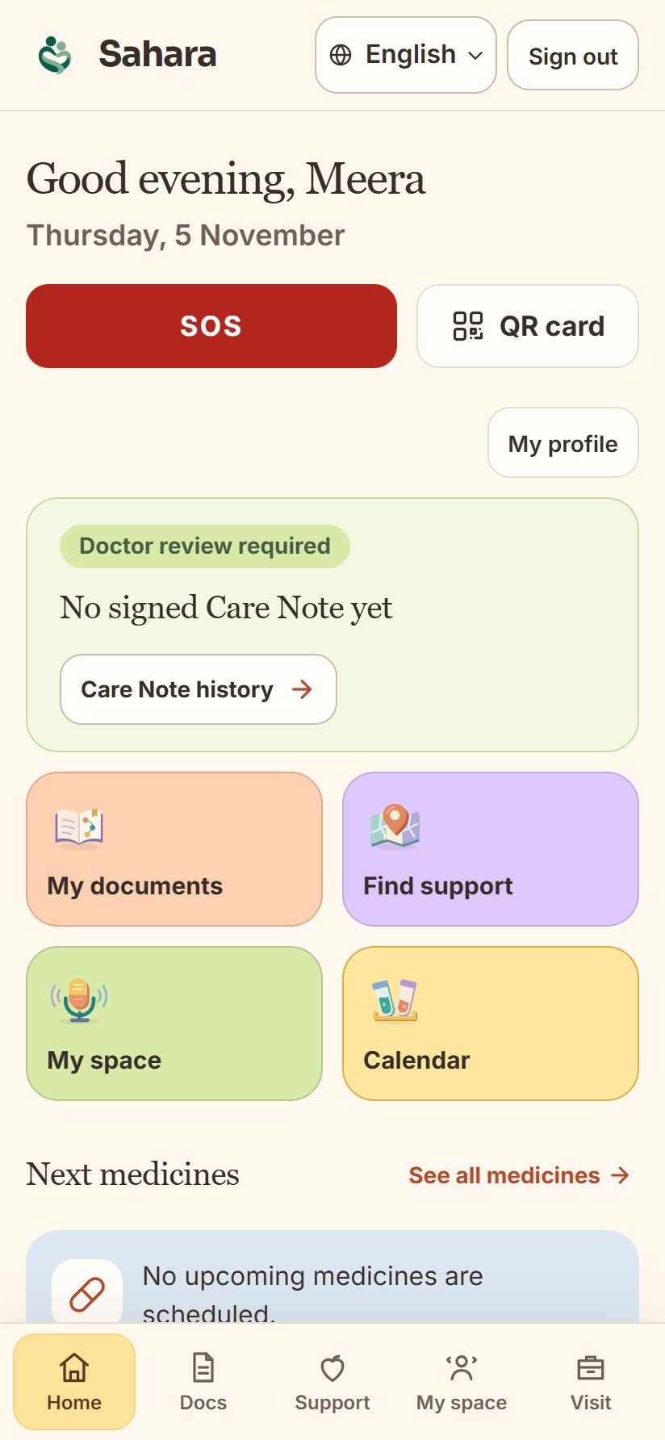
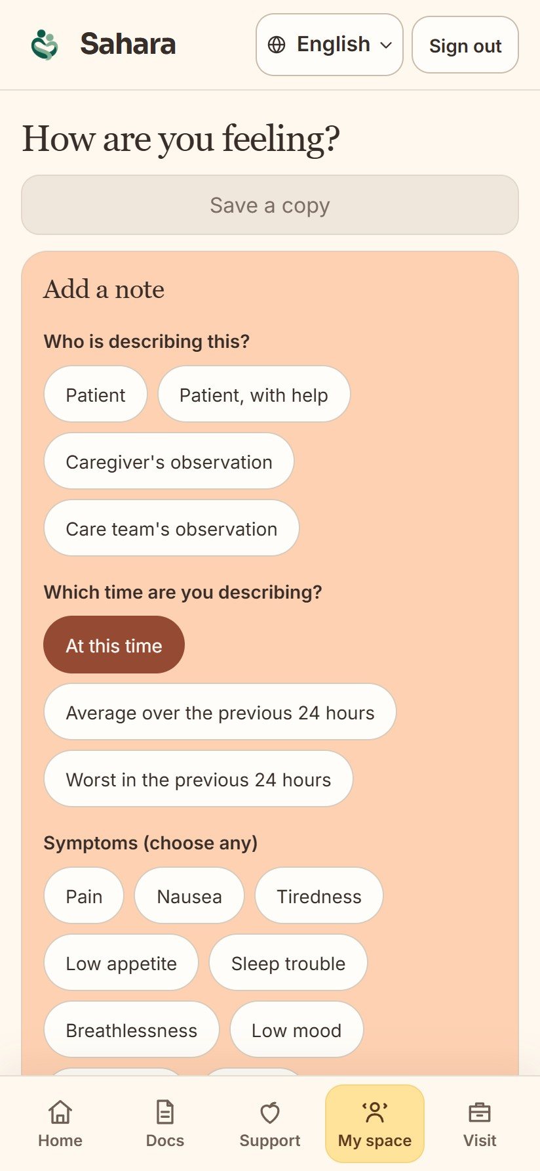
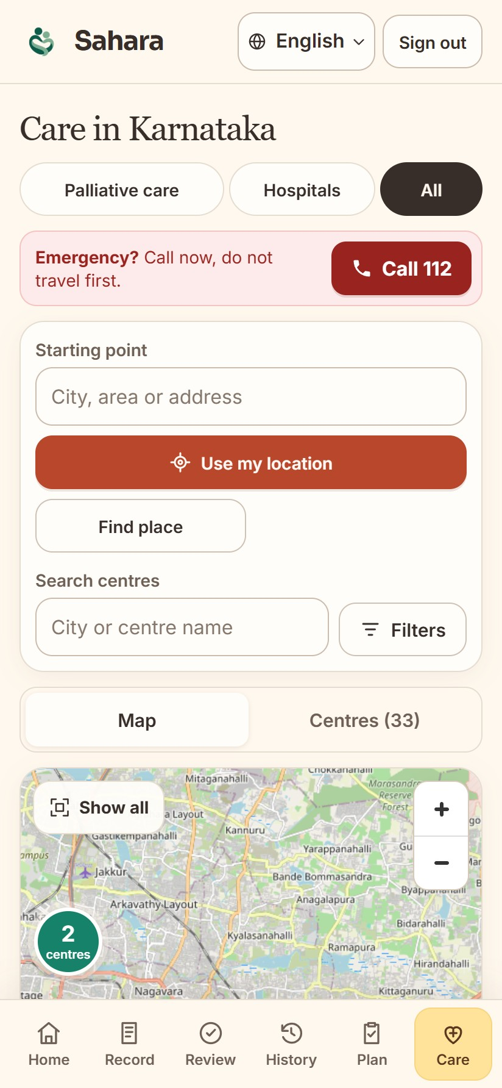
Solution Overview, Key Features & Impact (2/2)
At home, between visits: patients and families log how things are going; their doctor sees it.
Symptoms: 0–10 diary covering the ESAS-r symptoms (pain, tiredness, breathlessness, mood…) and a pain body map; the doctor sees charts.
Distress: NCCN Distress Thermometer and Problem List (NCCN permission being sought).
Caregiver check (new): family rate their own stress; if it worsens, counselling, Tele-MANAS 14416, respite care, support groups.
Medicines: tick each dose; reminders; photograph a prescription to add it.
Reports: ask a question about a hospital report and get the answer with the line it came from.
Emergency: SOS button and a QR code with goals of care, contacts and medicines.
Help nearby and family: palliative-care centres, ambulances, support groups; invited relatives share the record.
What we expect to change (to be measured in a pilot):
more of these talks written and signed · wishes found in seconds in an emergency · fewer family arguments at the bedside · doctors see problems before the next visit.
HEALTH-A-THON 2026 • FINAL SUBMISSION

Slide 7






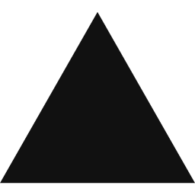
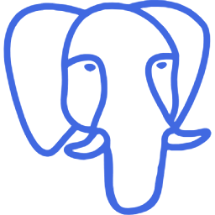
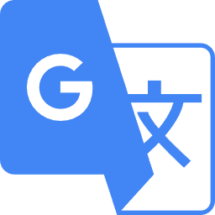

Technology, Tools and AI Approach
How a conversation becomes a signed clinical document
Doctor’s phone
records only after the patient agrees
Our server
keeps the AI password; the phone never has it
Google Gemini AI
types out the talk and fills in the clinical document
Doctor
reads it, corrects it, signs
Locked document
PDF + QR code; any later change cancels the signatures
No internet, or the AI is busy? OpenAI Whisper turns speech into text on the phone itself. If that fails too, the doctor types.
Built with
Android
Kotlin + Compose
Next.js
Vercel
Supabase
PostgreSQL
the phone app
language and screens of the app
the website
puts the website online
server, sign-in, storage
database; each family sees only its own
Google Gemini
OpenAI Whisper
Google ML Kit
OpenStreetMap
Clinical document
FHIR
AI: speech to text, fills the document
speech to text with no internet
5 languages and read-aloud on the phone
free map of nearby centres
goals-of-care format, refined with legal advice
standard format hospital software can read
HEALTH-A-THON 2026 • FINAL SUBMISSION
Notes:
Logos from the simple-icons set (CC0), used only to name the tools we use. Gemini models: 3.1 Flash-Lite first, then other Flash models when busy; on-device Whisper; typing.

Slide 8
Build Sprint Journey and Progress
October – November 2026
Built
Doctor / legal feedback
Milestone
✓ Working now
Patient and family app · doctor’s view · recording → signed clinical document · QR code · website live
MON
TUE
WED
THU
FRI
SAT
SUN
Week 1
5 Oct
6
7
8
9
10
11
Shortlisted!
AI medicine organiser
Prescription organiser
Android app + map of centres
↻ Changed on the way
Website first, then a real Android app. The AI used to write the note; now the doctor leads and the AI only writes it down.
Week 2
12
13
14
15
16
17
18
Google Play test version
Testers invited
Privacy and account safety
Week 3
19
20
21
22
23
24
25
Sent to Google Play
Mentor review
Hospital survey feedback
Symptom tracker
⚠ Problems we solved
Google’s AI was often busy → automatic backups. Exact goals-of-care wording → copied.
Week 4
26
27
28
29
30
31
1 Nov
Pain body map
Hospital survey live
Team meeting: 9 changes
Dr Sharada’s medical rules
Goals of care + QR code
Legal advice on format
Recording → text
Ask your reports
Telugu, Urdu, Kannada
… Still to do
Test on many real phones · record a real practice talk with Dr Sharada
2
3
4
5
6
7
8
Doctor schedule
Dr Sujay tests the whole app
Clinical document word for word
Gemini AI + backups
8 practice talks pass
Final polish
Blue circle: 5 Nov, the day of this submission. Grey days are outside the 4-week build sprint.
HEALTH-A-THON 2026 • FINAL SUBMISSION
Notes:
Dates from the git history and team chat: shortlisted 9 Oct; native Android 9 Oct; Play testing 13-14 Oct; Play submission 19 Oct; survey feedback 23 Oct; survey live 27 Oct; team meeting 28 Oct; clinical spec 29 Oct; legal review 31 Oct; Dr Sujay walkthrough 3 Nov; clinical document word for word 4 Nov; Gemini fallback 5 Nov.

Slide 9
Evaluation and User Validation
1. Does it work? Our own tests
877
594 / 594
8 / 8
4 / 4
automatic checks on the Android app: all pass
automatic checks on the website: all pass
practice doctor–patient talks in 6 languages: every answer landed in the right place on the document
questions about a sample hospital report answered correctly
Automatic checks are small test programs that run after every change, so a broken feature is caught before release. The practice talks are made up, not real patients.
2. What experts told us, and what we changed
Dr Sujay Halkur Shankar
doctor, used the whole app on 3 Nov
Legal advice
sought on 31 Oct
Dr Sharada Vinod Kutty
doctor, wrote our medical rules on 29 Oct
Said: Is there a guide telling the doctor what to talk about next? And a medicine taken 4 times a day needs 4 ticks.
We changed: Checklist in the doctors’ order with a “not yet discussed” prompt; one tick per dose. Team chat: tubes-and-drains tracker, darker text.
Said: Refine the goals-of-care wording and format.
We changed: Document copied word for word; signing locks it.
Said: Comfort care must always continue, whatever treatment a patient refuses.
We changed: The app shows this on every signed document.
Not tested yet: with real patients · on many real phones · speech-to-text on real Hindi, Telugu and Kannada recordings · a doctor checking each translation means the same
HEALTH-A-THON 2026 • FINAL SUBMISSION
Notes:
Unit tests: HANDOFF 5 Nov (Android 877, web 594/594). Mock conversations: docs/goc-mock-conversations, English, Hindi, Hinglish, Telugu, Urdu, Kannada, disagreement, short talk; both matchers pass all 8. Ask documents: 4 questions on a practice discharge PDF (one needed a retry). Feedback: 3 Nov meeting transcript and team chat to 4 Nov (tubes and lines, faded text, checklist order); legal review 31 Oct; clinical spec 29 Oct.

Slide 10
Safety and Responsible AI
Privacy and consent
Limits on the AI
✓ Recording starts only after the patient ticks “I agree”
✓ The AI is used only with that consent
✓ Each family sees only their own records
✓ The AI never suggests treatment
✓ If a topic was not discussed, it says so; it does not guess
✓ If the AI is down, the phone or the doctor writes it
A person decides
For everyone
✓ The doctor reads, corrects and signs first
✓ The patient or family signs too
✓ After signing, any change cancels the signatures
✓ 5 Indian languages, and it reads text aloud
✓ Sign with a thumbprint; large text
✓ Demos use made-up patients only
HEALTH-A-THON 2026 • FINAL SUBMISSION

Slide 11
Deployment, Cost and Sustainability Plan
Pilot
Start in 1 clinic with our own doctors. Patients give consent as India’s data-protection law (DPDP Act) requires.
What it costs | Once | Every month
Servers and website (Supabase + Vercel) | – | ₹3,900
Google Gemini AI, per 30-minute talk | – | ≈ ₹2 a talk
Setting up and training clinic staff | ₹25,000 | –
Consent forms and legal check | ₹25,000 | –
Support from our team | – | ₹10,000
Cost per clinic, if 10 clinics share it | ₹5,000 | ≈ ₹1,600
Fitting in
Today it records on the doctor’s phone. Next: ambient listening, with room or lapel microphones in clinics. Later, FHIR export for hospital software.
Who pays
Clinics or charities pay a monthly fee. Free for patients and families.
We would charge ₹1,500–2,000 per clinic a month
Growing
Grants first, then palliative-care networks across India.
Our estimates from public prices: US$1 ≈ ₹86; Supabase $25 and Vercel $20 a month; Gemini ≈ $0.30 per million audio units (a 30-minute talk ≈ 58,000); 100 talks per clinic a month.
HEALTH-A-THON 2026 • FINAL SUBMISSION
Notes:
COST FIGURES ARE TEAM ESTIMATES from public list prices and an assumed Gemini audio price; confirm before submission. Per clinic monthly = (3,900 + 10,000) / 10 + 100 x 2 = ~1,590. One-time per clinic = 50,000 / 10 = 5,000.

Slide 12
What Next? Plans to take initiative forward (if any)
1
2
3
4
Prove it works
Test on many real phones; try room and lapel microphones (ambient listening). Record a real practice talk with Dr Sharada.
Pilot, 60–90 days
One clinic. Count how many talks get signed and how fast wishes are found.
Legal rules
What to do when a patient cannot decide, who may sign for them, and how a patient changes their goals of care.
Fund and grow
Grants, palliative-care networks, then link with hospital software.
Can the organisers share our solution publicly? YES
Slides, brief, video and app description. Not patient records, passwords or private code.
HEALTH-A-THON 2026 • FINAL SUBMISSION

Slide 13
Thank you
Zeros and Ones • 37MYUP
Try it: sahara.wedevit.in | Demo video: [add demo video link] | workwithdevit@gmail.com | Code: github.com/basithladdu/healthathon (private)
Shaik Abdul Basith · Shaik Muhammad Awaiz · Dr Sharada Vinod Kutty · Dr Sujay Halkur Shankar · Shirin Ayub
Health-a-thon 2026
HEALTH-A-THON 2026

