Slide 1
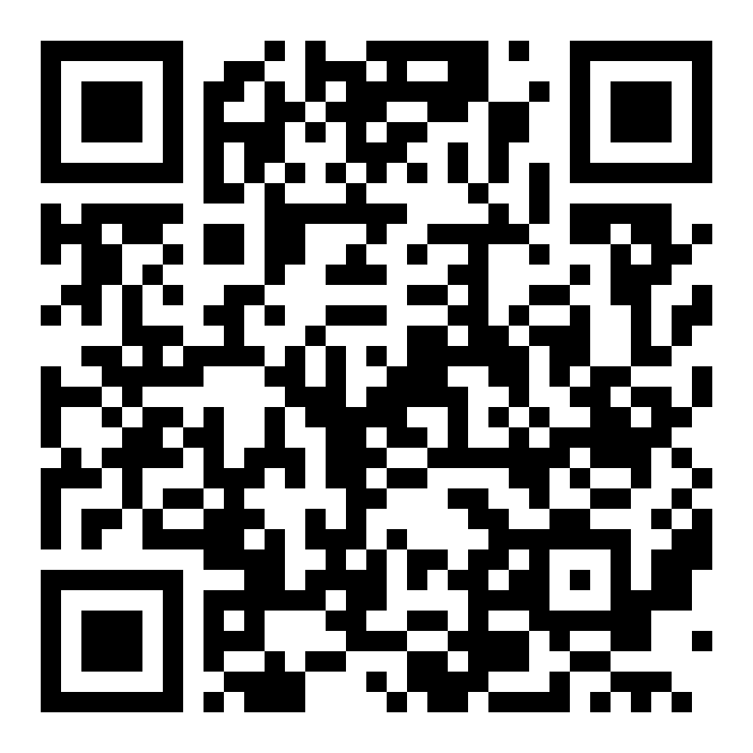
Continuity Loop
Scan it. Try it.
continuity-loop-healthathon.vercel.app
One care plan. Every handoff.
Synthetic patients · works in the browser

Slide 2
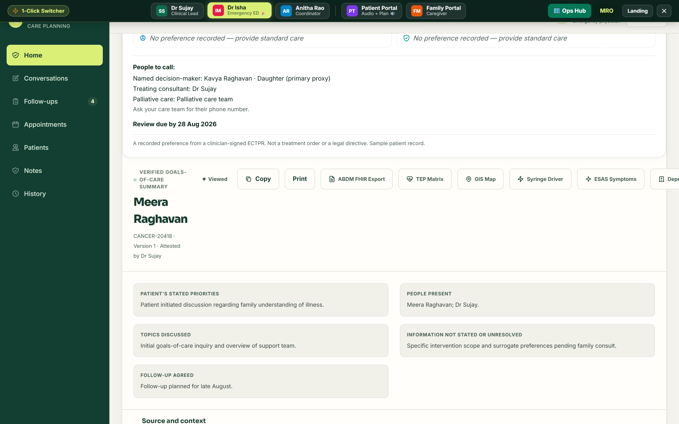
2 a.m. in the ED
The emergency doctor finds the plan in seconds.

Slide 3
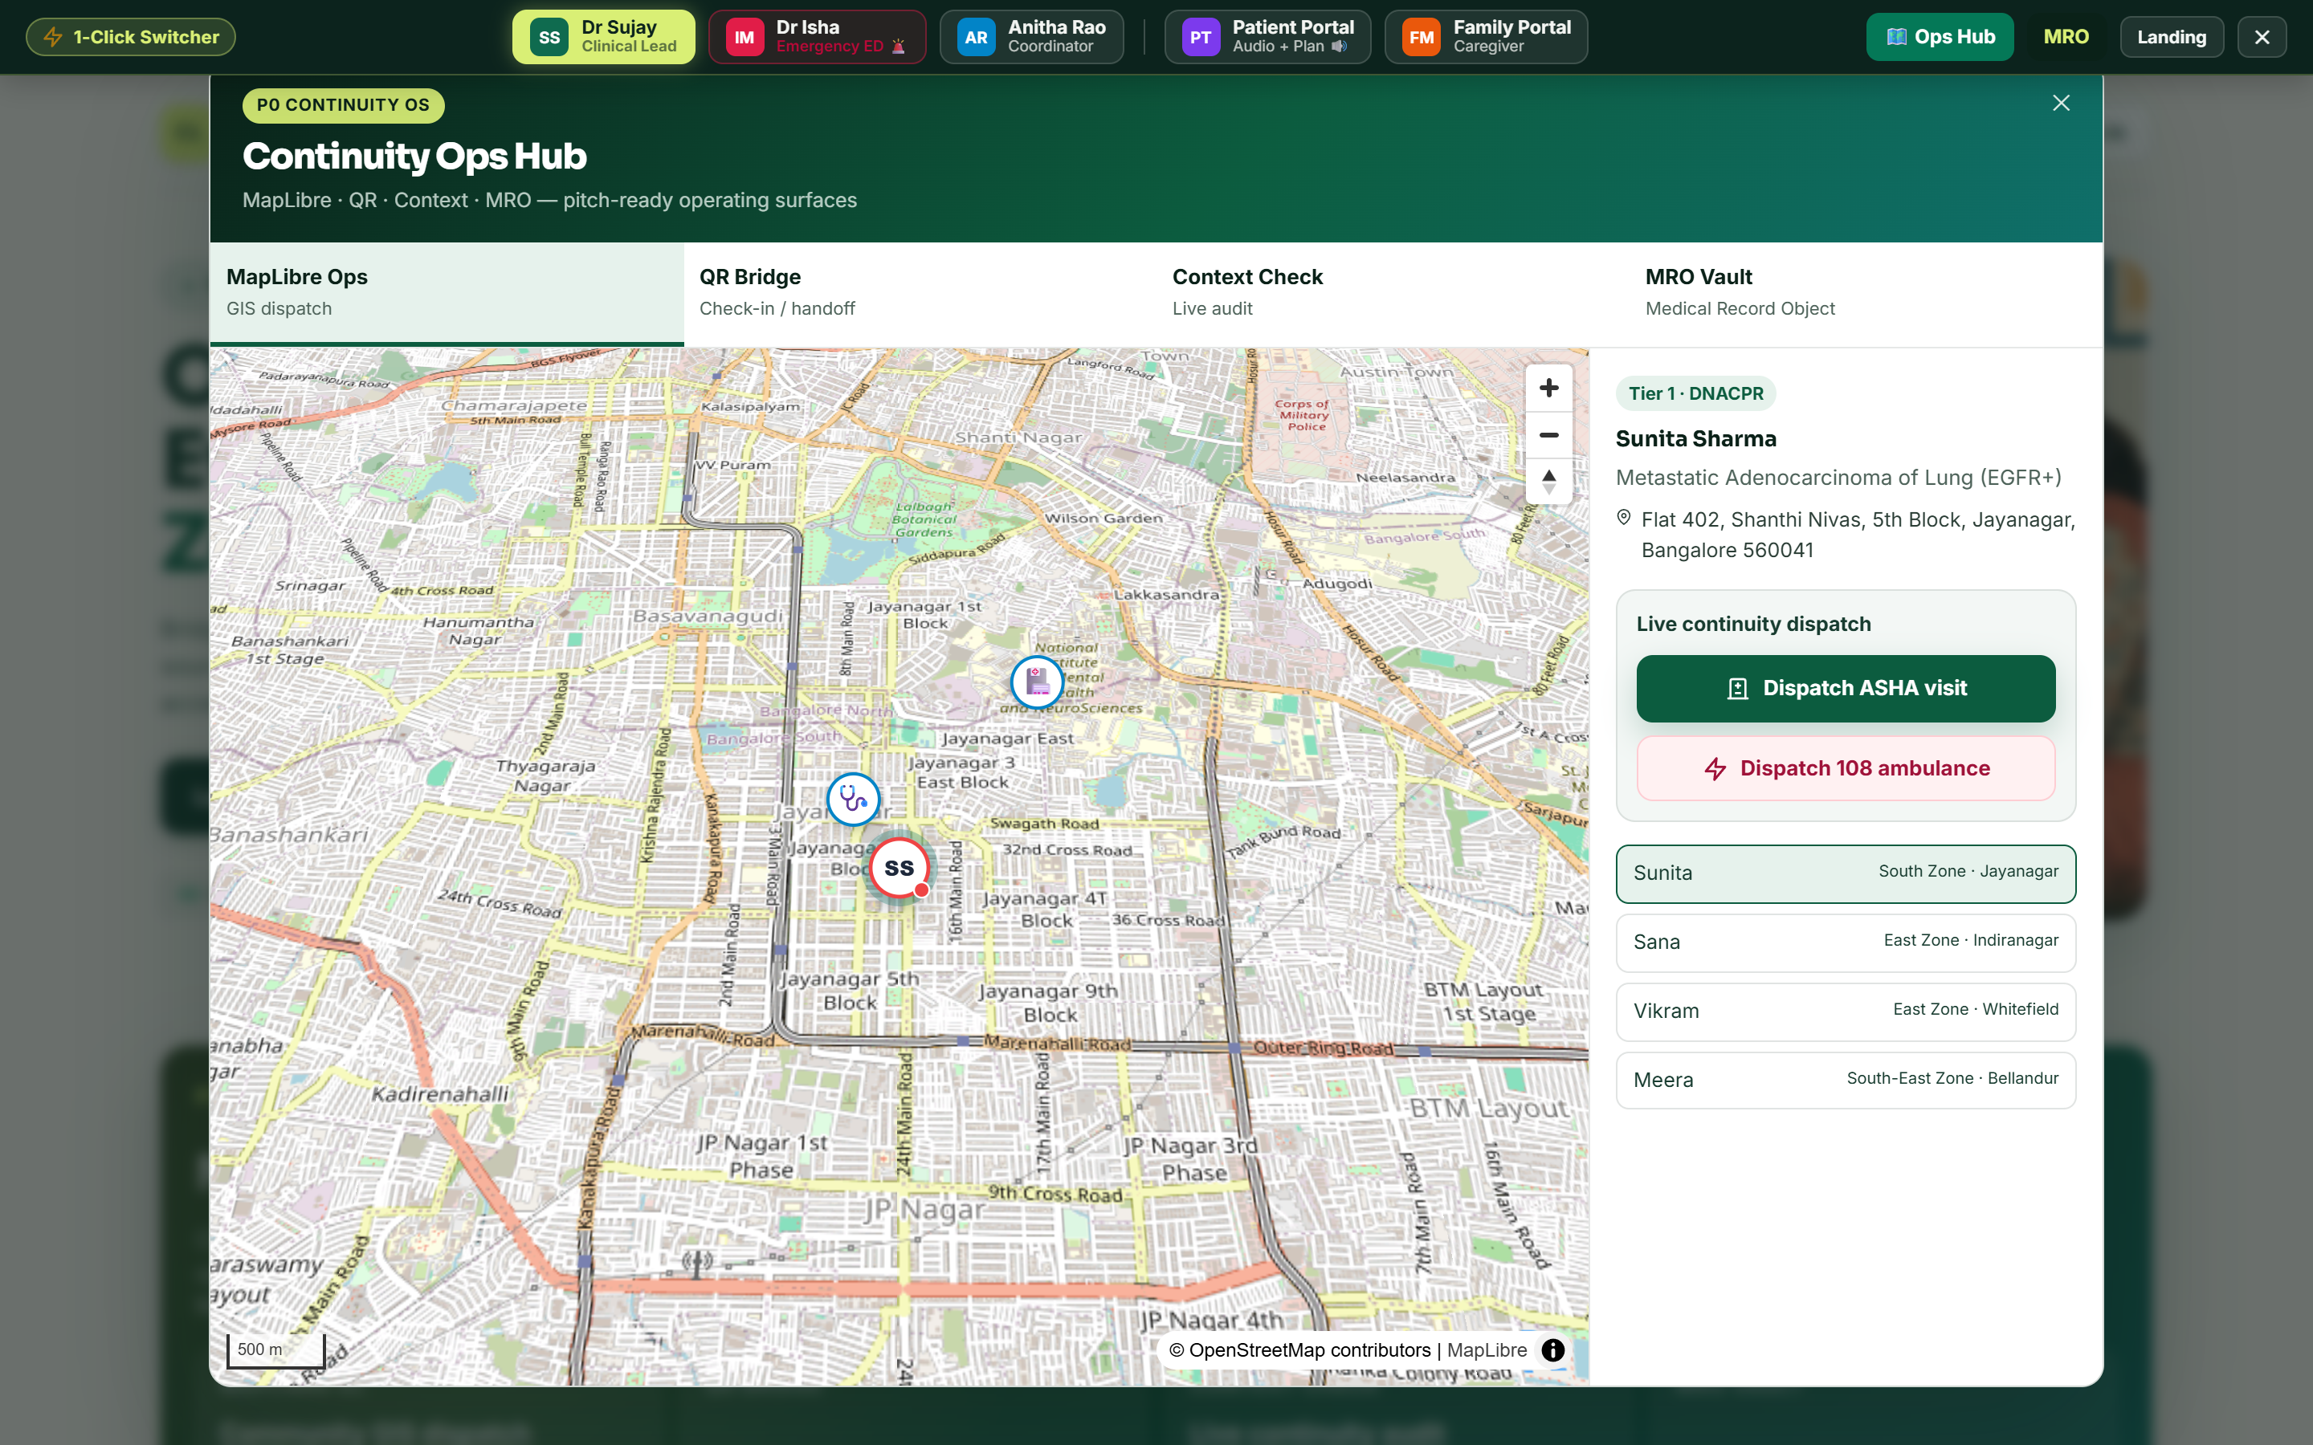
Where every patient is
Live Bangalore map — send an ASHA or a 108.

Slide 4
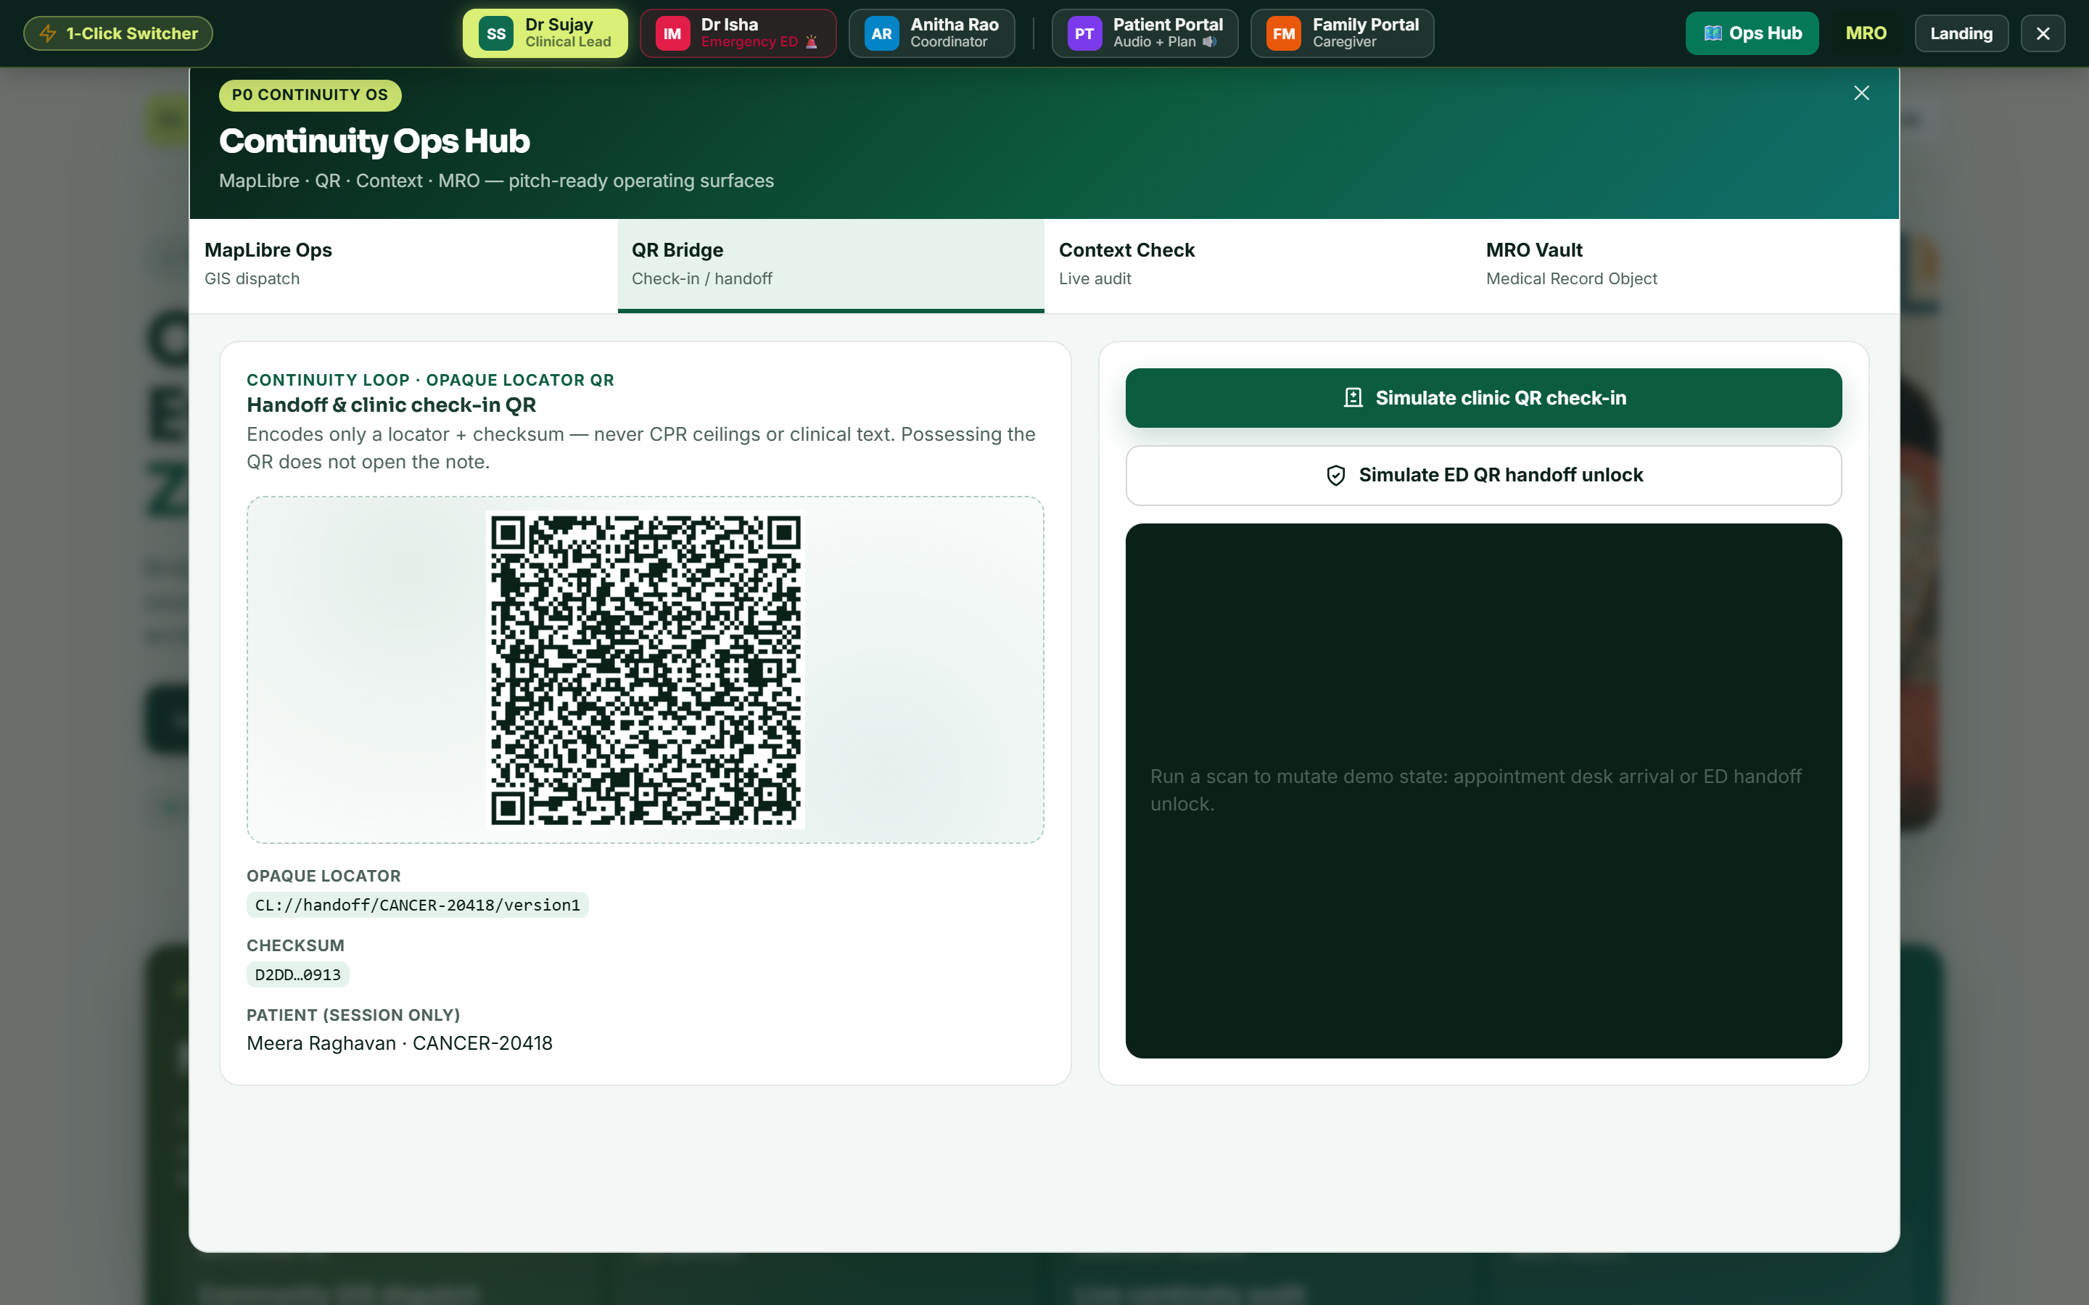
Scan at the door
A QR that unlocks the handoff, never the notes.

Slide 5
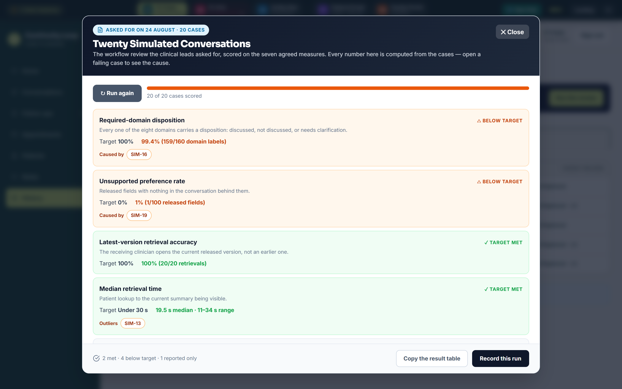
20 conversations, scored
Every number computed. Every miss named.

Slide 6
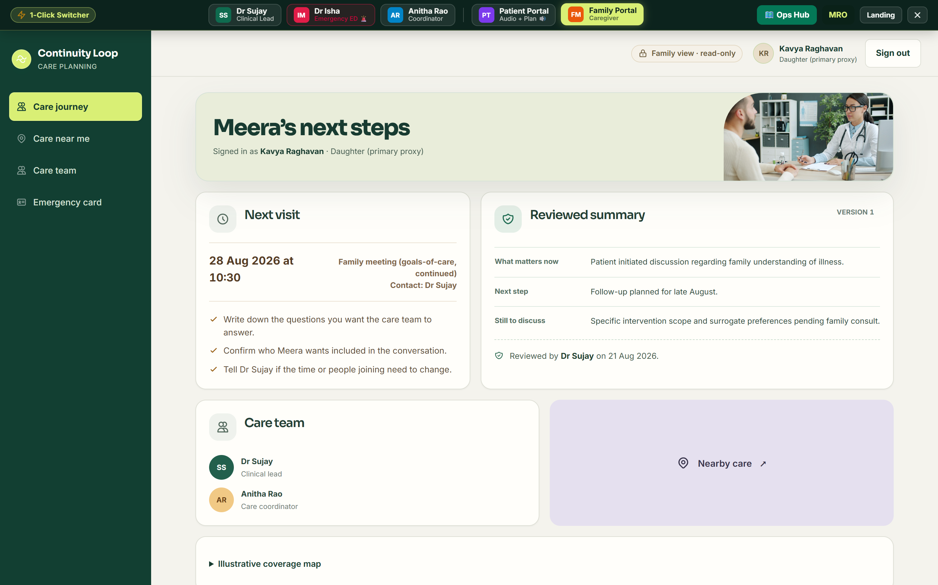
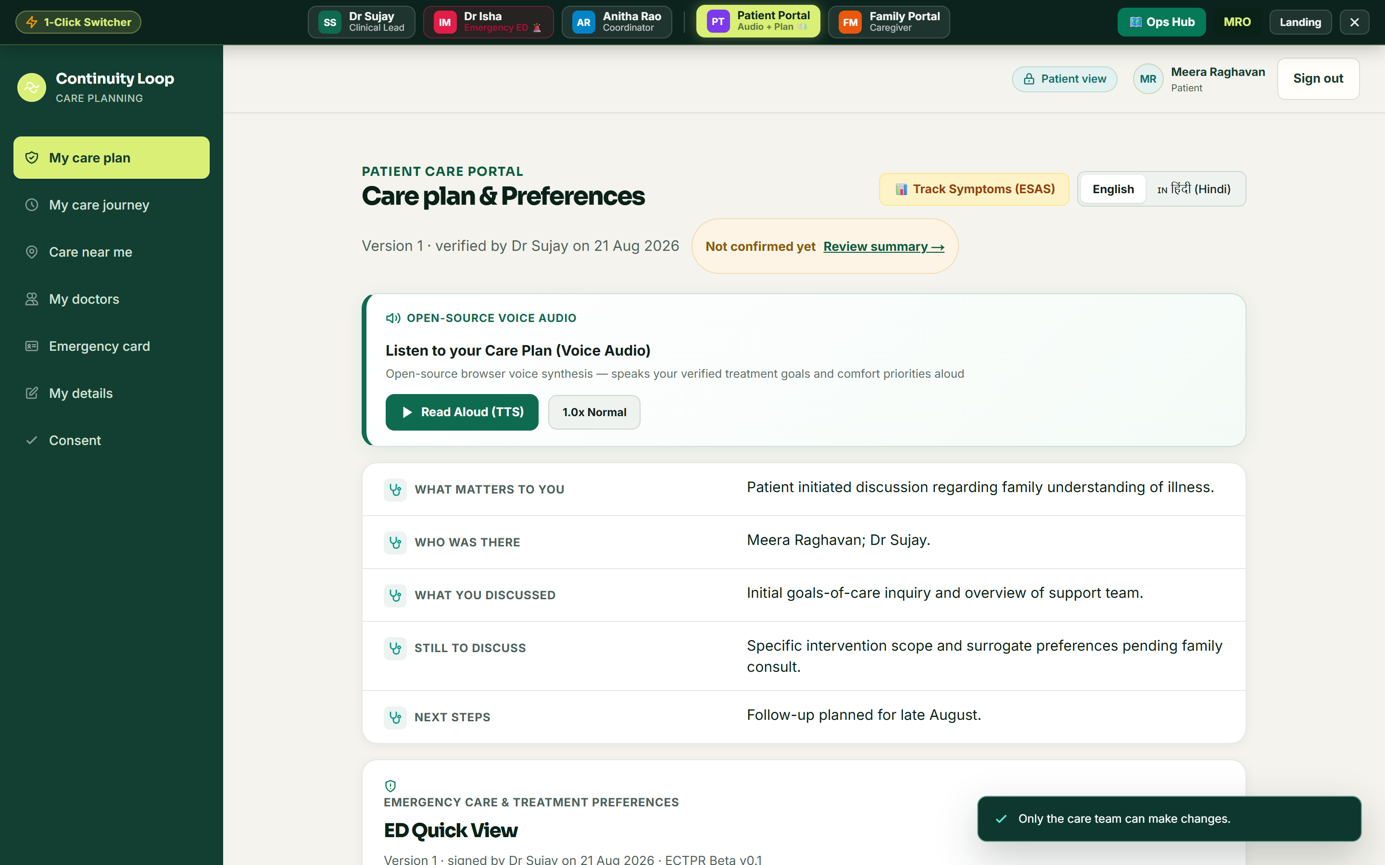
The family sees it too
Plain words. Hindi. Read aloud.

Slide 7
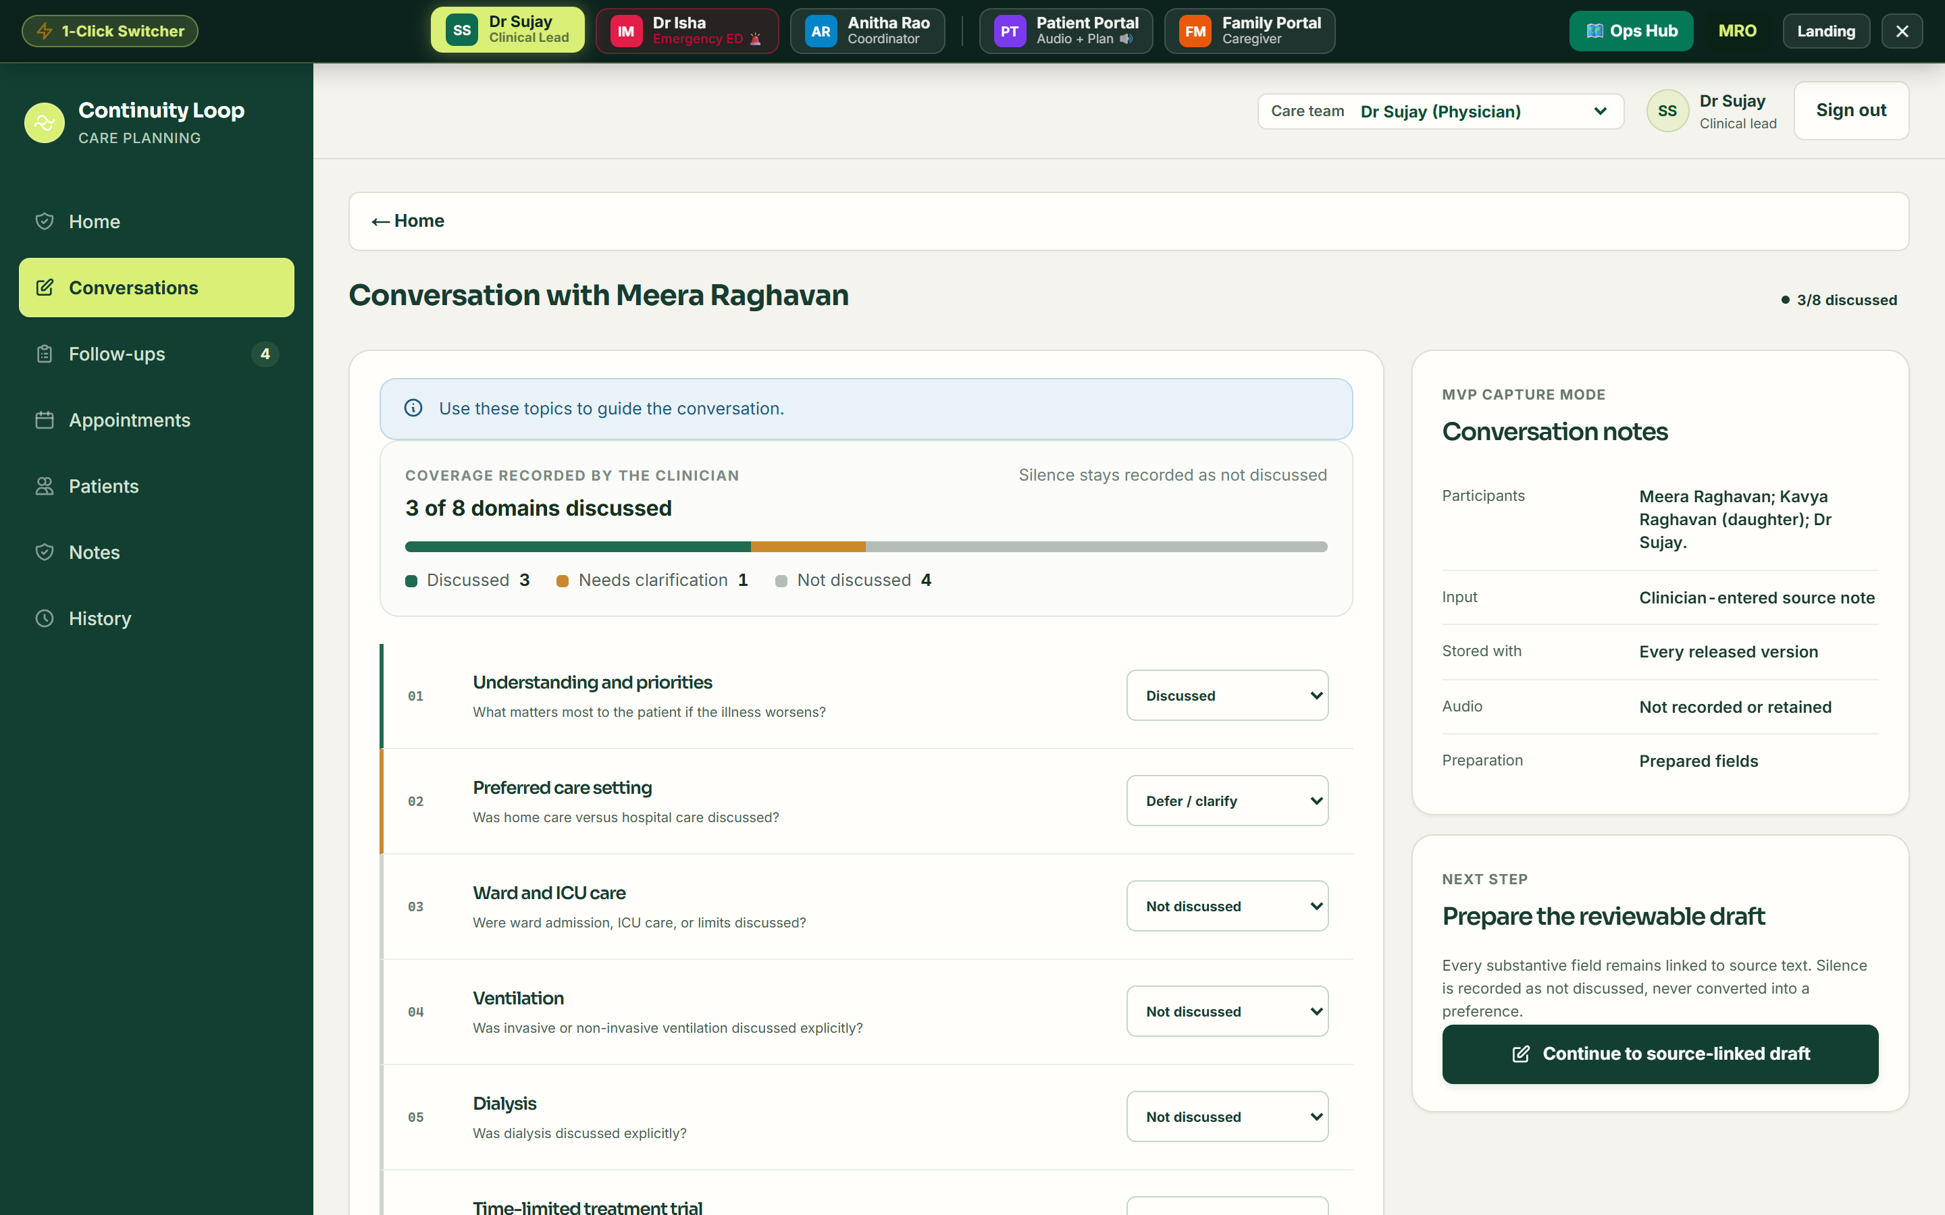
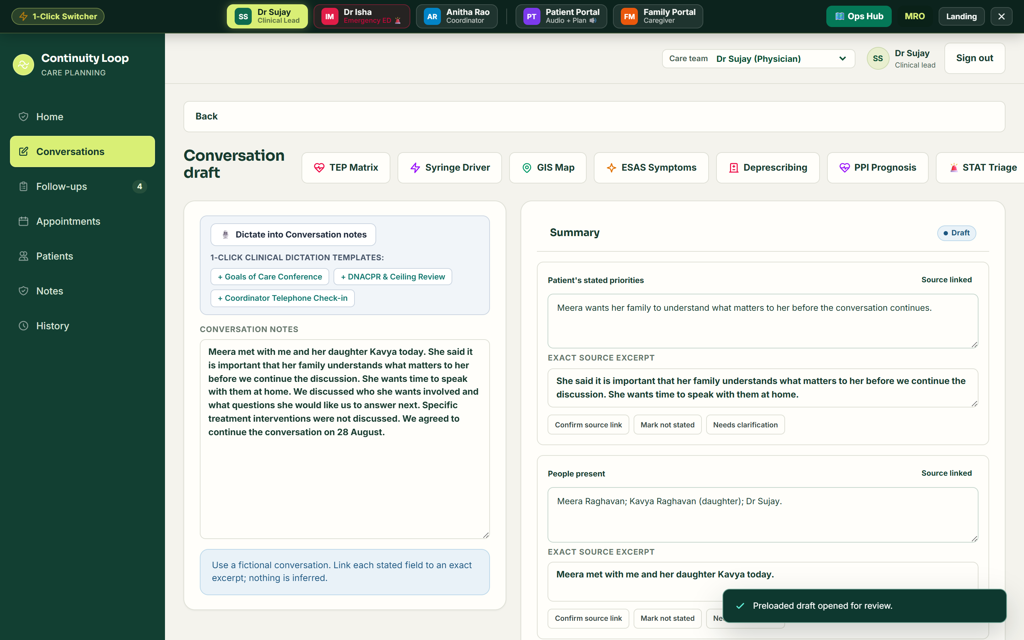
The doctor leads
Guided conversation → reviewed draft → locked version.

