Slide 1
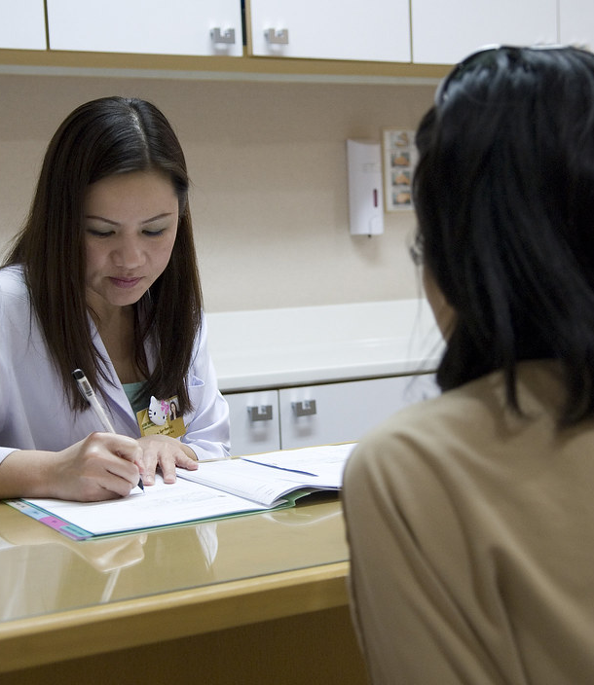
Saanthvana
A shared care record for people with cancer and their families.
Imagine a 62-year-old woman with advanced breast cancer. She starts best supportive care to help manage her symptoms. Her doctor discusses what she would want if her health worsens, but only her husband is there.
Two months later, she is unconscious and rushed to hospital. The doctor asks whether she would want attempts to restart her heart or a machine to help her breathe. Her husband says yes. Her daughter says no. Her son is unsure. No one can find the earlier discussion.
Saanthvana brings that conversation together with the records and next steps the family needs.
Context photograph. A general consultation, not the story patient.
Cancer / Patient and Caregiver / Family & Caregiver Support
continuity-loop-healthathon.vercel.app
Notes:
This is the team's illustrative story, not a reported patient case. The photograph is a separate contextual image and does not depict the woman in the scenario. The story does not recommend or reject any emergency treatment.
[Sources]
- docs/meetings/2026-09-23-chat-follow-up.md
- submission/Saanthvana_Round_1_Judge_Text_2026-09-24.md
[Photo credit and rights]
- Thierry Falise / ILO Asia-Pacific.
- Source page: https://commons.wikimedia.org/wiki/File:Doctor_consultation.jpg
- CC BY-SA 4.0: https://creativecommons.org/licenses/by-sa/4.0/
- Cropped for placement.

Slide 2
The need is large. Better records are one part of the answer.
15.6 lakh
A clearer process helped one hospital
Documented care conversations
India had an estimated 15.6 lakh new cancer cases in 2024.
98.39%
A registry analysis estimated that 98.39% of people whose cancer had spread did not receive palliative care.
A standard form and process helped a Chennai cancer hospital document conversations for 24 of 26 eligible patients.
The analysis covered 10 cancer types in Indian registry data.
IARC GLOBOCAN 2024 · Patil et al. 2024 · Thangasamy et al. 2025
Notes:
The slide shows published research, not Saanthvana outcomes or an AI result. The studies cover different populations and must not be multiplied together. The app addresses documentation and coordination; it cannot by itself supply missing care services.
[Sources]
- IARC. India fact sheet, GLOBOCAN 2024. 1,562,581 estimated new cases in 2024, rounded to 15.6 lakh. https://gco.iarc.who.int/media/globocan/factsheets/populations/356-india-fact-sheet.pdf
- Patil S, Sharma P, Arora A, Zadey S. Unmet need for cancer palliative care in India. BMJ Supportive & Palliative Care, 2024. DOI: 10.1136/spcare-2024-004978. The estimate uses people with metastatic cancer who did not receive palliative care, drawing on NCRP 2020 data for ten cancer types. It is not an awareness rate or a national survey of all people with cancer. https://pubmed.ncbi.nlm.nih.gov/38834235/
- Thangasamy DRJ et al. Initiating and documenting goals-of-care discussion in patients with advanced pancreatic and colorectal cancers: a quality improvement project in a low-resource setting. Palliat Med Rep, 2025. DOI: 10.1177/26892820251392545. Single-centre Cancer Institute (WIA), Chennai; 0% baseline and 92% after implementation, with 24 of 26 eligible patients documented. The intervention included a standard process, colour-coded form and awareness/referral work. It is not a national rate or Saanthvana result. https://journals.sagepub.com/doi/10.1177/26892820251392545
[Chart data]
The editable native chart contains the published values [0, 92] percent for before and after the single-centre QI intervention.

Slide 3
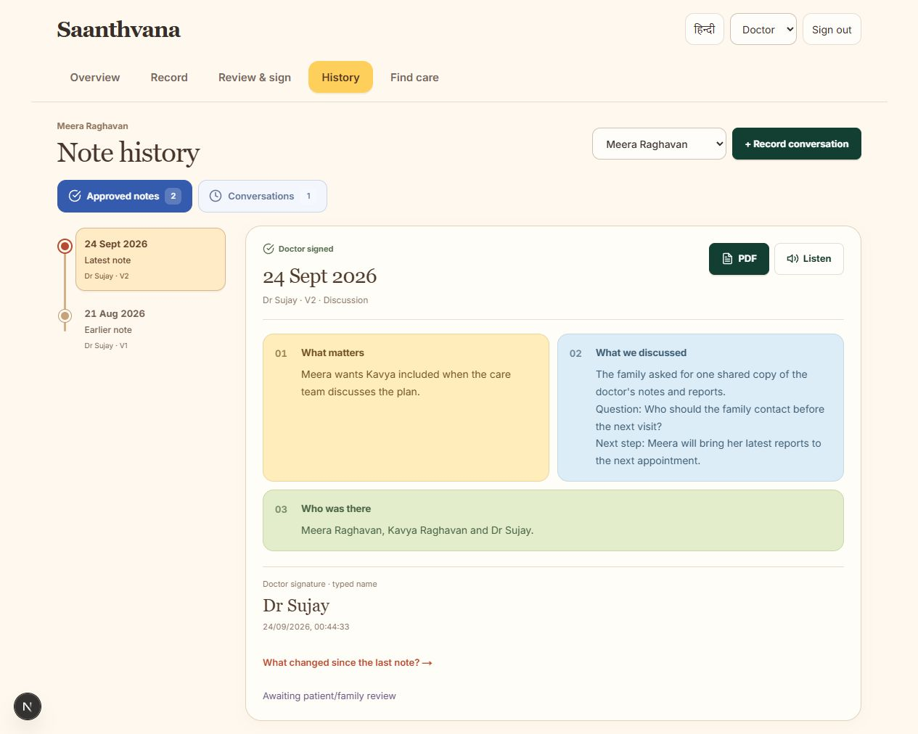

The patient’s wishes stay with the care record
Doctors call this a goals-of-care conversation. It means talking about what matters to the patient and what they want from their care.
The patient or family can ask to talk. The doctor can start the conversation too.
The note keeps what was discussed separate from what was decided. An unanswered question stays unanswered.
The doctor checks the note. In the shared app we are building, the patient will choose which family members can see it. A later conversation gets a new dated version, so earlier discussions stay available.
Open Saanthvana
Care note history. The screen is an actual product capture.
Notes:
The screenshot is an actual local product capture. Names and patient details in its fictional account are illustrative interface content. The current app records typed names, not verified digital signatures. A care note is not a legal advance directive or an instruction for automatic treatment. Patient selection of family members is the intended shared workflow; separate verified accounts and across-phone sharing are not yet connected.
[Sources]
- 21 September transcript, lines 337–395 and 903–959.
- 23 September transcript, lines 15–21 and 123–167.
- docs/meetings/2026-09-23-chat-follow-up.md
- Actual screenshot: output/playwright/2026-09-24-note-history.png
[QR target]
https://continuity-loop-healthathon.vercel.app/

Slide 4
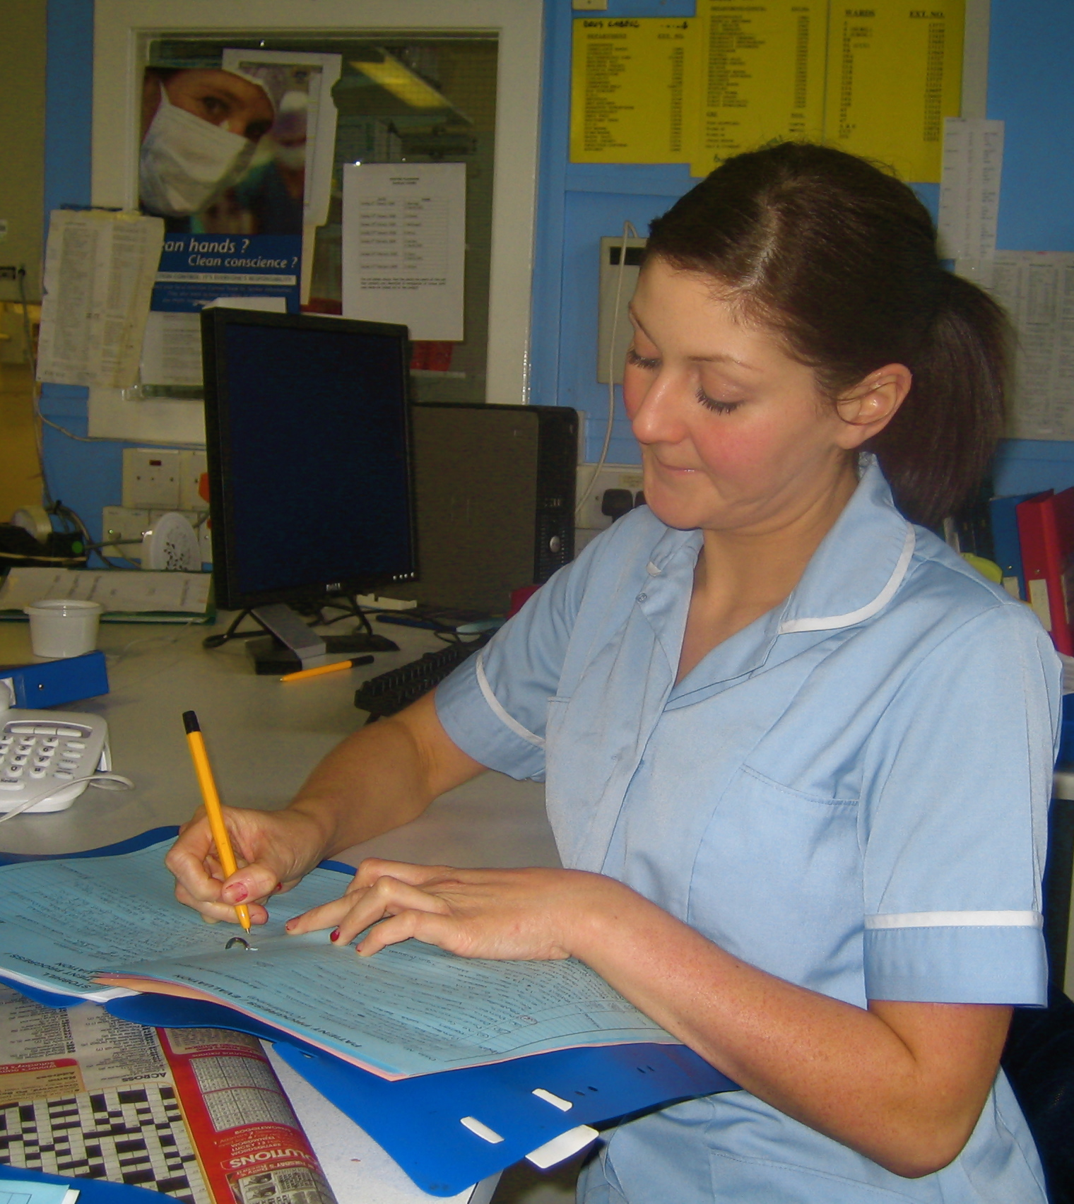
AI has two clear jobs
Help write the care note
With permission, the doctor records the conversation or adds existing notes. AI will prepare a draft and point back to the source. The doctor corrects it before signing.
Find information in the patient’s own documents
AI will organise uploaded reports by date and help answer questions such as “When was my last chemotherapy?” Each answer must show the original record. If the answer is missing, it must say so.
AI will help organise information. It will not diagnose, interpret test results or recommend treatment.
A nurse writes clinical notes. Context photograph, United Kingdom.
Notes:
These are planned connected-AI functions. Today the app supports document upload, source passages, literal retrieval, recording and rule-based note preparation. A model, reliable transcription and image OCR are still to be connected. The reviewed conversation remains the main AI use case; document retrieval supports continuity.
[Sources]
- 21 September discussion, lines 251–303 and 1097–1155.
- submission/Saanthvana_Round_1_Judge_Text_2026-09-24.md
[Photo credit and rights]
- Photo by goodcatmum (Flickr), “Staff Nurse Andrea writing up her notes.”
- Source page: https://commons.wikimedia.org/wiki/File:Staff_Nurse_Andrea_writing_up_her_notes.jpg
- CC BY-SA 2.0: https://creativecommons.org/licenses/by-sa/2.0/
- Attribution is required. The image was cropped/resized. The source warns that personality/model rights may restrict some reuse; this is contextual illustration and not documentary evidence.

Slide 5
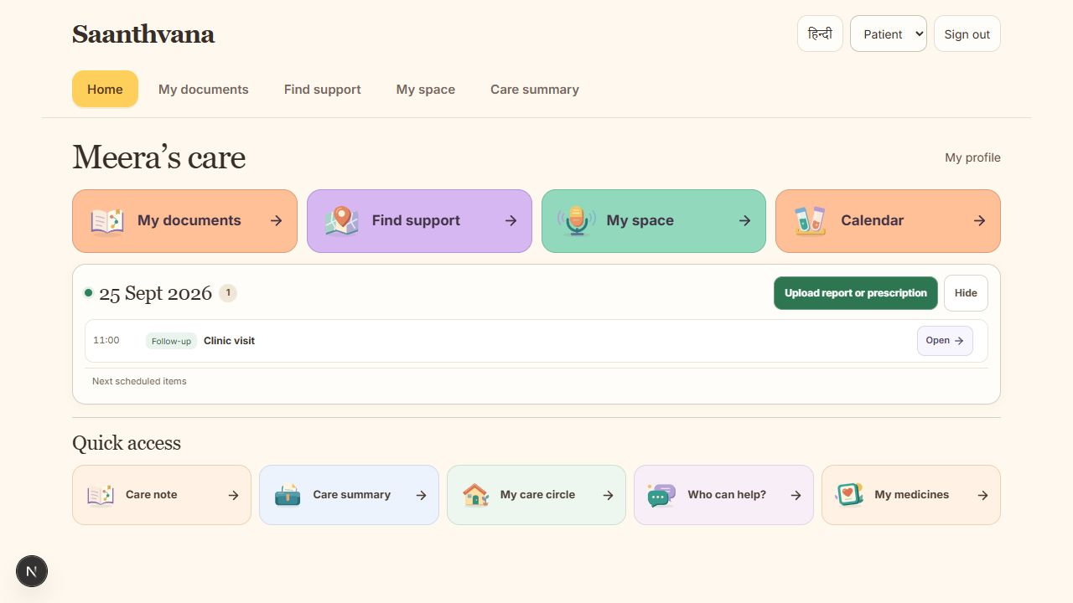
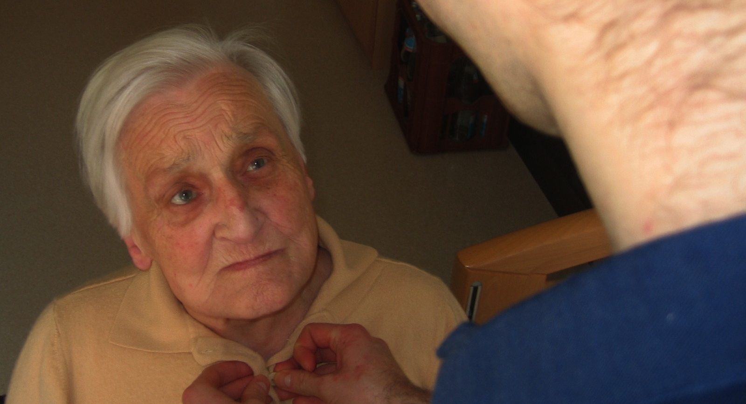
The family still needs help between visits
Actual Home screen capture. The photograph shows general home support.
Today’s plan
Documents and personal notes
Help from people and places
The family can find appointments, medicine times and the doctor’s preparation notes together.
Reports stay in one place. The patient can keep symptoms, feelings and questions for the next visit.
A task goes to a named family member who can accept it and mark it done. The map and support-group links help the family find people to contact.
The care conversation stays at the centre of these everyday tools.
Notes:
Actual local Home capture, 24 September 2026. The home-care photograph is generic and does not depict a Saanthvana user. Medicine times rely on reviewed prescription details; the app gives no dose advice. Symptom entries are for sharing with clinicians, not automatic interpretation. Named tasks are not transport bookings. Map markers and links do not establish opening hours, beds, dispensing availability or emergency response. External groups are not an in-app community. Across-device delivery remains unfinished.
[Sources]
- 21 September and 23 September meeting transcripts.
- Shirin/Sujay follow-up, 23 September: bring today's medicines and appointments to Home.
- Actual screenshot: output/playwright/2026-09-24-home-desktop.png
[Photo credit and rights]
- geralt / Pixabay, “Old man being assisted” (file 63616).
- Source page: https://commons.wikimedia.org/wiki/File:Old_man_being_assisted.jpg
- CC0 1.0: https://creativecommons.org/publicdomain/zero/1.0/
- Credit included as courtesy. The source does not establish model-release status. Cropped for placement.

Slide 6
Doctors need a clear starting point. Families need a say.
88%
11.5%
In a 2019 survey of over 2,400 urban respondents, 88% wanted to choose their treatment near the end of life, according to IndiaSpend.
Only 45 of 391 doctors in one hospital survey reported prior training in advance directives, which formally record a person’s wishes for future care.
We are building guided questions and a draft from the conversation. The patient can say what matters to them and choose who can read the checked note.
Two separate surveys. Neither is a national estimate.
Sources: HCAH survey in seven cities, reported by IndiaSpend, 2019; Jacob et al., one hospital survey, 2026.
Notes:
Doctor measure is prior training in advance directives, not knowledge of their definition. Table 1 reports 45/391 (11.5%). The hospital is CMC Vellore. The 88% is Priya Sharma's original IndiaSpend reporting, 3 June 2019, of HCAH's Living Will Survey. It covered seven cities, 350–400 respondents per city, with equal numbers of men and women who had been hospitalized for more than one day in the preceding year. It is not a cancer-only or nationally representative sample. The original survey's Adobe link was inaccessible, so this is a reported finding, not an independently examined dataset or instrument. Related research motivates the design but does not prove app effectiveness. Guided questions aid discussion; the care note is not a substitute for a legal advance directive.
[Sources]
- Sharma P. 73% urban Indians ignorant of legal right to living will. IndiaSpend, 3 June 2019. https://www.indiaspend.com/73-urban-indians-ignorant-of-legal-right-to-living-will/
- Jacob JA, Thangadurai P, Rebekah GJJ, Kuruvilla A, Gopalakrishnan R. Knowledge and attitude towards advance directives for patients with terminal illnesses among doctors working in a tertiary care hospital. National Medical Journal of India 2026;39:140–146. DOI: 10.25259/NMJI_817_2023. Table 1: 45 of 391 (11.5%) reported prior training. CMC Vellore. https://nmji.in/knowledge-and-attitude-towards-advance-directives-for-patients-with-terminal-illnesses-among-doctors-working-in-a-tertiary-care-hospital/
- Patient preference and guided-question choice are distinct sources. These two samples must not be combined or described as nationally representative.

Slide 7
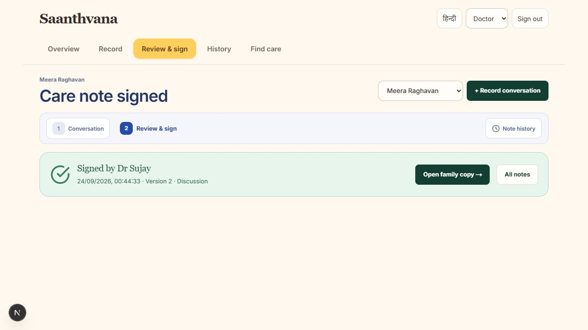
What works now, and what we need to prove
You can use the app today
The next connections
Upload documents, record a conversation, review a care note, add a typed signature, open earlier versions and download a PDF. The calendar, journal and family tasks are connected within the app.
Connect AI and reliable transcription, verified accounts and sharing between different phones. Check translations and care-centre details with the people who will use them.
Our proposed 60–90 day trial
Measure the time doctors spend writing and correcting notes, how quickly families find the latest plan, and whether agreed tasks get done. Count mistakes and extra work too.
We have not measured these results yet.
Actual browser capture. The signature shown is a typed name.
Notes:
Current functionality is a browser implementation, not evidence of clinical deployment. No connected model, reliable transcription, verified ABHA/medical registration, delivered notifications, shared backend or legal digital signing is claimed. The proposed 60–90 day evaluation aligns with the supplied Health-a-thon brief; that time range was not agreed in either meeting. Partners, enrollment and protocol remain to be arranged. No time-saving percentage, outcome or accuracy claim exists.
[Sources]
- submission/Round_1_Answers_2026-09-24.md
- docs/releases/2026-09-24-uploads-signing-and-tasks.md
- Health-a-thon guide: https://healthathon.reskilll.com/guide
- Actual screenshot: output/playwright/2026-09-24-doctor-signed.png
[Product boundary]
The screenshot shows a typed-name signature. It is not a verified digital signature. Current connected flow is in the browser app and does not demonstrate clinical deployment or cross-device sharing.

Slide 8

The hardest decisions shouldn’t be made without the right information
We are starting with cancer care conversations, then keeping the family’s next steps connected to that record.
Zeros and Ones
Dr Sharada Vinod Kutty
Dr Sujay Halkur Shankar
Shaik Abdul Basith
Shaik Muhammad Awaiz
Open Saanthvana
continuity-loop-healthathon.vercel.app
Context photograph. A family reviewing care with a clinician.
Notes:
The four people listed are the confirmed team members. No pilot partners are represented. The photo is a general family-inclusion image and is not the illustrative story patient, a Saanthvana user or an Indian clinical case.
[Photo credit and rights]
- Rhoda Baer / National Cancer Institute Visuals Online, image ID 8002.
- Source page: https://commons.wikimedia.org/wiki/File:Doctor_consults_with_family_(1).jpg
- Public domain, worldwide release per source page. Cropped for placement.
[QR target]
https://continuity-loop-healthathon.vercel.app/

