Slide 1

FINAL SUBMISSION
Sahara
A Palliative Care Companion
TEAM NAME Zeros and Ones
TEAM CODE To confirm
HEALTH-A-THON 2026 • PHASE 2 DRAFT
Notes:
Draft identity: current product name from TEAM_HANDOFF.md. Team name from the submitted 3 October deck.
Team code is not present in inspected source records and remains to confirm.
Original organiser template: source-materials/healthathon-phase-2/Health-a-thon-2026-Phase-2-Submission-Template-original.pptx.

Slide 2
Team Overview & Background
Team member | Role in prior submission | Contribution / detail
Shaik Abdul Basith | Technical lead | Product and engineering
Shaik Muhammad Awaiz | Technical member | Web and Android development
Dr Sharada Vinod Kutty | Doctor partner | Clinical workflow input
Dr Sujay Halkur Shankar | Clinician | Clinical concept and care framework
Shirin Ayub | Medical student | Team member
Team photos and individual write-ups will follow the team discussion.
Doctor specialities, experience and institutional affiliations remain to confirm.
HEALTH-A-THON 2026 • FINAL SUBMISSION
Notes:
Roster and roles: original submitted deck, submission/final/Saanthvana_Healthathon_2026-10-03-final.pptx, slide 1.
Engineering contributions are evidenced by repository commits and TEAM_HANDOFF.md. Clinical concept/input: MEETING_EVIDENCE_MAP.md.
The user explicitly deferred photos and teammate write-ups. No doctor speciality or institution is inferred.

Slide 3
Problem Statement and Supporting Evidence
Families may face an emergency without a clear, current record of the patient’s care preferences.
Our clinicians identified inconsistent goals-of-care conversations, documentation and later retrieval. These are team observations, not a measured baseline.
Sahara connects the reviewed conversation to family access and follow-up tasks.
A clinical pilot must establish whether this improves retrieval time, understanding and continuity.
HEALTH-A-THON 2026 • FINAL SUBMISSION
Notes:
Problem source: MEETING_EVIDENCE_MAP.md, clinician discussion from 24 August and subsequent September follow-ups.
Previous submitted deck slides 2–3 supplies the scenario and literature context. The illustrative scenario is not a reported patient outcome.
No prevalence estimate or impact claim is carried forward without fresh primary-source verification. Proposed metrics are hypotheses, not measured results.

Slide 4
Target Users and Use Case
Primary users: people with advanced cancer and their family caregivers.
The clinician leads the goals-of-care discussion and reviews each released record.
Clinic and home use: prepare for a conversation, retain the reviewed note and keep track of agreed care tasks.
At a later care encounter, the patient chooses who may retrieve the current version.
Hindi and English support aims to reduce language friction.
HEALTH-A-THON 2026 • FINAL SUBMISSION
Notes:
Current adopted Cancer / Patient-Caregiver / Family & Caregiver Support framing: form.md and FAMILY_CAREGIVER_DIRECTION.md.
Implementation and access boundaries: TEAM_HANDOFF.md. A verified clinician role requires independent approval.
No hospital deployment or real-patient usage is claimed.

Slide 5
Solution Overview, Key Features & Impact - Max 2 Slides
Record with consent or enter the conversation. Keep original words and source links.
Review the note, release an immutable version, then capture patient and family confirmation against that exact version.
Share by permission, with expiry and revocation. Assign follow-up tasks to named accounts.
Daily support includes medicines, appointments, documents and a source-linked palliative-care directory.
Expected benefit: less repeated explanation and a retrievable care record. Impact remains to be measured.
HEALTH-A-THON 2026 • FINAL SUBMISSION
Notes:
Current implementation: TEAM_HANDOFF.md and android/release/store-draft.json.
Original report/audio files remain private phone copies. Shared note facts do not imply original file synchronization.
Care record acknowledgements do not establish a legally valid advance directive, certified digital signature or treatment order.

Slide 6
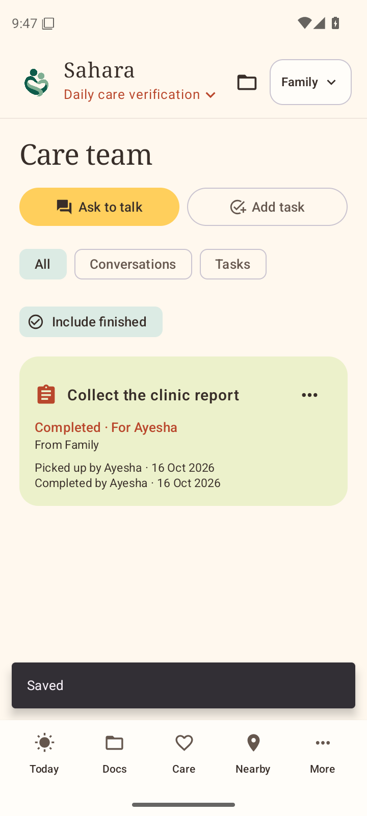
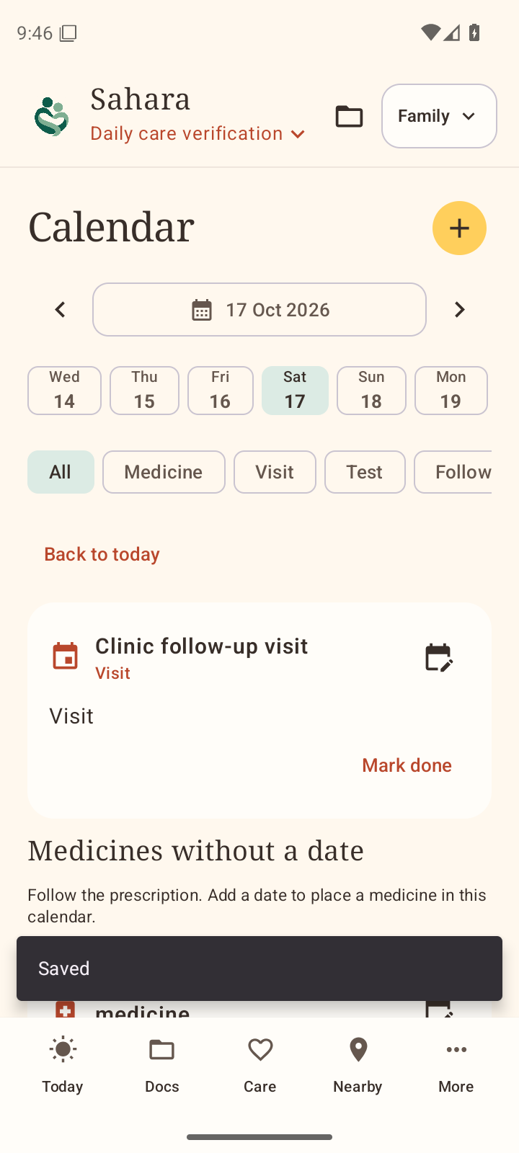
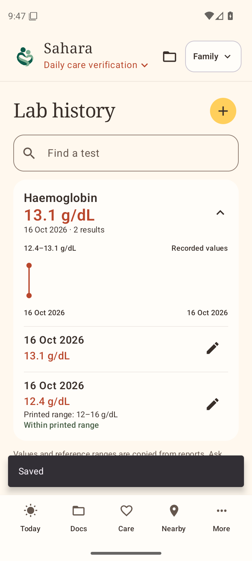
Solution Working MVP / Demo
Actual Android screens
0.5 emulator, 19 October
Fictional records
Current 0.6 test APK:
phone testing pending
Web MVP:
sahara.wedevit.in
Updated video: pending
HEALTH-A-THON 2026 • FINAL SUBMISSION
Notes:
Actual screenshots: output/android/verification/0.5.0/ci-runtime-38882501784/care-task-completed.png, calendar-dated-visit.png, lab-history-series.png. Source ebffb7b.
Captured and inspected in 19 October emulator verification. Fictional records. These are not screenshots of the latest 0.6 build and do not establish patient use.
Latest build: output/android/verification/features/mentor-delivery.json. 0.6.0 (7) debug APK, not uploaded to Play, no current phone test.
Public web MVP: https://sahara.wedevit.in/. An updated end-to-end narrated demo URL remains pending.

Slide 7
Technology, Tools and AI Approach-
Android: Kotlin, Jetpack Compose, Room and MapLibre Native. Web: React/Next.js with shared Supabase records.
Optional local speech: Qwen3-ASR-0.6B int8 through sherpa-onnx. Original audio and reviewed corrections remain attributable.
Bundled Latin/Devanagari OCR and optional on-device Hindi/English translation assist document review.
Directory: 1,631 public listings from Pallium India and IAPC sources.
CARE integration is proposed. Generative clinical drafting remains off.
AI output requires human review. No diagnosis or treatment recommendation.
HEALTH-A-THON 2026 • FINAL SUBMISSION
Notes:
Technology and model identities: TEAM_HANDOFF.md, android/release/store-draft.json.
Qwen3-ASR model and sherpa-onnx are Apache-2.0. Google ML Kit is not described as open source.
Speech pack: 987,015,347 bytes, 64-bit process and at least 2.5 GiB available RAM. Translation needs an optional model download.
Public cloud photo scanning and cloud patient audio remain off. No patient inputs are sent to free-tier Gemini. Sponsor Sarvam access is not assumed available.
Directory provenance: android/directory/README.md and android/app/src/main/assets/india-directory-sources.json. Listings are not an exhaustive census, verified partners or live medicine stock.
CARE/OHC: proposed clinician-side integration only. No connection, deployment or patient-record exchange exists.

Slide 8
Build Sprint Journey and Progress
September to 3 October: clinician framework, family workflow and the original Round 1 deck.
9–14 October: native Android app, shared records and initial Play release work.
16–19 October: version confirmations, permissions, task transitions, calendar/labs and backend role checks.
20 October: local Hindi/English tools, national directory and a 0.6 test APK with 147 unit checks.
Next: current phone tests, clinical language evaluation and a governed pilot.
Scope changes: stronger source attribution and local processing. Clinical drafting and CARE integration remain incomplete.
HEALTH-A-THON 2026 • FINAL SUBMISSION
Notes:
Milestone dates are from PROJECT_CONTEXT_MAP.md, the original 3 October submission, TEAM_HANDOFF.md and output/android/verification/features/mentor-delivery.json.
This is progress to date. The four-week sprint is still in progress and later weeks are not presented as completed.
0.6 packaging is a debug test build. Historical Play versions and review outcomes remain separate.

Slide 9
Evaluation and User Validation
20 October: 147 native unit checks passed. Instrumentation compiled but did not run on the current APK.
19 October: 284 web checks plus 65 workflow/directory database checks.
Desktop ASR: 7.15 s English clip transcribed exactly in 5.95 s. A 9.12 s Hindi clip took 22.05 s and contained word errors.
An 8.28 s public Hinglish clip took 22.53 s and also contained errors.
No clinical accuracy score or patient outcome is established.
Still required: current handset tests, clinician-reviewed bilingual cases and patient/family usability validation.
HEALTH-A-THON 2026 • FINAL SUBMISSION
Notes:
Native counts/build: output/android/verification/features/mentor-delivery.json, 20 October. Unit checks do not establish speech recognition quality or runtime behavior.
Web/database counts: TEAM_HANDOFF.md dated 19 October. 47 workflow and 18 directory database checks = 65.
ASR source: output/android/verification/qwen3-asr-inference.log. Actual desktop CPU tests, not Android tests. English-synthetic: 7.15 s input, 5.953 s inference, text exactly matched that fixture including negation. Hindi-public: 9.12 s input, 22.047 s inference, substitution error in original output.
Hinglish source: output/android/verification/qwen3-asr-low-memory-inference.json, 8.275 s input and 22.531 s inference. Mixed script/word errors remain. No WER/CER clinical benchmark was completed.
Historical memory-allocation failures are retained in the evidence. App uses pinned models, local guards and mandatory review.
User-feedback changes: fewer visible form choices, retained source originals and direct routine controls, as recorded in TEAM_HANDOFF.md. No formal usability sample size or benefit estimate exists.

Slide 10
Safety and Responsible AI
Obtain recording consent and bind audio, speaker attribution and review to the correct person.
Keep source audio/text, corrections and immutable note versions. AI may mishear words, numbers or negation.
A clinician reviews release. Patient confirmation applies to the exact reviewed version.
Enforce account roles and permissioned sharing with expiry/revocation. Original files stay on the phone.
Before patient use: validate recovery/deletion, language comprehension, access controls and clinical oversight.
HEALTH-A-THON 2026 • FINAL SUBMISSION
Notes:
Current safeguards and limitations: TEAM_HANDOFF.md and deployed workflow source. No unsupported claim of legal/compliance certification is made.
The system does not diagnose, choose treatment, produce autonomous clinical advice or create a legal treatment order.
Clinical/ethics review before a health research pilot: ICMR handbook https://www.icmr.gov.in/icmrobject/uploads/Guidelines/1724914217_handbook_on_icmr_ethical_guidelines_2018.pdf.
Hindi/English does not establish coverage for other Indian languages, universal accessibility or clinical language accuracy.

Slide 11
Deployment, Cost and Sustainability Plan
Pilot requirements: clinical owner, agreed consent, approved users, phone checks and a supported recovery/deletion process.
Integration: Sahara already shares approved note data across its own web and native apps. CARE/EHR integration remains proposed.
One-time budget: device checks, onboarding, clinician validation and integration. Costing remains to confirm.
Ongoing budget: hosting, database, storage, support and governance. Local inference has no per-call cloud AI fee.
Sustainability proposal: facility/NGO/government support. Patient access and final pricing require team agreement.
HEALTH-A-THON 2026 • FINAL SUBMISSION
Notes:
This slide is a first planning draft. No approved monetary budget, procurement quote, service price, paid customer or payer commitment is recorded.
Required cost fields remain explicit gaps: one-time deployment estimate, per-transaction cost if applicable and monthly doctor/facility price. Do not infer that existing free tiers make operation free.
Architecture assumptions: existing user phones, optional local model download and server records. Device/data costs, clinician time, hosting and support remain.
No fee, subscription, billing, contract or paid cloud setup is authorized or created by this draft.

Slide 12
What Next? Plans to take initiative forward (if any)
Complete Android phone checks using fictional inputs and clinician-reviewed Hindi/English cases.
Finish signup/recovery and independent clinician verification before patient use.
Agree a pilot setting, baseline measures and consent/oversight with clinical partners.
Prototype a CARE clinician extension and test patient and consent workflows.
Public sharing of solution information on Health-a-thon or other websites: Yes.
HEALTH-A-THON 2026 • FINAL SUBMISSION
Notes:
The user explicitly answered Yes to the template’s public solution-information question in this task.
Yes applies to the solution summary. It does not authorize publication of credentials, government IDs, patient material, raw private chats, private support cases or unrestricted access to the private repository.
Remaining pilot/account/runtime requirements: TEAM_HANDOFF.md. Proposed work is not presented as achieved.

Slide 13
Thank you
Zeros and Ones • Team code to confirm
workwithdevit@gmail.com
MVP: https://sahara.wedevit.in
Demo video: updated link pending
Code: github.com/basithladdu/healthathon (private)
Health-a-thon 2026
HEALTH-A-THON 2026
Notes:
MVP and repo: TEAM_HANDOFF.md. Contact is the existing Devit project/release correspondence address.
Private repository access for jury review remains to arrange. The URL alone does not make code public or accessible without approval.
Updated narrated demonstration link and team code remain pending.

