Slide 1
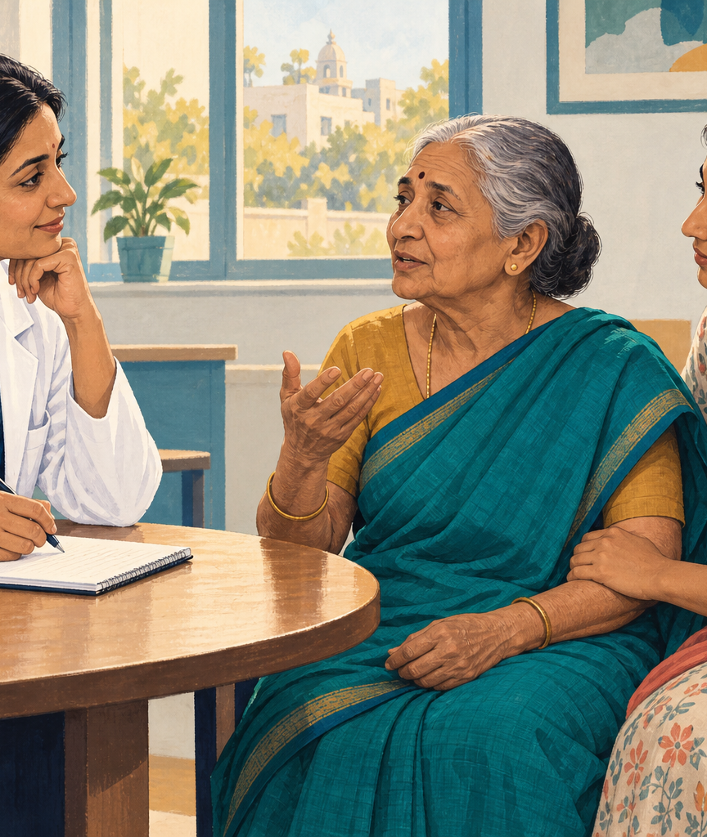
Saanthvana
Saanthvana helps people with cancer and their families keep track of what they discussed with their doctor.
We are building it so the family can find the patient's wishes, the doctor's notes and the next steps in one place.
Our Health-a-thon entry focuses on family and caregiver support in cancer care.
Notes:
The cover image is an illustration, not a photograph of a real patient or visit.
[Sources]
- Saanthvana_Background_Rationale_1.pptx
- User-provided slide text: submission/Saanthvana_Round_1_Slide_Text_2026-09-24.md

Slide 2
When the family cannot find the earlier conversation
Two months earlier
Her family remembers it differently
Imagine a 62-year-old woman with advanced breast cancer who starts best supportive care to help manage her symptoms. Her doctor discusses what she would want if her condition worsens, but only her husband attends.
Her husband says yes to attempts to restart her heart and help her breathe. Her daughter says no. Her son, calling from another city, is unsure.
No one can find the earlier discussion or her records. A shared note could help the family and doctors understand what she had said.
At the hospital
She later becomes unconscious at home and is taken to hospital. The doctor asks what she would want if her heart stopped or she could not breathe on her own.
Notes:
Illustrative scenario supplied by the team; this is not a reported patient case. The story does not recommend or reject any emergency treatment.
[Sources]
- docs/meetings/2026-09-23-chat-follow-up.md
- User-provided slide text: submission/Saanthvana_Round_1_Slide_Text_2026-09-24.md

Slide 3
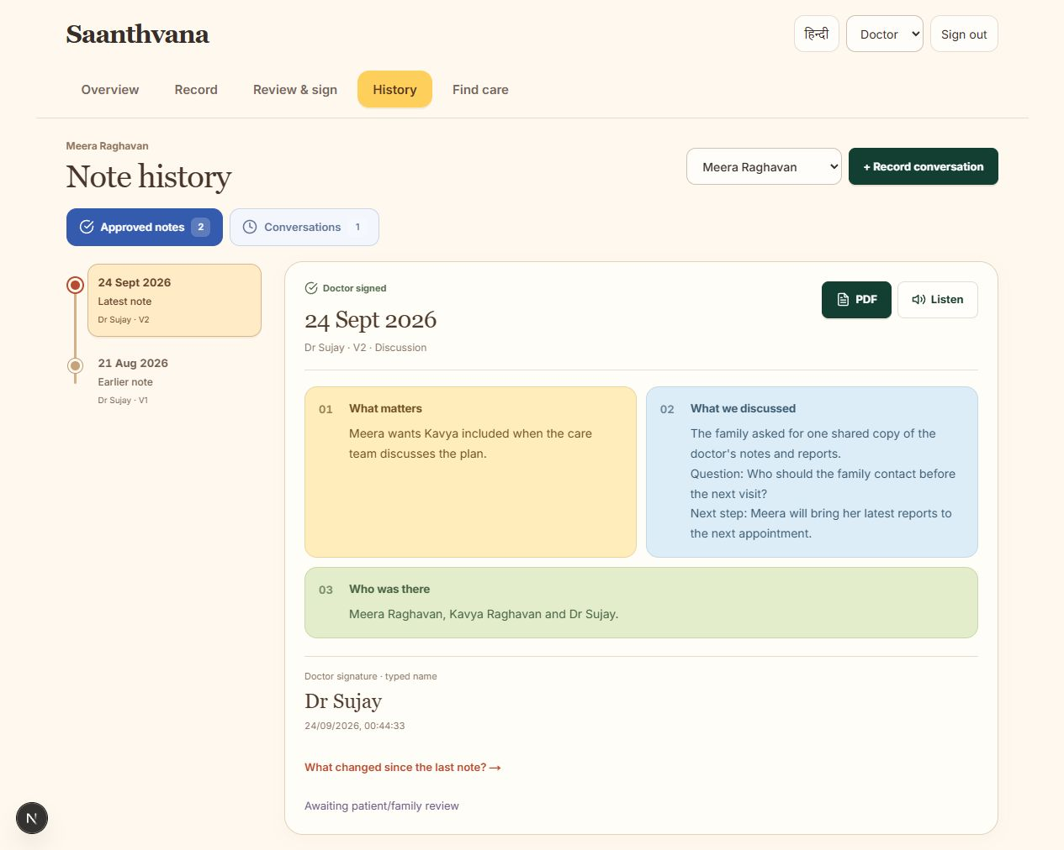
The patient's wishes stay at the centre
Doctors call this a goals-of-care conversation. In everyday words, it means talking about what matters to the patient and what they want from their care.
The patient or a family member can ask for a conversation with the doctor.
The doctor records what the patient said, what everyone agreed and what they still need to discuss.
In the shared app we are building, the patient will choose which family members can read the checked note. A later conversation gets a new dated note, while earlier notes stay available.
Notes:
The note-history screenshot is an actual local product capture. Names and patient details shown in the interface are sample data. The signing flow records a typed name.
[Sources]
- output/playwright/2026-09-24-note-history.png
- docs/meetings/2026-09-23-chat-follow-up.md

Slide 4
AI will help write the note. The doctor will check it.
Artificial intelligence (AI) will help turn the doctor's conversation into a written note.
01
02
03
The doctor adds the conversation
AI prepares a draft
The doctor checks and signs
With permission, the doctor records the conversation or adds their existing notes.
AI turns those words into a draft and shows where each detail came from.
The doctor fixes mistakes and signs the note before the family can use it.
AI will organise what people actually said. It will not diagnose cancer, interpret tests or choose treatment.
The recording, review and signing screens work. Connecting AI to this flow is our next step.
Notes:
The AI connection is planned and is not connected in the current app. The current conversation, review and typed-name signing screens work. The doctor remains responsible for checking and signing the note.
[Sources]
- Truly Left.md
- submission/Round_1_Answers_2026-09-24.md
- docs/releases/2026-09-24-uploads-signing-and-tasks.md

Slide 5
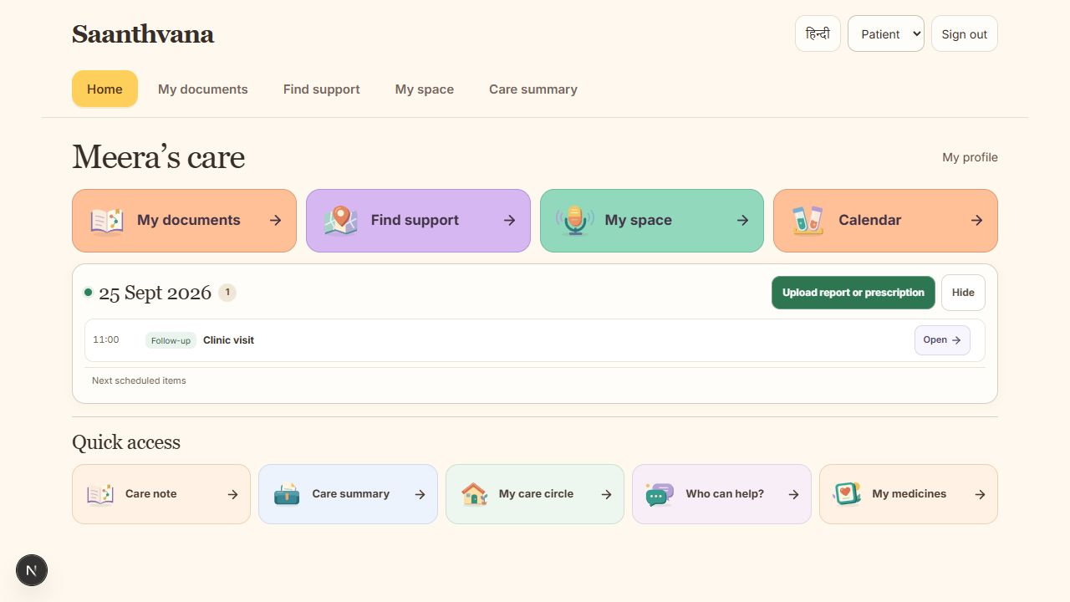
The same app helps the family between visits
My documents
Families can keep reports together and look back at test results by date.
Calendar
They can see scheduled medicines, visits and the doctor's preparation notes.
My space
Patients can write down symptoms, feelings and questions for their next visit.
Find support
Families can find nearby care centres and support groups, then call to confirm the help available.
These everyday tools help families follow the care plan after the conversation ends.
Notes:
Actual local Home capture from 24 September 2026. The screen shows the four care areas, Today panel, upload action and Quick access.
[Sources]
- output/playwright/2026-09-24-home-desktop.png
- prototype/app/family-care-home.tsx

Slide 6
A request goes to someone who can help
Here is how a shared task will work when the doctor asks the family to bring earlier reports to a visit.
01
02
03
The doctor asks a named person
She agrees to help
The family can see when it is done
The doctor assigns “Bring the reports” to the patient’s daughter.
She accepts the request, so everyone knows who is taking care of it.
She marks it done when the reports are ready. The person who asked can see the update.
The family should know what needs doing and who has agreed to do it.
These steps can be tried in the app today. Sharing updates between separate phones still needs connecting.
Notes:
This is a future example of how a shared task will work. Task updates between separate phones still need connecting.
[Sources]
- docs/releases/2026-09-24-uploads-signing-and-tasks.md
- submission/Round_1_Answers_2026-09-24.md

Slide 7
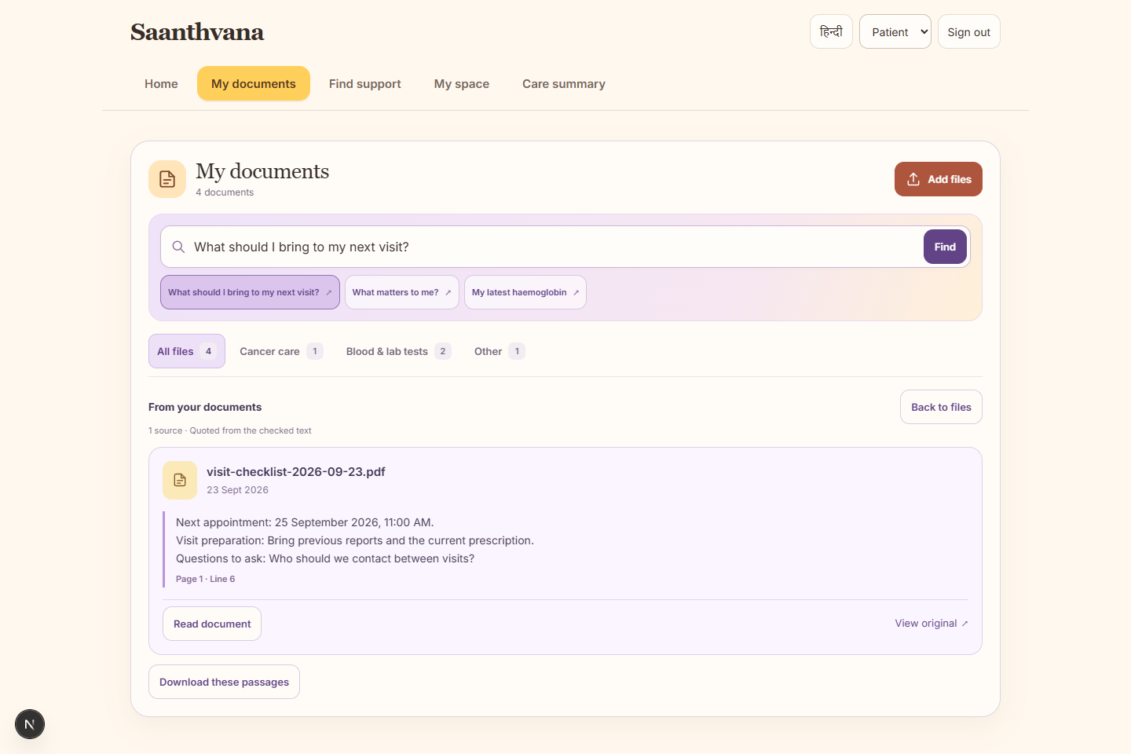
What works today, and what comes next
What you can try today
What we still need to connect
You can upload reports, record a care discussion and check the note. The doctor types their name to sign it. Families can see earlier notes and organise medicines, visits and tasks.
Next, we will connect AI drafts, reliable speech-to-text and separate accounts that share only what the patient allows.
We will also finish the key screens in the languages our users need and check care-centre details before families rely on them.
We still need to try the complete app with patients, families and doctors before using it in real care.
Notes:
Current capabilities and remaining work are described in the 24 September release notes and submission answers. The documents screenshot is an actual local capture.
[Sources]
- output/playwright/2026-09-23-documents-desktop.png
- Truly Left.md
- submission/Round_1_Answers_2026-09-24.md
- docs/releases/2026-09-24-uploads-signing-and-tasks.md

Slide 8

How we will know whether it helps
We plan to try Saanthvana with willing families and doctors over 60–90 days.
Doctors on our team
Dr Sharada Vinod Kutty
Dr Sujay Halkur Shankar
Does the doctor spend less time writing the note?
Can the family quickly find the latest note and understand the next step?
Building the app
Shaik Abdul Basith
Shaik Muhammad Awaiz
Do agreed tasks get done without extra work for the care team?
These are the questions we will test. We do not have results yet.
Open the app
https://continuity-loop-healthathon.vercel.app/
The hardest decisions shouldn't be made without the right information.
Notes:
The 60–90 day evaluation is a proposal; there are no results yet. The cover illustration and clinical story are illustrative, not evidence of outcomes.
[Sources]
- submission/Saanthvana_Round_1_Slide_Text_2026-09-24.md
- PROJECT_CONTEXT_MAP.md
- VERCEL_DEPLOYMENT_HANDOFF.md

