Slide 1
CONTINUITY LOOP
CLINICIAN
OWNED
VERIFIED
RETRIEVABLE
Keep a clinician-owned
conversation current.
Goals-of-care follow-up and verified clinical handoff for cancer care.
SYNTHETIC PROTOTYPE
CANCER CARE / PATIENT FOLLOW-UP & CONTINUITY OF CARE / HACKATHON MVP
CONTINUITY LOOP · HEALTH-A-THON 2026
01
Notes:
Open with the continuity failure and the product's narrow promise: keep a clinician-owned conversation current and retrievable when care changes.
[Sources]
- C:\Users\basit\Downloads\CODE\healthathon\VENTURE_DECISION_MATRIX.md (selected use case and product position)
- C:\Users\basit\Downloads\CODE\healthathon\MEETING_SUMMARY_FOR_TEAM.md (one-sentence concept)

Slide 2
The failure is continuity, not the absence of another note.
A difficult conversation can be unfinished, informal, or hard to find when care changes.
01
02
03
At night, the receiving physician and family may repeat the conversation under pressure.
Treating clinician
Patient + family
Receiving physician
Conversation may remain incomplete.
Preferences can change or need revisiting.
The latest verified context must be findable.
The operational wedge is not a document repository. It is a closed loop from follow-up ownership to verified retrieval.
CONTINUITY LOOP · HEALTH-A-THON 2026
02
Notes:
Name the failure as a continuity problem: the conversation may exist somewhere, but it does not reliably travel with the patient's changing care context.
[Sources]
- C:\Users\basit\Downloads\CODE\healthathon\MEETING_SUMMARY_FOR_TEAM.md (problem described by clinicians)
- C:\Users\basit\Downloads\CODE\healthathon\VENTURE_DECISION_MATRIX.md (visible handoff wedge and operational product)

Slide 3
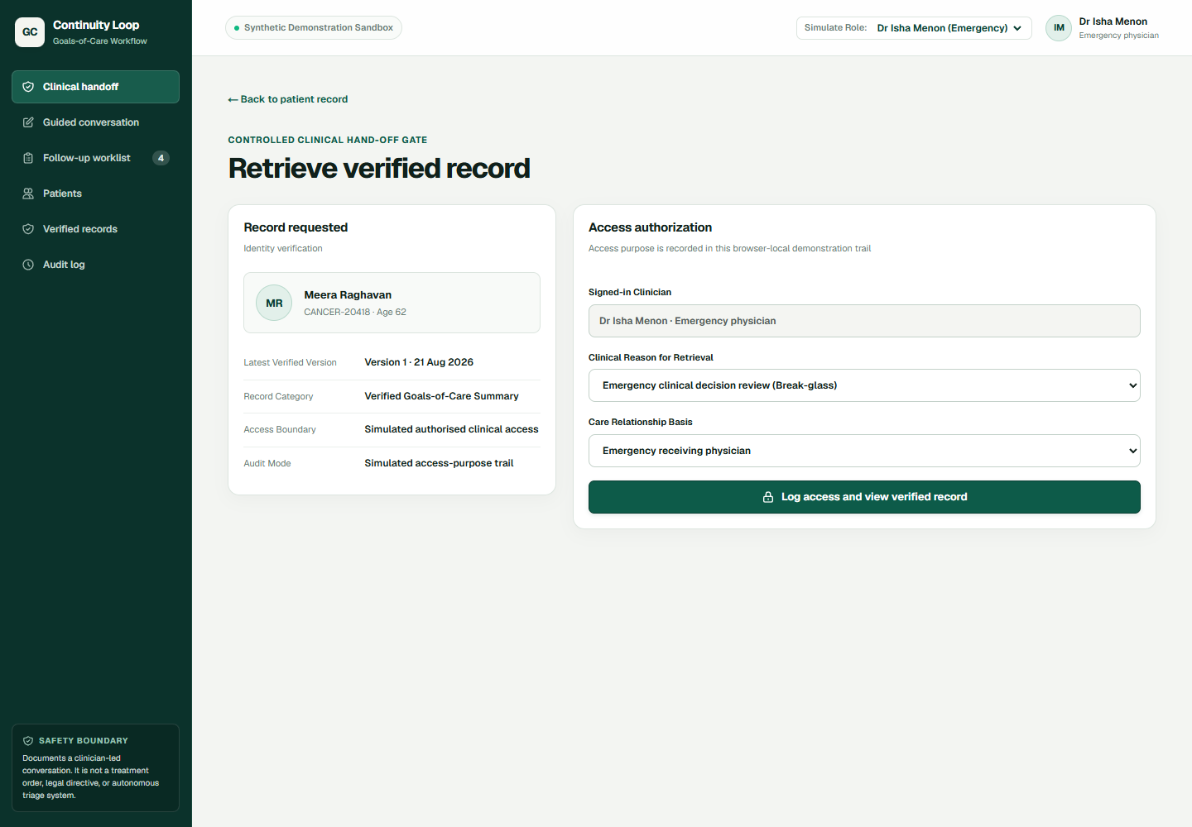
The first high-trust moment is a verified handoff.
RECEIVING PHYSICIAN
Find the latest
record—after
recording why.
The receiving clinician sees a controlled access gate before the verified summary is opened.
Patient-bound record
Purpose + care relationship
Latest version + audit event
Production UI capture · synthetic data · emergency access gate
CONTINUITY LOOP · HEALTH-A-THON 2026
03
Notes:
Use the screenshot as the product proof point. The value is the controlled handoff gate: the clinician records the access purpose and relationship before retrieving the current verified record.
[Sources]
- C:\Users\basit\Downloads\CODE\healthathon\PRODUCT_REQUIREMENTS.md (emergency retrieval requirements)
- C:\Users\basit\Downloads\CODE\healthathon\PROTOTYPE_HANDOFF.md (demonstrated retrieval workflow and boundaries)
- Visual asset: https://continuity-loop-healthathon.vercel.app/ (captured 27 August 2026 at 1440 x 1000 CSS pixels; synthetic data)

Slide 4
A closed loop connects follow-up, documentation, verification and retrieval.
Five clinician-owned states make the continuity handoff explicit.
01
02
03
04
05
Enrol + assign
Talk + mark
Draft + trace
Review + acknowledge
Retrieve + reconfirm
The clinician selects the patient, owner and next review date.
The clinician records discussed, not discussed or defer/clarify.
Each substantive field stays linked to the source conversation.
The physician edits, resolves and releases the verified version.
The receiving physician records purpose and checks what may have changed.
A changed preference creates a new version; nothing released is overwritten.
CONTINUITY LOOP · HEALTH-A-THON 2026
04
Notes:
Walk left to right. The worklist is the operational layer, but the record is only released after the physician review and acknowledgement gate; retrieval ends with reconfirmation, not an automatic order.
[Sources]
- C:\Users\basit\Downloads\CODE\healthathon\PRODUCT_REQUIREMENTS.md (P0 workflow, verification, versioning and retrieval requirements)
- C:\Users\basit\Downloads\CODE\healthathon\PROTOTYPE_HANDOFF.md (demonstrated workflow)

Slide 5
Every field has a source. Every release has a human gate.
SYNTHETIC EXCERPT
STRUCTURED FIELD
Patient priority
“Patient initiated discussion
regarding family understanding
of illness.”
maps to
Patient initiated discussion regarding family understanding of illness.
Source-linked draft · synthetic patient
RELEASE GATE
Unstated stays unstated.
Clarification blocks publication.
Physician review and acknowledgement are explicit.
Deterministic prototype behaviour · no external AI model is active
CONTINUITY LOOP · HEALTH-A-THON 2026
05
Notes:
Show the trust mechanism, not an AI magic trick. The source excerpt anchors the field; unsupported silence remains visible, and the physician gate is what makes release possible.
[Sources]
- C:\Users\basit\Downloads\CODE\healthathon\PRODUCT_REQUIREMENTS.md (source mapping, unresolved fields and verification gate)
- C:\Users\basit\Downloads\CODE\healthathon\PROTOTYPE_HANDOFF.md (deterministic extraction and no external AI claim)

Slide 6
The MVP is useful because its boundaries are explicit.
DEMONSTRATED NOW
NOT CLAIMED
Synthetic patient binding
Live AI transcription or model accuracy
Guided eight-domain checklist
Real authentication, encryption or cryptographic audit
Deterministic source-linked draft
EHR, ABDM or messaging integration
Physician review + acknowledgement gate
Patient outcomes or treatment effects
Append-only version 2
Legal signature, living will or treatment order
Purpose-bound retrieval + audit
Coordinator outreach worklist
Autonomous triage, prognosis or recommendation
Clinical summary only · Reconfirm current status before acute orders.
CONTINUITY LOOP · HEALTH-A-THON 2026
06
Notes:
Say the exclusions plainly. These are not missing features to hide; they are the safety boundary of the hackathon prototype and the reason the current proof can be evaluated honestly.
[Sources]
- C:\Users\basit\Downloads\CODE\healthathon\PRODUCT_REQUIREMENTS.md (demonstration integrity and non-goals)
- C:\Users\basit\Downloads\CODE\healthathon\PROTOTYPE_HANDOFF.md (current implementation boundary)
- C:\Users\basit\Downloads\CODE\healthathon\MEETING_SUMMARY_FOR_TEAM.md (clinical summary, not legal/treatment authority)

Slide 7
The next credible proof is a clinician-reviewed simulation.
Compare product output with clinician-authored references across varied synthetic or fully anonymised scenarios.
20
8
<30 sec
0
scenarios to run
conversation domains
retrieval target
unstated preferences filled
A clinician-owned reference set.
The current prototype checklist.
A target, not an observed result.
An integrity invariant.
MEASURE
Required-domain coverage · unsupported statement rate · unresolved-item capture · clinician correction rate · time to prepare/retrieve · receiving-clinician clarity
Targets / plan — not observed outcomes.
CONTINUITY LOOP · HEALTH-A-THON 2026
07
Notes:
Make the next step concrete. The 20-case exercise is a proposed validation plan; it is not a result. Compare the product record to a clinician-authored reference and measure fidelity, uncertainty capture and retrieval clarity.
[Sources]
- C:\Users\basit\Downloads\CODE\healthathon\VENTURE_DECISION_MATRIX.md (20-case pilot hypothesis and measures)
- C:\Users\basit\Downloads\CODE\healthathon\PRODUCT_REQUIREMENTS.md (eight-domain checklist and no-inference requirement)
- C:\Users\basit\Downloads\CODE\healthathon\PROTOTYPE_HANDOFF.md (current MVP scorecard boundaries)

Slide 8

THE NEXT DECISION
The decision needed now
is clinical ownership.
01
Approve the exact conversation domains and wording.
02
Provide 20 synthetic scenarios and clinician reference records.
To make this a real pilot, we need four inputs from clinicians.
03
Name one workflow owner, pilot setting and due-date rule.
04
Define acknowledgement, surrogate authority and retrieval roles.
Documents, verifies and retrieves clinician decisions.
It does not select patients, recommend treatment or create a legal directive.
SCAN TO TRY
continuity-loop-healthathon.vercel.app · synthetic prototype · clinical review pending
CONTINUITY LOOP · HEALTH-A-THON 2026
08
Notes:
Close with a decision, not a generic thank-you. The product is ready for clinician-owned validation, but the clinical protocol, reference cases, pilot owner and access semantics still need explicit agreement.
[Sources]
- C:\Users\basit\Downloads\CODE\healthathon\TOMORROW_CALL_CARD.md (clinician decision gate and required inputs)
- C:\Users\basit\Downloads\CODE\healthathon\VENTURE_DECISION_MATRIX.md (remaining clinical decisions and pilot hypothesis)
- C:\Users\basit\Downloads\CODE\healthathon\PRODUCT_REQUIREMENTS.md (P1 clinician protocol requirements)

