Slide 1

HEALTH-A-THON 2026
Continuity
Loop
Goals-of-care conversations
that the next clinician can find
Cancer care
Patient follow-up & continuity of care
SYNTHETIC MVP / PHYSICIAN REVIEW
CONTINUITY LOOP / HEALTH-A-THON 2026
01
Notes:
Continuity Loop supports clinician-controlled goals-of-care documentation and follow-up for people with advanced cancer. The doctor/care team is the primary user. Current prototype is synthetic and browser-local. The care scene is an AI-generated editorial illustration, not a photo or a clinical-pilot record.
[Sources]
- submission.md, sections 1-4
- PRODUCT_REQUIREMENTS.md
- visual-assets/README.md

Slide 2

Care moves between settings.
The conversation can get left behind.
01
At the clinic
Some topics remain unresolved.
02
Between visits
Priorities and questions can change.
03
With a new care team
The latest reviewed context is hard to find.
CONTINUITY LOOP / HEALTH-A-THON 2026
02
Notes:
The source problem describes conversations spread across notes, visits and institutions. Families may need to repeat distressing discussions, and receiving clinicians can lack the current reviewed context. This is the proposed problem framing, not a quantified prevalence claim. Image is an AI-generated editorial illustration.
[Sources]
- submission.md, section 2
- GOCD_PDF_AUDIT.md
- visual-assets/README.md

Slide 3
One reviewed conversation, ready for the next visit
WORKFLOW CONCEPT / SYNTHETIC EXAMPLE
Goals-of-care summary
After
release
DRAFT / AWAITING REVIEW
Family understanding
Discussed
Capture
Patient priorities
Retrieve
Needs clarification
A guided conversation
with source-linked notes
Future care discussion
Latest verified version
Purpose recorded
Context reconfirmed
Not discussed
Physician review before release
CONTINUITY LOOP / HEALTH-A-THON 2026
03
Notes:
Native editable workflow illustration, not an app screenshot. Discussion-status examples are synthetic. Review resolves clarification blockers before physician release. Authorised retrieval records the care relationship and access purpose. Released versions are never silently overwritten. Product-surface artwork may be replaced by the teammate's final app capture after it is built and checked.
[Sources]
- submission.md, section 3
- PRODUCT_REQUIREMENTS.md
- PROTOTYPE_HANDOFF.md

Slide 4
Every step has a human owner
01 Assign
02 Talk
03 Draft
04 Review
05 Revisit
Name the patient, owner
and next review date
Mark discussed, deferred
or unclear topics
Link each substantive
field to its source
Physician resolves gaps
and releases a version
Receiving clinician retrieves
and reconfirms context
Changed preferences create a new version
CONTINUITY LOOP / HEALTH-A-THON 2026
04
Notes:
Workflow is based on the existing prototype and clinician-led requirements. Follow-up belongs to a named coordinator or clinician; the clinician sets review timing. The system does not choose treatment or automate clinical decisions. The return connector represents explicit revision and follow-up, not background automation.
[Sources]
- PRODUCT_REQUIREMENTS.md
- submission.md, section 3
- PROTOTYPE_HANDOFF.md

Slide 5
The source stays visible through review
SYNTHETIC EXAMPLE
SOURCE NOTE
STRUCTURED FIELD
“Patient initiated discussion
regarding family understanding
of illness.”
Patient priority
Family understanding of illness
is a stated priority.
Discussed
Not discussed
Needs clarification
May be reviewed for release
Remains visibly incomplete
Blocks publication until resolved
Source link Reviewer Timestamp Version
CONTINUITY LOOP / HEALTH-A-THON 2026
05
Notes:
The quoted synthetic note and structured field are carried over from the previous visual deck. This is a documentation example, not medical advice or patient evidence. Discussed is not equivalent to automatic publication; physician review and all required release checks still apply. Missing preferences remain unfilled. No external AI model is active in this prototype.
[Sources]
- tmp/pitch-deck/build_healthathon_visual_deck.mjs, original source-linked example
- submission.md, sections 3-4
- PRODUCT_REQUIREMENTS.md

Slide 6
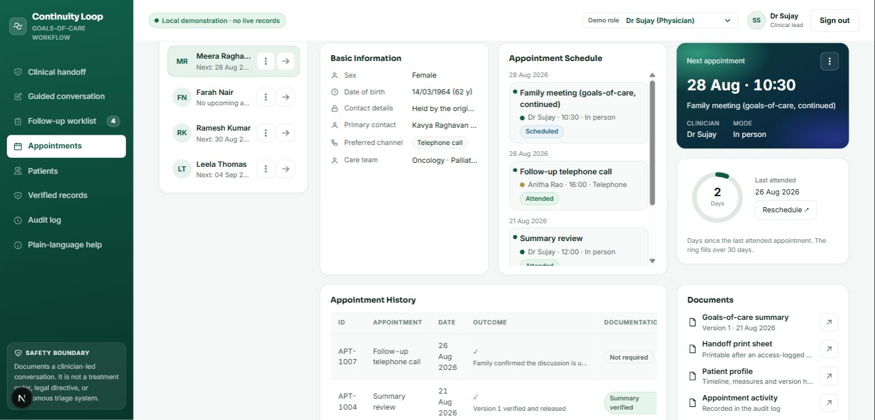
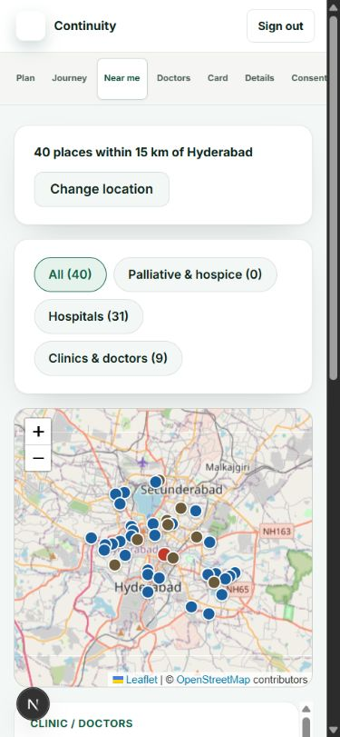
The working prototype spans the handoff
CARE TEAM / APPOINTMENTS
PATIENT / NEARBY CARE
LOCAL DEMONSTRATION / NO LIVE AI MODEL
CONTINUITY LOOP / HEALTH-A-THON 2026
06
Notes:
Screenshots captured in Chrome from the local prototype after pulling commit 2fb5ebb on 13 September 2026 and repairing map remounting, consent availability, appointment dialog resets and QR readiness. All patient details are synthetic. Nearby places and map tiles come from public Photon/OpenStreetMap services. Browser checks covered desktop and 390-pixel layouts. The app has no production authentication, durable clinical database, live AI model, messaging or EHR/ABDM connection. Planned next work remains source-grounded transcription, durable storage and access control, multilingual evaluation, hospital integration and a clinician-owned pilot. No clinical outcomes or model accuracy have been established.
[Sources]
- prototype/app/appointments-page.tsx
- prototype/app/care-near-me.tsx
- submission/screenshots/README.md
- PROTOTYPE_HANDOFF.md

Slide 7
A clinician-reviewed simulation is the next test
PROPOSED TARGETS / NOT MEASURED RESULTS
20
8
<30s
0
Synthetic scenarios
Conversation domains
Retrieval target
Unstated preferences filled
1
2
3
4
Reference set
Draft review
Retrieval test
Follow-up review
Clinicians agree domains
and unresolved cases
Check field faithfulness
and source traceability
Find and reconfirm
the latest version
Check whether owners
revisit open topics
CONTINUITY LOOP / HEALTH-A-THON 2026
07
Notes:
All numbers are planned scope, targets or invariants, not achieved outcomes. The source plan specifies 20 synthetic or fully anonymised scenarios, eight domains, a retrieval target below 30 seconds, and zero unstated preferences filled in. Clinicians must agree the domains, reference records and unresolved cases before testing. Follow-up closure and visible uncertainty are also to be measured. No clinical benefit or model accuracy has been established.
[Sources]
- PITCH_READINESS.md, proposed Round 1 and validation targets
- PITCH_EVIDENCE_MAP.md, slide 7
- PRODUCT_REQUIREMENTS.md

Slide 8


The next step is a clinician-owned pilot
Clinical owners
Agree the domains and release rules.
Pilot partner
Choose the care setting and pilot owner.
Shared review
Measure missed topics and repeat discussions.
Current synthetic MVP
continuity-loop-healthathon
.vercel.app
2 clinicians + 1 coordinator + a pilot owner
CONTINUITY LOOP / HEALTH-A-THON 2026
08
Notes:
Ask: two clinicians, one coordinator, agreed scenarios and a named pilot owner. Clinical owners define discussion domains and review rules. A pilot partner chooses the care context across oncology, palliative, emergency or home settings. The QR is the existing prototype QR and points to https://continuity-loop-healthathon.vercel.app/. It does not link to a completed pilot. The image is an AI-generated editorial illustration. Replace concept diagrams with real final app captures only after the teammate's UI is built and verified.
[Sources]
- submission.md
- TEAM_HANDOFF.md
- PITCH_READINESS.md
- visual-assets/README.md

