Slide 1


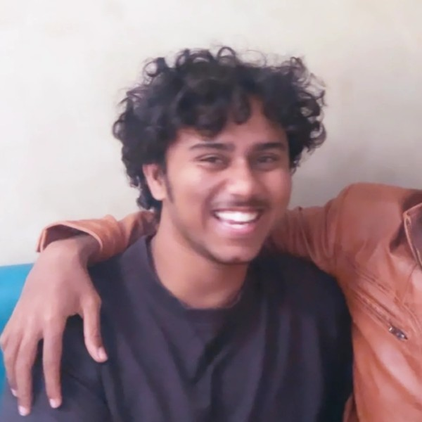
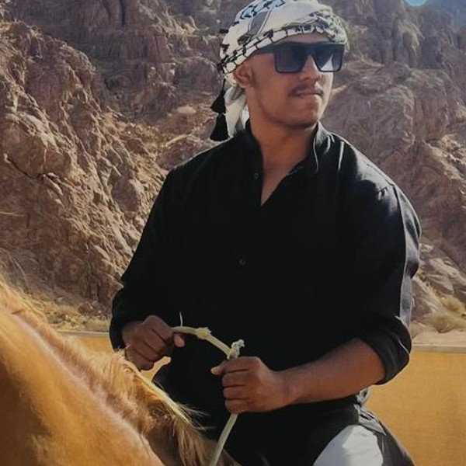
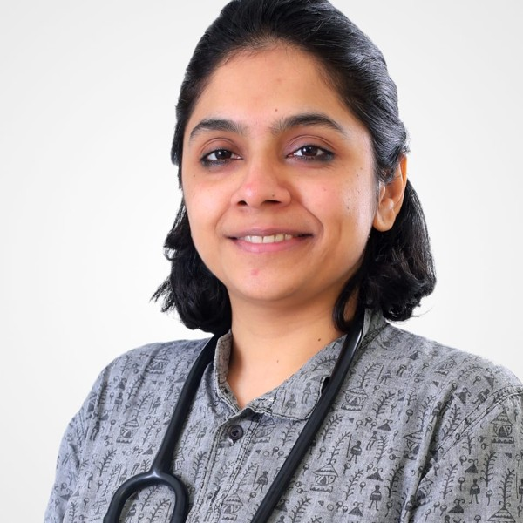
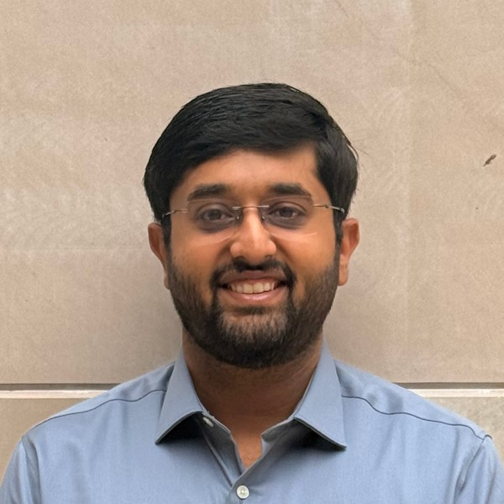
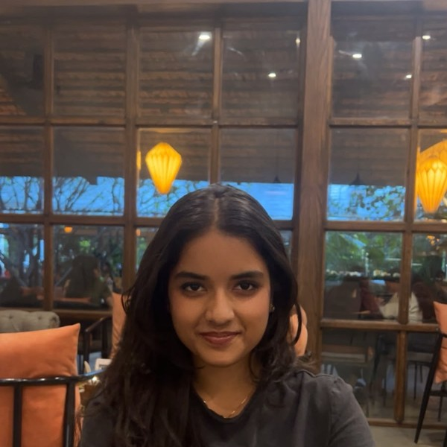
FINAL SUBMISSION
Sahara
A palliative-care companion. Doctor-led goals-of-care conversations, written onto the legal form and ready in an emergency.
TEAM NAME Zeros and Ones
TEAM CODE [add team code]
Shaik Abdul Basith
Shaik Muhammad Awaiz
Dr Sharada Vinod Kutty
Dr Sujay Halkur Shankar
Shirin Ayub
sahara.wedevit.in · Android app and website · English, Hindi, Telugu, Urdu, Kannada
HEALTH-A-THON 2026 • TITLE

Slide 2
Team Overview & Background
Shaik Abdul Basith
Technical lead
Product design, website, AI (Gemini, Whisper) and the goals-of-care flow.
Shaik Muhammad Awaiz
Technical member
Android app, Supabase server, deployment and phone testing.
Dr Sharada Vinod Kutty
Doctor partner
Pulmonary specialist, lung-cancer care. Wrote the clinical specification: care plan, living will, emergency card.
Dr Sujay Halkur Shankar
Clinician
Pulmonary specialist with palliative-medicine experience. Chose the problem, set the goals-of-care checklist, led app walkthroughs.
Shirin Ayub
Medical student
Symptom tracker: symptom list, scales and check-in wording.
Doctor partners. Both are pulmonary specialists who have worked extensively with lung cancer, and Dr Sujay also has palliative-medicine experience. They chose the problem, wrote the clinical rules, and reviewed every build; the last walkthrough was on 3 Nov.
Legal review. Rituparna P reviewed the goals-of-care form; the app copies it word for word. Organisation: independent team; apps published under WeDevit.
HEALTH-A-THON 2026 • FINAL SUBMISSION
Notes:
Doctor background from Dr Sujay (team chat, 25 Aug 2026): "Dr. Sharada and I are pulmonary specialists who have worked extensively with lung cancer. I additionally have some palliative medicine exposure." Photos from the submitted 3 Oct deck. Team: please confirm roles and the organisation line.

Slide 3
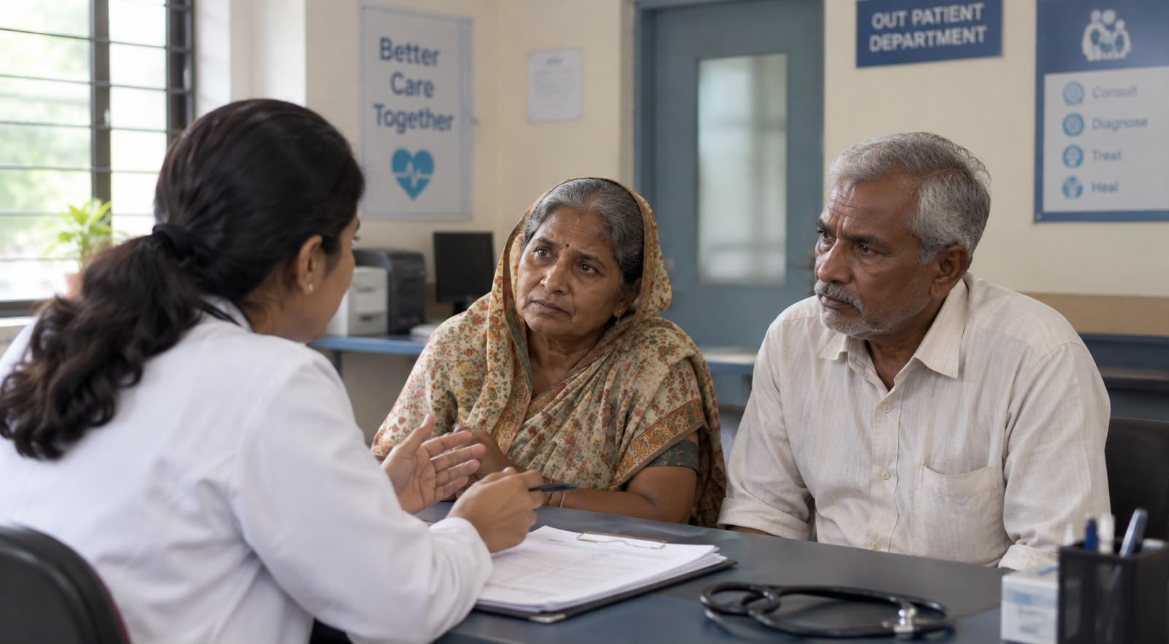



Problem Statement and Supporting Evidence
15.6 lakh
98.39%
new cancer cases in India in 2024.
IARC, GLOBOCAN 2024
unmet palliative-care need in metastatic cancer.
Patil et al., 2024
88%
11.5%
of surveyed urban patients wanted to choose their end-of-life treatment.
IndiaSpend, 2019
of doctors (45/391) in one hospital were trained in advance directives.
Jacob et al., 2026
Illustrative scene. A 62-year-old woman with advanced breast cancer.
At the clinic, her doctor discusses her wishes. Only her husband attends.
What needs to improve
A doctor-led goals-of-care conversation, written down on a legally valid form, signed by doctor and patient or family, and found in seconds in an emergency. Between visits, symptoms and medicines need a simple record the doctor can see.
Studies of different groups; not results from Sahara.
Two months later, she is unconscious in the Emergency Department. Did she want CPR?
The family disagrees and her earlier note is missing.
HEALTH-A-THON 2026 • FINAL SUBMISSION

Slide 4
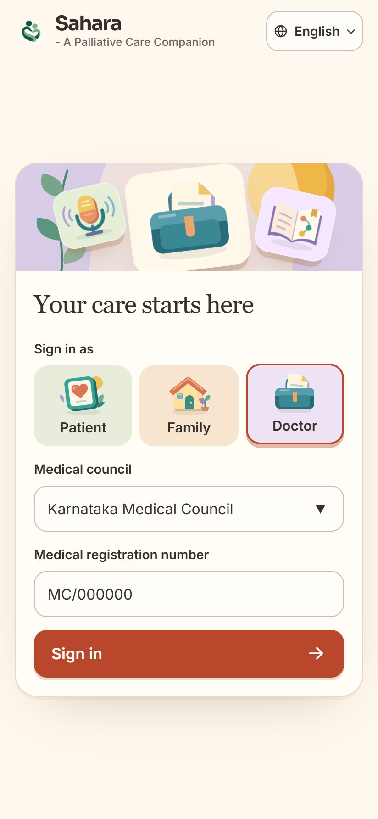
Target Users and Use Case
Patients receiving palliative care At home, between clinic visits.
Record how they feel, keep medicines and reports, and know their wishes are written down.
Family caregivers At home, often deciding for the patient.
See the same record, log symptoms, and read exactly what the patient said, signed.
Palliative, oncology and pulmonary doctors Outpatient clinic and ward.
Lead the goals-of-care conversation; the app writes it onto the legal form so they only review and sign.
Emergency doctors Emergency Department, minutes to decide.
Scan the patient’s QR card to read their wishes, decision-maker and medicines.
Fits their workflow: one app, three sign-ins (patient, family, doctor); five languages; works on low-cost Android phones.
HEALTH-A-THON 2026 • FINAL SUBMISSION

Slide 5
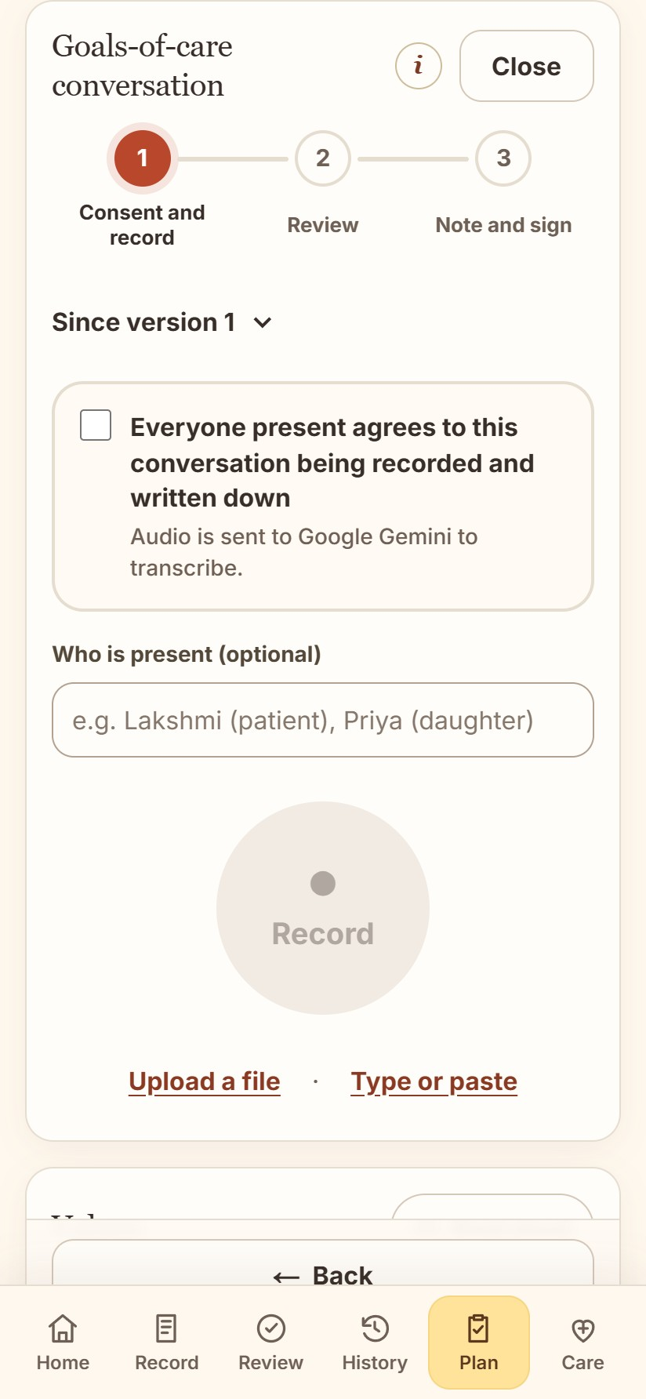
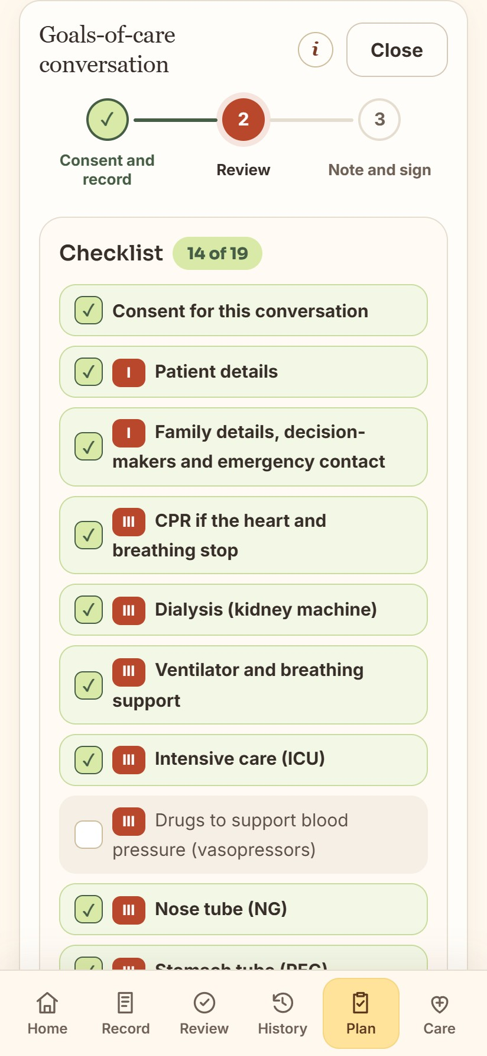
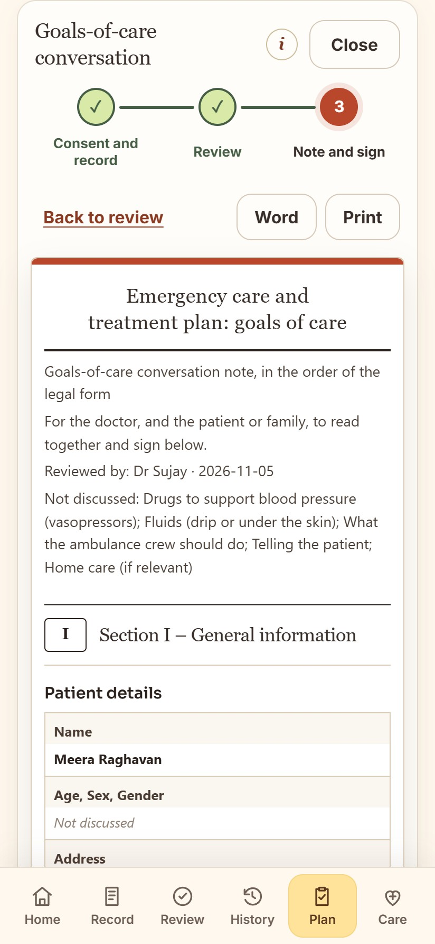
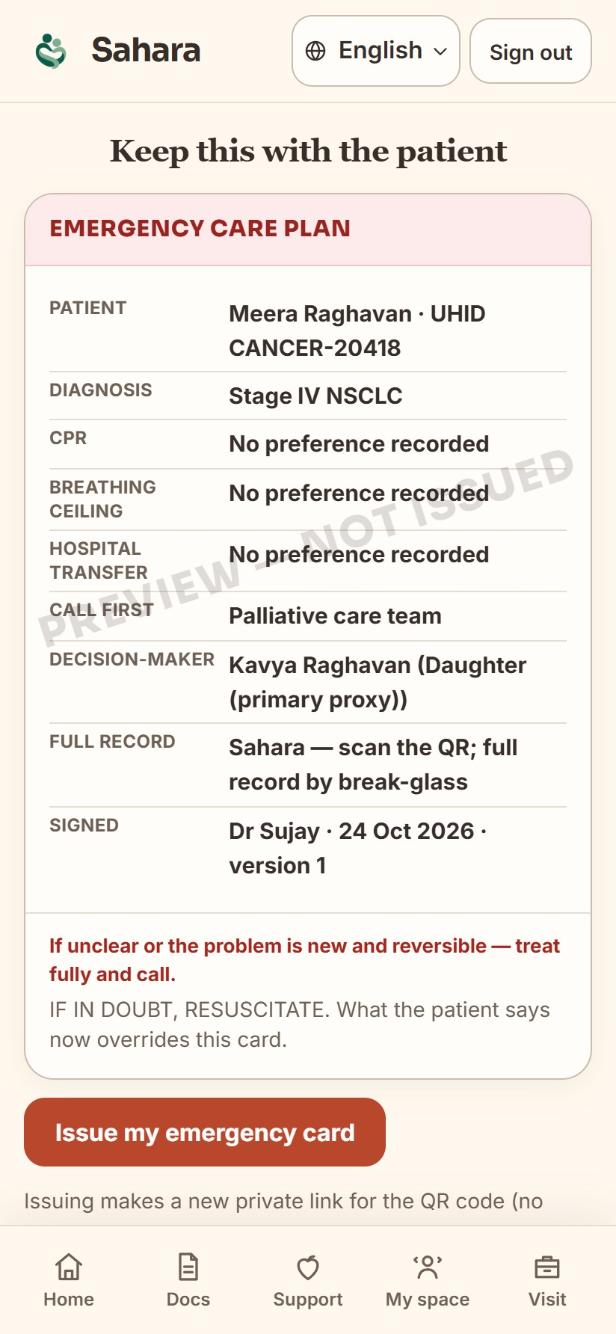
Solution Overview, Key Features & Impact (1/2)
Doctor leads. AI writes it down. The goals-of-care conversation, from consent to a signed note.
1. Consent, then record
Everyone agrees. Gemini transcribes; Whisper on the phone if offline.
2. Checklist ticks itself
Topics in the doctors’ order. Gaps are flagged before the note.
3. Written on the legal form
Sections I–IV, word for word. The doctor reviews and edits.
4. Signed, locked, findable
Doctor and patient or family sign. Wishes go on the emergency QR card.
HEALTH-A-THON 2026 • FINAL SUBMISSION
Notes:
Screens captured from the live website demo (sahara.wedevit.in, 5 Nov 2026) with a fictional patient (Meera Raghavan) and the fictional mock conversation docs/goc-mock-conversations/01-english.txt. The Android app has the same flow.

Slide 6
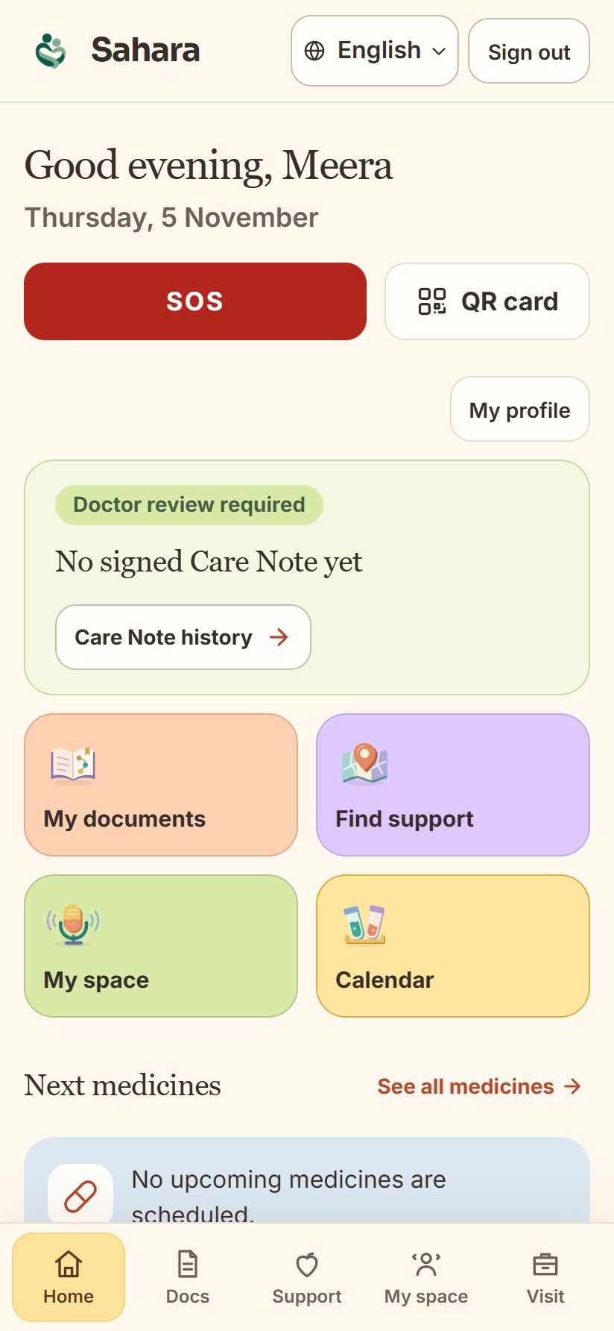
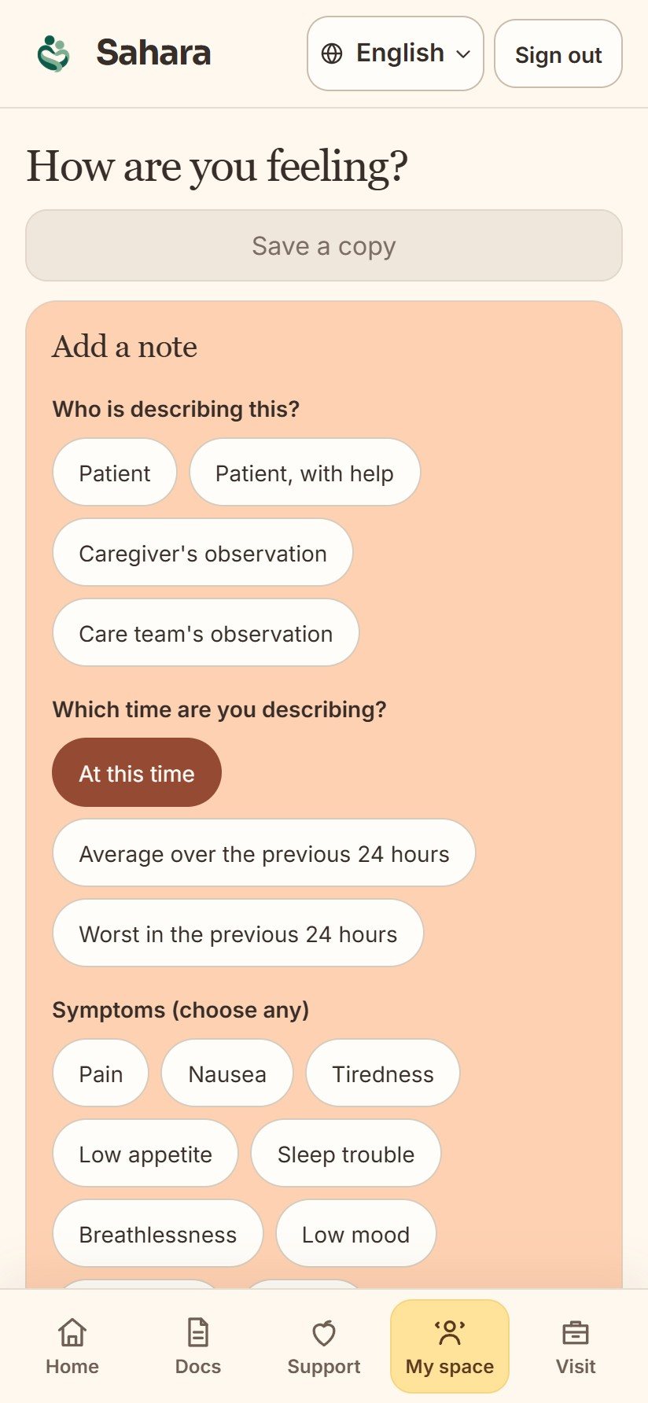
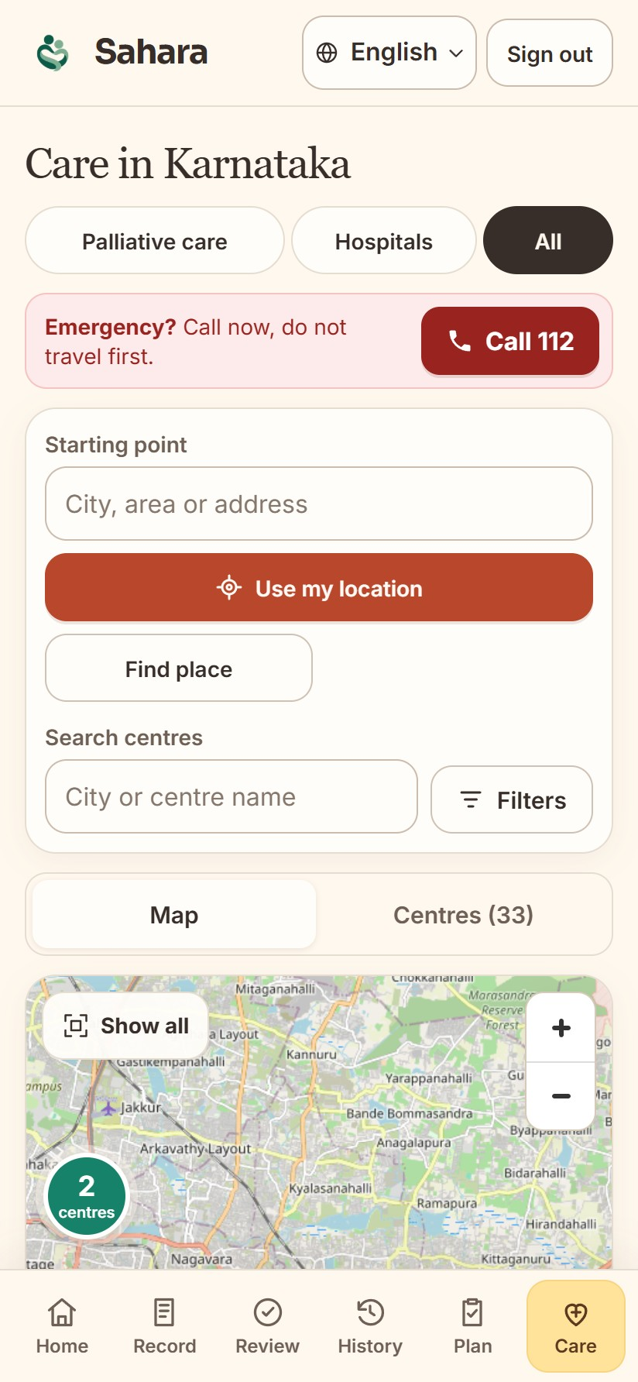
Solution Overview, Key Features & Impact (2/2)
Between visits: a companion for patients and families, shared with their doctor.
How I feel: symptoms, 0–10 distress and a pain body map; trend charts for the doctor.
Medicines: each dose is a tick, with reminders and prescription scan.
Labs and documents: trends, and “Ask your documents” answers with the source line.
Emergency QR card and SOS: wishes, contacts and medicines in one scan.
Help nearby: palliative centres, ambulances and support groups.
Family: invited relatives see and add to the same record.
Expected impact (to be measured in the pilot):
more goals-of-care conversations written and signed · wishes found in seconds in an emergency · fewer family disputes at the bedside · symptoms seen before the next visit.
HEALTH-A-THON 2026 • FINAL SUBMISSION

Slide 7
Technology, Tools and AI Approach
Doctor’s phone
Consent tick, then record
Sahara server
Supabase function or Vercel; AI keys stay here
Google Gemini
Transcript, who said what, mapped to the form
Doctor
Reviews, edits and signs; patient or family signs
Locked note
SHA-256 seal, PDF, emergency QR card
If Gemini is busy: next model (Flash-Lite, then Flash) and next key. Offline or no consent: OpenAI Whisper on the phone or in the browser, then typing. Speakers are separated on the device.
What AI does
• Turns speech into text (Indian languages).
• Labels speakers.
• Places each statement in the right section of the legal form; flags topics not discussed.
• “Ask your documents”: answers with the source line.
• It never diagnoses or suggests treatment.
Tools and models
• Google Gemini 3.x Flash-Lite and Flash.
• OpenAI Whisper (on device).
• Google ML Kit translation and read aloud.
• Android: Kotlin, Jetpack Compose.
• Web: Next.js on Vercel.
Data and integrations
• Supabase: sign-in, Postgres with row-level security, Edge Functions.
• Legal goals-of-care form (Rituparna P).
• Clinical spec (Dr Sharada); Vidhi living-will template.
• Pallium India directory and OpenStreetMap.
• FHIR R4 export for hospital systems.
HEALTH-A-THON 2026 • FINAL SUBMISSION

Slide 8
Build Sprint Journey and Progress
Week 1 · 9–15 Oct
Week 2 · 16–22 Oct
Week 3 · 23–29 Oct
Week 4 · 30 Oct–5 Nov
Native Android app, Play testing
Nearby centres map, national directory
Medicines and prescription scan
Symptom tracker, pain map, distress
Hospital survey (live 27 Oct)
Documents and “Ask your documents”
Care plan, living will, QR card (clinical spec)
Telugu, Urdu and Kannada
Goals of care on the legal form, with Gemini
Doctor side: patients, schedule, history
Working now
Patient and family app; doctor side; goals of care from recording to a locked, signed note; QR card; website live; Android app on Google Play testing.
How it evolved
Round 1: a web prototype where AI drafted a “Care Note”. Now: a native app; the doctor leads; the note is the legal form word for word; daily companion added from doctors’ walkthroughs.
Challenges and changes
Gemini free tier said “high demand”: added model and key fallback. Legal wording: copied the form exactly. Faded text on some phones: fixed.
Still incomplete
Full test on real phones; a recorded conversation with Dr Sharada; clinician back-translation; open legal questions (capacity, partners).
HEALTH-A-THON 2026 • FINAL SUBMISSION
Notes:
Dates from the git history: shortlisted 9 Oct; native Android app 9 Oct; prescription organiser 11 Oct; Play closed testing 10-14 Oct; 0.5 alpha 16 Oct; national directory 20 Oct; survey feedback 23 Oct, live 27 Oct; Ask your documents 28 Oct; SVK clinical spec 29 Oct; care plan translations 30 Oct; legal comments and goals-of-care transcription 1 Nov; doctor schedule 2 Nov; legal form word for word 4 Nov; Gemini model fallback 5 Nov.

Slide 9
Evaluation and User Validation
What we tested | How | Result
Code | Automated tests on every build | Android: 877 unit tests pass. Website: 594/594.
Goals-of-care mapping | 8 fictional conversations with expected answers: English, Hindi, Hinglish (change of mind), Telugu, Urdu, Kannada, family disagreement, short talk | 8/8 matched the expected form.
Speech to text | Gemini in the cloud; Whisper on the device; synthetic audio | English works end to end. Telugu and Kannada weak on the device, so typing is offered.
Ask your documents | 4 questions on a practice discharge PDF | 4/4 correct, with the source line.
Hospital survey | Real browser flows; changed after doctors’ feedback | Live since 27 Oct.
Feedback and what we changed
Dr Sujay’s walkthrough, 3 Nov: added tubes-and-lines care, “If…” wording in the care plan, darker text, a shorter side-effect list, fewer ambulance types.
Legal review, 31 Oct: the note now copies the legal form word for word; 31 comments tracked.
Dr Sharada’s clinical spec: the 12 “care that always continues” items used word for word.
Limits and what still needs validation
No real-patient pilot yet. Most checks ran on an emulator or in a browser; the full real-phone test is pending. Gemini accuracy on real Hindi, Telugu and other Indian-language audio is not yet measured. Translations are machine-drafted and need clinician back-translation.
HEALTH-A-THON 2026 • FINAL SUBMISSION

Slide 10
Safety and Responsible AI
Privacy, consent and security
AI limits and errors
• Recording starts only after everyone agrees.
• Audio goes to Gemini only with that consent; otherwise Whisper runs on the phone.
• Per-patient access, by invite; row-level security; AI keys only on the server.
• Patients can download their data.
• AI only transcribes and fills the form; it never advises treatment.
• Topics not discussed are listed, not guessed.
• If a person changes their mind, the latest statement wins and the earlier one is shown struck through; disagreements show both.
• Busy or failing model: next model, then the phone, then typing.
Human oversight
Bias, accessibility and inclusion
• The doctor starts, reviews, edits and signs first.
• Patient or family signs on the same phone.
• The version is locked with a SHA-256 seal; any edit voids the signatures.
• Every version stays in the history.
• Five languages, with read aloud.
• Large text; thumb signature for people who cannot write.
• Works on low-cost Android phones.
• Speech weak in Telugu and Kannada: typing offered. Demos use fictional patients only.
HEALTH-A-THON 2026 • FINAL SUBMISSION

Slide 11
Deployment, Cost and Sustainability Plan
To run a pilot
A palliative or oncology clinic with our doctors; Android phones for doctors; 2 short training sessions; a consent and privacy process under India’s DPDP Act; the legal team’s open questions settled.
Integration
Not required to start: Sahara works on its own. Later: FHIR R4 export into the hospital record, and a link to CARE (Open Healthcare Network) palliative programmes.
Scale and sustain
Free for patients and families. Clinics, hospitals or NGO palliative programmes pay a small monthly fee per clinic; grants or CSR fund the first pilots. New languages are added through the translation dictionary.
Item | One-time | Ongoing
Hosting: Supabase Pro + Vercel Pro | – | ≈ ₹3,900 / month
Gemini, per 30-min conversation | – | ≈ ₹2 (per transaction)
Clinic set-up and staff training | ≈ ₹25,000 | –
Consent, privacy and legal review | ≈ ₹25,000 | –
Support and updates (part-time) | – | ≈ ₹10,000 / month
Per clinic, at 10 clinics | ≈ ₹5,000 | ≈ ₹1,600 / month
Pricing assumptions
US$1 ≈ ₹86. Supabase Pro US$25 and Vercel Pro US$20 a month. Gemini Flash-Lite paid tier, about US$0.30 per million audio tokens; 30 minutes of audio ≈ 58,000 tokens. 100 conversations per clinic a month. Team estimates, not quotes.
Suggested price: ₹1,500–2,000 per clinic per month; free for patients.
HEALTH-A-THON 2026 • FINAL SUBMISSION
Notes:
COST FIGURES ARE TEAM ESTIMATES built from public list prices (Supabase Pro $25/month, Vercel Pro $20/seat/month) and an assumed Gemini audio price; please confirm before submission. Per-clinic monthly = (3,900 + 10,000) / 10 + 100 x 2 = ~1,590. One-time per clinic = 50,000 / 10 = 5,000.

Slide 12
What Next? Plans to take initiative forward (if any)
1
2
3
4
Finish and prove the app
Real-phone tests; record a goals-of-care conversation with Dr Sharada; clinician back-translation of Hindi, Telugu, Urdu and Kannada.
Pilot for 60–90 days
With ethics approval, in a palliative-care clinic. Compare before and after: goals-of-care conversations documented; signed notes per clinic; time to find the patient’s wishes in an emergency drill.
Settle the legal questions
With Rituparna P: capacity checks, partners as decision-makers, withdrawal of treatment (Common Cause judgments).
Fund and grow
Apply for grants and CSR support; offer Sahara to palliative-care networks; link to hospital records through FHIR.
Make the solution information public? Yes.
Our slides, brief, demo video and app description may be shared on Health-a-thon and other websites. This excludes patient records, credentials and the private code repository.
HEALTH-A-THON 2026 • FINAL SUBMISSION

Slide 13
Thank you
Zeros and Ones • [add team code]
workwithdevit@gmail.com | sahara.wedevit.in | Demo video: [add demo video link] | github.com/basithladdu/healthathon (private)
Shaik Abdul Basith
Shaik Muhammad Awaiz
Dr Sharada Vinod Kutty
Dr Sujay Halkur Shankar
Shirin Ayub
Health-a-thon 2026
HEALTH-A-THON 2026

