Slide 1
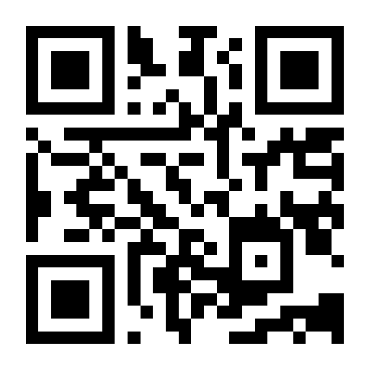




Saathi
साथी
Companion
Saathi is a palliative care companion that helps align cancer care with the patient’s values and makes care easier to access.
OPEN THE WEBSITE - saathi.wedevit.in
github.com/basithladdu/healthathon
Questions? Contact us
wa.me/919553321211
By Zeros and Ones
Shaik Abdul
Basith
Shaik Muhammad
Awaiz
Dr Sharada
Vinod Kutty
Dr Sujay
Halkur Shankar
Shirin Ayub
Technical lead
Technical member
Doctor partner
Clinician
Medical student
Notes:
Saathi (साथी) means companion. The five named people are the current team; Shirin Ayub was added in the user's latest roster. Basith and Awaiz portraits are original team assets from the DevIT ITI deck, with provenance in submission/assets/2026-09-24-team/README.md. Sujay and Shirin portraits are the unaltered user-supplied photos received on 25 September 2026, presented using native picture crops. Only Sharada's portrait remains blank, as requested. Roles use the supplied roster. The app logo is extracted from the actual app. GitHub and WhatsApp marks use Simple Icons paths; the WhatsApp mark is coloured green. The QR and OPEN THE WEBSITE link open https://saathi.wedevit.in/. GitHub opens the public project repository; WhatsApp is a contact for questions, not an access request. Entry: Cancer / Patient and Caregiver / Family & Caregiver Support. The cover frames Saathi as a palliative care companion centred on patient values and access to cancer care. Values belong to the patient; family involvement follows patient consent. The app supports documentation and coordination, not treatment advice. Transport booking, payments and connected AI are not operational claims.

Slide 2
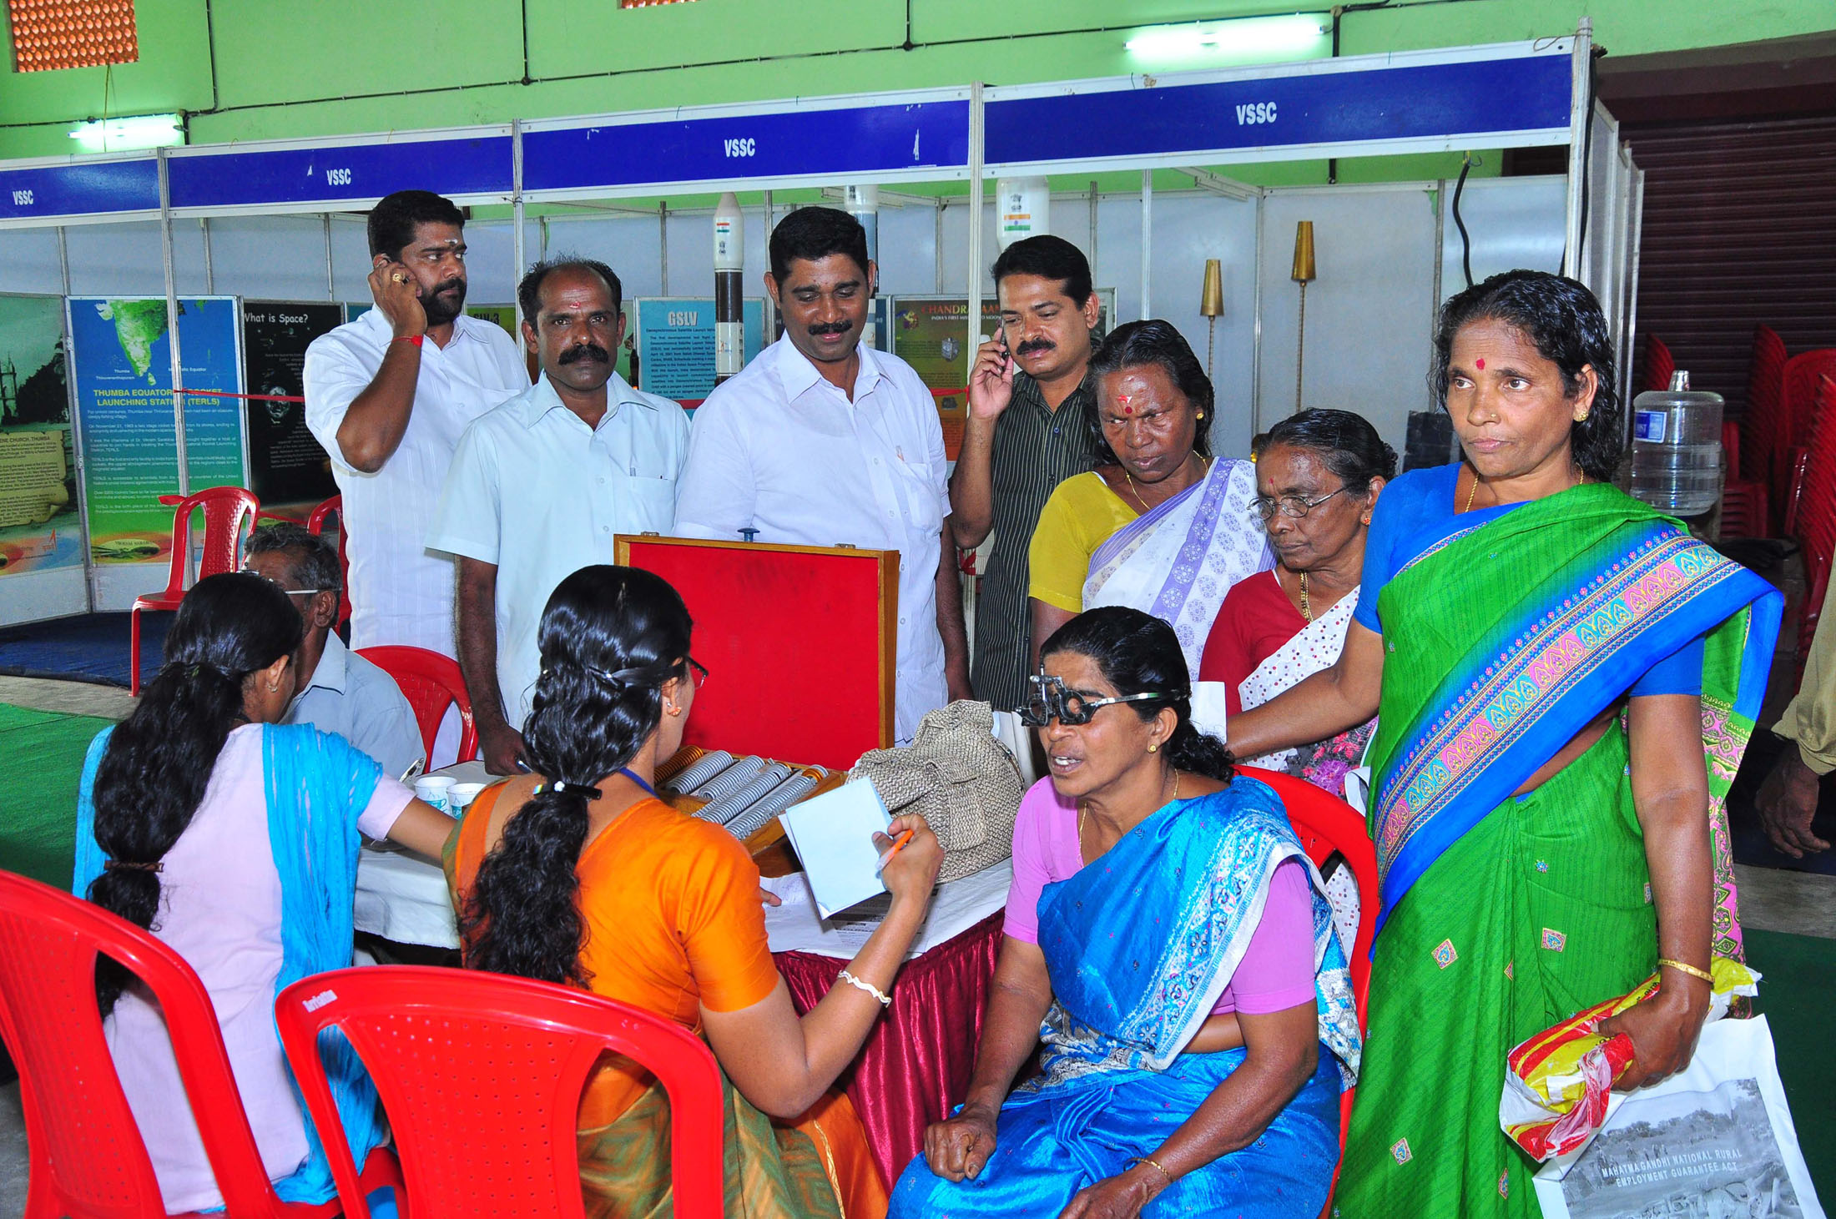
When the patient’s voice is lost
A 62-year-old woman with advanced breast cancer receives best supportive care.
At the clinic
Her doctor discusses her wishes. Only her husband attends.
Two months later
She becomes unconscious and reaches the Emergency Department. The doctor asks if she wanted CPR if her heart stopped.
The family disagrees
Her husband says yes. Her daughter says no. Her son calls from another city. No one can find the earlier discussion.
Mannar, Kerala · PIB photograph, 2011 · Not the story patient.
Families need the patient’s wishes to guide care when the patient cannot speak.
Notes:
Illustrative story supplied by the team, not a reported patient case. A 62-year-old woman with advanced breast cancer receives best supportive care. Her husband attends the first discussion. In the later crisis the husband and daughter disagree about attempts to restart her heart and her son is in another city. The story does not recommend or reject emergency treatment. The patient introduction now precedes the clinic step, so the narrative starts with her diagnosis and care context. CPR is cardiopulmonary resuscitation. Family involvement must reflect the patient’s values and wishes, not replace them with conflicting family preferences. Clinical treatment decisions remain with the patient and treating team. A Care Note records wishes and discussion; it is not an automatic treatment order or a legal advance directive. The contextual photo is a real medical camp in Mannar, Alappuzha district, Kerala, 23 August 2011. It does not depict this story, a cancer-specific visit or a Saathi user. Photo credit: Ministry of Information & Broadcasting / Press Information Bureau, Government of India, photo ID 36197, CNR 39173. Source: https://commons.wikimedia.org/wiki/File:A_medical_camp_conducted_as_part_of_the_public_information_campaign_organized_by_PIB_Thiruvananthapuram,_at_Mannar,_in_Alappuzha_district,_Kerala_on_August_23,_2011.jpg ; original source https://archive.pib.gov.in/photo.aspx?photoid=36197 . Licensed under Government Open Data License – India, https://data.gov.in/sites/default/files/Gazette_Notification_OGDL.pdf . Displayed without image alterations apart from resizing. No government endorsement is implied. Icons: Lucide, https://lucide.dev/license, ISC/MIT, SVG paths unchanged and colours adapted. Full license and credits: submission/assets/2026-09-24-family/. Story sources: docs/meetings/2026-09-23-chat-follow-up.md and both meetings this week.

Slide 3
Why a palliative care companion is needed
15.6 lakh
98.39%
Goals-of-care discussion
A clinician-led conversation about a patient’s values, priorities and care preferences, used to agree care goals with the patient and, with consent, their family.
Estimated new cancer cases in India in 2024.
Estimated unmet palliative-care need in metastatic disease across 10 cancer types.
IARC, GLOBOCAN 2024
Patil et al., 2024
88%
11.5%
Surveyed patients wanted to choose their end-of-life treatment. 2,400+ urban respondents with a recent hospital stay (2019).
45/391 doctors had training in advance directives and their practical aspects. One hospital.
A standard procedure improved goals-of-care documentation to 92% (24/26 eligible patients).
IndiaSpend; seven-city survey
Jacob et al., CMC Vellore, 2026
Advanced pancreatic / colorectal cancer, Chennai.
Thangasamy et al., 2025
Different study groups. These are not results from Saathi.
Proposed 60-90 day study: compare before and after
Number of patient- and doctor-initiated goals-of-care discussions.
Number of written and signed Care Notes per cancer facility.
Time to retrieve goals-of-care discussions during an emergency.
Notes:
Five findings with distinct scopes, verified in docs/pitch/2026-09-24-verified-evidence.md: IARC GLOBOCAN estimates 1,562,581 new cancer cases in India in 2024, rounded to 15.6 lakh. Patil et al. report 98.39% unmet palliative-care need among metastatic cancer cases across ten cancer types, using the NCRP 2020 report; this is not all cancer patients and must not be multiplied by the incidence estimate. The 88% figure is from IndiaSpend reporting of the 2019 HCAH Living Will Survey of over 2,400 urban respondents in seven cities; the original survey was inaccessible and this is not a cancer-only or national sample. Jacob et al. report 45 of 391 doctors (11.5%) with prior advance-directive training at CMC Vellore, not a national estimate. Thangasamy et al. report 0% to 92% documented discussions, with 24 of 26 eligible advanced pancreatic or colorectal cancer patients in one Chennai quality-improvement project. A structured process, form and team work produced this result; this was not a Saathi or AI intervention. The native chart and source workbook are preserved byte-for-byte from the existing supplied pitch chart. Each short source credit is a native hyperlink and the full nine-source list remains on slide 8. Icons: Lucide, ISC/MIT, https://lucide.dev/license, source SVGs and full license in submission/assets/2026-09-24-family/. Definition source: National Cancer Institute, Communication in Cancer Care (PDQ), https://www.cancer.gov/about-cancer/coping/adjusting-to-cancer/communication-hp-pdq and Cancer Care Ontario, Goals of Care Toolkit for Oncology Settings, https://www.cancercareontario.ca/en/guidelines-advice/treatment-modality/person-centred-care/goals-of-care-toolkit-oncology . Goals-of-care discussion is not synonymous with an advance directive. The proposed 60-90 day study is retained on this page. Its three headline measures are patient-initiated and doctor-initiated discussions, written and signed Care Notes per cancer facility, and emergency retrieval time. Separate requests from completed discussions, and written notes from signed notes. Define emergency retrieval timing from the request for the latest note to the correct version being opened, using a pre-specified exercise during the initial pilot; real clinical emergency evaluation requires site approval. It compares an agreed baseline with the same definitions after deployment. Count eligible/informed/consented people, requests, doctor-started and held discussions, saved notes and signatures separately. Report documented discussions divided by eligible patients with n/N, and deduplicate repeat activity. Also time finding the latest record, clinician review and visit preparation, and track assigned, accepted and completed family jobs and failed handoffs. This is a study proposal, not a result or a confirmed clinic partner. Protocol: docs/pitch/2026-09-24-impact-plan.md.

Slide 4


Physician leads. AI assists
The physician initiates the goals-of-care discussion. AI provides a structured guide.
1. Record with consent.
2. AI guides the physician through a structured goals-of-care discussion.
3. AI drafts the Care Note.
4. The physician reviews, edits and signs.
Every version of the goals-of-care discussion stays in the Care Note history.
5. The patient reviews and signs.
Planned: an encrypted Care Note for the patient to keep for emergencies.
Planned with Sarvam AI: Indian-language speech, translation and read-aloud.
Notes:
The consultation scene was generated with the built-in image generation tool at the user's request. It illustrates an Indian doctor and a patient talking while a phone records their conversation. The people and setting are fictional. This is a concept illustration, not a real patient photograph or evidence of a clinical deployment. The adjacent blue Voice note panel is a crop of the actual user-supplied Saathi screen, not a generated app screenshot. The original generated image and exact prompt are saved in submission/assets/2026-09-24-generated-scenes/. This is the central proposed AI workflow, not a claim that a model is already connected. A physician initiates and leads the goals-of-care discussion. AI presents the clinician-approved structured discussion guide, helps identify unanswered fields and prepares documentation. It does not choose clinical goals, infer a treatment preference or recommend care. Every version, including revisions rather than only signed notes, belongs in the proposed discussion history. Current persistence of every draft revision has not been verified. The patient receives the physician-reviewed and patient-signed Care Note for emergency retrieval. Encrypted patient-held export, recovery and permission-controlled sharing are proposed security requirements, not capabilities established by the current downloadable PDF. The slide marks that handoff Planned. Routine encryption of web traffic is not evidence of encrypted portable documents. With recording consent, a transcript or existing note becomes a source-linked draft. The doctor can edit, reject or correct it in a distinct review step, and signs first. The patient then reviews and signs that exact version; changed wording requires a newly reviewed version. Unanswered questions remain unanswered. No diagnosis, treatment recommendation, risk scoring or interpretation of medical results. Clinical choices from the supplied Healthathon form and Saanthvana v 1.0 document belong to the clinician, not the AI. Today the browser app supports recording, source-based rule preparation, editing and typed-name signing. Reliable transcription, model integration, verified accounts and sharing between phones remain to connect. A typed name is not a verified digital signature; a Care Note is not a legal advance directive. Sarvam AI is a proposed provider for Indian-language speech-to-text, translation and read-aloud, supported by official documentation: https://docs.sarvam.ai/api/getting-started/building-for-india and https://docs.sarvam.ai/api-reference/speech-to-text/transcribe. No provider version or working connection is claimed. The recording screen is the actual app screenshot supplied by the user on 24 September, preserved unchanged at submission/assets/2026-09-24-family/saathi-record-conversation.png. It shows the Voice note panel, recording consent, Start recording, English language selection, Upload audio and the Prepare draft, Review & edit and Sign Care Note steps. This image shows the interface before recording; it does not establish that microphone capture or live transcription has been verified. The displayed Meera profile is fictional. Sources: 21 September transcript lines 251–303 and 1097–1155; 23 September meeting and chat; Sujay's 24 September feedback; supplied clinical forms. Icons: original Lucide SVGs from https://github.com/lucide-icons/lucide/tree/main/icons, with stroke colours changed for this deck. ISC/MIT notices are saved in submission/assets/2026-09-24-visual-revision/Lucide-LICENSE.txt.

Slide 5

Help with palliative care near you
1. Find palliative care nearby
Find palliative-care centres and hospitals, with phone numbers and directions.
2. Access to prescribed opioids
Ask about oral morphine, prescription documents and collection hours before travelling.
3. Find your cancer-specific support group
Find patient and caregiver groups for your cancer type, locally or online.
4. Plan travel and help at home
Arrange a ride or ambulance, home nursing or medicine collection with your care circle.
Map data: © OpenStreetMap contributors
Open the care map
Pallium India directory
Notes:
This separate page restores the wider Family & Caregiver Support proposition. It follows the clinician-led AI discussion slide and precedes the family-records assistant. Four separate features cover palliative care, prescribed opioids, cancer-specific support groups, and travel/home help, in that order. The map is a real live-site capture on 24 September 2026, with Hyderabad chosen as an example starting point, All selected, and Basavatarakam Indo-American Cancer Hospital selected. MapLibre renders OpenStreetMap tiles and numbered supportive-care and hospital markers. The actual screen includes a road-route estimate, call and directions links. No person's actual location was requested and no call was placed. Chrome's automation bridge timed out, so this capture used the Codex in-app browser. Original file: submission/assets/2026-09-24-family-workflows/find-support-map.png. Map attribution remains visible. The official Pallium India Telangana directory was checked on 24 September 2026 at https://palliumindia.org/clinics/telangana and lists services, contacts and morphine availability for some entries. It is not live stock, dispensing authorization, guaranteed oral formulation or booked care. The app's /medicine-access page lets a family find whom to contact, ask about prescribed oral morphine and prescription documents, then record the reply. A family must confirm availability before travelling. It does not recommend a drug or dose. /help-at-home supports transport, home nursing and medicine/equipment delivery as family arrangements with helper, phone, date and manual To arrange/Arranged/Done states. An ambulance is a transport job for a person to arrange; there is no connected ambulance booking or dispatch. /family-tasks supports a named recipient and acceptance/completion within the current browser records; separate-user delivery and shared storage remain to connect. /costs supports expenses, paid/pending amounts, an assistance-document checklist and a question for the hospital social worker. Bill attachments, verified assistance contacts and real application submission/tracking remain to connect; no payment collection, eligibility determination or funding is promised. The financial block was removed from this map page in response to Sujay’s comments; financial tracking is retained on slide 7. The generic task-ownership footer was removed. The third feature now links to /support-groups, where the actual app supports filters for cancer type and audience and links to named support organisations and online groups. It does not promise admission or clinical moderation. The preserved real map screenshot uses the app’s existing Best supportive care label; the authored clinical description now says palliative care, as requested. The links open the distinct existing app routes. Future service integrations should reuse the same appointment, prescription, documents and family rather than create another disconnected workflow. Research: Fereydooni S et al. (2022), Empowering families to take on a palliative caregiver role for patients with cancer in India: Persistent challenges and promising strategies, PLOS ONE 17(9), e0274770, https://doi.org/10.1371/journal.pone.0274770; LeBaron V et al. (2014), An Ethnographic Study of Barriers to Cancer Pain Management and Opioid Availability in India, https://doi.org/10.1634/theoncologist.2013-0435. These describe needs, not results from Saathi. Detailed journeys and boundaries: docs/pitch/2026-09-24-family-support-research.md. The proposed impact study previously on this page is retained visibly on slide 3 and in docs/pitch/2026-09-24-impact-plan.md. Icons: Lucide, original SVGs and notices in submission/assets/2026-09-24-family/ and submission/assets/2026-09-24-visual-revision/.

Slide 6

AI helps families use patient records
With the patient’s permission, find answers and see the original passage.
1. Add a report.
Or a printed prescription.
2. Ask in your own words.
3. Check the original text.
Keep treatment dates in order.
Check medicine reminders before saving.
Notes:
The records scene was generated with the built-in image generation tool at the user's request. It is a concept illustration with fictional people and an illustrative tablet interface, not a screenshot of the current app. The question asks what to bring to a visit. The answer repeats a supplied instruction to bring previous reports and the medicine list, with a matching highlight on the paper source. It conveys retrieval of an existing instruction, not interpretation of medical data. The original image and exact prompt are saved in submission/assets/2026-09-24-generated-scenes/. The three visual steps show adding a report, asking a question and checking the original text. The medicine and calendar icons represent the previously discussed reminders and dated treatment history. This slide focuses on families using patient records with the patient’s permission, as requested in the reviewer comments. The clinician-led documentation workflow appears separately on slide 4. The conceptual photograph includes a clinician pointing to the original instruction as context, not as a claim that this family-facing assistant makes clinical decisions. This slide describes three AI jobs adopted in the meetings: answer questions from the patient's own files with the exact source passage; prepare a dated treatment history from recorded chemotherapy and radiotherapy dates; read medicine details from printed or typed prescriptions for a person to check before adding reminders. Current workflow explicitly asks a person to check extracted text before saving it and to confirm a treatment happened and supply its date before adding it to the care timeline. A report or appointment date must not be inferred as a completed treatment date. Handwritten prescription recognition was not adopted. The earlier real Chrome capture remains saved at output/playwright/2026-09-24-saathi-documents-source.png. It showed literal retrieval from a fictional stored record, Add treatment date and View original. The generated concept illustration on this slide does not demonstrate connected semantic AI or image OCR. Provider integration code exists but live model calls are not enabled or verified. AI must not interpret test results or create clinical advice. Sources: 21 September transcript lines 1025–1043, 1099–1123 and 1135–1151; 23 September transcript lines 269–277; output/playwright/2026-09-24-saathi-documents-source.png. Icons: original Lucide SVGs from https://github.com/lucide-icons/lucide/tree/main/icons, with stroke colours changed for this deck. ISC/MIT notices are saved in submission/assets/2026-09-24-visual-revision/Lucide-LICENSE.txt.

Slide 7
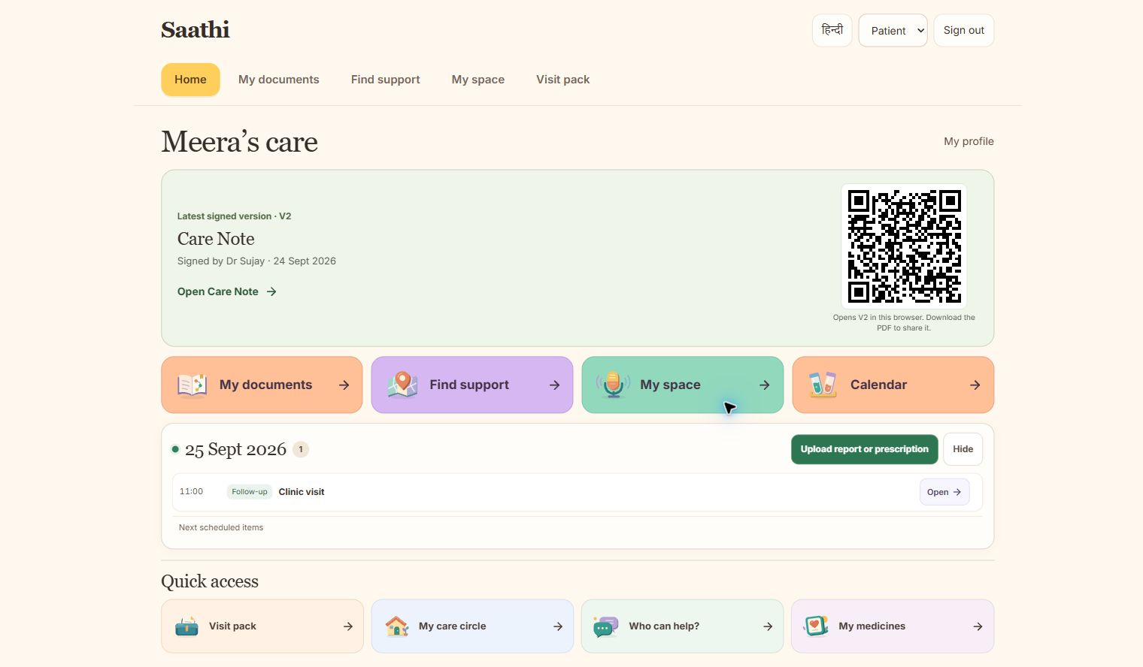


Saathi also keeps your cancer care in one place
Three sign-ins
Medicines and prescription reminders
Visits, tests and treatment dates
Journals and symptom tracking
Financial tracking
OPEN - saathi.wedevit.in
Notes:
The home image is the actual Chrome capture retained from the previous deck, output/playwright/2026-09-24-saathi-patient-home.png. The sign-in choices are a native crop of the existing actual sign-in image. The new calendar image is an unaltered capture of the live site in the Codex browser on 24 September 2026, with 25 September selected. The saved fictional appointment already says to bring previous reports and the current prescription. No events or prescriptions were added for this capture. Original screenshots remain in submission/assets/2026-09-24-family-workflows/. The labels now make prescribed medicine schedules/reminders, visits, tests, dated treatment history, personal journals, symptom tracking and financial tracking visible as distinct features. Cancer-specific support groups have their own point on slide 5. Named family jobs remain within the existing app. Financial tracking includes paid/pending bills and preparation for assistance; it is not payment processing or a funding application. Medicine schedule entries, Taken/Undo, upload/review routes and dated appointments exist. Delivered phone notifications, refill fulfilment, verified sign-in and cross-device shared updates still need connecting. The current 14-digit sign-in accepts a format-only identifier and does not verify ABHA. The roles shown are Patient, Family and Doctor. Do not infer treatment completion from a report or appointment date. All personal records shown are fictional. Human review is required before extracting prescription instructions, using translations or adding a medicine reminder. Source and feature mapping: docs/pitch/2026-09-24-family-support-research.md, prototype/app/care-medicines.tsx, prototype/app/care-calendar.tsx and prototype/app/family-care-workspace.tsx. Icons: Lucide, original SVGs and licenses retained in the family and visual-revision asset folders.

Slide 8
References
1. IARC. Global Cancer Observatory, 2024.
5. Sharma P. IndiaSpend / Scroll.in, 2019.
India: GLOBOCAN 2024 Fact Sheet
73% urban Indians do not know about their right to make a living will, finds a survey
https://gco.iarc.who.int/media/globocan/factsheets/populations/356-india-fact-sheet.pdf
https://scroll.in/article/925875/73-urban-indians-do-not-know-about-their-right-to-make-a-living-will-finds-a-survey
2. Patil S, et al. BMJ Support Palliat Care, 2024.
6. Jacob JA, et al. Natl Med J India, 2026.
Unmet need for cancer palliative care in India
Knowledge and attitude towards advance directives for patients with terminal illnesses among doctors working in a tertiary care hospital
https://doi.org/10.1136/spcare-2024-004978
https://doi.org/10.25259/NMJI_817_2023
3. Aslam N, Hayat A. J Pain Symptom Manage, 2024.
7. Singh P, et al. medRxiv, 2025. Preprint.
Early Goal of Care Discussions in Healthcare: A Survey Case Report on Benefits and Perceptions
Barriers and Facilitators to Advance Care Planning Implementation for Patients with Neurodegenerative Diseases among Indian Physicians: A Mixed-Methods Analysis
https://doi.org/10.1016/j.jpainsymman.2024.02.030
https://doi.org/10.1101/2025.10.17.25338242
4. Thangasamy DRJ, et al. Palliat Med Rep, 2025.
8. LeBaron V, et al. The Oncologist, 2014.
Initiating and Documenting Goals of Care Discussion in Patients with Advanced Pancreatic and Colorectal Cancers: A Quality Improvement Project in a Low Resource Setting
An Ethnographic Study of Barriers to Cancer Pain Management and Opioid Availability in India
https://doi.org/10.1634/theoncologist.2013-0435
9. Forsythe LP, et al. J Clin Oncol, 2013. U.S. cohort.
https://doi.org/10.1177/26892820251392545
Receipt of Psychosocial Care Among Cancer Survivors in the United States
https://doi.org/10.1200/JCO.2012.46.2101
Notes:
Complete reference set from slide 8 of Saanthvana_Background_Rationale_1.pptx. The source collection includes research, a fact sheet and secondary reporting. Not every background source supports a numerical claim in this pitch. Reference 7 is a preprint; its primary index confirms the title and DOI, while full-text access returned 403. The author attribution follows the supplied deck. Reference 9 concerns a U.S. cohort. For exact scope of the figures used, see docs/pitch/2026-09-24-verified-evidence.md.
1. IARC. Global Cancer Observatory, 2024. India: GLOBOCAN 2024 Fact Sheet
https://gco.iarc.who.int/media/globocan/factsheets/populations/356-india-fact-sheet.pdf
2. Patil S, et al. BMJ Support Palliat Care, 2024. Unmet need for cancer palliative care in India
https://doi.org/10.1136/spcare-2024-004978
3. Aslam N, Hayat A. J Pain Symptom Manage, 2024. Early Goal of Care Discussions in Healthcare: A Survey Case Report on Benefits and Perceptions
https://doi.org/10.1016/j.jpainsymman.2024.02.030
4. Thangasamy DRJ, et al. Palliat Med Rep, 2025. Initiating and Documenting Goals of Care Discussion in Patients with Advanced Pancreatic and Colorectal Cancers: A Quality Improvement Project in a Low Resource Setting
https://doi.org/10.1177/26892820251392545
5. Sharma P. IndiaSpend / Scroll.in, 2019. 73% urban Indians do not know about their right to make a living will, finds a survey
https://scroll.in/article/925875/73-urban-indians-do-not-know-about-their-right-to-make-a-living-will-finds-a-survey
6. Jacob JA, et al. Natl Med J India, 2026. Knowledge and attitude towards advance directives for patients with terminal illnesses among doctors working in a tertiary care hospital
https://doi.org/10.25259/NMJI_817_2023
7. Singh P, et al. medRxiv, 2025. Preprint. Barriers and Facilitators to Advance Care Planning Implementation for Patients with Neurodegenerative Diseases among Indian Physicians: A Mixed-Methods Analysis
https://doi.org/10.1101/2025.10.17.25338242
8. LeBaron V, et al. The Oncologist, 2014. An Ethnographic Study of Barriers to Cancer Pain Management and Opioid Availability in India
https://doi.org/10.1634/theoncologist.2013-0435
9. Forsythe LP, et al. J Clin Oncol, 2013. U.S. cohort. Receipt of Psychosocial Care Among Cancer Survivors in the United States
https://doi.org/10.1200/JCO.2012.46.2101
Additional proposed-workflow sources: Sarvam AI official docs https://docs.sarvam.ai/api/getting-started/building-for-india ; Pallium India directory https://palliumindia.org/clinics/telangana ; caregiver support research https://journals.plos.org/plosone/article?id=10.1371/journal.pone.0274770 . These additional sources do not replace the original nine background references.
Icon source: https://github.com/lucide-icons/lucide/tree/main/icons . Paths unchanged; colours adapted. The following complete Lucide/Feather notices apply to icons on slides 2, 3 and 6.
ISC License
Copyright (c) 2026 Lucide Icons and Contributors
Permission to use, copy, modify, and/or distribute this software for any
purpose with or without fee is hereby granted, provided that the above
copyright notice and this permission notice appear in all copies.
THE SOFTWARE IS PROVIDED "AS IS" AND THE AUTHOR DISCLAIMS ALL WARRANTIES
WITH REGARD TO THIS SOFTWARE INCLUDING ALL IMPLIED WARRANTIES OF
MERCHANTABILITY AND FITNESS. IN NO EVENT SHALL THE AUTHOR BE LIABLE FOR
ANY SPECIAL, DIRECT, INDIRECT, OR CONSEQUENTIAL DAMAGES OR ANY DAMAGES
WHATSOEVER RESULTING FROM LOSS OF USE, DATA OR PROFITS, WHETHER IN AN
ACTION OF CONTRACT, NEGLIGENCE OR OTHER TORTIOUS ACTION, ARISING OUT OF
OR IN CONNECTION WITH THE USE OR PERFORMANCE OF THIS SOFTWARE.
---
The following Lucide icons are derived from the Feather project:
airplay, alert-circle, alert-octagon, alert-triangle, aperture, arrow-down-circle, arrow-down-left, arrow-down-right, arrow-down, arrow-left-circle, arrow-left, arrow-right-circle, arrow-right, arrow-up-circle, arrow-up-left, arrow-up-right, arrow-up, at-sign, calendar, cast, check, chevron-down, chevron-left, chevron-right, chevron-up, chevrons-down, chevrons-left, chevrons-right, chevrons-up, circle, clipboard, clock, code, columns, command, compass, corner-down-left, corner-down-right, corner-left-down, corner-left-up, corner-right-down, corner-right-up, corner-up-left, corner-up-right, crosshair, database, divide-circle, divide-square, dollar-sign, download, external-link, feather, frown, hash, headphones, help-circle, info, italic, key, layout, life-buoy, link-2, link, loader, lock, log-in, log-out, maximize, meh, minimize, minimize-2, minus-circle, minus-square, minus, monitor, moon, more-horizontal, more-vertical, move, music, navigation-2, navigation, octagon, pause-circle, percent, plus-circle, plus-square, plus, power, radio, rss, search, server, share, shopping-bag, sidebar, smartphone, smile, square, table-2, tablet, target, terminal, trash-2, trash, triangle, tv, type, upload, x-circle, x-octagon, x-square, x, zoom-in, zoom-out
The MIT License (MIT) (for the icons listed above)
Copyright (c) 2013-present Cole Bemis
Permission is hereby granted, free of charge, to any person obtaining a copy
of this software and associated documentation files (the "Software"), to deal
in the Software without restriction, including without limitation the rights
to use, copy, modify, merge, publish, distribute, sublicense, and/or sell
copies of the Software, and to permit persons to whom the Software is
furnished to do so, subject to the following conditions:
The above copyright notice and this permission notice shall be included in all
copies or substantial portions of the Software.
THE SOFTWARE IS PROVIDED "AS IS", WITHOUT WARRANTY OF ANY KIND, EXPRESS OR
IMPLIED, INCLUDING BUT NOT LIMITED TO THE WARRANTIES OF MERCHANTABILITY,
FITNESS FOR A PARTICULAR PURPOSE AND NONINFRINGEMENT. IN NO EVENT SHALL THE
AUTHORS OR COPYRIGHT HOLDERS BE LIABLE FOR ANY CLAIM, DAMAGES OR OTHER
LIABILITY, WHETHER IN AN ACTION OF CONTRACT, TORT OR OTHERWISE, ARISING FROM,
OUT OF OR IN CONNECTION WITH THE SOFTWARE OR THE USE OR OTHER DEALINGS IN THE
SOFTWARE.

